Slide 1











ICAICCIT-2025, 3rd International conference on Advances in Computing, Communication and Information Technology, technically Co-Sponsored by IEEE Delhi SECTION (IEEE record no # 68829)
on 1st Nov. 2025

Slide 2
Adaptive Intrusion Detection Using Hybrid Deep Learning Models and Feature Selection
Paper ID-398
Presented by
T. Durga Bhavani,
G. Kavya,
SK.Y.khajabi,
A.Deepthi Priya
Authors & Affiliation:
Dr. K. Suresh Babu¹, T. DurgaBhavani²,
G. Kavya³, Sk. Y. Khajabi⁴, A. Deepthi Priya⁵, R. P. Ram Kumar⁶
Department of Computer Science and Engineering,
Narasaraopeta Engineering College, Andhra Pradesh, India

Slide 3
INTRODUCTION
The Internet is essential for communication, data sharing, and online activities, but it also increases cybersecurity risks.
Growing network complexity has led to frequent and advanced cyberattacks like DoS, DDoS, and botnets.
Intrusion Detection Systems (IDS) help identify abnormal or malicious network behavior.
Traditional IDS detect only known attacks, while Deep Learning (DL) models can learn to detect new threats automatically.
This work presents a hybrid deep learning–based IDS that improves detection accuracy through preprocessing, feature selection, and advanced neural models

Slide 4
PROBLEM STATEMENT
Detecting Unbalanced Network Traffic Intrusions with Deep Learning (Reference Base Paper)
Problems Identified:
Suffered from imbalanced network data, causing biased model results.
Contained irrelevant and redundant features that lowered accuracy.
Deep learning models were not optimized for spatial or temporal attack patterns.
Could detect only known attacks, failing to identify zero-day or new threats.
No hybrid feature selection or preprocessing methods were used to enhance performance.
Adaptive Intrusion Detection Using Hybrid Deep Learning Models and Feature Selection(Proposed Base Paper)
Problems Solved:
Used SMOTE-ENN to balance the dataset and improve model learning.
Applied Boruta algorithm for selecting significant features and removing noise.
Integrated multiple deep models (Autoencoder, GRU, AlexNet, MiniVGGNet) for hybrid detection.
Achieved high detection accuracy (99.67%) with lower false positives.
Enhanced capability to detect new and complex network attacks efficiently.

Slide 5
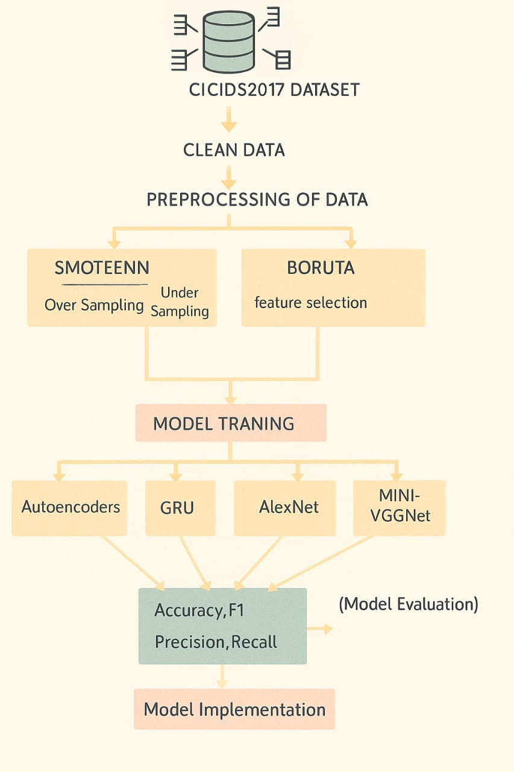
OBJECTIVE
To design an adaptive Intrusion Detection System (IDS) using hybrid deep learning models.
To handle class imbalance effectively using the SMOTE-ENN technique.
To improve model performance by applying the Boruta algorithm for feature selection.
To develop and compare multiple deep learning models — Autoencoder, GRU, AlexNet, and MiniVGGNet.
To achieve high detection accuracy and reduce false positives in identifying network attacks.
To build a system that can detect both known and unknown (zero-day) attacks efficiently.
Model architecture of the proposed hybrid intrusion detection system

Slide 6
LITERATURE REVIEW
Li et al. (2021): Proposed DSSTE method to handle class imbalance using K-Means and ENN — improved accuracy but computationally complex for real-time use.
Khan et al. (2022): Used AdaBoost + Decision Trees with SMOTE-Tomek Links — achieved ~96% accuracy but lacked support for sequential data.
Laghrissi et al. (2019): Applied LSTM with PCA and Mutual Information — good temporal learning but based on outdated KDD99 dataset.
Hu et al. (2020): Designed Hybrid ResNet–BiLSTM with attention — high accuracy but high computational cost.
Sama (2022): Compared various DL models — found DL effective but with high false positive rates.
Ravindran & Sarveshwaran (2023): Reviewed over 50 DL-based IDS studies — identified common issues like high dimensional data and poor IoT performance, suggesting the need for better feature selection and model balance.

Slide 7
METHODOLOGY
Dataset Selection:
Utilized CICIDS2017 dataset containing real-world normal and attack traffic.
Data Preprocessing:
Performed data cleaning and Min–Max normalization.
Encoded categorical values and removed irrelevant fields.
Class Imbalance Handling:
Used SMOTE-ENN to balance minority and majority classes by oversampling and noise removal.
Feature Selection:
Implemented Boruta algorithm to identify and retain only the most significant features.
Model Development:
Built and trained four deep learning models:
  Autoencoder – detects anomalies using reconstruction error.
  GRU (Gated Recurrent Unit) – captures temporal attack patterns.
  AlexNet – extracts spatial features from traffic matrices.
  MiniVGGNet – lightweight CNN for real-time detection.
Integrated them into a hybrid IDS framework for improved accuracy and efficiency.
Evaluation Metrics:
Accuracy, Precision, Recall, and F1-Score were used to evaluate model performance.

Slide 8
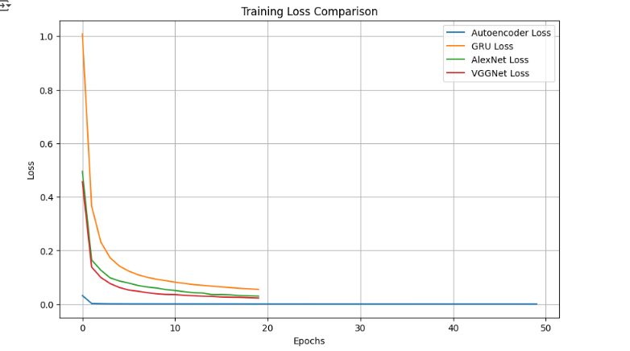
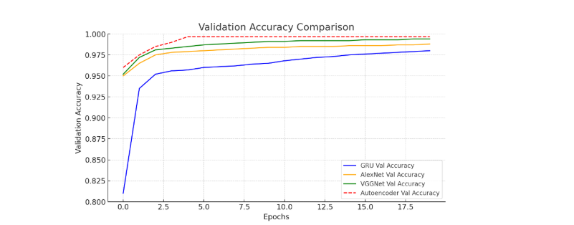
RESULTS AND DISCUSSIONS
Training Loss Comparison of Autoencoder, GRU, AlexNet, and VGGNet models
Validation Accuracy Comparison across Models

Slide 9
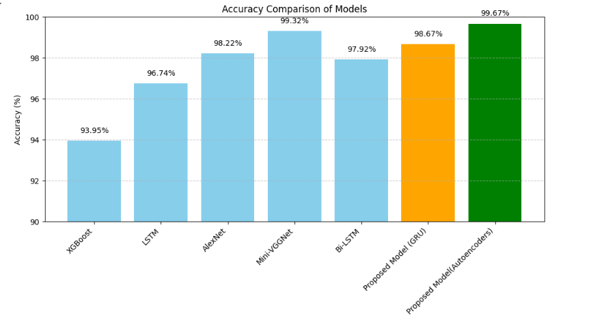
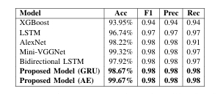
RESULTS AND DISCUSSIONS
Comparing plots for all models
Performance comparison of models with the proposed model.

Slide 10
CONCLUSION AND FUTURE SCOPE
Conclusion:
An adaptive hybrid intrusion detection framework was developed to enhance network security using deep learning and intelligent preprocessing.
SMOTE-ENN effectively balanced the dataset, while Boruta feature selection improved model efficiency and accuracy.
The combination of Autoencoder, GRU, AlexNet, and MiniVGGNet provided robust detection of diverse cyberattacks.
The system achieved high accuracy (99.67%) and demonstrated strong ability to identify unknown and zero-day attacks.
Overall, the approach proved that integrating balanced data, optimized features, and hybrid deep models significantly boosts IDS performance performance.
Future scope:
Extend the model to real-time and large-scale network monitoring systems.
Incorporate attention and transformer mechanisms to improve pattern learning.
Optimize for IoT, cloud, and edge computing environments with lightweight deployment.
Enable online or continual learning for adaptive intrusion detection in dynamic networks.
Implement explainable AI (XAI) methods to make the model’s decisions more transparent.

Slide 11
REFERENCES
S. Aljawarneh, M. Aldwairi, and M. Yassein,
“Anomaly-based intrusion detection system through feature selection analysis and building hybrid efficient model,”
Journal of Computer Science, vol. 25, pp. 152–160, 2018.
N. Shone, T. N. Ngoc, V. D. Phai, and Q. Shi,
“A deep learning approach to network intrusion detection,”
IEEE Transactions on Emerging Topics in Computational Intelligence, vol. 2, no. 1, pp. 41–50, 2018.
N. V. Chawla, K. W. Bowyer, L. O. Hall, and W. P. Kegelmeyer,
“SMOTE: Synthetic minority over-sampling technique,”
Journal of Artificial Intelligence Research, vol. 16, pp. 321–357, 2002.
M. B. Kursa and W. R. Rudnicki,
“Feature selection with the Boruta package,”
Journal of Statistical Software, vol. 36, no. 11, pp. 1–13, 2010.
K. S. Babu and Y. N. Rao,
“MCGAN: Modified Conditional Generative Adversarial Network for class imbalance problems in network intrusion detection system,”
Applied Sciences, vol. 13, no. 4, p. 2576, 2023.
I. Sharafaldin, A. Habibi Lashkari, and A. Ghorbani,
“Toward generating a new intrusion detection dataset and intrusion traffic characterization,”
Proceedings of ICISSP, 2018.

Slide 12
THANK YOU

