Slide 1

2025 IEEE International Conference on Women in Computing (INCOWOCO)
(14-15, November 2025)
Paper ID:148
Paper Title: Leveraging Operational and Environmental Data for Train Delay Prediction via Deep Learning Models
Author(s): Rama Krishna Eluri,Kotha Lahari,Appala Chandana Priya,
Yarroju Rekha Sri,Dharmapuri Siri,Kandukuri Swanalatha

Slide 2
Contents:
Abstract
Introduction
Problem Statement
Objectives
Block Diagram
Methodology
Result & Discussion
Conclusion
References

Slide 3
Abstract
The study focuses on predicting train delays using deep learning techniques to enhance rail operations, passenger satisfaction, and traffic management. A comprehensive dataset comprising operational and environmental features such as distance between stations, weather conditions, weekday, train type, time slot, congestion level, and historical delays was utilized. Four deep learning models DNN, CNN, LSTM, and BiLSTM were implemented and evaluated to determine their performance in train delay prediction. The data underwent preprocessing steps, including cleaning, encoding, normalization, and splitting into training and testing sets to ensure consistent and efficient model performance. Experimental results demonstrated improved accuracy and reliability, as measured by evaluation metrics such as R², MAE, RMSE, and sMAPE. Among these models, BiLSTM showed superior predictive capability, indicating strong potential for real-time railway delay forecasting and contributing to the development of intelligent transportation systems and smart city infrastructure.

Slide 4
Introduction
The project focuses on predicting train delays using deep learning techniques applied to operational and environmental railway data. It compares four models — DNN, CNN, LSTM, and BiLSTM — to determine the most accurate approach for time-series delay prediction. Among these, the BiLSTM model achieved the best results, demonstrating its effectiveness in real-time forecasting and intelligent railway system management. The motivation behind this project arises from the frequent train delays that cause inconvenience to passengers and challenges for railway authorities. Traditional prediction methods are unable to handle complex, non-linear factors such as weather conditions, congestion levels, and historical delay patterns. With advancements in deep learning, models like LSTM and BiLSTM provide powerful tools to accurately forecast train delays and enhance real-time management. Among these, the BiLSTM model provides the most accurate and reliable predictions, enabling real-time forecasting, efficient train scheduling, and improved passenger satisfaction. This approach contributes to developing smarter, data-driven, and more sustainable railway management systems. This project is highly relevant as it contributes to improving passenger satisfaction, optimizing train schedules, and increasing overall system efficiency. By integrating deep learning into railway operations, the project aims to make railways smarter, reduce delays, and enhance the overall travel experience.

Slide 5
Problem Statement
Inefficiency of Traditional Models
Conventional machine learning and statistical models fail to effectively capture complex non-linear relationships and long-term dependencies present in railway operational data.
Integration Gap with Smart Transportation Systems
Existing research does not sufficiently bridge predictive modeling with intelligent railway management systems for automated scheduling and passenger information.
Insufficient Use of Multidimensional Data
Current studies often overlook important operational and environmental parameters (like time of day, station distance, and route congestion) that significantly affect delay prediction.
Limited Comparative Analysis
There is a lack of comprehensive evaluation among different deep learning architectures (DNN, CNN, LSTM, BiLSTM) under uniform experimental conditions.
High Computational Cost
Advanced models like BiLSTM, though accurate, often demand high training time and computational power, making deployment in real-time systems difficult.

Slide 6
Objectives
To develop a Deep Learning Model for accurate and efficient Train Delay Prediction.
Specific Objectives:
To develop a deep learning framework for accurate prediction of train delays using operational and environmental railway data.
To preprocess and construct a comprehensive dataset that includes time-related, operational, and contextual factors such as weather, distance, congestion, and historical delays.
To compare multiple deep learning architectures—DNN, CNN, LSTM, and BiLSTM—for identifying the most effective model for train delay forecasting.
To evaluate the models’ performance using key statistical metrics like RMSE, MAE, R², and sMAPE for a fair and detailed comparison.
To analyze the temporal and spatial dependencies in delay data and determine how bidirectional sequence learning (BiLSTM) improves predictive accuracy.
To contribute toward the development of intelligent railway systems by enhancing real-time scheduling, passenger alerting, and traffic management through predictive analytics.

Slide 7
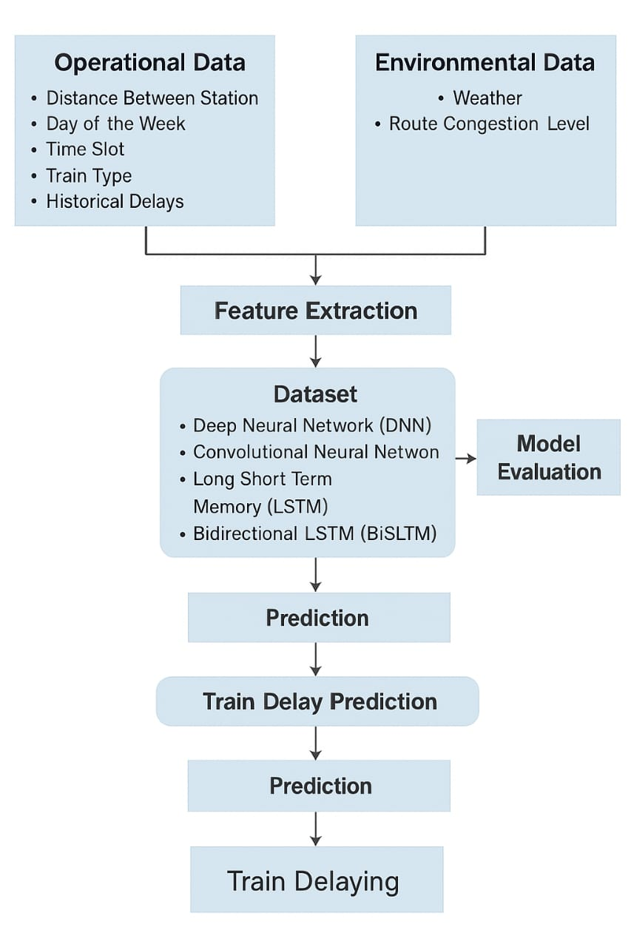
Block Diagram

Slide 8
Methodology
1. Data Collection
The dataset combines both operational and environmental factors that influence train delays.
Operational Data: Distance between stations, day of the week, time slot, train type, and historical delays.
Environmental Data: Weather conditions and route congestion level.These parameters provide comprehensive insights into the temporal and contextual causes of delays.
2. Feature Extraction
In this stage, raw data is processed to extract relevant features. Missing values are handled, categorical variables are encoded, and numerical features are normalized. This ensures the dataset is clean, consistent, and ready for model training.
3. Model Development
Four deep learning models are developed and trained to analyze and predict train delays:
Deep Neural Network (DNN): Captures complex non-linear relationships between features.

Slide 9
Convolutional Neural Network (CNN): Extracts spatial and temporal feature patterns.
Long Short-Term Memory (LSTM): Learns long-term dependencies in sequential delay data.
Bidirectional LSTM (BiLSTM): Processes data in both forward and backward directions for higher accuracy.
4. Model Evaluation
Each model is evaluated using multiple statistical performance metrics:
Root Mean Square Error (RMSE) – Measures overall prediction error.
Mean Absolute Error (MAE) – Calculates average deviation between predicted and actual values.
Coefficient of Determination (R²) – Indicates how well the model explains variance.
Symmetric Mean Absolute Percentage Error (sMAPE) – Evaluates percentage-based prediction accuracy.
The BiLSTM model achieved the best performance across all evaluation metrics, showing its effectiveness in learning bidirectional temporal dependencies.

Slide 10
5. Prediction and Output
The trained deep learning models are used to forecast train delays based on real-time operational and environmental data.
The BiLSTM model provides the most accurate delay predictions by learning from both past and future data sequences.
Predictions are continuously updated as new data (e.g., weather or congestion changes) becomes available.
Output includes estimated delay duration and probability of delay occurrence at each station.
The system can be integrated with real-time railway dashboards to alert operators and passengers.
Helps railway authorities reschedule trains, reduce congestion, and optimize resource allocation.
Improves passenger experience by providing timely and reliable delay information.
Forms the basis for future AI-driven decision support systems in smart railway management.

Slide 11
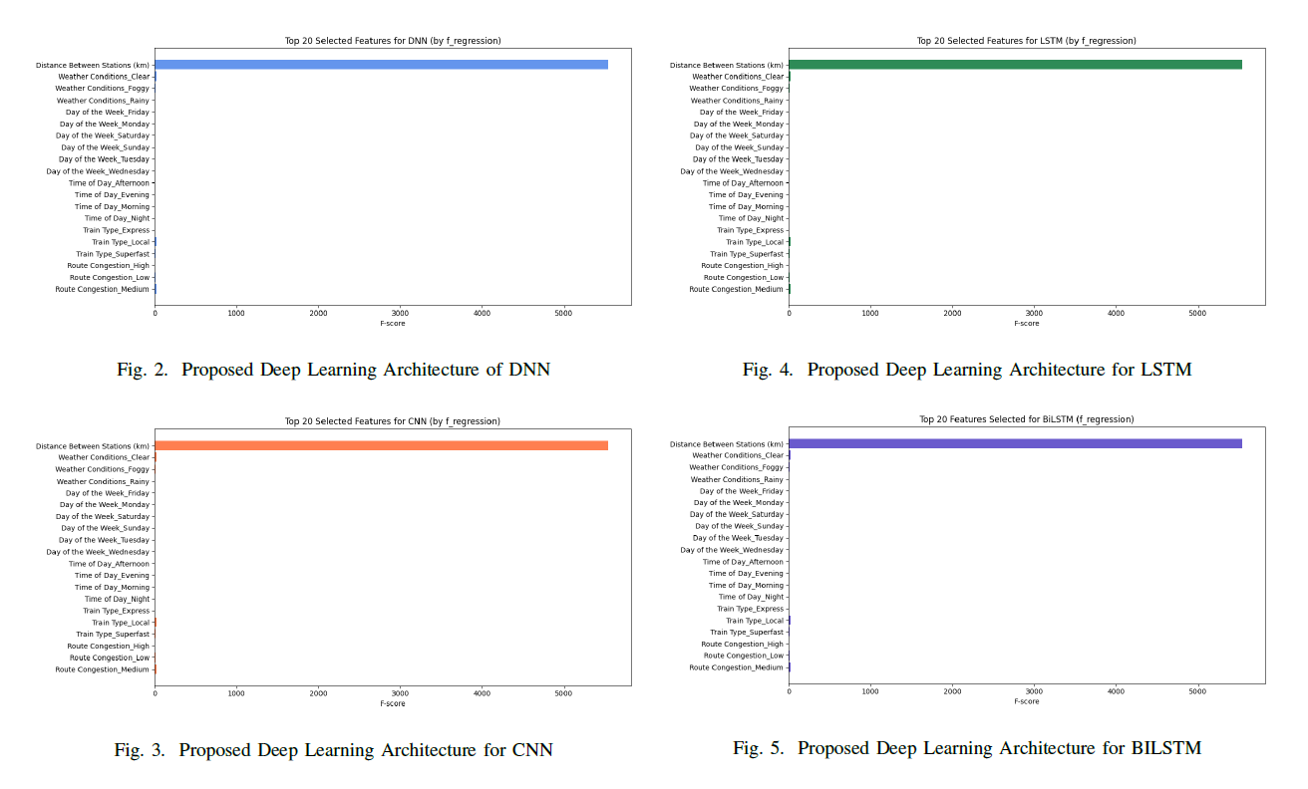

Result & Discussion

Slide 13
Conclusion
The project successfully demonstrates that deep learning models, particularly the Bidirectional LSTM (BiLSTM), are highly effective for predicting train delays using operational and environmental data. By comparing DNN, CNN, LSTM, and BiLSTM models, it was found that BiLSTM achieved the highest accuracy (R² = 96.17%) and lowest error values, proving its strength in learning temporal dependencies from both past and future contexts. This approach enhances real-time forecasting, enabling better train scheduling, reduced congestion, and improved passenger satisfaction. The study also emphasizes that incorporating factors such as weather, route congestion, and historical delays significantly improves model reliability. Furthermore, the developed framework is modular and can be integrated with real-time railway systems for dynamic delay monitoring. Overall, this work highlights the potential of deep learning in creating intelligent, adaptive, and sustainable railway management systems for future smart transportation.

Slide 14
References
[1] K. Rautela, M. C. Trivedi, and P. P. Roy, "A BiLSTM based deep learning model for predicting train delays," in Proc. Int. Joint Conf.
Neural Netw. (IJCNN)*, Glasgow, UK, Jul. 2020, pp. 1-7.
[2] L. Ge, M. Sarhani, S. Vos, and L. Xie, "Review of transit data sources:Potentials, challenges and complementarity," Sustainability, vol. 13,no. 20, p. 11450, 2021.
[3] Z. Li, C. Wen, R. Hu, C. Xu, P. Huang, and X. Jiang, "Near-term train delay prediction in the Dutch railways network," Int. J. Rail Transportation, vol. 9, no. 6, pp. 520-539, 2020.
[4] N. Markovic, S. Milinkovic, K. S. Tikhonov, and P. Schonfeld, "Examiningpassenger train arrival delays with support vector regression,"Transportation Research Part C*, vol. 56, pp. 251-262, 2015.
[5] M. Sarhani and S. Vos, "On the effectiveness of SVM-based feature selection for transit delay prediction," 2021.
[6] J. Wessel, J. Allen, and K. Watkins, "Integrating real-time data into GTFS, a public transit data standard," *Transportation Research Record, vol. 2650, no. 1, pp. 110-118, 2017.
[7] P. Huang, C. Wen, L. Fu, et al, "Modeling train operation as sequences:A study of delay prediction with operation and weather data," *Transportation Research Part E*, vol. 141, p. 102022, 2020.
[8] M. Shoman, T. Laverty, and C. Andris, "Transit delay prediction using entity embeddings on heterogeneous data," *IEEE Trans. Intell. Transp.Syst.*, vol. 22, no. 7, pp. 4151-4161, 2020.
[9] C. Wen, P. Huang, and L. Fu, "Predicting transit delays using graph attention networks," *Transportation Research Part C*, vol. 149, p.103935, 2023.
[10] X. Wang, L. Chen, and Y. Zhao, "Comparative study of machine learning models for metro delay forecasting," *Expert Syst. Appl.*, vol. 216, p.119419, 2023.

Slide 15
Thank You

