Slide 1

NARASARAOPETA ENGINEERING COLLEGE (AUTONOMOUS) Department of computer science and engineering
Book recommendation system
Under the estimeed guidance of
DR.B.Jhansi vazram M.Tech.,ph.d
Professor
PRESENTED BY
g.siva sankar tarun(19471A0522)
g.Anjani Sudheer(19471a0520)
K.kalyan(19471A0533)

Slide 2
CONTENTS
Abstract
Software and Hardware Requirements
Requirement Analysis
System Architecture
Existing and proposed system
Data Collection
conclusion
References

Slide 3
Abstract
As the amounts of online books are exponentially increasing due to COVID-19 pandemic, finding relevant books from a vast e-book space becomes a tremendous challenge for online users.
recommendation systems have been emerged to conduct effective search which mine related books based on user rating and interest.
Most of these existing systems are user-based ratings where popularity-based and collaborative learning methods are used.
This proposed an effective system for recommending books for online users that rated a book using the clustering method and then found a similarity of that book to suggest a new book.

Slide 4
System Requirements
Hardware Requirements:
Software Requirements :
Operating System : Windows 10
Server : Flask
Programming Languages : Python ,html
Database : Dataset
Editor : Jupyter notebook, PyCharm
Processor | : | I3 processor or higher versions
Hard Disk | : | 30 GB or more.
RAM | : | 2GB or more.

Slide 5
REQUIREMENT ANALYSIS
FUNCTIONAL REQUIREMENT
A Functional Requirement is a description of the service that the software must offer.
• Applying the algorithms on the train data
• Display the recommendations by the model.
NON-FUNCTIONAL REQUIREMENT
Ensures high availability of book data here datasets.
User should get the result as fast as possible.
It should be easy to use user is just required to type the words and click then the result is displayed or user is just required to enter a pair of reasonable sentence.
• Accuracy
• Reliability
• Flexibility

Slide 6
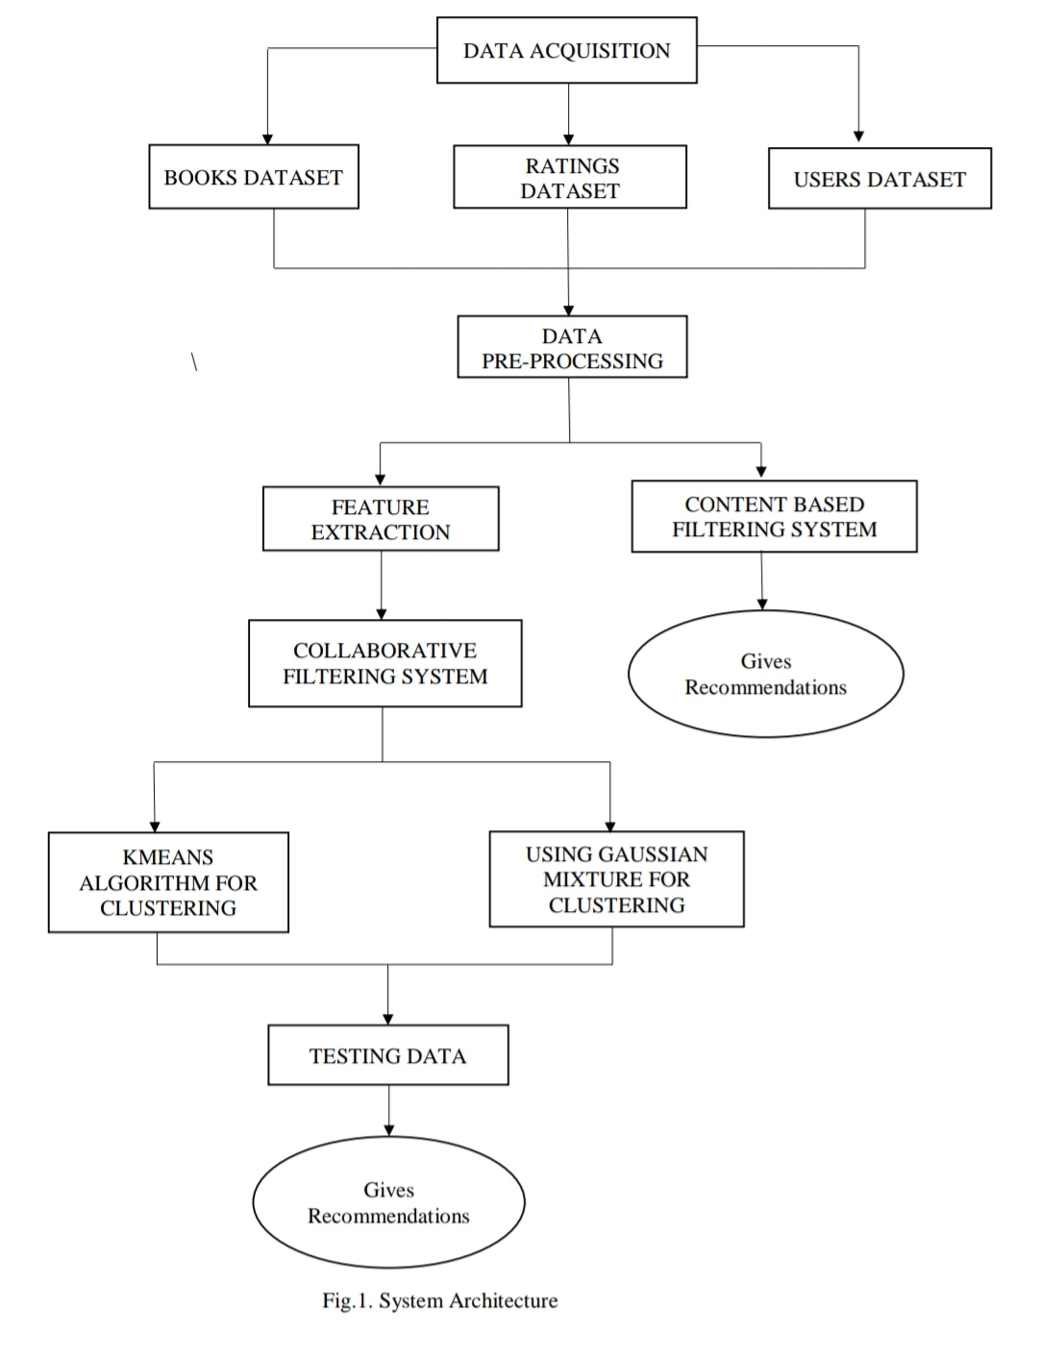
System Architecture

Slide 7
Existing System
Book recommendation systems aim to provide personalized book recommendations to users based on their preferences and reading history. The existing system for book recommendation, Content-based filtering : Content-based filtering recommends books based on their attributes such as genre, author, language, publication date, and user reviews. It has analyzes the user's past reading history and recommends books with similar attributes.
Collaborative filtering requires a large amount of data to generate accurate recommendations. However, in practice, user data is often sparse, meaning that there may be limited overlap in the books that different users have rated or reviewed. This can lead to inaccurate recommendations.
Disadvantages:
1. It doesn’t provides accurate recommendations.

Slide 8
Proposed System
The Proposed System of Book Recommendation System provides the user an interface such that it performs searching and finding the relevant books using this interface with an ease.
The system can generate a list of book recommendations that are likely to be of interest to the user. These recommendations can be based on the collaborative and popularity based methods.
Advantages:
1. Speed up the recommendations.
2. It provides quality of recommendations.

Slide 9
Dataset Collection
we have 3 files in our dataset which is extracted from Kaggle website:
https://www.kaggle.com/datasets/arashnic/book-recommendation-dataset
Books – first are about books which contain all the information related to books like an author, title, publication year, etc.
Users – The second file contains registered user’s information like user id, location.
ratings – Ratings contain information like which user has given how much rating to which book.

Slide 10
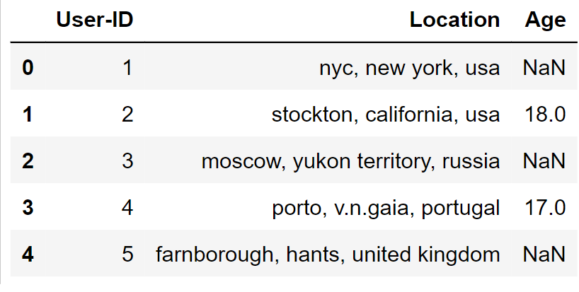
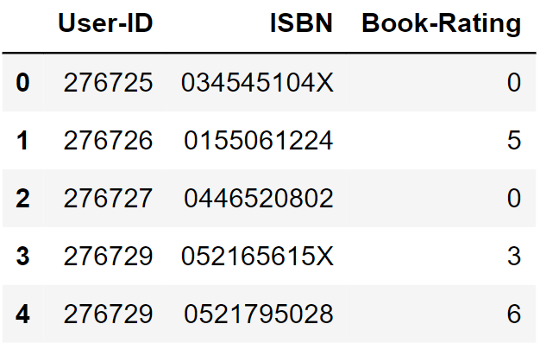
users.csv
ratings.csv

Slide 11
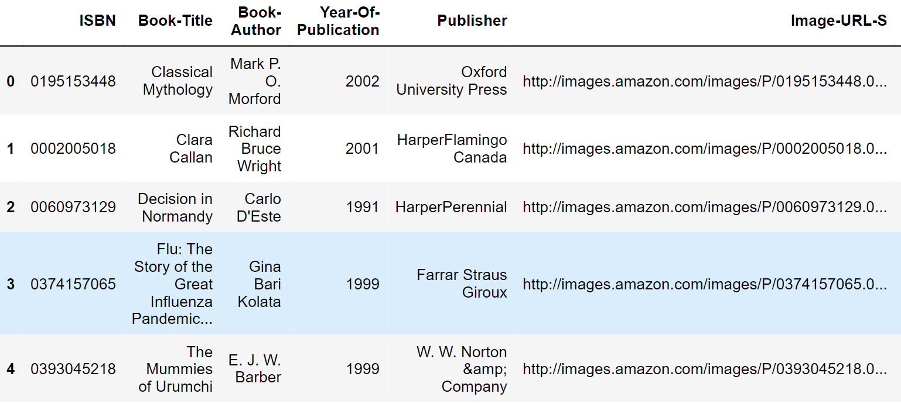
Books.csv

Slide 12
Pre-processing and cleaning
We will process the text data like a book title, book Author and remove useless characters, symbols, whitespaces, etc. We need to ensure that all numeric data like book-average rating, rating counts are of numeric data type.
Data cleansing: identifying and removing any duplicate, incorrect, or irrelevant data. For example, if there are two entries for the same book with different ISBNs, one of them should be removed to avoid duplicate recommendations.
Data normalization: This involves transforming the data into a common format, such as converting book titles to lowercase or standardizing author names. This makes it easier to compare and group similar items.

Slide 13
Implementaion Phase
K-NN Algorithm
Step-1: Select the number K of the neighbors
Step-2: Calculate the Euclidean distance of K number of neighbors
Step-3: Take the K nearest neighbors as per the calculated Euclidean distance.
Step-4: Among these k neighbors, count the number of the data points in each category.
Step-5: Assign the new data points to that category for which the number of the neighbor is maximum.
Step-6: Stop.

Slide 14
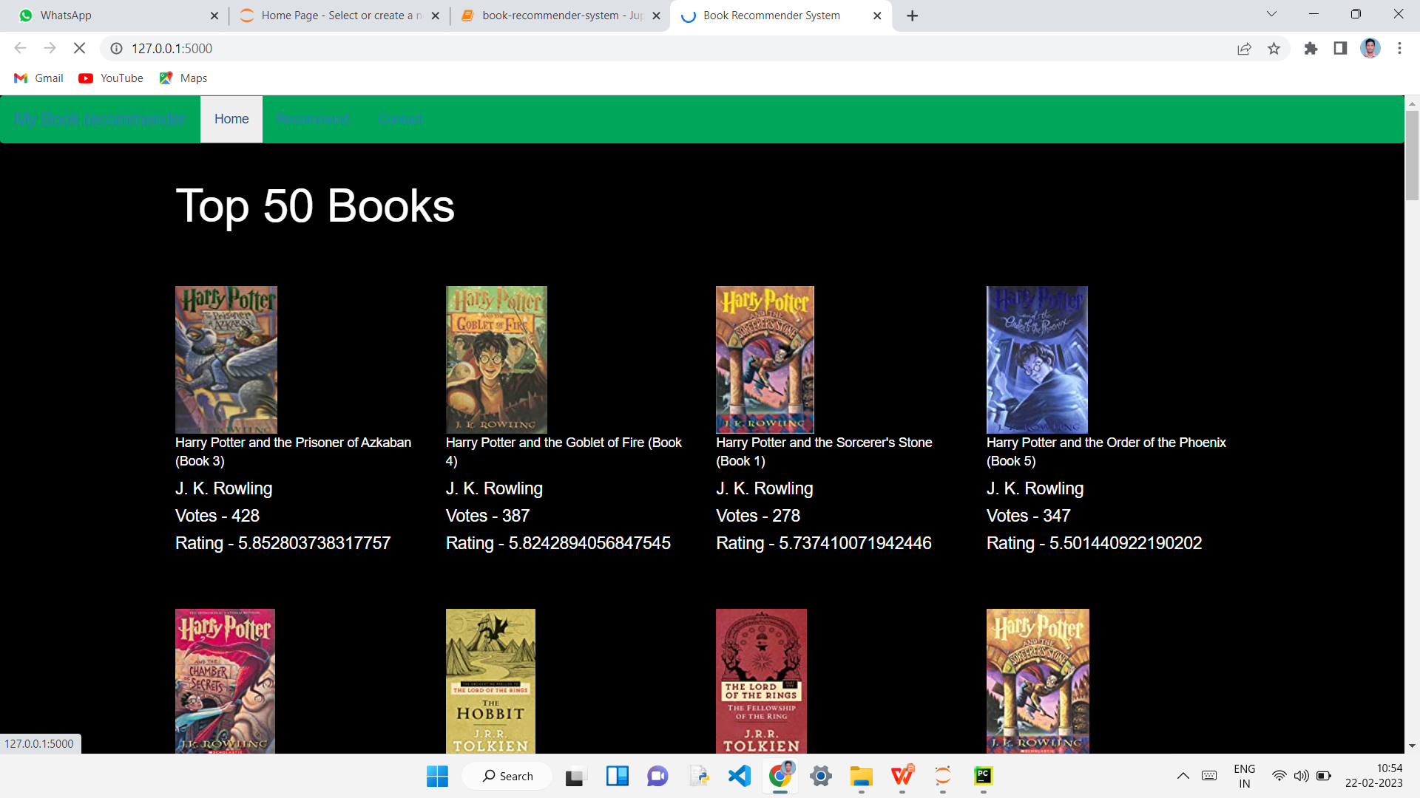
output screens

Slide 15
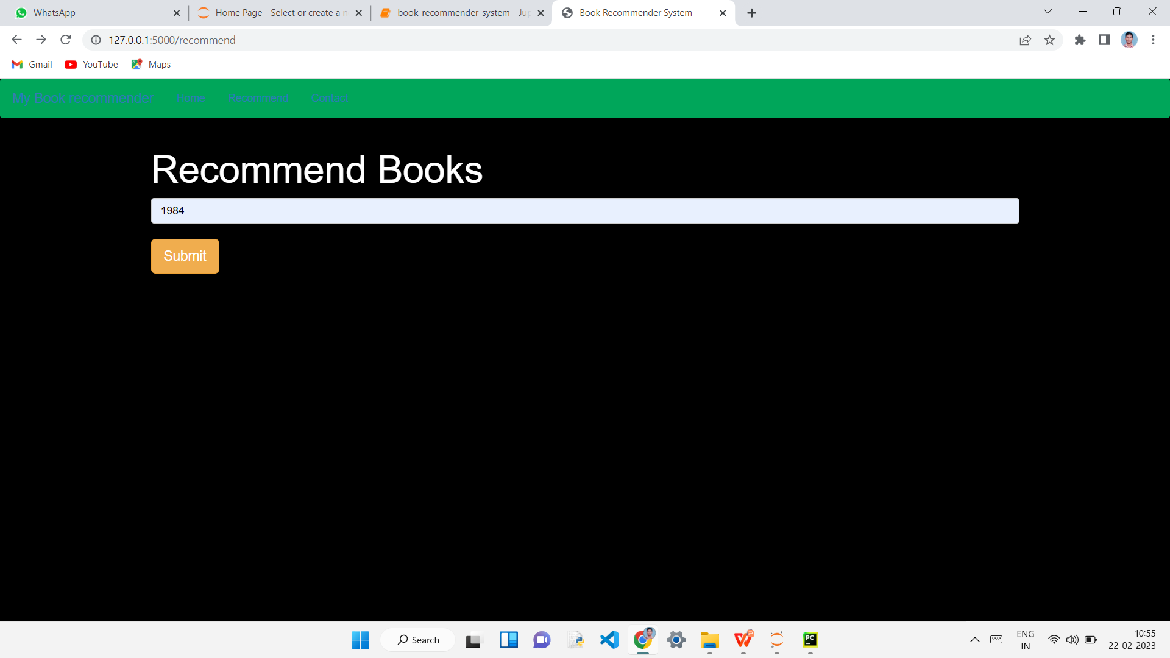

Slide 16
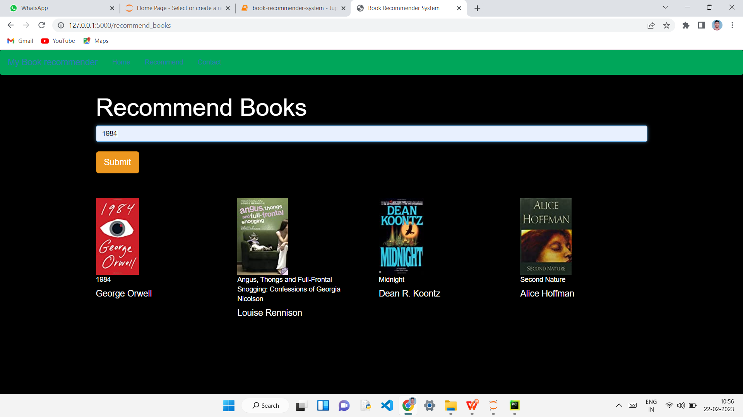

Slide 17
CONCLUSION
In this we present a Book recommendation system based on a collaborative filtering approach and popularity based approach. The main goal was to speed up recommendations which is to create such a system, which can provide quality recommendations to their users without the need for long-term registration.

Slide 18
References
Avi Rana and K. Deeba et.al, “Online Book Recommendation System using Collaborative Filtering (With Jaccard Similarity)” in IOP ebooks 1362, 2019.
G. Naveen Kishore, V. Dhiraj, Sk Hasane Ahammad, Sivaramireddy Gudise, Balaji Kummaraa and Likhita Ravuru Akkala, “Online Book Recommendation System” International Journal of Scientific & Technology Research vol.8, issue 12, Dec 2019.
Jinny Cho, Ryan Gorey, Sofia Serrano, Shatian Wang, JordiKai Watanabe-Inouye, “Book Recommendation System” Winter 2016.
Ms. Sushma Rjpurkar, Ms. Darshana Bhatt and Ms. Pooja Malhotra, “Book Recommendation System” International Journal for Innovative Research in Science & Technology vol.1, issue 11, April 2015.

Slide 19


