Slide 1

NARASARAOPETA ENGINEERING COLLEGE (AUTONOMOUS) Department of computer science and engineering
CROP YIELD PREDICTION system
Under the estimeed guidance of
Dr.K.Lakshminadh M.Tech,Ph.d
Professor
PRESENTED BY
SK.ABDUL SALAM(19471A0555)
K.GOPICHAND(19471a0529)
S.VENKATESH(19471A0552)

Slide 2
CONTENTS
Abstract
Software and Hardware Requirements
Requirement Analysis
System Architecture
Existing and proposed system
Data Collection
conclusion
References

Slide 3
Abstract
Collects data from various sources, such as weather data, soil data and farmer inputs.
Pre-processes data to remove outliers, missing values, and inconsistencies and selects relevant features for analysis.
Develops machine learning models, such as decision trees, random forests, neural networks, or support vector machines, to predict crop yield based on selected features.
Evaluates model performance using various metrics to select the best-performing model.
Provides a user interface for farmers and policymakers with visualizations of collected data and a visual representation of the predicted crop yield.
Predicts crop yield for the upcoming season based on the selected machine learning model and input data, which could help make informed decisions about crop management practices and food security.

Slide 4
System Requirements
Hardware Requirements:
Software Requirements :
Operating System : Windows 10
Server : Flask
Programming Languages : Python ,html
Database : Dataset
Editor : Jupyter notebook, PyCharm
Processor | : | I5 processor or higher versions
Hard Disk | : | 30 GB or more.
RAM | : | 4GB or more.

Slide 5
REQUIREMENT ANALYSIS
FUNCTIONAL REQUIREMENT
Data Collection
Data Pre-Processing
Feature Selection
Machine Learning Model Development
NON-FUNCTIONAL REQUIREMENT
Performance
Reliability
Scalability
Usability
Security

Slide 6
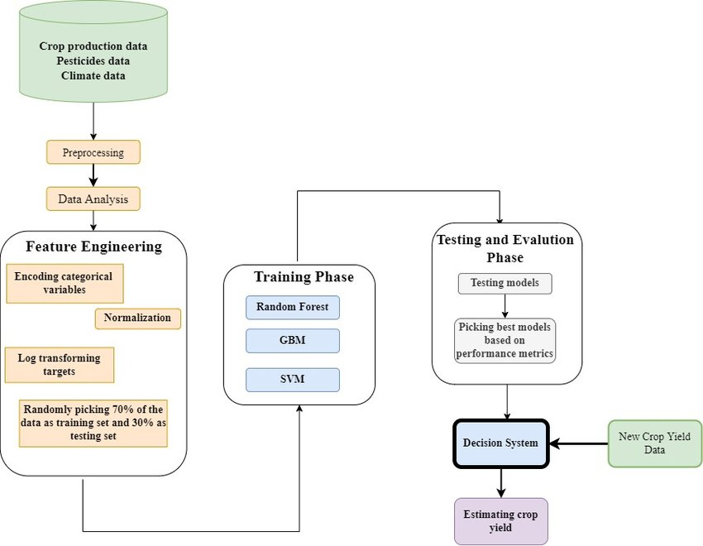
System Architecture

Slide 7
Existing System
The Cropping System Model is another crop growth model that uses a combination of weather, soil, and management data to predict crop yield. It can simulate a wide range of crops and management practices, and can be used to explore different scenarios and management strategies
Existing crop yield prediction systems rely on statistical and mathematical models, such as linear regression or time series analysis, to predict crop yield based on historical data and environmental factors.
Existing systems may also incorporate data from remote sensing to estimate crop growth and condition, as well as weather data, soil data, and other factors that may impact crop yield.
Disadvantages:
Predicts only one crop.
Did not provide alternative crops to choose.
The accuracy is less

Slide 8
Proposed System
The system incorporates data from various sources, such as weather data, soil data, and satellite imagery, and can be customized for different crops and regions. It also provides a user-friendly interface for farmers and other stakeholders to access and interpret the predictions.
The proposed system uses machine learning algorithms, such as regression, random forests, or artificial neural networks, to analyze historical data and environmental factors and predict crop yield.
The system can automatically learn and adjust to new data, improving the accuracy of predictions over time. It can also incorporate data from multiple sources, such as weather data, soil data, and satellite imagery, to provide a more comprehensive view of crop growth and yield.
Advantages:
Provides alternative crops to choose.
Farmers can choose any crop among the predicted crops.
It will predicts which is best for the season
The Accuracy is High

Slide 9
Dataset Collection
we have 2 files in our dataset which is extracted from Kaggle website:
https://www.kaggle.com/datasets/patelris/crop-yield-prediction-dataset
Crop –The dataset should include historical data on crop yield, weather conditions, soil properties, and other relevant factors for the crop of interest. The data should be collected over several years to capture variability in crop performance due to weather, management practices, and other factors.
Users –Users of a crop yield prediction system can vary depending on the purpose and design of the system. Here are a few examples of potential users Farmers , Agronomists and Researchers.

Slide 10
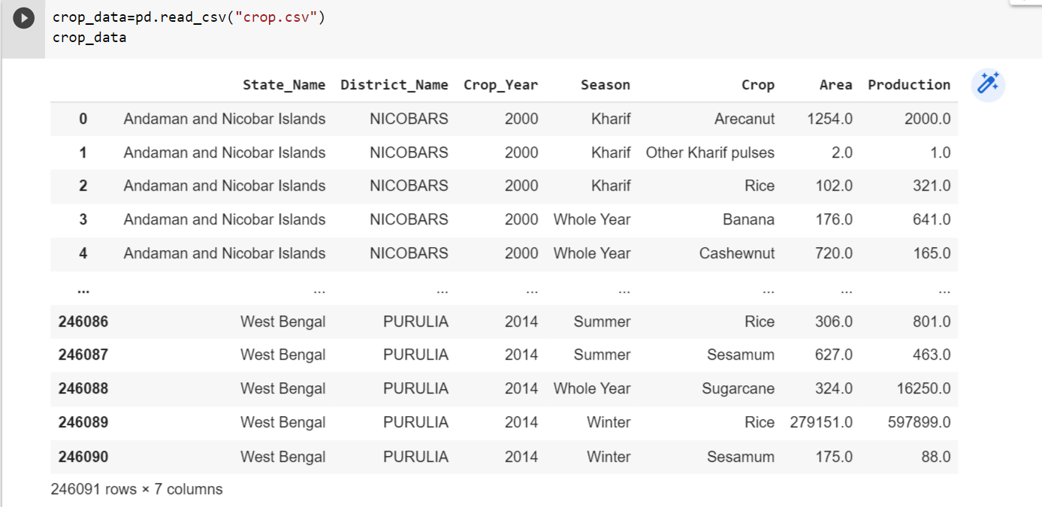
Dataset.csv

Slide 11
Pre-processing and cleaning
Regression analysis: Regression analysis is a supervised learning technique that can be used to model the relationship between crop yield and various predictor variables, such as weather conditions, soil properties, and management practices. Linear regression, polynomial regression, and multiple regression are some common regression techniques used in crop yield prediction
Decision tree analysis: Decision tree analysis is a supervised learning technique that can be used to model the relationship between crop yield and predictor variables in the form of a decision tree. The decision tree consists of a series of nodes that represent predictor variables and branches that represent the possible outcomes of each variable. Decision tree analysis is useful for identifying the most important predictors of crop yield and for generating decision rules based on these predictors
Random Forest: Random forest is machine learning technique that can be used for crop yield prediction. Random forest is an ensemble learning method that combines multiple decision trees to create a more accurate and robust prediction mode.

Slide 12
Random Forest Algorithm
Implementaion Phase
Collect and preprocess data: Collect the data on crop yield and various predictor variables, such as weather data, soil properties, and crop management practices. Preprocess the data by cleaning, transforming, and normalizing it to make it suitable for use in machine learning algorithms.
Divide the data into training and testing sets: Split the preprocessed data into training and testing sets. The training set is used to train the Random Forest model, while the testing set is used to evaluate the performance of the model.
Create the Random Forest model: Create a Random Forest model by selecting the appropriate hyperparameters, such as the number of trees in the forest, the maximum depth of each tree, and the minimum number of samples required to split a node. Train the model on the training data using the scikit-learn library in Python.
Make predictions: Use the trained Random Forest model to make predictions on the testing data. Evaluate the performance of the model using metrics such as mean squared error, mean absolute error, and R-squared.
Tune hyperparameters: Tune the hyperparameters of the Random Forest model to improve its performance. Use techniques such as grid search or random search to find the optimal combination of hyperparameters.
Deploy the model: Deploy the final Random Forest model on new data to make predictions on crop yield based on various predictor variables

Slide 13
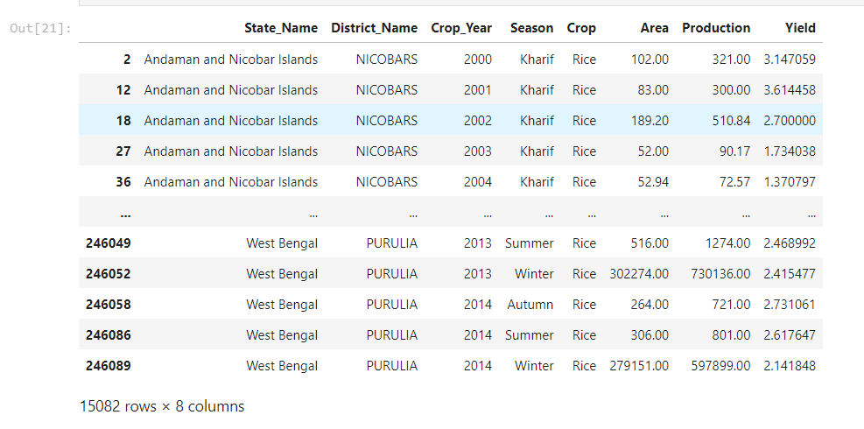
Testing Phase

Slide 14
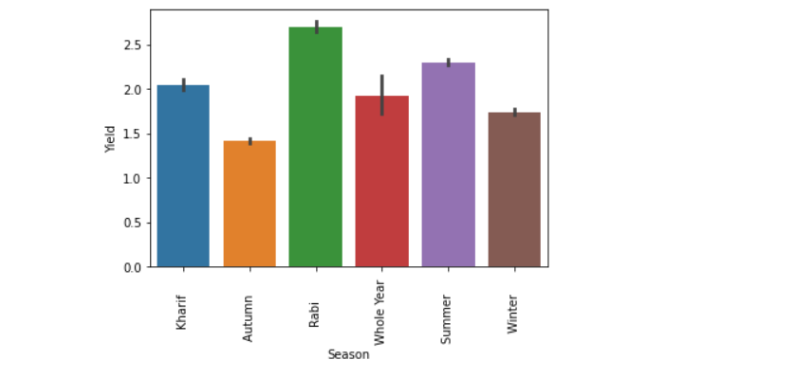

Slide 15
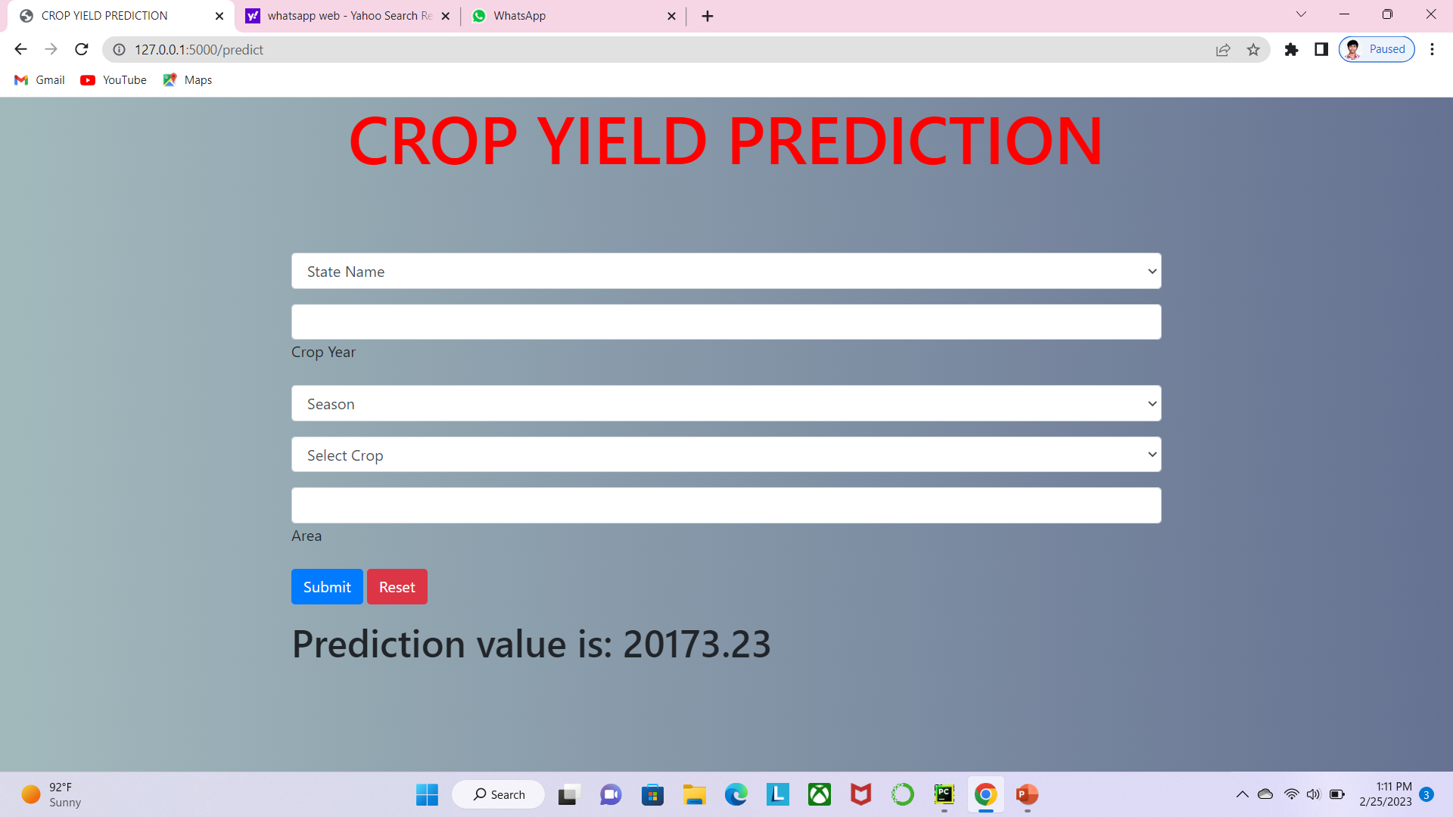
Output screen:

Slide 16
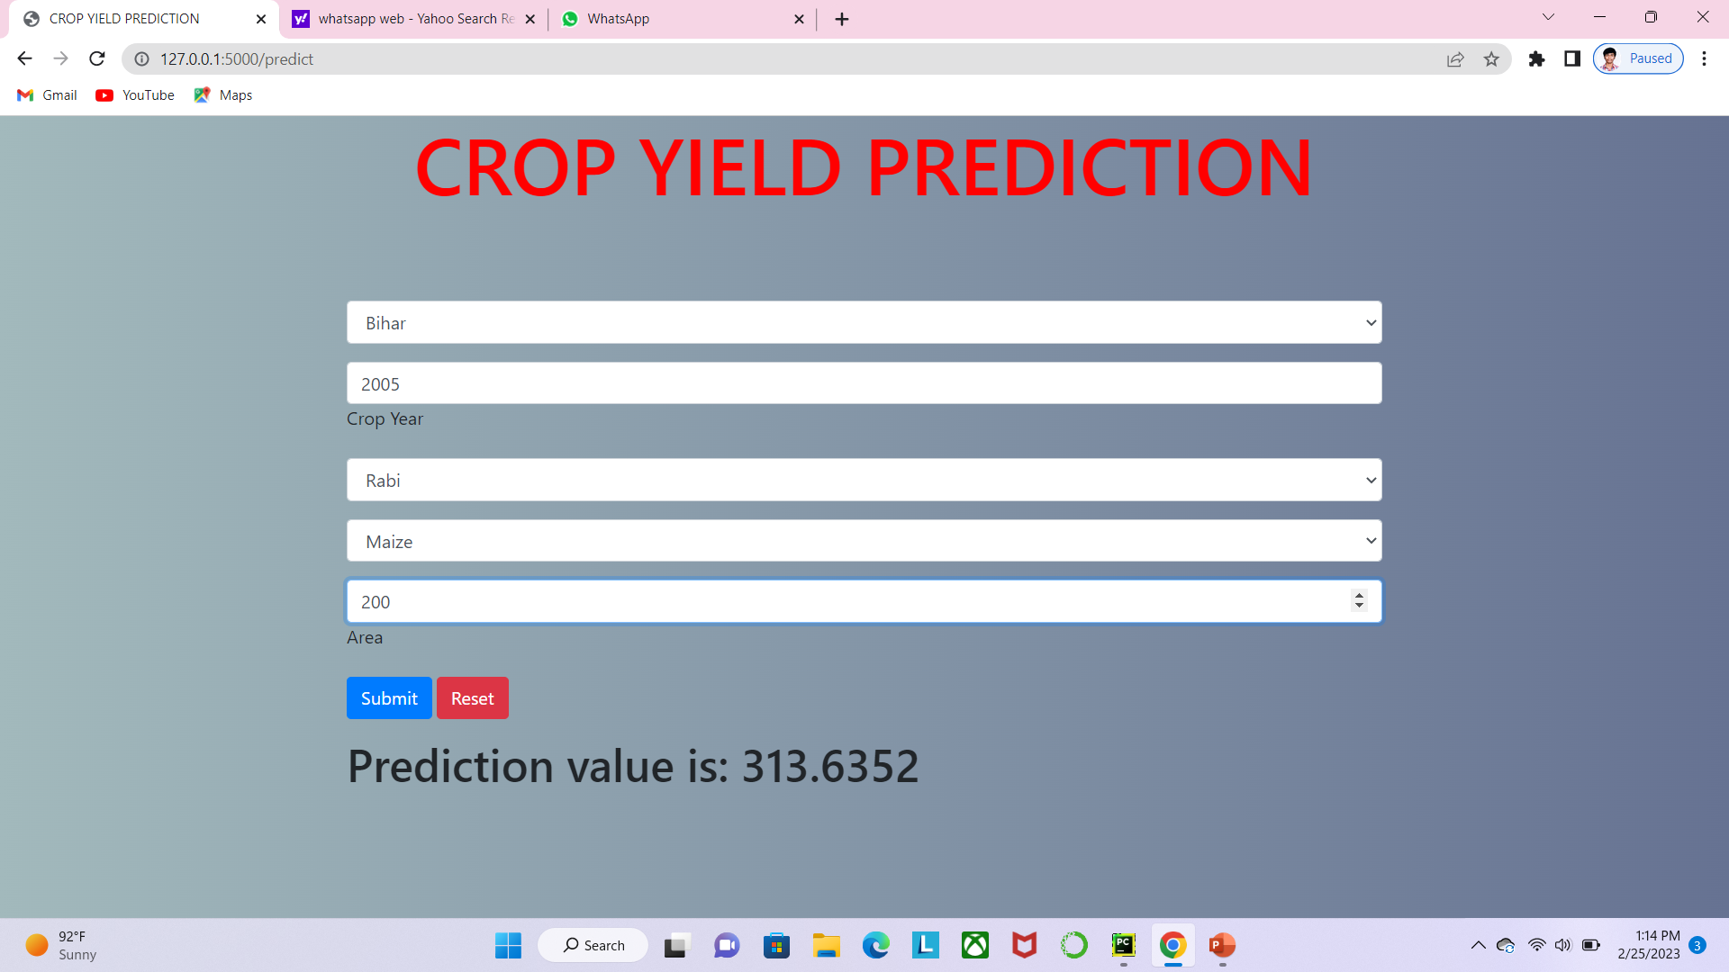

Slide 17
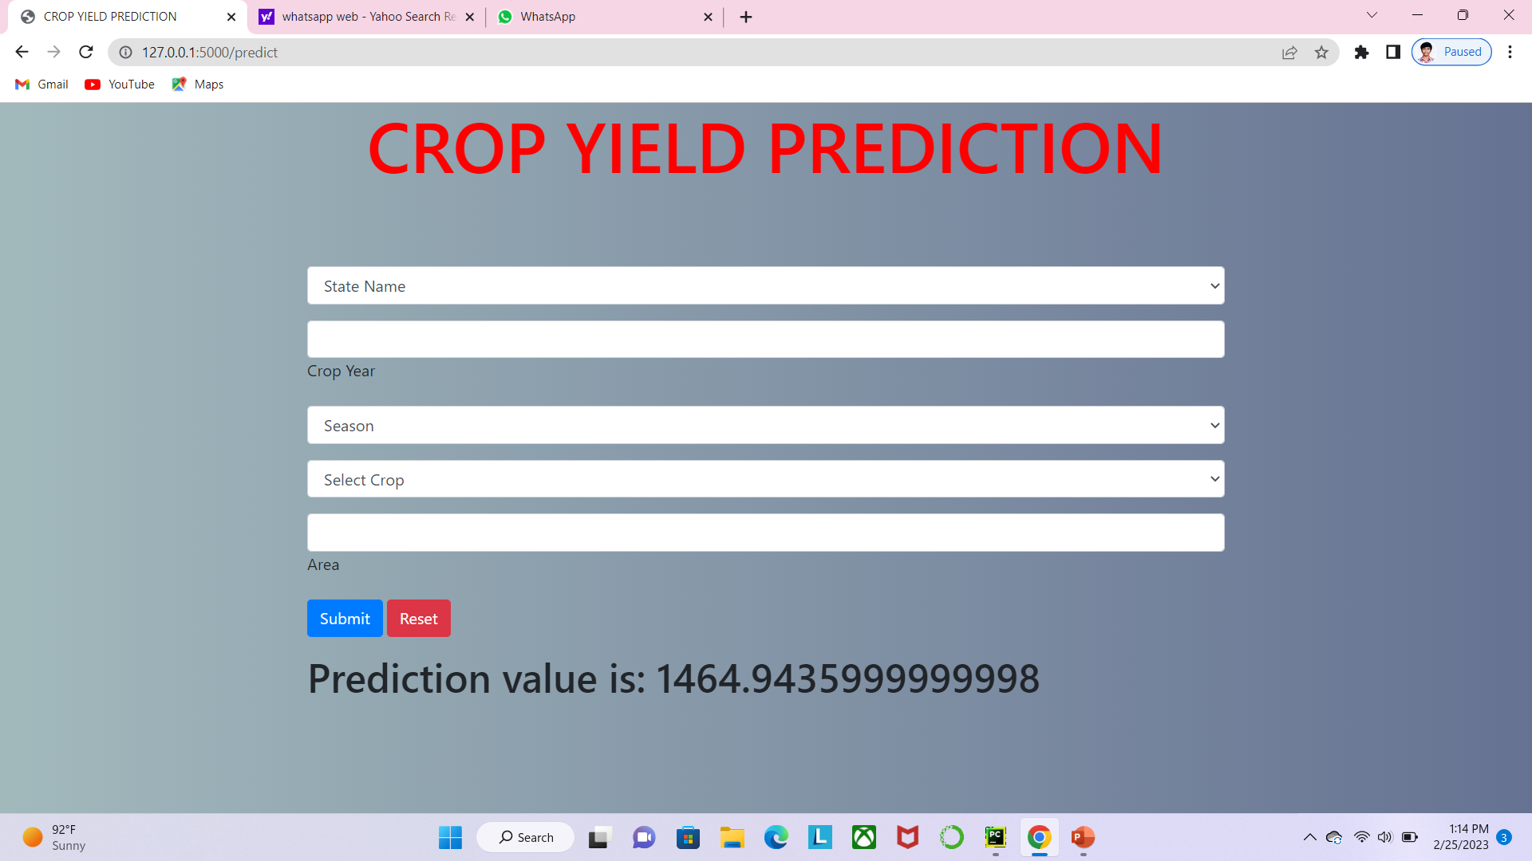

Slide 18
CONCLUSION
In conclusion, predicting crop yield is a crucial task for farmers and agricultural organizations. Machine learning techniques such as Artificial Neural Networks, Support Vector Regression, and Random Forest can be used to predict crop yield based on various predictor variables, such as weather data, soil properties, and crop management practices.
However, it is important to collect high-quality data, preprocess it appropriately, and tune the machine learning models carefully to obtain accurate and robust predictions. Additionally, the models should be regularly updated with new data to ensure their continued relevance and effectiveness. Overall, the use of machine learning techniques in crop yield prediction has the potential to revolutionize agriculture and increase food security for people around the world

Slide 19
References
[online] Available: https://www.omicsonline.org/open-access/agriculture-role-on-indian-economy-2151-6219-1000176.php?aid=62176..
S. S. Dahikar and S. V. Rode, "Agricultural crop yield prediction using artificial neural network approach", International journal of innovative research in electrical electronics instrumentation and control engineering, vol. 2, no. 1, pp. 683-686, 2014.
S. Mishra, D. Mishra and G. H. Santra, "Applications of machine learning techniques in agricultural crop production: a review paper", Indian J. Sci. Technol, vol. 9, no. 38, pp. 1-14, 2016.
E. Manjula and S. Djodiltachoumy, "A Model for Prediction of Crop Yield", International Journal of Computational Intelligence and Informatics, vol. 6, no. 4, pp. 2349-6363, 2017.

Slide 20


