Slide 1
Team Guide: Dr.M.Sireesha,M.Tech.,Ph.D. Presented By: A.Adhilakshmi (19471A0535) N.Bhuvaneswari (19471A0538) E.Madhavi (19471A0519)
Prediction of Employee Attrition Using Machine
Learning

Slide 2
CONTENTS OF THIS TEMPLATE
Abstract
Introduction
Existing System
Proposed System
Steps involved in this machine learning Project
Data Collection and Data Preprocessing
Model Selection
Training the model
Result Analysis
Confusion matrix
Output Screens
Conclusion

Slide 3
ABSTRACT
The term Attrition refers to the voluntary or involuntary discontinuation of employees in an organization. This project focuses on discussing a systematic flow for predicting Attrition using Data Analysis and Machine Learning techniques.
The steps include Data Collection, Data Preprocessing,and Classification by applying the following Classification Models: Support Vector Machine, Decision Tree, Random Forest, and Logistic Regression algorithms in the Python environment. The resulting predictions of classification were evaluated using three performance metrics: Accuracy Score, Confusion Matrix. Based on the obtained results, we inferred that Random Forest classifier delivered the highest accuracy being 85.3% compared to Decision Tree and Support Vector Machine .
This paper intends to be of great use to the Organizations aiming at detecting the key causes of Attrition and minimizing them using the power of data.

Slide 4
Introduction
In today’s world data is being created at an ever-increasing rate. The analysis of this stored data has proved to be beneficial in gaining insights and creating general awareness about any business or organization. Data analysis is the process of collecting, inspecting, cleansing, transforming, and modeling raw data with the aim of deriving valuable insights and retrieving relevant information to reach a conclusion for good decision making. Machine Learning is the process of using algorithms to train a machine to predict accurately using the existing data. Employees are a crucial resource for any organization, and hence withdrawal of productive employees might affect an organization with respect to various aspects. Some of the consequences of Employee Attrition are: Investing in staffing and training new employees, increased burden on existing employees and a decline in the performance of the organization. In this paper, we intend to classify employees with respect to previous ‘Attrition’ patterns and other relevant attributes.

Slide 5
Existing System
In the traditional methods, all the activities inside an organization are carried out manually. The employee records are maintained manually and if any employee wants to leave an organization, they are maintained manually. All this requires a lot of human effort and time and they are prone to a lot of errors. There are many factors involved which may cause a potential employee to leave an organization.?
For example, an employee may leave an organization due to poor salary, lack of proper infrastructure, and many other factors. All these things can’t be predicted manually. To overcome these shortcomings, an employee attrition model is designed by using various machine learning techniques. The model is trained properly by providing the proper data so that the model makes good predictions.
The performance of the model is evaluated by calculating the proper accuracy score.
Disadvantages:
Prediction accuracy is not good when compared to other methods.
Less efficient and less robust when compared to other methods.

Slide 6
Proposed system
The main aim of this project is to predict the employee attrition rate by employing various machine learning techniques. There are various factors that affect the number of employees in an organization. Parameters like salary, work culture, and work environment affects the employees working in an organization. So, first, we need to collect the datasets from the data source. After collecting the datasets, we need to apply various pre-processing techniques in order to remove null values and unwanted values.Split data into train set and test set after that train model using different machine learning algorithms. Finally evaluate the test results.
Advantagess:
More robust and reliable when compared to all the previous methods.
Prediction accuracy is good and it consumes less time in order to make predictions.

Slide 7
Literature Survey
Paper[1]: Amir Mohammad EsmaieeliSikaroudi, RouzbehGhousi and Ali EsmaieeliSikaroudi et al, implemented knowledge discovery steps on real data of a manufacturing plant. They chew over many characteristics of employees such as age, technical skills and work experience. They used to find out importance of data features is measured by Pearson Chi-Square test.
Paper[2]:John M. Kirimi and Christopher Moturi et al, proposed a prediction model for employee performance forecasting that enables the human resource professionals to refocus on human capability criteria and thereby enhance the performance appraisal process of its human capital.
Paper[3]:RohitPunnoose and PankajAjit et al, explored the application of Extreme Gradient Boosting (XGBoost) technique which is more robust because of its regularization formulation. Data from the HRIS of a global retailer is used to compare XGBoost against six historically used supervised classifiers and demonstrate its significantly higher accuracy for predicting employee turnover.

Slide 8
Steps involved in machine Learning Project
Data Collection
Data Preprocessing
Machine learning algorithms
Train the Model
Evaluating Model
Result Analysis

Slide 9
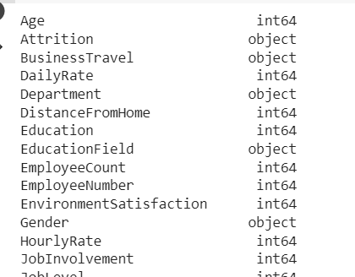
Data Collection
The dataset was collected from Kaggle, a website that provides datasets and serves as a venue for data science-related contests.There are 35 attributes and 1470 records in the dataset. website https://www.kaggle.com/pavansubhasht/ibm-hr-analytics-attrition-dataset
Fig: Dataset attributes and its datatypes

Slide 10
Data Pre-Processing
For the easy interpretation of the data, the data should be transformed from it raw state.
The raw data is transformed into useful data for model training.
The data pre-processing steps we considered are:
1. Importing libraries
2. Removing Null values & outliers
3. Correlation of attributes
4. Balance the class labels in target variable
5. Feature Importance

Slide 11
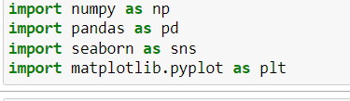
Libraries Imported
A library is a predefined module . Library consists of set of funcitons.
Some of the libraries used are:
import numpy as np
import pandas as pd
import seaborn as sns
import matplotlib.pyplot as plt
from sklearn.ensemble import RandomForestClassifier
from sklearn.model_selection import KFold

Slide 12
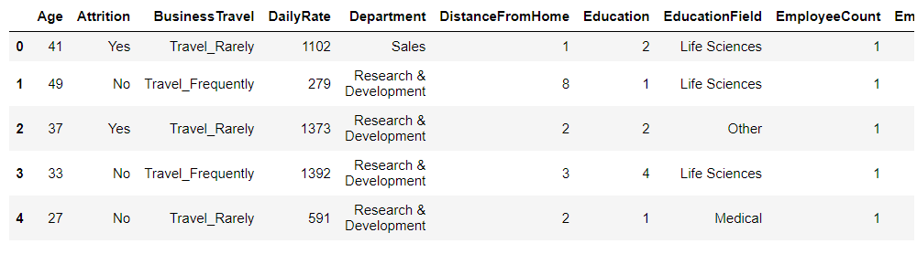
Dataset
Here is the table representation of employee dataset .

Slide 13
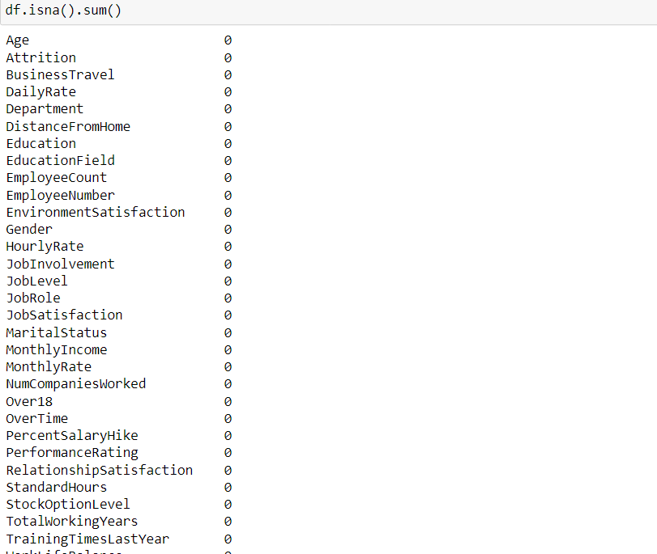

Verifying Null values
In order to verify whether null values are present in the dataset we have to use isnull() or isna() methods along with sum function. Isna().sum() returns the number of null existed records in every column in the dataset.

Slide 14
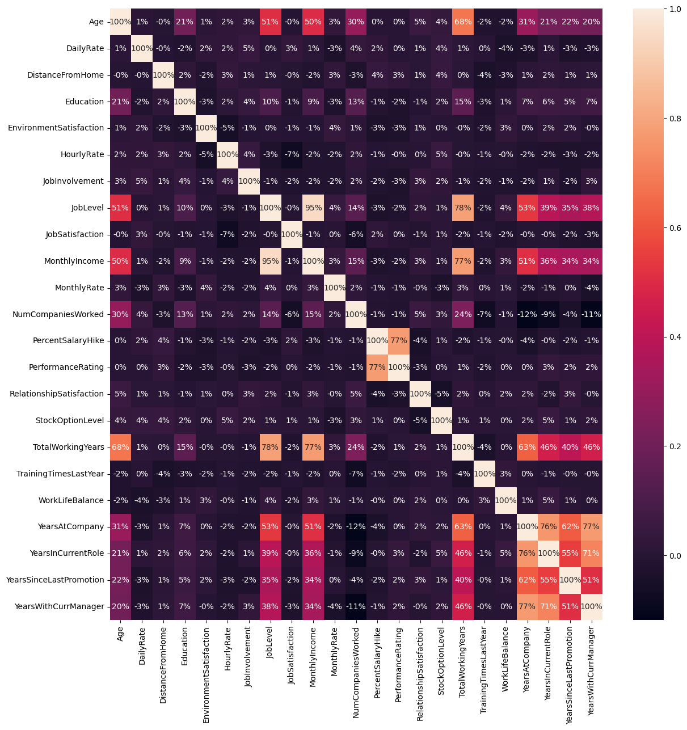
Correlation of attributes
Correlation of attributes shows how two attributes are depends on each other. Dark shaded areas are
weakly related attributes where are brighted areas are corelated to each other on scale of 0-1. From
below figure we can clearly observe that YearsAtCompany and YearsWithCurrManager are 77%
correlated. JobLevel and MothlyIncome are more related to each other with 95% .
Fig: correlation of attributes

Slide 15
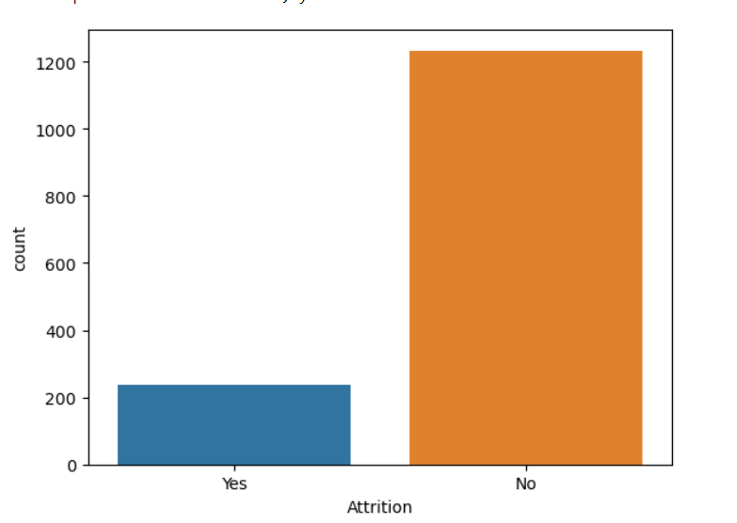
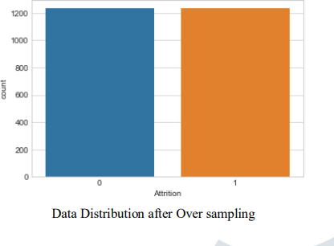
Balance the class labels
In our dataset ‘Attrition’ is the target variable to predict in between ‘YES’ or ‘NO’. This below figure shows count of each class label . The count two labels are not same this is known as imbalanced data.While evaluating model, imbalanced data model lead to wrong predictions.For balance the data we have used SMOTE oversampling method. This method generates new records in order to equal the majority and minority classes.
Imbalanced data
Balanced data after SMOTE applying

Slide 16
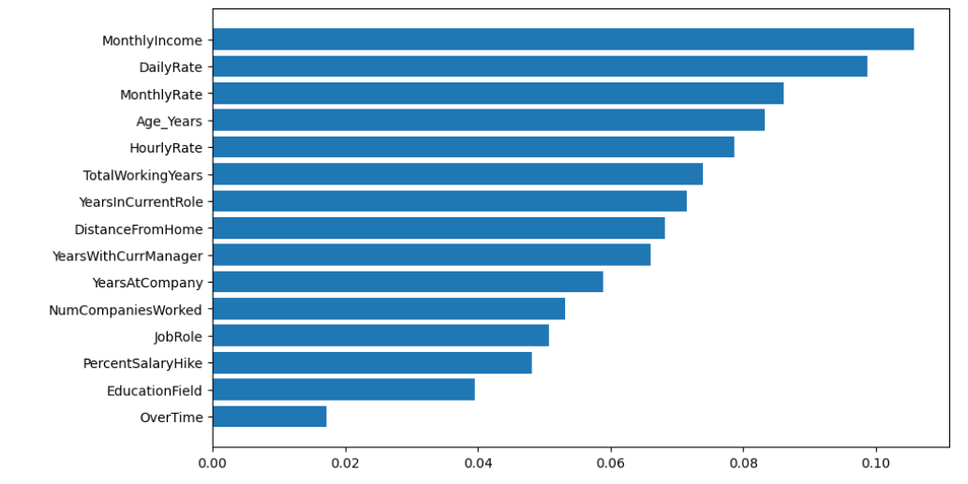
Feature Importance
Feature importance gives you a score for each feature of your data, the higher the score more important or relevant is the feature towards your output variable. Feature importance is an inbuilt class that comes with Tree Based Classifiers, we will be using Extra Tree Classifier for extracting the top features for the dataset.
Feature Importance

Slide 17
Machine Learning ALgorithms
Model selection is the process of choosing between different machine learning algorithms-Random Forest, SVM, Logistic Regression,Decision Tree,Naïve Bayes. Some of the algorithms used in this project is:Random Forest, SVM, Logistic Regression,Decision Tree. Although we used different algorithms, we obtained higher accuracy for Random Forest and it is also very efficient compared to other algorithms.

Slide 18
Train the model
Creating a train and test split of your dataset is one method to quickly evaluate the algorithm based on the performance. The training dataset is used to prepare a model, to train it. We pretend the test dataset is new data where the output values are withheld from the algorithm.
In Employee attrition, we have splited original data into two datasets. Training Data with 85% of original data, and for test data remaining 15% of original data.
After splitting the data into subsets, we get the train data shape is 9852,and test data shape is 1231.
#Model code
from sklearn.model_selection import train_test_split X_train,X_test,Y_train,Y_test=train_test_split(x_smote,y_smote,test_size=0.15,random_state=0) plt.figure(figsize=(10,6))
sort=forest.feature_importances_.argsort() plt.barh(df.columns[1:31][sort],forest.feature_importances_[sort])
forest.fit(X_train,Y_train)
forest.score(X_train,Y_train)

Slide 19
Random Forest
The random forest algorithm improves the flexibility and decision-making capacity of
individual trees. It is another machine learning algorithm incorporating the ensemble
learning theorem as its foundation, combining results from various decision trees to
optimize training. In some use cases of loan and credit risk prediction, some features are
more important than the rest or, more specifically, some features whose removal would
improve the overall performance. Since we know the fundamentals of decision trees and
how they choose features based on information gain, random forests would incorporate
these benefits to give superior performance.

Slide 20
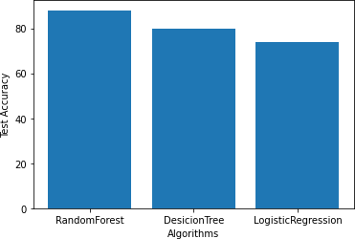
Result Analysis
By comparative analysis of below 3 algorithms we came to a firm conclusion
that Random Forest Algorithm has the best accuracy. Therefore RFA is used
for model building for our system.
Fig: Result analysis

Slide 21
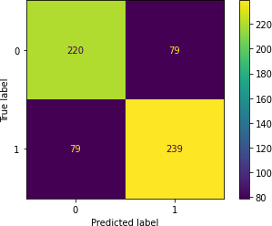
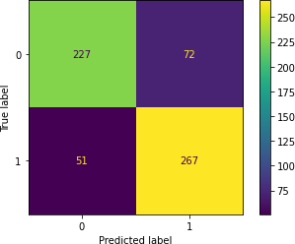
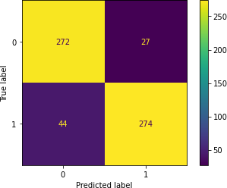
Confusion matrix
Fig:- Confusion Matrix Logistic Regression Fig:- Confusion matrix for Decision Tree Fig:-Confusion matrix for Random Forest
Notes:
Confusion matrix for VGG16 model

Slide 22


Output Screens
Fig:- Home page Fig:-After giving input

Slide 23


Fig:- Result of prediction for employee discontinuation Fig:- Result of prediction for employee continuation

Slide 24
Conclusion
After assessing the execution of four classification models, a significant finding was that if feature reduction for prediction is appropriately conducted, the accuracy rate of the classification models always be better compared to classification with feature selection. In particular, the Random Forest classifier with feature reduction achieved an accuracy score of 85.3%, while the Decision tree classifier achieved 83%. Random Forest model giving best classification for True positives and True negatives data. The methods described in the paper for analyzing and categorizing data can form a basis for improving data-driven decision- making processes. These techniques can unlock new insights from data and help organizations improve their operations. Implementation of these methods can also contribute to a positive work culture and improve an organization's reputation in their respective industry.

Slide 25
References
https://ieeexplore.ieee.org/document/9033784
Srivastava, Devesh Kumar, and Priyanka Nair. "Employee attrition analysis using predictive techniques." International Conference on Information and Communication Technology for Intelligent Systems. Springer, Cham, 2017.
S. S. Gavankar and S. D. Sawarkar, "Eager decision tree," 2017 2nd International Conference for Convergence in Technology (I2CT), Mumbai, 2017, pp. 837-840.
Safavian, S.R. Landgrebe. D, “A survey of decision tree classifier methodology”, IEEE Transactions on Systems, Man, And Cybernetics, Vol. 21, No. 3, May-June 1991.
Shmilovici A. (2009) Support Vector Machines. In: Maimon O., Rokach L. (eds) Data Mining and Knowledge DiscoveryHandbook. Springer, Boston.

Slide 26
Thank you!

