Slide 1


Rainfall Prediction Using ML
UNDER THE GUIDENCE OF
A.THANUJA M.Tech
N.Bhanu Sravya - 19471A0539
P.Rafiya - 19471A0545
K.V.S.Abhigna - 19471A0528

Slide 2
CONTENT
ABSTRACT
EXISTING SYSTEM VERS PROPOSED SYSTEM
ALGORITHMS
OUTPUT SCREENS
CONCLUSION

Slide 3
ABSTRACT
Rainfall prediction is one of the challenging and uncertain tasks which has a significant impact on human society.
Accurate and timely rainfall prediction can be very helpful to take effective security measures in advance regarding: ongoing construction projects, transportation activities, agricultural tasks, flight operations and flood situation, etc.
To Analyze this we used the Australian dataset.
For this we used the different machine learning algorithms.

Slide 4
EXISTING SYSTEM
Doesn’t generate accurate and efficient results.
Computation time is very high.
Lacking of accuracy may result in lack of efficient further treatment.

Slide 5
PROPOSED SYSTEM
Generates accurate and efficient results.
Computation time is greatly reduced.
Reduces Manual work.

Slide 6
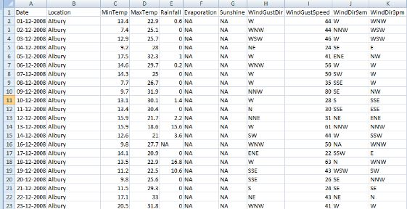
DATASET

Slide 7
ALGORITHMS
KNN | RANDOM FOREST | DECISION TREE
LOGISTIC REGRESSION | GRADIENT BOOSTING CLASSIFIER | ADABOOST CLASSIFIER

Slide 8
IN ADDITION TO THAT WE USED ANOTHER ALGORITHM NAMELY CatBoostClassifier
WE PREDICTED THE ACCURACY FOR THIS ALGORITHM.
AS COMPARED TO ALL ALGORITHMS WE GET THE BEST ACCURACY FOR THE CATBOOSTCLASSFIER
SO WE GENERATED THE PICKEL FILE FOR THIS MODEL AND USED IN OUR PROJECT.

Slide 9

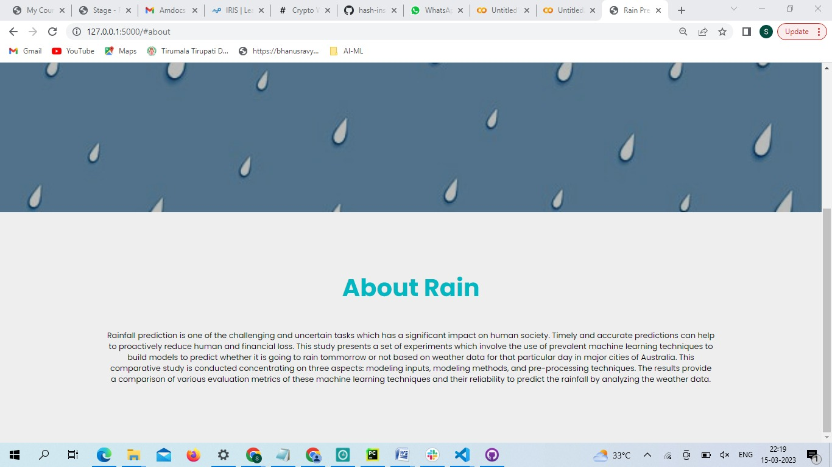
SCREENSHOTS
HOME PAGE
ABOUT PAGE

Slide 10
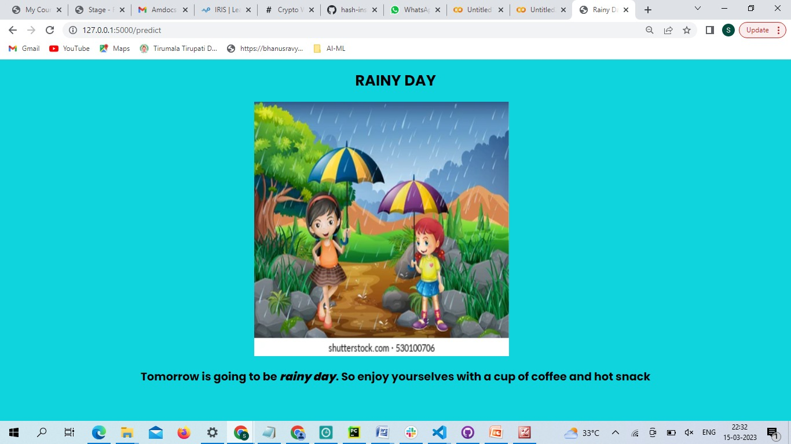
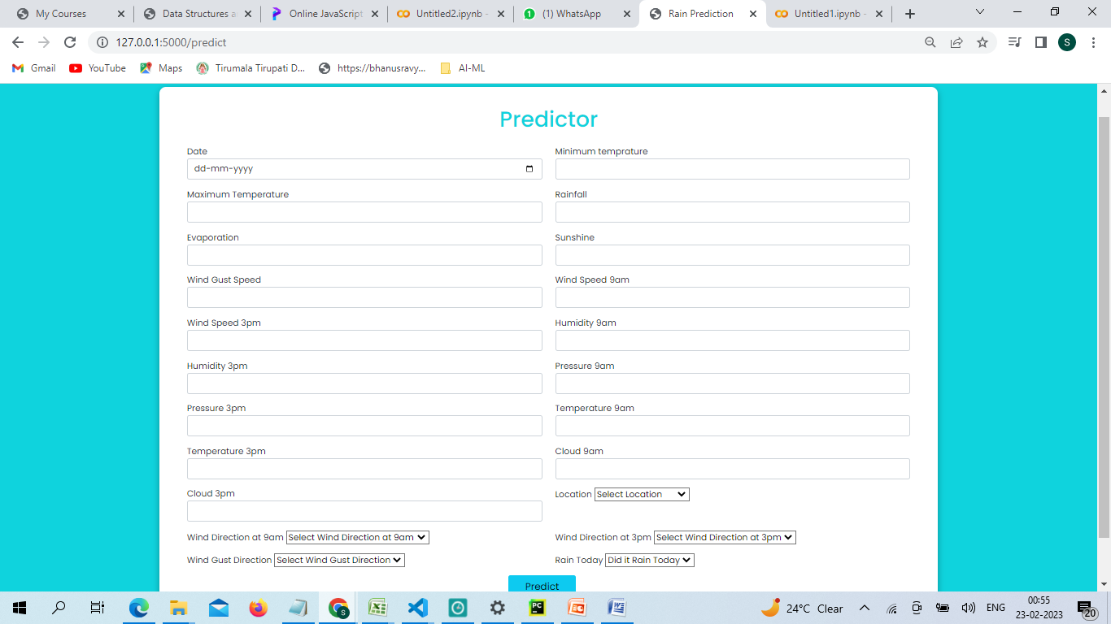

PREDICTOR

Slide 11
CONCLUSION
We are able to predict that whether tomorrow is going to be sunny day or rainy day by taking some values as input shown in the predictor page.

Slide 12

Thank you for listening

