Slide 1

Glaucoma Detection Using Fundus Images through Deep Learning
UNDER THE ESTEEMED GUIDANCE OF: Dr.S.V.N.Sreenivasu,M.Tech,Ph.D
Professor
Presented by :
Tagore Yuvana – 19471A05I5
Mekala Hadassa – 19471A05E7
Nandigam Nireekshana – 19471A05H0

Slide 2
PROJECT AGENDA
Abstract
Introduction
Existing System
Problem Definition
Proposed System
Objectives
Software Requirements
Flowchart
Algorithm
Results
Conclusion
References

Slide 3
Abstract
A chronic eye condition called glaucoma has a deleterious effect on the optic nerve, which carries visual data from the brain to the eye. Early detection is essential for stopping the condition's progression. Glaucoma is one of the most prevalent eye conditions, and it's important to catch it early because it can cause blindness and neurological issues. In this study, a neural network convolutional suggested (CNN) system for the early detection of glaucoma. The system utilizes enlarged images of the eyes as input data for deep learning. The eye images undergo pre-processing to eliminate any noise and prepare them for further analysis. When new eye images are fed into the proposed system, it uses the features it learned during training to classify the images as either having normal pupils or being affected by glaucoma.
Keywords: Glaucoma, CNN, Deep Learning, pre-processed, Fundus Images

Slide 4
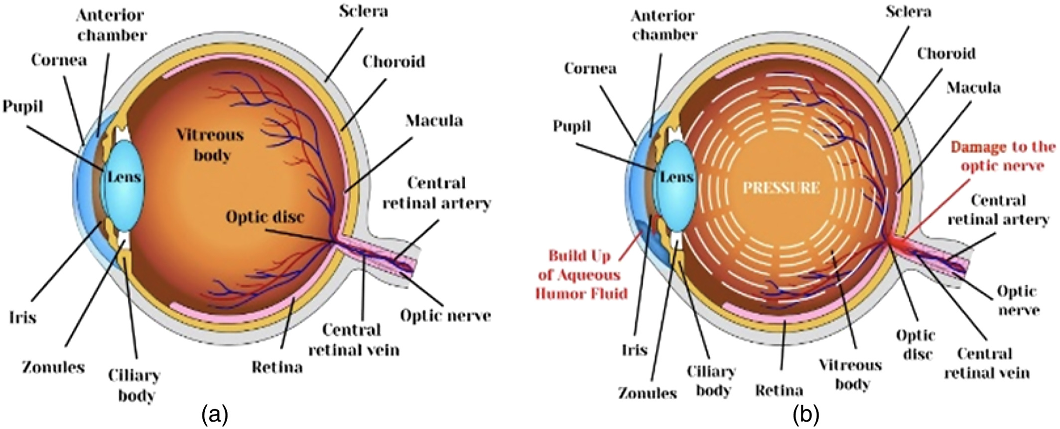
INTRODUCTION

Slide 5
LITERATURE SURVEY
Rashmi Panda et al. Introduced the new method performs detection in fundus images using patch characteristics driven RNN(Recurrent neural network). Fundus images dataset is used to evaluate performance. This system obtains high RNFLD(Retinal fiber layer defect) detection and accurate boundary localisation.
Kavita Choudhary et al. done an analysis of glaucoma disease by Classification method such as cross-validation algorithm & split validation algorithm. The outcome reveals that patients who have high blood pressure, high sugar level, myopia & with the family history of this disease can suffer from glaucoma. It is also observed that the patients with age more than 50 have higher chances of glaucoma.

Slide 6
Proposed System
By considering the above existing system, a new system using CNN is proposed. Glaucoma detection from fundus images is implemented based on CNN.
Initially input images are collected from the user or dataset which is input to the data augmentation. The major problem which causes blurred non clarity images are rectified in preprocessing.
Color space conversion, image restoration and image enhancement are the stages in this process. These are composed of gray shades such as black being the weakest intensity and white being the strongest intensity.
Data augmentation is used to create new data with different orientations. It plays vital role in the balance of 2 classes in glaucoma. The two classes are class 0(No glaucoma),class 1(Glaucoma).

Slide 7
OBJECTIVES
Useful for patient diagnostics by early predictions from our model.
Reliable model because of better performance we aim for higher accuracy.
Glaucoma is rare among the age group 0 to 18 but from 19 to 41 moderate,60+high risk.
Rare disease has to be seriously considered because later they increase more by destroying existing condition so this can be minimized by early alerts.

Slide 8
INITIAL PLAN FOR SOFTWARE PLATFORMS
Software Requirements:
Operating System: Windows 7 or Higher
Coding Language: Python
FrontEnd: Streamlit
BackEnd: Tenser flow and Keras

Slide 9
Hardware Requirements
System Type : Intel core I3
RAM : 8GB
Hard Disc : 1TB

Slide 10
Flowchart
start
Preprocessing
Apply CNN model
Classify the data
If
Res[0][0]
False
True
Glaucoma
Non glaucoma

Slide 11
Algorithm
Algorithm for Glaucoma detection using Deep learning
Step1: Initially pass an image as input as argument which is of any size. Step2: we then use pre-processing to preprocess the image. In this some techniques are used like data cleaning, transformation, data integrity etc. Step3: Next we use CNN model. This model is used to train and test, each input image will pass it through a series of convolutional layers with filters pooling, fully convoluted layer it apply SoftMax function is used.
Step4: Then it classify the data according to the training data 11.
Step5: Next we use decision in this we take condition as result[0][0] if result is 1 then we get output as Glaucoma else we get output as Not Glaucoma

Slide 12
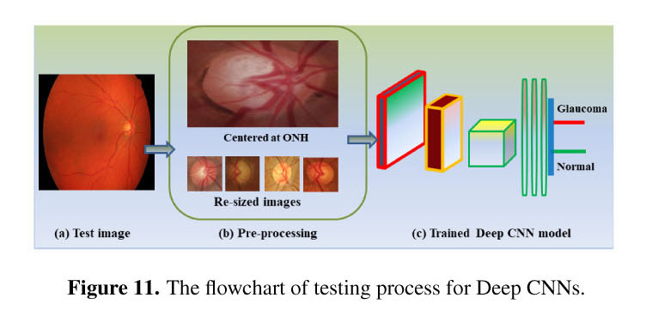

Slide 13
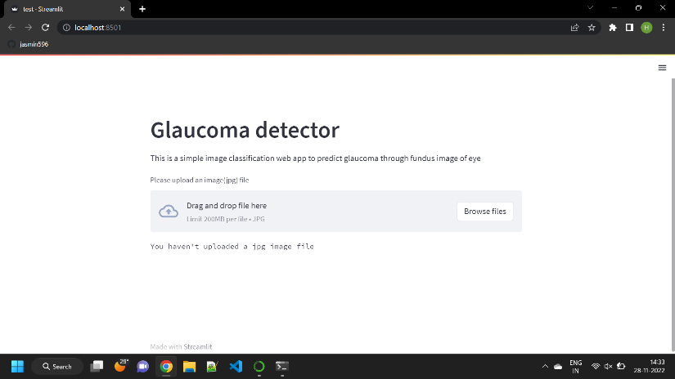
Results

Slide 14
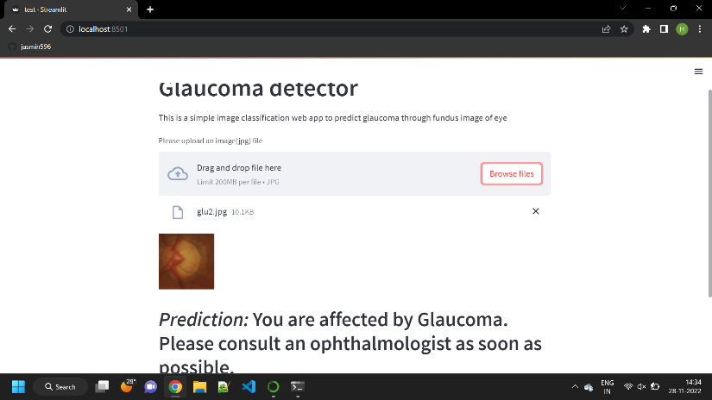

Slide 15
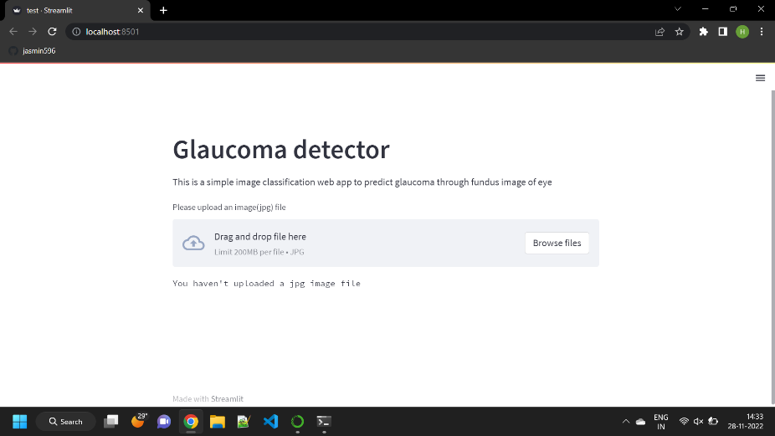

Slide 16
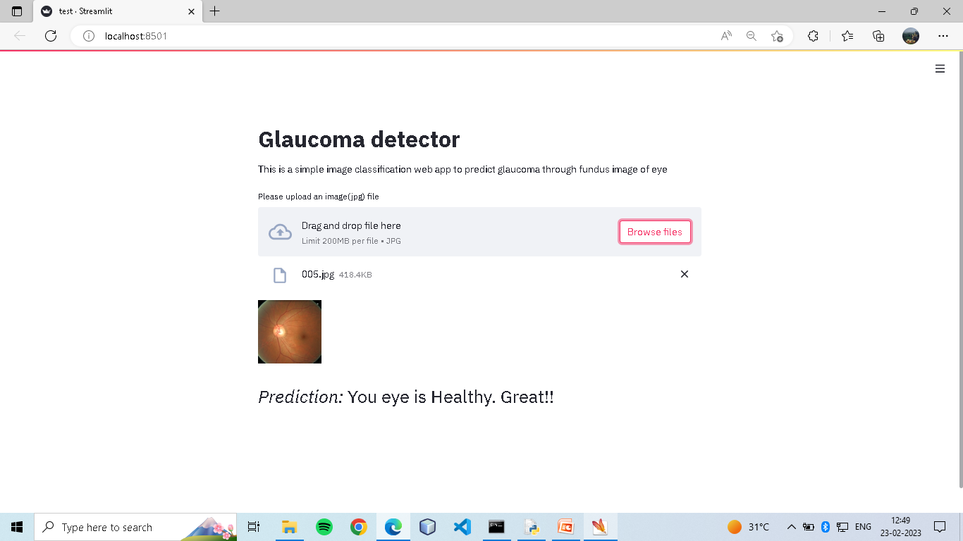

Slide 17
Conclusion
Glaucoma is one of the leading causes of blindness in the world.The developed CNN model can efficiently detect the class (not Glaucoma glaucoma) of fundus image. The main advantage of CNN model is it will take entire image instead of defected part and filtered outputs are pooled together which avoids the sophisticated design of features and it gives accurate output. Thus, it avoids the segmentations and provides the powerful features which is used to describe normal and glaucoma subjects. In future, our developed model can be used to detect the glaucoma at an early stage so doctors can advice early treatment for patients.

Slide 18
REFERENCES
[1]Diaz-Pinto, A., Morales, S., Naranjo, V., et al. CNNs for automatic glaucoma assessment using fundus images: an extensive validation. BioMed Eng Online 18, 29 (2019). https://doi.org/10.1186/s12938-019-0649-y
[2] Hafsah Ahmad, Abubakar Yamin, Aqsa Shakeel, Syed Omer Gillani, Umer Ansari ‘Detection of Glaucoma Using Retinal Fundus Images’ 978-14799-5132-1/14/$31.00 ©2014 IEEE.
[3] A. Budai, R. Bock, A. Maier, J. Hornegger, G. Michelson, "Robust Vessel Segmentation in Fundus Images", International Journal of Biomedical Imaging, vol. 2013, Article ID 154860, 11 pages, 2013. https://doi.org/10.1155/2013/154860
[4] Aukif Yousuf Wani, Preeti Sondhi, "Glaucoma Detection Using Support Vector Machine Algorithm", International Journal of Science and Research (IJSR), Volume 10 Issue 3, March 2021, pp.376379, https://www.ijsr.net/get_abstract.php?paper_id=SR2122609 2410
[5] D. W. K. Wong et al., "Level-set based automatic cup-to-disc ratio determination using retinal fundus images in ARGALI," 2008 30th Annual International Conference of the IEEE Engineering in Medicine and Biology Society, Vancouver, BC, Canada, 2008, pp. 2266-2269, doi: 10.1109/IEMBS.2008.4649648

Slide 19
Thank You

