Slide 1

SALARY PREDICTION USING MACHINE LEARNING
Under the esteemed guidance of
M.Satyam Reddy _{M.Tech}
Assistant Professor
Team members
D.Ajay Babu (19471A05L4)
P.Venkata Rohith (19471A05N9)
B.Sandeep Reddy (19471A05P5)

Slide 2
ABSTRACT
Our salary prediction system is aimed toward providing better assistance to the school students regarding the salary that they will aspect after completing their course.
Not only they are going to be ready to get a thought of their deserving salary but also, they will get to understand about the talents that they have to satisfy their professional goals. this may enhance the motivation of scholars.
Who are enrolled in education institutes and supply better assistance also. Through this paper we have tried to provide a system for salary prediction during which data processing technique is employed.
During this system, the profile of student is going to be compared with graduated student. we have used data mining techniques for comparison as they perform best.
we have also performed an experiment on student data set.

Slide 3
SYSTEM REQUIREMENTS
HARDWARE REQUIREMENTS
Processor : Intel(R) Core™2 i7-5500U CPU @2.50GHz
RAM : 8GB(gigabyte)
System Type : 64-bit operating system, x64-based processor
SOFTWARE REQUIREMENTS
Browser : Any Latest browser like Chrome
Operating System : Windows 10
Language : Python
Platform : Google COLAB

Slide 4
LITERATURE SURVEY
According to recent research [1], factors such as demographics, academic performance, personality traits and standardized test scores have an impact on the starting salary of individuals.
A paper abstract [2] states that the goal of the project is to predict the salary of a person after a certain year using graphical representations. To build a more suitable salary prediction model, a literature survey [3] can be conducted to review recent and existing methodologies.
The project on salary prediction using machine learning! In this project, we will explore how we can use machine learning algorithms to predict the salary of an employee based on various features such as education, experience, job location, etc.
The ability to predict salaries accurately can be very beneficial for both employees and employers.
For employees, it can help them negotiate better salaries and plan their career growth. For employers, it can help them determine fair compensation packages, attract top talent, and improve retention rates

Slide 5
EXISTING SYSTEM
These systems use a variety of techniques to predict salaries based on factors such as job title, education level, location, and experience.
Some of the commonly used machine learning algorithms for salary prediction include linear regression, decision trees, random forests, support vector machines (SVMs), and neural networks. These algorithms are used to build predictive models that can estimate a person's salary based on various input parameters.
One of the most popular salary prediction systems is Glassdoor's Know Your Worth tool. This tool uses machine learning algorithms to analyze job market trends and individual user data to estimate a person's worth in the job market. The tool takes into account factors such as job title, years of experience, location, and company size to provide a salary estimate.

Slide 6
PROPOSED SYSTEM
The main objective of this salary prediction is aimed toward providing better assistance to the school students regarding the salary that they will aspect after completing their course.
We have tried to provide a system for salary prediction during which data processing technique is employed.
STEPS
Data collection
Data preprocessing
Feature selection
Model selection
Model training
Model evaluation

Slide 7
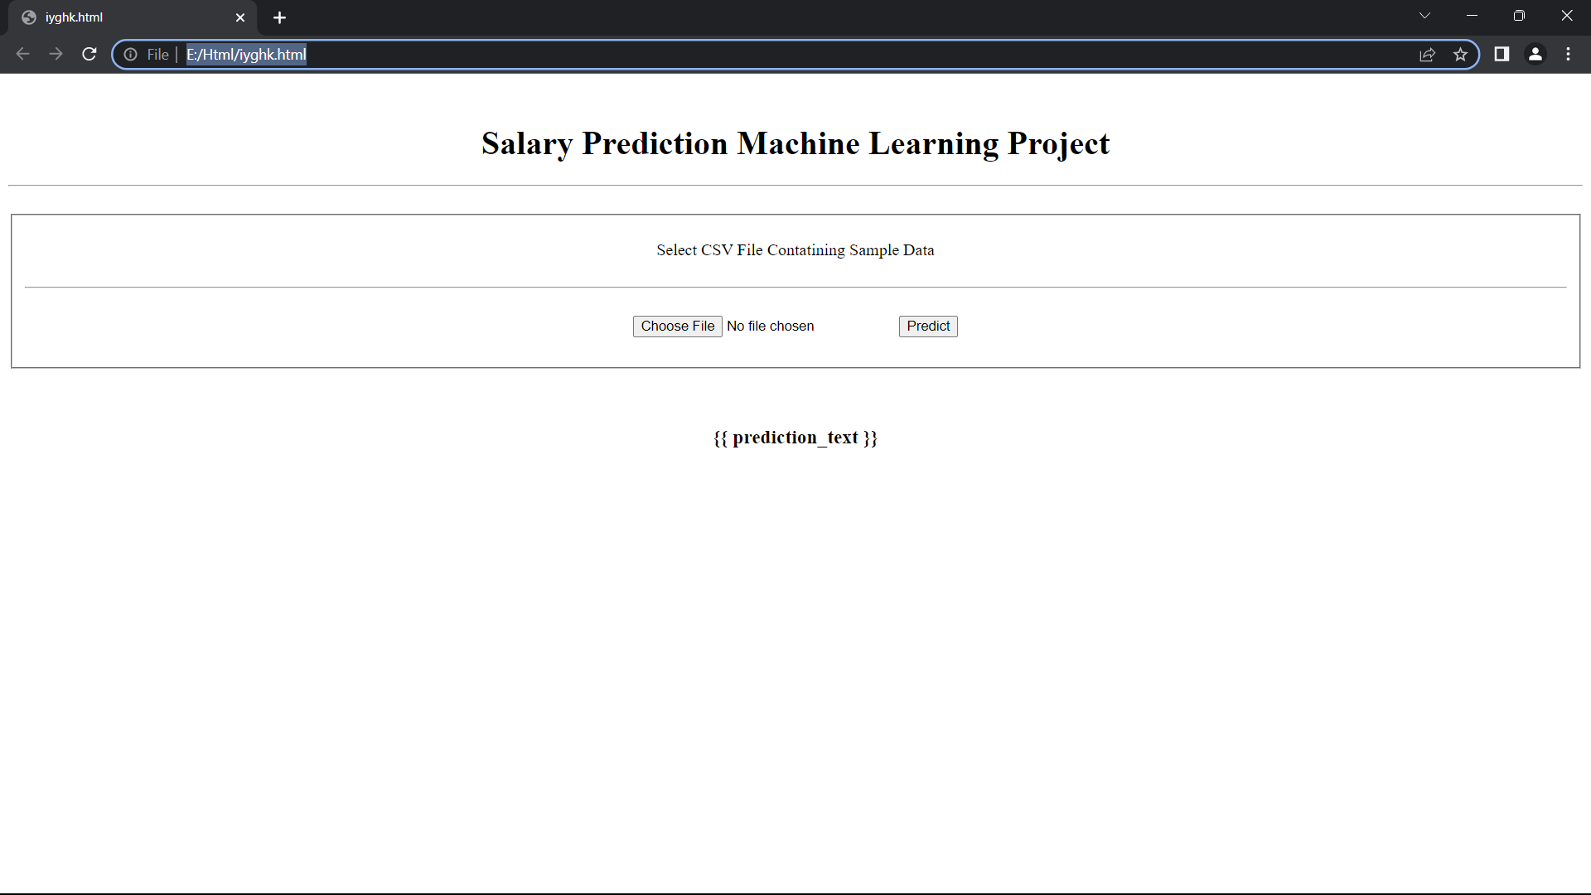
Output Screens

Slide 8
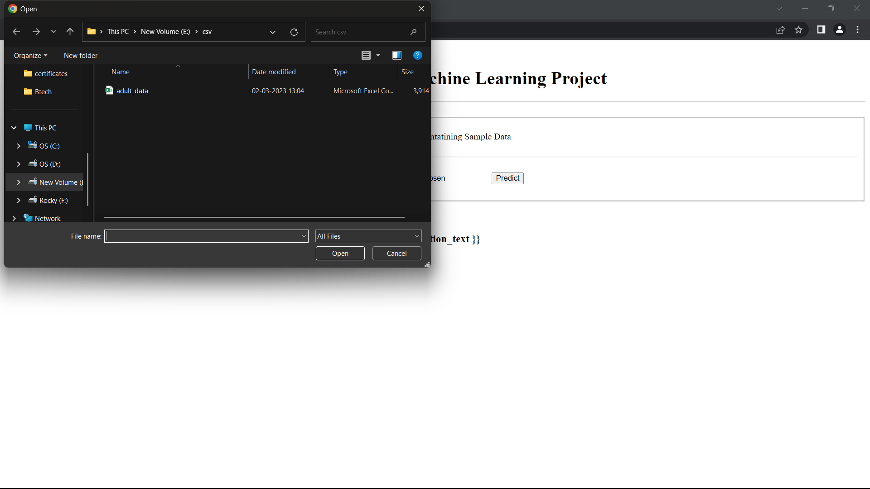

Slide 9
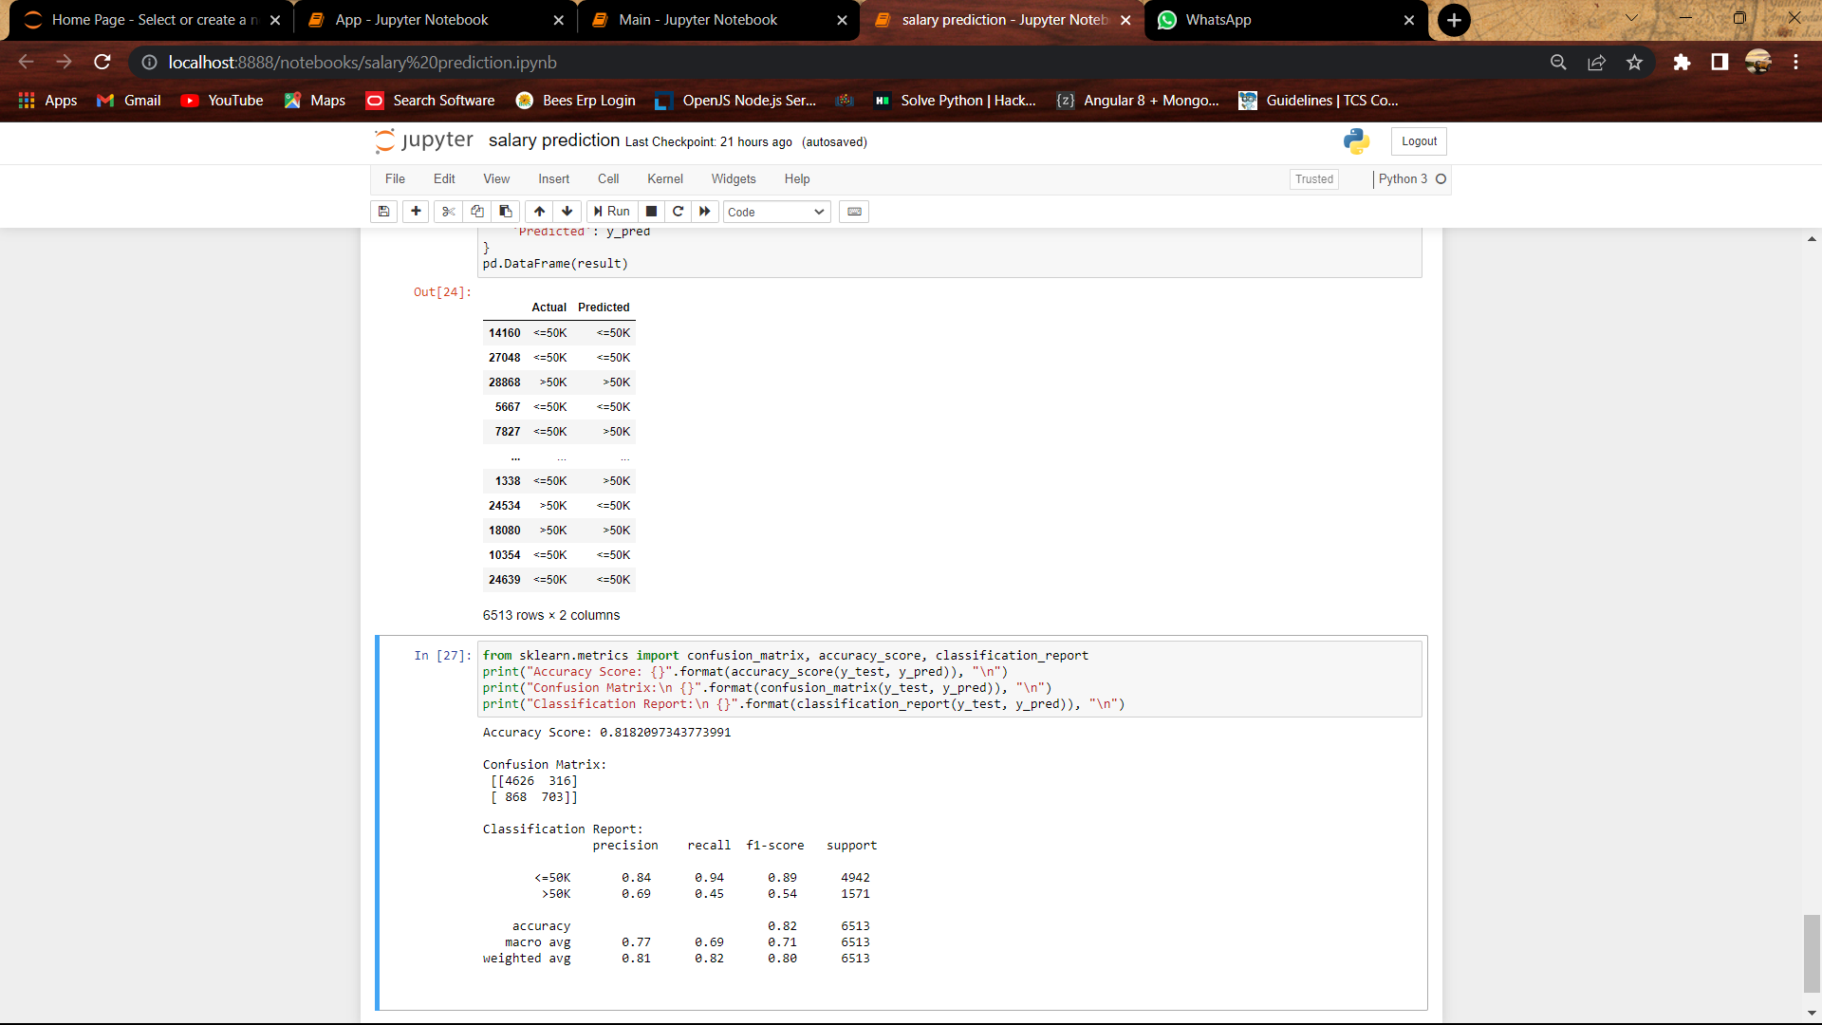

Slide 10
CONCLUSION
From review of phishing attacks and several existing approaches to detect this attack. We further described the limitation of all the existing approaches and formulated our novel approach in phishing detection.
Our approach used only nine features based on the lexical properties of URLs and produced an accuracy of 99.57%. To clearly extract the features from URLs, we also described the feature extraction algorithms in brief. Later on, we provided the distribution of lexical data in both legitimate and phishing URLs to make readers easier to understand the difference between phishing and legitimate websites.
THANK YOU

