Slide 1

BIRD SPECIES CLASSIFICATION
Under the esteemed guidance of
Sk.Rafi,M.Tech.,(Ph.D)
Team members
N.Bhargava Raju : 19471A05N3
Ch.Shanmukha Chakravarthy :19471A05K6
D.Balaji : 19471A05K9

Slide 2
CONTENTS
Abstract
Existing System
Proposed System
Methodologies
Design
Outputs
Conclusion

Slide 3
ABSTRACT
Birdwatching is a common hobby but to identify their species requires the assistance of bird books. To provide birdwatchers a handy tool to admire the beauty of birds, we developed a deep learning platform to assist users in recognizing 27 species of birds endemic to Taiwan using a mobile app named the Internet of Birds (IoB).
Bird images were learned by a convolutional neural network (CNN) to localize prominent features in the images.
First, we established and generated a bounded region of interest to refine the shapes and colors of the object granularities and subsequently balanced the distribution of bird species.
Then, a skip connection method was used to linearly combine the outputs of the previous and current layers to improve feature extraction. Finally, we applied the softmax function to obtain a probability distribution of bird features.
The proposed CNN model with skip connections achieved higher accuracy of 99.00 % compared with the 93.98% from a CNN and 89.00% from the SVM for the training images.

Slide 4
EXISTING SYSTEM
The existing system usually for a of bird image retrieval and recognition:
The first phase is image pre-processing once you have acquired images, the next step is to pre-process them to prepare them for recognition.
The second phase is Feature extraction: This step involves extracting relevant features from the pre-processed images. These features are used to represent the image and are used in the recognition process. Common features include color histograms, edge detection, and textures.
The final phase is Recognition: Using the trained model, new images can be passed through the model to recognize the species of birds present in the images. The model will output the species of bird along with a confidence score indicating the model's confidence in its prediction.

Slide 5
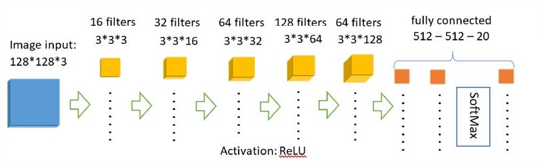
PROPOSED SYSTEM:
The proposed system for bird image retrieval and recognition would involve several key components, including image acquisition, feature extraction, and classification.
The proposed system would be able to identify different species of birds with high accuracy and efficiency, making it useful for a wide range of applications, such as bird watching, conservation, and scientific research.
STEPS:
Data collection
Data preprocessing
Feature extraction
Model training
Model evaluation
Model deployment

Slide 6
METHODOLOGIES
The first step is to gather and localize the bird dataset. The Microsoft Bing Image Search API v7 was used to build the deep learning image dataset. The dataset includes birds found in the Asian subcontinent, and it consists of 8218 images from 60 different species of birds.
The second step involves implementing the CNN architecture. The CNN architecture to be developed is a smaller and more portable version of the VGGNet network, a popular CNN architecture used in image classification tasks.
The third step is training the CNN model. The model is trained with bird images using Keras and Adam Optimizer. Data augmentation techniques are used to increase the diversity of information available for training models significantly and prevent overfitting. The ImageDataGenerator classs used for data augmentation.

Slide 7
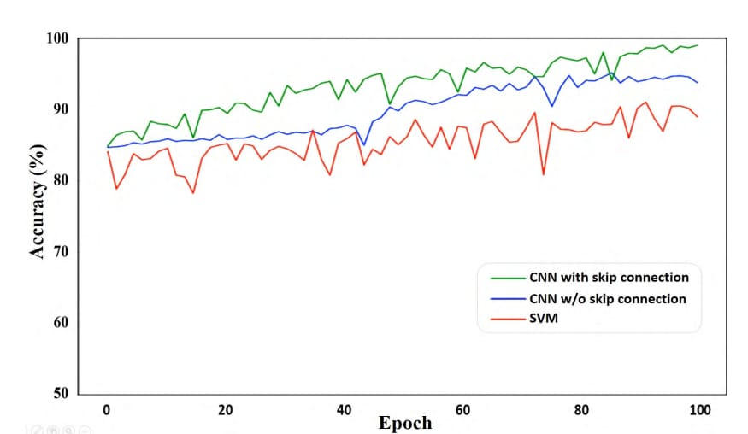
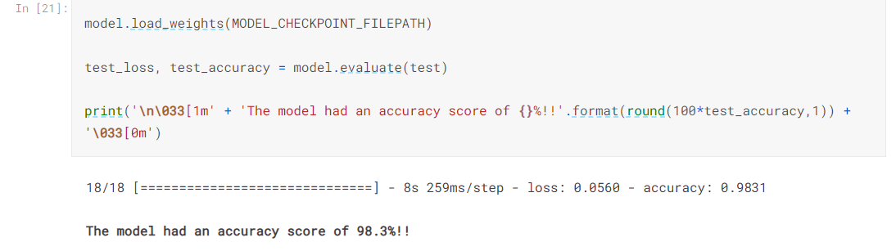
DESIGN

Slide 8
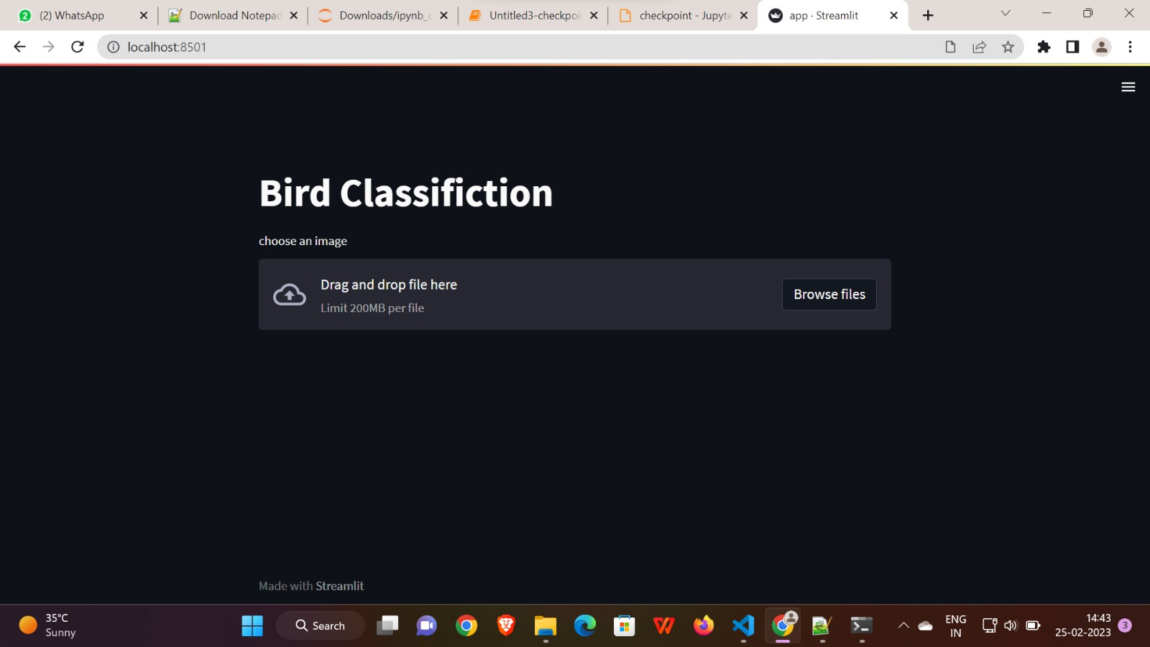
OUTPUTS

Slide 9
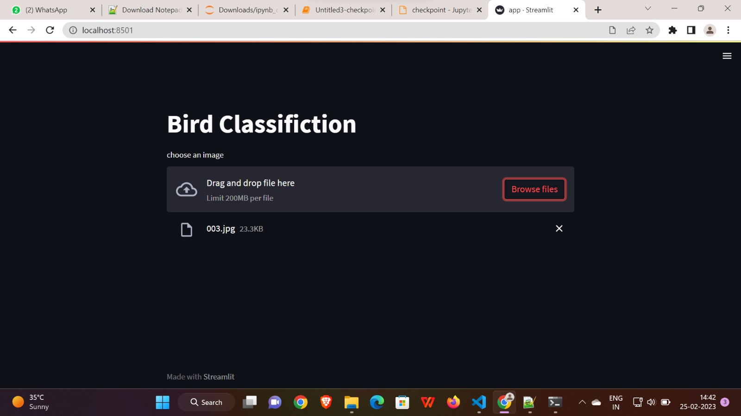
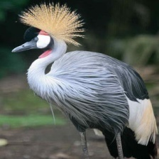
AFRICAN CROWNED CRANE

Slide 10
CONCLUSION
Bird image retrieval and recognition is a challenging problem that requires the development of robust and accurate algorithms, as well as large datasets of annotated images. The recent progress made in deep learning, especially in CNNs, has led to significant advances in this field, and these techniques are now being used to build large datasets of birds.
Future research will likely focus on further improving the accuracy of these algorithms and developing more effective ways to collect and annotate large datasets of bird images.

Slide 11
THANK YOU

