Slide 1


Slide 2

Department of Computer Science and Engineering
Fake News Detection
Presented By
Guttikonda Ramya 20471A0522
Anna Jaya Venkata Asritha 20471A0505
Kummaragunta Mounika 20471A0528
Under the Guidance of,
T.G.Ramnadh Babu, _{M.Tech.}
_{Asst.Prof.}
Department of Computer Science and Engineering,
Narasaraopeta Engineering College (Autonomous),
Narasaraopet- 522 601.

Slide 3
OUTLINE
Abstract
Introduction
Literature Survey
Research Gaps
Problem Statement
Objectives
Block Diagram / Flow Diagram
Methodology
Implementation
Results and Analysis
Conclusion & Future Scope
References
Question and Answers
Acknowledgements

Slide 4
ABSTRACT
The misinformation presents a significant threat to societal well-being and stability. The rapid expansion of social media platforms has intensified the spread of fake news, exacerbated by the absence of effective countermeasures. This study aims to tackle this issue by investigating a range of machine learning techniques customized for analyzing and detecting fake news. Leveraging the WELFake dataset, which encompasses diverse textual data sources, we explore various methodologies, including Logistic Regression. Our research is solely focused on textual data, with the primary objective of constructing robust models capable of accurately identifying the propagation of fake news across social media platforms. Through rigorous experimentation and methodological comparison, this research endeavor seeks to push forward the field of fake news detection algorithms, thereby safeguarding society's integrity and prosperity in the digital age.

Slide 5
INTRODUCTION
Nowadays, social media networks are the most popular way to distribute thousands of pieces of news, whether they are public or private.
There is a danger of getting exposed to false information which is purposefully wrong or contains inaccurate information in order to support a certain political or economic objective as it is simpler for users or readers to share their particular opinions.
We think it will aid in the identification of rumours and have a transformative effect on the veracity of social media news.

Slide 6
LITERATURE SURVEY
No | Title | Author | Journal Name & Year | Methodology Adapted | Key Findings | Gaps
1 | Fake News Detection | Baarir and Djeffal | https://ieeexplore.ieee.org/document/9378748 | Navie Bayes Classifier, Support Vector Machine | TF-IDF Navie Bayis Classifier | Limited dataset, Short news articles
2 | Effect of Corpora on Classification of Fake News using Naive Bayes Classifier | Farzana Islam | https://www.researchgate.net/publication/352551511_Effect_of_Corpora_on_Classification_of_Fake_News_using_Naive_Bayes_Classifier | Navie Bayies Logistic Regression | Various categories of data in dataset, Stemming | Small dataset
3 | Automatic Detection of Fake News | Perez-Rosas | https://iopscience.iop.org/article/10.1088/1757-899X/1099/1/012040 | KNN SVM | Count Vectorizer POS Taggers | Less Acuuracy
4 | Fake News Detection Using Machine Learning | Jasmine Shaikh | https://www.researchgate.net/publication/349610439_Fake_News_Detection_using_Machine_Learning | Random Forest XGB Classifier | Variation with and without N-gram | Stemming. Stopwords
5 | Comparative Analysis Of Machine Learning Models For Fake News Classification | Archit Guptha | https://ieeexplore.ieee.org/document/10205870 | Navie Bayes, Random Forest | Stopwords Navie Bayies | Lack of detailed discussion validation methods

Slide 7
RESEARCH GAPS
In existing system used Navie bayes classifier used.
It is useful to work on small data sets only.
It does not provide more accuracy
In proposed system we used Logistic Regression to work on large datasets and provide more accuracy than existing system

Slide 8
PROBLEM STATEMENT
Fake news is purposely spread throughout the internet and social media, become difficult to differentiating between facts and opinions.
We use various NLP and Preprocessing methods, Machine learning algotithms and analyze the performance of these various classification methodologies to choose best classifier.

Slide 9
OBJECTIVES
Protect Public Trust: Minimizing the trusting of false or misleading content
Deployment : Develop user-friendly interfaces
Identify and Mitigate Disinformation: By developing models
Reduce False Positives: By apply Cross validation on the model to identify accurately.

Slide 10
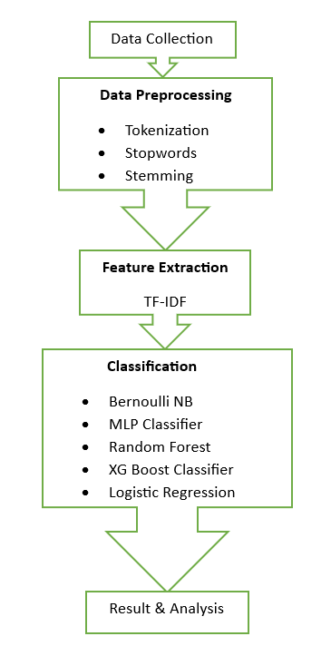
BLOCK DIAGRAM OR FLOW DIAGRAM
Fig. 1. General Approach for Fake News Detection

Slide 11

METHODOLOGY
A dataset containing real and fake news articles was obtained from Kaggle.
Preprocessing: Stemming, Stopwords, Tokenization
Feature extraction: TF-IDF vectorizer
Classification: Models applied. Fig. 1. Stopwords Representation
Analysis: Compare the accuracy of models
Front-end : using HTML, CSS, and JavaScript.
Deployment: Flask
Fig. 2. Stemming Representation

Slide 12
IMPLEMENTATION
Software Specifications:
Browser: Chrome
Operating System: Windows 11
Python (Visual Studio Code)
Flask
Hardware Specifications:
Processor: Intel® Dual Core 2.0GHz
Hard Disk: 1TB
RAM: 8GB

Slide 13
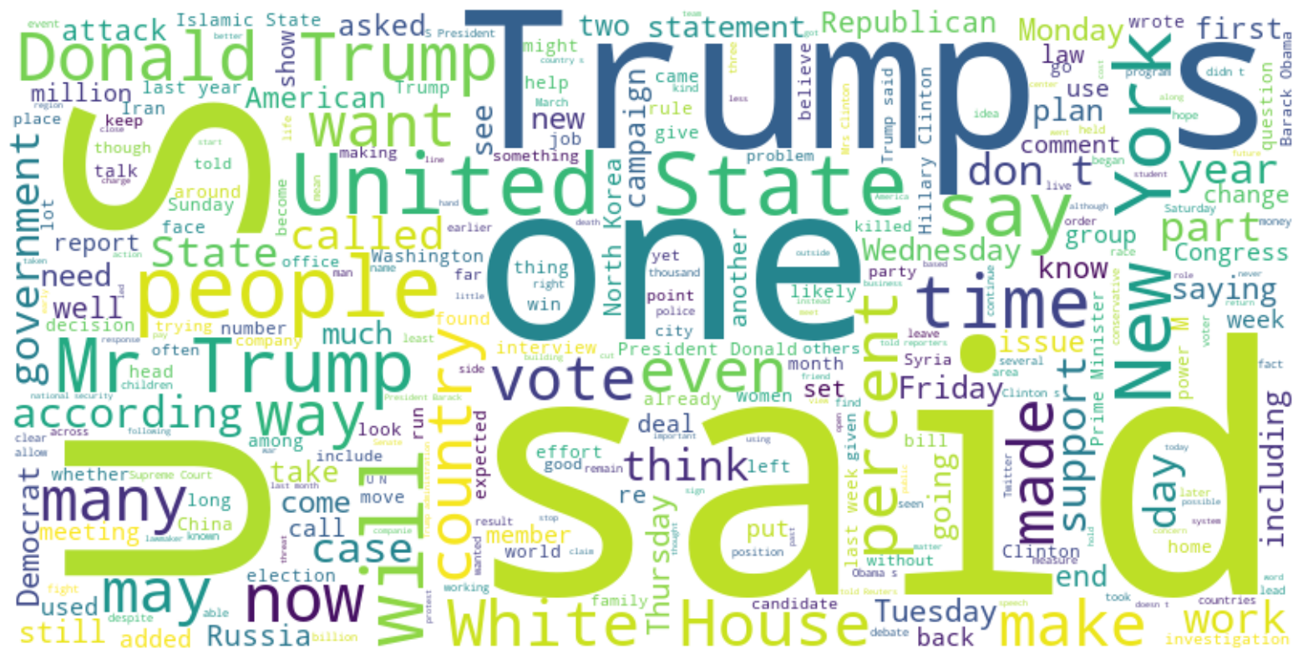
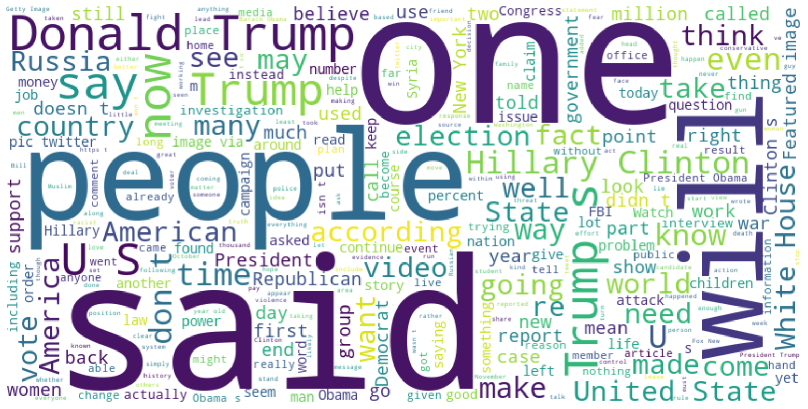
Fig.1 Word Cloud of Fake Label Data From Dataset
Fig.2 Word Cloud of Real Label Data From Dataset

Slide 14
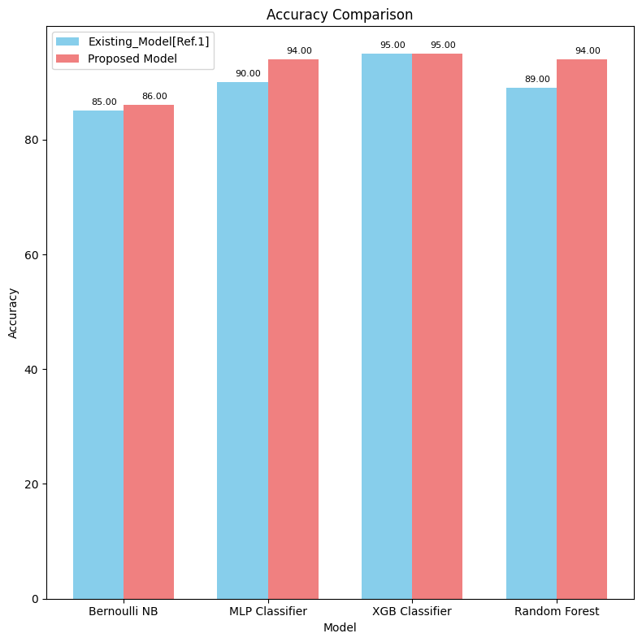
RESULTS & ANALYSIS
Model | Accuracy | Precision | F1 score | Recall
Bernouli NB | 86% | 84% | 86% | 89%
MLP Classifier | 94% | 94% | 94% | 94%
XGB Classifier | 95% | 94% | 95% | 97%
Random Forest | 94% | 93% | 94% | 96%
Logistic Regression | 96% | 95% | 96% | 97%
Comparision of all models of proposed system
Comparision of models with existing system

Slide 15
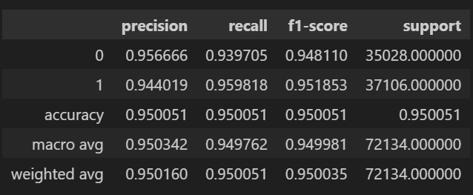
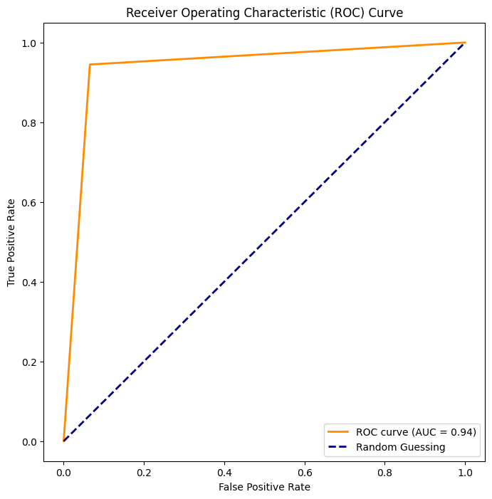
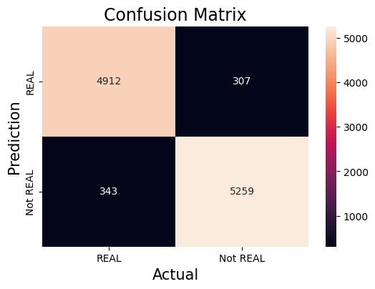
Fig. 27. Classification Report of Logistic Regression
Fig. 25. ROC Curve of Logistic Regression
Fig. 24. Confusion Matrix of Logistic Regression

Slide 16
CONCLUSION and FUTURE SCOPE
This study explored five popular machine learning algorithms. The results obtained indicate that the five algorithms.
Among all Logistic Regression give better result in terms of accuracy.
Future research can expand on this work by using more complex features, exploring alternative algorithms, and analyzing the model's performance on a larger dataset of different categories of News.

Slide 17
REFERENCES
Archit Guptha, Arnav Batla, at el. research on “Comparative the Analysis Of Machine Learning Models For Fake News Classification” 2023 3rd International Conference on Intelligent Technologies (CONIT) Karnataka, India. June 23-25, 2023.
https://www.kaggle.com/datasets/saurabhshahane/fake-news-classification. Last accessed date :18/03/2024
Perez-Rosas, Verónica, Kleinberg, Bennett, Lefevre, Alexandra, and Mihalcea Rada conducted research in 2017 on "Automatic Detection of Fake News".2017
A.Farzana Islam, and her team research on ”Effect of Corpora on Classification of Fake News using Naive Bayes Classifier.” International Journal of Automation, Artificial Intelligence and Machine Learning 1.1.2020
P. Bharadwaj, and Zongru Shao. ”Fake news detection with semantic features and text mining.” International Journal on Natural Language Computing (IJNLC) Vol 8 -2019.
Chaowei Zhang, Ashish Gupta, Christian Kauten, Amit V. Deokar, and Xiao Qin, "Detecting fake news for reducing misinformation risks using analytics approaches," in the proceedings of ELSEVIER, European Journal of Operational Research, 2019.

Slide 18
Fahim Belal Mahmud and his team research on ”A comparative analysis of Graph Neural Networks and commonly used machine learning algorithms on fake news detection.” 2022 7th International Conference on Data Science and Machine Learning Applications (CDMA). IEEE, 2022.
Z Khanam and his team research on “False News Detection Using Machine Learning Approaches” 2021 IOP Conf. Ser. Mater. Sci. Eng. 1099 012040.
Gahirwal Manisha et. al; International Journal of Advance Research, Ideas and Innovations in Technology ISSN: 2454-132X Impact factor: 4.295.
Smitha.N, Bharath.R, "Performance Comparison of Machine Learning Classifiers for Fake News Detection" Proceedings of the Second International Conference on Inventive Research in Computing Applications (ICIRCA-2020).
Baarir and Djeffal's research on "Fake News Detection Using Machine Learning" 2020: Second International Workshop on Human-Centric Smart Environments for Health and Well-Being (IHSH).2020

Slide 19
Jasmine Shaikh and Rupali Patil conducted study on "Fake News Detection Using Machine Learning". 2020 IEEE International Symposium on Sustainable Energy, Signal Processing, and Cybersecurity (iSSSC).2020
T. H. Borkar, T. Ahuja, "Comparative Study of Supervised Learning Algorithms for Fake News Classification," Tirunelveli will host the sixth International Conference on Trends in Electronics and Informatics (ICOEI) in 2022.2022
Rubin, Victoria, L., and their team investigate if fake news is true or not. Using sarcastic clues to identify possibly deceptive news. In: Proceedings of NAACLHLT 2016.
Cristina M Pulido, Laura Ruiz-Eugenio, Gisela Redondo-Sama, and Beatriz Villarejo-Carballido. A new application of social impact in social media for overcoming fake news in health. International journal of environmental research and public health, 17(7):2430,2020.

Slide 20


Slide 21


