Slide 1

Department of Computer Science and Engineering
Enhancing Online Learning Engagement and Performance through Predictive Modeling Using Machine Learning
PRESENTED BY
A.Lakshmi Naga Priya (20471A0501)
Ch.Anjani Thanmayee (20471A0510)
V.Leela Pavani (20471A0565)
Under the Guidance of,
Shaik Khaja Mohiddin Basha M.Tech,Asst.Professor
Department of Computer Science and Engineering,
Narasaraopeta Engineering College (Autonomous),
Narasaraopet- 522 601.

Slide 2
OUTLINE
Abstract
Introduction
Literature Survey
Research Gaps
Problem Statement
Objectives
Block Diagram / Flow Diagram
Methodology
Implementation
Results and Analysis
Conclusion & Future Scope
References
Question and Answers
Acknowledgements

Slide 3
ABSTRACT
Predictive analysis is a machine learning analytical technique that is the focus of this research. The problem of reliable performance prediction is addressed by a number of online learning systems, including number of Courses and number of learning platforms.
We are recommending this work by the contrasting techniques like the regression and the classification, which are useful for the prediction modelling to obtain the most accurate outcomes. By doing this research we want to reduce the number of dropouts registered for the course by providing their test results.
And also users can check their results by giving their details at any time. The prediction model will train the data and test the data by using random forest and different models to explain the learning behaviour of the students in connection with their study factors. These predictive model was trained with random forest and it has the higher accuracy.

Slide 4
INTRODUCTION
The advancement of technology in online learning platforms made access to education easy and affordable.This project is defined to reduce the number of dropouts registered in online courses by generating performance reports using different classification and predictive models.
Earlier the data is generated from online learning platforms is stored in the database record that can help instructors to know the performance of students in the futureRegistered students or Coaching guides can check students performance at any point of time in their course duriation thereby the students can concentrate more on course or even the instructors can take more care for them so that it will help in reducing dropouts.

Slide 5
LITERATURE SURVEY
No | Title | Author | Journal Name & Year | Methodology Adapted | Key Findings | Gaps
1 | A Systematic Literature Review of Student’ Performance Prediction Using Machine Learning | Balqis Albreiki,Nazar Zaki | https://doi.org/ 10.3390/educsci11090552 | Dynamic approach,Semi-supervised ML | predicting student perfo rmance,highlight s the precision through ML . | practical implementation for timely intervention .
2 | Predicting Students' AcademicPerformance in Virtual Learning Environment Using ML | Alimurtaza Merchant,Naveen Shenoy | https://www.researchgate.net/publication/360887792 | click stream,Decision Trees | emphasizing the VLE engagement with Gradient Bo osting Classifier | exploration on specific validation across diverse online learning contexts.
3 | Predicting Student Outcomes in Online Courses Using ML | Areej Alhothali , Maram Albsisi | https://doi.org/10.3390/su14106199 | correlation-based | prevalence of statistical tempor features | enhance predictive accuracy
4 | Student Performance Prediction Using ML | Priya S , Ankit T | https://www.researchgate.net/publication/367820845 | Naive Bayes data mining simulation methodology | achieving 79% precision in performance | insight into feature selection criteria
5 | Explore the Relation Between Student Engagement and Student Performance | Fidelia Orji, Julita Vassileva | https://ieeexplore.ieee.org/document/9373084 | Exploring distributions, Spearman correlation, | identifies distinct student clusters based on assessment scores. | limited exploration of external factors affecting engagement.

Slide 6
RESEARCH GAPS
Limited exploration of specific engagement metrics' influence on performance prediction.
Insufficient emphasis on actionable remedial strategies.
Practical implementation of machine learning-based predictive models for timely interventions not thoroughly addressed.

Slide 7
PROBLEM STATEMENT
The aim is to address the challenge of early performance prediction in online learning systems. The project focuses on using a different classification and predicttive algorithms like K-Nearest Neighbour,Extra Tree Classifier,Adaboost Classifiers,Gradient Boosting,Random Forest and Support Vector Machine to reduce dropout rates in online courses, enhance user experience, and provide valuable insights for effective and supportive online learning environments.
This research leverages machine learning algorithms to predict student performance at any point of time in their course duriation in online courses, aiming to substantially enhance the overall learning experience, contributing to the improvement of online education platforms.

Slide 8
OBJECTIVES
Provide a user-friendly interface for students to access and interpret their performance reports.
Produce comprehensive test result reports.Enabling them to track their progress at any point of time after their course start and make informed decisions about their studies.
Provide visualized graphs to know about other students details.
Reduce the number of dropouts.

Slide 9
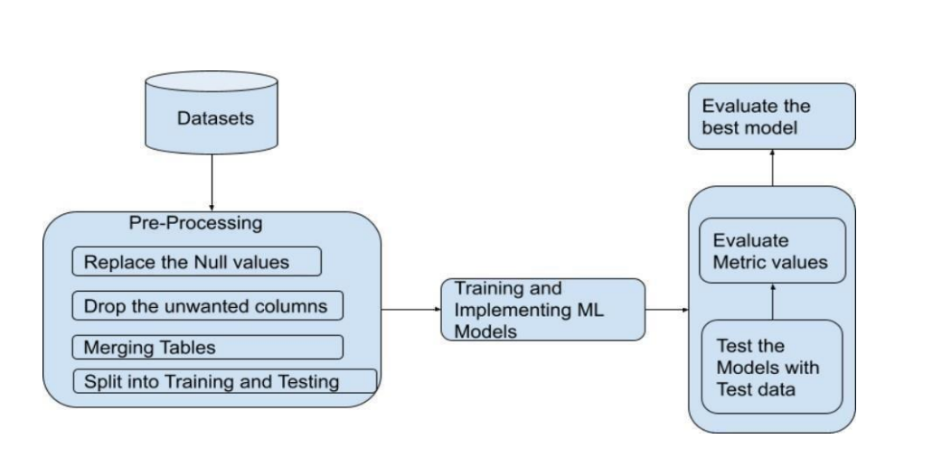
BLOCK DIAGRAM OR FLOW DIAGRAM

Slide 10
METHODOLOGY
Preprocessing:
Replace the null values
Drop the unwanted columns
Split into train and test data sets
Algorithms:
k-Nearest-Neighbor (k-NN).
Random Forest (RF).
Mathematical Functions:
Matplotlib.
Numpy.

Slide 11
IMPLEMENTATION
Software Specifications:
Programming Language: Python
Operating System:Windows or Macos
Hardware Specifications:
RAM : 12GB
Hard Disk : 8GB
Implementation
https://colab.research.google.com/drive/1F3NLNc8K5bcrqanDTMnHblcTJ7juS5Oo?usp=sharing

Slide 12
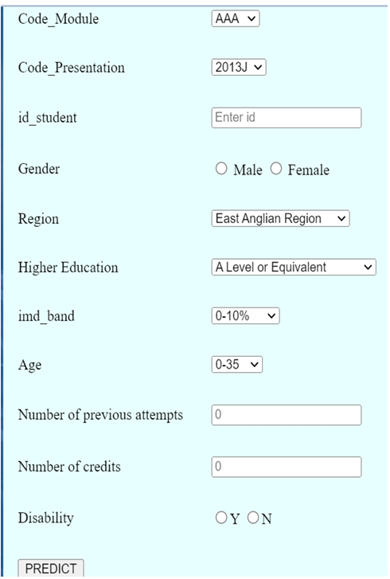
RESULTS & ANALYSIS

Slide 13
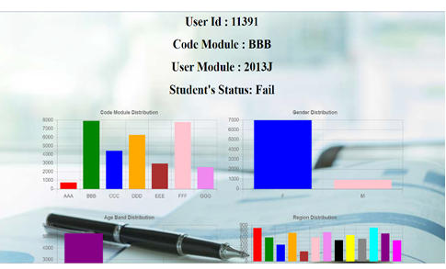
RESULTS & ANALYSIS

Slide 14
CONCLUSION and FUTURE SCOPE
The primary goal of the undertaking is to use the Machine learning algorithm to estimate student risk at any stage of course length. Four classification metrics were used in the study and for evaluations.
The research revealed in addition to demonstrated data usingclickstream data and assignment ratings significantly improved the models performance. The best performing algorithm is Random Forest which resulted 80% accuracy was chosen to forecast student performance. Clickstream data and assessment scores have the biggest influence on the outcome of all the variables.
Our future endeavors will focus on scrutinizing the activity-specific significance that significantly influences student performance through the dissemination of textual messages and reminders about their performance..

Slide 15
REFERENCES
A. Oritgosa , R. M. Carro, J. Bravo-Agapito, D. Lizcano, J. J. Alcolea, and O. Blanco, ‘‘From lab to production: Lessons learnt and real-life challenges of an early student-dropout prevention system,’’ IEEE Trans. Learn. Technol., vol. 12, no. 2, pp. 264–277,Apr. 2019.
A. S. Imran, F. Dalipi, and Z. Kastrati, ‘‘Predicting student dropout in a MOOC: An evaluation of a deep neural network model,’’ in Proc. 5th Int. Conf. Comput. Artif. Intell. (ICCAI), 2019, pp. 190–195.
A. A. Mubarak, H. Cao, and S. A. M. Ahmed, ‘‘Predictive learning analytics using deep learning model in MOOCs’ courses videos, ’’ Edu. Inf.Technol.,vol. 6, pp. 1–22, Jul. 2020.
B. Sekeroglu, K. Dimililer, and K. Tuncal, ‘‘Student performance prediction and classification using machinelearning algorithms,’’ in Proc. 8th Int. Conf. Educ. Inf. Technol., Mar. 2019, pp. 7–11.
A.Behr,M.Giese,and K.Theune,”Early Prediction of University droputs-A random forest approach,”J.Nat. stat., vol. 1,pp. 743-789,Feb.2020.

Slide 16
J. Figueroa-Ca nas and T. Sancho-Vinuesa, ‘‘Predicting early dropout student is a matter of checking completed quizzes: The case of an online statistics module,’’ in Proc. LASI- SPAIN, 2019, pp. 100–111.
J. Xu, K. H. Moon, and M. van der Schaar, ‘‘A machine learning approach for tracking and predictingstudent performance in degree programs,’’ IEEE J. Sel. Topics Signal Process.
S. Lee and J. Y. Chung, ‘‘The machine learningbased dropout early warning system for improving the performance of dropout prediction,’’ Appl. Sci., vol. 9, no. 15, p. 3093,Jul. 2019.
R. F. Kizilcec, M. Pérez-Sanagustín, and J. J. Maldonado, ‘‘Selfregulated learning strategies predict learner behavior and goal attainment in massive open online courses,’’ Comput. Edu., vol. 104, pp. 18–33, Jan. 2017.
M. Hlosta, D. Herrmannova, L. Vachova, J. Kuzilek, Z. Zdrahal, and A. Wolff, ‘‘Modelling student online behaviour in a virtual learning environment,’’ 2018, arXiv:1811.06369. [Online]. Available: http://arxiv.org/abs/1811.06369

Slide 17
Y. Cui, F. Chen, and A. Shiri, ‘‘Scale up predictive models for early detection of at-risk students: A feasibility study,’’ Inf. Learn. Sci., vol. 121, nos. 3–4, pp. 97–116, Feb. 2020.
T. Soffer and A. Cohen, ‘‘Students’ engagement characteristics predict success and completion of online courses,’’ J. Comput. Assist. Learn., vol. 35, no. 3, pp. 378–389, Jun. 2019.
R. Baker, B. Evans, Q. Li, and B. Cung, ‘‘Does inducing students to schedule lecture watching in online classes improve their academic performance? An experimental analysis of a time management intervention,’’ Res. Higher Edu., vol. 60, no. 4, pp. 521–552, 2019.
A. Cicchinelli, E. Veas, A. Pardo, V. Pammer-Schindler, A. Fessl, C. Barreiros, and S. Lindstädt, ‘‘Finding traces of self-regulated learning in activity streams,’’ in Proc. 8th Int. Conf. Learn. Anal. Knowl., Mar. 2018, pp. 191–200.
H. L. Fwa and L. Marshall, ‘‘Modeling engagement of programming students using unsupervised machine learning technique,’’ GSTF J. Comput., vol. 6, no. 1, pp. 1–6, 2018.

Slide 18


Slide 19


