Slide 1

Department of Computer Science and Engineering
Brain Tumor Detection using Deep Learning
Presented By
M.Venkata Sai Pavan Kumar – 20471A0596
S.Gopi Krishna – 20471A05B0
Under the Guidance of,
N.Vijaya Kumar M.E
Asst.Professor,
Department of Computer Science and Engineering,
Narasaraopeta Engineering College (Autonomous),
Narasaraopet- 522 601.

Slide 2
OUTLINE
Abstract
Introduction
Problem Statement
Literature Survey
Research Gaps
Objectives
Block Diagram / Flow Diagram
Methodology
Implementation
Results and Analysis
Conclusion & Future Scope
References
Question and Answers
Acknowledgements

Slide 3
ABSTRACT
The accurate and timely detection of brain tumors plays a crucial role in the effective management of neurological disorders. This abstract presents a comprehensive overview of a novel approach for brain tumor detection leveraging deep learning techniques. Our proposed method utilizes convolutional neural networks (CNNs) and VGG16 techniques to analyze medical imaging data, specifically magnetic resonance imaging (MRI) scans.The workflow involves pre- processing of MRI images to enhance features, followed by a CNN- based feature extraction stage that learns hierarchical representations. The extracted features are then fed into an VGG16 methodology to capture temporal dependencies and spatial relationships within the data. This hybrid deep learning architecture enhances the model's ability to discern subtle patterns indicative of brain tumors, improving both sensitivity and specificity.To facilitate model training and evaluation, a curated dataset of diverse brain tumor cases is utilized. The model demonstrates promising results in terms of accuracy, sensitivity, and specificity during rigorous validation and testing phases. The proposed approach not only outperforms traditional methods but also exhibits robustness against variations in imaging conditions and tumor characteristics.In conclusion, our deep learning-based approach showcases the potential for significantly improving the accuracy and efficiency of brain tumor detection in clinical settings. The integration of CNN and VGG16 methods in a unified framework demonstrates the synergy of spatial and temporal information, making it a promising avenue for enhancing the capabilities of automated brain tumor diagnosis.

Slide 4
INTRODUCTION
1. Brain tumors result from abnormal cell growth in the brain, impacting both normal brain activity and cell destruction processes.
2. MRI technology plays a crucial role in detecting and diagnosing brain tumors due to its detailed imaging capabilities.
3. Deep learning techniques, particularly Convolutional Neural Networks (CNNs), offer promising avenues for automating tumor segmentation and detection in MRI scans.
4. Automated segmentation using deep learning models reduces the burden on radiologists, minimizes subjective interpretation errors, and enhances the detection of tumors, including small and numerous ones.
5. Early detection facilitated by automated tumor segmentation can lead to faster initiation of treatment and improved patient outcomes, highlighting the importance of integrating technology into clinical processes.

Slide 5
PROBLEM STATEMENT
Existing methods for brain tumor detection lack the necessary accuracy and efficiency required for effective neurological disorder management.
Traditional approaches may struggle to discern subtle patterns indicative of brain tumors in medical imaging data, particularly in magnetic resonance imaging (MRI) scans.
The absence of a unified framework that effectively integrates spatial and temporal information hinders the capabilities of automated brain tumor diagnosis.
Variations in imaging conditions and tumor characteristics pose challenges for current methods, emphasizing the need for a more robust and adaptable solution in clinical settings.

Slide 6
LITERATURE SURVEY
No | Title | Author | Journal Name & Year | Methodology Adapted | Key Findings | Gaps
1 | "Brain Tumor Detection Using Deep Learning Models" | S. Grampurohit | https://ieeexplore.ieee.org/document/9344555 | CNN and VGG-16 models on MRI images | Utilization of CNN and VGG16 models on MRI images for brain tumor detection. CNN achieved 93% accuracy, while VGG-16 achieved 97.16% training and 97.42% validation accuracy. | Exploration of methods to reduce computational resources and time required, particularly for VGG-16 model.
2 | Pioneering Method for Brain Tumor | S. S. Abu-Naser | https://ieeexplore.ieee.org/document/9328072 | Deep learning and CNNs (Xception, ResNet50, InceptionV3, VGG16, MobileNet) trained on 4480 MRI images | Impressive F1- scores ranging from 97.25% to 98.75% across five pre-trained CNN models.Xception model achieved highest accuracy of 98.75%. | Reliance on pre-trained models may hinder generalization across diverse datasets.Imbalanced data distribution.

Slide 7

3 | Brain Tumor Detection and Classification Using Deep Learning | Pushpalatha | https://ieeexplore.ieee.org/document/10133851 | Deep learning techniques | Emphasis on the need for extensive and varied datasets to ensure model robustness, and computational resources for training intricate deep learning architectures. | Validation of the approach's performance across diverse patient cohorts and clinical environments.
4 | Comparative Study between VGG-19 and ResNet-50 Algorithms for Brain Tumor Detection | Periasamy | https://ieeexplore.ieee.org/document/10126451 | Evaluation of VGG-19 and ResNet-50 algorithms using MRI images | Evaluation of performance in terms of accuracy, sensitivity, and specificity for brain tumor detection | Investigation into datasets with greater diversity to enhance generalizability.

Slide 8
5 | System for Brain Tumor Detection using Deep Learning and Image Classification Techniques | Prakram | https://ieeexplore.ieee.org/document/10397805 | Preprocessing, feature extraction, and CNNs | Enhanced accuracy demonstrated compared to conventional methods. utilizing deep learning and image classification techniques for brain tumor detection | Detailed analysis of computational resource requirements and potential hardware constraints for practical implementation in clinical settings.

Slide 9
RESEARCH GAPS
Variability in accuracy across different DL algorithms needs further exploration and optimization.
Lack of detailed information on the dataset and delay with the quality extraction from the images.
Limited discussion on dataset and potential biases affects detection of brain tumor in the final stage.
Insufficient details on CNN and VGG16 techniques impact understanding of their role in screening and classification.
Research on the temporal aspects of tumor progression and how they influence model predictions may provide additional insights.

Slide 10
OBJECTIVES
1. Improving Detection Accuracy:
Enhance the accuracy of brain tumor detection to ensure timely and precise identification of neurological disorders.
2. Incorporating Deep Learning Techniques:
Introduce a novel approach utilizing deep learning, specifically convolutional neural networks (CNNs) and Visual Geometric Group (VGG16), for the analysis of MRI scans.
3. Addressing Sensitivity and Specificity:
Improve the model's sensitivity and specificity by employing a hybrid deep learning architecture that combines CNNs for hierarchical feature extraction and VGG16 for capturing temporal dependencies.
4. Dataset Utilization and Validation:
Train and evaluate the proposed model on a curated dataset of diverse brain tumor cases to demonstrate its effectiveness and reliability in clinical scenarios.

Slide 11
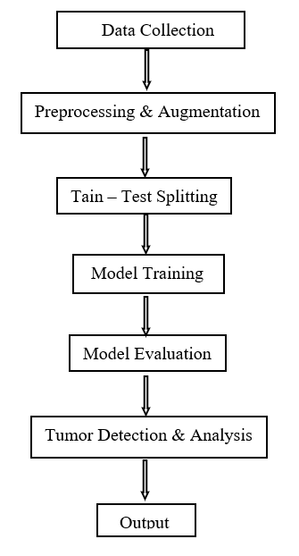
BLOCK DIAGRAM

Slide 12
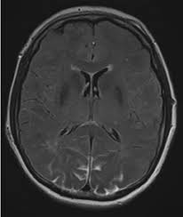
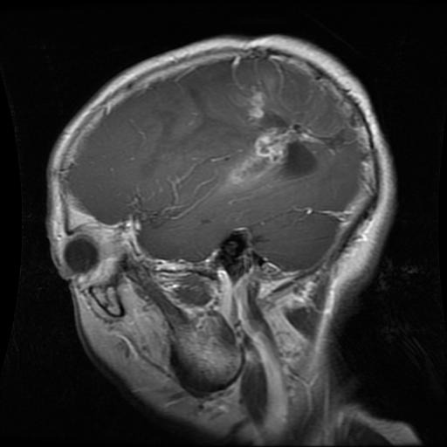
METHODOLOGY
Data collection :
Data set is collected from Kaggle website which contains tumor and normal images.Our dataset has 2442 images.
Normal Image Tumor Image
Data preprocessing and Augmentation :
Data preprocessing is done by applying smoothning, Blurring , Gaussin Blurring techniques
along with resizing the images.
DataSet splitting :
Dataset is splitted into training and testing sets Whereas each set contains 1221 images.

Slide 13
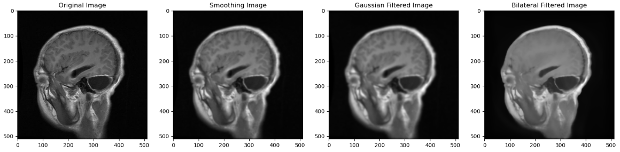
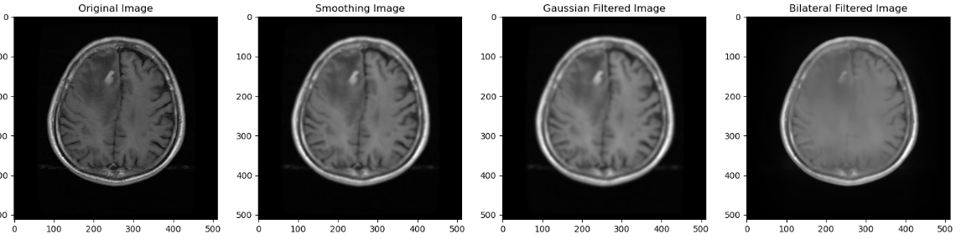
With Tumor
Without Tumor

Slide 14
Model selection :
Both CNN and VGG16 models are utilized for binary classification tasks, specifically in detecting brain tumors from MRI images. They employ convolutional layers to extract relevant features from the input images. These models can provide accurate predictions of tumor presence or absence based on input MRI images.
Model training :
Model training involves preparing data using ImageDataGenerator, defining CNN and VGG16 architectures, then training the models with fit() function by providing training data, validating on test data, and optimizing parameters with Adam optimizer and binary cross-entropy loss.
Model evaluation :
Model evaluation comprises plotting accuracy and loss curves using plot_accuracy_loss(), evaluating models on test data via evaluate() to obtain loss and accuracy metrics, and making predictions on individual images using predict() to classify brain tumor presence or absence based on MRI scans.

Slide 15
IMPLEMENTATION
Software Specifications:
Programming Language: Python.
Libraries and Frameworks: NumPy, TensorFlow, keras, ImageDatagenerator, Matplotlib.
Model Architecture: CNN and VGG16
Data Preprocessing: Data Set Loading ,Visualization of Data, Cleaning the Data ,TF-IDF Vectorization.
Visualization: Matplotlib for visualizing original and predicted images.
Hardware Specifications:
Compute Resources: CPUs/GPUs for TensorFlow operations
Memory: Adequate RAM for dataset loading and processing

Slide 16
Challenges Faced and Solutions: Data Availability and Quality: Collaborate with healthcare institutions and research organizations to access large, diverse, and well-annotated datasets. Implement rigorous data curation and quality control processes to ensure the reliability of the data. Model Generalization : Augment the training dataset with a wide range of cases, encompassing various imaging conditions, equipment types, and patient demographics. Implement techniques such as transfer learning to enhance the model's ability to generalize to new data. Real-Time Application: Optimize the deep learning model for inference speed, possibly by using model quantization, pruning, or deploying specialized hardware like GPUs or TPUs. Consider parallel processing to accelerate real-time predictions. Handling Imbalanced Datasets: Employ techniques such as oversampling, undersampling, or the use of synthetic data to address imbalances. Carefully evaluate the impact of imbalanced datasets on model performance and adjust the training strategy accordingly.

Slide 17
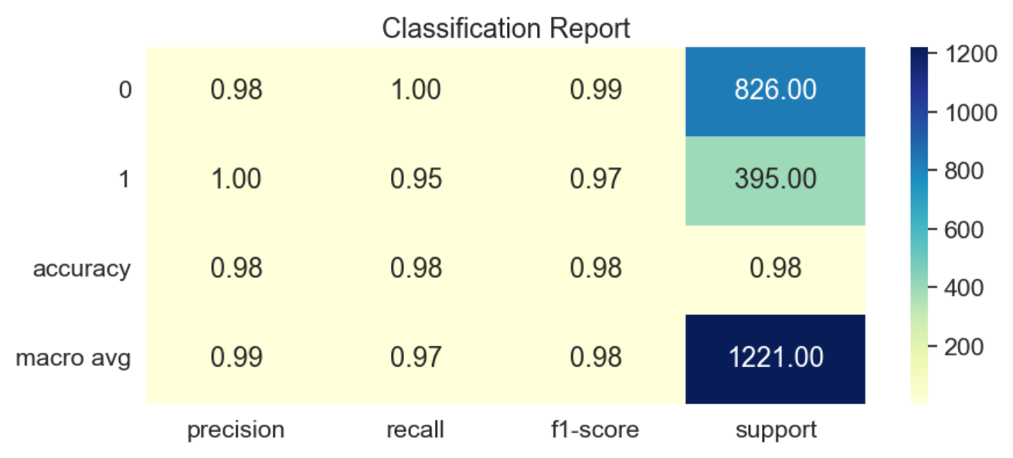
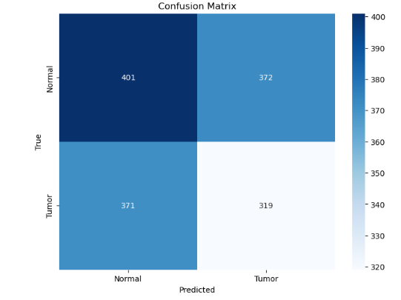
Results and Analysis
Classification report provides a comprehensive summary of the performance of a classification model. It typically includes several key metrics such as precision, recall, F1-score, and support for each class.
Confusion matrix is a table that is often used to describe the performance of a classification model on a set of test data for which the true values are known. It allows visualization of the performance of an algorithm.

Slide 18
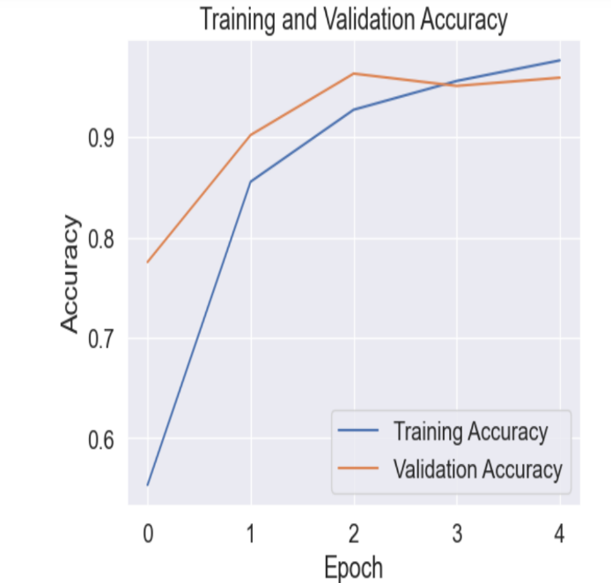
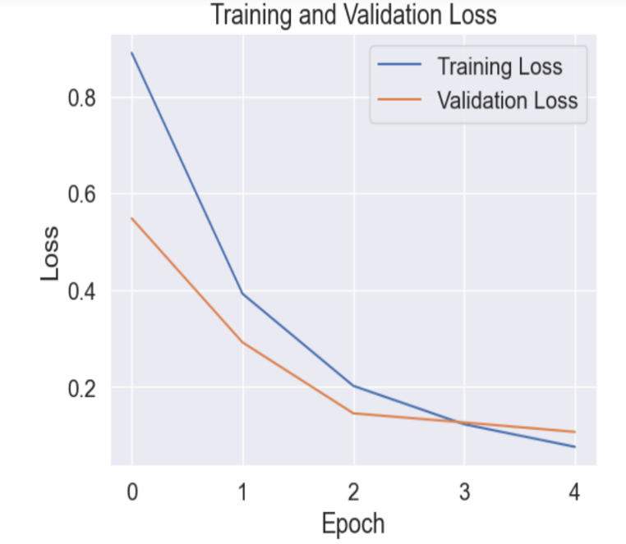
The training accuracy and validation accuracy results in 99% and 97% respectively.
The small gap between trainig and validation indicates to avoid overfitting on the training data.
As training progresses, the model learns to minimize training loss by fitting closely to the training data.
The training loss reflects how well the model is fitting the training data, whereas the validation loss indicates how well the model generalizes to unseen data. Monitoring the training and validation loss enables early detection of overfitting.

Slide 19
CONCLUSION and FUTURE SCOPE
Conclusion:
The study underscores the potential of deep learning techniques, such as transfer learning and data augmentation, in improving brain tumor diagnosis accuracy from MRI images.
The developed model demonstrates promising results, showcasing its effectiveness as a diagnostic tool in medical imaging.
Future Scope:
Further refinement and validation of the proposed model are essential steps for its integration into clinical settings.
Real-world validation studies involving larger and more diverse datasets, along with collaboration with medical professionals, can enhance the model's reliability and applicability in real-world scenarios.

Slide 20
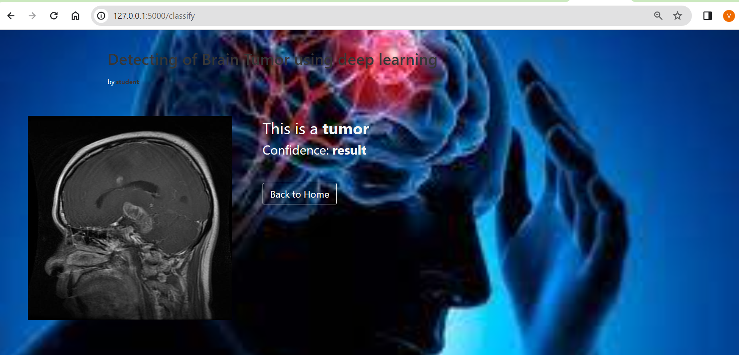
With Tumor image

Slide 21
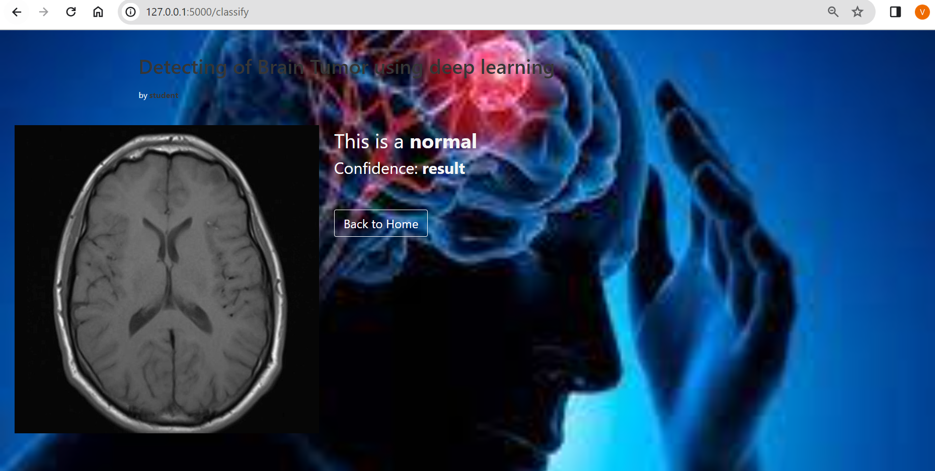
Without Tumor Image

Slide 22
REFERENCES
S. Grampurohit, V. Shalavadi, V. R. Dhotargavi, M. Kudari and S. Jolad, "Brain Tumor Detection Using Deep Learning Models," 2020 IEEE India Council International Subsections Conference (INDISCON), Visakhapatnam, India, 2020, pp. 129 134,doi:10.1109/INDISCON50162.2020.00037.
A. Saleh, R. Sukaik and S. S. Abu-Naser, "Brain Tumor Classification Using Deep Learning," 2020 International Conference on Assistive and Rehabilitation Technologies (iCareTech), Gaza, Palestine,2020, pp. 131-136, doi:10.1109/iCareTech49914.2020.00032.
G. N, V. Pushpalatha, R. C, S. L and S. S, "Brain Tumor Detection and Classification Using Deep Learning," 2023 Winter Summit on Smart Computing and Networks (WiSSCoN), Chennai, India, 2023, pp. 1-6, doi: 10.1109/WiSSCoN56857.2023.10133851.
V. Sravya and S. Malathi, "Survey on Brain Tumor Detection using Machine Learning and Deep Learning," 2021 International Conference on Computer Communication and Informatics (ICCCI), Coimbatore, India, 2021, pp. 1-3, doi: 10.1109/ICCCI50826.2021.9457019.
S. Poornam and S. Alagarsamy, "Detection of Brain Tumor in MRI Images using Deep Learning Method," 2022 3rd International Conference on Electronics and Sustainable Communication Systems (ICESC), Coimbatore, India, 2022, pp. 855-859, doi: 10.1109/ICESC54411.2022.9885583.

Slide 23
A. Sinha, A. R P, M. Suresh, N. Mohan R, A. D and A. G.Singerji, "Brain Tumour Detection Using Deep Learning," 2021 Seventh International conference on Bio Signals, Images, and Instrumentation (ICBSII), Chennai, India, 2021, pp. 1-5, doi: 10.1109/ICBSII51839.2021.9445185.
F. l. HAMEED and O. DAKKAK, "Brain Tumor Detection and Classification Using Convolutional Neural Network (CNN)," 2022 International Congress on Human-Computer Interaction, Optimization and Robotic Applications (HORA), Ankara, Turkey, 2022, pp. 1-7, doi: 10.1109/HORA55278.2022.9800032.
F. Derikvand and H. Khotanlou, "Brain Tumor Segmentation in MRI Images Using a Hybrid Deep Network Based on Patch and Pixel," 2020 International Conference on Machine Vision and Image Processing (MVIP), Iran, 2020, pp. 1-5, doi: 10.1109/MVIP49855.2020.9116880.
G. Hemanth, M. Janardhan and L. Sujihelen, "Design and Implementing Brain Tumor Detection Using Machine Learning Approach," 2019 3rd International Conference on Trends in Electronics and Informatics (ICOEI), Tirunelveli, India, 2019, pp. 1289-1294, doi: 10.1109/ICOEI.2019.8862553.
M. Siar and M. Teshnehlab, "Brain Tumor Detection Using Deep Neural Network and Machine Learning Algorithm," 2019 9th International Conference on Computer and Knowledge Engineering (ICCKE), Mashhad, Iran, 2019, pp. 363-368, doi: 10.1109/ICCKE48569.2019.8964846.

Slide 24
J. K. Periasamy, B. S and J. P, "Comparison of VGG-19 and RESNET-50 Algorithms in Brain Tumor Detection," 2023 IEEE 8th International Conference for Convergence in Technology (I2CT), Lonavla, India, 2023, pp. 1-5, doi: 10.1109/I2CT57861.2023.10126451.
S. Sankara Narayanan, L. C. Meena, K. C. Thanu and P. Chandrasekar, "Enhancing Glioma Brain Tumor Detection from MRI using Deep Learning Techniques," 2023 International Conference on Data Science, Agents & Artificial Intelligence (ICDSAAI), Chennai, India, 2023, pp. 1-6, doi: 10.1109/ICDSAAI59313.2023.10452496.
M. Prakram, K. Rawal and A. Singh, "A System For Detecting Brain Tumors Through the Use of Deep Learning and Image Classification with Improved Accuracy," 2023 6th International Conference on Contemporary Computing and Informatics (IC3I), Gautam Buddha Nagar, India, 2023, pp. 1143-1148, doi: 10.1109/IC3I59117.2023.10397805.
N. Sengupta, C. B. McNabb, N. Kasabov and B. R. Russell, "Integrating Space, Time, and Orientation in Spiking Neural Networks: A Case Study on Multimodal Brain Data Modeling," in IEEE Transactions on Neural Networks and Learning Systems, vol. 29, no. 11, pp. 5249-5263, Nov. 2018, doi: 10.1109/TNNLS.2018.2796023.
M. Malik, M. A. Jaffar and M. R. Naqvi, "Comparison of Brain Tumor Detection in MRI Images Using Straightforward Image Processing Techniques and Deep Learning Techniques," 2021 3rd International Congress on Human-Computer Interaction, Optimization and Robotic Applications (HORA), Ankara, Turkey, 2021, pp. 1-6, doi: 10.1109/HORA52670.2021.

Slide 25


Slide 26


