Slide 1

Bone Fracture Detection

Slide 2
Department of Computer Science and Engineering
Bone Fracture Detection
PRESENTED BY
Badri Venkata Durga Praveen 20471A05D7
Elchuri Rushi Naga Manikanta 20471A05E7
Thota Sumanth 20471A05J0
Under the Guidance of,
D. Venkata Reddy _{M.Tech,}
Assistant Professor,
Department of Computer Science and Engineering,
Narasaraopeta Engineering College (Autonomous),
Narasaraopet- 522 601.

Slide 3
OUTLINE
Abstract
Introduction
Literature Survey
Research Gaps
Problem Statement
Objectives
Block Diagram / Flow Diagram
Methodology
Implementation
References
Question and Answers
Acknowledgements

Slide 4
ABSTRACT
Rapidly developing technologies are emerging every day in different fields, especially in medical environment. However, still some old techniques are quite popular, efficient and effective in this manner. X-Rays are one of these techniques for detection of bone fractures. Nevertheless, sometimes the size of fractures is not significant and could not be detected easily. Therefore, effective and intelligent systems should be designed. This paper aims to develop an intelligent classification system that would be capable of detecting the bone fractures.

Slide 5
INTRODUCTION
This project focuses on creating a smart system to detect bone fractures, using advanced machine learning and image processing techniques for better accuracy than regular X-rays.
The project is motivated by the problems with unclear X-ray images and manual checks. It aims to offer a more precise and efficient solution for spotting bone fractures, making life easier for medical professionals.
This project important because it addresses the global challenge of increasing bone fractures. By improving how we diagnose fractures, it helps doctors provide timely and effective treatment, aligning with the growing trend of integrating advanced technologies into healthcare for better patient outcomes.

Slide 6
LITERATURE SURVEY
No | Title | Author | Journal Name & Year | Methodology Adapted | Key Findings | Gaps
1 | Detection of bone fracture based on machine learning techniques | Kosrat Dlshad Ahmed | Science Direct (2023) https://doi.org/10.1016/j.measen.2023.100723 | Preprocessing, Canny edge detection, GLCM feature extraction, SVM classification | SVM achieved accuracy of 92.86% for fracture detection and classification | Limited dataset size, only focused on lower leg bone fractures
2 | Lower Leg Bone Fracture Detection and Classification Using Faster RCNN for X-Rays Images | Waseem Abbas Syed M. Adnan | IEEE (2021) https://doi.org/10.1109/INMIC50486.2020.9318052 | Faster R-CNN deep learning model | Achieved accuracy of 94% for fracture detection and classification | Requires large dataset for training, computationally expensive
3 | Artificial intelligence application in bone fracture detection | Ahmed Al Ghaithi | Journal of Musculoskeletal Surgery and Research (2021) http://dx.doi.org/10.4103/jmsr.jmsr_132_20 | Review of various AI techniques for bone fracture detection | AI has potential to improve accuracy and efficiency of fracture diagnosis | Limited research on specific fracture types and integration with clinical workflows
4 | Automatic detection of fracture in femur bones using image processing | Ankur Mani Tripathi | IEEE (2017) http://dx.doi.org/10.1109/ICIIECS.2017.8275843 | Preprocessing, edge detection, feature extraction, Decision Tree classification | Achieved accuracy of 84.7% for fracture detection | Limited feature analysis, requires manual parameter tuning for different fractures

Slide 7
LITERATURE SURVEY
Detection of bone fracture based on machine learning techniques by Kosrat Dlshad Ahmed, the key finding of this paper is that SVM achieved accuracy of 92.86% for fracture detection and classification.
Lower Leg Bone Fracture Detection and Classification Using Faster RCNN for X-Rays Images by Waseem Abbas, Syed M. Adnan, The key finding of this paper is achieved accuracy of 94% for fracture detection and classification.
Automatic detection of fracture in femur bones using image processing by Ankur Mani Tripathi, the key finding of this paper is achieved accuracy of 84.7% for fracture detection.
Artificial intelligence application in bone fracture detection by Ahmed Al Ghaithi, the key finding of this paper is AI has potential to improve accuracy and efficiency of fracture diagnosis
X-Ray Bone Fracture Classification Using Deep Learning: A Baseline for Designing a Reliable Approach by Leonardo Tanzi the key finding of this paper is achieved accuracy of 82% for fracture classification.

Slide 8
RESEARCH GAPS
Limited dataset size, only focused on lower leg bone fractures
Limited research on specific fracture types and integration with clinical workflows
Limited accuracy for complex fractures, requires manual feature selection
Primarily focused on binary classification (fracture vs. non-fracture).

Slide 9
PROBLEM STATEMENT
Millions of people suffer from bone fractures each year, and spotting these fractures quickly is crucial for effective treatment. The current methods, which involve manual checks and traditional X-rays, can be slow and prone to errors. The rising global incidence of bone fractures adds complexity to the challenges faced by healthcare professionals.
The commonly used X-ray techniques have drawbacks, like producing unclear images of bones, making it tough for surgeons to make precise diagnoses. This can lead to delayed or incorrect treatments, negatively impacting patients. To overcome these issues, there's a need for an automated system to help healthcare professionals swiftly and accurately identify bone fractures from X-ray images.

Slide 10
OBJECTIVES
Develop a reliable system for finding bone fractures in X-ray images
Improve the quality of X-ray images through effective preprocessing techniques
Implement advanced feature extraction methods and utilize machine learning algorithms, including Naïve Bayes, Decision Tree, Nearest Neighbors, Random Forest, and SVM, for accurate classification of fractures.
Assess the performance of the developed system by evaluating precision, recall, and accuracy metrics.
Compare the outcomes with existing studies to validate the effectiveness and efficiency of the proposed methodology in bone fracture detection.

Slide 11
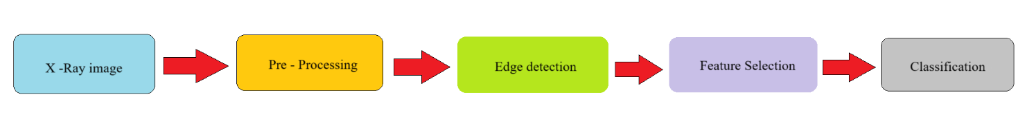
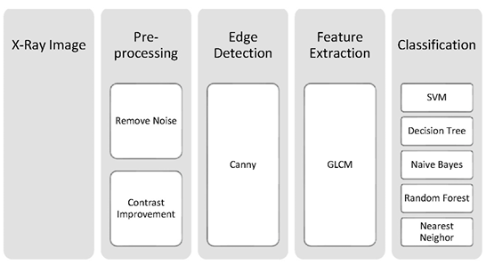
BLOCK DIAGRAM OR FLOW DIAGRAM

Slide 12
METHODOLOGY
Gaussian filter is used to eliminate noise in X-ray images.
Canny edge detection identifies bone boundaries, with an adaptive histogram for enhanced contrast.
Gray-Level Co-occurrence Matrix is used to extract textural properties crucial for analysis.
Support Vector Machine (SVM), Random Forest (RF), Naive Bayes and Nearest Neighbour algorithms are used for effective classification in detecting fractures.

Slide 13
IMPLEMENTATION
Software Specifications:
Browser : Any Latest browser like Chrome, Edge etc.,
Operating System : Windows 10 or Later versions
Language : Python
Platform : Google COLAB
Hardware Specifications:
Processor : Minimum Intel(R) Core™i5-10 Gen or equivalent processor
RAM : 8GB (4 GB usable)
System Type : 64-bit operating system

Slide 14
REFERENCES
W. Abbas, S. Adnan, M. Javid, F. Majeed, Lower Leg Bone Fracture Detection and Classification Using Faster RCNN for X-Rays Images, IEEE 23rd International Multitopic Conference (INMIC), 2020.
A. Al-Ghaithi, S. Al Maskari, Artificial intelligence application in bone fracture detection. Journal of Musculoskeletal Surgery and Research, J. Mach. Learn. 5 (1) (2021) 4–9.
Sami H. Ismael, Shahab W. Kareem, Firas H. Almukhta, Medical Image Classification Using Different Machine Learning Algorithms, AL-Rafidain Journal of Computer Sciences and Mathematics, 2020.
about the use and safety of CT scans, in: Mayo Clinic Proceedings, 2015. Amin Salih Mohammed Hersh, A. Muhamad, Shahab Wahhab Kareem, A Deep Learning Method for Detecting Leukemia in Real Images, NeuroQuantology, 2022.
P. Cephas, H. Hepzibah, A robust approach for detection of the type of fracture from X-ray images, International Journal of Advanced Research in Computer and Communication Engineering (2015).

Slide 15

QUESTIONS and ANSWERS

Slide 16

ACKNOWLEGEMENTS

