Slide 1

Department of Computer Science and Engineering
FAKE PROFILE IDENTIFICATION USING MACHINE LEARNING
PRESENTED BY
P.Venkata Deepthi – 20471A05G9
S.Thejita Lasya – 20471A05I7
M.Saraswathi – 20471A05G1
Under the Guidance of,
Dr.S.N.Tirumala Rao,MTech,Ph.D,
Head of Computer Science and Engineering Department,
Narasaraopeta Engineering College (Autonomous),
Narasaraopet- 522 601.

Slide 2
OUTLINE
Abstract
Introduction
Literature Survey
Research Gaps
Problem Statement
Objectives
Block Diagram / Flow Diagram
Methodology
Implementation
Results and Analysis
Conclusion & Future Scope
References
Question and Answers
Acknowledgements

Slide 3
ABSTRACT
In today's world, social media is an essential component of everyone's social life on the internet.
It's become simpler to make new contacts and stay updated on their activities.
Numerous fields are impacted by online social networks, including business, education, employment, community involvement, and research.
Employers use these social networking sites to find and hire qualified applicants who are enthusiastic about their job.
Spreading misinformation via social media is another problem. Incorrect accounts that propagate unsuitable and incorrect information may give rise to conflicts.
These made-up accounts are likewise intended to attract followers. More harm is done to people by false profiles than by other internet crimes. Consequently, it's critical to be able to recognize a fake profile.

Slide 4
INTRODUCTION
You have access to a wide range of contacts and possibilities via the Internet. Popular social networking services like Facebook, Instagram, Snapchat, and WhatsApp are certainly recognizable to you. Fake profiles can be created for various malicious purposes, including identity theft, misinformation dissemination, and cybercrime.
Apart from these conventional modes of social engagement, the contemporary generation engages in a plethora of alternative types of interaction.
Social networking services are quite simple to use for educators to instruct children and these days, teachers use these websites extensively to provide online lectures, give homework, host conversations, and more—all of which greatly enhance student learning.
Employers may find candidates who are knowledgeable and passionate about their profession by using social networking sites. These websites make it easy to check candidates' backgrounds.
They often arise from a straightforward absence of in-person interactions, and this frequently results in invites that, in the absence of these phony [1] identities on social media, we wouldn't typically receive.

Slide 5
LITERATURE SURVEY
S.No | Title | Author | Journal Name & Year | Methodology Adapted | Key Findings | Gaps
1 | Detecting malicious users in the social networks using machine learning | Gururaj | 2021 | NLP, SVM Classifier. | It is representing a machine learning algorithm for the classification, analysis, and prediction of multimedia messages in social networks. | The study primarily focuses on identifying malicious users based on historical data and patterns. A research gap may exist in developing real-time detection mechanisms that can quickly identify and respond to emerging threats in social networks.
2 | To identify phony social media profiles | Kodati | 2021 | SVM Classifier. | The proposed hybrid SVM algorithm achieved an impressive accuracy of 98% in detecting fake profiles. | In investigating the scalability and generalizability of the algorithm to larger datasets or different social media platforms beyond Twitter to assess its robustness in diverse settings.

Slide 6
S.No | Title | Author | Journal Name & Year | Methodology Adapted | Key Findings | Gaps
 | Detecting Fake Accounts on Social Media. | Khaled | 2018 | SVM, NN | Feature reduction techniques like Principal Component Analysis, Spearman's Rank-Order Correlation, Wrapper Feature Selection using SVM, and Multiple Linear Regression were applied to identify the most promising feature patterns for detecting fake accounts. | Exploration of the impact of fake accounts on different demographics and user groups, including vulnerable populations such as teenagers and elderly users.
4 | Use of Artificial Neural Networks to Identify Fake Profiles. | Hajdu | 2019 | Neural Network | This technique was found to be unreliable as it did not consider the possibility of real profiles being ranked low and fake profiles being ranked high. | While the paper discusses the use of artificial neural networks for identifying fake profiles, further research could focus on evaluating the effectiveness of different machine learning algorithms.

Slide 7
RESEARCH GAPS
Scalability: The document mentions the use of a training dataset from Facebook or other social networks. Further research could investigate the scalability of the proposed algorithm to handle large volumes of data from diverse social media platforms.
Psychological Factors: Investigation into the psychological and sociological aspects of user behavior and interaction with fake accounts on social media, including the susceptibility of users to manipulation and misinformation .
Limited Focus on Specific Social Networks: The existing research may primarily focus on popular social networks like Facebook, Instagram, and Twitter. There could be a research gap in exploring the detection of malicious users in emerging or niche social networking platforms.
Feature Selection: Traditional machine learning algorithms like random forest, naive bayes, SVM, and decision tree lack the capability to perform feature selection independently. Researchers often need to manually study the relationship between features and the target variable to determine which features to consider or reject. This manual process can be time-consuming and may not always lead to optimal feature selection .

Slide 8
PROBLEM STATEMENT
Many issues, including fake profiles and online impersonation, have arisen in today’s online social networks.
No one has developed a potential solution for these issues as of yet.
To safeguard human social lives, we want to provide a novel model for computerized fake profile early detection in this project.
. We can also make it simpler for websites to change the large diversity of profiles by using our automatic detecting technology which is hard to accomplish manually.

Slide 9
OBJECTIVES
Dataset Analysis: Analyzing the datasets obtained from sources like Kaggle to understand the characteristics of genuine and fake user profiles .
Data Pre-Processing Techniques: Implementing data cleaning, normalization, and feature encoding to prepare the raw data for machine learning model analysis .
Creation and Evaluation of Model: Developing a machine learning model to identify fake profiles and evaluating its performance using metrics like accuracy, precision, recall, and F1 score .
Outlier Detection: Identifying and handling anomalous instances within the dataset that may indicate fake profiles .

Slide 10
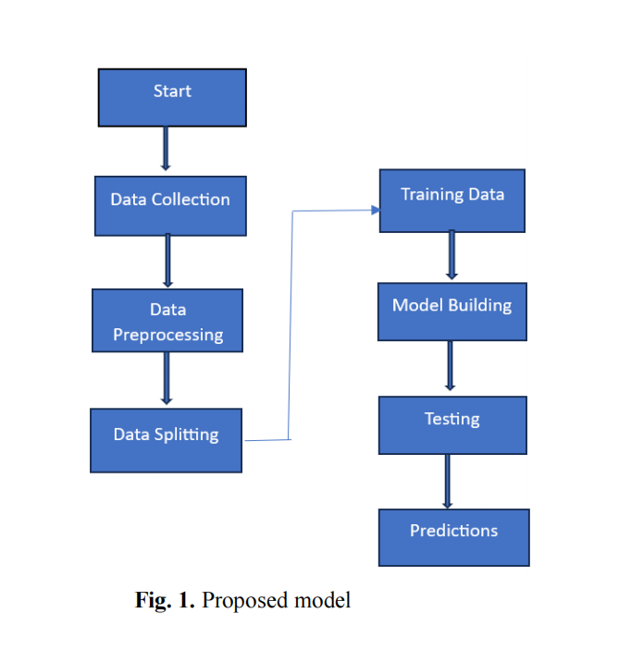
BLOCK DIAGRAM OR FLOW DIAGRAM

Slide 11
METHODOLOGY
1. Random Forest will split the data randomly into many data samples which are then split into trees that are trained and tested for prediction. The prediction score is then finalized by the voting scheme in between the trees
2. Gradient Boosting is similar to the random forest model but it relies on the intuition that the best possible next model would be the one that gives a minimum number of errors when combined with the previous one.
3.Logistic Regression is a statistical method for investigating data when the outcome is controlled by one or more independent factors.
4.Gaussian Naive Bayes is also a particular use of the Naive Bayes method where the characteristics have continuous values. This algorithm assumes that all the features follow a Gaussian distribution which is also called a normal distribution.

Slide 12
IMPLEMENTATION
1.Loaded two datasets, Added isfake target variable, Concated,
Check for missing or null values.
check correlation.
Detecting and removing of outliers.
2. Creating percentage share of Train and Test data set
3. Cross-validation

Slide 13
Implementation: https://drive.google.com/file/d/1yaOgCJRVUOvn4ZkNUVw20JekotI2dOth/view?usp=sharing

Slide 14
Challenges Faced and Solutions Data set: The dataset contains two sets that is fake user and isfake user. So, we merged those both datasets. And we took those both datasets and found out what is fake profile and what is real profile. Error Handling: Handling categorical data was a major challenge while training the model using the machine learning algorithms.

Slide 15
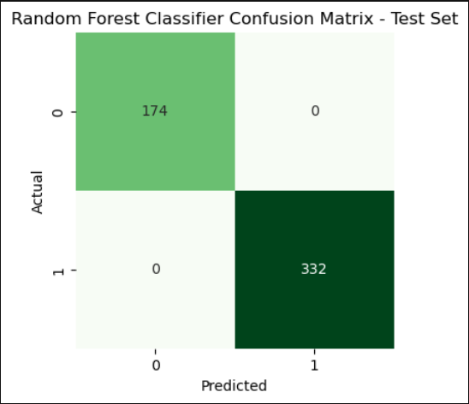
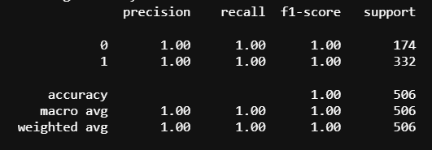
RESULTS & ANALYSIS
Random Forest:

Slide 16
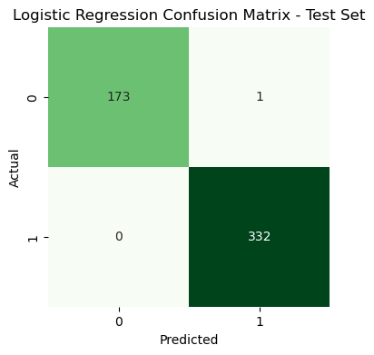
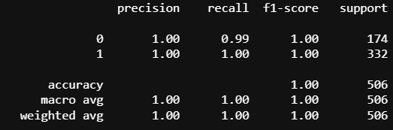
Logistic Regression:

Slide 17
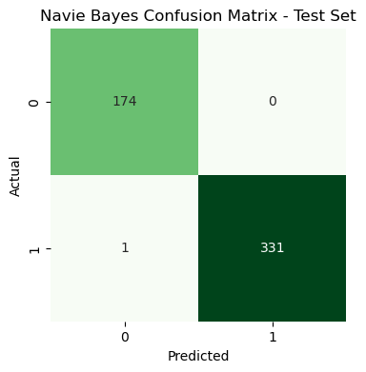
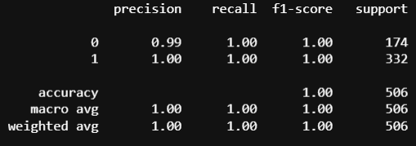
Naive Bayes:

Slide 18
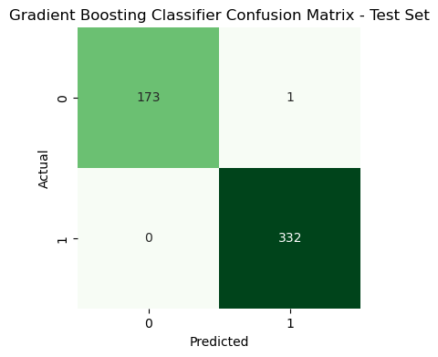
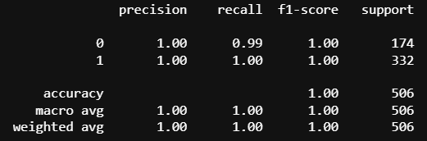
Gradient Boosting Classifier:

Slide 19
CONCLUSION AND FUTURE SCOPE
This study explored the application of four popular machine learning algorithms, Random Forest, XG Boosting algorithm, and Logistic Regression, for predicting whether a social media account of a user is real or fake.
The results indicate that of the four algorithms we have used for our predictions, the random forest algorithm is the most effective in generating accurate predictions, with random Forest outperforming the XG boost, Naïve Bayes, and Logistic Regression in terms of accuracy and efficiency.
The predictive model developed in this study can be useful for better safety and privacy protection of authentic users from the fraudulent practices of fake users on social media platforms.
Overall, this project highlights the potential of machine learning in enhancing user safety and privacy and allowing safe online engagement of users on social media platforms. Future research can expand this work by incorporating more complex features, exploring more optimized machine learning algorithms.

Slide 20
REFERENCES
Gururaj, H.L., Tanuja, U., Janhavi, V., Ramesh, B.: Detecting malicious users in the social networks using machine learning approach. Int. J. Soc. Comput. Cyber-Phys. Syst. 2(3), 229–243 (2021).
Kodati, S., Reddy, K.P., Mekala, S., Murthy, P.S., and Reddy, P.C.S. (2021) Detection of Fake Profiles on Twitter Using Hybrid SVM Algorithm. E3S Web of Conferences, 309, Article No. 01046.
Hajdu, G., Minoso, Y., Lopez, R., Acosta, M. and Elleithy, A. (2019) Use of Artificial Neural Networks to Identify Fake Profiles. 2019 IEEE Long Island Systems, Applications and Technology Conference (LISAT), Farmingdale, 3 May 2019, 1-4.
Khaled, S., El-Tazi, N. and Mokhtar, H.M. (2018) Detecting Fake Accounts on Social Media 2018 IEEE International Conference on Big Data (Big Data), Seattle, 10-13 December 2018, 3672-3681.
K.Harish, R.Naveen Kumar, Dr.J.Briso Becky Bell(2023) Fake profile detection using machine learning.Fake Profile Identification Using Machine Learning: Asso. Prof. G Swathi, R Vaishnavi, Shaik Noorus Sabiha, P Rakesh Anand, P Nithish Kumar Sreyas Institute of Engineering and Technology(2023).

Slide 21
Fake Profile Identification Using Machine Learning: Asso. Prof. G Swathi, R Vaishnavi, Shaik Noorus Sabiha, P Rakesh Anand, P Nithish Kumar Sreyas Institute of Engineering and Technology(2023)
Kulkarni, Sumit Milind, and Vidya Dhamdhere."Automatic detection of fake profiles in online social networks." Open access International Journal of Science and Engineering 3.1 (2018):70-73. M. Young, The Techincal Writers Handbook. Mill Valley, CA: University Science,1989.
Sarah Khaled, Neamat El-Tazi, Hoda M. O.Mokhta: Detecting Fake Accounts on Social Media,2018 IEEE International Conference on Big Data (Big Data).
Meshram, E.P., Bhambulkar, R., Pokale, P., Kharbikar, K. and Awachat, A. (2021) Automatic Detection of Fake Profile Using Machine Learning on Instagram. International Journal of Scientific Research in Science and Technology, 8, 117-127.
Joshi, U.D., Singh, A.P., Pahuja, T.R., Naval, S. and Singal, G. (2021) Fake Social Media Profile Detection. In: Srinivas, M., Sucharitha, G., Matta, A. and Chatterjee, P., Eds., Machine Learning Algorithms and Applications, Scrivener Publishing LLC, Beverly, MA, 193-209.
Reddy, S.D.P. (2019) Fake Profile Identification Using Machine Learning. International Research Journal of Engineering and Technology (IRJET), 6, 1145-1150.
Exploring machine learning techniques for fake profile detection in online social networks: Bharti, Nasib Gill, Preeti Gulia vol. 3, June 2023, pp. 2962~2971.

Slide 22
Sk.Shama, K. Siva Nandini, P.Bhavya Anjali, K. Devi Manaswi, Fake Profile.Identification in Online Social Network, 2019.
Prof of. Vivek Solvande, Vaishnavi Ambolkar, Siddhesh Birmole, Divya Gawas, Dnyanada Juvale and Fake Profile Identification Using Machine Learning Algorithm,2021.
S. Sheikhi, An Efficient Method for Detection of Fake Accounts on the Instagram Platform, 2020.

Slide 23


Slide 24


