Slide 1

Department of Computer Science and Engineering
Automatic Attendance Management System
Presented By
Teja Mannepuli (20471A05L8)
Nandam Pavankumar (21475A0515)
Nandam Venkata Siva Suneel (21475A0503)
Under the Guidance of,
DR.S.V.N Sreenivasu _{M.Tech,Ph.D}
Department of Computer Science and Engineering,
Narasaraopeta Engineering College (Autonomous),
Narasaraopet- 522 601.

Slide 2
OUTLINE
Abstract
Introduction
Literature Survey
Research Gaps
Problem Statement
Objectives
Block Diagram / Flow Diagram
Methodology
Implementation
Results and Analysis
Conclusion & Future Scope
References
Question and Answers

Slide 3
ABSTRACT
The aim of project is an innovative approach for real time class attendance capture using OpenCV & Convolutional Neural Networks (CNNs). The project focuses on facial identification through a meticulously curated dataset of NEC student photographs. The goal is to automate attendance tracking during live classroom sessions.
Keywords: OpenCV, Convolutional Neural Network, Real-Time Face Identification, Attendance Tracking, Deep Learning, Dataset Preparation

Slide 4
INTRODUCTION
This project focuses on streamlining student attendance in educational institutions.
Conventional attendance methods are time-consuming. This project offers an innovative solution by automating attendance through real-time facial recognition.
Convolutional Neural Networks (CNNs) are a specialized class of deep neural networks designed for visual recognition tasks.
CNNs consist of convolutional layers, pooling layers, and fully connected layers, each playing a crucial role in feature extraction and classification.
At project completion, the Convolutional Neural Network identifies face IDs and updates attendance.

Slide 5
LITERATURE SURVEY
No | Title | Author | Journal Name & Year | Methodology Adapted | Key Findings | Gaps
1 | FaceTime: Deep Learning-based Face Recognition Attendance System | Marko Arsenovic | https://ieeexplore.ieee.org/document/8080587 (2017) | CNN for face detection, FaceNet module | Face recognition attendance system using CNN | Lack of mention of CNN for face recognition
2 | Face Recognition Attendance System Based on Real-Time Video Processing | H. Yang and X. Han | IEEE Access, 2020 | Real-time video processing, OpenCV | Real-time face recognition for attendance tracking | Scalability and robustness of the system for large datasets
3 | Machine Learning Techniques for Lung Cancer Risk Prediction using Text Dataset | Kumar Mohan, Bhraguram Thayyil | International Journal of Data Informatics and Intelligent Computing&2023 | Text Dataset Analysis | Utilized machine learning techniques for lung cancer risk prediction from textual datasets. | Lack of specific details on the ML algorithms employed and their performance metrics.
4 | Smart Attendance Management System Based on Face Recognition Using CNN | Syam Kakarla, Priyaranjan Gangula, M. Sai Rahul, C. Sai Charan Singh, T. Hitendra Sarma | 2020 IEEE-HYDCON | 2020 | Convolutional Neural Networks (CNN) | Smart attendance management system using face recognition

Slide 6
RESEARCH GAPS
Limited Exploration of Face Recognition Algorithms
Insufficient Discussion on Real-time Challenges
Limited Consideration of Privacy and Ethical Implications

Slide 7
PROBLEM STATEMENT
Develop a project which provide a seamless and automated way to mark attendance, reducing time complexity and human errors in various organizations, particularly in scenarios with large public gatherings, ensuring reliability and ease of administration.

Slide 8
OBJECTIVES
Reduce Time Complexity
Automation of Record
Integration with Administration Systems

Slide 9
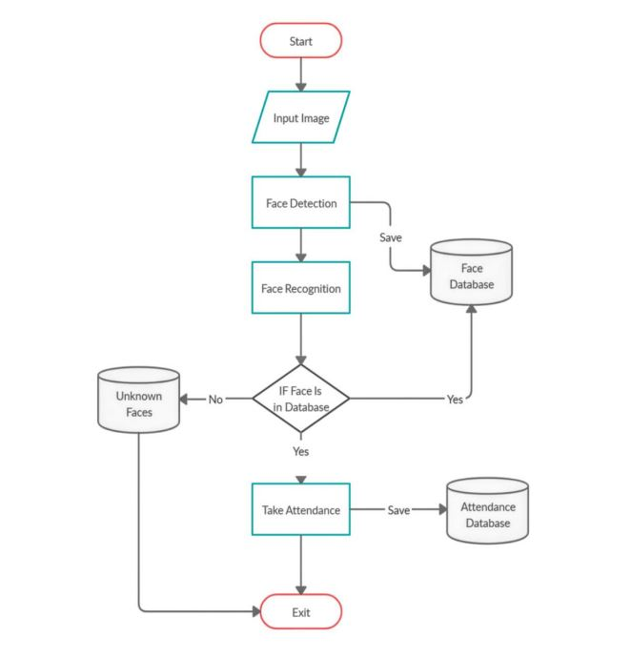
BLOCK DIAGRAM OR FLOW DIAGRAM

Slide 10
METHODOLOGY
We have to Import Necessary Modules required for project
We have to upload an dataset considered my class members images
In the next step we have to clean the dataset by removing blur ness ,filter etc. This can be achieved through some techniques like:
Resizing
Normalization
Data Augmentation
Rescaling Train CNN Algorithm

Slide 11
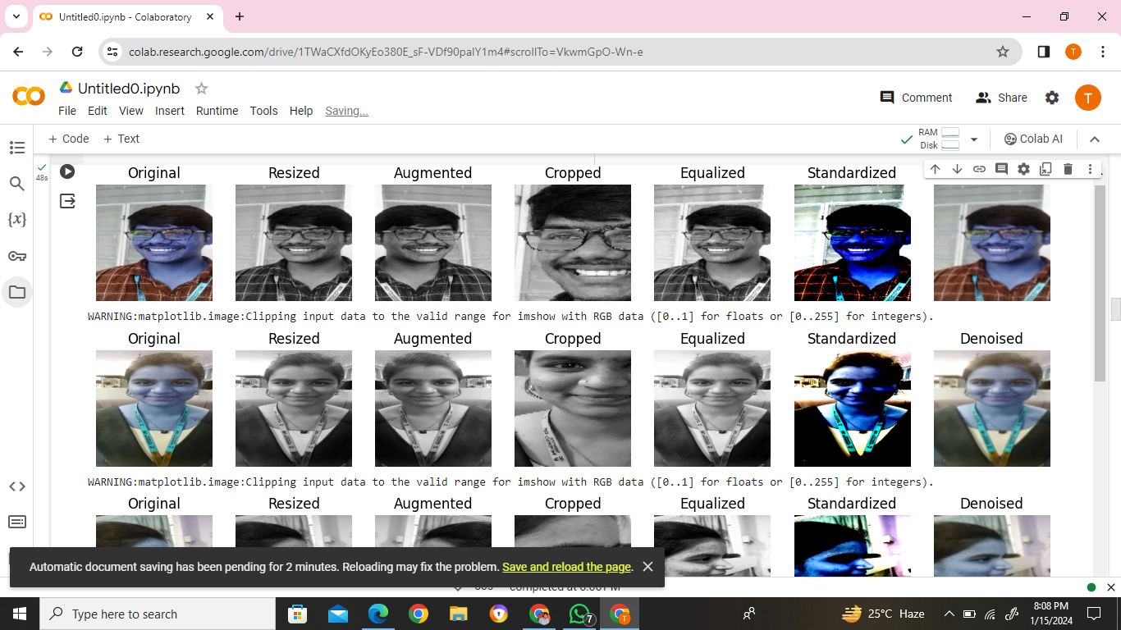

Slide 12
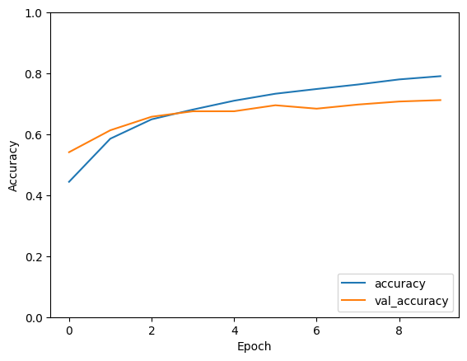
Train CNN

Slide 13
IMPLEMENTATION
Hardware Requirements
Processor : intel®corEi5
Cache memory : 4 MB
System type : 64-bit operating system
RAM : 8 GB
Software Requirements
Operating system : windows-10, 64 bit OS
Coding language : Python
Python distribution : VS Code
Browser :Any Latest Browser like Chrome

Slide 14
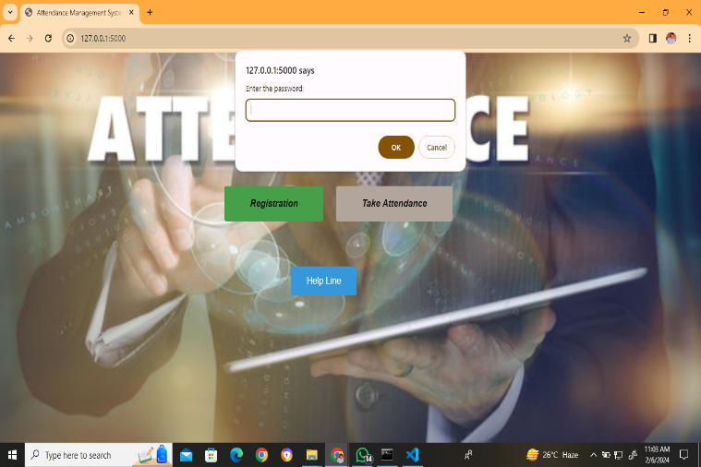

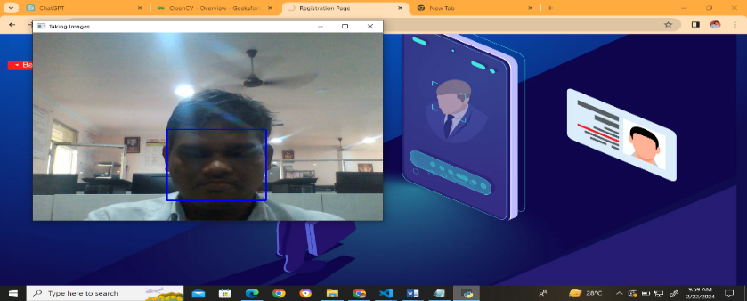
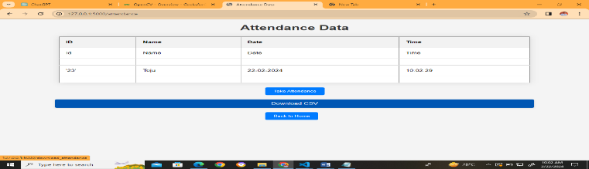
RESULTS & ANALYSIS

Slide 15
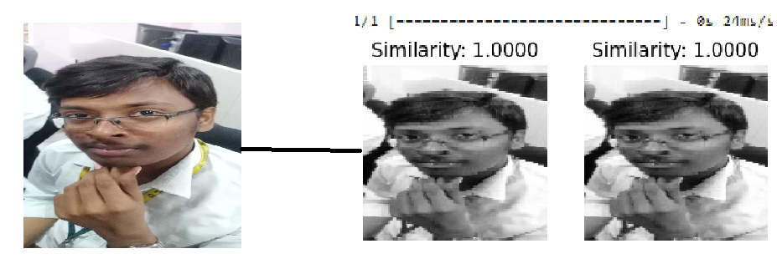
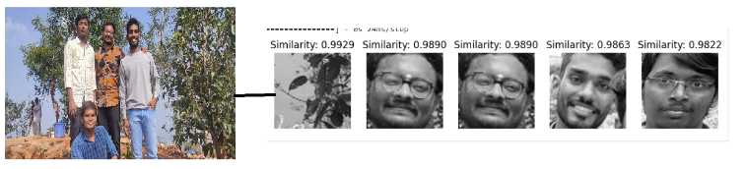
RESULTS & ANALYSIS
Single Photo Matching
Group Photo Matching

Slide 16
CONCLUSION and FUTURE SCOPE
The facial recognition system, leveraging OpenCV and deep learning, achieves a 71.34% recognition rate, offering a secure and reliable solution for attendance marking..
Future enhancements include developing a mobile application for student access and expanding the system to mark attendance automatically on the organization's website, eliminating manual processes and enhancing accessibility..

Slide 17
REFERENCES
H. Yang and X. Han, "Face Recognition Attendance System Based on Real-Time Video Processing", IEEE Access, vol. 8, pp. 159143-159150, 2020.
D. M. Prasanna and C. G. Reddy, "Development of Real Time Face Recognition System Using OpenCV", International Research Journal of Engineering and Technology.
Siti Ummi Masruroh et al., "NFC Based Mobile Attendence System with Facial Authorization on Raspberry Pi and Cloud Server", 2018 6th International Conference on Cyber and IT Service Management (CITSM), pp. 1-6, 2018.
J. Alghamdi, R. Alharthi, R. Alghamdi, W. Alsubaie, R. Alsubaie, D. Alqahtani, et al., "A survey on face recognition algorithms", 2020 3rd International Conference on Computer Applications & Information Security (ICCAIS), pp. 1-5, 2020.
S. M. Anzar, N. P. Subheesh, A. Panthakkan, S. Malayil and H. A. Ahmad, "Random interval attendance management system (RIAMS): A novel multimodal approach for post-COVID virtual learning", IEEE Access, vol. 9, pp. 91001-91016, 2021.

Slide 18
J. W. D’Souza, S. Jothi and A. Chandrasekar, "Automated attendance marking and management system by facial recognition using histogram", 2019 5th International Conference on Advanced Computing & Communication Systems (ICACCS), pp. 66-69, 2019.
T. Sharanya, U. Kasturi, P. Sucharith, T. Mahesh and V. Dhivya, "Online attendance using facial recognition", Int. J. Eng. Res, vol. 9, no. 06, pp. 202-207, 2020.
N. Yasmeen, K. K. R. C and S. Doss, "Intelligent systems powered hourly attendance capturing system", 2023 7th International Conference on Trends in Electronics and Informatics (ICOEI), pp. 1536-1541, 2023.
R. S, K. A, A. R and C. K. Kannan, "Automatic attendance monitoring system using LBPH and HAAR algorithm", 2023 9th International Conference on Advanced Computing and Communication Systems (ICACCS), vol. 1, pp. 1604-1608, 2023.
K. Vignesh, A. Abirami, P. Manideep, K. Vasu, K. Rakesh and S. V. Vardhan, "Smart attendance system using deep learning", 2023 7th International Conference on Trends in Electronics and Informatics (ICOEI), pp. 1081-1087, 2023.

Slide 19


Slide 20


