Slide 1

Department of Computer Science and Engineering
Prediction of Employee Attrition Using Machine Learning
Presented By
P. Bhavani Manjunadha – 20471A05M2
G. Venkata Sai – 20471A05K6
A. Narendra Reddy – 20471A05O0
Under the Guidance of,
SK.CH.M. Subhani, _{M. Tech}
Assistant Professor
Department of Computer Science and Engineering,
Narasaraopeta Engineering College (Autonomous),
Narasaraopet- 522 601.

Slide 2
OUTLINE
Abstract
Introduction
Literature Survey
Research Gaps
Problem Statement
Objectives
Block Diagram / Flow Diagram
Methodology
Implementation
Results and Analysis
Conclusion & Future Scope
References
Question and Answers
Acknowledgements

Slide 3
ABSTRACT
Attrition is the departure of employees from the organization for any reason (voluntary or involuntary), including resignation, termination, death or retirement. Attrition rate refers to the rate at which employees leave a company over a specified period of time. It is typically expressed as a percentage and is calculated by dividing the number of employees who leave the company (voluntarily or involuntarily) by the average number of employees during that period, and then multiplying by 100. Attrition can be caused by a variety of factors, including dissatisfaction with the job, a poor work environment, or a desire for a better salary or benefits. The attrition reports are seen by the human resources department and the manager of the department where the employee who left work worked. we have implemented various Machine Learning Algorithms to predict the attrition rate of an organization. We have followed various processes such as Dataset Collection, Data Preprocessing, Data Visualization, apply SMOTE on the data and training the model by using the various machine learning models like Random Forest, Decision Tree, Extra Tree Classifier, Logistic Regression, K-Nearest Neighbors, Gradient Boost and XG Boost Classifier algorithms. The results are evaluated using accuracy score and confusion matrix. XG Boost classifier algorithm giving the best accuracy i.e., 91.16% compared to the other evaluating models. This work will help organizations to better understand the attrition causes.

Slide 4
INTRODUCTION
In today’s world data is being created at an ever-increasing rate. The analysis of this stored data has proved to be beneficial in gaining insights and creating general awareness about any business or organization.
Data analysis is the process of collecting, inspecting, cleansing, transforming, and modeling raw data with the aim of deriving valuable insights and retrieving relevant information to reach a conclusion for good decision making.
The outcome of many research shows that the most valuable asset and important resource in organizations are their employees.
Now a day due to increased competition and improved requirement in employees proficiency determines the attrition rate. The employee attrition is considered to be a serious issue for organizations. The cost of searching and training employees is very high.

Slide 5
INTRODUCTION
Organizations need to search, hire and train new employees. Loss of experienced workers especially high performers is difficult to manage and is negatively related to the success and performance of organizations.
The study focuses on the variables that may lead to control the attrition rate of the employee.
The problem of employee turnover has turn to eminence in organizations because of its pessimistic impacts on issues on work place self-esteem and efficiency.
The organizations deal with this problem is by predicting the risk of attrition of employees using machine learning techniques thus giving organizations to take proactive action for retention.

Slide 6
LITERATURE SURVEY
No | Title | Author | Journal Name & Year | Methodology Adapted | Key Findings | Gaps
1 | Using Data Mining Techniques to Build a Classification Model for Predicting Employees Performance | Qasem A, A.Radaideh and Eman A Nagi | https://thesai.org/Publications/ViewPaper?Volume=3&Issue=2&Code=IJACSA&SerialNo=25 | CRISP-DM data mining methodology | The study has found that several factors might have a great effect on employee performance. One of the most effective factors is the job title. | Limited proper data from various companies
2 | Early Prediction of Employee Attrition using Data Mining Techniques | Sandeep Yadav | https://ieeexplore.ieee.org/abstract/document/8692137 | Input Data Set, Feature Engineering: Brute-force approach, One Hot Encoding, Feature Selection, Experienced Employee Data | CLASSIFICATION RESULTS OF EXPERIENCED EMPLOYEE DATA by SVM with accuracy 93% | Combining HR data with employee survey data, performance reviews, and external economic data can provide a more comprehensive picture.

Slide 7

3 | Prediction of Employee Attrition Using Machine Learning and Ensemble Methods | Aseel Qutub, Asmaa Al-Mehmadi | https://www.researchgate.net/publication/351911311_Prediction_of_Employee_Attrition_Using_Machine_Learning_and_Ensemble_Methods | Six different machine learning models have been trained and evaluated in this work; decision tree model, random forest model, gradient boosting model, adaboost, and logistic regression model. | The results show the superiority of the linear model in terms of accuracy, recall and AUC | The performance of the ensembles is slightly lower than their best base models, these ensembles would generalize better for unseen examples and larger datasets.
4 | Predicting Employee Attrition Using Machine Learning Approaches | Ali Raza , Kashif Munir | https://www.researchgate.net/publication/361522993_Predicting_Employee_Attrition_Using_Machine_Learning_Approaches | Employee Exploratory Data Analysis (EEDA), SMOTE data resampling technique, Extra Trees Classifier (ETC) | The proposed Extra Trees Classifier (ETC) achieved 93% accuracy | Enhance the dataset feature space to obtain more accurate results by using deep learning techniques.
5 | Predictive Modelling of Employee Turnover in Indian IT Industry Using Machine Learning Techniques | Shikha N. Khera, Divya | https://www.researchgate.net/publication/331524668_Predictive_Modelling_of_Employee_Turnover_in_Indian_IT_Industry_Using_Machine_Learning_Techniques | The SVM models, based on training, will attempt to generalize about the input data, based on their features and, subsequently, predict correctly on novel data | The accuracy of the model was found to be 0.85 (or 85%), which is a significantly accuracy level. | The feature set needs to be changed, to develop a more accurate model and also reduce the misclassification rates.

Slide 8
RESEARCH GAPS
The quality of data used for training models is critical. Research can explore methods to handle missing or noisy data, as well as effective feature engineering techniques.
Employee attrition is often a dynamic process influenced by various internal and external factors. Existing models may not adequately capture the evolving nature of employee behavior and organizational changes over time.
Variability in accuracy across different ML algorithms needs further exploration and optimization.
Lack of detailed information on the dataset's composition and diversity raises representativeness concerns.
Lack of information on dataset and biases raises concerns about generalizability of the proposed approach.

Slide 9
PROBLEM STATEMENT
The main aim of this project is to predict the employee attrition rate by employing various machine learning techniques. There are various factors that affect the number of employees in an organization.
Parameters like salary, work culture, and work environment affects the employees working in an organization.
So, first, we need to collect the datasets from the data source. After collecting the datasets, we need to apply various pre-processing techniques in order to remove null values and unwanted values.
Split data into train set and test set after that train model using different machine learning algorithms. Finally evaluate the test results.

Slide 10
OBJECTIVES
Early Identification: Detect and identify employees at risk of attrition as early as possible to provide the organization with an opportunity to intervene and implement retention strategies.
Retention Strategy Optimization: Optimize the effectiveness of retention strategies by tailoring interventions to the specific needs and concerns of employees identified as high-risk for attrition.
Data-Driven Decision- Making: Foster a data-driven culture within the organization by leveraging machine learning models to inform HR and management decisions related to talent management and workforce planning.
Long-Term Impact Assessment: Evaluate the long-term impact of attrition prediction efforts on organizational performance, employee satisfaction, and overall business success.

Slide 11
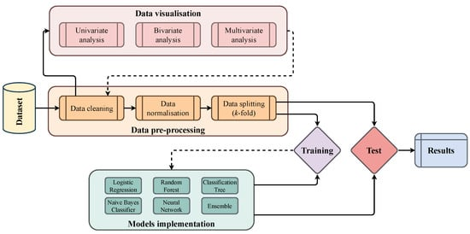
BLOCK DIAGRAM OR FLOW DIAGRAM

Slide 12
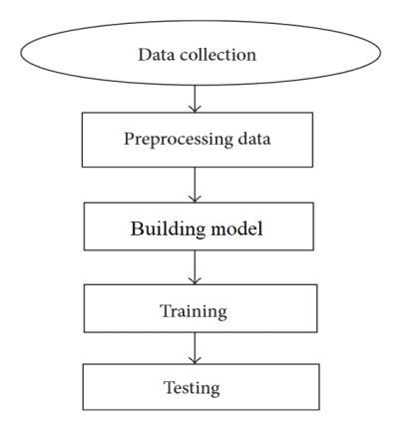
METHODOLOGY
Dataset Collection
Data Preprocessing:
Verifying NULL values
Correlation of attributes
Feature Selection
Balance the class labels
Implementation of machine learning algorithm
On training data
Model Selection
Web Development
Result Analysis
Testing and Evaluation

Slide 13
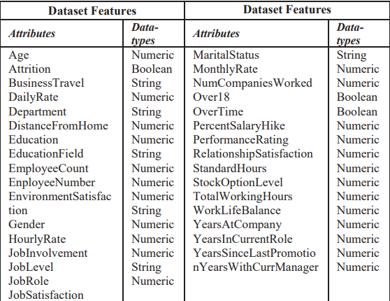
DATA COLLECTION
The "IBM HR Employee Analytics Attrition and Performance" dataset was acquired from Kaggle, a website that provides datasets and serves as a venue for data science-related contests [13]. There are 35 attributes and 1470 entries in this collection.
The data categories include independent factors like "Age," "Daily Rate," "Education Field," "Number of companies worked," etc.; however, in this study, "Attrition" is regarded as the dependent variable. Two class names, "Yes" or "No," make up the "Attrition" data field.
The dataset is available in the following link: https://www.kaggle.com/datasets/pavansubhasht/ibm-hr-analytics-attrition- dataset?select=WA_Fn-UseC_-HR-Employee-Attrition.csv
Fig.Dataset Features

Slide 14
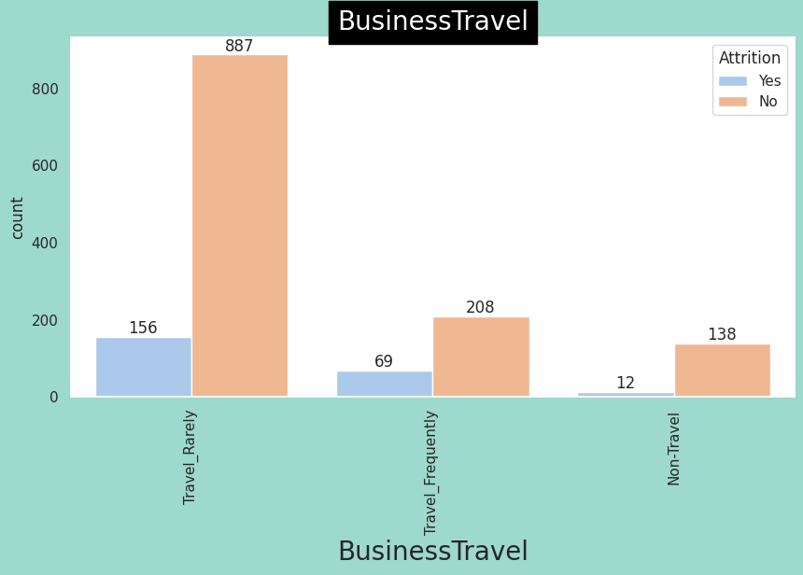
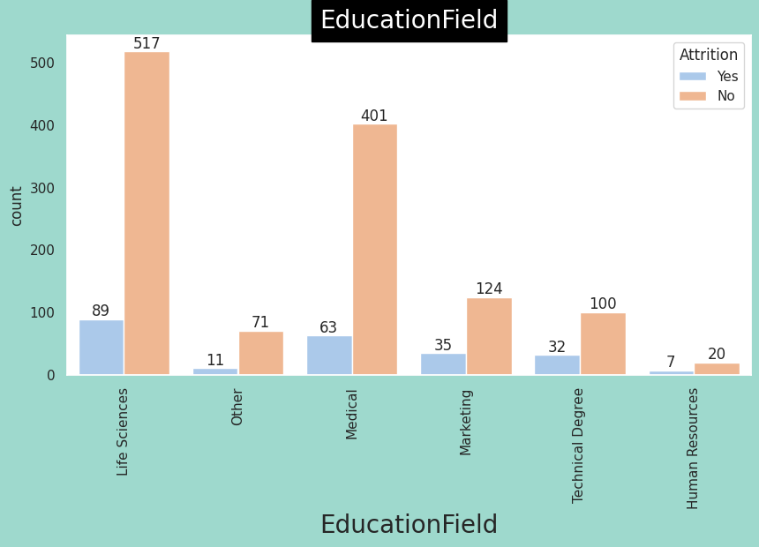
DATA VISUALIZATION
This process provides valuable insights into the dataset and helps to distinguish important features from irrelevant ones. Overall, visualization is a crucial step in data analysis that enables us to quickly gain a high-level understanding of the data and make informed decisions about feature selection.
Fig. Bar Plot Representation For Business Travel
Fig. Attrition Vs Education Field

Slide 15
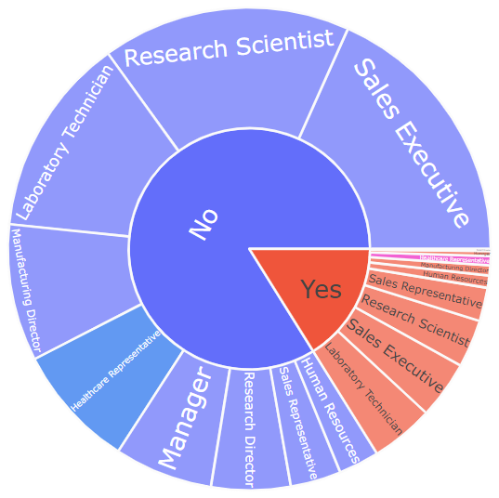
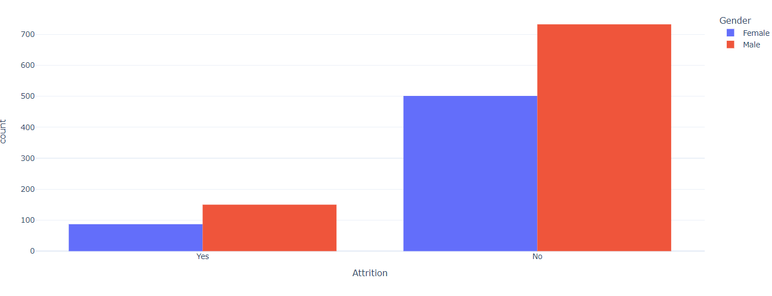
DATA VISUALIZATION
Fig. Bar Chart Representation For Gender
Fig.10 Pie chart of job role
The above figure represents the which job role is causing more attritions. We observed that the Laboratory technician is the attritions. Laboratory technician attrition may stem from factors like inadequate compensation, limited career advancement opportunities, stressful work environments, and insufficient support for professional development. Addressing these issues through improved benefits, clearer career pathways, and better work-life balance initiatives can help organizations retain skilled technicians and mitigate turnover.

Slide 16
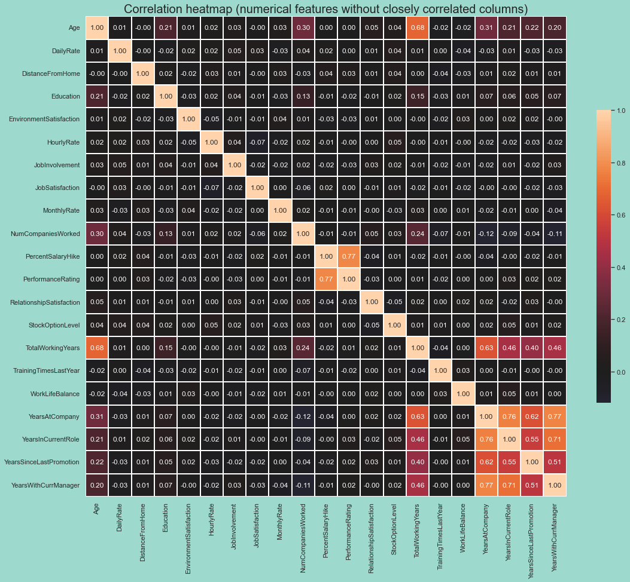
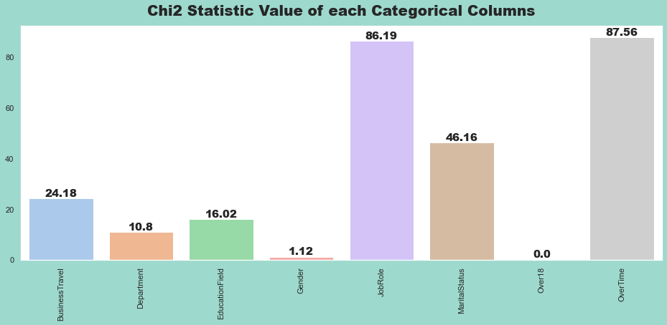
DATA VISUALIZATION
Fig. Correlation matrix for numerical features without closely correlated columns
Fig.Chi2 Statistic Value of each Categorical Columns

Slide 17
DATA PRE-PROCESSING
Pre-processing means cleaning data, normalizing datasets and operate the changes in the data. These steps are performed to get the datasets into a state that enables analysis in further phases [1]. In Data preprocessing the following steps were performed:
Investigate Dataset Properties
Feature Reduction
Attributes with numbers that are not unique
Data cleaning
Categorical to Numerical
Data preparation
Dealing null values
Dropping Duplicates
Dataset balancing

Slide 18
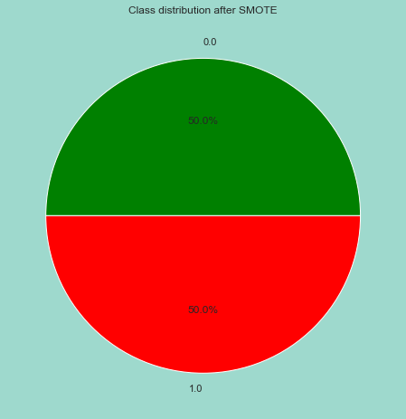
FEATURE IMPORTANCE & MODEL SELECTION
In machine learning, feature importance refers to the process of determining the relative importance of different input variables[7], or features, in predicting the output of a model.
Feature importance is useful because it helps to identify which features are most relevant to the problem being solved, and which features can be ignored or removed to simplify the model without sacrificing accuracy. This information can be used to optimize the performance of the model by focusing on the most important features and reducing the dimensionality of the data.
SMOTE:When one class predominates over another in a situation like predicting loan acceptance, SMOTE (Synthetic Minority Over-sampling Technique) is an essential technique for resolving class imbalance in datasets. SMOTE helps balance the dataset.
Fig. attrition status after smote

Slide 19
FEATURE IMPORTANCE & MODEL SELECTION
After preparing the data, the next step in using machine learning models for prediction involves an loop process that aims to improve the accuracy of the models. There are several classification models that can be used for this purpose:
Decision Tree Classifier: This method is suitable for multistage decision-making and breaks down complex decisions into elementary ones for easy interpretation[2][3].
Extra Tree Classifier: Extra Trees, or Extremely Randomized Trees, is similar to Random Forest but with more randomness.
Logistic Regression: It is one of the simplest supervised machine learning algorithms. The logistic regression technique employs a linear model to convert the predictor variables into a probability value between 0 and 1.
Random Forest: Random Forest is an ensemble learning method that constructs multiple decision trees during training and outputs the mode of the classes (classification) or mean prediction (regression) of individual trees.
Gradient Boost Classifier: Gradient Boosting is an ensemble learning technique that builds models sequentially
K-Nearest Neighbors (KNN): KNN is a non-parametric, lazy learning algorithm that classifies data points based on the majority class of their k nearest neighbors.
XG Boost Classifier: XG Boost (Extreme Gradient Boosting) is a powerful gradient boosting algorithm used for supervised learning tasks, particularly for classification and regression.

Slide 20
IMPLEMENTATION
Software Specifications:
Programming Language: Python.
Libraries and Frameworks: NumPy, Seaborn, Scikit-learn, Pandas, Matplotlib.
Model Architecture: Logistic Regression, Decision Tree, Random Forest, Ada Boost
Browser: Any Latest Browser Like Chrome
Visualization: Matplotlib for visualizing original and predicted images.
Hardware Specifications:
Processor : Intel Core i5
Cache Memory : 4MB
Hard Disk : 30GB or more
RAM : 8GB
URL for code:
https://colab.research.google.com/drive/13YYTp2hXyT19kygsY7qeNSAt0a4jXZ3h

Slide 21
RESULTS & ANALYSIS
We found that the models that were used are Random Forest, Extra Trees, XG Boost Classifier Decision Trees, Gradient Boosting, Logistic Regression, and K-Nearest Neighbors performed differently.
MODEL | ACCURACY | TRAINING ACCURACY | TESTING ACCURACY | SENSITIVITY | SPECIFICITY | F1-SCORE | PRECISION
XG Boost | 91.15 | 91.582 | 91.15 | 0.58 | 0.96 | 0.65 | 0.75
Logistic Regression | 89.11 | 86.05 | 89.11 | 0.39 | 0.97 | 0.51 | 0.74
Gradient Boost | 88.77 | 100.00 | 88.77 | 0.39 | 0.97 | 0.50 | 0.70
Random Forest | 87.07 | 87.58 | 87.07 | 0.14 | 0.99 | 0.24 | 0.85
K Neighbors | 86.73 | 84.09 | 86.05 | 0.04 | 1.00 | 0.08 | 1.00
Extra Trees Classifier | 86.39 | 85.37 | 86.39 | 0.07 | 1.00 | 0.13 | 1.00
Decision Tree | 85.37 | 88.94 | 82.99 | 0.25 | 0.92 | 0.30 | 0.38
Table.1 Statistics Of ML Algorithms For Prediction Of Employee Attrition
From table1, we depicts that It is clear from the given data that the XG Boost algorithm outperformed all other models in terms of accuracy, coming in at 91.15%. The discrepancy between the test and training accuracies, however, highlights the fact that it also shows the largest overfitting. Gradient Boost and Logistic Regression come a close second and third, with accuracy rates of 88.77% and 89.11%, respectively. In comparison to other models, K Neighbors and Extra Trees Classifier perform relatively poorly, particularly when it comes to sensitivity and F1-score. Overall, XG Boost stands out as the top performer in the table, which offers a clear comparison of several machine learning algorithms in forecasting staff attrition.

Slide 22
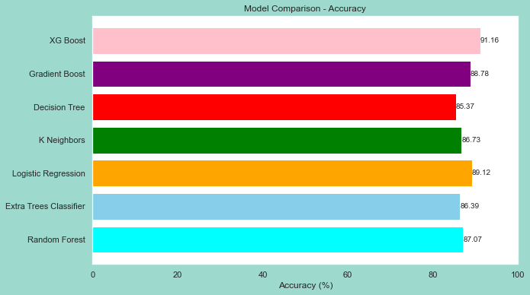
RESULTS & ANALYSIS
Fig. Performance Analysis of ML Algorithms
The graph plotted in Figure 18; using the same values as given in Table-1 illustrates the accuracy comparison of various machine learning models for predicting employee attrition. XG Boost emerges as the top-performing model with an accuracy of 91.16%, followed by Gradient Boost at 88.77%. Decision Tree and K Neighbours demonstrate comparable accuracies around 85%, while Logistic Regression and Extra Trees Classifier exhibit accuracies exceeding 80%. Random Forest, although slightly lower in accuracy compared to the top models, still achieves a respectable accuracy of 87.07%. This visualization underscores the effectiveness of XG Boost and Gradient Boost in predicting employee attrition, offering valuable insights for workforce management strategies.

Slide 23
CONCLUSION and FUTURE SCOPE
After assessing the execution of four classification models, a significant finding was that if feature reduction for prediction is appropriately conducted, the accuracy rate of the classification models always be better compared to classification with feature selection.
In particular, the XG Boost classifier with feature reduction achieved an accuracy score of 91.16, while the Logistic Regression achieved 89%. Random Forest model giving best classification for True positives and True negatives data.
The methods described in the paper for analyzing and categorizing data can form a basis for improving data-driven decision making processes.
To develop more accuracy using machine learning algorithms and advanced techniques. The work can extend and improved for the automation of employee attrition prediction by using advanced techniques

Slide 24
CONCLUSION & FUTURE SCOPE
Further research could explore the integration of these models with additional data sources, such as employee sentiment analysis or external market trends, to improve predictive accuracy and identify early warning signs of attrition. Additionally, the development of interpretability techniques for these complex models could facilitate better understanding and actionable insights for organizational decision-makers. Overall, the future scope involves continuous innovation and refinement of predictive models to better support workforce management and employee retention efforts.
Advanced Predictive Models: Future systems will likely leverage more advanced predictive models such as ensemble methods, deep learning, and reinforcement learning.
Integration with HR Systems: Future systems will seamlessly integrate with existing HR management software and systems.
Explainable AI: As AI systems become more complex, there will be a growing need for transparency and interpretability.
Personalized Interventions: Machine learning algorithms will not only predict attrition but also recommend personalized interventions to mitigate the risk. These interventions could range from targeted training programs and career development opportunities to adjustments in compensation or work-life balance initiatives tailored to individual employee needs.
Long-term Impact Assessment: Future systems may also incorporate features to assess the long-term impact of retention strategies. By tracking the effectiveness of interventions over time, organizations can refine their approaches to employee retention and continuously improve their workforce management strategies.

Slide 25
REFERENCES
1. https://ieeexplore.ieee.org/document/9033784
2. Srivastava, Devesh Kumar, and Priyanka Nair. "Employee attrition analysis using Predictive techniques." International Conference on Information and Communication Technology for Intelligent Systems. Springer, Cham, 2017.
3. S. S. Gavankar and S. D. Sawarkar, "Eager decision tree," 2017 2nd International Conference for Convergence in Technology (I2CT), Mumbai, 2017, pp. 837-840.
4. Safavian, S.R. Landgrebe. D, “A survey of decision tree classifier methodology”, IEEE Transactions on Systems, Man, And Cybernetics, Vol. 21,No. 3, May-June 1991.
5. Shmilovici A. (2009) Support Vector Machines. In: MaimonO, Rokach L. (eds) Data Mining and Knowledge Discovery Handbook. Springer, Boston.
6. Setiawan, I., et al. "HR analytics: Employee attrition analysis using logistic regression." IOP Conference Series: Materials Science and Engineering. Vol. 830. No.3. IOP Publishing, 2020

Slide 26
REFERENCES
7. Schober, Patrick MD, PhD, MMedStat*; Vetter, Thomas R. MD, MPH†. Logistic
Regression in Medical Research. Anesthesia & Analgesia 132(2):p 365-366, February
2021.| DOI: 10.1213/ANE.0000000000005247
8. Jayalekshmi J, Tessy Mathew, “Facial Expression Recognition and Emotion Classification
System for Sentiment Analysis”, 2017 5 Authorized licensed use limited to: University
College London. Downloaded on May 23,2020 at 00:07:22 UTC from IEEE Xplore.
Restrictions apply. International Conference on Networks & Advances in Computational
Technologies (NetACT) |20-22July 2017| Trivandrum.
9. Isabelle Guyon, Andre Elisseeff, “An Introduction to Variable and Feature Selection”,
Journal of Machine Learning Research 3 (2003) 1157-1182.
10. Ilan Reinstein, “Random Forest(r), Explained”, kdnuggets. com, October
2017[Online]. Available: https://www.kdnuggets.com/2017/ 10/randomforestsexplained.html
11. http://scikitlearn.org/stable/modules/generated/sklearn.metri cs.confusion_matrix.html

Slide 27


Slide 28


