Slide 1

Department of Computer Science and Engineering
Health Care Chatbot
PRESENTED BY
Chimakurthi Likhitha Bhavya (20471A05K4)
Annem Bhargavi (20471A05J6)
Shaik Meerabi (20471A05M9)
Under the Guidance of,
D.Venkata Reddy _{M.Tech(Ph.D)}
Asst.Professor,
Department of Computer Science and Engineering,
Narasaraopeta Engineering College (Autonomous),
Narasaraopet- 522 601.

Slide 2
OUTLINE
Abstract
Introduction
Literature Survey
Research Gaps
Problem Statement
Objectives
Block Diagram / Flow Diagram
Methodology
System Requirements
Algorithms used
Result and analysis
Conclusion and future scope
Communication page
References
Question and Answers

Slide 3
ABSTRACT
To start a good life healthcare is very important. But it is very difficult to consult the doctor for minor health issues. The proposed idea is to create a healthcare chatbot using Machine Learning techniques that can diagnose the disease and provide basic details about the disease before consulting a doctor. The study aims to develop an accurate and interpretable machine learning model for early disease prediction using demographic and clinical features, contributing to the growing field of medical research applications.

Slide 4
INTRODUCTION
Nowadays, being busy with their works at home and office people are not concerned about their health and they avoid to go to hospitals for small problems which may become a major problem.
Motivated by the desire to improve health outcomes by early diagnosis of some major diseases.
The importance of prioritizing healthcare for a healthy lifestyle is evident, yet accessing medical consultation can be challenging at times.

Slide 5
LITERATURE SURVEY
No | Title | Author | Journal Name & Year | Methodology Adapted | Key Findings | Gaps
1 | Disha- An Implementation of Machine Learning Based Bangla Healthcare Chatbot. | Md. Moshiur Rahman, Ruhul Amin, Md Nazmul Khan Liton. | https://ieeexplore.ieee.org/document/9038579 | KNN,SVM, Random Forest. | SVM gives the highest accuracy. | Less Accuracy, Bengali Language model.
2 | Chatbot for Disease Prediction and Treatment Recommendation using Machine Learning | Rohit Binu Mathew, Sandra Varghese, Sera Elsa Joy | https://ieeexplore.ieee.org/document/8862707 | K-Nearest Neighbors (KNN),Natural Language Toolkit (NLTK). | KNN algorithm is effective. | Lack of information on Model.

Slide 6
No | Title | Author | Journal Name & Year | Methodology Adapted | Key Findings | Gaps
3 | Automatized Medical Chatbot. | Prakhar Srivastava, Nishant Singh. | https://ieeexplore.ieee.org/document/9087096 | Support Vector Machine,Naive Bayes,KNN. | SVM has more accuracy. | Limited Diversity in Datasets.
4 | Chatbot for Healthcare System Using Artificial Intelligence. | Lekha Athota,Vinod Kumar Shukla,Nitin Pandey. | https://ieeexplore.ieee.org/document/9197833 | N-gram,TF-IDF,Cosine Similarity. | Knowledge database utilization. | Handling Ambiguity and Complex Queries.

Slide 7
RESEARCH GAPS
Limited diversity in datasets.
Improving the Acuuracy.
Different data cleaning methods impacts the accuracy.

Slide 8
PROBLEM STATEMENT
Nowadays, decisions are made by doctors based on their experiences and knowledge.
This practice may consume a lot of time and excessive medical costs which affects the quality of service provided to patients.
Machine learning models may reliably forecast a patient's disease and provide the nearby health care center of user based on the model prediction of disease.

Slide 9
OBJECTIVES
The objectives of HealthCare Chatbot prediction is to develop accurate machine learning model that analyze medical data to predict the disease in individuals, enabling early detection and intervention for improved patient outcomes by providing more diverse datasets.
The objective is to increase the accuracy of the existing model.
Some existing system may charge money and have only live chats through texts so there may be no instant response given to user. These are overcome by the proposed model.

Slide 10
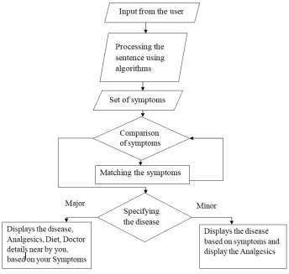
BLOCK DIAGRAM OR FLOW DIAGRAM

Slide 11
METHODOLOGY
Dataset link: https://www.kaggle.com/datasets/itachi9604/disease-symptom-description-dataset?select=dataset.csv
Contains 4920 records and 18 attributes.
Preprocessing steps:
Removing null values
One hotEncoding
Tools:
Jupyter notebook
Visual studio code
idle

Slide 12
System Requirements
Hardware Requirements:
System Type : intel®core™i7-7500UCPU@2.70gh
Cache memory : 4MB(Megabyte)
RAM : 8 gigabyte(GB)
Bus Speed : 5 GT/s DB12
Number of cores : 2
Software Requirements:
Operating System : Windows 10,64 bit Operating System
Coding Language : Python

Slide 13
Algorithms used
Random Forest
Support Vector Machine
K-Nearest Neighbour
Decision Tree Classifier

Slide 14
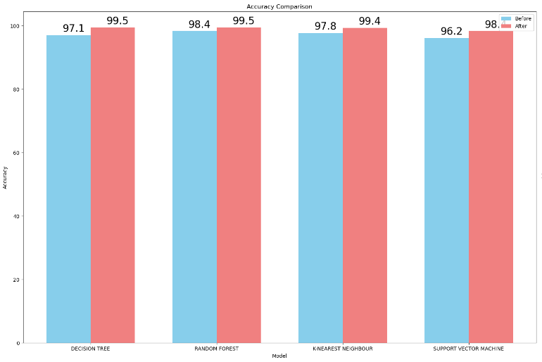
Result analysis of algorithms:

Slide 15
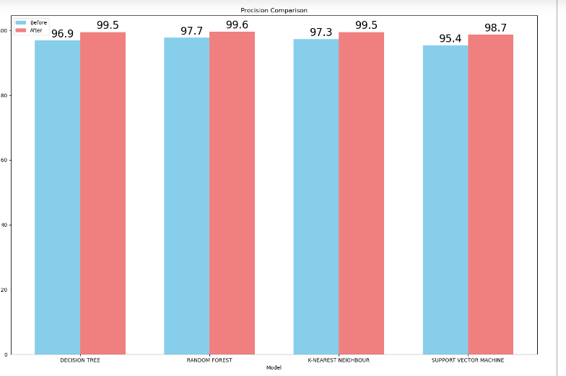

Slide 16
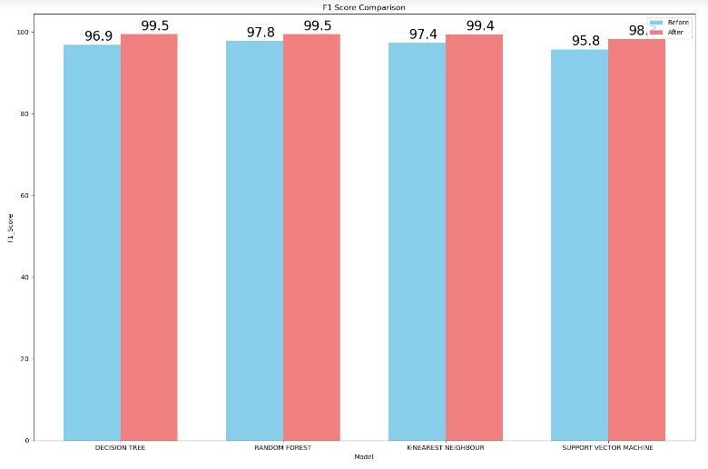

Slide 17
Classification Algorithms | Exsisting [9]work values | Proposed work values
Random Forest | 97.15 | 99.45
Decision Tree | 96.41 | 99.00
SVM | 96.00 | 98.33
KNN | 96.88 | 99.35
Classificati of lgorithm s | Exsistingwork[9]values |  |  | Proposedwork values
 | Accu racy | preci sion | F1 Scor e | Accu racy | preci sion | F1 Scor e
Random Forest | 98.4 3 | 97.7 4 | 97.8 1 | 99.5 1 | 99.6 1 | 99.5 2
Decision Tree | 97.1 2 | 96.9 3 | 96.9 | 99.5 1 | 99.5 9 | 99.5 1
SVM | 96.2 2 | 95.4 7 | 95.8 2 | 98.4 1 | 98.7 2 | 98.3 6
KNN | 97.8 8 | 97.3 1 | 97.4 9 | 98.6 2 | 98.1 5 | 99.0 1

Slide 18
Conclusion and future scope:
The chatbot serves as an effective tool for facilitating conversations between humans and machines. It's designed to provide prompt and accurate responses without any delay, ensuring a seamless user experience. Overall, the chatbot is deemed user-friendly and accessible to individuals proficient in typing in their native language. Furthermore, it offers individualized diagnosis based on symptoms given by user
This is the era of messaging applications, as people will use them for longer than any other app in the future. The adoption of customized care would effectively save many lives and increase public awareness of health issues. This medical chat can take place from any location. The only things they need are their basic desktop computer or smartphone and an active internet connection.
DEPLOYMENT LINK:http://13.51.254.233:5000/

Slide 19
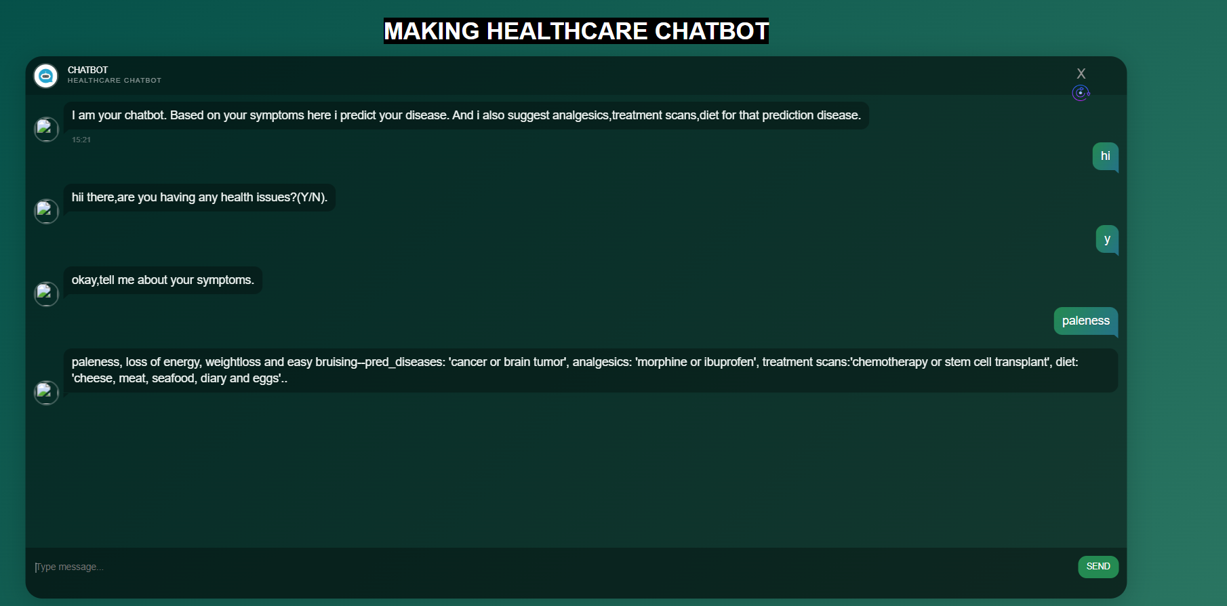
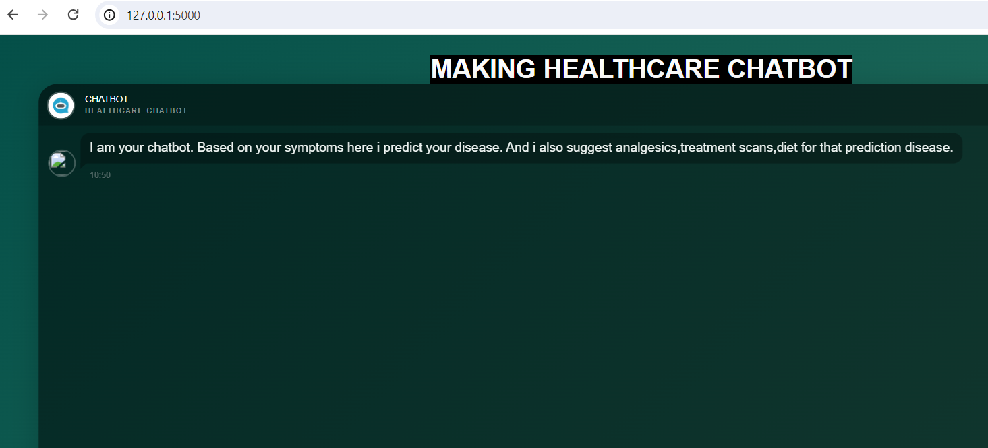
Communication page

Slide 20
REFERENCES
1. K. Oh, D. Lee, B. Ko and H. Choi, "A Chatbot for Psychiatric Counseling in Mental Healthcare Service Based on Emotional Dialogue Analysis and Sentence Generation," 2017 18th IEEE International Conference on Mobile Data Management (MDM), Daejeon, 2017, pp. 371-375. doi: 10.1109/MDM.2017.64
2. Du Preez, S.J. & Lall, Manoj & Sinha, S. (2009). An intelligent web-based voice chat bot. 386 - 391.10.1109/EURCON.2009.5167660
3.Bayu Setiaji, Ferry Wahyu Wibowo, "Chatbot Using a Knowledge in Database: Human-to-Machine Conversation Modeling", Intelligent Systems Modelling and Simulation (ISMS) 2016 7th International Conference on, pp. 72-77, 2016.
4. Dahiya, Menal. (2017). A Tool of Conversation: Chatbot. INTERNATIONAL JOURNAL OF COMPUTER SCIENCES AND ENGINEERING. 5. 158-161.2017.
5. C.P. Shabariram, V. Srinath, C.S. Indhuja, Vidhya (2017). Ratatta: Chatbot Application Using Expert System, International Journal of Advanced Research in Computer Science and Software Engineering,2017

Slide 21

6. Mrs Rashmi Dharwadkar1, Dr.Mrs. Neeta A. Deshpande, A Medical ChatBot, International Journal of Computer Trends and Technology (IJCTT) – Volume 60 Issue 1- June 2018
7. Farheen Naaz, Farheen Siddiqui, modified n-gram based model for identifying and filtering near-duplicate documents detection, International Journal of Advanced Computational Engineering and Networking, ISSN: 2320- 2106, Volume-5, Issue-10, Oct.-2017
8. N-gram Accuracy Analysis in the Method of Chatbot Response, International Journal of Engineering & Technology. (2018)
9. s.Badlani, T. Aditya, M. Dave and S. Chaudhari, "Multilingual Healthcare Chatbot Using Machine Learning," 2021 2nd International Conference for Emerging Technology (INCET), Belagavi, India, 2021,pp.1-6 doi10.1109/INCET51464.2021.9456304

Slide 22
ANY QUESTIONS?

Slide 23


