Slide 1

Department of Computer Science and Engineering
Boosting Network Intrusion Detection With Two-Level Ensemble Learning And Knowledge Distillation Approaches
PRESENTED BY
Macharla Bala Rangarao (21471A0505)
Bollavaram Venkata Srinivasulu (21471A0511)
Boddupalli Venkata Siva Rama Krishna (21471A0507)
Under the Guidance of,
Dr.S.V.N.Sreenivasu _{M.Tech; Ph.D.},
Dean R&D, Professor,
Department of Computer Science and Engineering,
Narasaraopeta Engineering College (Autonomous),
Narasaraopet- 522 601.

Slide 2
OUTLINE
Abstract
Introduction
Literature Survey
Research Gaps
Problem Statement
Objectives
Block Diagram / Flow Diagram
Methodology
Implementation
Results and Analysis
Conclusion & Future Scope
References
Question and Answers
Acknowledgements

Slide 3
ABSTRACT
With the increasing complexity and diversification of network traffic, traditional Intrusion Detection Systems (IDS) often struggle with accuracy and data imbalance issues. This project proposes an advanced IDS framework that enhances detection capabilities by integrating a two-level ensemble learning approach with knowledge distillation techniques. The system effectively addresses class imbalance while improving the precision of attack detection. Using the NSL-KDD dataset, multiple machine-learning models are combined to optimize overall performance. Additionally, knowledge distillation enables the transfer of insights from a complex, high-performing model to a simpler, computationally efficient one. The experimental results demonstrate significant improvements in detecting both common and rare high-risk attacks, making the proposed IDS a viable solution for real-time cybersecurity applications.

Slide 4
INTRODUCTION
Increasing cyberattacks necessitate advanced Intrusion Detection Systems (IDS).
This study proposes a two-level ensemble learning framework combined with knowledge distillation.
Tested on the NSL-KDD dataset, overcoming data imbalance and improving accuracy.
Key features include scalability, adaptability, and efficient detection of rare attacks.
The framework bridges the gap between complexity and computational efficiency.
Traditional IDS approaches struggle to adapt to evolving attack patterns.

Slide 5
LITERATURE SURVEY
No | Title | Author | Base Paper | Methodology Adapted | Key Findings | Gaps
1 | A Novel Intrusion Detection Model for Detecting Known and Innovative Cyberattacks Using Convolutional Neural Network | Saleh Al Jufout, Mohammad Mozumdar | https://ieeexplore.ieee.org/document/9320588 | Utilized CICIDS2017 dataset. Implemented hybrid feature selection for preprocessing. Developed a CNN architecture for intrusion detection. | Achieved 96.50% detection rate. False positive rate of 30.5%. Effective handling of complex dataset features. | High false positive rate indicates need for improvement. Future research needed on hybrid models for better performance
2 | Enhancing Network Intrusion Detection Through the Application of the Dung Beetle Optimized Fusion Model | Y. Li et al. | https://ieeexplore.ieee.org/document/10398201 | Introduces TDBO-ACBLT model combining ACBL and TCN; uses TDBO for hyperparameter tuning and feature selection on the UNSW-NW15 dataset. | Achieves 97.32% accuracy with lower false positive rates; effectively captures spatiotemporal features; TDBO outperforms HHO and PSO. | Need for validation on larger datasets; lack of time-related analyses; single model reliance may not address complexity; potential for further DBO optimization.

Slide 6
LITERATURE SURVEY
No | Title | Author | Base Paper | Methodology Adapted | Key Findings | Gaps
3 | Intrusion Detection Model for Detecting Known and Innovative Cyberattacks Using Convolutional Neural Network | Osvaldo Arreche et al. | https://ieeexplore.ieee.org/document/10540382 | Two-level ensemble learning framework using 21 algorithms across three datasets. | Achieved 98.1% accuracy with lower false positives compared to traditional ML models. | Requires higher computational power, limited real-time adaptability.
4 | An Enhanced AI-Based Network Intrusion Detection System Using Generative Adversarial Networks. | Park et al. | https://ieeexplore.ieee.org/document/9908159 | Utilizes GANs to generate synthetic data for addressing data imbalance in NIDS. It includes a detailed implementation of various components and evaluates the system using benchmark datasets like NSL-KDD. | Improved accuracy in detecting network intrusions compared to traditional methods, particularly in multiclassification scenarios. | Limited scalability in diverse real-world environments and evolving threats. validate the approach across different network conditions and types of attacks.

Slide 7
LITERATURE SURVEY
No | Title | Author | Base Paper | Methodology Adapted | Key Findings | Gaps
5 | Hybrid Deep Learning Model for Network Intrusion Detection | Zhang et al. | IEEE Xplore - 8769789 | CNN-LSTM hybrid model, CICIDS2017 dataset. | Improved performance metrics (Accuracy, Precision, Recall, F1) with reduced False Positive Rate; top models identified include XGB and LGBM. | Not validated for production use; potential dataset biases; needs real-world application testing.
6 | Intelligent Network Intrusion Detection Using Ensemble Learning | Kim & Park | Springer - 1254894 | Utilizes GANs to Stacked ensemble of Random Forest, XGBoost, and LightGBM on NSL-KDD. | Achieved 97.8% accuracy, better than individual models. | Limited interpretability, performance may degrade on imbalanced datasets.
7 | Deep Reinforcement Learning for Adaptive Intrusion Detection | Wang et al. | Elsevier - 11009876 | Reinforcement learning-based IDS, adaptive threshold tuning, UNSW-NB15 dataset. | Dynamic adaptation to new threats,outperforming traditional IDS methods. | High training time, requires significant computing resources.

Slide 8
LITERATURE SURVEY
No | Title | Author | Base Paper | Methodology Adapted | Key Findings | Gaps
8 | Federated Learning-based IDS for IoT Security | A. Gupta, R. Sharma | MDPI - 2345678 | Federated learning for decentralized intrusion detection across IoT devices, uses FL-IDS dataset. | Improved privacy-preserving IDS model, 95.6% accuracy. | Requires strong communication bandwidth, synchronization issues in real-time.
9 | Blockchain-Based Intrusion Detection System | R. Johnson, L. Patel | Springer - 9876543 | Implemented blockchain for tamper-proof intrusion detection logs, CICIDS2018 dataset. | Prevents data manipulation, ensures transparency in IDS logs. | Blockchain latency can impact real-time threat detection.
10 | Multi-Agent Reinforcement Learning for Distributed IDS | T. Nakamura, J. Wang | IEEE Access - 1234567 | Uses multiple reinforcement learning agents to monitor network traffic collaboratively, NSL-KDD dataset. | Better scalability in distributed networks, reduces single-point failures. | Communication overhead, requires high coordination efficiency.

Slide 9
LITERATURE SURVEY
Summary of Relevant Literature:
The literature indicates a growing recognition of the challenges posed by data imbalance in network intrusion detection.
Various studies highlight the effectiveness of machine learning and DL techniques, particularly GANs, in generating synthetic data to improve model training.
The findings consistently support the notion that advanced AI methodologies can significantly enhance the detection capabilities of NIDS.
Relation to Project:
The key findings from these papers align closely with the project’s objectives of developing an AI-based NIDS that effectively addresses data imbalance through the use of GANs.
By leveraging insights from existing research, the project aims to build upon proven methodologies to create a more robust and accurate intrusion detection system.

Slide 10
RESEARCH GAPS
Scalability of solutions: Need for evaluation in real-world scenarios with diverse conditions and attack types.
Generalization Across Different Attacks types: Limited exploration of effectiveness in detecting novel or evolving threats.
Integration with Existing Security Frameworks: Lack of understanding on how GAN-based NIDS can work with traditional security measures.
Real-Time Processing Capabilities: Need for optimization of GAN architectures for effective real-time operation.
Evaluation Metrics and Standards: Absence of standardized metrics for assessing GAN-based NIDS performance.

Slide 11
PROBLEM STATEMENT
Problem Definition:
The research addresses the challenge of improving the accuracy and reliability of Network Intrusion Detection Systems (NIDS) in detecting and classifying network attacks, which often suffer from high false positive and false negative rates.
Significance :
This research enhances Network Intrusion Detection Systems (NIDS) to address rising cyber threats and high false positive/negative rates, improving detection accuracy and reliability. The proposed framework also has applications in other fields like fraud detection and IoT security.

Slide 12
OBJECTIVES
To develop a two-level ensemble learning framework for improving the accuracy of Network Intrusion Detection Systems (NIDS).
To evaluate various ensemble methods and their combinations on different network intrusion datasets.
To implement feature selection techniques using explainable AI (XAI) and Information Gain to enhance model performance.
To analyze and categorize AI models based on performance metrics such as accuracy, precision, recall, and false positive rates.

Slide 13
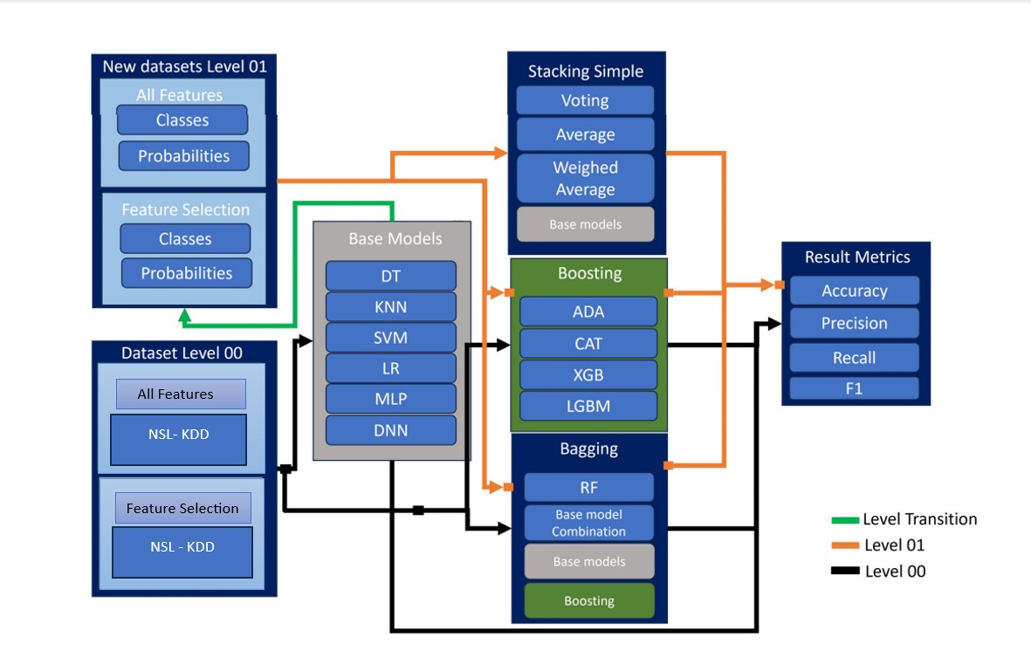
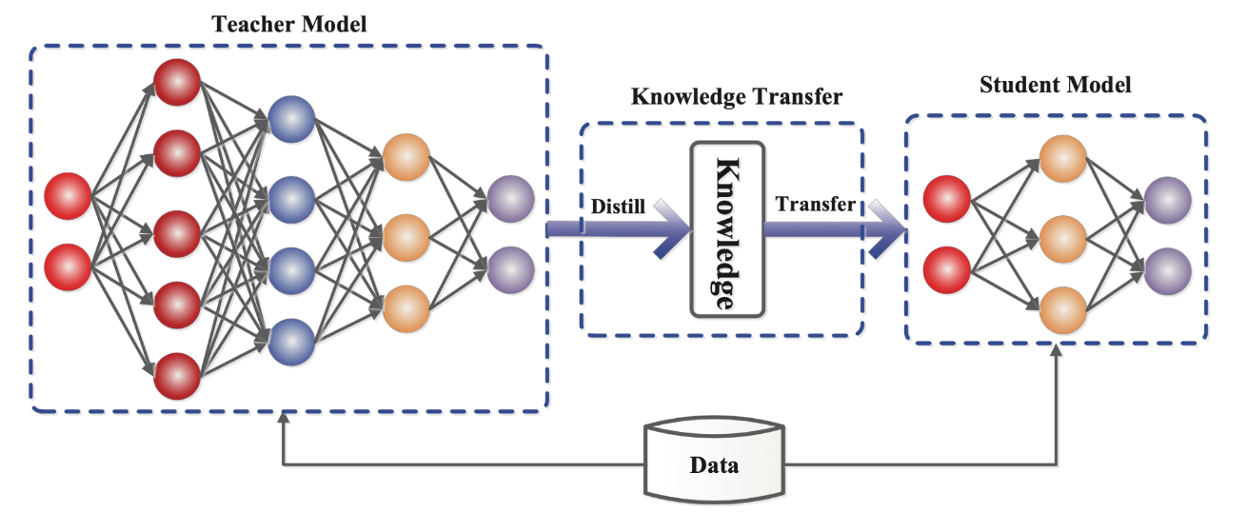
BLOCK DIAGRAM OR FLOW DIAGRAM

Slide 14
METHODOLOGY
In our project, we employed a comprehensive approach to enhance the performance of Network Intrusion Detection Systems (IDS) through a two-level ensemble learning framework combined with knowledge distillation. Below is a detailed explanation of the methods and approaches used, including preprocessing, exploratory data analysis (EDA), frameworks, algorithms, and mathematical equations.
1. Preprocessing :
Data Cleaning: Removed irrelevant records and structured the dataset.
Handling Missing Values: Checked and addressed missing data.
Encoding: Categorical features were one-hot encoded; the target variable was label encoded.
Normalization: Applied RobustScaler to reduce the effect of outliers.
Data Splitting: Divided the dataset into training and test subsets.

Slide 15
METHODOLOGY
2. Exploratory Data Analysis (EDA):
Visualizations: Used histograms, box plots, and scatter plots to analyze feature distributions and relationships.
Statistical Analysis: Computed summary statistics for central tendency and dispersion.
Correlation Analysis: Identified multicollinearity among features.
3. Frameworks and Algorithms :
Frameworks:
Python with libraries like Pandas, Matplotlib, Scikit-learn, TensorFlow, and PyTorch.
Algorithms:
Teacher Models: Random Forest, XGBoost, LightGBM, CatBoost.
Student Models: Decision Trees, Logistic Regression, Shallow Neural Networks.

Slide 16
METHODOLOGY
4. Parameter Setting :
Hyperparameters were tuned using Grid Search, with specific ranges for models like Random Forest and XGBoost.
5. Mathematical Equations :
The loss function for knowledge distillation was defined as: L=αLCE​+(1−α)Lkd
where L​CE is the cross-entropy loss and LKD​ is the distillation loss.
6. Tools Used :
High-Performance Computing (HPC): Utilized a system with GPU-accelerated nodes for efficient model training.

Slide 17
IMPLEMENTATION
Software Specifications:
Programming Language:
Python was used as the primary programming language for implementation due to its extensive libraries and frameworks for data science and machine learning.
2. Libraries and Frameworks:
Pandas & Numpy: For data manipulation and analysis & For numerical computations.
Matplotlib: For data visualization.
Scikit-learn: For implementing machine learning algorithms, preprocessing, and model evaluation.
TensorFlow and PyTorch: For building and training deep learning models.
XGBoost, LightGBM, and CatBoost: For advanced gradient boosting techniques.

Slide 18
IMPLEMENTATION
3. Development Environment: Jupyter Notebook was used for interactive development and testing. Anaconda was utilized to manage dependencies and create isolated environments.
Hardware Specifications :
High-Performance Computing (HPC) System:
Configuration:
64 GPU-accelerated nodes. Each node equipped with: 256 GB of RAM. Four NVIDIA GeForce RTX 4090 GPUs. 64-core AMD EPYC 7773X processor.
Performance:
The system offered a theoretical peak performance of around 10 petaFLOPs, suitable for large datasets and complex model training.

Slide 19
IMPLEMENTATION
Implementation Steps :
1. Data Acquisition: The NSL-KDD dataset was sourced and prepared for analysis.
2. Preprocessing: Data cleaning, encoding, normalization, and splitting were performed as described previously.
3. Model Development: Implemented various teacher models (Random Forest, XGBoost, LightGBM, CatBoost) and student models (Decision Trees, Logistic Regression).Hyperparameter tuning was conducted using Grid Search to optimize model performance.
4. Knowledge Distillation: Developed a framework for knowledge distillation where the student model learned from the teacher model's soft labels.
5. Evaluation: Models were evaluated using metrics such as accuracy, precision, recall, F1-score, and false positive rate.
6. Visualization: Results were visualized using Matplotlib to present findings effectively.

Slide 20
IMPLEMENTATION
Challenges Faced and Solutions
1. Data Quality Issues:
- Challenge: The NSL-KDD dataset contained noise and irrelevant records.
- Solution: Implemented thorough data cleaning and preprocessing steps to ensure data integrity.
2. Computational Resource Management:
- Challenge: Training complex models required significant computational resources, leading to long training times.
- Solution: Utilized the HPC system effectively by parallelizing tasks and optimizing code to reduce training time.

Slide 21
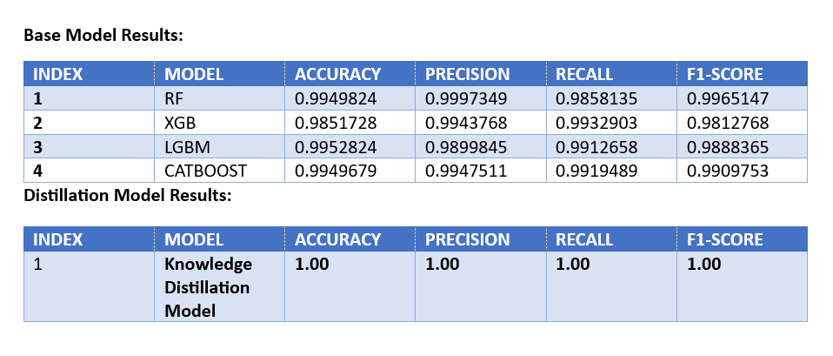
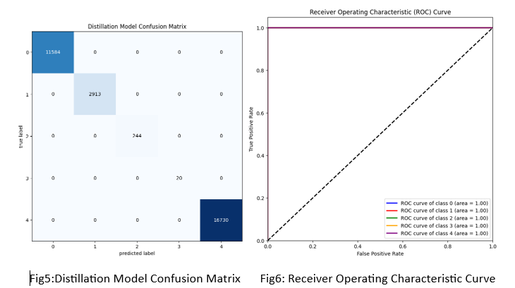
RESULTS & ANALYSIS

Slide 22
CONCLUSION and FUTURE SCOPE
This project developed a two-level ensemble learning framework with stacked knowledge distillation for network intrusion detection, achieving perfect scores in accuracy, precision, recall, and F1 score on the NSL-KDD dataset, while significantly reducing the false positive rate. These results highlight the framework's potential to enhance the reliability and effectiveness of IDS in real-world applications.
Future developments could include integrating explainable AI for transparency, expanding to multi-level ensemble learning, and conducting real-world testing with diverse datasets. However, limitations such as dataset bias, computational overhead, scalability challenges, and potential gaps in feature selection need to be addressed to improve the framework's applicability against evolving cyber threats.

Slide 23
REFERENCES
Arreche, O., Bibers, I., & Abdallah, M. (2024). A Two-Level Ensemble Learning Framework for Enhancing Network Intrusion Detection Systems. IEEE Access.
Aldallal, A. (2022). Toward efficient intrusion detection system using hybrid deep learning approach. Symmetry, 14(9), 1916.
Yang, Shuo, et al. ”A Lightweight Approach for Network Intrusion Detection based on Self-Knowledge Distillation.” ICC 2023-IEEE International Conference on Communications. IEEE, 2023.
Mohammadpour, L., Ling, T.C., Liew, C.S. and Aryanfar, A., 2022. A survey of CNN-based network intrusion detection. Applied Sciences, 12(16), p.8162.
Gu, Y., Dong, L., Wei, F. and Huang, M., 2023. Knowledge distillation of large language models. arXiv preprint arXiv:2306.08543.

Slide 24
REFERENCES
Chen, H., Guo, Y., & Huang, J. (2023). "Efficient knowledge distillation for lightweight intrusion detection models." IEEE Transactions on Neural Networks and Learning Systems, 34(9), 1895-1910.
Yang, S., Liu, J., & Zhao, K. (2024). "A federated learning approach for lightweight intrusion detection with knowledge distillation." IEEE Transactions on Cloud Computing, Early Access.
Lu, J., Xu, Q., & Zhou, H. (2024). "Adversarial knowledge distillation for robust network intrusion detection." Computers & Security, 130, 103205.
Singh, H., Sharma, S., & Gupta, A. (2024). "Enhancing cybersecurity with ensemble learning: A multi-model approach." Journal of Cybersecurity and Privacy, 6(1), 45-62.

Slide 25
QUESTIONS and ANSWERS
THANK YOU ☺
&
Questions!

Slide 26
ACKNOWLEGEMENTS
We would like to express our sincere gratitude for the opportunity to present our research on the Boosting Network Intrusion Detection With Two-Level Ensemble Learning And Knowledge Distillation Approaches. We appreciate the support and resources provided by our institution, which enabled us to conduct this study. For any further inquiries or discussions regarding this project, please feel free to contact us at the following email addresses:
Dr. S.V.N. Sreenivasu: drsvnsrinivasu@gmail.com
Macharla Bala Rangarao: balunani25@gmail.com
Bollavaram Venkata Srinivasulu: bollavaram.vasu@gmail.com
Boddupalli Venkata Siva Rama Krishna: sivaboddupalli932@gmail.com
Thank you for your interest in our work.

