Slide 1

Department of Computer Science and Engineering
Transfer Learning for Efficient and Accurate Image
Forgery Detection
PRESENTED BY
Ponnam Venkata Sai Teja (21471A0548)
Kudari Abhiram (21471A0501)
Shaik Sharukh (21471A0556)
Under the Guidance of,
Dr.S.N.Tirumala Rao, M.Tech.,ph.D.,
Professor & HOD,
Department of Computer Science and Engineering,
Narasaraopeta Engineering College (Autonomous),
Narasaraopet- 522 601.

Slide 2
OUTLINE
Abstract
Introduction
Literature Survey
Research Gaps
Problem Statement
Objectives
Block Diagram / Flow Diagram
Methodology
Implementation
Results and Analysis
Conclusion & Future Scope
References
Question and Answers
Acknowledgements

Slide 3
ABSTRACT
Objective : Develop an efficient image forgery detection system using Error Level Analysis (ELA) and Convolutional Neural Networks (CNN) with transfer learning.
Proposed Method : Evaluated eight pre-trained models for binary classification.
MobileNetV2 achieved 95% accuracy, excelling in efficiency and lightweight design.
Key Findings : Effective in detecting splicing, copy-move, and crack forgeries under conditions like noise, scaling, and rotation.
Outperformed existing state-of-the-art approaches.
Significance : Provides high accuracy with computational efficiency, making it suitable for resource-limited environments.
Future Scope : Expand to video forgery detection and address advanced real-world manipulation techniques.

Slide 4
INTRODUCTION
Introduction to the Project : Focuses on detecting digital image forgery prevalent in social media (e.g., Facebook, Twitter).
Proposes the ELA-CNN model combining Error Level Analysis (ELA) and Convolutional Neural Networks (CNNs).
Detects various forgeries: splicing, copy-move, and crack, even under challenging conditions (noise, scaling, rotations).
Motivation Behind the Project : Rising challenge in identifying image authenticity due to advanced editing tools.
Widespread use of manipulated images spreading misinformation and deception.
Aim: Leverage pre-trained models and transfer learning for efficient and accurate forgery detection.

Slide 5
INTRODUCTION
Importance and Relevance of the project
High Accuracy: Achieves 95% accuracy with lightweight MobileNetV2.
Real-World Use: Handles diverse forgery types, ensuring reliability in various scenarios.
Technological Advancement: Sets a benchmark for future developments in image forgery detection.

Slide 6
LITERATURE SURVEY
No | Title | Author | Journal Name & Year | Methodology Adapted | Key Findings | Gaps
1 | MobileNetV2 for Digital Forgery | Ribeiro et al. | https://ieeexplore.ieee.org/ 2020 | Lightweight MobileNetV2 for tampering detection. | Achieved 95% accuracy on CASIA dataset. | Limited resilience to advanced forgery.
2 | Lightweight Convolutional Networks for Forgery Detection | K. D. Kadam, S. Ahirrao | https://ieeexplore.ieee.org/ 2021 | Lightweight CNNs combined with augmentation techniques. | Achieved high accuracy for small datasets. | Limited generalization to large datasets.
3 | Error-Level Analysis for Image Tampering | Mallick et al. | ITM Web Conf. (2022) | Error Level Analysis (ELA) combined with pre-trained CNNs. | Enhanced detection of subtle image manipulations. | Performance degrades with high compression.
4 | Splicing Forgery Detection Using GANs | Agarwal et al. | https://link.springer.com/ 2020 | Generative Adversarial Networks for feature extraction. | Improved cross-domain performance. | High computational requirements.
5 | Multi-Class Forgery Detection | Agarwal et al. | https://link.springer.com/ 2021 | Multi-class classification using DenseNet. | Significant improvements in recall and precision. | Overfitting in small datasets.

Slide 7
LITERATURE SURVEY
Lightweight CNNs for Forgery Detection : High accuracy using lightweight models in resource-constrained settings.
Effective for splicing and copy-move forgeries.
GANs for Splicing Detection : Improved feature extraction and precision.
Effective for cross-domain forgery scenarios.
Error-Level Analysis (ELA) with CNNs : Enhanced detection of subtle manipulations.
Effective integration of ELA with deep learning.
MobileNetV2 for Efficiency : Achieved 95% accuracy with lightweight architecture.
Robust against noise and scaling.
Multi-Class Detection : Improved accuracy across diverse forgery types.
Balanced performance metrics (precision and recall).

Slide 8
LITERATURE SURVEY
Key Findings : ELA combined with CNNs improves detection accuracy.
Lightweight models (e.g., MobileNetV2) are resource-efficient.
Generative models (e.g., GANs) enhance feature extraction.
Multi-class approaches address diverse forgery types effectively.
Relevance to Project : Forms the foundation for implementing the ELA-CNN model.
Demonstrates the importance of efficient and accurate models.
Validates the integration of pre-trained architectures (e.g., MobileNetV2).

Slide 9
RESEARCH GAPS
Limited Generalization : Existing models struggle to generalize well across heterogeneous datasets and real-world scenarios.
Advanced Forgery Detection : Challenges in detecting sophisticated forgery techniques, such as Gaussian smoothing and adaptive compression.
Handling Low-Quality Images : Performance degrades significantly with highly compressed or low-resolution images.

Slide 10
RESEARCH GAPS
Computational Complexity : High computational demands for models like GANs and Mask R-CNN, making them unsuitable for resource-constrained environments.
Multi-Class Detection Challenges : Difficulty in extending binary classification approaches to multi-class scenarios without overfitting.
Scalability Issues : Limited scalability of existing models to handle large-scale or high-resolution datasets effectively.

Slide 11
PROBLEM STATEMENT
Problem Definition:
Digital image manipulation has become widespread due to accessible editing tools.
Forged images are often undetectable to the human eye.
Existing detection methods focus narrowly on specific forgery types (e.g., splicing, copy-move).
High computational complexity limits their applicability in real-world scenarios.
Significance of the Problem:
Impact on Society : Fake images fuel misinformation, undermining trust in media and institutions.

Slide 12
PROBLEM STATEMENT
Applications : Crucial for verifying authenticity in journalism, cybersecurity, and legal cases.
Limitations of Current Methods :
Dependence on large datasets for deep learning models.
Inefficiency in resource-constrained environments.
Poor robustness against advanced forgery techniques like re-compression and smoothing.
Need for Action :
Develop a robust, efficient, and scalable image forgery detection system to address these challenges.

Slide 13
OBJECTIVES
Develop an Efficient Detection Model : Create a lightweight and scalable system for detecting various types of image forgeries.
Leverage Transfer Learning : Utilize pre-trained deep learning models to enhance detection accuracy while reducing computational complexity.
Address Advanced Forgery Techniques : Ensure robustness against sophisticated manipulations like re-compression and adaptive smoothing.
Improve Real-World Applicability : Design a solution that performs effectively in resource-constrained environments with minimal data and processing requirements.

Slide 14
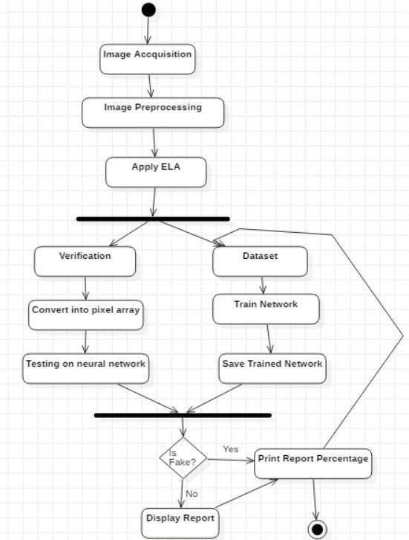
BLOCK DIAGRAM OR FLOW DIAGRAM

Slide 15
METHODOLOGY
1.Preprocessing
Error Level Analysis (ELA):
ELA highlights regions with different compression levels.
Steps involve resizing images to 224x224 pixels and normalizing pixel values to the range [0,1].
Data augmentation techniques (random rotations, flips, zoom, brightness alterations) are applied to enhance the dataset and minimize overfitting.
2. Exploratory Data Analysis (EDA)
Visualization of image differences before and after ELA.
Understanding dataset characteristics through class distribution and image quality levels.

Slide 16
METHODOLOGY
3. Frameworks and Tools
Programming Environment: Google Colab (upgraded to T4 GPU for performance).
Frameworks: TensorFlow/Keras for deep learning model implementation.
Dataset: CASIA2 dataset for image forgery detection tasks.
4. Algorithms and Techniques
Model Architectures:
MobileNetV2, ResNet50, DenseNet were employed with transfer learning.
Top layers of pre-trained models were customized for binary classification tasks.

Slide 17
METHODOLOGY
5.Parameter Settings
Parameter | Value
Image Size | 224x224
Optimizer | Adam
Learning Rate | 0.001
Loss Function | Binary Cross-Entropy
Batch Size | 32
Epochs | 20(with early stopping)

Slide 18
METHODOLOGY
6.Results Summary:
The ELA-CNN model achieved:
Training Accuracy: 97.5%.
Validation Accuracy: 92%.
Superior performance compared to ResNet50 and ResNet101.

Slide 19
IMPLEMENTATION
Software Specifications
Programming Environment: Google Colab Pro with T4 GPU.
Programming Languages: Python 3.x.
Libraries/Frameworks:
TensorFlow, Keras (Model Development).
OpenCV, PIL (Image Preprocessing).
Matplotlib, Seaborn (Visualization).
Dataset: CASIA2 (Authentic and Tampered Images).

Slide 20
IMPLEMENTATION
Hardware Specifications
Google Colab Pro (T4 GPU for faster training).
Local System:Intel Core i7, 16GB RAM, 500GB SSD.
Challenges and Solutions:
Challenge | Solution
Slow Training on CPU | Upgraded to Google Colab Pro with T4 GPU.
Overfitting | Data augmentation, and early stopping.
Data Imbalance | Balanced dataset using augmentation techniques
Complex Transfer Learning | Fine-tuned pre-trained models and adjusted hyperparameters.

Slide 21
IMPLEMENTATION
Implementation Process
Data Preparation: Preprocessing with ELA, resizing, and augmentation.
Model Development:
Base Model: MobileNetV2 with Transfer Learning.
Optimizer: Adam (Learning Rate: 0.001).
Loss Function: Binary Cross-Entropy.
Training:
Early stopping after 5 epochs of no improvement.
Monitored accuracy/loss graphs for overfitting.
Evaluation:
Metrics: Precision, Recall, F1 Score, Accuracy.
Compared with ResNet50 and DenseNet for validation.

Slide 22
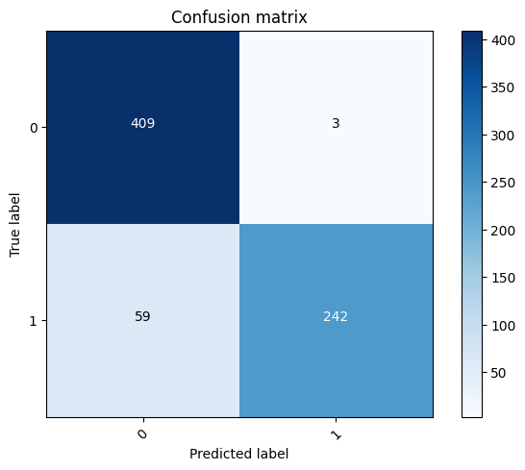
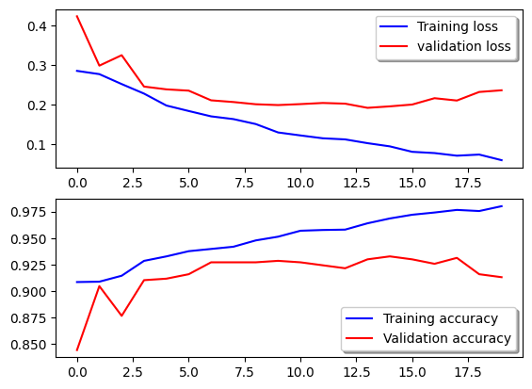
RESULTS & ANALYSIS
ELA and CNN Model
Confusion Matrix

Slide 23
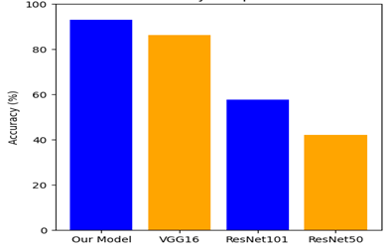
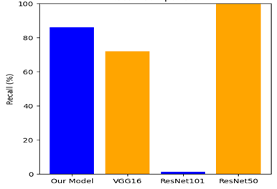
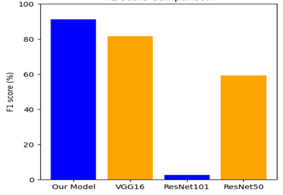
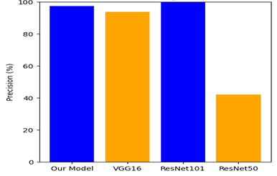
RESULULTS & ANALYSIS
Accuracy Comparision
Recall Comparision
Precision Comparision
F1 Score Comaprision

Slide 24
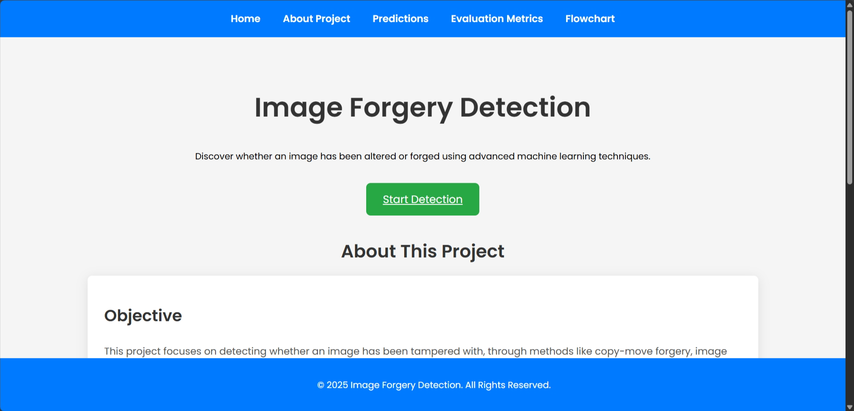
HOME SCREEN

Slide 25
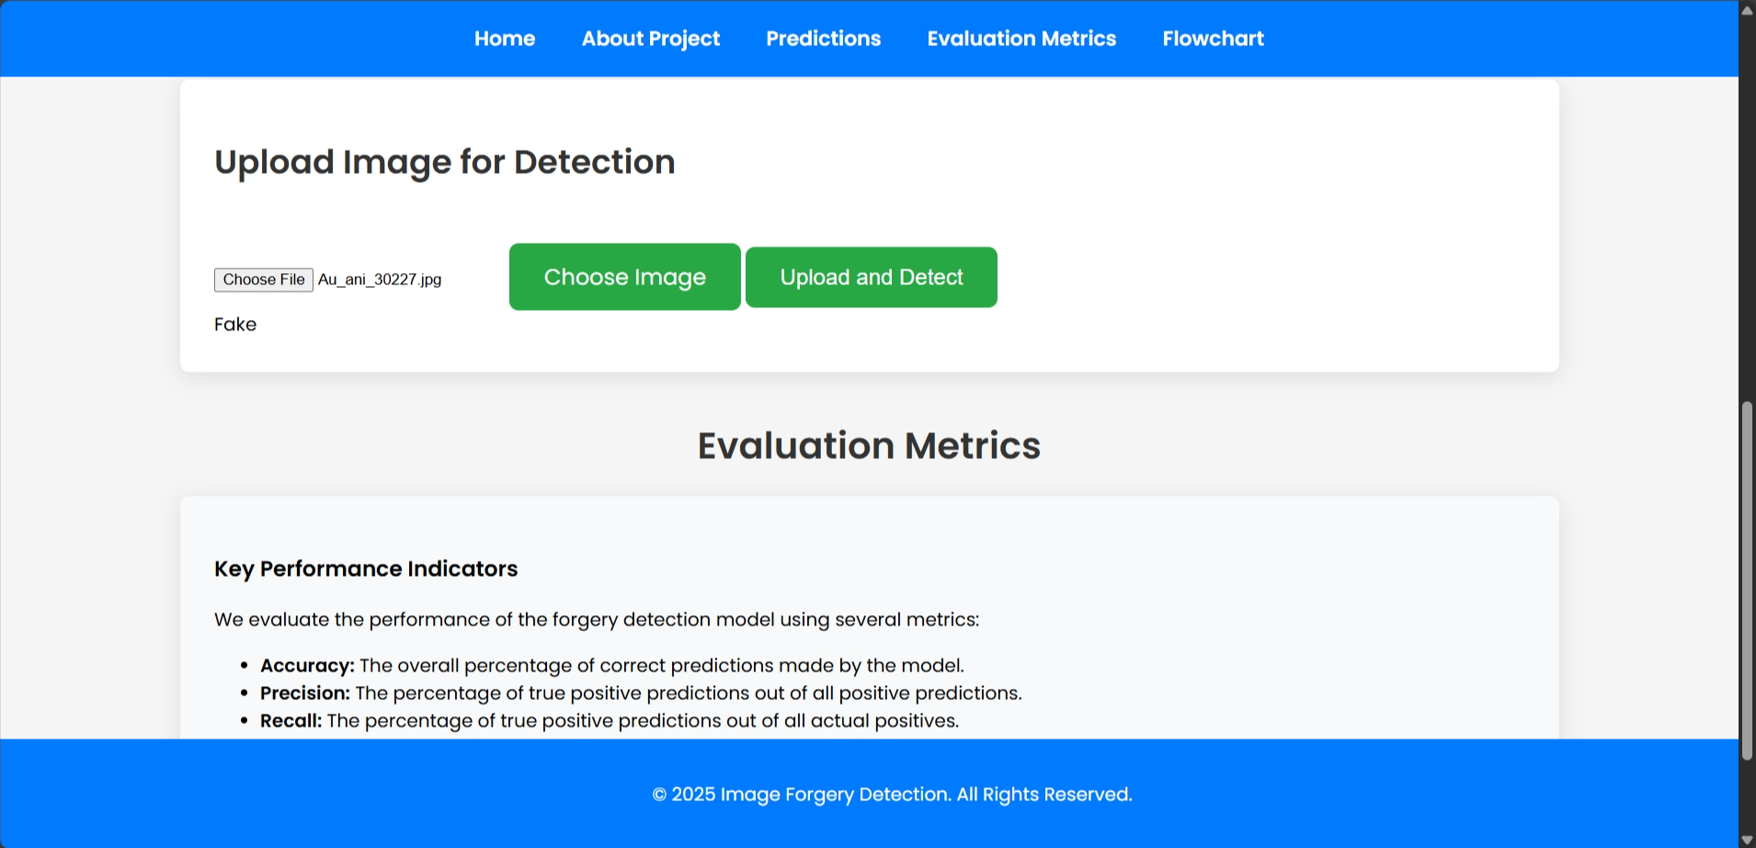
STATUS OF FAKE IMAGE

Slide 26
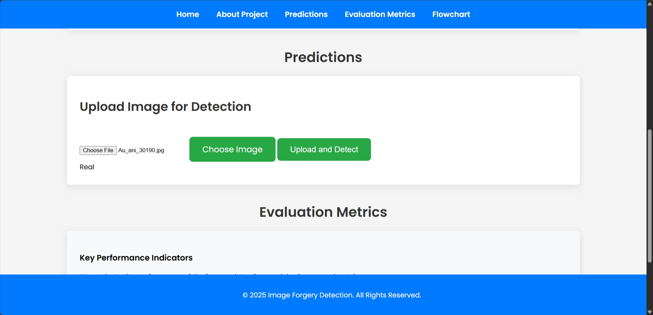
STATUS OF REAL IMAGE

Slide 27
CONCLUSION and FUTURE SCOPE
Key Findings
Efficiency: ELA-CNN model demonstrated computational efficiency with faster training and fewer parameters, making it suitable for limited-resource environments.
Robust Preprocessing: The use of Error Level Analysis (ELA) effectively highlighted tampered regions, aiding in precise classification.
Balanced Metrics: The model delivered high precision (98.24%), recall (80.4%), and F1-score (88.64%), ensuring reliable detection.
Significance of Results
Provides a scalable solution for image forgery detection in diverse applications, including social media moderation and digital forensics.
Demonstrates how transfer learning and lightweight architectures like MobileNetV2 can enhance performance in resource-limited scenarios.
Offers a foundation for developing real-time and multimodal forgery detection systems.

Slide 28
CONCLUSION and FEATURE SCOPE
Future Developments
Video Forgery Detection: Extend the model to analyze video sequences for manipulation.
Advanced Forgery Techniques: Enhance robustness against adaptive compression and Gaussian smoothing.
Real-Time Applications: Optimize the model for deployment on mobile and embedded systems.
Dataset Expansion: Incorporate larger, more diverse datasets for improved generalization across domains.
Limitations
Dependence on ELA: Limited effectiveness against forgeries involving uniform recompression or advanced smoothing techniques.
Dataset Size: Performance is constrained by the relatively small size and scope of the CASIA2 dataset.

Slide 29
REFERENCES
[1] Y. 1. Y. Rao, J. Ni, and H. Zhao, ”Significant learning adjacent descriptor for picture joining area and localization,” IEEE Get to, vol. 8, pp. 25611– 25625, 2020.
[2] Abhishek and N. Jindal, ”Duplicate move and joining fraud location utilizing profound convolution neural arrange,
and semantic division,” Mixed media Instruments Appl., vol. 80, no. 3, pp. 3571–3599, Jan. 2021.
[3] S. Gupta, N. Mohan, and P. Kaushal, ”Detached picture forensics utilizing all inclusive strategies: A audit,” Artif.
Intell. Rev., vol. 55, no. 3, pp.1629– 1679, Jul. 2021.
[4] W. H. Khoh, Y. H. Throb, A. B. J. Teoh, and S. Y. Ooi, ”In-air hand motion signature utilizing exchange learning and its imitation assault,” Appl. Delicate Comput., vol. 113, Dec. 2021, Craftsmanship. no. 108033.
[5]. K. B. Meena and V. Tyagi, ”Picture Joining Fraud Location Methods: A Audit,” Cham, Switzerland: Springer,2021.
[6] K. Kadam, S. Ahirrao, K. Kotecha, and S.Sahu, ”Discovery and localization of numerous picture grafting utilizing MobileNet v1,” IEEE Get to, vol. 9, pp.162499–162519, 2021.
[7] Singh, R., Agarwal, A., Khan, M. K. (2021). Picture impersonation revelation utilizing gathering of convolutional neural frameworks. Journal of Visual Communication and Picture Representation, 73, 102893.

Slide 30
REFERENCES
[8] Ribeiro, A., Oliveira, M., Pinto, A. (2020).Fighting Deepfake Picture Control Utilizing MultiClass Area Convolutional Neural Frameworks. In Methods of the all inclusive Joint Conference on Neural Frameworks (IJCNN) (pp. 1-8).
[9] S. Jabeen, U. G. Khan, R. Iqbal, M. Mukherjee, and J. Lloret, ”A profound multimodal framework for provenance sifting with all inclusive imitation discovery and localization,” Interactive media Apparatuses Appl., vol. 80, no. 11, pp. 17025– 17044, May 2021.
[10] D. Mallick, M. Shaikh, A. Gulhane, and T. Maktum presented a strategy for identifying copymove and grafting picture imitation utilizing CNN. Their work was displayed in Proc. ITM Web Conf., vol. 44, 2022, Craftsmanship. no. 03052.
[11] In another think about, M. N. Abbas, M. S. Ansari, M. N. Asghar, N. Kanwal, T. O’Neill, and B. Lee proposed a lightweight profound learning demonstrate for identifying copy-move picture fraud, especially centering on post_x0002_processed assaults. This inquire about was displayed at the IEEE 19th World Symp. Appl. Mach. Intell. Informat. (SAMI) in Jan. 2021, pp. 125–130.
[12] C. D. P. Kumar and S. S. Sundaram created a novel method for copy-move fraud location utilizing metaheuristics combined with ideal profound exchange learning. Their discoveries were distributed in Intell. Autom. Delicate Comput., vol. 35, no. 1, pp. 881–899, 2023.
[13] N. Krishnaraj, B. Sivakumar, R. Kuppusamy, Y. Teekaraman, and A. R. Thelkar planned an computerized profound learning-based combination show for recognizing copy-move picture imitation. Their work was distributed in Comput. Intell. Neurosci., vol. 2022, pp. 1–13, Jan. 2022.

Slide 31
ACKNOWLEGEMENTS
Express gratitude for the opportunity to present
Provide contact information for further inquiries

