Slide 1


Slide 2

Department of Computer Science and Engineering
Beyond Parental Height: A Multi-Model Approach for Personalized Adult Height Prediction
PRESENTED BY
A. Siva Nagendra (21471A0560)
G. Gowtham (21471A0525)
Ch. Ravi Sankar (21471A0515)
Under the Guidance of,
Dr. S. Siva Nageswara Rao_{M. Tech., Ph.D.},
Professor,
Department of Computer Science and Engineering,
Narasaraopeta Engineering College (Autonomous),
Narasaraopet - 522 601.

Slide 3
OUTLINE
Abstract
Introduction
Literature Survey
Research Gaps
Problem Statement
Objectives
Block Diagram
Methodology
Implementation
Results and Analysis
Conclusion & Future Scope
References
Acknowledgement
Question and Answers

Slide 4
ABSTRACT
This study presents a multi-model approach for predicting adult height using Galton's historical dataset, integrating advanced feature engineering and outlier handling. Traditional methods rely on linear relationships between parental and child heights, overlooking environmental, lifestyle, and socioeconomic factors.
By incorporating features like birth order, living environment, diet quality, grandparent height, and sports activity, the proposed approach achieves more accurate predictions. Experiments demonstrate that removing outliers significantly enhances model performance.
This research provides a reliable tool for personalized growth forecasts, highlighting the impact of advanced data science techniques in healthcare.

Slide 5
INTRODUCTION
The study develops a multi-model deep learning framework to predict adult height using Galton's historical dataset, integrating birth order, living environment, diet quality, grandparent height, and sports activity.
Advanced feature engineering improves prediction accuracy.
Data preprocessing, especially outlier removal, significantly enhances model reliability and performance.

Slide 6
LITERATURE SURVEY
No | Title | Author | Journal Name & Year | Methodology Adapted | Key Findings | Gaps
1 | Improving the Accuracy of Adult Height Prediction With Exploiting Multiple Machine Learning Models According to the Distribution of Parental Height | Ji-Sung Park, Dong-Ho Lee. | IEEE, 2021 | Collected height data, analyzed influence of parental height, applied machine learning models based on distribution and combination of parental heights | Parental height significantly impacts child’s height; machine learning models improve prediction accuracy under RMSE 4. | Potential application for pediatricians and parents, further improvement by adding more features and using different datasets
2 | A Valuable Improvement Of Adult Height Prediction Methods | M. Maes, M. Vandeweghe, M. Du Caju, Ch. Ernould, J.-P. Bourguignon, and G. Massa | Semantic scholar, 2022 | The study evaluated and improved accuracy of three height prediction methods using retrospective analysis. | Bayley-Pinneau was most accurate for boys, Tanner-Whitehouse best for girls; correction factors improved predictions. | Small sample size, lack of environmental factors, no unified ethnic diversity.
3 | A Hybrid Model for Children Adulthood | Keji Mao, LijianChen, Xinben Fan, JiafaMao, XiaolongZhou, and Kai Fang. | PLoS ONE, 2023 | Enhanced BP network integrates LSALO optimizer for improved adult height prediction accuracy in children. | LSALO-BP model achieved superior accuracy, improving boys' prediction by 16.08%, girls' by 6.6%. | Limited exploration of diverse datasets and additional optimization techniques for broader prediction applicability

Slide 7
No | Title | Author | Journal Name & Year | Methodology Adapted | Key Findings | Gaps
4 | A Hybrid Model for Children Adulthood | Keji Mao, Lijian Chen, Xinben Fan, Jiafa Mao, Xiaolong Zhou, Kai Fang. | Research Square, 2022 | Combines ant lion optimizer with BP neural network for height prediction accuracy. | LSALO-BP shows superior global search and convergence ability over traditional optimization methods. | Limited dataset diversity; no external validation or comparison with real-world deployment scenarios.
5 | Prediction of Adult Height by Machine Learning | Michael, ShmoishAlina, GermanNurit, DevirAnn, HechtGary, ButlerAimon. | Clinical Endocrinology & Metabolism, 2021 | Machine learning models, especially random forests, predicted adult height using growth data until age 6. | Random forests achieved 87% accuracy; height at 3.4-6 years and sex were crucial predictors. | Predictions less accurate for extreme heights; environmental and pubertal growth effects not fully modeled.
6 | Bone Age Estimation and Prediction of Final Adult Height Using Deep Learning | Junghwan Suh, Jinkyoung Heo, Su Jin Kim, Soyeong Park, Mo Kyung Jung | Yonsei Medical Journal, 2023 | Used regression model with growth charts and LMS method for adult height prediction. | AI predicted adult height accurately with a mean absolute error of 4.62 cm. | Limited accuracy improvement for older boys and lack of longitudinal validation.

Slide 8
LITERATURE SURVEY
Traditional Statistical Models:
Linear regression and classical statistical models have been widely used for height prediction, relying on parental height and demographic data.
These approaches face limitations in accuracy due to their inability to capture complex genetic and environmental interactions.
Machine Learning Techniques:
More recent studies have employed machine learning models like Support Vector Machines (SVMs) and Random Forests to enhance prediction accuracy.
While these models outperform traditional methods, they often struggle with overfitting and require extensive feature engineering.

Slide 9
RESEARCH GAPS
Many models do not combine all possible factors, like genetics, environment, and health, which makes their predictions less accurate and reliable.
Some models work well on small datasets but fail on larger ones, and they often focus too much on the training data, leading to poor performance on new data.
Many models are not tested on a wide variety of people or real-world situations, which raises questions about their reliability.
Models often overlook how things like diet, exercise, or environment change over time, which can affect a person’s growth and height.

Slide 10
PROBLEM STATEMENT
Predicting a child's adult height remains a challenge due to the limitations of traditional methods that primarily consider parental height. These methods often fail to account for other critical factors that influence growth, such as birth order, living environment, diet quality, grandparental height, and participation in sports activities. The lack of a comprehensive approach results in inaccuracies, highlighting the need for an improved prediction model that integrates multiple variables to enhance precision and reliability.

Slide 11
OBJECTIVES
Design a comprehensive framework integrating multiple machine learning models to achieve robust adult height predictions.
Integrate features like birth order, living environment, diet quality, grandparental height, and participation in sports activities.
Apply sophisticated feature engineering methods, including extraction, selection, and transformation, to improve predictive model accuracy.
Evaluate how removing outliers affects the performance, reliability, and robustness of height prediction models effectively.

Slide 12
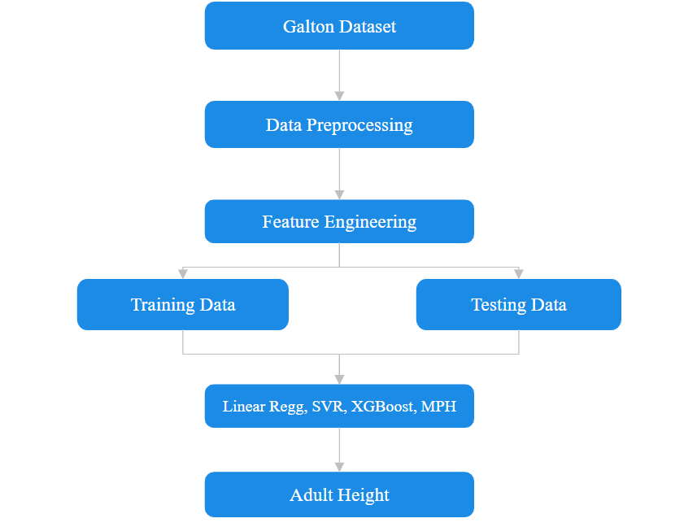
BLOCK DIAGRAM OR FLOW DIAGRAM

Slide 13
METHODOLOGY
PRE-PROCESSING:
Data Cleaning: Removed outliers from Galton’s dataset to improve data quality and model reliability.
Feature Engineering: Created additional features, such as average parental height, birth order, and sports participation.
Correlation Analysis: Examined relationships between child and parental heights to identify key predictive variables.
Categorical Encoding: Converted categorical variables, such as gender, into numerical formats for machine learning models.
Data Splitting: Divided the dataset into training and testing sets to evaluate model performance accurately.

Slide 14
METHODOLOGY
Preprocessing Result: Dataset: Galton Height Dataset
Feature | Galton Dataset | Updated Galton Dataset
Family ID | ✓ | ✓
Father's Height | ✓ | ✓
Mother's Height | ✓ | ✓
Gender | ✓ | ✓
Child's Height | ✓ | ✓
Number of Children | ✓ | ✓
Male/Female Binary Columns | ✓ | ✓
Household income | ✘ | ✓
Living environment | ✘ | ✓
Diet quality | ✘ | ✓
Urban environment | ✘ | ✓
Diet quality | ✘ | ✓

Slide 15
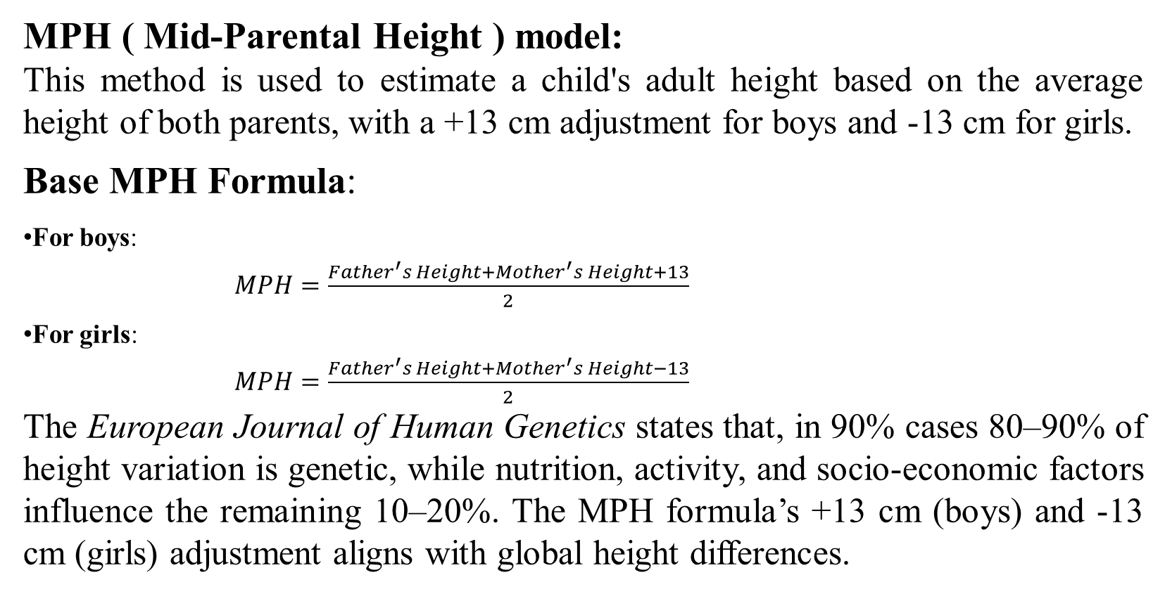
METHODOLOGY
MPH ( Mid-Parental Height ) model:
This method is used to estimate a child's adult height based on the average height of both parents, with a +13 cm adjustment for boys and -13 cm for girls.
Base MPH Formula:
For boys:
$MPH=\frac{Father^{′}s Height+Mother^{′}s Height+13}{2}$
For girls:
$MPH=\frac{Father^{′}s Height+Mother^{′}s Height−13}{2}$ The European Journal of Human Genetics states that, in 90% cases 80–90% of height variation is genetic, while nutrition, activity, and socio-economic factors influence the remaining 10–20%. The MPH formula’s +13 cm (boys) and -13 cm (girls) adjustment aligns with global height differences.

Slide 16
System Requirements
Hardware Requirements
Processor : intel Core i5
Cache memory : 4MB(Megabyte)
RAM : 12.7GB (gigabyte)
Hard Disk : 166.8GB
Compute Engine : T4 GPU
Software Requirements
Operating System : Windows 10, 64-bit OS
Coding Language : Python
Python distribution : Google Colab Pro , Flask
Browser : Any Latest Browser like Chrome

Slide 17
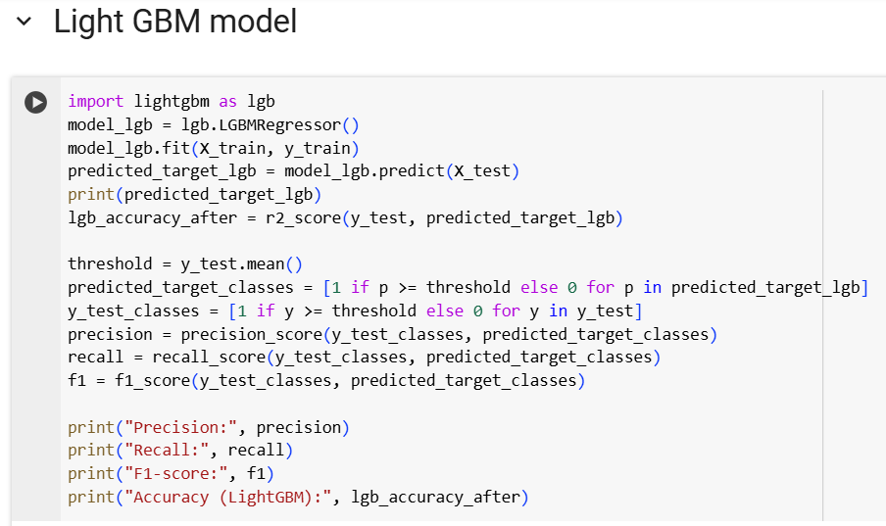
Implementation

Slide 18
Challenges Vs Overcomes
Issue | Problem | Solution
Outliers in Data | Extreme values made predictions less accurate. | Removed outliers to improve accuracy.
Limited Features | Only parental height was used, missing other factors. | Added features like average parental height, sports participation, and grandparental height.
Too Many or Too Few Features | Too many features made the model slow; too few reduced accuracy. | Used feature selection to keep only the most useful features.

Slide 19
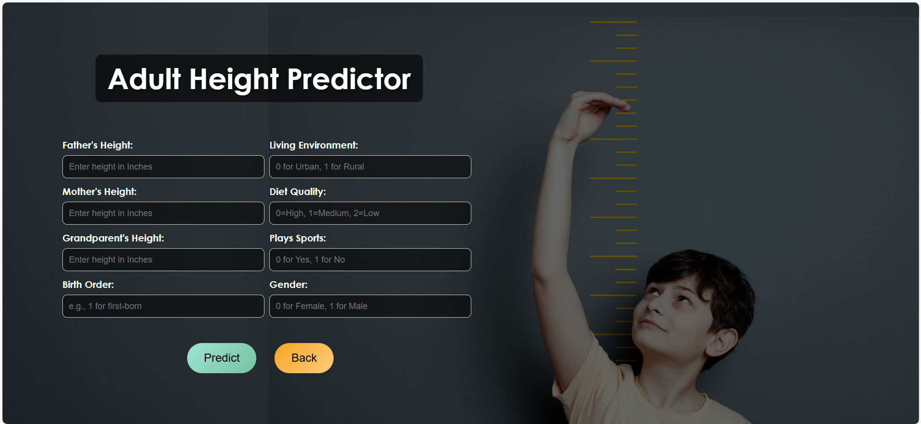
Frontend Implementation

Slide 20
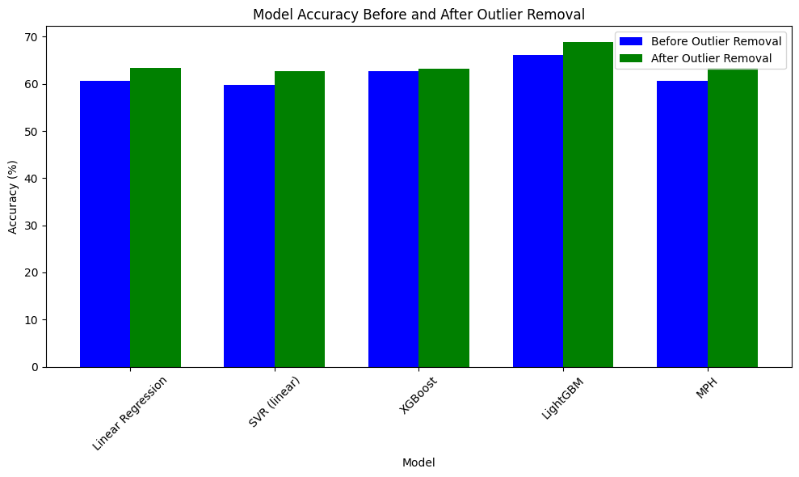
RESULTS & ANALYSIS
The chart compares model accuracy before and after outlier removal, showing an increase in accuracy across all models.
LightGBM has the highest accuracy improvement, while other models also shows noticeable gains.

Slide 21
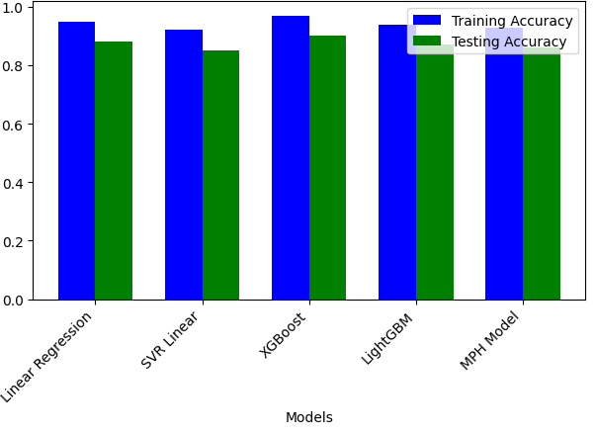
RESULTS & ANALYSIS
The graph shows training and testing accuracy for five models, with minimal gaps indicating good generalization.
XGBoost and LightGBM achieve the highest accuracy, performing well in both training and testing.

Slide 22
RESULTS & ANALYSIS
Model | Original Data (RMSE) | Before Outlier Removal (RMSE) | After Outlier Removal (RMSE)
Linear Regression | 3.47 | 2.31 | 2.19
SVR (linear) | 3.48 | 3.20 | 2.20
XGBoost | 3.74 | 3.29 | 2.16
LightGBM | 3.56 | 3.14 | 2.02
MPH | 3.47 | 3.18 | 2.19

Slide 23
CONCLUSION & FUTURE SCOPE
The study demonstrates the importance of combining birth order, diet, and physical activity alongside genetic data for personalized height forecasting.
Outlier removal and feature engineering significantly boosted model performance compared to traditional approaches.
Modern Machine learning models like XGBoost and LightGBM outperformed the traditional models in prediction accuracy.
Expanding the dataset to include diverse ethnic groups and geographical variations.

Slide 24
REFERENCES
[1] J. Suh, J. Heo, S. J. Kim, S. Park, M. K. Jung, H. S. Choi, Y. Choi, J. S. Oh, H. I. Lee, M. Lee, K. Song, A. Kwon, H. W. Chae, and H.-S. Kim, “Bone Age Estimation and Prediction of Final Adult Height Using Deep Learning,” Yonsei Medical, vol. 64, no. 11, pp. 1150–1159, Nov. 2023.
[2] J.-H. Park, M. Lee, D. Kim, H.-W. Kwon, Y.-J. Choi, K.-R. Park, S. Park, S.-B. Park, and J. Cho, “Estimating Adult Stature Using Metatarsal Length in the Korean Population: A Cadaveric Study,” Int. J. Environ. Res. Public Health, vol. 19, no. 22, p. 15124, Nov. 2022.
[3] K. Mao, L. Chen, X. Fan, J. Mao, X. Zhou, and K. Fang, “Lsalo-Bp: A Hybrid Model for Children Adulthood Height Prediction,” Zhejiang University of Technology, Jan. 2022.
[4] A. Holmgren, A. Niklasson, A. F. M. Nierop, G. Butler, and K. Albertsson-Wikland, “Growth Pattern Evaluation of the Edinburgh and Gothenburg Cohorts by QEPS Height Model,” Pediatric Res., vol. 92, no. 2, pp. 592–601, Aug. 2022.

Slide 25
REFERENCES
[5] M. Shmoish, A. German, N. Devir, A. Hecht, G. Butler, A. Niklasson, K. Albertsson-Wikland, and Z. Hochberg, “Prediction of Adult Height by Machine Learning Technique,” Clinical Endocrinology & Metabolism, vol. 106, no. 7, pp. 301–310, Jan. 2021.
[6] A. Bemporad, “A Piecewise Linear Regression and Classification Algorithm with Application to Learning and Model Predictive Control of Hybrid Systems,” IEEE Trans. Autom. Control, vol. 68, no. 6, pp. 3194–3209, Jun. 2023.
[7] H. B. Khazri, S. C. Shimmi, and M. T. H. Parash, “A Multivariate Analysis to Propose Linear Models for the Stature Estimation in the Sabahan Young Adult Population,” PLoS ONE, vol. 17, no. 8, Art. no. e0273840, Aug. 2022.
[8] M. Maes, M. Vandeweghe, M. Du Caju, Ch. Ernould, J.-P. Bourguignon, and G. Massa, “A Valuable Improvement of Adult Height Prediction Methods in Short Normal Children,” Hormone Research, vol. 48, no. 8, pp. 555–561, Jan. 1997.

Slide 26
ACKNOWLEDGEMENT
We would like to express our sincere gratitude to the faculty and staff of Narasaraopeta Engineering College for their guidance and encouragement throughout the development of this project. Their insights and expertise have been invaluable.
We also extend our thanks to the administration for providing the necessary resources and a platform to showcase our work. This opportunity has been instrumental in enhancing our learning and growth.
For any questions or further discussions, feel free to reach out:-
Email: sivanagendra2004@gmail.com Phone: 8096137414
Email: gowthamguntur25@gmail.com Phone: 8977443549
Email: ravichalla023@gmail.com Phone: 7842486859

Slide 27


Slide 28


