Slide 1

Department of Computer Science and Engineering
Unveiling Student Success: A Multifaceted Approach with Learning Coefficients and Beyond
PRESENTED BY
Tumpala Mahith (21471A0565)
Kethavath Ravi Naik (21471A0528)
Kolakani Raju (21471A0529)
Under the Guidance of,
Nukala VijayaKumar _{M.E}
Associate Professor,
Department of Computer Science and Engineering,
Narasaraopeta Engineering College (Autonomous),
Narasaraopet- 522 601.

Slide 2
OUTLINE
Abstract
Introduction
Literature Survey
Research Gaps
Problem Statement
Objectives
Block Diagram / Flow Diagram
Methodology
Implementation
Results and Analysis
Conclusion & Future Scope
References
Question and Answers
Acknowledgements

Slide 3
ABSTRACT
The study examines student performance using Educational Data Mining (EDM) techniques.
Clustering and classification techniques are used.
Machine learning models like Random Forest and XGBoost are employed.
Deep learning models such as CNN and LSTM are utilized.
Random Forest and XGBoost outperform traditional methods in predicting student success.
CNN and LSTM models further improve prediction accuracy.
Metrics used for evaluation include accuracy, precision, recall, and F1-score.
Early pattern recognition helps significantly reduce failure rates.
Findings are relevant for educational institutions to enhance student success.

Slide 4
INTRODUCTION
Project Overview:
The project focuses on predicting student academic performance using machine learning and deep learning models.
It aims to identify key factors influencing performance and provide actionable insights for improving outcomes in higher education. Motivation behind the project
Motivation:
Early prediction of student performance is crucial for addressing potential academic challenges.
Importance and Relevance:
Helps institutions improve resource allocation.
Supports at-risk students through timely interventions.
Promotes data-driven education strategies for better academic results.

Slide 5
LITERATURE SURVEY
No | Title | Author | Journal Name & Year | Methodology Adapted | Key Findings | Gaps
1 | Prediction of Students’ Academic Performance in the Programming Fundamentals Course Using Long Short-Term Memory Neural Networks | Luis Vives, Ivan Cabezas, Juan Carlos Vives, Nilton German Reyes, Janet Aquino, Jose Bautista Cóndor, S. Francisco Segura Altamirano | IEEE access 2024 | Compared performance with other models like DNN, Decision Trees, Random Forest, Logistic Regression, SVM, and KNN. | LSTM-GAN achieved the highest accuracy (98.3%) in week 8 predictions. | Limited to programming fundamentals; broader generalization requires validation across diverse datasets and courses.
2 | Prediction of Student’s Performance With Learning Coefficients Using Regression-Based Machine Learning Models | Pallavi Asthana, Sumita Mishra, Nishu Gupta, Mohammad Derawi, Anil Kumar | IEEE access 2023 | Introduced "Learning Coefficients" as dynamic predictors derived from adaptive assessments. | Learning coefficients provided quantified metrics for improvement. | Need for further refinement of adaptive assessment tools for broader applicability.

Slide 6
LITERATURE SURVEY
No | Title | Author | Journal Name & Year | Methodology Adapted | Key findings | Gaps
3 | Predicting University Student Graduation Using Academic Performance and Machine Learning: A Systematic Literature Review | Lidya R. Pelima, Yuda Sukmana, Yusep Rosmansyah. | IEEE access 2024 | Variables analyzed included academic, behavioral, and demographic data from LMS and SIS systems​ | Prediction models can aid institutions in early identification of at-risk students. | Lack of exploration of predictive models and algorithms.
4 | Prediction of Students’ Academic Performance Based on Courses’ Grades Using Deep Neural Networks | Aya Nabil, Mohammed Seyam, Ahmed Abou-Elfetouh. | IEEE access 2021 | Algorithms used: Deep Neural Networks (DNN), Decision Trees, Random Forest, Gradient Boosting, Logistic Regression, and SVM. | Resampling methods improved model perfor-mance, adderssing class imbalance issues. | Focused only on academic features, ignoring non-academic factors like demographics or behavioral data.
5 | Early Warning of Student Performance With Integration of Subjective and Objective Elements | Kuangyu Qin, Xiaoyang Xie, Qian He, and Guofeng Deng | IEEE access 2023 | Collected data from academic management systems, attendance records, course grades, library activity logs, and external environmental factors. | Successfully incorporated external disruptions caused by COVID-19 into prediction models to address changes in teaching methods and student behaviors​. | Accuracy decrea-ses for later years in multi-year forecasts, indicating a need for more robust data models for upper-level courses​.
4

Slide 7
LITERATURE SURVEY
NO | Title | Author | Journal Name & Year | Methodology Adapted | Key findings | Gaps
6 | An Adaptive Feature Selection Algorithm for Student Performance Prediction | Koushik Roy, Dewan Md. Farid | IEEE access 2024 | Proposed an Adaptive Feature Selection Algorithm (AFSA) integrating five feature ranking methods | AFSA significantly reduced feature count while maintaining high accuracy. | Needs further testing on larger and more diverse datasets.
7 | Explainable Student Performance Prediction Models: A Systematic Review | Rahaf Alamri, Basma Alharbi | IEEE Access 2022 | Classified models based on nine dimensions, including explainability and accuracy. | Decision Trees and Rule-Based Learning were commonly used explainable models. | No standardized metrics for evaluating model explainability.
8 | Utilizing Social Clustering-Based Regression Model for Predicting Students’ GPA | Yomna M. I. Hassan, Abeer Elkorany, Khaled Wassif | IEEE Access 2022 | Utilized the Community of Inquiry (CoI) framework to select features that best represent students. | The CoI-based feature selection reduced the number of features by 62.8%, improving efficiency. | Needs further validation on larger datasets.

Slide 8
LITERATURE SURVEY
NO | Title | Author | Journal Name & Year | Methodology Adapted | Key findings | Gaps
9 | Predicting and Interpreting Student Performance Using Ensemble Models and Shapley Additive Explanations | Hayat Sahlaoui, El Arbi Abdellaoui Alaoui, Anand Nayyar, Said Agoujil, Mustafa Musa Jaber | IEEE ACCESS 2021 | Used ensemble learning techniques, including XGBoost and Extra Trees (ET) | Features like student absences, participation, and resource usage had the greatest impact on performance predictions. | Focused only on structured data; does not address unstructured data sources like textual student feedback.
10 | Multiclass Prediction Model for Student Grade Prediction Using Machine Learning | Siti Dianah Abdul Bujang, Ali Selamat, Roliana Ibrahim, Ondrej Krejcar, Enrique Herrera-Viedma, Hamido Fujita, Nor Azura Md. Ghani | IEEE ACCESS 2021 | Performance evaluated using accuracy, precision, recall, and F1-score. | The study confirmed that feature selection enhanced prediction performance by reducing overfitting. | The model needs validation on larger and more diverse datasets.

Slide 9
RESEARCH GAPS
The study primarily focuses on supervised learning techniques (e.g., CNN, LSTM), neglecting the exploration of unsupervised and semi-supervised approaches that could enhance generalizabilityDo not change font style or colours.
The dataset used has limitations in terms of size and diversity, which could hinder the model’s applicability across broader populations. More extensive datasets with varying demographic factors are needed.
Evaluation relies heavily on accuracy without providing insights into other critical metrics like recall, precision and F1-s.core especially in identifying at-risk students.
The Study does not incorporate temporal trends or longitudinal data to analyze performance variations over time ,limiting its ability to predict long-term outcomes.

Slide 10
PROBLEM STATEMENT
Early identification of at-risk students is crucial for timely interventions and academic improvements.
Focus primarily on either academic or non-academic features, neglecting their combined effects.
Inadequate handling of data imbalance, leading to biased predictions.
Lack of interpretability in machine learning models, reducing trust and usability.
Insufficient consideration of longitudinal data for long-term performance tracking.
Utilizes t-SNE for dimensionality reduction.
Implements Random Forest, XGBoost, CNN, and LSTM for improved accuracy.

Slide 11
OBJECTIVES
Design a framework that integrates academic and non-academic features to predict student performance effectively.
Utilize advanced machine learning (Random Forest, XGBoost) and deep learning techniques (CNN, LSTM) to improve prediction accuracy and handle imbalanced data.
Address the impact of environmental factors, such as COVID-19 disruptions, by integrating subjective and objective elements into the prediction model.
Provide actionable insights to institutions for early identification of at-risk students, enabling timely interventions to enhance academic outcomes.

Slide 12
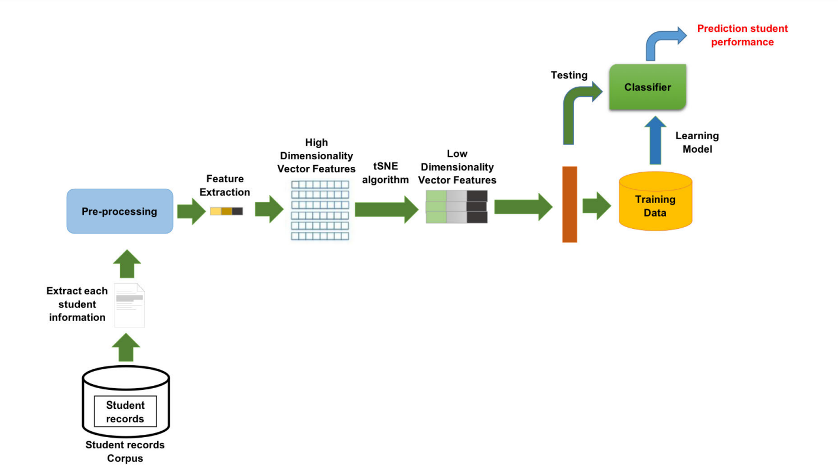
BLOCK DIAGRAM OR FLOW DIAGRAM

Slide 13
METHODOLOGY
Data collection:
Gather academic and non-academic data
Data preprocessing:
Encoding, Normalization, Feature selection, splitting
Model Selection and Training:
Implement and train the models
Model Evaluation :
Assess performance using evaluation metrics such as accuracy, precision, recall, f1-score
Comparative analysis :
compare model performance based on evaluation metrics

Slide 14
IMPLEMENTATION
Software Specifications:
Tools: Google Colab for model training and testing.
Flask used as web framework
Hardware Specifications:
High-performance systems with 16GB RAM and T4 GPU for training and testing.
Intel core i5 processor and Google drive for data storage
Challenge – High Dimensionality
Problem: The dataset included multiple features, leading to high computational complexity and reduced model performance.
Solution: Implemented t-SNE (t-Distributed Stochastic Neighbor Embedding) for dimensionality reduction and visualizing high-dimensional data effectively.

Slide 15
RESULTS & ANALYSIS
Model | Accuracy | Precision | Recall | F1-Score
Random Forest | 92.5 | 91.8 | 90.6 | 91.2
XGBoost | 93.1 | 92.4 | 91.9 | 92.1
CNN | 94.0 | 93.5 | 92.8 | 93.2
LSTM | 91.5 | 90.9 | 90.2 | 90.6
SVM | 87.8 | 85.2 | 86.5 | 85.8

Slide 16
CONCLUSION and FUTURE SCOPE
Conclusion:
Achieved 94% accuracy using advanced deep learning techniques for student performance prediction.
Developed a scalable and interpretable framework to identify at-risk students and enable timely interventions.
Integrated academic, non-academic, and external factors to enhance prediction reliability and robustness
Future scope:
Combine machine learning, deep learning and reinforcement learning to build more adaptive and accurate frameworks.
Create a real-time monitoring system for continuous performance tracking and proactive interventions.

Slide 17
REFERENCES
Roy, K., & Farid, D. M. (2024). An Adaptive Feature Selection Algorithm for Student Performance Prediction. IEEE Access. K. B. Meena and V. Tyagi, Image Splicing Forgery Detection Techniques: A Review.
Qin, K., Xie, X., He, Q., & Deng, G. (2023). Early Warning of Student Performance With Integration of Subjective and Objective Elements. IEEE Access.
Alhazmi, E., & Sheneamer, A. (2023). Early predicting of students performance in higher education. IEEE Access, 11, 27579-27589.
Liu, D., Zhang, Y., Zhang, J. U. N., Li, Q., Zhang, C., & Yin, Y. U. (2020). Multiple features fusion attention mechanism enhanced deep knowledge tracing for student performance prediction. IEEE Access, 8, 194894-194903.
Butt, N. A., Mahmood, Z., Shakeel, K., Alfarhood, S., Safran, M., & Ashraf, I. (2023). Performance Prediction of Students in Higher Education Using Multi-Model Ensemble Approach. IEEE Access, 11, 136091-136108.
Alamri, R., & Alharbi, B. (2021). Explainable student performance prediction models: a systematic review. IEEE Access, 9, 33132-33143.

Slide 18
REFERENCES
Bujang, S. D. A., Selamat, A., Ibrahim, R., Krejcar, O., Herrera- Viedma, E., Fujita, H., & Ghani, N. A. M. (2021). Multiclass prediction model for student grade prediction using machine learning. IEEE Access, 9, 95608-95621.
Alshanqiti, A., & Namoun, A. (2020). Predicting student performance and its influential factors using hybrid regression and multi-label classification. IEEE Access, 8, 203827- 203844.
Nabil, A., Seyam, M., & Abou-Elfetouh, A. (2021). Prediction of students’ academic performance based on courses’ grades using deep neural networks. IEEE Access, 9, 140731- 140746
Pelima, L. R., Sukmana, Y., & Rosmansyah, Y. (2024). Predicting university student graduation using academic performance and machine learning: a systematic literature review. IEEE Access.
Vives, L., Cabezas, I., Vives, J. C., Reyes, N. G., Aquino, J., Condor, J. ´ B., & Altamirano, S. F. S. (2024). Prediction of Students’ Academic Performance in the Programming Fundamentals Course Using Long Short-Term Memory Neural Networks. IEEE Access.

