Slide 1

Department of Computer Science and Engineering
Movie Recommendation System
PRESENTED BY
Rongala Gangadhar 21471A0521
Kunchapu Akhil Kumar 21471A0532
Nallamekala Gopi Krishna 21471A0539
Under the Guidance of,
Dr.Moturi Sireesha _{B.Tech,M.Tech, Ph.D}
Assoc. Professor
Department of Computer Science and Engineering,
Narasaraopeta Engineering College (Autonomous),
Narasaraopet- 522 601.

Slide 2
OUTLINE
Abstract
Introduction
Literature Survey
Research Gaps
Problem Statement
Objectives
Block Diagram / Flow Diagram
Methodology
Implementation
Results and Analysis
Conclusion & Future Scope
References
Question and Answers
Acknowledgements

Slide 3
ABSTRACT
With the rise of the internet, people now have easy access to a lot of information in various fields. However, when faced with too many choices, it's often hard for users to decide what's best for them. Recommendation systems are tools designed to help with this problem by suggesting options tailored to users' interests. Generally, these systems are categorized into two main types: content-based, which recommend items similar to what a user likes, and collaborative filtering, which recommends items liked by similar users.Researchers are investigating hybrid systems, Techniques like direct context modeling, post-filtering, and pre-filtering can be used to include contextual information. In order to improve movie recommendations, this study presents a novel hybrid approach that makes use of pre- and post-filtering techniques. This system makes use of an extensive database that includes ratings, context information, item descriptions, and user profiles.

Slide 4
INTRODUCTION
In today's digital age, where content overload is common, a movie recommendation system is crucial. Such a system helps users navigate vast libraries by offering tailored suggestions, ensuring they discover content aligned with their tastes, saving time, and enhancing their overall viewing experience.
Collaborative filtering techniques examine the viewing habits and ratings of a large user base, identifying patterns to suggest movies aligned with a user's tastes.
Content-based filtering recommends movies based on inherent features like genre, actors, or themes, ensuring suggestions align with specific content characteristics.
Hybrid models combine collaborative and content-based filtering, leveraging both approaches to provide accurate and diverse movie suggestions for a broader range of user preferences.

Slide 5
LITERATURE SURVEY
No | Title | Author | Journal Name & Year | Methodology Adapted | Key Findings | Gaps
1 | Movie Recommendation System Using Collaborative Filtering | Ching-Seh Mike Wu; Deepti Garg; Unnathi Bhandary | https://doi.org/10.1109/ICSESS.2018.8663822 2018 | Data Collection and Preprocessing. Implementation of Collaborative Filtering Algorithms. | User Preferences and Trends. Effective Movie Recommendations. | Real-time User Feedback Integration.
2 | Movie Recommendation System using Machine Learning | Narendra Kumar Rao; Nagendra Panini Challa; S Sreenivasa Chakravarthi; R Ranjana | https://doi.org/10.1109/ICIRCA54612.2022.9985512 2022 | Demographic Filtering. Content-Based Filtering. | Effective Recommendation Accuracy. Adaptability and User Engagement. | Explainability and Transparency.
3 | Movie Recommendation System | Shivam Kumar Gupta; A. Suresh | https://doi.org/10.1109/ICCCI56745.2023.10128220 2023 | Data Collection and Enrichment. Hybrid Approach Implementation. | Enhanced Recommendation Accuracy. Adaptability to Changing Contexts. | Dynamic Contextual Modeling.
4 | Machine Learning Based Movie Recommendation System | Nitasha Soni; Krishan Kumar; Ashish Sharma; Satyam Kukreja; Aman Yadav | https://doi.org/10.1109/UPCON52273.2021.9667602 2021 | Data Collection and Preprocessing. Feature Representation | Personalization. Transparency. Reduced Cold Start Problem. | Hybrid Approaches.

Slide 6
RESEARCH GAPS
Cold Start Problem: Investigate strategies to address the cold start problem, where new users or items have limited or no historical data available, posing a challenge for accurate recommendations.
Temporal Dynamics: Explore methods to incorporate temporal dynamics into recommendation algorithms, considering that user preferences for movies may change over time.
Cross-Domain Recommendations: Investigate techniques for making recommendations across multiple domains, such as suggesting movies based on user preferences in one domain (e.g., drama) to another domain (e.g., comedy).
Diversity in Recommendations: Address the need for diverse recommendations by developing algorithms that consider not only user preferences but also provide a variety of movie choices to enhance user satisfaction and engagement.

Slide 7
PROBLEM STATEMENT
Existing systems struggle to accurately recommend hybrid content for users, often treating them as movies or TV shows based on arbitrary classifications.
New users experience a "cold start" challenge, entering platforms with limited data, hindering personalized recommendations.
Seamless cross-genre recommendations prove difficult, limiting the user experience across diverse movie categories.
The goal is to enhance user satisfaction by delivering accurate and diverse movie recommendations tailored to individual preferences, ultimately improving the overall user experience in a dynamic and evolving entertainment landscape.
Identify and leverage genre combinations common in hybrid content to expand users' horizons and offer unexpected but relevant recommendations.

Slide 8
OBJECTIVES
Enhance User Satisfaction: Improve user experience by providing accurate and personalized movie recommendations tailored to individual preferences, ensuring higher satisfaction and engagement.
Increase Engagement and Interaction: Encourage users to spend more time on the platform by delivering compelling movie suggestions, fostering increased interaction and exploration of the available content.
Address Cold Start Challenges: Develop strategies to effectively handle the "cold start" problem, ensuring that even new users or items with limited data receive relevant and appealing movie recommendations.
Introducing users to diverse movie genres or styles outside their usual preferences, promoting discovery and variety in content consumption.

Slide 9
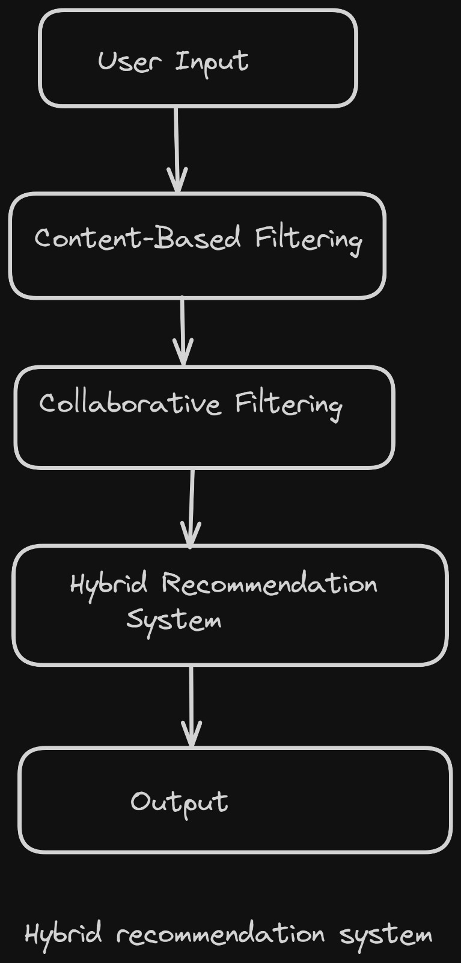
BLOCK DIAGRAM OR FLOW DIAGRAM

Slide 10
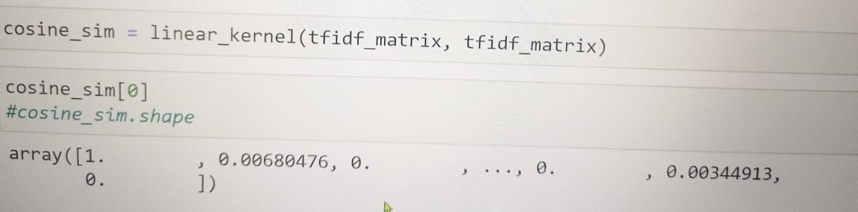
METHODOLOGY
Preprocessing:
Cleaned data (Removed null values in data set, ).
Found relation between columns of our movie dataset.
EDA:
Merged ‘overview’ and ‘genre’ columns to one column called ‘tags’.
Dropped unnecessary columns(popularity, original language, released date)
Frameworks/Tools:
Leveraged sklearn(count-vectorizer, cosine_similarity)
Leveraged surprise (SVD, Reader, Dataset)
Combine CBF and CF by integrating cosine similarity scores and predicted ratings from SVD.

Slide 11
IMPLEMENTATION
Software Requirements :
System : Windows 10 and later.
Language : Python.
Platform : Jupyter Notebook.
Hardware Requirements :
Processor : Intel(R) Core 2 i7-5500U CPU @ 2.50GHz.
RAM : 8GB(gigabyte).
System Type : 64-bit operating system, x64-based processor

Slide 12
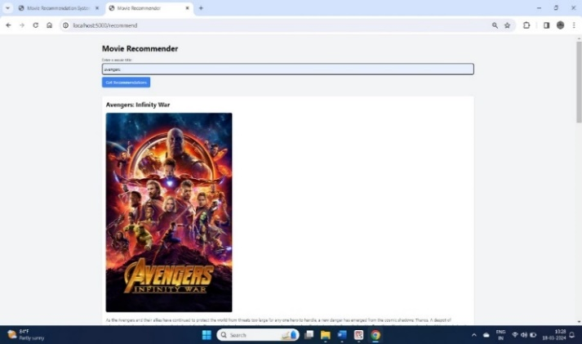
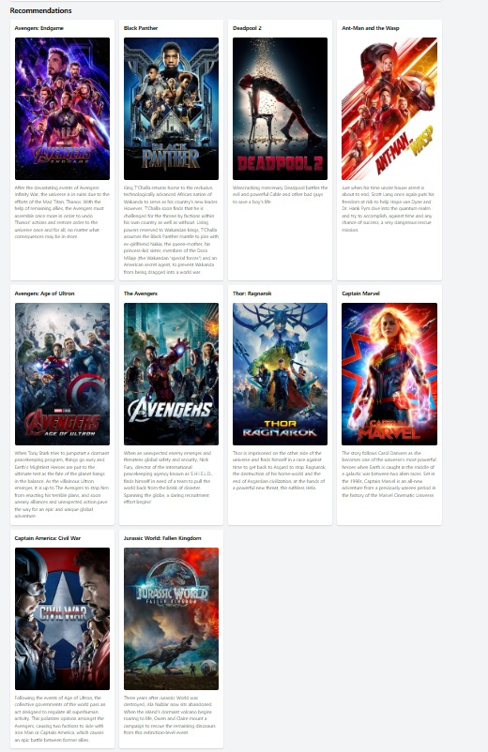
RESULTS & ANALYSIS

Slide 13
RESULTS&ANALYSIS
The above picture below shows our application's results page,(figure 6) where users are greeted with a list of suggested movies based on their search query. The capacity of the hybrid recommendation system to examine and combine the user's past preferences with the content attributes of the chosen movie is reflected in this dynamically created list.
The recommendation process begins when a user searches for a certain movie by looking up the film's qualities, including cast, genre, director, and user ratings. The system then uses algorithms to find and rate other movies with similar qualities or those that people with similar interests enjoy

Slide 14
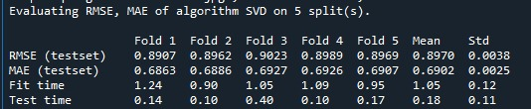
RESULTS&ANALYSIS
Method | Existing Work[17] | Accuracy
Content-based | 0.9325 | 0.9023
Collaborative | 0.8888 | 0.8907
SVD | 0.8735 | 0.6863
Hybrid Model | 0.76 | 0.6902

Slide 15
CONCLUSION and FUTURE SCOPE
Now a days recommendation systems become more popular in various fields such as movie recommendation, music recommendation, product recommendations and so on. The applications which are using such recommendations are Netflix, Amazon prime, Aha, Meesho, Flipkart, Ajio and so on. Most of the fields using recommendation system, so we need to increase the accuracy of the results using different machine learning algorithms. Movie Recommendation System will help to users discover new movies based on their preference and interests. Benefits of using this system is saving users time for searching the movies, Discovers new content movies.
Looking for the future, there is much potential for further development and improvement of the Movie Recommendation System. Advances in machine learning and natural language processing additional data sources such as social media can provide even more personalized recommendations. Overall, the future of the Movie Recommendation System is promising and we can expect continued innovation in this field.

Slide 16
REFERENCES
S. Agrawal and P. Jain, “An improved approach for movie recommendation system,” 2017 International Conference on I-SMAC (IoT in Social, Mobile, Analytics and Cloud) (I-SMAC), 2017, pp. 336-342, doi: 10.1109/ISMAC.2017.8058367.
N. Vaidya and A. R. Khachane, “Recommender systems-the need of the ecommerce ERA,” 2017 International Conference on Computing Methodologies and Communication (ICCMC), 2017, pp. 100-104, doi: 10.1109/ICCMC.2017.8282616.
M. Talukder, M. M. Rahman, S. Halder and M. J.Uddin, “Novel recommendation systems in social networks,” 2017 IEEE International Conference on Imaging, Vision and Pattern Recognition (icIVPR), 2017, pp. 1-6, doi: 10.1109/ICIVPR.2017.7890864.
Y. Xiong and H. Li, “Collaborative Filtering Algorithm in Pictures Recommendation Based on SVD,” 2018 International Conference on Robots and Intelligent System (ICRIS), 2018, pp. 262-265, doi: 10.1109/ICRIS.2018.00074.

Slide 17
REFERENCES
S. Bhat and K. Aishwarya, “Item-based Hybrid Recommender System for newly marketed pharmaceutical drugs,” 2013 International Conference on Advances in Computing, Communications and Informatics (ICACCI), 2013, pp. 2107-2111, doi: 10.1109/ICACCI.2013.6637506.
J. Chen, K. Chao and N. Shah, “Hybrid Recommendation System for Tourism,” 2013 IEEE 10th International Conference on e-Business Engineering, 2013, pp. 156161, doi: 10.1109/ICEBE.2013.24.
V. Powar, S. Girase, D. Mukhopadhyay, A. Jadhav, S. Khude and S. Mandlik, “Analysing recommendation of colleges for students using data mining techniques,” 2017 International Conference on Advances in Computing, Communication and Control (ICAC3), 2017, pp. 1-5, doi: 10.1109/ICAC3.2017.8318781.
S. Roy, M. Sharma and S. K. Singh, “Movie Recommendation System Using Semi-Supervised Learning,” 2019 Global Conference for Advancement in Technology (GCAT), 2019, pp. 1-5, doi: 10.1109/GCAT47503.2019.8978353.

Slide 18

QUESTIONS and ANSWERS

Slide 19

ACKNOWLEGEMENTS

