Slide 1

Department of Computer Science and Engineering
Chronic Kidney Disease Prediction Using Machine Learning and Deep Learning Models
PRESENTED BY
Name of the Student: Nuti Revanth (Roll No.):21471A0541
Name of the Student: Veera Raghava Reddy (Roll No.):21471A0531
Name of the Student : Mahesh Babu (Roll No.):21471A0533
Name of the Student : Y.Likhith Prasanna Kumar (Roll No.):21471A0570
Under the Guidance of,
SHAIK.RAFI _{M.Tech,ph.D.,}
Designation: Assitant Professor,
Department of Computer Science and Engineering,
Narasaraopeta Engineering College (Autonomous),
Narasaraopet- 522 601.

Slide 2
OUTLINE
Abstract
Introduction
Literature Survey
Research Gaps
Problem Statement
Objectives
Block Diagram / Flow Diagram
Methodology
Implementation
Results and Analysis
Conclusion & Future Scope
References
Question and Answers
Acknowledgements

Slide 3
ABSTRACT
Chronic kidney disease is a noticeable health condition that can persist throughout an individual’s life, resulting from either kidney malignancy or diminished kidney function. In this work, we investigate how several machine learning techniques might provide an early CKD diagnosis. The data set used in this study underwent extensive processing, including changing the names of columns for clarity, converting identified columns to numbers, treating unique values with letters handling of partitioned values, fixing incorrect values, filling null values with mean, and encoding categorical values into mathematical notation. In addition,Principal component analysis (PCA) was also employed to lower dimensionality. Our findings demonstrated that the XG Boost classifier surpassed every other algorithm, with an accuracy of 99.12.

Slide 4
INTRODUCTION
Chronic Kidney Disease (CKD) is a severe medical condition characterized by the progressive and irreversible loss of kidney function.
Early detection and timely treatment are crucial to preventing severe complications, including kidney failure.
This project focuses on developing a robust prediction system for CKD using advanced machine learning algorithms.
By leveraging a dataset containing medical attributes, the models are trained to accurately classify individuals as CKD-positive or CKD-negative, assisting healthcare professionals in making informed decisions.

Slide 5
The motivation for this project stems from the growing global prevalence of CKD, which poses significant health and economic burdens.
CKD often remains asymptomatic in its early stages, leading to late diagnoses and poor patient outcomes.
Traditional diagnostic methods can be time-consuming and resource-intensive.
This project seeks to address these challenges by providing an efficient, automated, and accurate diagnostic tool to facilitate early detection, ultimately improving patient care and outcomes.

Slide 6
Importance: Early diagnosis of CKD is essential for initiating interventions that can slow disease progression, improve quality of life, and reduce mortality rates.
Machine learning offers a powerful solution for analyzing large medical datasets and identifying subtle patterns indicative of CKD.
Relevance: This project aligns with the increasing integration of artificial intelligence in healthcare, showcasing how technology can support clinical decision-making.
It also emphasizes the practical application of machine learning to real-world problems, highlighting its potential to enhance diagnostic accuracy and efficiency.

Slide 7
LITERATURE SURVEY
No | Title | Author | Journal Name & Year | Methodology Adapted | Key Findings | Gaps
1 | Chronic Kidney disease prediction based on machine learning algorithms | Md.Ariful Islam,Md.Ziaul Majumder | Science Direct & 2023 | Ml nodels like RF,SVM,LR and KNN | XgBoost classifier has highest performance metrics with an accuracy of 0.973 | Exploring the integration of additional clinical features and advanced data sources to enhance predictive accuracy.
2 | HDLNET:A Hybrid Deep Learning Network Model With Intelligent IOT for Detection and Classification of CKD | Kommuri Venkatrao, Shaik Kareemulla | IEEE & 2023 | DSCNN,CapsNet,RF,SVM,KNN | HDLNET model with accuracy of 97.18% | Future research could explore additional optimization techniques and the integration of more diverse datasets to enhance the robustness of the model

Slide 8
No | Title | Author | Journal Name & Year | Methodology Adapted | Key Findings | Gaps
3 | Early Prediction of Chronic Kidney Disease Using Deep Belief Network | S. M. M. Elkholy, Amira Rezk, and Ahmed Abo El Fetoh Saleh. | IEEE& 2021 | The proposed model uses a DBN with Softmax activation and categorical cross-entropy loss function to classify and predict CKD. | The DBN model achieved an accuracy of 96.5% and a sensitivity of 87.5%, outperforming existing models in early CKD prediction. | Future work could explore the application of the model in real-time clinical settings and extend the approach to other related diseases.
4 | Prediction of Chronic Kidney Disease - A Machine Learning Perspective | P. Chittora, Zbigniew Leonowicz, Michał Jasiński, Sandeep Chaurasia, Gaurav Kumawat, Tulika Chakrabarti, and Prasun Chakrabarti | IEEE& 2021 | 7 machine learning classifiers: ANN, C5.0, CHAID, Logistic Regression, Linear SVM (L1 and L2), Random Tree; Feature selection techniques; Deep Neural Network | Highest accuracy of 97.6% achieved by Deep Neural Network; LSVM with penalty L2 also performed well with 95.86% accuracy | Further research could focus on improving model accuracy and exploring more advanced feature selection methods and other deep learning models
5 | Data-Driven Early Diagnosis of Chronic Kidney Disease: Development and Evaluation of an Explainable AI Model | Pedro A. Moreno-Sánchez. | IEEE&2023 | Development of an explainable AI model using the SCI-XAI framework. The model was optimized for feature selection and classification, focusing on accuracy and explainability. | The optimal model achieved 98.2% accuracy using only 3 features: hemoglobin, specific gravity, and hypertension. Hemoglobin was found to be the most significant feature. | The research suggests exploring additional explainability techniques and applying the model to other datasets or clinical settings to validate generalizability

Slide 9
RESEARCH GAPS
Md. Ariful Islam (2023)The study focused on a mix of machine learning methods but did not explore deep learning models or hybrid techniques, which could potentially enhance prediction accuracy.
Aljaaf et al. (2018)The use of evolutionary computation techniques was promising, but the paper did not discuss the computational overhead or scalability of these methods for large datasets.
Bhavya Gudeti and Terrance Li (2020)The Support Vector Machine (SVM)-based approach achieved good accuracy but did not address the challenges of hyperparameter tuning, which is crucial for SVM performance.

Slide 10
Most studies did not address the interpretability of their models, a crucial factor for clinical adoption.
Few papers discussed the real-world deployment challenges, including integration with healthcare systems and handling unseen data.
The generalizability of the models to diverse populations or datasets was not comprehensively studied in many cases.

Slide 11
PROBLEM STATEMENT
Chronic Kidney Disease (CKD) is a progressive and often asymptomatic condition that affects millions of people worldwide, posing significant health risks and economic burdens.
Early detection is crucial to mitigate severe complications, such as kidney failure, and improve patient outcomes.
The challenge lies in developing an automated, accurate, and efficient diagnostic system capable of identifying CKD at an early stage by leveraging machine learning algorithms.

Slide 12
This requires addressing issues of data preprocessing, feature selection, model optimization, and the generalizability of the predictive model to diverse populations.
Such a system must effectively handle missing data, interpret medical features, and produce reliable predictions that align with clinical standards.
This project aims to bridge this gap by building a robust CKD prediction model using advanced machine learning techniques, focusing on optimizing accuracy, interpretability, and scalability to support real-world clinical applications.

Slide 13
OBJECTIVES
To develop a machine learning-based predictive system capable of accurately diagnosing CKD at an early stage, enabling timely medical interventions and reducing the risk of severe complications.
To evaluate and compare the performance of various machine learning algorithms, such as XGBoost, Random Forest, and Support Vector Machines, and identify the best model for CKD prediction.
To implement techniques like Principal Component Analysis (PCA) to identify critical features and reduce dataset dimensionality, ensuring the model remains efficient and interpretable.

Slide 14
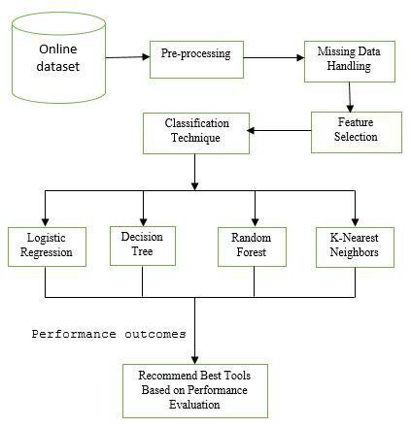
BLOCK DIAGRAM OR FLOW DIAGRAM

Slide 15
METHODOLOGY
Data Collection:
Acquired CKD dataset from Kaggle with 400 samples and 24 features.
Dataset included both numerical and categorical attributes
Data Preprocessing:
Handled missing values using mean (for numerical) and mode (for categorical).
Encoded categorical variables into numerical formats.
Applied Principal Component Analysis (PCA) for dimensionality reduction and feature optimization.

Slide 16
Model Development:
Implemented various machine learning models, including XGBoost, Random Forest, SVM, and KNN.
Trained models on an 80:20 split for training and testing.
Evaluation and Selection:
Evaluated models using metrics like accuracy, precision, recall, and F1-score.Identified XGBoost as the best-performing model with 99.12% accuracy after PCA.
The best model (XGBoost in this case) is prepared for deployment by integrating it into a user-friendly interface, making it suitable for real-world clinical applications.

Slide 17
IMPLEMENTATION
Tools and Technologies:
Programming Language: Python
Libraries Used: NumPy, Pandas, Scikit-learn, Matplotlib, Seaborn, XGBoost
Platform: Jupyter Notebook or Google Colab
Data Loading:
Imported the CKD dataset and performed initial exploration to understand its structure and characteristics.

Slide 18
Data Cleaning:
Replaced missing values and corrected inconsistent entries.
Encoded categorical variables into numerical formats for machine learning compatibility.
Feature Engineering:
Applied Principal Component Analysis (PCA) to reduce dimensionality and improve model efficiency.
Model Training:
Implemented multiple machine learning models (XGBoost, Random Forest, etc.).
Split the data into training (80%) and testing (20%) sets for evaluation.

Slide 19
Performance Evaluation:
Compared models based on metrics like accuracy, precision, recall, and F1-score.
Visualization and Insights:
Used heatmaps, confusion matrices, and graphs to visualize correlations, model performance, and prediction outcomes.
Outcome:
Developed a robust, interpretable CKD prediction model ready for deployment in clinical settings.

Slide 20
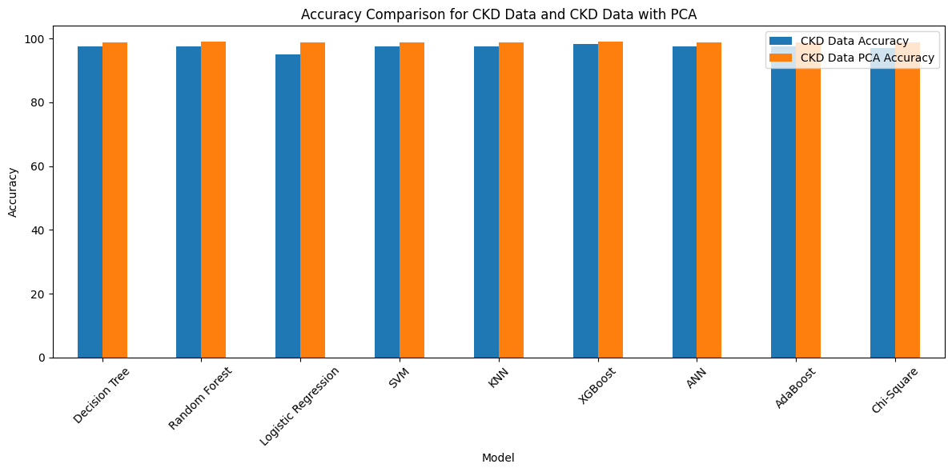
RESULTS & ANALYSIS

Slide 21
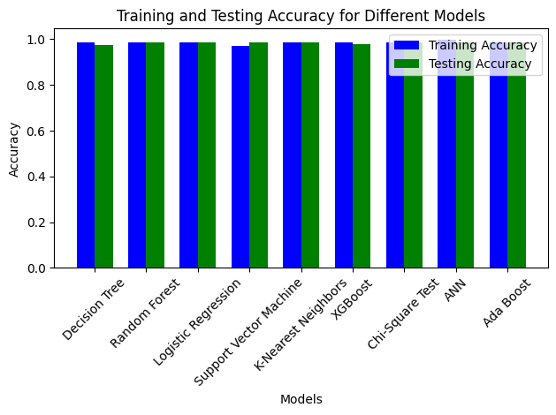

Slide 22
CONCLUSION and FUTURE SCOPE
Conclusion:
This project successfully developed a robust machine learning model for predicting Chronic Kidney Disease (CKD) with high accuracy.
The XGBoost algorithm, with an accuracy of 99.12% after applying PCA, emerged as the most effective model.
Advanced preprocessing techniques, such as handling missing values and dimensionality reduction, played a crucial role in improving model performance.

Slide 23
The model provides an efficient and reliable tool for the early diagnosis of CKD, which can aid healthcare professionals in timely interventions and improving patient outcomes.
Future Scope:
Dataset Expansion:
Incorporate larger and more diverse datasets to enhance model generalizability and robustness.
Explainable AI:
Implement explainability techniques like SHAP or LIME to improve model transparency and foster trust among medical professionals.

Slide 24
REFERENCES
Ammirati, A. L. (2020). Chronic kidney disease. Revista da Associac ¸˜ ao M´edica Brasileira, 66(Suppl 1), s03-s09.
Elkholy, S. M. M., Rezk, A., & Saleh, A. A. E. F. (2021). Early prediction of chronic kidney disease using deep belief network. IEEE Access, 9, 135542-135549.
Roweis, S. (1998). Em algorithms for pca and spca. Advances in NeuralInformation Processing Systems.
Chittora, P., Chaurasia, S., Chakrabarti, P., Kumawat, G., Chakrabarti, T., Leonowicz, Z., ... & Bolshev, V. (2021). Predic tion of chronic kidney disease-a machine learning perspective. IEEE access, 9, 17312-17334.
Islam, M. A., Majumder, M. Z. H., & Hussein, M. A. (2023). Chronic kidney disease prediction based on machine learning algorithms. Journal of pathology informatics, 14, 100189.
DatasetLink: https://www.kaggle.com/datasets/mansoordaku/ckdisease
Rafi, S., & Das, R. (2023). Topic-guided abstractive multimodal summarization with multimodal output. Neural Computing and Applications, 1-16.

Slide 25
Aljaaf, A. J., Al-Jumeily, D., Haglan, H. M., Alloghani, M., Baker, T., Hussain, A. J., & Mustafina, J. (2018, July). Early prediction of chronic kidney disease using machine learning supported by predictive analytics. In 2018 IEEE congress on evolutionary computation (CEC) (pp. 1-9). IEEE.
Gudeti, B., Mishra, S., Malik, S., Fernandez, T. F., Tyagi, A. K., & Kumari, S. (2020, November). A novel approach to predict chronic kidney disease using machine learning algorithms. In 2020 4th International Conference on Electronics, Communi cation and Aerospace Technology (ICECA) (pp. 1630-1635). IEEE.
Hossain, M. M., Swarna, R. A., Mostafiz, R., Shaha, P., Pinky, L. Y., Rahman, M. M., ... & Iqbal, M. S. (2022). Analysis of the performance of feature optimization techniques for the diagnosis of machine learning-based chronic kidney disease. Machine Learning with Applications, 9, 100330.
Islam, M. A., Akter, S., Hossen, M. S., Keya, S. A., Tisha, S. A., & Hossain, S. (2020, December). Risk factor prediction of chronic kidney disease based on machine learning algorithms. In 2020 3rd international conference on intelligent sustainable systems (ICISS) (pp. 952-957). IEEE.
Islam, M. A., Majumder, M. Z. H., & Hussein, M. A. (2023). Chronic kidney disease prediction based on machine learning algorithms. Journal of pathology informatics, 14, 100189.
Venkatrao, K., & Kareemulla, S. (2023). HDLNET: a hybrid deep learning network model with intelligent IoT for detection and classification of chronic kidney disease. IEEE Access

Slide 26
QUESTIONS and ANSWERS
Q1: What is the primary goal of the project? A1: The primary goal is to develop an accurate and efficient machine learning-based system for early detection and prediction of Chronic Kidney Disease (CKD) to assist in timely medical interventions.
Q5: What are the future applications of the project? A5: The model can be integrated into clinical systems for real-time CKD prediction, expanded with larger datasets, and enhanced using explainable AI techniques for improved interpretability and trust.
Q4: What is the significance of PCA in the project? A4: Principal Component Analysis (PCA) was used for dimensionality reduction, which improved computational efficiency, avoided overfitting, and enhanced model performance.

Slide 27
ACKNOWLEGEMENTS
Thank you
If Any Queries …?
contact us:
7672001772
nutirevanth541@gmail.com

