Slide 1

WELCOME
WELCOME

Slide 2
Department of Computer Science and Engineering
Classification and Feature Selection Method for Medical Datasets by BGEO TVFL(Binary golden eagle optimization-Time Varying Flight length) and KNN(k-nearest neighbour)
PRESENTED BY
Bommu Lakshmi Prasanna 21471A0513
Paruchuri Swetha Lakshmi 21471A0543
Mellacheruvu Sahithi 21471A0535
Under the Guidance of,
Dr. Rama Krishna Eluri_{, M.Tech., Ph.D}
Assistant Professor
Department of Computer Science and Engineering,
Narasaraopeta Engineering College (Autonomous),
Narasaraopet- 522 601.

Slide 3
OUTLINE
Abstract
Introduction
Literature Survey
Research Gaps
Problem Statement
Objectives
Block Diagram / Flow Diagram
Methodology
Implementation
Results and Analysis
Conclusion & Future Scope
References
Question and Answers
Acknowledgements

Slide 4
ABSTRACT
Classification accuracy and feature selection are important steps in medical data analysis to identify suitable features that can improve the performance of machine learning models. In this study, we present a new method called BGEO TVFL (Binary Golden Eagle Optimization-Time Varying Flight Length) algorithm together is proposed for its K-nearest neighbour (KNN) algorithm. The TVFL algorithm feature of BGEO is used for optimal subset selection, while the KNN algorithm is used for classification.
The proposed method is tested in several projects. The experimental results show that the proposed method outperforms other existing methods such as BWOA, BGWO, ACO, and ABC in terms of accuracy and selected features. Our results show that BGEO TVFL outperforms other algorithms in terms of accuracy and feature selection, achieving higher classification accuracy and selecting fewer features compared to how BGEO TVFL performs well as a good optimization algorithm for feature selection and classification in medical data sets.

Slide 5
INTRODUCTION
Feature selection is a critical step in machine learning, particularly for medical datasets, where large numbers of features can lead to poor model performance and increased computational complexity. It involves selecting the most relevant and informative features while eliminating redundant or irrelevant ones, thus improving model accuracy, reducing training time, and preventing overfitting. The process typically includes generating feature subsets, evaluating their quality, applying stopping criteria, and validating the selected features to ensure their effectiveness. In this project, the Binary Golden Eagle Optimization with Time-Varying Flight Length (BGEO-TVFL) algorithm is utilized to optimize feature selection. By dynamically balancing exploration and exploitation, BGEO-TVFL efficiently identifies key features, which are then validated using the K-Nearest Neighbor (KNN) classifier. This approach demonstrates superior accuracy and computational efficiency compared to traditional methods like Binary Whale Optimization and Artificial Bee Colony, making it highly effective for medical data classification

Slide 6
LITERATURE SURVEY
S.No | Title | Year | Model | Key findings | Limitations
1 | Feature selection for high dimensional classification using a competitive swarm optimizer | 2018 | CSO-KNN(Competitive Swarm Optimization with k-Nearest Neighbors) | 1.Performance Improvement 2.Robustness to Initialization 3.Higher Solution 4.Diversity Efficiency in Feature Subset Selection 5.Experimental Validation | 1.Complexity 2.Computational Expense 3. Adaptation Variability 4. Metaheuristic Limitations 5. Need for Further Validation

Slide 7
LITERATURE SURVEY
S.No | Title | Year | Model | Key findings | Limitations
2 | Feature selection using bare-bones particle swarm optimization with mutual information | 2020 | MIBBPSO (Mutual Information BBPSO). | 1. Improved Swarm Initialization Proposed Strategy 2. Effective Local Search Operators 3. Adaptive Flip Mutation 4. Parameter-Free Advantage 5. Classification Accuracy 6. Efficiency in Feature Subset Selection 7. Applicability to Finding 8. Competitive Performance | Random Initialization Issue Redundancy in Features Parameter Dependency Local Optima Problem High Computational Cost

Slide 8
LITERATURE SURVEY
S.No | Title | Year | Model | Key findings | Limitations
3 | Quantum-Based Whale Optimization Algorithm for Wrapper Feature Selection | 2020 | Quantum Whale Optimization Algorithm (QWOA) | 1. Performance of QWOA 2. Quantum Advantages 3. High-Dimensional Data Handling 4. Statistical Validation 5. Versatility Across Domain 6. Practical Benefits | 1.Complexity 2.Scalability Issues 3.Population Dependency 4.Parameter Tuning 5.Dataset Specificity

Slide 9
LITERATURE SURVEY
S.No | Title | Year | Model | Key findings | Limitations
4 | Feature Selection Method Based on Artificial Bee Colony Algorithm and Support Vector Machine for Medical Diagnosis. | 2013 | Artificial Bee Colony (ABC) algorithm for feature selection with Support Vector Machines (SVM) for classification. | 1. Effectiveness of Feature Selection: 2. High Classification Accuracy 3. Reliability of the Classifier 4. Comparison with Existing Methods 5. Promising for Pattern Recognition | 1.Overfitting Risk 2.Dataset Dependence 3.Complexity of Hybrid Methods 4.Sensitivity to Parameter Settings 5.Limited Feature Exploration

Slide 10
LITERATURE SURVEY
S.No | Title | Year | Model | Key findings | Limitations
5 | A Hyper Learning Binary Dragonfly Algorithm for Feature Selection: A COVID-19 Case Study. | 2021 | Hyper Learning Binary Dragonfly Algorithm (HLBDA) | 1. Enhanced Performance 2. Robust Feature Selection 3. Statistical Validation 4. Application to COVID-19 Data 5. Dimensionality Reduction 6. Comparison with State-of-the-Art Methods | 1.Computational Complexity 2.Performance with Large Datasets 3.Scalability Issues 4.Parameter Sensitivity 5.Complexity of Implementation:

Slide 11
RESEARCH GAPS
Designing optimization-based feature selection methods that are robust to imbalanced datasets.
Developing multi-objective optimization algorithms that balance competing objectives.
Reducing the computational cost without compromising performance.
Creating optimization-based approaches that are robust to noisy and redundant features.
Developing optimization methods that efficiently handle high-dimensional data while maintaining accuracy
Developing optimization-based feature selection methods for dynamic and streaming data environments

Slide 12
PROBLEM STATEMENT
Medical datasets often contain a vast number of features, many of which may be irrelevant or redundant, leading to increased computational complexity and reduced model accuracy. Existing feature selection methods, such as Grey Wolf Optimizer (GWO), Artificial Bee Colony (ABC), and Ant Colony Optimization (ACO), face challenges in efficiently handling high-dimensional data. These methods often struggle with scalability and computational efficiency, making them less suitable for real-world healthcare applications. There is a pressing need for an advanced feature selection approach that improves accuracy, reduces processing time, and effectively handles diverse and complex medical datasets.

Slide 13
OBJECTIVES
Develop an efficient and accurate feature selection method for medical datasets to improve model performance.
Reduce computational complexity while maintaining high classification accuracy.
Address the limitations of existing optimization techniques such as GWO, ABC, and ACO, which struggle with high-dimensional data and scalability.
Ensure scalability and lightweight operation, making the solution practical for real-world healthcare applications.
Improve interpretability of the feature selection process, making it easier to identify the most relevant features for disease detection.
Provide a solution that can handle diverse datasets, including noisy, incomplete, or imbalanced medical data, to increase the robustness of the model.

Slide 14
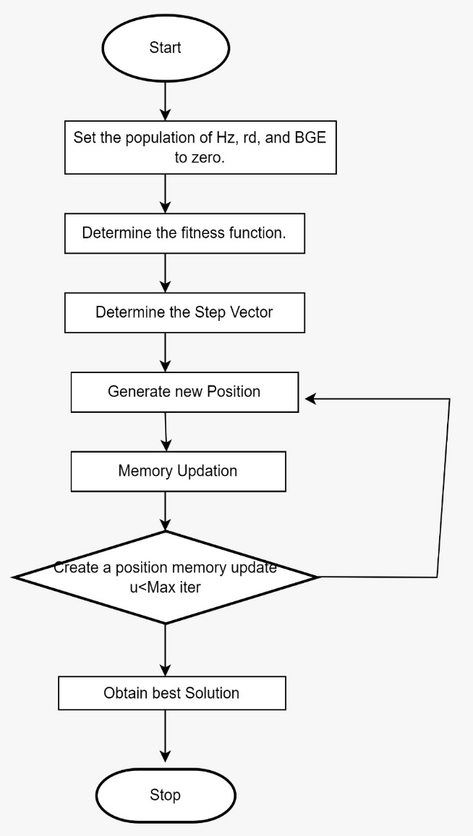
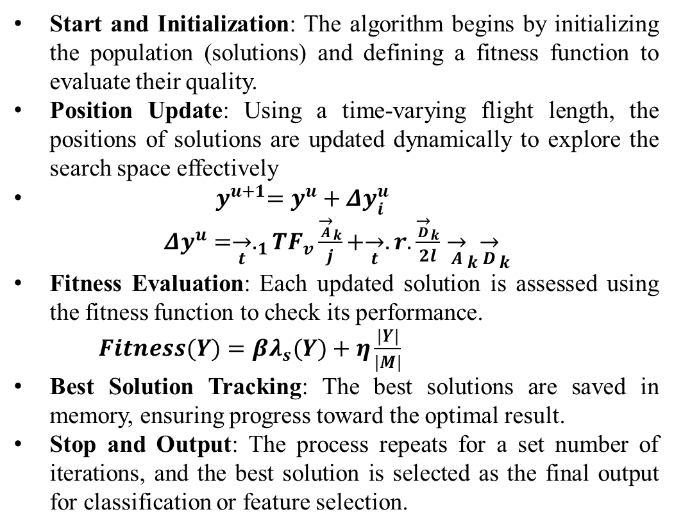
BLOCK DIAGRAM OR FLOW DIAGRAM
Start and Initialization: The algorithm begins by initializing the population (solutions) and defining a fitness function to evaluate their quality.
Position Update: Using a time-varying flight length, the positions of solutions are updated dynamically to explore the search space effectively
${ y}^{u+1}=y^{u}+Δy_{i}^{u}$
$Δy^{u}=\underset{t}{→}._{1}TF_{v}\frac{{\underset{A}{→}}_{k}}{j}+\underset{t}{→}.r.\frac{{\underset{D}{→}}_{k}}{2l}{\underset{A}{→}}_{k}{\underset{D}{→}}_{k}$
Fitness Evaluation: Each updated solution is assessed using the fitness function to check its performance.
$Fitness(Y)=βλ_{s}(Y)+η\frac{|Y|}{|M|}$
Best Solution Tracking: The best solutions are saved in memory, ensuring progress toward the optimal result.
Stop and Output: The process repeats for a set number of iterations, and the best solution is selected as the final output for classification or feature selection.
Fig: Flow chart for BGEO-TVFL

Slide 15
METHODOLOGY
The project utilizes five different medical datasets, including breast cancer, heart disease, diabetes, iris, and thyroid datasets. These datasets contain varying numbers of instances and features. Before applying the feature selection algorithm, data is preprocessed by normalizing the feature values to ensure optimal model performance.
Preprocessing Steps
To address these challenges, the following preprocessing techniques were employed:
Data Cleaning
Feature Scaling
Feature Encoding
Outlier Detection
S.no | Dataset | samples | Features | Class
01 | breast_cancer.csv | 117 | 9 | 2
02 | heart.csv | 304 | 13 | 2
03 | diabetes.csv | 769 | 8 | 2
04 | Iris.csv | 151 | 4 | 2
05 | thyroid_csv.xlsx | 3153 | 23 | 2
Fig 1: Dataset Description

Slide 16
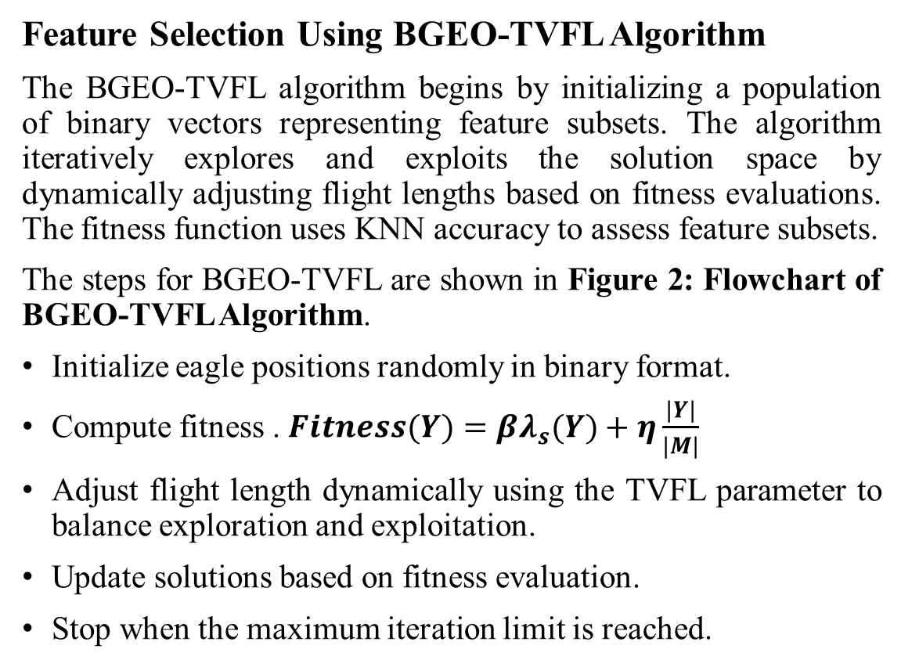
METHODOLOGY
Feature Selection Using BGEO-TVFL Algorithm
The BGEO-TVFL algorithm begins by initializing a population of binary vectors representing feature subsets. The algorithm iteratively explores and exploits the solution space by dynamically adjusting flight lengths based on fitness evaluations. The fitness function uses KNN accuracy to assess feature subsets.
The steps for BGEO-TVFL are shown in Figure 2: Flowchart of BGEO-TVFL Algorithm.
Initialize eagle positions randomly in binary format.
Compute fitness . $Fitness(Y)=βλ_{s}(Y)+η\frac{|Y|}{|M|}$
Adjust flight length dynamically using the TVFL parameter to balance exploration and exploitation.
Update solutions based on fitness evaluation.
Stop when the maximum iteration limit is reached.
Fig: Flow chart for BGEO-TVFL

Slide 17
METHODOLOGY
Classification Using K-Nearest Neighbor (KNN)
The BGEO-TVFL algorithm selects optimal feature subsets, which are then classified using KNN. This reduced feature set improves computational efficiency and enhances model accuracy, making it suitable for complex medical datasets
S.no | Dataset | Classification accuracy | Computational Time
01 | breast_cancer.csv | 91.66 | 5sec
02 | heart.csv | 90.16 | 7sec
03 | diabetes.csv | 88.9 | 10sec
04 | Iris.csv | 1 | 3sec
05 | thyroid_csv.xlsx | 96.03 | 120sec
Fig 2:BGEO-TVFL Classification Accuracy and Computational Time

Slide 18
METHODOLOGY
Comparative Performance Analysis
The BGEO-TVFL algorithm outperforms traditional optimization methods, including BWOA, BGWO, ACO, and ABC, in classification accuracy and computational efficiency across various medical datasets. Its ability to dynamically adapt and balance exploration and exploitation enables it to achieve higher accuracy and select fewer, more relevant features, contributing to its superior performance. This makes BGEO-TVFL a robust and effective solution for complex medical data classification tasks.

Slide 19
IMPLEMENTATION
Software Specifications:
Programming Language: Python
Libraries Used: TensorFlow, Keras, Scikit-Image, OpenCV, Matplotlib, Numpy, Seaborn
Data Storage: DDSM dataset in image format
Development Environment: Google Colab for model training and testing.
Hardware Specifications:
System: NVIDIA GPU-enabled machine for accelerated training.
Processor: Intel Core i7 or equivalent.
RAM: Minimum 16 GB for handling dataset and model complexity.
Storage: SSD for faster data access and storage.

Slide 20
IMPLEMENTATION
#KNN for breast_cancer.csv using BGEO-TVFL
import numpy as np
import pandas as pd
import time
from sklearn.model_selection import train_test_split
from sklearn.preprocessing import StandardScaler
from sklearn.neighbors import KNeighborsClassifier
from sklearn.metrics import accuracy_score
# Load the breast cancer dataset
data_path = "/content/drive/My Drive/AG4"
# Read the breast cancer data from the CSV file
breast_cancer_data = pd.read_csv(os.path.join(data_path, "breast_cancer.csv"))
# Assuming the last column is the target variable and the rest are features
X = breast_cancer_data.iloc[:, :-1].values # Use breast_cancer_data instead of data
y = breast_cancer_data.iloc[:, -1].values # Use breast_cancer_data instead of data
# Split the dataset into training and testing sets
X_train, X_test, y_train, y_test = train_test_split(X, y, test_size=0.2, random_state=42)
# Standardize the features if necessary
scaler = StandardScaler()
X_train = scaler.fit_transform(X_train)
X_test = scaler.transform(X_test)

Slide 21
IMPLEMENTATION
# BGEOTVFL Parameters
num_eagles = 20
max_iter = 100
dimension = X_train.shape[1]
# Initialize eagles' positions
eagles_position = np.random.randint(2, size=(num_eagles, dimension))
# Fitness function: accuracy of K-Nearest Neighbors
def fitness_knn(selected_features):
if np.sum(selected_features) == 0:
return 0
X_train_selected = X_train[:, selected_features == 1]
X_test_selected = X_test[:, selected_features == 1]
model = KNeighborsClassifier(n_neighbors=5)
model.fit(X_train_selected, y_train)
y_pred = model.predict(X_test_selected)
return accuracy_score(y_test, y_pred)
# BGEOTVFL Optimization Loop
best_solution = None
best_score = -1
worst_score = 1
all_scores = []
all_solutions = []

Slide 22
IMPLEMENTATION
average_solution = np.zeros(dimension)
# Measure start time
start_time = time.time()
for iteration in range(max_iter):
iteration_best_score = 0
iteration_best_solution = None
for i in range(num_eagles):
# Evaluate fitness of the current position
score = fitness_knn(eagles_position[i])
all_scores.append(score)
all_solutions.append(eagles_position[i].copy())
# Update best and worst score
if score > best_score:
best_score = score
best_solution = eagles_position[i].copy()
if score < worst_score:
worst_score = score
# Update iteration best score and solution
if score > iteration_best_score:
iteration_best_score = score
iteration_best_solution = eagles_position[i].copy()

Slide 23
IMPLEMENTATION
# Apply the BGEOTVFL algorithm logic
l = 0.05 + (0.95 - 0.05) * (iteration / max_iter)
if np.random.rand() < 0.5:
new_position = best_solution - l * np.abs(best_solution - eagles_position[i])
else:
new_position = best_solution + l * np.abs(best_solution - eagles_position[i])
# Convert position to binary based on thresholding
new_position = 1 / (1 + np.exp(-new_position))
new_position = np.where(new_position >= 0.5, 1, 0)
# Update the position
eagles_position[i] = new_position
# Calculate the average solution for this iteration
average_solution += np.array(iteration_best_solution)

Slide 24
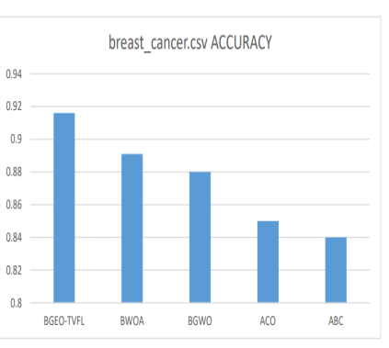
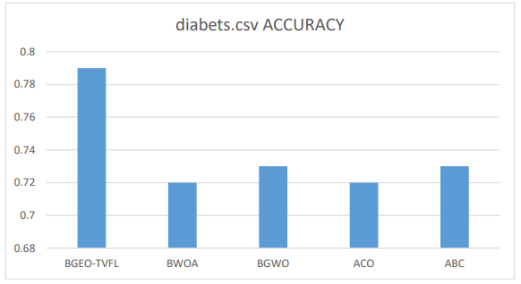
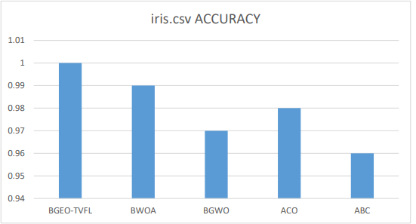
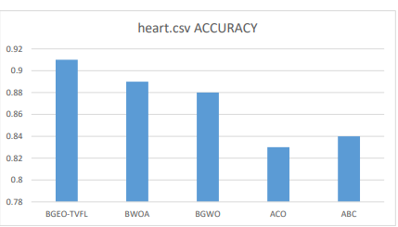
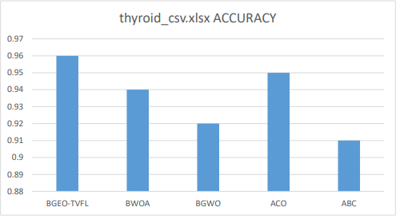
RESULTS & ANALYSIS
Fig : Accuracy graph for all datasets

Slide 25
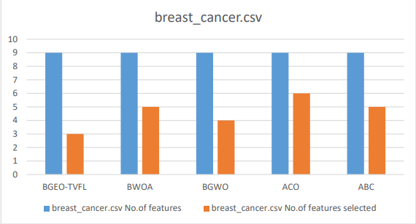
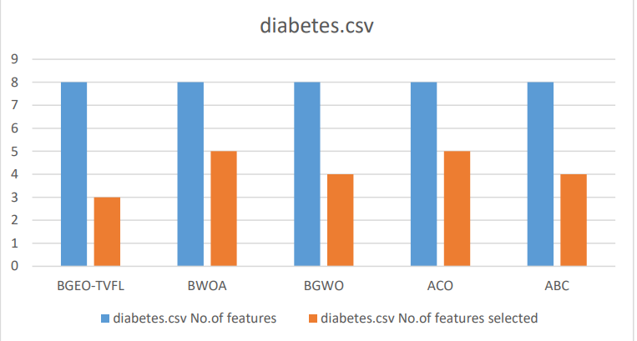
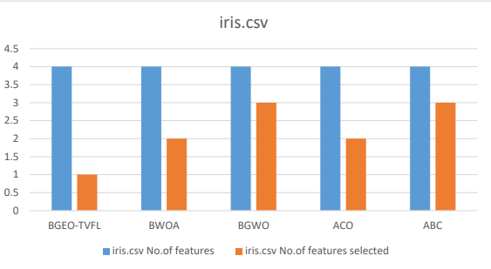
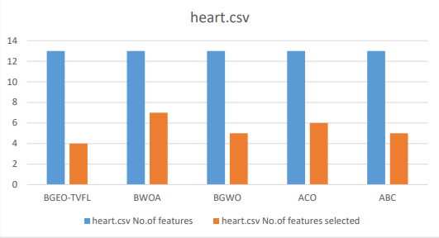
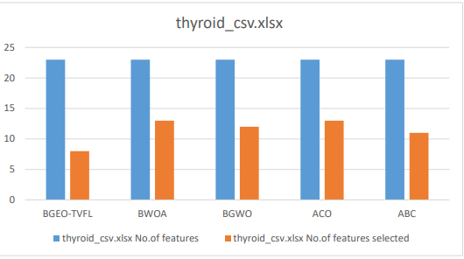
RESULTS & ANALYSIS
Fig : Classification graphs for all datasets

Slide 26
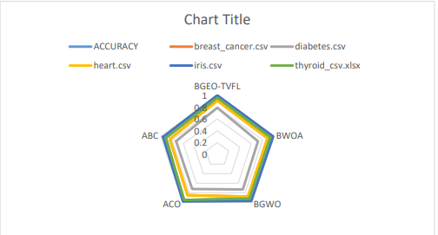
RESULTS & ANALYSIS
Fig : Radar Graph for all algorithms with all datasets

Slide 27
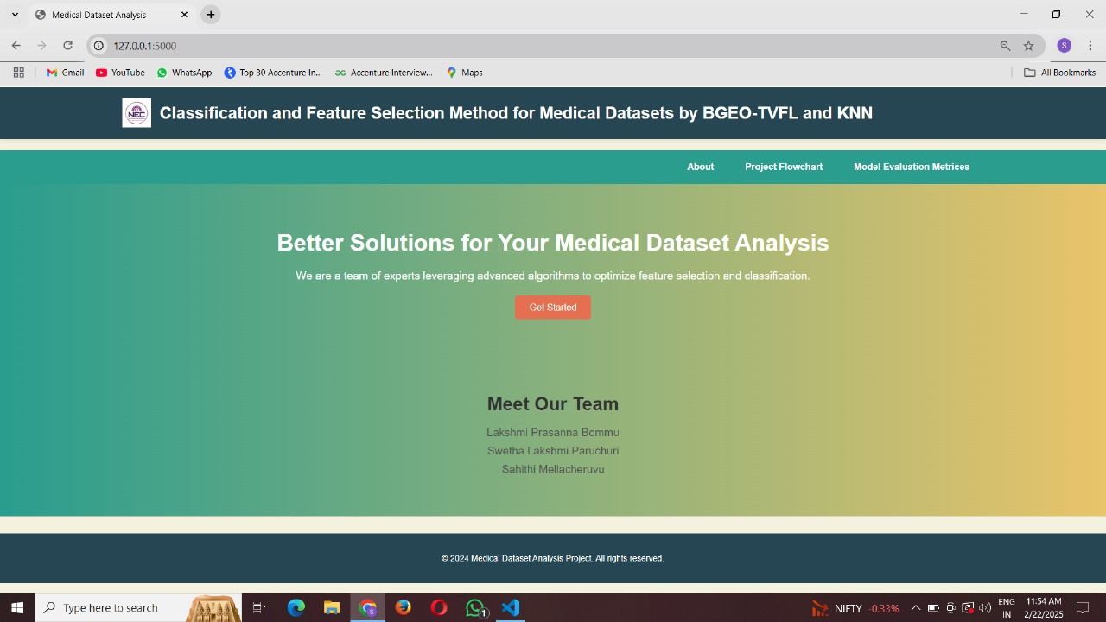
RESULTS & ANALYSIS
Fig: Home Page

Slide 28
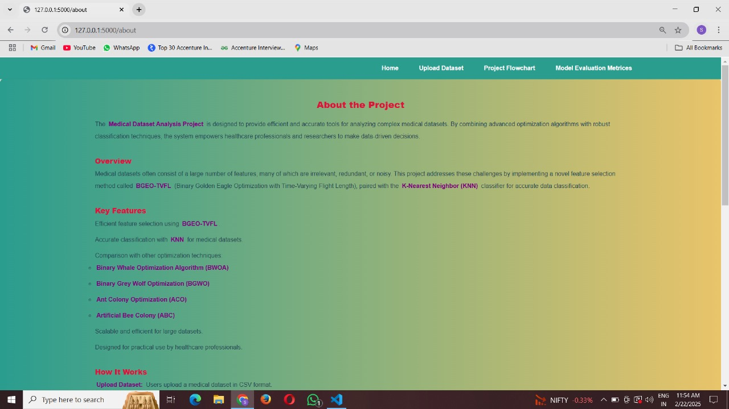
RESULTS & ANALYSIS
Fig: About Page

Slide 29
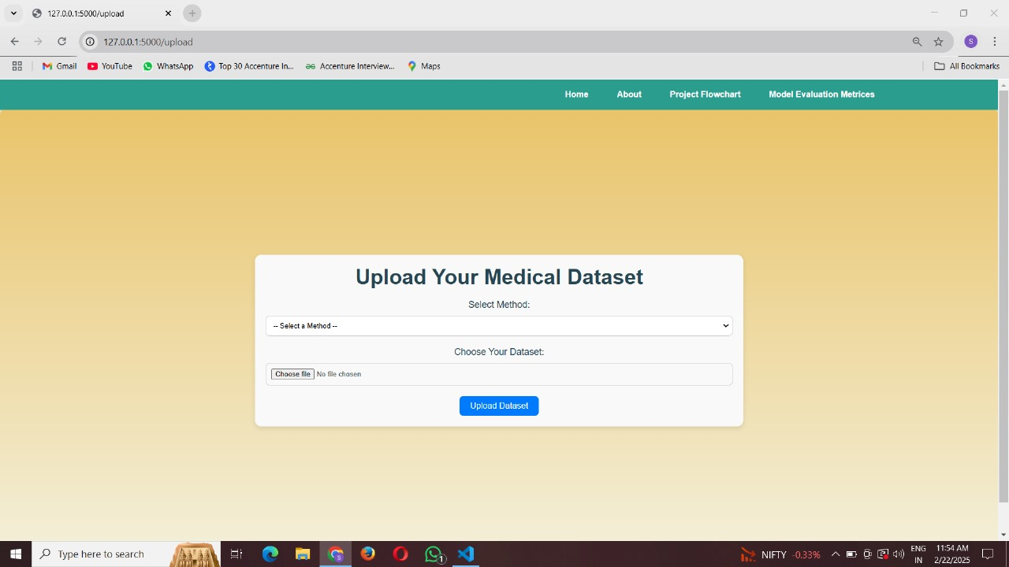
RESULTS & ANALYSIS
Fig: Upload Dataset Page

Slide 30
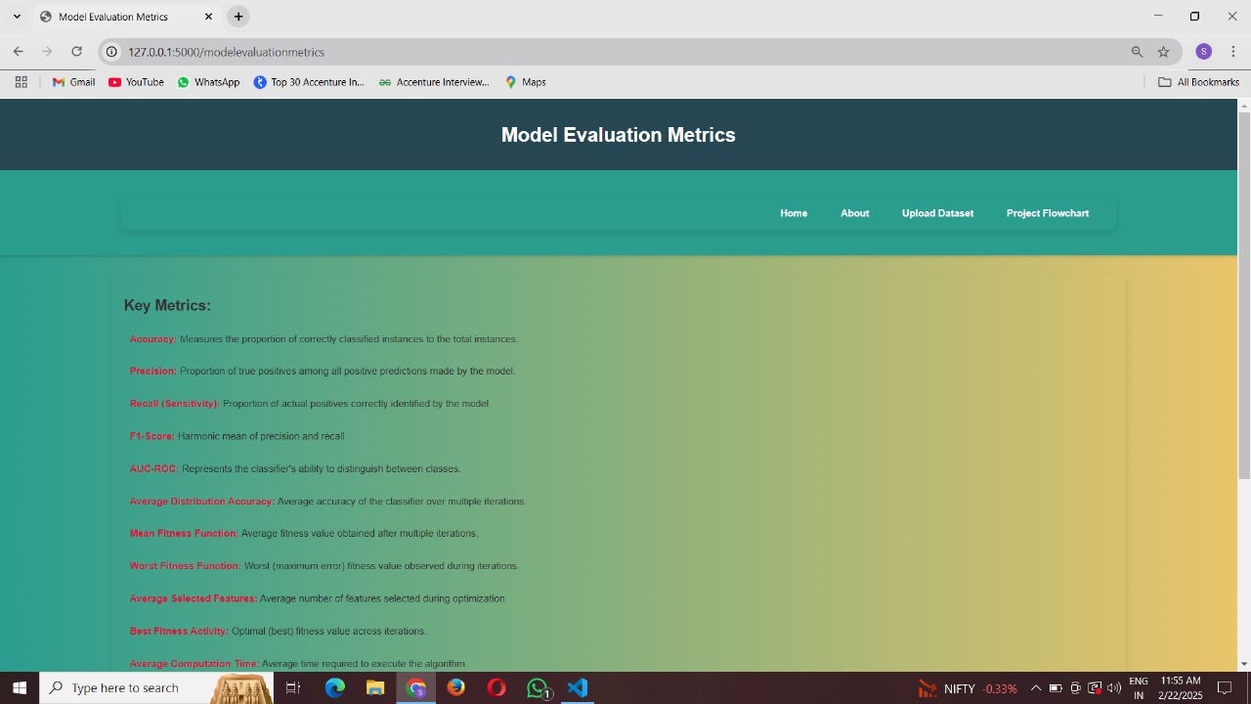
RESULTS & ANALYSIS
Fig: Model Evaluation Metrics

Slide 31
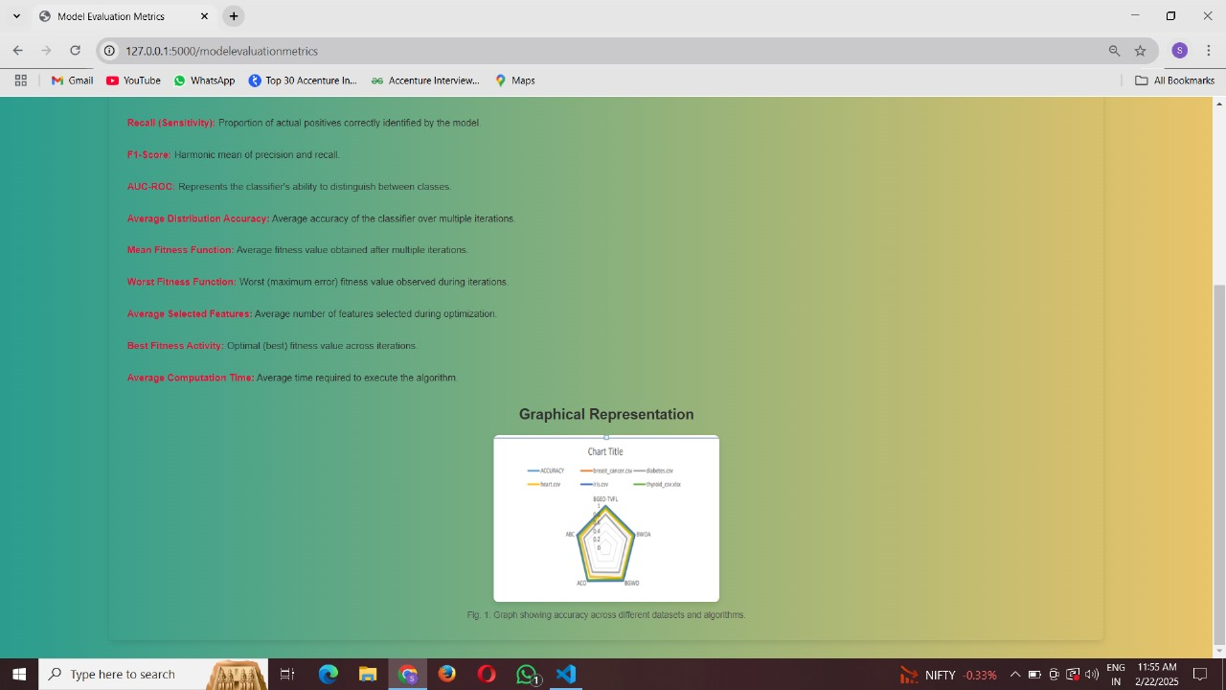
RESULTS & ANALYSIS
Fig: Model Evaluation Metrics

Slide 32
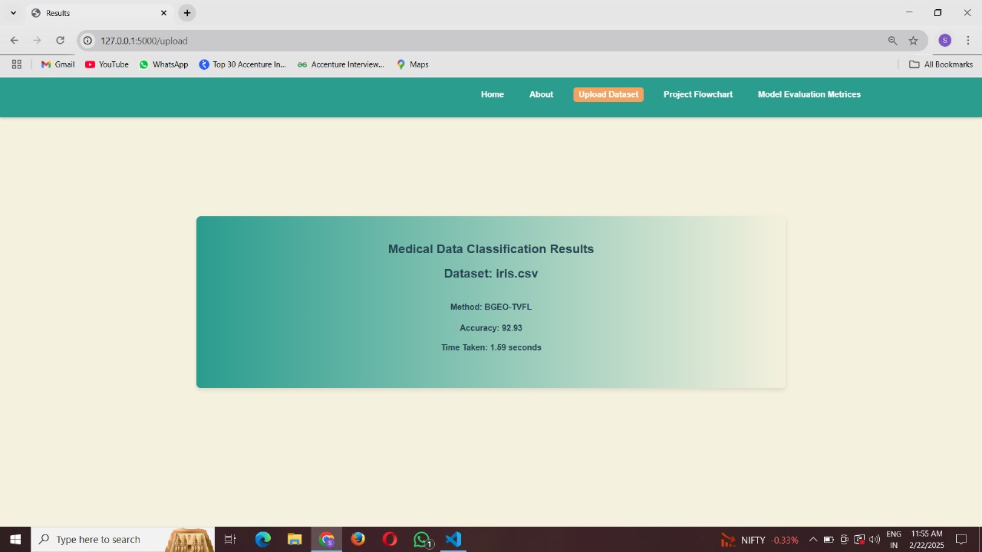
RESULTS & ANALYSIS
Fig: Result Page

Slide 33
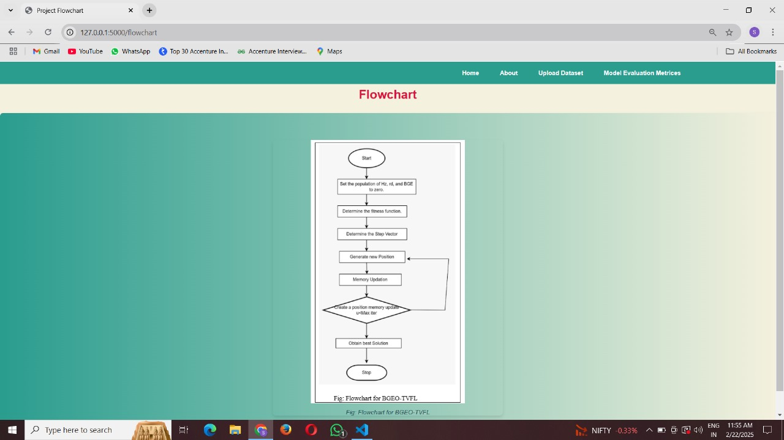
RESULTS & ANALYSIS
Fig: Flowchart

Slide 34
CONCLUSION
The Binary Golden Eagle Optimization with Time-Varying Flight Length (BGEO-TVFL) algorithm, combined with the K-Nearest Neighbor (KNN) classifier, was successfully applied to feature selection and classification tasks for diverse medical datasets. The proposed approach demonstrated superior performance compared to traditional optimization techniques, achieving higher classification accuracy and computational efficiency. By selecting fewer but more relevant features, BGEO-TVFL optimized the feature selection process, reducing complexity and enhancing model generalization. The experimental results confirmed the adaptability and robustness of the method across various datasets, including breast cancer, heart disease, diabetes, iris, and thyroid, with notable accuracy improvements. This study highlights the importance of combining advanced optimization techniques with efficient machine learning models to address the challenges posed by complex medical datasets. The findings suggest that the BGEO-TVFL approach can be a valuable tool for resource-limited healthcare settings, providing fast, accurate, and scalable solutions for medical data analysis and decision-making.

Slide 35
Future Scope
The project utilizes BGEO-TVFL and KNN for classification and feature selection on medical datasets, with vast potential for further development and application.
It can be extended to handle large-scale and high-dimensional medical datasets, such as genomic data, medical imaging (MRI and CT scans), and real-time patient monitoring.
Integrating advanced machine learning models, such as Support Vector Machines (SVM), Random Forests, or Deep Neural Networks, can further enhance classification accuracy and adaptability.
Deploying the project on cloud platforms, such as AWS or Azure, would make it accessible to healthcare providers and researchers for real-time classification and feature selection.
Hybridizing BGEO-TVFL with optimization techniques like Particle Swarm Optimization (PSO) or Genetic Algorithms (GA) can improve its efficiency and scalability for more complex datasets.
Incorporating explainable AI (XAI) would make the system more transparent and trustworthy, allowing healthcare professionals to understand the reasoning behind feature selection and classification decisions..

Slide 36
REFERENCES
Remeseiro, B., & Bolon-Canedo, V. (2019). A review of feature selection methods in medical applications. Computers in biology and medicine, 112, 103375.
Krishna, E. R., Devarakonda, N., Al-Shamri, M. Y. H., & Revathi, D. (2022). A novel hybrid clustering analysis based on combination of k-means and pso algorithm. In Data Intelligence and Cognitive Informatics: Proceedings of ICDICI 2021 (pp. 139-150). Singapore: Springer Nature Singapore.
Eluri, R. K., & Devarakonda, N. (2023). Chaotic binary pelican optimization algorithm for feature selection. International Journal of Uncertainty, Fuzziness and Knowledge-Based Systems, 31(03), 497-530.
Mafarja, M., Aljarah, I., Heidari, A. A., Hammouri, A. I., Faris, H., Ala’M, A. Z., & Mirjalili, S. (2018). Evolutionary population dynamics and grasshopper optimization approaches for feature selection problems. Knowledge-Based Systems, 145, 25-45.
Eluri, R. K., & Devarakonda, N. (2023). Feature selection with a binary flamingo search algorithm and a genetic algorithm. Multimedia Tools and Applications, 82(17), 26679-26730.
Mafarja, M., & Mirjalili, S. (2018). Whale optimization approaches for wrapper feature selection. Applied Soft Computing, 62, 441-453.

Slide 37
REFERENCES
Eluri, R. K., & Devarakonda, N. (2021, October). A concise survey on solving feature selection problems with metaheuristic algorithms. In International Conference on Advances in Electrical and Computer Technologies (pp. 207-224). Singapore: Springer Nature Singapore.
Durgam, R., Devarakonda, N., Nayyar, A., & Eluri, R. (2022). Improved genetic algorithm using machine learning approaches to feature modelled for microarray gene data. In Soft Computing for Security Applications: Proceedings of ICSCS 2021 (pp. 859-872). Springer Singapore
GU, S., Cheng, R., & Jin, Y. (2018). Feature selection for high-dimensional classification using a competitive swarm optimizer. Soft Computing, 22, 811-822.
Agrawal, R. K., Kaur, B., & Sharma, S. (2020). Quantum based whale optimization algorithm for wrapper feature selection. Applied Soft Computing, 89, and 106092.
Song, X. F., Zhang, Y., Gong, D. W., & Sun, X. Y. (2021). Feature selection using bare-bones particle swarm optimization with mutual information. Pattern Recognition, 112, 107804.
Uzer, M. S., Yilmaz, N., & Inan, O. (2013). Feature selection method based on artificial bee colony algorithm and support vector machines for medical datasets classification. The Scientific World Journal, 2013(1), 419187.

Slide 38
REFERENCES
Too, J., & Mirjalili, S. (2021). A hyper learning binary dragonfly algorithm for feature selection: A COVID-19 case study. Knowledge-Based Systems, 212, 106553.
Eluri, R. K., & Devarakonda, N. (2022). Binary golden eagle optimizer with time-varying flight length for feature selection. Knowledge-Based Systems, 247, 108771.
Faris, H., Hassonah, M. A., Al-Zoubi, A. M., Mirjalili, S., & Aljarah, I. (2018). A multi-verse optimizer approach for feature selection and optimizing SVM parameters based on a robust system architecture. Neural Computing and Applications, 30, 2355-2369.
Wang, X. D., Chen, R. C., Yan, F., Zeng, Z. Q., & Hong, C. Q. (2019). Fast adaptive K-means subspace clustering for high-dimensional data. IEEE Access, 7, 42639-42651.
Krishna, E. R., & Devarakonda, N. (2023, January). Feature selection method based on GWO-PSO for coronary artery disease classification. In 2023 Third International Conference on Advances in Electrical, Computing, Communication and Sustainable Technologies (ICAECT) (pp. 1-8). IEEE.

Slide 39

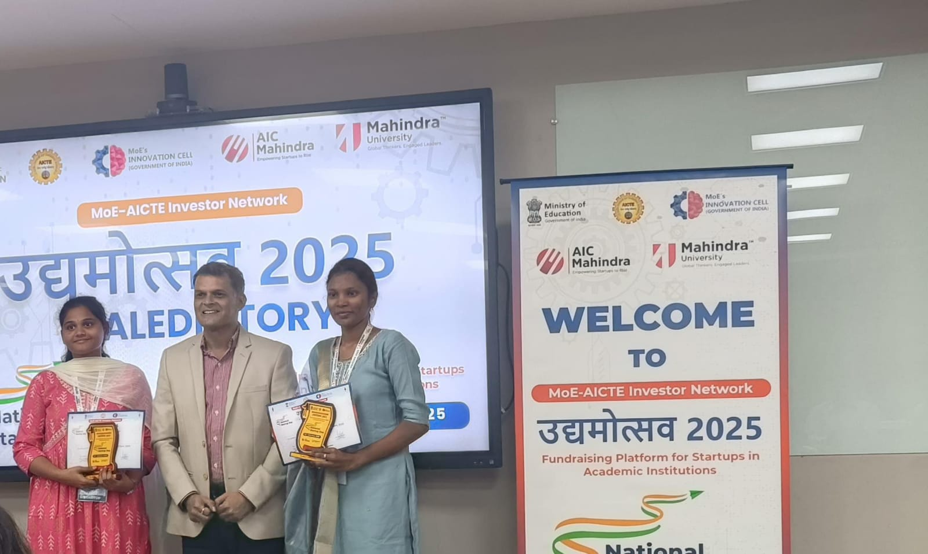
Achievements.

Slide 40
QUESTIONS and ANSWERS
Any Questions

Slide 41
ACKNOWLEGEMENTS
First, I would like to thank my team members for their dedication, hard work, and invaluable contributions throughout the development of this project. Without their collaboration and expertise, this project would not have been possible.
Thank you for the opportunity to present our research on the "Classification and Feature Selection Method for Medical Datasets by BGEO TVFL (Binary Golden Eagle Optimization-Time Varying Flight Length) and KNN (K-Nearest Neighbour)." We appreciate your interest in our work and are excited to contribute to advancements in medical data analysis and classification.
Bommu Lakshmi Prasanna
prasannabommu31@gmail.com
Paruchuri Swetha Lakshmi
swethaparuchuri43@gmail.com
Mellacheruvu Sahithi
sahithims54@gmail.com
.

Slide 42
Thank You

