Slide 1

Department of Computer Science and Engineering
Making Sleep Disorder Classification Using Optimized Machine Learning Models
PRESENTED BY
M. Dileep Kumar (21471A05A2)
D. Abhishikth (21471A0571)
Sk. Yalavarthi Alimoon (21471A05C5)
Under the Guidance of,
Y.Chandana _{M.Tech},
Asst. Professor,
Department of Computer Science and Engineering,
Narasaraopeta Engineering College (Autonomous),
Narasaraopet- 522 601.

Slide 2
OUTLINE
Abstract
Introduction
Literature Survey
Research Gaps
Problem Statement
Objectives
Block Diagram / Flow Diagram
Methodology
Implementation
Results and Analysis
Conclusion & Future Scope
References
Question and Answers
Acknowledgements

Slide 3
ABSTRACT
Sleep disorders have a significant impact on human health and early diagnosis is crucial for the improvement of quality of life. In this work, machine learning models that classify sleep disorders have been developed from the data set of 374 participants that comprises features relating to sleep health and lifestyle, such as sleep duration, physical activity, stress levels, and BMI. It has used many machine learning algorithms, like GNB, KNN, SVM, RF, Logistic Regression, and ANN/MLP Classifier. Dataset was highly preprocessed to deal with missing values and normalize features, thereby offering the best performance to the models. Feature engineering and optimization through a Genetic Algorithm improved the predictive ability of these models. GA was highly effective especially in the extraction of the most relevant features, improving the classification accuracy, and dealing with the problem of small dataset size. The best accuracy by GNB was achieved in combination with GA, namely 94%, compared to all other models: SVM 93%, Logistic Regression 92%, and ANN 93%. Importantly, issues like dealing with missing data and feature extraction, where meaningful features such as systolic and diastolic blood pressure levels had to be extracted, were addressed in order to enhance the outcome.

Slide 4
INTRODUCTION
Recently, sleeping disorders have emerged as a serious public health issue due to findings where sleep quality and duration directly impact the total well-being of an individual.
These technological developments in practice would bring much improvement in diagnosis and treatments. Such developments do heighten the quality of lives of afflicted people suffering from sleep disorders, but they also open pathways for future discoveries in sleep medicine.
The advancement of diagnostic tools and further research on treatment methodologies can help a healthcare provider deal better with the complexities of sleep-related disorders. Hence, this approach can lead to better care and improved long-term health outcomes.

Slide 5
LITERATURE SURVEY
No | Title | Author | Journal Name & Year | Methodology Adapted | Key Findings | Gaps
1 | "Classification of sleep disorders using random forest on sleep health and lifestyle dataset" | I. A. Hidayat | https://journal.ittelkompwt.ac.id/index.php/dinda/article/download/1215/356 | Utilized Random Forest to classify sleep disorders | Demonstrated effectiveness of random forest model. | Limited exploration of advanced models.
2 | “A portable GUI-based sleep disorder system classification based on CNN in Raspberry Pi" | A. Atianashie Miracle, E. Armah, N. Mohammed | https://ieeexplore.ieee.org/abstract/document/10404662/ | CNN on raspberry pi | Portable system for classifying sleep disorders. | Raspberry pi is not powerful as regular computer so it will be slow.
3 | "Automated Identification of Sleep Disorder Types Using Triplet Half-Band Filter and Ensemble ml Techniques with EEG Signals" | M. Sharma, J. Tiwari, V. Patel, U. R. Acharya | https://www.thaiscience.info/Journals/Article/JHRE/10985248.pdf | EEG data collection. | High accuracy with ensembled models. | Dependency on EEG data.
4 | Prediction of sleep apnea in Korean adults using ml | Y.J.Kim,Jeon,G,Kong. | https://journals.healio.com/doi/full/10.3928/0048-5713-19870701-07 | Used ML techniques. | Developed accurate models for sleep apnea. | Limited to specific dempgraphic.
5 | Sleep disorders and their classification–an overview | P. Levy, V. Viot-Blanc, and J.-L. Pépin | https://karger.com/Article/PDF/93136 | Used icsd frame work | Discussed the interplay between sleep disorders and cardiovascular health. | Lack of discussion on advancements in automated diagnostic tools.

Slide 6
RESEARCH GAPS
Limited Large-Scale Datasets: Lack of diverse, large-scale datasets with labeled sleep disorder data, particularly from varied demographic groups.
Data Quality and Noise: Inconsistent and noisy data from wearable devices and home-based sleep trackers, affecting the accuracy of classification models.
Explainability of AI Models: Many machine learning models used for classification lack interpretability, making it difficult for healthcare providers to trust or use them in clinical settings.
Standardization of Metrics and Methods: Lack of standardized evaluation metrics and methodologies across different studies, making it challenging to compare results.

Slide 7
PROBLEM STATEMENT
A significant portion of the global population suffers from sleep disorders (e.g., insomnia, sleep apnea).
Untreated sleep disorders lead to serious health consequences such as cardiovascular diseases, mental health issues, diabetes, and decreased quality of life.
Insufficient, inconsistent, or noisy data from existing sleep tracking tools hinder accurate classification and diagnosis of sleep disorders.

Slide 8
OBJECTIVES
To accurately identify and differentiate between various sleep disorders (e.g., insomnia, sleep apnea) based on physiological data and behavioral patterns.
To provide actionable insights to individuals about their sleep habits, helping them improve their sleep hygiene and overall quality of life.
To reduce the need for manual interpretation of sleep data by healthcare professionals, leading to more efficient use of resources and a reduction in healthcare costs.
To enable early identification of sleep disorders, which can lead to quicker intervention and prevent further health complications associated with poor sleep, such as cardiovascular issues, diabetes, or mental health disorders.

Slide 9
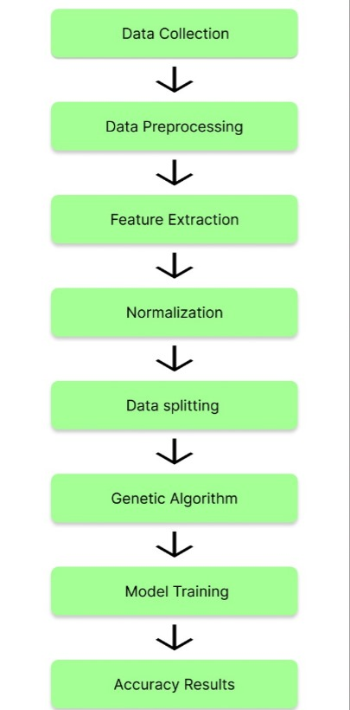
METHODOLOGY

Slide 10
METHODOLOGY
1.Dataset: Used "Sleep Health and Lifestyle" dataset with 374 participants and 12 features.
2. Preprocessing - Null Values: Handled null values by replacing them with "none.“
3. Feature Extraction: Derived hidden features like systolic and diastolic blood pressure.
4. Label Encoding: Converted categorical data (e.g., gender, occupation) to numerical values.
5. Standardization: Scaled features to a uniform range for consistent model training.
6. Feature Selection: Applied Genetic Algorithm (GA) to optimize and reduce input features.
7. Model Training: Trained six models – GNB, SVM, RF, KNN, ANN, and Logistic Regression.
8. Performance Metrics: Evaluated models using accuracy, F1-score, precision, and recall; GNB achieved 94% accuracy.

Slide 11
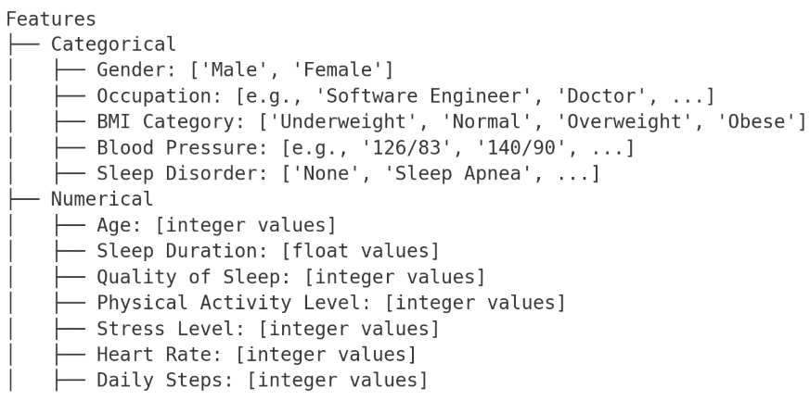
IMPLEMENTATION
DATA SET
The data is collected from the Kaggle named as “Sleep Health and Lifestyle” This dataset covers 374 participants with 12 features. It dives into their habits, work life, physical activities, health markers like heart & blood pressure. Researchers generally use it to see how these factors might affect sleep quality or even lead to issues like sleep apnea and Insomnia.

Slide 12
Preprocessing:
Handling Null Values: Null values can cause the data inconsistency and may the model cannot be trained well at the same time there will be the downfall in achieving accuracy. In our dataset the target column contains the null values we replace it with the ‘none’ .
Feature Extraction
Extracted relevant features like upper and lower blood pressure levels.
Added derived features for better model performance.
Label Encoding
Transformed categorical variables into numerical values using label encoding
Example: "Gender" converted to 0 (Male) and 1 (Female).
Data Normalization
Scaled numeric values to improve model convergence and avoid biases.

Slide 13
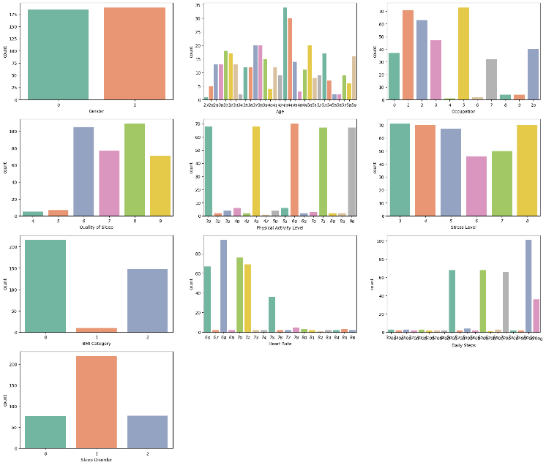
Analysis of features :
a.Categorical columns
categorical columns are often used with a non-numerical type and also it can be converted into a numerical columns in machine learning. In our dataset the categorical columns are divided as gender, age, occupation, bmi category, sleep duration etc. We used the count plot graphs to analyse and distribution of each category.

Slide 14
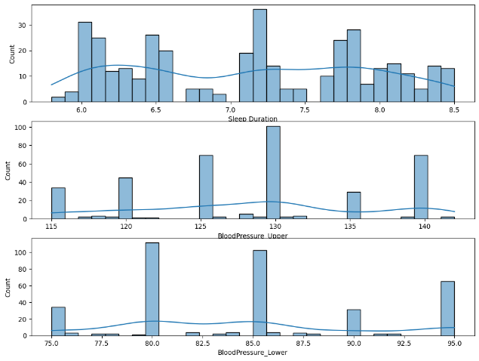
Numerical Columns:
Numerical features are quantitative and it also can be a continuous and discrete. In our dataset contains the numerical columns like sleep duration, blood pressure upper and blood pressure lower which deals with the effective model training and understanding to the model.

Slide 15
Model Selection
Gaussian Naive Bayes (GNB)
A probabilistic classifier based on Bayes' Theorem.
Assumes independence among predictors (features).
Best suited for small datasets with simple relationships between features.
Achieved 94% accuracy in the project.
Multi-Layer Perceptron (MLP)
A type of artificial neural network with one hidden layer.
Utilizes backpropagation for training.
Suitable for learning non-linear patterns in data.
Achieved 93% accuracy in the project with optimized hyperparameters.
Random Forest
An ensemble learning method using multiple decision trees.
Reduces overfitting by averaging predictions across trees.
Handles large datasets with high dimensionality effectively.
Achieved 92% accuracy in the project.

Slide 16
Genetic Algorithm
Steps:
Initialization: Create random solutions.
Selection: Choose the best individuals.
Crossover: Combine solutions to produce offspring.
Mutation: Introduce random changes.
Replacement: Replace old solutions with new ones.

Slide 17
Challenges Faced
Data Quality and Availability:Sleep disorder datasets are often small, unbalanced, or incomplete, making it difficult to train reliable models.
Model Complexity and Overfitting:Machine learning models may become overfit to the training data, making them less effective when applied to new, unseen data
Interpretability and Trust:Many advanced machine learning models lack transparency, making it challenging for healthcare providers to trust and interpret the model's results.
Ethical and Privacy Concerns:Collecting and storing sensitive sleep data raises privacy and security concerns, especially with the widespread use of personal devices for data collection.

Slide 18
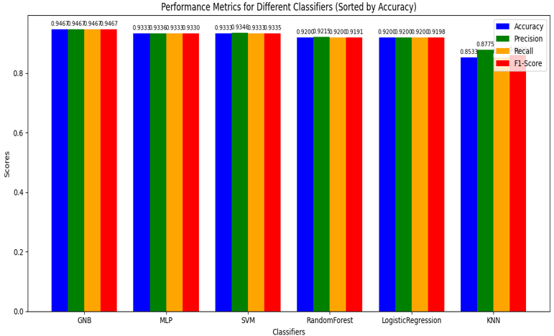
RESULTS & ANALYSIS
GNB: 94.67% accuracy
MLP: 93.30% accuracy.
SVM: 93% accuracy.
Random Forest: 92% accuracy.
Logistic:92% accuracy.
KNN:85% accuracy.

Slide 19
CONCLUSION and FUTURE SCOPE
CONCLUSION
Accuracy of Classification: The model demonstrated a high accuracy rate in classifying different sleep disorders, such as insomnia, sleep apnea.
Improved Diagnosis: The model offers a more objective and efficient tool for diagnosing sleep disorders, potentially aiding healthcare professionals in early intervention and treatment.
FUTURE SCOPE
Incorporating More Data: Integrating a broader range of sleep data sources (e.g., wearable devices, smartphone apps) could enhance the model's robustness and accuracy.Address any limitations of project.
Data Quality and Availability: The accuracy of the model is heavily dependent on the quality and amount of training data, which may be limited or inconsistent for certain populations.

Slide 20
REFERENCES
P. Levy, V. Viot-Blanc, and J.-L. Pépin, "Sleep disorders and their classification–an overview," Sleep Apnea, vol. 35, pp. 1-12, 2006.
C. R. Soldatos, J. D. Kales, T. L. Tan, and A. Kales, "Classification of sleep disorders," Psychiatric Annals, vol. 17, no. 7, pp. 454-458, 1987.
A. Atianashie Miracle, E. Armah, and N. Mohammed, "A portable GUI-based sleep disorder system classification based on convolution neural networks (CNN) in Raspberry Pi," J Eng Appl Sci Human, vol. 6, pp. 13-23, 2021.
T. Wongsirichot and A. Hanskunatai, "A classification of sleep disorders with optimal features using machine learning techniques," J Health Res, vol. 31, no. 3, 2017.
T. Alshammari, "Applying machine learning algorithms for the classification of sleep disorders," IEEE Access, 2024.
P. K. Yadav, U. K. Singh, J. J. A. Kovilpiaali, and R. Tamilarasi, "Sleep disorder detection using machine learning method," in 2023 2nd International Conference on Automation, Computing and Renewable Systems (ICACRS), IEEE, pp. 1530- 1532, 2023

Slide 21
I. A. Hidayat, "Classification of sleep disorders using random forest on sleep health and lifestyle dataset," Journal of Dinda: Data Science, Information Technology, and Data Analytics, vol. 3, no. 2, pp. 71-76, 2023.
G. Airlangga, "Evaluating machine learning models for predicting sleep disorders in a lifestyle and health data context," JIKO (Jurnal Informatika dan Komputer), vol. 7, no. 1, pp. 51-57, 2024.
J. Ramesh, N. Keeran, A. Sagahyroon, and F. Aloul, "Towards validating the effectiveness of obstructive sleep apnea classification from electronic health records using machine learning," Healthcare, vol. 9, no. 11, p. 1450, 2021.
Y. J. Kim, J. S. Jeon, S.-E. Cho, K. G. Kim, and S.-G. Kang, "Prediction models for obstructive sleep apnea in Korean adults using machine learning techniques," Diagnostics, vol. 11, no. 4, p. 612, 2021.
M.Sireesha, S. N. TirumalaRao, Srikanth Vemuru, Optimized Feature Extraction and Hybrid Classification Model for Heart Disease and Breast Cancer Prediction International Journal of Recent Technology and Engineering Vol - 7, No 6, Mar - 2019 ISSN - 2277-3878, Pages – 1754 – 1772

Slide 22
gvl
Sleep Health and Lifestyle Dataset. Available at: http://www.kaggle.com/datasets/uom190346a/sleep-health-andlifestyledataset, 2023.
M. Sharma, J. Tiwari, V. Patel, and U. R. Acharya, "Automated identification of sleep disorder types using triplet half-band filter and ensemble machine learning techniques with EEG signals," Electronics, vol. 10, no. 13, p. 1531, 2021.
Sunayna, S. Siva, SN Thirumala Rao, and M. Sireesha. "Performance evaluation of machine learning algorithms to predict breast cancer." In Computational Intelligence in Data Mining: Proceedings of ICCIDM 2021, pp. 323-335. Singapore: Springer Nature Singapore, 2022
Moturi, Sireesha, Jhansi Vazram Bolla, M. Anusha, M. Mounika Naga Bhavani, Srikanth Vemuru, SN Tirumala Rao, and Sneha Ananya Mallipeddi. "Prediction of Liver Disease Using Machine Learning Algorithms." In International Conference on Data Science and Applications, pp. 243-254. Singapore: Springer Nature Singapore, 2023.

Slide 23
QUESTIONS and ANSWERS
What is the primary objective of the study?
Ans: The study aims to develop machine learning models for classifying sleep disorders using a dataset of 374 participants.
2.Which machine learning algorithms were utilized in the research?
Ans: The research employed GNB, KNN, SVM, RF, Logistic Regression, and ANN/MLP Classifier.
3.How was the dataset prepared for analysis?
Ans: The dataset underwent extensive preprocessing to handle missing values and normalize features.
4.What role did Genetic Algorithms (GA) play in the study?
Ans: GA was used for feature selection and optimization, enhancing the predictive ability of the models.
5.What was the highest accuracy achieved by any model in the study?
Ans: The Gaussian Naive Bayes (GNB) model along with genetic algorithm (GA) achieved the highest accuracy of 94%.

Slide 24
6.What are the implications of the study for healthcare professionals?
Ans: The proposed model can assist healthcare professionals in diagnosing sleep-related conditions more efficiently.
7.What limitations were acknowledged in the study?
Ans: The study recognized the small dataset size and potential biases that may affect generalizability.
8.How does the study contribute to advancements in sleep medicine?
Ans: It provides a scalable and automated classification tool that can improve real-time diagnostics and healthcare outcomes.
9.What future research directions does the paper suggest?
Ans: Future studies should focus on larger, more diverse datasets and explore the application of deep learning models.
10.How does the performance of GNB compare to other classifiers in terms of computational efficiency?
Ans: GNB demonstrated greater computational efficiency and faster training times compared to MLP, making it suitable for real-time applications.

Slide 25
ACKNOWLEGEMENTS
Gratitude to the faculty and mentors at NEC for their guidance and support.
Appreciation for the access to the Sleep ,Health and life style dataset by henry shun, which was critical for the project.
Thanks to the open-source community for providing resources and pre-trained Machine learning models.
Acknowledgment of team members for their collaboration and dedication throughout the project.
Special thanks to [Y. Chandana, M. Sireesha and S. Siva Nageswararao] for their valuable inputs and assistance.

