Slide 1

Department of Computer Science and Engineering
Multimodal Cyberbullying Detection Using Deep Learning Techniques
PRESENTED BY
Bolla Lakshmi Varsha 21471A0577
Kalyanam Jahnavi Sai Priya 21471A0591
Sunkari Kavya 21471A05C9
Velchuri Bala Harshitha 21471A05D6
Under the Guidance of,
Shaik Rafi _{MTech}
Asst. Professor,
Department of Computer Science and Engineering,
Narasaraopeta Engineering College (Autonomous),
Narasaraopet- 522 601.

Slide 2
OUTLINE
Abstract
Introduction
Literature Survey
Research Gaps
Problem Statement
Objectives
Block Diagram / Flow Diagram
Methodology
Implementation
Results and Analysis
Conclusion & Future Scope
References
Question and Answers
Acknowledgements

Slide 3
ABSTRACT
Cyberbullying detection is the process of detecting cyberbullying activity, which includes using technology to harass or threaten people usually via online platforms. In order to address this, we examined a publicly available dataset. Next we trained a deep learning model to recognize cyberbullying in multimodal data. The VGG16 pre-trained model detects bullying in images. The XLM-RoBERTa with BiGRU model detects bullying in text. By combining these models (VGG16 + XLM-RoBERTa and BiGRU), we created a model for detecting cyberbullying in image-text based memes.Our final model showed that the algorithm is able to identify most cyberbullying occurrences with a decent accuracy of 74%.

Slide 4
INTRODUCTION
Cyberbullying on social media platforms is a growing concern, targeting individuals through harmful text and images.
Cyberbullying can be conveyed through various formats, including text-only posts, images, and memes that combine text and visuals.
Traditional models often focus on a single modality (either text or image), which limits detection scope.
Objective : This study proposes a multimodal approach to enhance detection accuracy by combining text and image data for cyberbullying detection.
Research Goal : To provide a comprehensive model that accurately detects cyberbullying and creates a safer online environment using advanced deep learning techniques across multiple modalities.

Slide 5
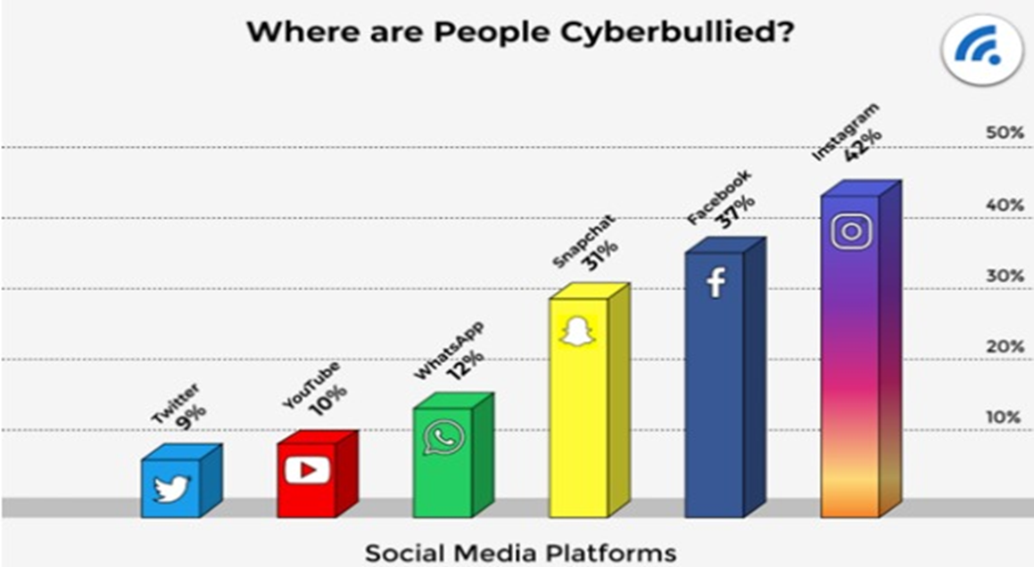
Fig : Global statistics Graph

Slide 6
LITERATURE SURVEY
No | Title | Author | Journal Name & Year | Methodology Adapted | Key Findings | Gaps
1 | A Multitask Framework for Sentiment, Emotion and Sarcasm aware Cyberbullying Detection from Multi-modal Code-Mixed Memes | Krishanu Maity et al. | ACM journal-2022 DOI:10.1145/3477495.3531925 | ResNet, mBERT, Bi-GRU | Achieved 72% accuracy for bullying detection in meme dataset. | Very complex model and slow processing.
2 | Towards Cyberbullying-Free Social Media in Smart Cities: A Unified Multi-Modal Approach | Kumari et al. | Springer-2020 DOI:10.1007/s00500-019-04550-x | CNN, TFIDF | Achieved 71% accuracy for bullying detection. | Simplistic feature integration reduces detection accuracy.
3 | Multimodal Cyberbullying Meme Detection from Social Media Using Deep Learning Approach | Md. Tofael Ahmed et al. | IJCSIT-2023 DOI:10.5121/ijcsit.2023.15403 | VGG16, BiLSTM | Achieved accuracy of 85% on balanced meme dataset. | Dataset is limited to a single language.
4 | Overcoming the Challenge of Cyberbullying Detection in Images: A Deep Learning Approach with Image Captioning and OCR Integration | Subbaraju Pericherla et al. | IJCDS-2023 DOI:10.12785/ijcds/150130 | VGG16, LSTM, OCR | Achieved 98.23% accuracy showing effectiveness of combining OCR and image-text analysis. | Model performance might not generalize well to multilingual content.
5 | Multimodal Detection of Cyberbullying on Twitter | Jiabao Qiu | scholorworks-2021 https://doi.org/10.31979/etd.4gxb-t5vx | VGG19, CNN | Achieved accuracy of 93% on the twitter data. | The study is limited to only twitter dataset.

Slide 7
LITERATURE SURVEY
Integrating text and image features enables the detection of bullying across a wide range of data.
Limited availability of large-scale, balanced multimodal datasets restricts the robustness and generalizability of existing models.
Most models are not optimized for real-time social media content analysis, which is crucial for early cyberbullying detection.
The reviewed studies justify the choice of combining VGG16 for image feature extraction and BiGRU for contextualized text understanding in our project.
Insights from challenges in dataset diversity and imbalance influenced our preprocessing techniques to ensure a balanced and comprehensive dataset for training and evaluation.

Slide 8
RESEARCH GAPS
Limited Multimodal Focus: Most studies prioritize text or image independently, overlooking their combined context.
Dataset Constraints: Existing datasets are often small, homogeneous, or lack real-world diversity.
Real-Time Detection: Few systems are optimized for real-time applications on dynamic social media platforms.
Multilingual Challenges: Models lack adaptability to content in multiple languages, particularly in culturally diverse settings.

Slide 9
PROBLEM STATEMENT
In today’s digital era, the widespread use of social media platforms has led to a significant rise in cyberbullying.
This form of harassment often occurs through comments in the form of text and images, severely impacting the mental and emotional well-being of victims.
Existing models either focus on text or images independently, failing to address the complexities of combined modalities.
The wide spread of cyberbullying in multimodal formats like memes poses unique challenges for detection.

Slide 10
OBJECTIVES
Designed a deep learning-based system for effective multimodal cyberbullying detection.
Developed a unified model using transfer learning models like VGG16 for images and XLM-RoBERTa with BiGRU for text.
Ensure robustness in detecting cyberbullying across diverse formats, including memes.
Build a complete pipeline for multimodal cyberbullying detection, encompassing preprocessing, model training, and deployment.

Slide 11
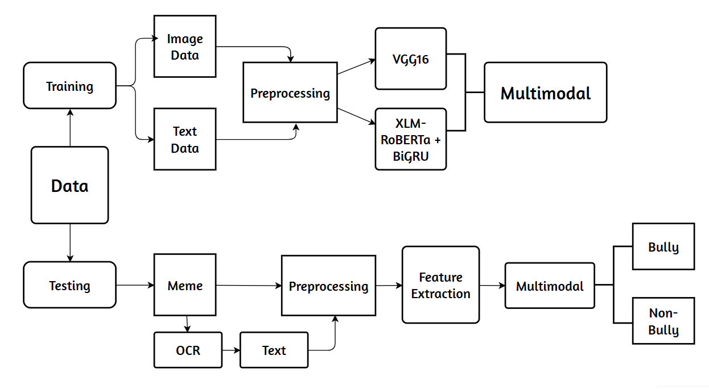
BLOCK DIAGRAM OR FLOW DIAGRAM

Slide 12
METHODOLOGY
About Dataset
Data Preprocessing
Image Preprocessing
Text Preprocessing
Proposed Work
Image Architecture
Text Architecture
Multimodal Development

Slide 13
METHODOLOGY
The dataset was first collected and preprocessed to eliminate null values and redundant entries, ensuring data quality.
After the data was divided into training and testing subsets .
Individual preprocessing was performed on the image and text data, tailored to their specific requirements.
Separate models were then trained independently on the preprocessed image and text data.
Finally, the features from both modalities are combined to enable the detection of bullying in multimodal data.

Slide 14
About Dataset
For this research, we utilized a dataset having 6,006 posts.
The Dataset consists of an images folder having all images in it and a .csv file which contains the label and text regarding each image in the folder.
Individual preprocessing is done on image and text data.
After preprocessing, the dataset was reduced to 5,798 posts, evenly distributed between bully and non-bully categories.
The data was then split into training and testing sets, with 80% allocated for training and 20% reserved for testing.

Slide 15
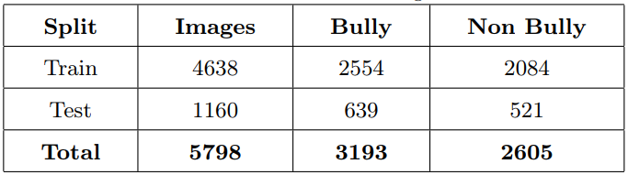
Fig: Train and Test Split of data

Slide 16
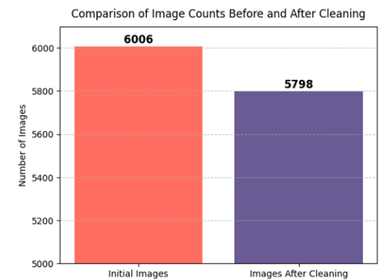
Data Preprocessing
Image Preprocessing:
Initially there are a lot of corrupted files and null files in the Images Folder. So in order to eliminate them we have used PIL Library and removed all those files.
After removing, the count was reduced from 6006 posts to 5798 posts.
The following graph shows the comparision of images before and after cleaning.

Slide 17
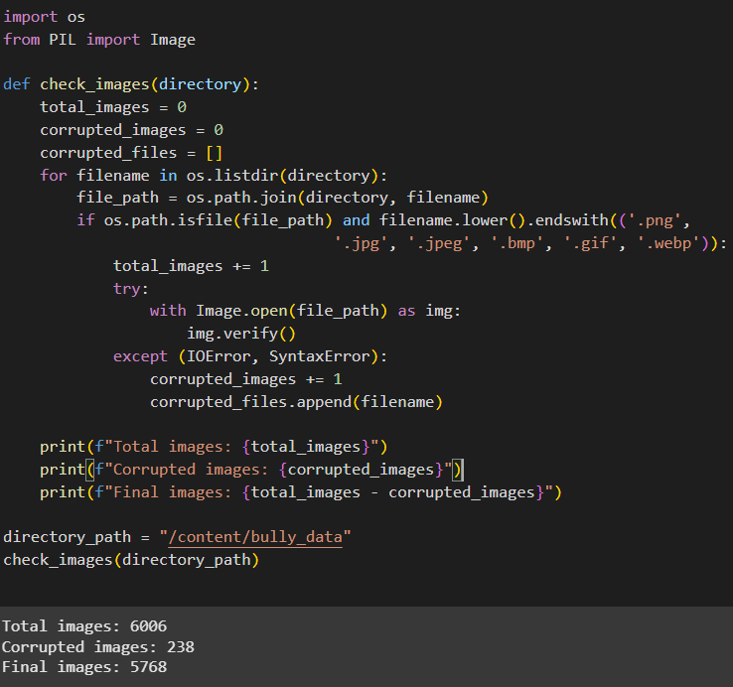
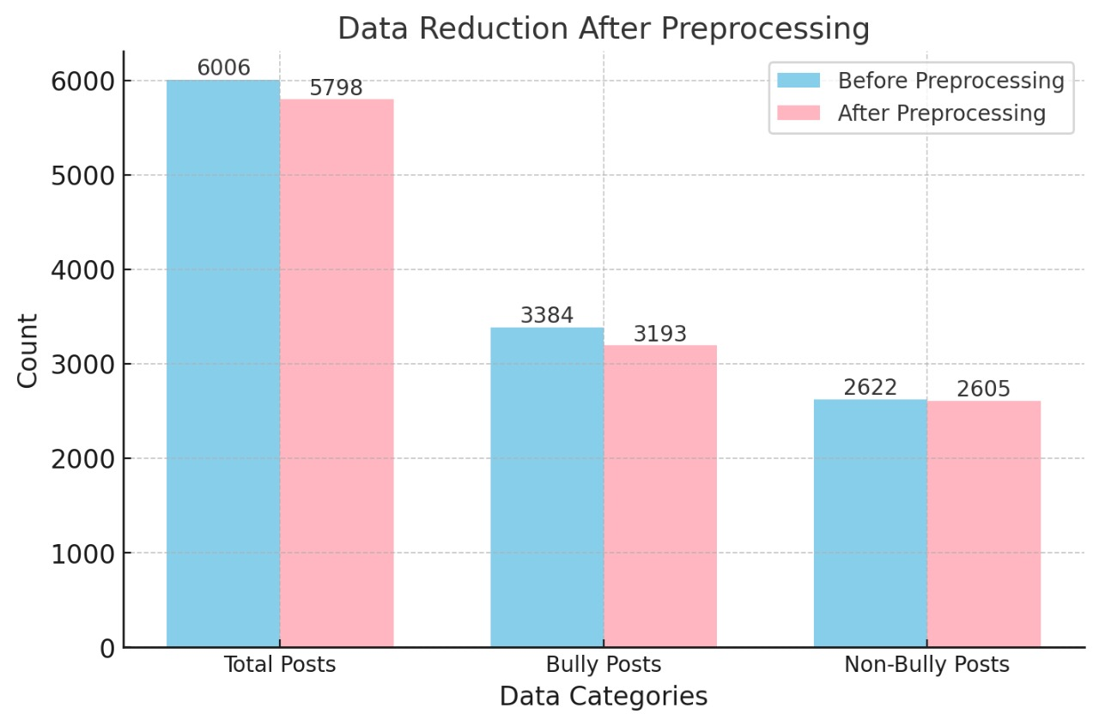
Fig: Data Reduction After Preprocessing

Slide 18
Data Preprocessing
Image Preprocessing:
Data Augmentation : Applied techniques like rotation, flipping, zooming, and brightness adjustment to expand the dataset and improve model generalization.
Resizing : Scaled images to a fixed size of 224x224 to maintain consistency with the VGG16 model input requirements.
Normalization : Pixel values normalized to the range [0, 1] using a scaling factor of 1/255 for compatibility with deep learning models.

Slide 19
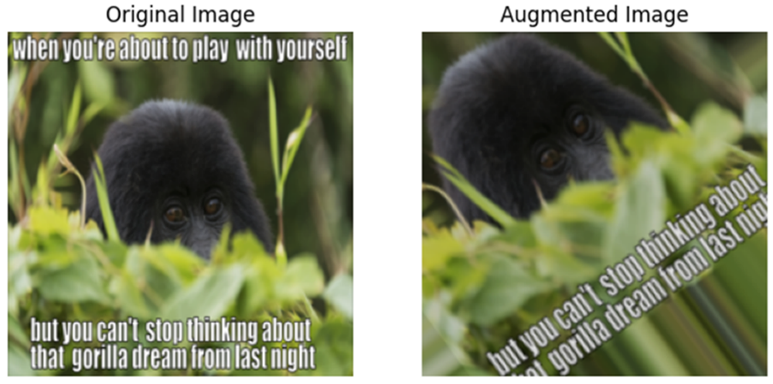
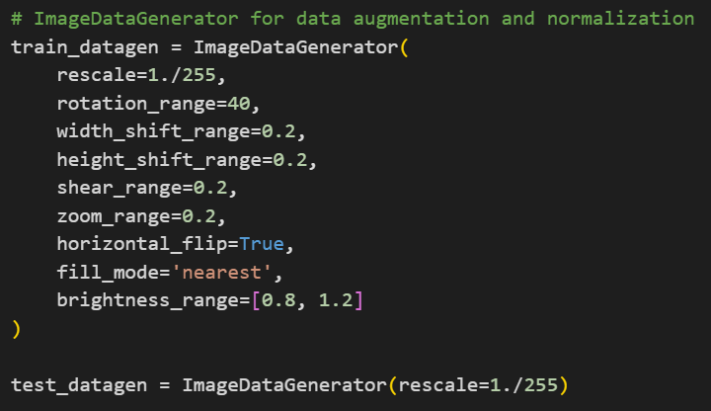
Fig: Image Augmentation
Fig: Code for Augmentation

Slide 20
Text Preprocessing :
Data Cleaning : Removed null values, duplicates, and irrelevant columns to ensure data quality.
Tokenization : Used XLM-RoBERTa tokenizer to split text into subword units, enabling better handling of complex lingual structures.
Label Encoding : Converted categorical labels (bully, non-bully) into numerical formats for model training.
Train-Test Split : Divided data into training (80%) and testing (20%) subsets to ensure reliable model evaluation.

Slide 21
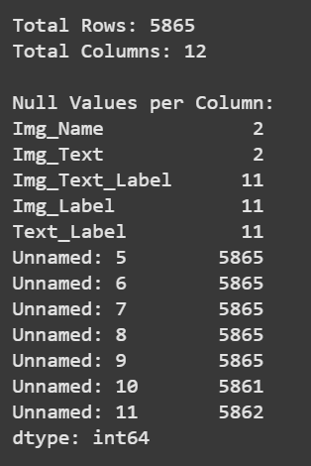
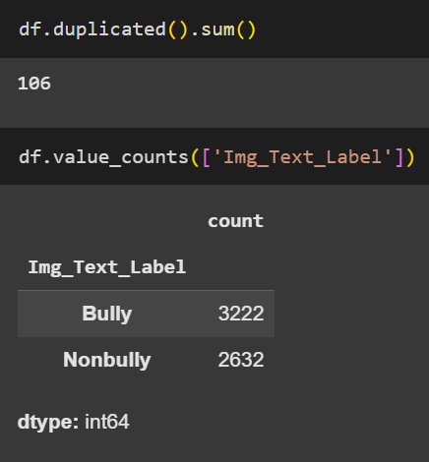
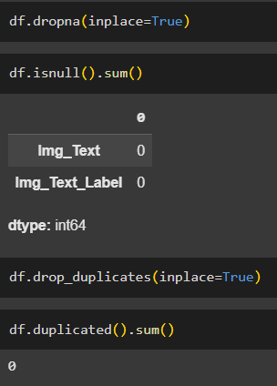
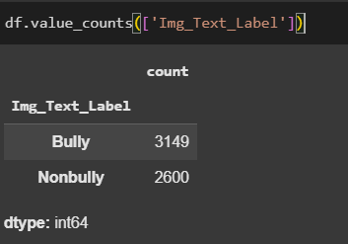
Fig : Before preprocessing
Fig : After preprocessing

Slide 22
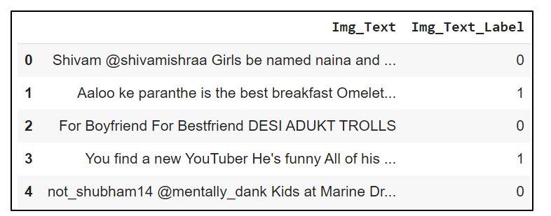
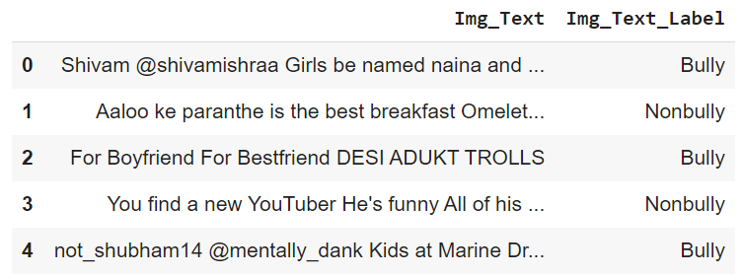
Fig: Before Label Encoding
Fig: After Label Encoding

Slide 23
Results:
Images: Incorrectly formatted images were removed, and data augmentation improved model generalization.
Text: Duplicates, missing values, and irrelevant characters were removed for cleaner input.
Normalization: Pixel values were scaled to [0,1], and text was tokenized for deep learning compatibility.
Final Data Split: After preprocessing, 80% of the data was used for training, and 20% for testing to ensure balanced evaluation.

Slide 24
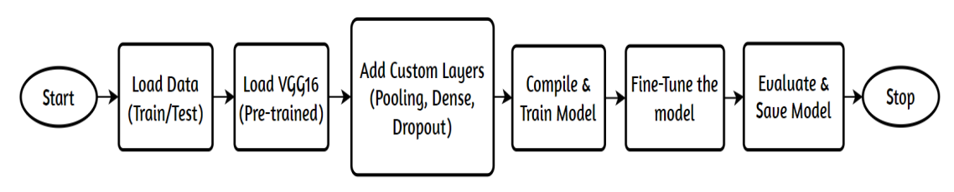
Proposed work
Image Based Detection :
We have experimented with a number of deep learning models on the image data. Out of all VGG16 performed well.
We employed a range of hyperparameters, such as the Adam optimizer, Dropout, Global Average Pooling, Dense layers etc., to optimize the training.

Slide 25
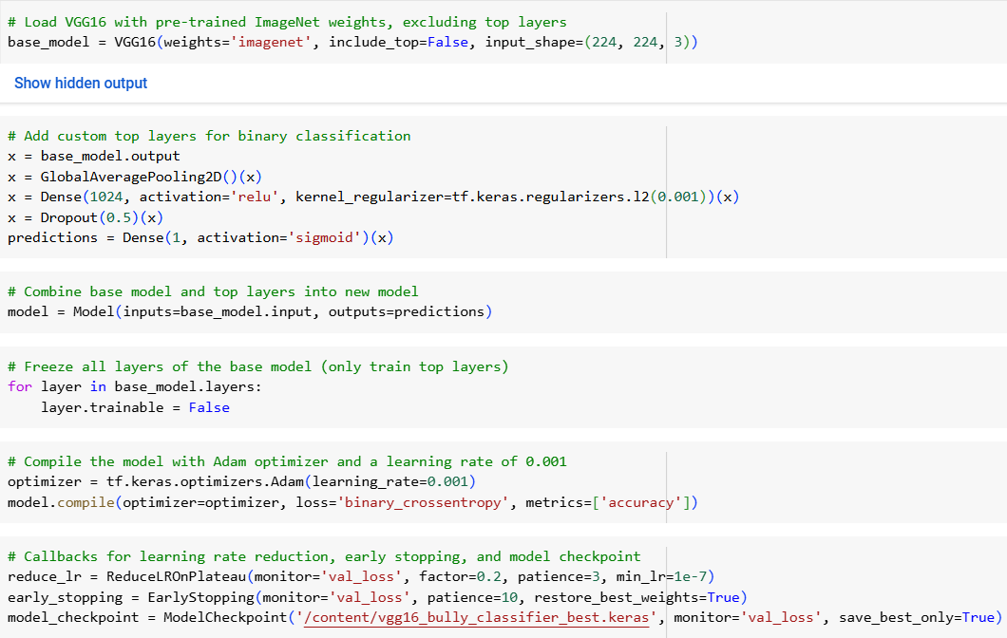
VGG16 Architecture

Slide 26
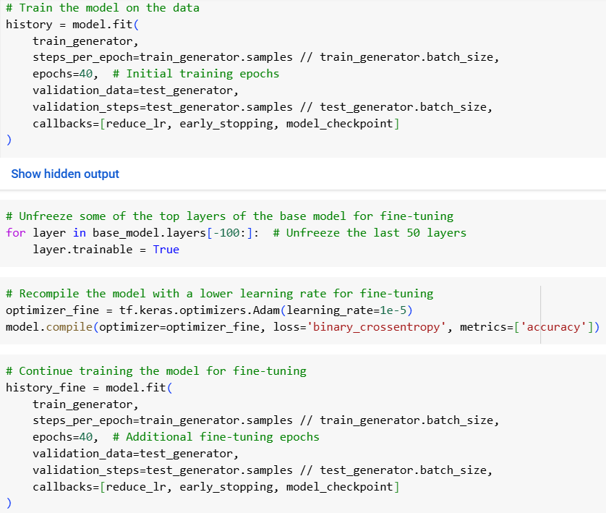
Training and Fine Tuning

Slide 27
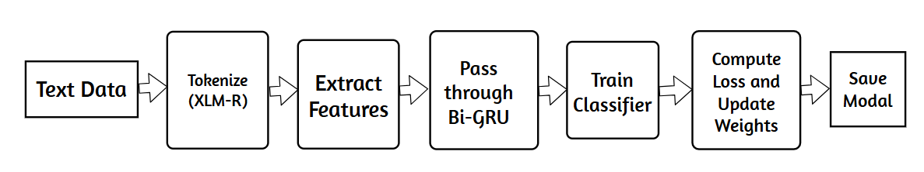
Text Based Detection :
Similar to the image training, we trained several models on the text data and XLM-RoBERTa with BiGRU performed well.
The XLM-Roberta language model is integrated with a special design that includes a transformer layer to help with context understanding and a special kind of memory layer (bidirectional GRU).

Slide 28
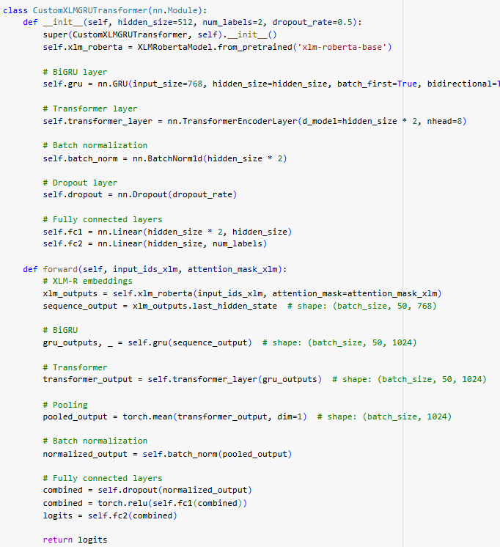
XLM-RoBERTa + BiGRU Architecture

Slide 29
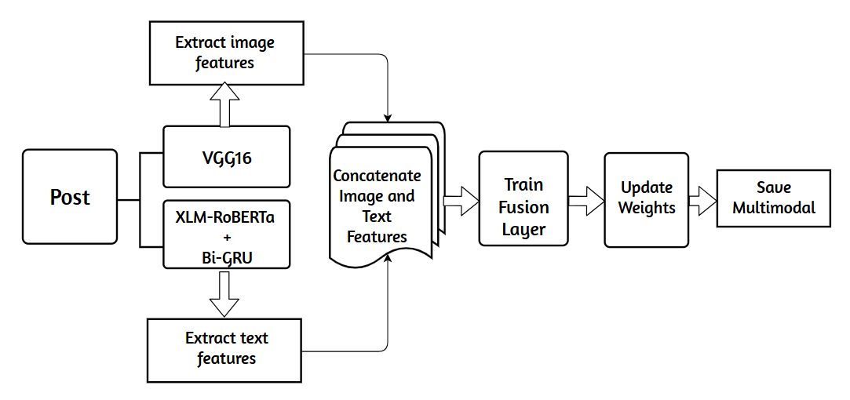
Multimodal Detection :

Slide 30
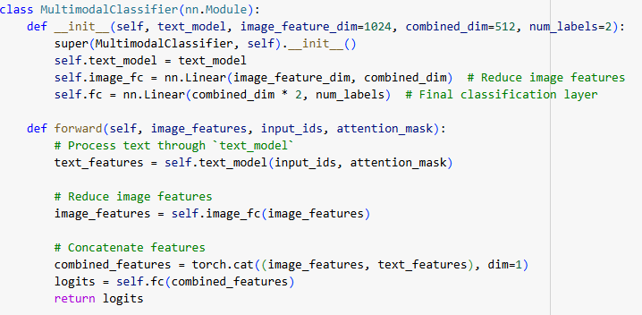
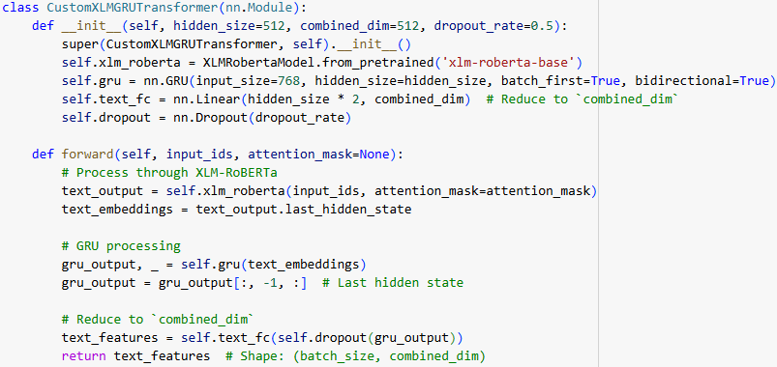
Multimodal Architecture

Slide 31
IMPLEMENTATION
Software Requirements :
Browser : Any latest browser like Chrome
Operating System : Windows 11
Python (Colab), Flask (Spyder)
Hardware Requirements :
System Type : Intel Core i5 or above
RAM : 8GB

Slide 32
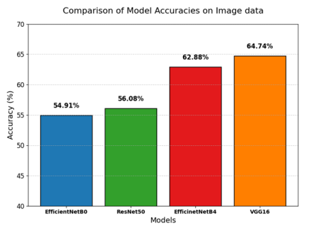
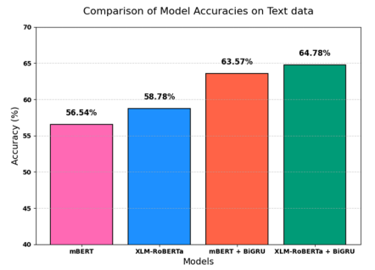
RESULTS & ANALYSIS

Slide 33
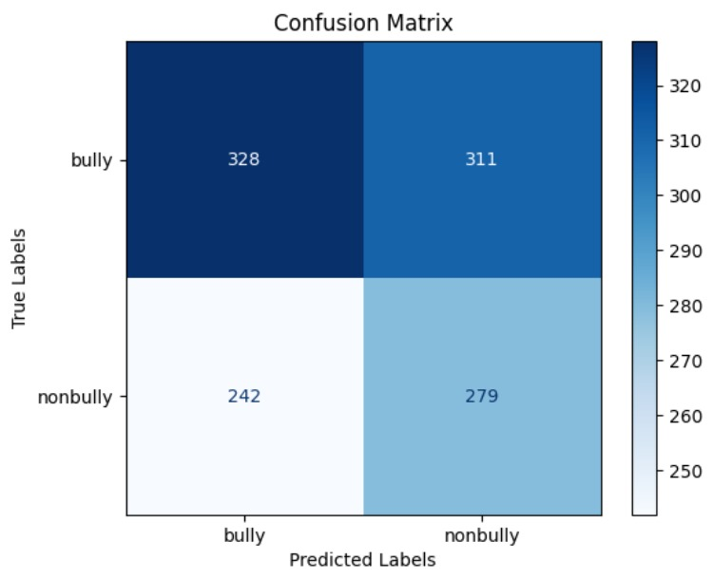
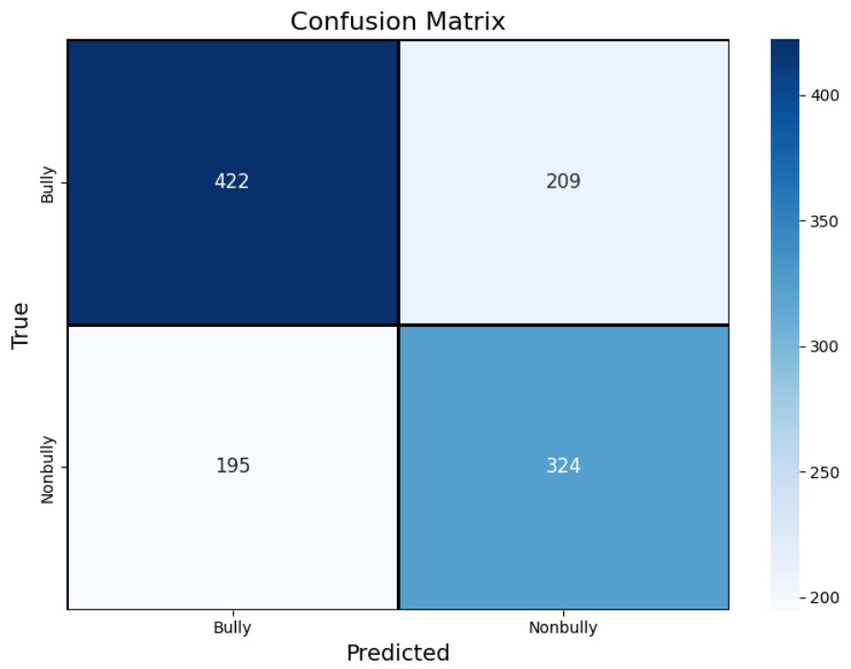
Image Model
Text Model

Slide 34
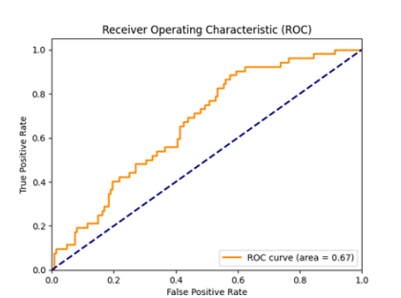
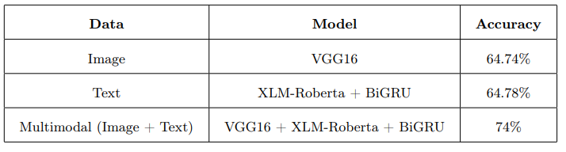

Slide 35
CONCLUSION and FUTURE SCOPE
Conclusion
Successfully created a system to detect cyberbullying in multimodal data, integrating VGG16 and XLM-RoBERTa with BiGRU.
Highlighted the significance of combining text and image features to enhance detection and address complex scenarios like memes.
Future Scope
Expand to include additional modalities like video and audio.
Real-time implementation on social media platforms.
Incorporate multilingual datasets for broader applicability.

Slide 36
REFERENCES
Debnath, Dipanwita & Das, Ranjita & Rafi, Shaik.(2022).Sentiment-Based Abstractive Text Summarization Using Attention Oriented LSTM Model. 10.1007/978-981-16-6624-7_20.
Rafi, S., Das, R. Topic-guided abstractive multimodal summarization with multimodal output. Neural Comput & Applic (2023). https://doi.org/10.1007/s00521-023-08821-5.
Greeshma, B., Sireesha, M., Thirumala Rao, S.N. (2022). Detection of Arrhythmia Using Convolutional Neural Networks. In: Shakya, S., Du, KL., Haoxiang, W. (eds) Proceedings of Second International Conference on Sustainable Expert Systems . Lecture Notes in Networks and Systems, vol 351. Springer, Singapore. https://doi.org/10.1007/978-981-16-7657-4_3
S. L. Jagannadham, K. L. Nadh and M. Sireesha, "Brain Tumour Detection Using CNN," 2021 Fifth International Conference on I-SMAC (IoT in Social, Mobile, Analytics and Cloud) (I-SMAC), Palladam, India, 2021, pp. 734-739, doi: 10.1109/ISMAC52330.2021.9640875

Slide 37
A. Varsha Reddy, Gugulothu Kalpana, N. Satish Kumar, and Dr. Sundaragiri Dheeraj, “Cyber Bullying Text Detection Using Machine Learning”, June 2022 , Available: https://doi.org/10.22214/ijraset.2022.44157
Alabdulwahab, Aljwharah & Haq, Mohd Anul & Alshehri, Mohammed. (2023). Cyberbullying Detection using Machine Learning and Deep Learning. International Journal of Advanced Computer Science and Applications. 14. 424-432.10.14569/IJACSA.2023.0141045.
Pradeep, Kumar, Roy., Fenish, Umeshbhai, Mali. (2022). Cyberbullying detection using deep transfer learning. Complex & Intelligent Systems, 8(6):5449-5467. doi:10.1007/s40747-022-00772-z
Vishwamitra, Nishant & Hu, Hongxin & Luo, Feng & Cheng, Long. (2021). Towards Understanding and Detecting Cyberbullying in Real-world Images. 10.14722/ndss.2021.24260.
Pericherla, Subbaraju & Ilavarasan, E.. (2024). Overcoming the Challenge of Cyberbullying Detection in Images: A Deep Learning Approach with Image Captioning and OCR Integration. International Journal of Computing and Digital Systems. 15.393-401. 10.12785/ijcds/150130.

Slide 38
Kumari, Kirti & Singh, Jyoti & Dwivedi, Yogesh & Rana, Nripendra. (2020). Towards Cyberbullying-free social media in smart cities: a unified multi-modal approach. Soft Computing. 24. 10.1007/s00500- 019-04550-x
Wang, Kaige & Xiong, Qingyu & Wu, Chao & Gao, Min & Yu, Yang. (2020). Multi-modal cyberbullying detection on social networks. 1-8. 10.1109/IJCNN48605.2020.9206663.
Ahmed, Md.Tofael & Akter, Nahida & Rahman, Maqsudur & Islam, Abu & Das, Dipankar & Rashed, Md. Golam. (2023). Multimodal Cyberbullying Meme Detection From Social Media Using Deep Learning Approach. International Journal of Computer Science and Information Technology. 15. 27-37. 10.5121/ijcsit.2023.15403.
Maity, Krishanu & Saha, Sriparna & Bhattacharyya, Pushpak. (2022). A Multitask Framework for Sentiment, Emotion and Sarcasm aware Cyberbullying Detection from Multi-modal Code-Mixed Memes. 1739- 1749. 10.1145/3477495.3531925.

Slide 39
QUESTIONS and ANSWERS
Open the floor for questions from the audience

Slide 40
ACKNOWLEGEMENTS
Express gratitude for the opportunity to present
Provide contact information for further inquiries

