Slide 1

Department of Computer Science and Engineering
Detecting Sarcasm Across Headlines and Text
PRESENTED BY
Ambati Lakshmi Niharika (Roll No. 21471A0573)
Seva Neelima (Roll No. 21471A05B8)
Kadiyala Nikhitha (Roll No. 21471A0590)
Under the Guidance of,
Shaik Rafi M.Tech.,(Ph.D.)
Assistant Professor,
Department of Computer Science and Engineering,
Narasaraopeta Engineering College (Autonomous),
Narasaraopet- 522601.

Slide 2
OUTLINE
Abstract
Introduction
Literature Survey
Research Gaps
Problem Statement
Objectives
Block Diagram / Flow Diagram
Methodology
Implementation
Results and Analysis
Conclusion & Future Scope
References
Question and Answers
Acknowledgements

Slide 3
ABSTRACT
.
.
.
In this era with the rapid growth in social media usage among the current generation, a huge amount of content and comments, most of them sarcastic, is seen. Sarcasm has turned out to be an important part of daily life, especially in news and social media, where sarcastic comments are often used for better attention. However, detecting sarcasm is always challenging because it deals with understanding the difference between what has been said and what is meant. The current paper focuses on the detection of sarcasm in news headlines with the help of deep learning. Previous works were based on a wide range of datasets; however, these had limitations regarding either size or quality. In this respect, the authors propose creating a new dataset of headlines from sarcastic news sites and real news sites that is large and of high quality, hence appropriate for machine learning model training. The authors have also used the CNN-BILSTM architecture for text analysis, identifying sarcasm expression and deciding whether it is sarcastic or not-sarcastic which gained an accuracy of 97%. This dataset is made publicly available to enable further research in this direction.

Slide 4
INTRODUCTION
.
Brief introduction to the project:
The project aims to detect sarcasm in news headlines using advanced deep learning techniques like CNN-BILSTM, leveraging a high-quality, manually labeled dataset to achieve 97% accuracy, enhancing applications in sentiment analysis and opinion mining.
Motivation behind the project:
The rise of sarcastic content in digital communication highlights the need for advanced sarcasm detection systems capable of addressing misinterpretation, misinformation, contextual subtleties, and cultural diversity through high-quality datasets and robust models.
Importance and relevance:
Sarcasm detection strengthens sentiment analysis, content moderation, and AI communication capabilities by decoding implicit context, supporting human-computer interaction, and driving future research with publicly available datasets and effective model architectures.

Slide 5

LITERATURE SURVEY
No | Title | Author | Journal Name & Year | Methodology Adapted | Key Findings | Gaps
1 | Sarcasm detection using news headlines dataset | Rishabh Misra, Prahal Arora | AI Open, 2023 | Hybrid Neural Network architecture with an attention mechanism | Hybrid Neural Network demonstrated about 89.9% accuracy in detecting sarcasm | Ignore general text nuances in sarcasm.
2 | Sarcasm Detection Using Bidirectional Encoder Representations from Transformers and Graph Convolutional Network | Anurag Mohan, Abhilash M Nair, Bhadra Jayakumar, Sanjay | Science Direct, 2023 | BERT-GCN architecture for sarcasm detection is developed along with sequential, LSTM, GCN. | BERT-GCN Model outperforms other models and shows 90.7% accuracy. | variations of transformer models need to be employed to further extend the evaluation of the proposed system.
3 | Deep Learning for Sarcasm Identification in News Headlines | Rasikh Ali, Tayyaba Farhat , Sanya Abdullah, Sheeraz Akram, Mousa Alhajlah , Awais Mahmood and Muhammad Amjad Iqbal | Applied Sciences, 2023 | A deep learning model known as GMP-LSTM (Gated Memory Pooling Long Short-Term Memory) for sarcasm detection including decision trees, random forests, Bernoulli naive Bayes, and support vector machines (SVM). | The GMP-LSTM model achieved the highest accuracy of 92.54%, outperforming other classifiers. | A significant gap identified is the lack of labeled data for training sarcasm detection models, which can limit the model's performance.

Slide 6
LITERATURE SURVEY
No | Title | Author | Journal Name & Year | Methodology Adapted | Key Findings | Gaps
4 | Sarcasm Detection in News Headlines Using Evidential Deep Learning-Based LSTM and GRU | Md. Shamsul Rayhan Chy, Md. Shamsul Rahat Chy, Mohammad Rakibul Hasan Mahin | November 2023 | Long Short-Term Memory (LSTM) and Gated Recurrent Unit (GRU) modelsto detect sarcasm in news headlines. | The LSTM-based model achieved a higher accuracy of 82% compared to the GRU model, which had an accuracy of 78%. | The paper notes that reliability measurements are often overlooked in sarcasm detection, indicating a gap in existing literature.
5 | Sarcasm Detection in News Headlines using Supervised Learning | Ashok Kumar Jayarama, Tina Esther, Gayathri Ananthakrishnan, Satanik Mitra, Qian Liu | Research gate 2 May 2023. | utilizing various models such as Naïve Bayes-support vector machine (NBSVM), logistic regression (LR), bidirectional gated recurrent units (BiGRU), BERT, DistilBERT, RoBERTa, and XLNet. | The RoBERTa model achieved the best performance in sarcasm detection compared to other models which is 93%. | There may be a lack of exploration into the impact of different preprocessing techniques on model performance.

Slide 7
LITERATURE SURVEY
Hybrid Neural Network with Attention Mechanism: Combines multiple neural network components with an attention layer to focus on critical parts of text for sarcasm detection.
BERT-GCN Architecture: Leverages BERT for contextual embeddings and GCN for capturing semantic relationships in sarcasm detection.
GMP-LSTM: Uses Gated Memory Pooling to effectively handle long-term dependencies and enhance sarcasm detection performance.
LSTM and GRU Models: Focus on capturing sequential dependencies and contextual nuances in sarcasm detection.
Various Models (SVM, LSTM, GRU, BERT, DistilBERT, RoBERTa): Utilize diverse feature extraction and contextual representation capabilities to improve sarcasm detection accuracy.

Slide 8
RESEARCH GAPS
Dataset Limitations:
Existing datasets for sarcasm detection often suffer from issues such as limited size, noisy data, and manual labeling inconsistencies. The reliance on datasets from social media introduces slang and informal language that complicate model training.
Contextual Challenges:
Many sarcasm detection models primarily focus on textual data, neglecting the meaning behind it. This lack of multimodal approaches limits the ability to capture the full nuances of sarcasm.
Generalization Across text: Models lack robustness when addressing sarcasm in different general text contexts. This results in reduced effectiveness for diverse audiences.
Psychological Insights:
Sarcasm models lack depth in capturing psychological nuances, relying on surface-level language features.

Slide 9
PROBLEM STATEMENT
The rapid growth of social media has led to an increase in sarcastic content, making sarcasm detection a significant challenge in understanding the difference between what is said and what is meant .
Existing datasets for sarcasm detection often suffer from limitations in size and quality, which hinders the effectiveness of machine learning models .
Sarcasm is inherently ambiguous and context-dependent, complicating the task for both humans and machines to accurately identify sarcastic expressions.
There is a need for advanced models that can capture the subtleties and contextual dependencies of sarcastic language, which is crucial for improving applications in sentiment analysis and natural language processing.

Slide 10
OBJECTIVES
Detect Sarcasm in Text: Develop an advanced model to identify sarcasm in news headlines and general text.
Leverage Deep Learning: Implement model architecture to capture local and global features in text for effective sarcasm detection.
Enhance Dataset Quality: Create and use a high-quality, large-scale dataset with accurate sarcasm labeling to overcome existing dataset limitations.
Improve Accuracy and Generalization: Achieve higher accuracy (89.9%) in sarcasm detection while ensuring the model generalizes well across unseen data.
Address Context Dependency: Build a model capable of understanding subtle contextual cues and linguistic nuances in sarcastic expressions.
Support Future Research: Make datasets and models publicly available to encourage further research and applications in NLP.

Slide 11
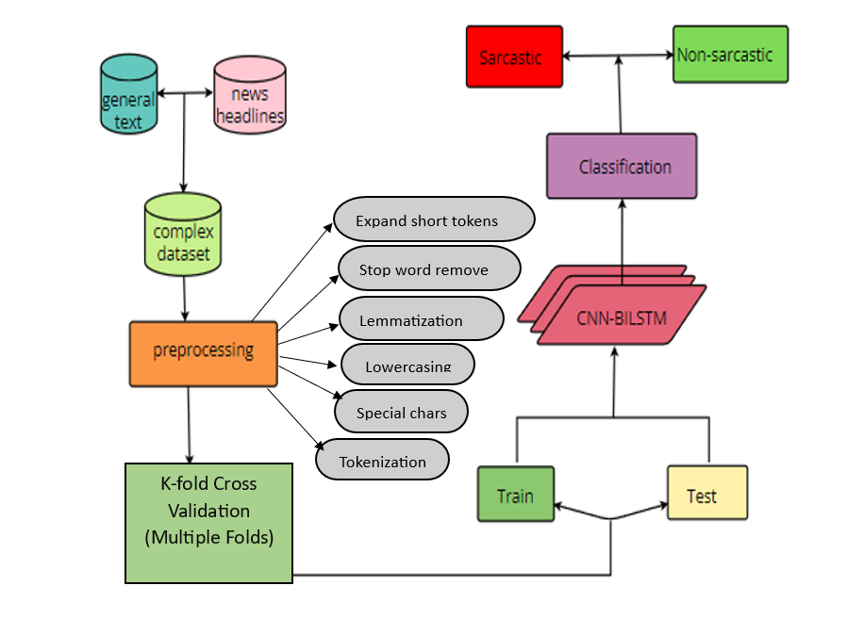
BLOCK DIAGRAM OR FLOW DIAGRAM

Slide 12
METHODOLOGY
1.Data Collection:
Datasets Used:
News Headlines Dataset from Kaggle: Headlines from "The Onion" (sarcastic) and "The HuffPost" (non-sarcastic).
Sarcasm Dataset: General sarcastic and non-sarcastic texts.
Dataset Size: Combined dataset of 63,904 samples (headlines and general text).
Labels: 1 - sarcastic, 0 - Non sarcastic
2. Preprocessing:
Handling special characters
Stop-word removal : the , an , is , are
Lowercasing
expanding shortend tokens : can’t to cannot
Tokenization : into words or subwords
Lemmatization: Lemmatization in deep learning refers to the reduction of inflectional forms by converting words into their base form

Slide 13
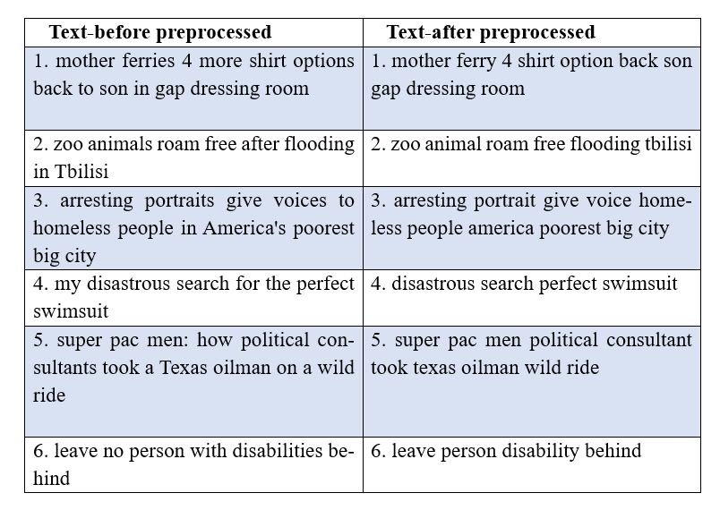
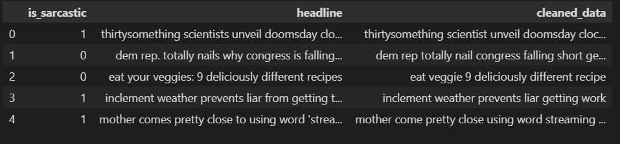
METHODOLOGY

Slide 14
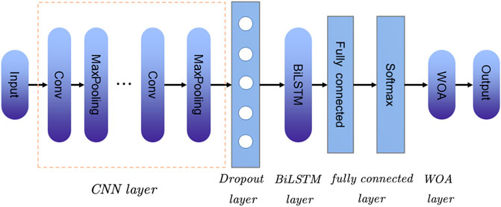
METHODOLOGY
3. Model Architecture:
Improved Text Classification: The CNN-BiLSTM model combines the strengths of Convolutional Neural Networks (CNNs) and Bidirectional Long Short-Term Memory (BiLSTM) networks. This combination improves text classification tasks, such as sentiment analysis, spam detection, and topic modeling.
Capture Local and Global Features:CNNs excel at capturing local features (e.g., phrases, sentences), while BiLSTMs capture global features (e.g., context, relationships). The CNN-BiLSTM model leverages both, providing a more comprehensive understanding of text data.
Preserve Sequential Information:BiLSTMs preserve sequential information, which is essential for text data where word order matters. By incorporating BiLSTMs, the CNN-BiLSTM model can capture the nuances of language and better understand the relationships between words.

Slide 15
METHODOLOGY
4. Training:
Environment: Google Colab with GPU support for efficient computation.
Loss Function: Binary Cross-entropy to handle binary classification.
Metrics:
Accuracy
F1-Score for balanced performance measurement.
5. Testing:
Confusion Matrix: Showed 97% accuracy for sarcastic text and 95% for non-sarcastic text.
Precision and Recall: High values for both sarcastic and non-sarcastic classes.

Slide 16
IMPLEMENTATION
Preprocessing Techniques : Data cleaning: Removal of special characters, lowercasing, stopword removal, tokenization, and lemmatization to prepare clean text for analysis.
CNN-BiLSTM Hybrid Model: CNN: Extracts local features like n-grams and sentiment-bearing expressions, BiLSTM: Captures contextual dependencies and subtle patterns in text sequences.
Datasets Used: Sarcastic news headlines from "The Onion.“ Non-sarcastic news headlines from "The HuffPost.“
Training Environment : Model training and evaluation performed on Google Colab leveraging free GPU access.
Evaluation Metrics : Accuracy, F1-Score, and confusion matrix used to assess model performance.
Output and Results : The model correctly identifies sarcastic and non-sarcastic text with high precision and recall.

Slide 17
RESULTS & ANALYSIS
Best Model: The CNN-BiLSTM, proving the model’s reliability.
Generalization: The CNN-BiLSTM model performed the best among all tested models, achieving an impressive 97% accuracy, significantly higher than SVM, GRU, and LSTM.
Evaluation Metrics: The model had high precision and recall, indicating accurate detection of both sarcastic and non-sarcastic text with minimal misclassifications.
Confusion Matrix: The confusion matrix showed 97% accuracy for sarcastic text and 95% for non-sarcastic text, with very few errors were handled unseen data by training on a combined dataset of headlines and general text, ensuring robust performance across various text types.
Learning Trends: Training graphs showed consistent improvement, with decreasing loss and increasing accuracy across epochs, confirming the model’s stability and efficiency.

Slide 18
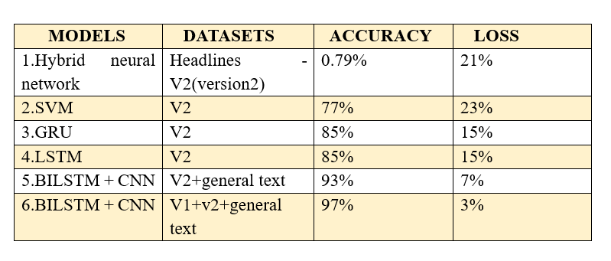
Results:

Slide 19
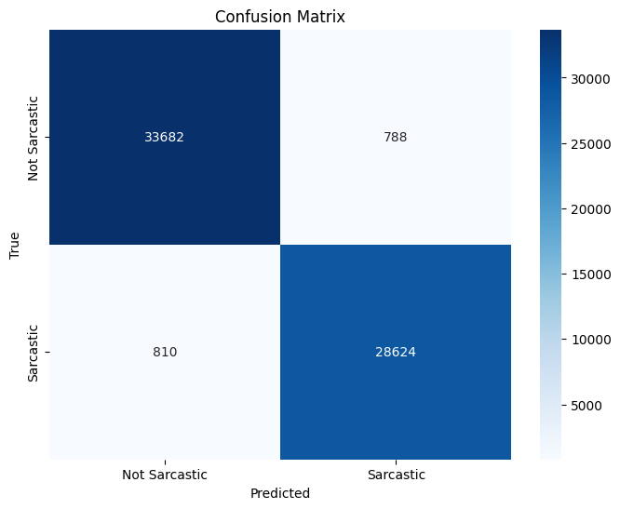
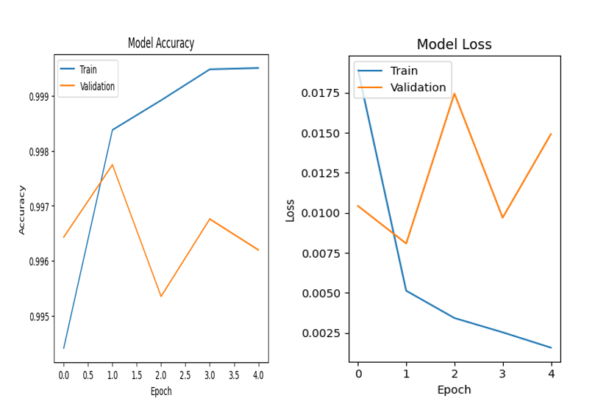
Result graph and Confusion matrix :

Slide 20
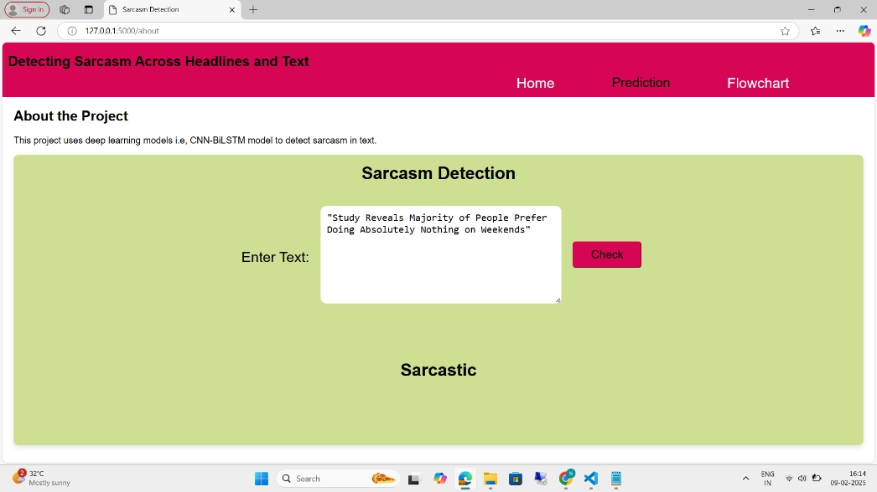

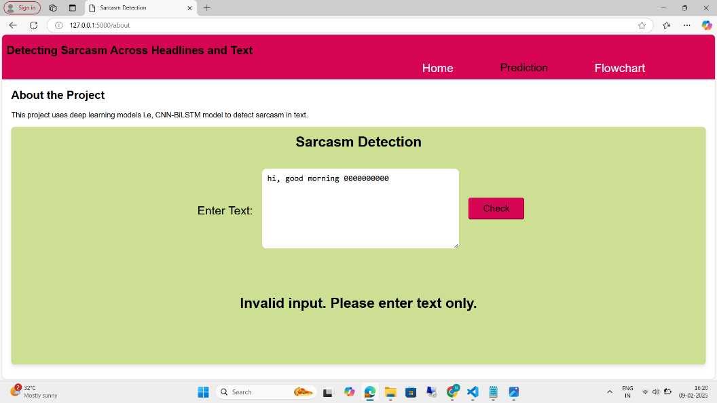

PREDICTIONS

Slide 21
CONCLUSION and FUTURE SCOPE
High Performance: The CNN-BiLSTM model achieved 97% accuracy, outperforming other models like SVM, GRU, and standalone LSTM, proving its effectiveness in sarcasm detection.
Robust Detection: The model successfully detects sarcasm in both headlines (seen data) and general text (unseen data), showcasing its generalization capability.
Key Features: The combination of CNN (for local features) and BiLSTM (for contextual understanding) made the model highly sensitive to sarcasm cues like irony and subtle undertones.
Applications: The results contribute to fields like sentiment analysis, text classification, and social media monitoring, improving how systems interpret human communication.
Multi-modal Analysis: Extend the project to include text, images, and audio for detecting sarcasm in real-world scenarios like videos or social media posts.
Cultural and Linguistic Diversity: Develop models that adapt to various languages and cultural nuances to improve sarcasm detection across global platforms.

Slide 22
REFERENCES
Chy, M. S. R., et al. "Sarcasm Detection in News Headlines Using Evidential Deep Learning-Based LSTM and GRU." Asian Conference on Pattern Recognition, 2023.
Misra, R., Arora, P. "Sarcasm Detection Using News Headlines Dataset." AI Open, 2023.
Rafi, S., Das, R. "Topic-Guided Abstractive Multimodal Summarization with Multimodal Output." Neural Comput and Applic, 2023.
Jayaraman, A. K., et al. "Sarcasm Detection in News Headlines Using Supervised Learning." IEEE, 2022.
Rafi, S., Das, R. "A Linear Sub-Structure with Co-Variance Shift for Image Captioning." ISCMI, 2021.
Ali, R., et al. "Deep Learning for Sarcasm Identification in News Headlines." Applied Sciences, 2023.
Mohan, A., et al. "Sarcasm Detection Using Bidirectional Encoder Representations from Transformers." Procedia Computer Science, 2023.
Chudi-Iwueze, O., Afli, H. "Detecting Sarcasm in News Headlines." CERC, 2020.
Kaya, S., Alatas, B. "Sarcasm Detection with a New CNN+BiLSTM Hybrid Neural Network and BERT." International Journal of Advanced Networking and Applications, 2022.
Azwar, A. S. "Sarcasm Detection Using Multi-Channel Attention-Based BLSTM." 2020.

Slide 23
QUESTIONS and ANSWERS
What is the main objective of your project?
Why is sarcasm detection important?
What datasets did you use for this project?
What preprocessing techniques did you apply?
Why did you choose CNN-BiLSTM as the model?
How did you split the dataset for training and testing?
What evaluation metrics did you use?
What were the key challenges faced during the project?
How does your model handle unseen data?
What are the future enhancements for this project?

Slide 24
ACKNOWLEGEMENTS
We sincerely thank the faculty and staff of Narasaraopeta Engineering College for their guidance and support throughout this project. Their expertise and encouragement have been invaluable.
We also express our gratitude to the administration for providing the resources and platform to showcase our work, which has greatly enhanced our learning and growth.
For any questions or discussions, please feel free to contact us:
Ambati Lakshmi Niharika – ambatinikki@gmail.com
Seva Neelima – sevaneelima13@gmail.com
Kadiyala Nikhitha – nikhitha.k234@gmail.com

