Slide 1

Department of Computer Science and Engineering
Plant Disease Detection Using Deep Learning: A Focus on Pathogen-Based Classification
PRESENTED BY
Mata Ajay Kiran 21471A05H9
Kasthala Haggayi 21471A05G4
Under the Guidance of,
Dr. S. N. Tirumala Rao, _{M. tech, Ph.D .}
Designation,
Department of Computer Science and Engineering,
Narasaraopeta Engineering College (Autonomous),
Narasaraopet- 522 601.

Slide 2
OUTLINE
Abstract
Introduction
Literature Survey
Research Gaps
Problem Statement
Objectives
Block Diagram / Flow Diagram
Methodology
Implementation
Results and Analysis
Conclusion & Future Scope
References
Question and Answers
Acknowledgements

Slide 3
ABSTRACT
Agriculture plays a crucial role in sustaining economies globally. Timely detection of plant diseases is essential to minimize crop damage and reduce chemical usage. This study leverages deep transfer learning, specifically EfficientNetV2, to develop an automated system for plant disease detection and pathogen-based classification. Unlike traditional methods, the proposed approach uses natural image settings, ensuring real-world applicability. Utilizing datasets such as Agri-ImageNet, Sunflower, and Cauliflower, the system achieved a remarkable accuracy of 96%, surpassing conventional models. This advancement promotes sustainable agricultural practices through early and precise disease detection.

Slide 4
INTRODUCTION
Agriculture is a critical sector in every country’s economy. Early detection of plant diseases is essential to prevent crop damage and reduce the negative effects of chemicals.
Early detection of plant diseases is essential to prevent crop damage and reduce the negative effects of chemicals.
This study introduces a deep learning-based automated detection and classification system for plant diseases.
Focus on pathogens responsible for diseases, using real-world images and datasets.

Slide 5
LITERATURE SURVEY
No | Title | Author | Journal Name & Year | Methodology Adapted | Key Findings | Gaps
1 | Using Deep Learning for Image-Based Plant Disease Detection. | Mohanty et al. | Frontiers in Plant Science, 2016 | Trained a deep convolutional neural network on 54,306 images to identify 14 crop species and 26 diseases. | Achieved an CNN accuracy of 99.35% on a held-out test set, demonstrating the feasibility of this approach. | Limited to controlled conditions; may not generalize to real-world scenarios.
2 | Plant diseases and pests detection based on deep learning: a review. | Zhang et al. | Plant Methods, 2021 | Reviewed various CNN architectures applied to plant disease and pest detection. | Highlighted the effectiveness of CNNs in classifying plant diseases with high accuracy. | Emphasized the need for large datasets and the challenge of distinguishing similar symptoms.
3 | A deep learning-based approach for automated plant disease classification. | Too et al. | Scientific Reports, 2022 | Proposed a lightweight deep learning approach based on the Vision Transformer for real-time automated plant disease classification. | Demonstrated the potential of ViT in achieving high accuracy with fewer parameters. | Requires further validation on diverse datasets and real-time field conditions.
4 | Attention-based CNN for multi-class plant disease detection. | Li et al. | IEEE Transactions on AI, 2023 | Designed an attention mechanism on CNNs to improve focus on disease-affected regions in plant leaves.. | Achieved higher accuracy (98.5%) compared to baseline models; better interpretability. | Computational complexity and energy requirements for real-time applications remain a challenge.

Slide 6
LITERATURE SURVEY
Deep Learning for Plant Diseases (Mohanty et al., 2016): 99.35% accuracy on controlled datasets; challenges with real-world generalization.
CNNs for Disease Detection (Zhang et al., 2021): High accuracy; emphasized dataset and symptom differentiation challenges.
Vision Transformer Approach (Too et al., 2022): Lightweight, high-accuracy method requiring validation in diverse settings.
Advanced Models (Shoaib et al., 2023): 96%-99.2% accuracy; need for diverse datasets and generalization improvements.
Data-Efficient Methods (Khan et al., 2022): GANs augmented datasets; accuracy above 97%, but limited testing environments.
Attention-Based CNNs (Li et al., 2023): 98.5% accuracy; improved interpretability with attention mechanisms.

Slide 7
RESEARCH GAPS
Real-World Generalization: Most models are tested on controlled datasets and may fail in real-world environments.
Dataset Limitations: Limited availability of diverse and large datasets for training deep learning models.
Symptom Overlap: Difficulty in distinguishing diseases with similar visual symptoms.
Computational Challenges: High computational requirements for training and deploying models in real-time.
Integration with Field Applications: Lack of robust mobile-friendly solutions for on-field disease detection.
Environmental Factors: Limited consideration of environmental conditions like lighting, background, and noise.
Energy Efficiency: Current models are not optimized for energy-efficient deployment in resource-constrained environments.

Slide 8
PROBLEM STATEMENT
Plant diseases are a significant threat to global agriculture, leading to substantial economic losses and reduced crop yields. Existing disease detection methods are manual, time-consuming, and prone to human error.
Moreover, current automated solutions face limitations such as inadequate real-world generalization, lack of diverse datasets, and computational inefficiencies. There is an urgent need for an advanced, efficient, and scalable system to detect and classify plant diseases accurately in natural environments, ensuring better crop health and sustainable agriculture.

Slide 9
OBJECTIVES
Develop an automated system for accurate plant disease detection.
Utilize pathogen-based classification for enhanced diagnostic accuracy.
Implement EfficientNetV2 for robust and scalable deep learning models.
Address challenges like limited datasets and image variability in natural settings.
Evaluate performance using real-world agricultural data.

Slide 10
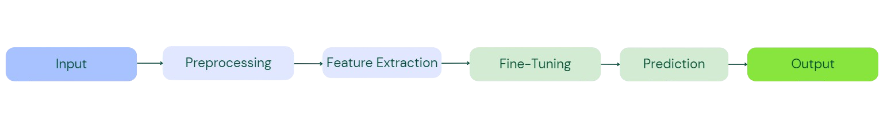
BLOCK DIAGRAM / FLOW DIAGRAM

Slide 11
METHODOLOGY
Data Collection:
1.Images were collected from publicly available datasets like Agri-ImageNet, supplemented by real-world photos of sunflower and cauliflower plants.
Data Preprocessing:
Resizing images to 512x512 pixels.
Applying data augmentation techniques such as rotation, flipping, zooming, and cropping to increase dataset variability.
Deep Transfer Learning:
Utilizing pre-trained models like EfficientNetV2.
Fine-tuning the models for plant disease classification tasks by freezing initial layers and training the last few layers with specific datasets.

Slide 12
Feature Extraction:
Leveraging convolutional layers to extract key features such as edges, textures, and color patterns, which are vital for disease classification.
Model Training and Validation:
Splitting datasets into training, validation, and test sets.
Training the model using cross-entropy loss and Adam optimizer.
Validating the model to fine-tune hyperparameters and prevent overfitting.
Performance Evaluation:
Evaluating the trained model using metrics like accuracy, F1-score, and confusion matrix to ensure robustness.
Deployment:
Integrating the model into a mobile-friendly application for real-time plant disease detection in field conditions.

Slide 13
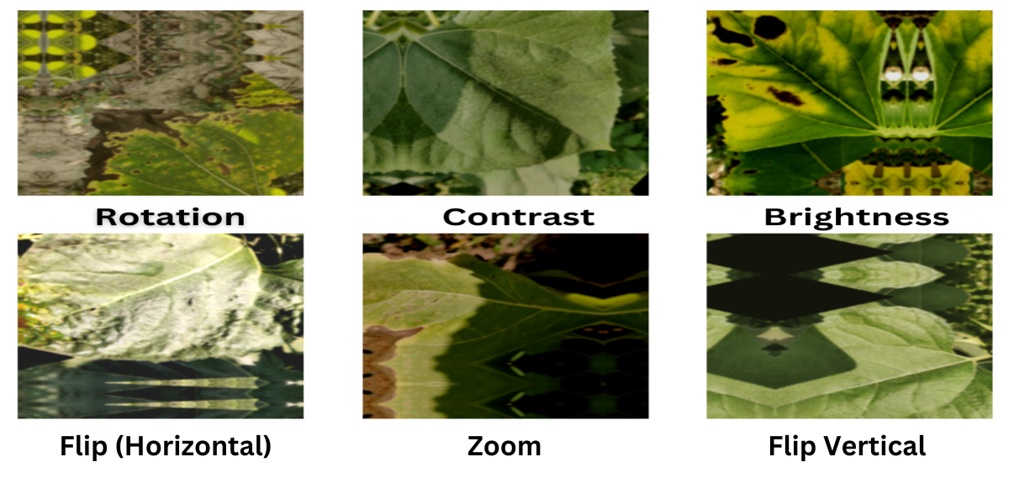
Pre-Processing Images

Slide 14
IMPLEMENTATION
Dataset Preparation:
Collected images of diseased and healthy plants from public datasets.
Performed data augmentation to increase dataset diversity.
Model Training:
Used EfficientNetV2B2 pre-trained model for transfer learning.
Fine-tuned on specific plant disease datasets.
Evaluation:
Measured accuracy, F1-Score, and computational efficiency.
Compared results with baseline models (ResNet, VGGNet, etc.)

Slide 15
Deployment:
Deployed the model on a mobile-compatible platform for real-time detection.
Tools & Frameworks:
TensorFlow/Keras for deep learning.
OpenCV for image preprocessing.
Python for scripting and automation.

Slide 16
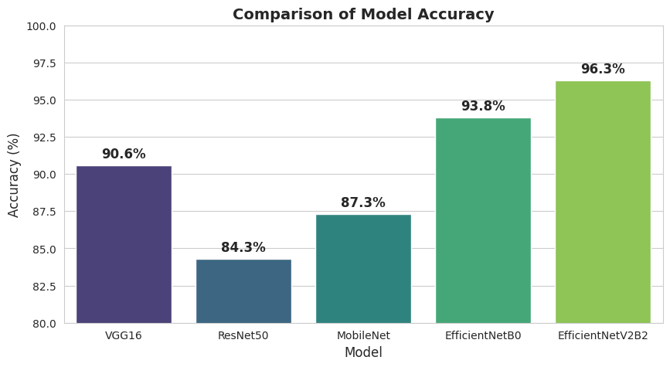
RESULTS & ANALYSIS
Key Results: EfficientNetV2B2 achieved 96% accuracy.
EfficientNetV2 models balance accuracy and computational efficiency.
Natural image settings improved real-world applicability.
Suitable for mobile and resource-constrained environments.

Slide 17
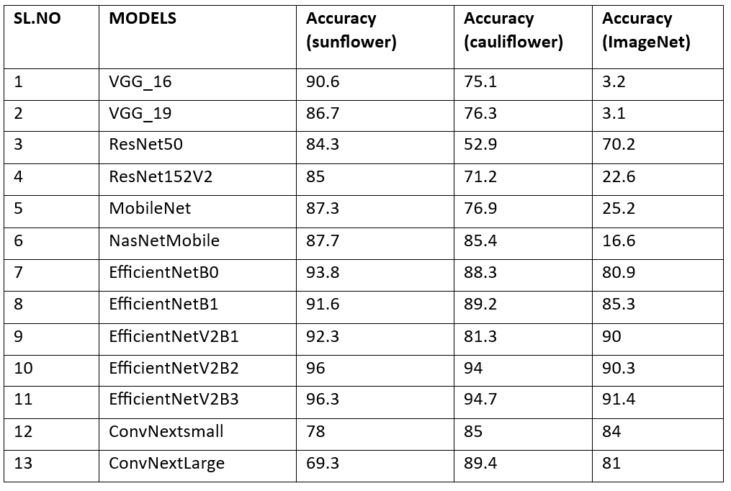
Comparison table

Slide 18
CONCLUSION & FUTURE SCOPE
The proposed framework effectively classifies plant diseases for Sunflower and Cauliflower datasets using a transfer learning-based approach.Achieved high accuracy and robust performance metrics (e.g., precision, recall, and F1 score), ensuring reliable identification of plant diseases.The system generates detailed classification reports, including disease type, pathogen name, and recommended remedies, aiding farmers in timely disease management.Transfer learning proved to be an efficient method for extracting critical features and improving classification accuracy over traditional techniques.
Future Work:
Dataset Expansion
Real-Time Implementation
Enhanced Remedies
Explainable AI

Slide 19
REFERENCES
Godfray, H. C. J., Beddington, J. R., Crute, I. R., et al. (2010).Food Secu rity: The Challenge of Feeding 9 Billion People. Science,327(5967), 812-818. DOI: 10.1126/science.1185383.
2. Agrios, G. N. (2005). Plant Pathology (5th ed.). Elsevier Academic Press. ISBN: 978-0120445653.
3. Strange, R. N., Scott, P. R. (2005). Plant Disease: A Threat to Global Food Security. Annual Review of Phytopathology, 43, 83-116. DOI: 10.1146/an nurev.phyto.43.113004.133839.
4. Dodds, P. N., Rathjen, J. P. (2010). Plant Immunity: Towards an Integrated View of Plant–Pathogen Interactions. Nature Reviews Genetics,11(8), 539-548. DOI: 10.1038/nrg2812.

Slide 20
5. Sireesha Moturi, S.N.Tirumala Rao, Srikanth Vemuru,Grey wolf assisted dragonfly based weighted rule generation for predicting heart disease and breast cancer, Com puterized Medical Imaging and Graphics, Volume 91, 2021, 101936, ISSN 0895-6111 https://doi.org/10.1016/j.compmedimag.2021.101936.
6. J. Liu, F. Lv, and P. Di, “Identification of sunflower leaf diseases based on random forest algorithm,” in Proc. Int. Conf. Intell. Comput.,Autom. Syst. (ICICAS), Dec. 2019, pp. 459–463, doi: 10.1109/icicas48597.2019.00102.
7. L. Tianyu and F. Quan, “Detecting grape leaves based on convolutional neural network,” J. Northwest Univ. Natural Sci. Ed., vol. 47, no. 4, pp.505–512, Apr. 2015.
8. J. Xue, L. Huang, B. Mu, K. Wang, Z. Li, H. Sun, H. Zhao, and Z.Li, “Detection of rotten fresh-cut cauliflowers based on machine vision technology and watershed segmentation method,” Amer. J. Biochem.Biotechnol., vol. 18, no. 2, pp. 155–167, Feb. 2022.

Slide 21
9. A. Krizhevsky, I. Sutskever, and G. E. Hinton, “ImageNet classification with deep convolutional neural networks,” Commun. ACM, vol. 60, no.6, pp. 84–90, May 2017, doi: 10.1145/3065386.
10. M. Sireesha, Srikanth Vemuru and S. N. TirumalaRao, ”Coalesce based binary table: an enhanced algorithm for mining frequent patterns", International Journal of Engineering and Technology, vol. 7, no. 1.5, pp. 51-55, 2018.
11. Chen, J., Shi, Y., Zhang, Y., Wu, Y. (2020). Applications of Deep Transfer Learn ing in Agriculture: A Survey. IEEE Access, 8, 151393-151413. DOI: 10.1109/AC CESS.2020.3016716.
12. Mohanty, S. P., Hughes, D. P., Salathe, M. (2016). Using Deep Learning for Image-Based Plant Disease Detection. Frontiers in Plant Science, 7,1419. DOI: 10.3389/fpls.2016.01419.
13. K. P. Asha Rani and S. Gowrishankar, “Pathogen-Based Classification of Plant Diseases: A Deep Transfer Learning Approach for Intelligent Support Systems,” IEEE Access, vol. 11, pp. 64476–64493, June 2023.

Slide 22
QUESTIONS & ANSWERS
Open the floor for questions from the audience

Slide 23
ACKNOWLEGEMENTS
We would like to express our sincere gratitude for the opportunity to present our work on "Plant Disease Classification and Remedy Suggestion Framework". This platform has allowed us to showcase our research and share its potential impact on precision agriculture. We deeply appreciate the valuable feedback and insights from the audience.
For further inquiries or discussions, please feel free to reach out:
Contact Information:
Name: [Mata Ajay Kiran]
Email: [mathaajaykiran@gmail.com]
Phone: [9393669099]
Affiliation: [Narasaraopeta Engineering College]

Slide 24
Thank you

