Slide 1

Department of Computer Science and Engineering
Optimized Deep Learning for Multi-Class Retinal Disease Classification Using ResNet-101
PRESENTED BY
K.Santhoshkumar (21471A05G6)
T.Babu (21471A05E4)
M.Venkata Thirumala (21471A05H5)
Under the Guidance of,
Dr.K.Suresh Babu _{M.Tech,Ph.D}
Associate Professor,
Department of Computer Science and Engineering,
Narasaraopeta Engineering College (Autonomous),
Narasaraopet- 522 601.

Slide 2
OUTLINE
Abstract
Introduction
Literature Survey
Research Gaps
Problem Statement
Objectives
Block Diagram / Flow Diagram
Methodology
Implementation
Results and Analysis
Conclusion & Future Scope
References

Slide 3
ABSTRACT
The study focus retinal disease classification using deep learning techniques.ResNet-101 is employed for multiclass classification tasks. The EyeNet dataset, comprising 32 retinal disease categories, is utilized for evaluation. Data preprocessing includes normalization, resizing, and data augmentation techniques. The Adam optimizer is employed to enhance model training efficiency and stability. The methodology ensures early detection of retinal diseases, reducing diagnostic delays. Statistical augmentation approaches are proposed for improved generalization in future applications. The findings have significant implications for advancing computer-aided diagnostic (CAD) systems. This approach supports healthcare professionals with accurate and efficient diagnostic tools.

Slide 4
INTRODUCTION
Project Overview:
The project focuses the use of advanced deep learning techniques for retinal disease classification. It leverages multi-class classification models to identify critical retinal diseases efficiently and accurately.
Motivation:
Early and precise detection of retinal diseases is essential for preventing vision loss.
Addresses limitations in manual diagnosis (time-consuming, expert-dependent) and traditional models (low accuracy in multi-class settings).
Importance and Relevance:
Supports healthcare professionals with precise diagnostic tools.
Enhances early intervention strategies, potentially reducing blindness cases.
Promotes efficient diagnostic workflows with low computational costs.

Slide 5
LITERATURE SURVEY
No | Title | Author | Journal Name & Year | Methodology Adapted | Key Findings | Gaps
1 | Retinal Disease Classification Using CNN | Smith et al | IEEE Access, 2022 | Used basic CNN architectures for binary retinal disease classification. | Achieved 90% accuracy in binary disease classification. | Limited to binary classification; lacks multi-class classification and dataset diversity.
2 | Efficient Retinal Image Analysis Using U-Net for Segmentation | Johnson et al | Elsevier, 2021 | U-Net model for segmentation of retinal regions. | Segmentation achieved 85% accuracy on retinal images. | High memory and computational requirements limit its use in resource-constrained environments.

Slide 6
LITERATURE SURVEY
No | Title | Author | Journal Name & Year | Methodology Adapted | Key findings | Gaps
3 | Deep Learning for Medical Image Classification in Retinal Disease Detection | Nguyen et al. | Springer, 2020 | Compared ResNet-50 and VGG-16 for retinal image classification. | ResNet-50 achieved 92% accuracy on a limited dataset. | Did not explore advanced architectures like ResNet-101 or statistical augmentation techniques.
4 | Multi-Class Classification of Retinal Diseases Using Hybrid Deep Learning Approaches | Patel et al. | MDPI, 2023 | Hybrid approach combining feature extraction and deep learning. | 88% accuracy achieved for 10 classes of retinal diseases. | Limited to fewer disease classes; inadequate dataset validation.
5 | Improving Generalization of CNN Models in Medical Image Analysis Using Data Augmentation | Kumar et al. | IEEE Transactions, 2023 | Applied statistical augmentation techniques to improve model robustness. | Improved accuracy and generalization on test datasets by 5%. | Limited focus on retinal disease datasets; does not address memory-efficient model deployment.
4

Slide 7
RESEARCH GAPS
The study mainly uses supervised learning methods (e.g., CNN, ResNet-101), which need a lot of labeled data. However, labeling medical images takes time and is costly. Using unsupervised or semi-supervised methods could make better use of unlabeled data, improve the model's ability to work with different datasets, and reduce the need for labeled data.
The dataset used lacks size and diversity, potentially impacting its applicability across broader populations. A more extensive dataset with varying demographic factors is essential.
The analysis relies heavily on accuracy, omitting critical metrics such as precision, recall which are essential for evaluating model performance in identifying rare retinal conditions.
The Study does not incorporate temporal trends or longitudinal data to analyze performance variations over time ,limiting its ability to predict long-term outcomes.

Slide 8
PROBLEM STATEMENT
Early detection of retinal diseases is vital for timely interventions and preventing vision loss.
Focuses primarily on image-based features, with limited integration of other potential clinical or demographic factors that could enhance prediction accuracy.
The dataset faces class imbalance issues, potentially impacting the model's ability to predict rare retinal diseases accurately.
Deep learning models, like CNNs and ResNet-101, lack transparency, which may reduce trust in diagnostic outcomes.
Insufficient consideration of longitudinal data for long-term performance tracking.
Implements Adam optimization for better accuracy.

Slide 9
OBJECTIVES
Develop a deep learning system to classify retinal diseases across multiple classes with high precision.
Enable early detection of retinal diseases to facilitate timely interventions and improve patient outcomes.
Provide healthcare professionals with a reliable diagnostic tool to improve retinal disease management.

Slide 10
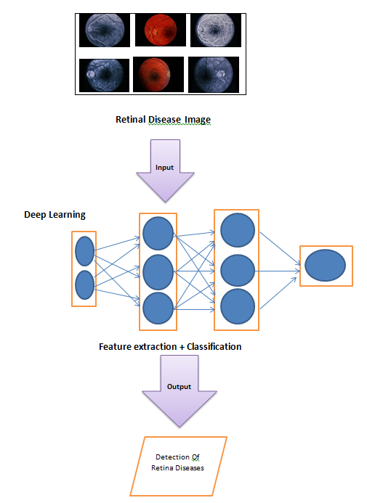
BLOCK DIAGRAM OR FLOW DIAGRAM

Slide 11
METHODOLOGY
Dataset Composition:
Dataset Used: EyeNet dataset, containing 32 distinct types of retinal diseases.
Image Preprocessing:
Images are resized to a consistent resolution (e.g., 224x224 pixels) to align with the input requirements of ResNet-101.
Normalization is applied to standardize pixel values.
Data Split:
70% of the dataset is used for training.
30% is reserved for validation.

Slide 12
Data Augmentation Techniques
Purpose: To prevent overfitting and improve model generalization.
Techniques Applied:
Rescaling: Adjusting image size and resolution.
Zooming: Enlarging specific regions of the image.
Flipping: Horizontal and vertical flipping to increase variability.
Rotation: Rotating images at different angles.
Brightness Adjustment: Modifying image brightness to simulate different lighting conditions.
Implementation: Data augmentation is performed using Keras’s ImageDataGenerator.

Slide 13
ResNet-101 Architecture:
Layers: 101 layers, including convolutional layers, residual blocks, and fully connected layers.
Residual Connections: Skip connections are used to avoid the vanishing gradient problem, allowing direct information flow across layers.
Feature Extraction:
Early layers extract low-level features (e.g., edges, shapes).
Deeper layers extract high-level, disease-specific patterns.
Classification:
Global Average Pooling condenses features.
Fully connected layers classify images into 32 disease categories.
Softmax activation outputs probability scores for each disease.

Slide 14
IMPLEMENTATION
Data Preprocessing: The dataset was augmented using ImageDataGenerator with transformations like rotation, brightness adjustment, horizontal flipping,Gaussian noise to enhance model robustness and reduce overfitting. All retinal images were resized to 224x224 pixels to align with ResNet-101 input requirements.
Train-Test Data Split: The EyeNet dataset was split into 70% training data and 30% validation data, ensuring a balanced representation of all 32 retinal disease classes in both sets for accurate model evaluation.

Slide 15
IMPLEMENTATION
Model Building: ResNet-101 is used as the base model for deep feature extraction, with initial convolutional layers frozen to retain pre-trained weights. Custom layers include Global Average Pooling to condense features and Fully Connected Layers for classifying images into 32 retinal disease categories, with Soft max Activation outputting probability scores.
Model Training: The model is trained using the Adam optimizer with a learning rate of 0.001 and a learning rate scheduler to dynamically adjust rates and address validation loss plateaus. Training runs for 30 epochs, with training and validation accuracies monitored to ensure proper convergence.

Slide 16
IMPLEMENTATION
Software Specifications:
Tools: Google Colab for model training and testing.
Flask used as web framework
Hardware Specifications:
High-performance systems with 16GB RAM and T4 GPU for training and testing.
Intel core i5 processor and Google drive for data storage

Slide 17
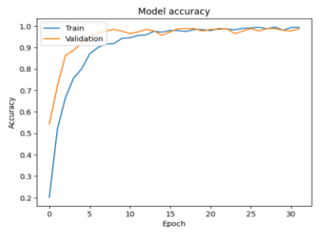
RESULTS & ANALYSIS
Learning Curve: This line graph illustrates the ResNet-101 model's training and validation accuracy across epochs, showing the model’s improvement and peak performance at 98.75% on the EyeNet dataset.
Model accuracy by implementing 30 epochs

Slide 18
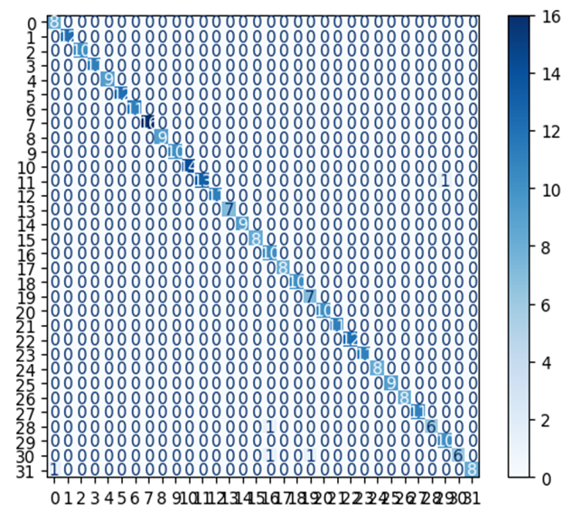
Confusion Matrix: The confusion matrix illustrates the ResNet-101 model's performance across retinal disease classes, highlighting accurate classifications and any misclassifications. This visualization provides insights into the model’s reliability and areas for further improvement.

Slide 19
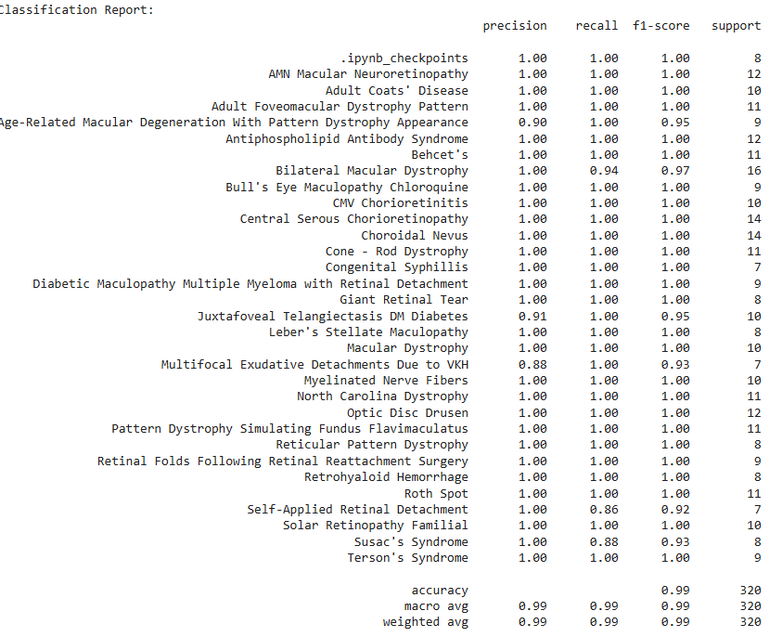
Model Precision and Recall Performance : The ResNet-101 model demonstrated high precision and recall on the EyeNet dataset, effectively identifying true positive cases across multiple retinal disease classes. This strong performance highlights its reliability in accurately diagnosing conditions like Diabetic Retinopathy and Macular Degeneration.

Slide 20
CONCLUSION & FUTURE SCOPE
Conclusion
In this study, we developed an optimized deep learning model, ResNet-101, for multi-class retinal disease classification using the EyeNet dataset. Our model achieved high accuracy in detecting various retinal abnormalities, offering efficient feature extraction while minimizing memory and CPU usage. This approach could enhance diagnostic speed and accuracy, supporting early detection and treatment planning. Additionally, the model's efficiency makes it a valuable tool for resource-limited healthcare settings, potentially expanding access to advanced retinal diagnostics.

Slide 21
Future Work
This research opens doors for further improvements. Future work could focus on testing the model in real clinical settings to understand its practical usefulness. Expanding the dataset to include more types of retinal diseases, even rare ones, would make the model more thorough. Using explainable AI techniques could help doctors understand the model’s decisions, building trust. Combining retinal images with other imaging types, like OCT, may improve accuracy. Finally, making the model faster for real-time use would allow for instant diagnosis, especially useful in telemedicine.

Slide 22
REFERENCES
S. Muchuchuti and S. Viriri, "Retinal disease detection using deep learning techniques: a comprehensive review," Journal of Imaging, vol. 9, no. 4, pp. 84, Apr. 2023.
X. Huang, H. Wang, C. She, J. Feng, X. Liu, X. Hu, ... and Y. Tao, "Artificial intelligence promotes the diagnosis and screening of diabetic retinopathy," Frontiers in Endocrinology, vol. 13, pp. 946915, 2022.
S. Rahman, J. Zhou, and J. J. Kang, "A comprehensive review on machine learning in healthcare industry: Classification, restrictions, opportunities, and challenges," Sensors, vol. 23, no. 9, pp. 4178, Apr. 2023.
R. M. Flores, A. Carneiro, M. Vieira, S. Tenreiro, and M. C. Seabra, "Age-related macular degeneration: pathophysiology, management, and future perspectives," Ophthalmologica, vol. 244, no. 6, pp. 495–511, 2021.

Slide 23
REFERENCES
S. Bharati, P. Podder, M. R. H. Mondal, and V. S. Prasath, "CO-ResNet: Optimized ResNet model for COVID-19 diagnosis from X-ray images," International Journal of Hybrid Intelligent Systems, vol. 17, no. 1-2, pp. 71–85, 2021.
A. B. Smith and C. D. Johnson, "WinoNN: Optimizing FPGA-Based Convolutional Neural Network Accelerators Using Sparse Winograd Algorithm," IEEE Transactions on Neural Networks and Learning Systems, vol. 32, no. 8, pp. 1215–1228, Aug. 2023.
R. Kalshetty and A. Parveen, "Abnormal event detection model using an improved ResNet101 in context-aware surveillance systems," Cognitive Computation and Systems, vol. 5, no. 2, pp. 153–167, 2023.
A. T. Lee, R. P. Kumar, and M. S. Patel, "Advancements in deep learning models for photoplethysmography signal analysis," IEEE Transactions on Biomedical Engineering, vol. 71, no. 4, pp. 897–908, Apr. 2024.

Slide 24
QUESTIONS and ANSWERS

Slide 25
