Slide 1

Department of Computer Science and Engineering
DeepWaveMRI: Early Alzheimer’s Detection
PRESENTED BY
Manepalli Yuva Sravani (21471A05H6)
Pulivarthi Priyanka (21471A05I9)
Gogada Sirisha (21471A05F2)
Under the Guidance of,
Sireesha Moturi _{M.Tech, P.hd},
Assoc. Professor,
Department of Computer Science and Engineering,
Narasaraopeta Engineering College (Autonomous),
Narasaraopet- 522 601.

Slide 2
OUTLINE
Abstract
Introduction
Literature Survey
Research Gaps
Problem Statement
Objectives
Block Diagram / Flow Diagram
Methodology
Implementation
Results and Analysis
Conclusion & Future Scope
References
Question and Answers
Acknowledgements

Slide 3
ABSTRACT
Alzheimer’s disease (AD) is the common type of dementia, which is a decline in cognition with significant memory loss that cannot be reversed causing the loss of independent functionality. Early detection is thus important for proper management because the current diagnostic methods, among them being cognitive testing, behavioral assessments, brain imaging, and history, are both unreliable and insufficient for the early stage diagnosis. The paper will propose a novel approach for early-stage AD detection based on MRI capability with enhanced image processing, using convolutional neural networks in combination with Wavelet Transform, Random Forest, and Support Vector Machine techniques. Our approach applies the Discrete Wavelet Transform of the MRI images to decompose them into multiple frequency frames, and further features are extracted by processing the wavelet coefficients with kurtosis-based thresholding for de noising enhanced representations. Then, the findings are used to train on a broad data set offered by Kaggle with CNN, Random Forest, and SVM models which can classify different stages of Alzheimer’s diseases. The proposed approach improves the ac curacy of detection significantly, which provides a more reliable solution for early diagnosis. Future work will be based on further optimization of the model’s performance and its extension to the application of the tool for other neurodegenerative conditions.

Slide 4
INTRODUCTION
Alzheimer’s is a brain disorder that causes memory loss and difficulty thinking. Detecting it early is important for treatment. The project uses MRI to identify changes in the brain linked to the disease, making diagnosis easier and more accurate.
Globally, Alzheimer's disease affects over 55 million people, with cases projected to triple by 2050 due to aging populations. In India, over 4 million people live with Alzheimer's, with rising numbers driven by an aging population and changing lifestyle patterns.
This project focuses on improving MRI technology to make it faster, more accurate, and cost-effective. Using machine learning algorithms, it enhances medical imaging to detect diseases like Alzheimer’s early. This can help doctors in fields like radiology and neurology provide better care and treatment for patients.

Slide 5
LITERATURE SURVEY
No | Title | Author | Journal Name & Year | Methodology Adapted | Key Findings | Gaps
1 | Dynamic Dual graph fusion convolutional network for Alzheimer’s disease diagnosis | Fanshi Li et al. | (Aug-2023) https://www.researchgate.net/publication/373518371_Dynamic_Dual-Graph_Fusion_Convolutional_Network_For_Alzheimer's_Disease_Diagnosis | Used DGCN(Dynamic dual graph fusion convolutional network) is used to classify the images(FMRI,PET,MRI) of brain. | Classification result obtained 95.3% | Results can be more accurate.
2 | Alzheimer’s disease stage identification using deep learning models | Santos Bringas et al. | (Sep-2020) https://www.sciencedirect.com/science/article/pii/S1532046420301428#ab010 | Used CNN(Convolutional Neural Network) model. | Obtained data from smartphone accelerometers worn by 35 patients in the period of 1-week. | The model’s findings are limited in generalizability due to its implementation.
3 | Generalizable deep learning model for early Alzheimer’s disease detection from structural MRIs | Sheng Liu et al. | (Oct-2022) https://www.nature.com/articles/s41598-022-20674-x | This study used FMRI scans and a CNN model combined with graph-based approaches to classify. | The CNN model demonstrated high accuracy in classifying Alzheimer’s stages. | FMRI captures brain spacing only by blood flow not by the structure of inner brain

Slide 6
LITERATURE SURVEY
No | Title | Author | Journal Name & Year | Methodology Adapted | Key Findings | Gaps
4 | Alzheimer’s Disease Detection Using Deep Learning | Kanmani.T et al. | (Oct-2024) https://www.irjet.net/archives/V11/i10/IRJET-V11I10113.pdf | CNN for MRI data and Machine Learning for EEG (electroencephalogram )data to classify disease. | Combining EEG and MRI data enhances classification. | More expensive method as both MRI and EEG images are used
5 | DeepCurvMRI:Deep Convolutional Curvlet Transform-Based MRI approach for Early Detection of Alzheimer’s Disease | Chahd M. Chabib et al. | (May-2023) https://ieeexplore.ieee.org/document/10113861 | Feature Extraction, Curvlet transform, CNN model. | Effective at capturing anatomical changes in MRI images to differentiate Alzheimer’s disease. Obtained 98.62%. | Curvlet Transformation is less efficient than wavelet transformation.

Slide 7
RESEARCH GAPS
Dataset Limitations: Many models, including CNNs, rely on small or homogenous datasets, limiting generalizability.
Cost Efficiency: Compared to MRI other scans like EEG, FMRI costs more.
Data Diversity: The models are often trained on data from limited demographic groups, missing diverse patient profiles.
Integration: The model fails while integrating the model with the web application.

Slide 8
PROBLEM STATEMENT
Magnetic Resonance Imaging (MRI) faces challenges like poor image quality, including noise and distortions, which make it difficult to obtain clear and accurate images for diagnosis.
High-quality MRI images are crucial for early and precise diagnosis of medical conditions. Enhancing MRI quality can lead to better patient outcomes by enabling doctors to identify diseases more accurately and make informed treatment decisions.

Slide 9
OBJECTIVES
Enhance the quality of MRI images with image preprocessing techniques like image resizing with a standard size of 208*208 pixels, normalization that brings pixel intensity to a standard range.
Reduce issues like noise and distortions in MRI images using Kurtosis.
Improve the effectiveness of MRI images using Fast discrete wavelet transform.
Provide a reliable method for better medical analysis and outcomes using the DeepWaveMRI model.

Slide 10
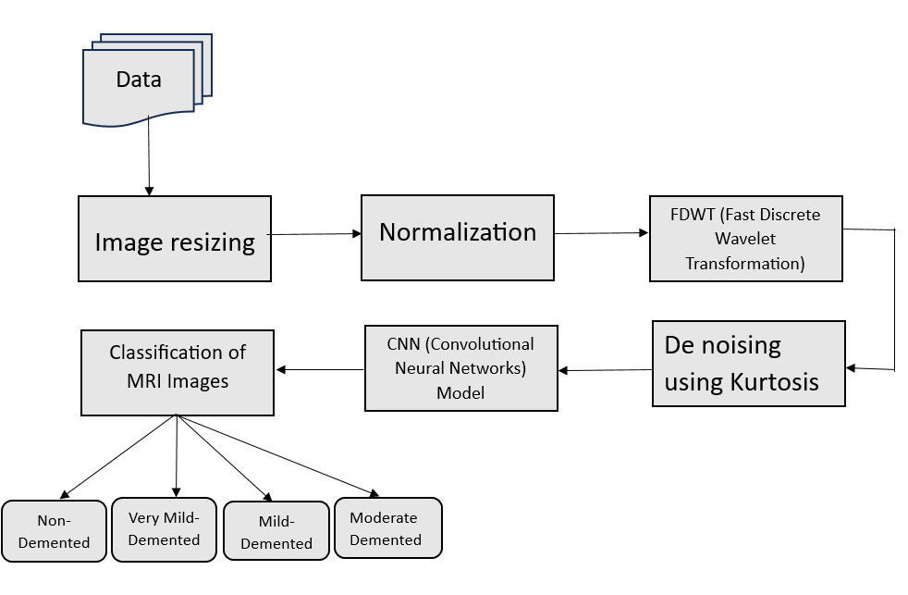
BLOCK DIAGRAM OR FLOW DIAGRAM

Slide 11
METHODOLOGY
Data Collection
Image Preprocessing
Image Resizing
Normalization
FDWT(Fast Discrete Wavelet Transform)
De noising using Kurtosis
Model Selection
Evaluation metrics
Confusion Matrix

Slide 12
METHODOLOGY
Data Collection: The dataset used in this study consists of MRI images of Alzheimer's patients. These images are sourced from publicly available databases like Kaggle or other medical image repositories. The dataset includes various stages of Alzheimer's disease
Stage0-non demented
Stage1-Mild
Stage2-Very mild
Stage3-Moderate
Image Resizing:
All MRI images are resized to a uniform resolution (208*208 pixels), ensuring consistent input size for the model.
Normalization:
Pixel intensity values are normalized to a standard range which helps the model converge more effectively during training.

Slide 13
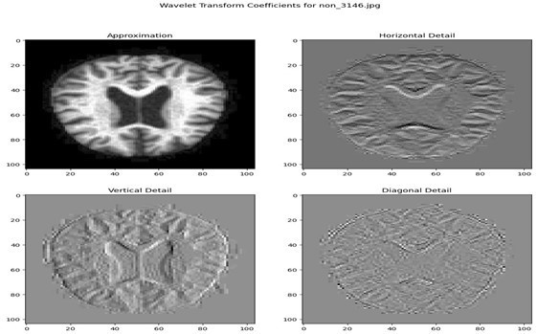
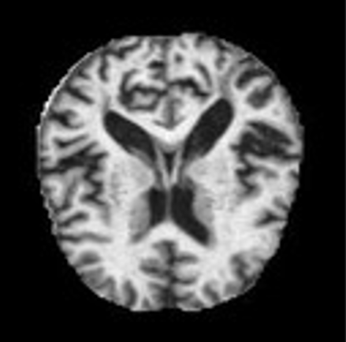
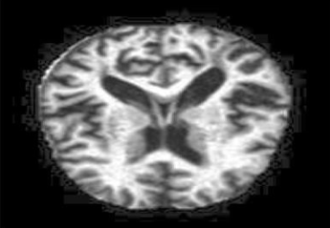
METHODOLOGY
FDWT(Fast Discrete Wavelet Transform):
Applied to extract multi-scale features that capture both edges and texture information of the brain images. It focuses on horizontal detail, vertical detail, diagonal details.
De noising with kurtosis:
Kurtosis is used to reduce image noise while preserving essential features, improving the quality of the data. It focusses on tail part of brain.
Fig2: Wavelet Transform
Fig3: De noising using Kurtosis

Slide 14
METHODOLOGY
Model Selection:
Convolutional layers are the primary building block of the DeepWaveMRImodel. They receive an image as an input and convolve using filters to produce an output image
A Convolutional Neural Network (CNN) is selected due to its ability to automatically learn spatial features and grid patterns from images. The model consists of multiple convolutional layers, pooling layers, and fully connected layers for classification tasks.
The Model performance is evaluated in the metrics as Accuracy, recall, F1-Score.

Slide 15
IMPLEMENTATION
Data Loading: MRI image data was imported from the Alzheimer's dataset, and the images were resized to a consistent dimension of 208x208 pixels for uniform input.
Libraries: pillow, os, image.
Preprocessing: Applied FDWT (Fast Discrete Wavelet Transform) for enhanced feature extraction.
Libraries: used pywavelets, matplotlib, Image, os, pywt.
De noising: kurtosis-based denoising to remove noise while preserving key features.
Libraries: open-cv, scipy, matplotlib, kurtosis, os.
Normalized the pixel intensity values for faster and stable convergence.
To obtain the effective accuracy, the data loading, pre-processing, de noising were very important.

Slide 16
IMPLEMENTATION
Model Development:
TensorFlow/Keras: For building and training the CNN model.
OpenCV: For resizing images during preprocessing.
PyWavelets: To implement FDCT for feature extraction.
scikit-learn: For evaluating metrics like accuracy, support, recall, and F1 score.
The CNN model includes convolutional layers for feature extraction, pooling layers for dimensionality reduction, and fully connected layers for classification.
Challenges:
Complex preprocessing.
Image quality variability
High computational demand.

Slide 17
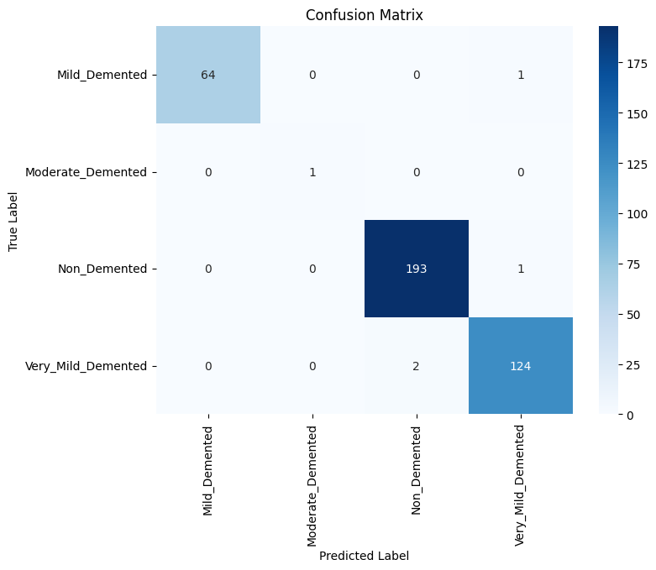
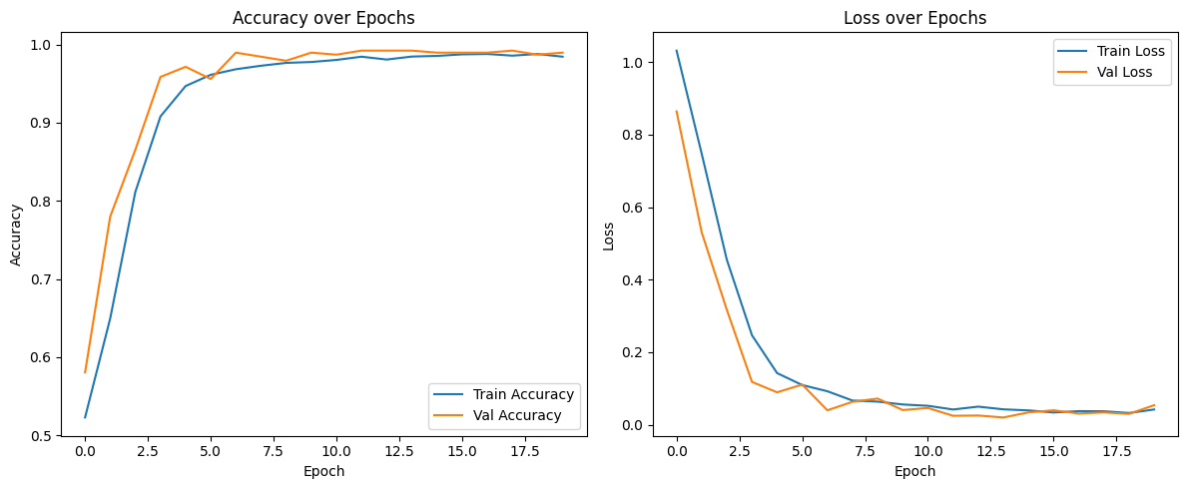
RESULTS & ANALYSIS
The proposed DeepWaveMRI model, utilizing CNN with Wavelet transform and kurtosis based preprocessing, achieved 98.96% accuracy, 99.07% F1-score, 98.96% sensitivity, and 99.74% specificity in MRI image classification. This highlights its effectiveness in distinguishing different MRI types.

Slide 18
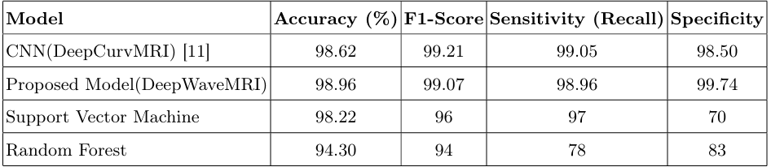
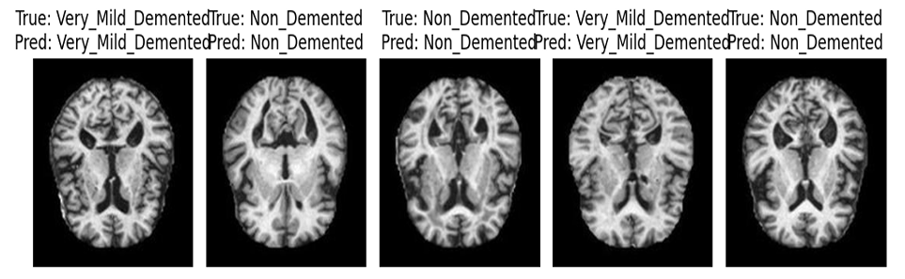
RESULTS & ANALYSIS

Slide 19
CONCLUSION and FUTURE SCOPE
DeepWaveMRI provides a highly accurate and non-invasive approach for Alzheimer’s detection, addressing a critical need in accessible diagnostics
The results show the model achieves 98.96% accuracy in detecting Alzheimer’s disease, enabling early and reliable diagnosis. This is crucial for starting treatment sooner and improving patient outcomes. The use of advanced techniques like Wavelet Transform and CNN makes the model highly effective for medical imaging.
Further optimize model performance and explore hybrid architectures.
The model requires high-quality datasets and significant computational resources, which may limit its accessibility.

Slide 20
REFERENCES
Greeshma, B., Sireesha, M., Thirumala Rao, S.N. (2022). Detection of Arrhyth mia Using Convolutional Neural Networks. In: Shakya, S., Du, K.L., Haoxiang, W. (eds) Proceedings of Second International Conference on Sustainable Expert Systems. Lecture Notes in Networks and Systems, vol 351. Springer, Singapore. https://doi.org/10.1007/978-981-16-7657-4-3.
Springer Nature. (2024). The future of Alzheimer’s diagnosis: Unlocking insights with multi-modal imaging models. Retrieved August 28, 2024, from: https://communities.springernature.com/posts/the-future-of-alzheimers diagnosis-unlocking-insights-with-multi-modal-imaging-models.
Mayo Clinic Staff. (n.d.). Alzheimer’s disease. Mayo Clinic. Retrieved Au gust 28, 2024, from: https://www.mayoclinic.org/diseases-conditions/alzheimers disease/in-depth/alzheimers/art-20048075.
S. L. Jagannadham, K. L. Nadh, and M. Sireesha, "Brain Tumour Detection Us ing CNN," 2021 Fifth International Conference on I-SMAC (IoT in Social, Mo bile, Analytics and Cloud) (I-SMAC), Palladam, India, 2021, pp. 734-739, doi: 10.1109/I-SMAC52330.2021.9640875.

Slide 21
REFERENCES
M. Sireesha, S. N. TirumalaRao, Srikanth Vemuru, Frequent Itemset Mining Al gorithms: A Survey. Journal of Theoretical and Applied Information Technology, 2018, Vol- 96, No. 3, pp. 744-755.
Moturi, S., Vemuru, S., Tirumala Rao, S.N., Mallipeddi, S.A. (2023). Hybrid Bi nary Dragonfly Algorithm with Grey Wolf Optimization for Feature Selection. In: Hassanien, A.E., Castillo, O., Anand, S., Jaiswal, A. (eds) International Confer ence on Innovative Computing and Communications. ICICC 2023. Lecture Notes in Networks and Systems, vol 703. Springer, Singapore. https://doi.org/10.1007/978 981-99-3315-047.
Tanveer, M., Richhariya, B., Khan, R. U., Rashid, A. H., Khanna, P., Prasad, M., Lin, T. C. (2020). Machine learning techniques for the diagnosis of Alzheimer’s disease: A review. ACM Transactions on Multimedia Computing, Communications, and Applications, 16(1), 1–35. https://doi.org/10.1145/3395454.
IBM. (n.d.). Random forest. IBM. Retrieved August 28, 2024, from: https://www.ibm.com/topics/randomforest.
GeeksforGeeks. (n.d.). Convolutional Neural Network (CNN) in Machine Learning. Retrieved August 28, 2024, from:https://www.geeksforgeeks.org/convolutional neural-network-cnnin-machine-learning/..

Slide 22
REFERENCES
Quora Contributors. (n.d.). What are the advantages of wavelet transforma tion over other conventional filters in image processing? Quora. Retrieved August 28, 2024, from: https://www.quora.com/What-are-the-advantages-of wavelettransformation-over-other-conventional-filters-in-image-processing..
C. M. Chabib, L. J. Hadjileontiadis, and A. A. Shehhi, ”DeepCurvMRI: Deep Convolutional Curvelet Transform-Based MRI Approach for Early Detection of Alzheimer’s Disease,” in IEEE Access, vol. 11, pp. 44650-44659, 2023. doi: 10.1109/ACCESS.2023.3272482.
Liu, C. (2023). Dynamic Dual-Graph Fusion Convolutional Network for Alzheimer’s Disease Diagnosis. In Proceedings of the 2023 IEEE Inter national Conference on Image Processing (ICIP) (p. 6). IEEE. DOI: 10.1109/ICIP49359.2023.10222732.
Wiem, T., Douik, A. (2021). Deep Convolutional Second Genera tion Curvelet Transform-based MR Image for Early Detection of Alzheimer’s Disease. In Proceedings of the VISIGRAPP. Retrieved from:https://api.semanticscholar.org/CorpusID:232094218.
Kumar, S., Shastri, S. (2022). Alzheimer MRI Preprocessed Dataset. Kaggle. https://www.kaggle.com/dsv/3364939. DOI: 10.34740/KAGGLE/DSV/3364939.

Slide 23

QUESTIONS and ANSWERS

Slide 24
ACKNOWLEGEMENTS
Thank you all for giving me the opportunity to present our project, “DeepWaveMRI: Early Alzheimer’s Detection”
If you have any further questions, need additional information
Contact Information:
Name: Manepalli Yuva Sravani
Phone Number: 8019501381
Email: manepalliyuvasravaniaa@gmail.com

