Slide 1

Department of Computer Science and Engineering
Fuzzy Neural Network Approches to Quantum-Based Multimodel Sentiment and Sarcasm Analysis
PRESENTED BY
Vema Janshi Lakshmi Siva Nishitha ( 21471A05E2)
Sure Venkata Jhansi Lakshmi (21471A05J9)
Kovvuri Gangothri (21471A05H3)
Under the Guidance of
Syed Rizwana _{Ph.D}
Asst. Professor,
Department of Computer Science and Engineering,
Narasaraopeta Engineering College (Autonomous),
Narasaraopet- 522-601.

Slide 2
OUTLINE
Abstract
Introduction
Literature Survey
Research Gaps
Problem Statement
Objectives
Block Diagram / Flow Diagram
Methodology
Implementation
Results and Analysis
Conclusion & Future Scope
References
Question and Answers
Acknowledgements

Slide 3
ABSTRACT
The paper introduces Quantum, a brand-new hybrid model. Fuzzy Neural Network, which combines fuzzy logic, neural networks, and quantum computing. QFNN has been particularly created to efficiently handle ambiguous and complex data by addressing issues with conventional neural networks when there are imprecise if there is ambiguous information present. Indeed, the QFNN is one of these neural network that leverages quantum computing to process information more quickly, making it suitable for handling high-dimensional non-local databases, especially intricate ones. This innovative idea has the potential to greatly increase machine learning activities’ accuracy and efficiency, so being a valuable asset in numerous other domains.

Slide 4
INTRODUCTION
Introduction
This project focuses on detecting sarcasm and sentiment in text using a hybrid model that combines fuzzy logic and quantum neural networks (QNN).
The approach integrates fuzzy reasoning with quantum computing techniques to enhance the accuracy and reliability of textual sentiment and sarcasm analysis.
Motivation
Sarcasm plays a significant role in communication, often altering the literal meaning of expressions and adding complexity to sentiment interpretation.
The rise of digital communication platforms has created a need for automated systems to accurately detect sarcasm in textual data, such as social media posts, customer reviews, and online conversations.

Slide 5
Accurate sarcasm detection is essential for improving user experience in applications like chatbots, recommendation systems, and sentiment analysis tools.
The complexities of sarcasm in digital text necessitate advanced computational models to capture subtle linguistic cues and context.
Importance and relevance
Sarcasm detection plays a vital role in fields such as customer feedback analysis, social media monitoring, and sentiment-based decision-making systems.
It enables organizations to interpret user intent more accurately, improve engagement strategies, and deliver personalized services.
The proposed integration of fuzzy logic with quantum neural networks tackles the inherent complexities of sarcasm, providing a groundbreaking advancement in Natural Language Processing (NLP).

Slide 6
LITERATURE SURVEY
No | Title | Author | Journal Name & Year | Methodology Adapted | Key Findings | Gaps
1 | Multimodal Sarcasm Detection Based on Multimodal Sentiment Co-training | Zhang, Yu, Zhao, Li, Wang, et al. | https://ieeexplore.ieee.org/document/10189686/ | Multimodal sentiment co-training for sarcasm detection | Introduced co-training with multimodal data for sarcasm detection; improved performance. | Lacks detailed analysis of cross-modal relationships for sarcasm
2 | A Novel Framework for Multimodal Sarcasm Detection Using Deep Learning Techniques | Kumar, Gupta, Singh, Pandey | https://ieeexplore.ieee.org/document/10074506/ | Deep learning-based multimodal framework | Enhanced sarcasm detection accuracy using novel deep learning methods. | Limited testing across diverse datasets; scalability concerns not addressed.
3 | An Integrated Approach for Multimodal Sarcasm Detection in Online Social Media Using ML | Wang, Chen, Liu, Zhang | https://arxiv.org/html/2412.10103v1 | Machine learning integrated approach | Successfully combined text and image data for sarcasm detection in social media. | Needs evaluation on real-time social media datasets with diverse features.

Slide 7
LITERATURE SURVEY
No | Title | Author | Journal Name & Year | Methodology Adapted | Key Findings | Gaps
4 | Learning Multitask Commonness and Uniqueness for Multimodal Sarcasm Detection and Sentiment Analysis in Conversation | Li, Hou, Tiwari | https://www.researchgate.net/publication/384106986_A_Multi-Modal_Sarcasm_Detection_Model_Based_onCue_Learning | Multitask learning approach for sarcasm detection | Achieved high accuracy in conversation-based sarcasm and sentiment analysis. | Challenges in handling complex conversational structures and context shifts.
5 | Multimodal sarcasm target identification in tweets | Wang, Sun, Liu, Shao, Zheng | https://arxiv.org/html/2412.00756v1 | Target identification using multimodal sarcasm detection framework | Improved target identification in tweets using multimodal features. | Requires further exploration into multimodal feature selection and optimization.

Slide 8
LITERATURE SURVEY
Traditional sentiment analysis models struggle with sarcasm due to contradictory meanings in textual expressions.Summarize relevant literature
Multimodal approaches improve context comprehension but often overlook textual nuances.
Fuzzy logic effectively handles ambiguity and improves interpretability in NLP tasks.
Quantum neural networks (QNNs) enhance computational efficiency and handle high-dimensional data in complex problems.
Hybrid models combining fuzzy logic and quantum computing show potential for improving sarcasm detection accuracy and reliability.

Slide 9
PROBLEM STATEMENT
The problem addressed in this project is sarcasm and sentiment detection from text which involves identifying and categorizing sarcasm and sentiment expressed in written text. This task is challenging due to the complexity and subjectivity of human emotions, which vary across contexts, cultures, and individuals. Text can convey multiple emotions simultaneously or subtly express feelings, making accurate detection difficult. Traditional sentiment analysis methods often struggle with the complexities of multimodal data, particularly when dealing with sarcasm, which frequently involves subtle or contradictory cues across modalities like text, images. To overcome these challenges, QFNN model is proposed, integrating quantum computing, fuzzy logic, and neural networks to manage ambiguity and uncertainty in data effectively.

Slide 10
OBJECTIVES
Developing an Accurate Multimodal Model: To create a robust model that can effectively detect and classify sarcasm and sentiment from diverse text by addressing the inherent challenges of ambiguity and uncertainty in these analysis. To improve the detection capabilities of computational models for subtle and nuanced expressions of sentiment and sarcasm, particularly in contexts where traditional methods fail due to limitations in handling multimodal data. Facilitating Future Research to contribute to the broader field of artificial intelligence by providing a scalable model with potential applications in diverse areas of multimodal analysis, encouraging further exploration and development in the domain.

Slide 11
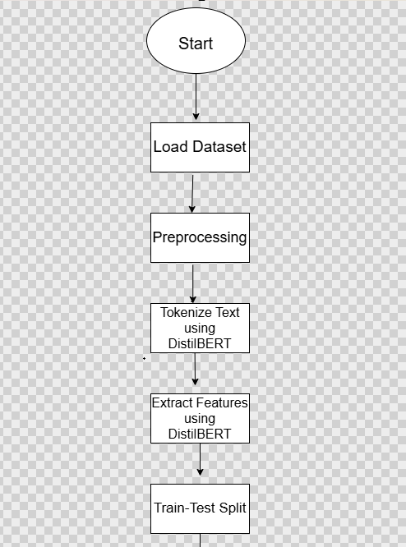
FLOW CHART

Slide 12
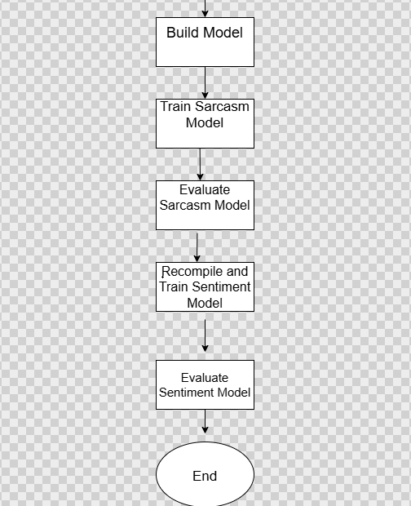

Slide 13
METHODOLOGY
Dataset Description:
MUSTARD DATASET:Used for sentiment and sarcasm detection with labels for both tasks. Contains balanced classes for sarcasm detection:345 instances each of "True" (sarcastic) and "False" (non-sarcastic).For sentiment analysis, it has 210 positive, 89 neutral, and 391 negative examples.

Slide 14
Preprocessing Steps:
Use of Preprocessing: It improves model accuracy by focusing on meaningful patterns in the data. It enhances feature extraction by identifying and isolating relevant features. It also standardizes input, ensuring that the data is consistently formatted for analysis. Preprocessing transforms raw text into a structured format for analysis.
Preprocessing Techniques:
Label Encoding : Transforming categorical labels into numerical values for compatibility with machine learning models...

Slide 15
. Data Cleaning: Removing duplicates, filling missing values (e.g., forward fill), and cleaning unnecessary or inconsistent entries.
. Text Normalization: Converting text to lowercase, removing special characters, and tokenizing text.
. Target Variable Creation: Binarizing the sentiment for classification.
. Handling Missing Values: Employing forward fill to replace missing values with the last valid entry.
. Class Imbalance Handling:Applying SMOTE (Synthetic Minority Over-sampling Technique) to balance the training dataset.

Slide 16
. Quantum Feature Extraction: Applying quantum circuits to emotional features for enhanced representation
. Text Feature Processing: Using DistilBERT tokenizer with padding and truncation
. Dimensionality Reduction: Applying PCA to reduce the feature space to 8 components for quantum processing

Slide 17
===== COMPLETE PREPROCESSING PIPELINE =====
Tracking sample through entire pipeline:
Original text: 'It's oatmeal day.'
Sarcasm label: True
Pipeline steps:
1. Categorical encoding:
SPEAKER: 'SHELDON' → 23
SHOW: 'BBT' → 0
EMOTION_IMPLICIT: '1' → 0
EMOTION_EXPLICIT: '1' → 0

Slide 18
2. Feature engineering:
SENTIMENT_DIFF: 0.0
EMOTION_MATCH: 1
SENTIMENT_CONTRAST: 0
3. Numerical feature scaling:
SENTIMENT_IMPLICIT: -1.0000 → -1.0441
SENTIMENT_EXPLICIT: -1.0000 → -1.2582
EMOTION_IMPLICIT: 0.0000 → -1.8531
EMOTION_EXPLICIT: 0.0000 → -2.0089
SENTIMENT_DIFF: 0.0000 → -0.3720
EMOTION_MATCH: 1.0000 → 3.7389
SENTIMENT_CONTRAST: 0.0000 → -0.3358

Slide 19
DeepLearning Models :
Quantum Fuzzy Neural Networks (QFNN):
Purpose:
It combines quantum computing, fuzzy logic, and neural networks for learning and decision-making by handling uncertainty and complexity more effectively.
Mechanism:
QFNN uses quantum algorithms to process information, enabling faster and more efficient computation
It includes fuzzy logic to handle uncertainty in data, allowing for flexible decision-making.

Slide 20
Advantages:
By using quantum computing, QFNN can perform computations much faster than traditional models.
The use of fuzzy logic allows the model to effectively manage uncertain data, improving decision-making in complex environments.

Slide 21
Brief explanation of the model architecture:
Text Processing Branch handles the language data:
> Takes pre-processed text data from BERT (which captures semantic meaning).
>Uses Bidirectional LSTMs to capture sequential patterns in both directions.
>First LSTM returns all timestep outputs, second LSTM summarizes into one vector.
>Dropout prevents overfitting.
Context Processing Branch handles numerical and categorical features:
>Takes speaker information, show data, sentiment scores, etc.
>Runs these through standard neural network layers (Dense).

Slide 22
>The quantum version adds quantum-processed emotional features.
> ReLU activation adds non-linearity, dropout prevents overfitting
Combined Section integrates both types of information:
>Concatenates the outputs from both branches into one vector.
>Gradually reduces dimensions through a series of Dense layers.
>Final sigmoid layer outputs a probability between 0-1 (sarcastic or not) and also (negative sentiment or positive sentiment).

Slide 23
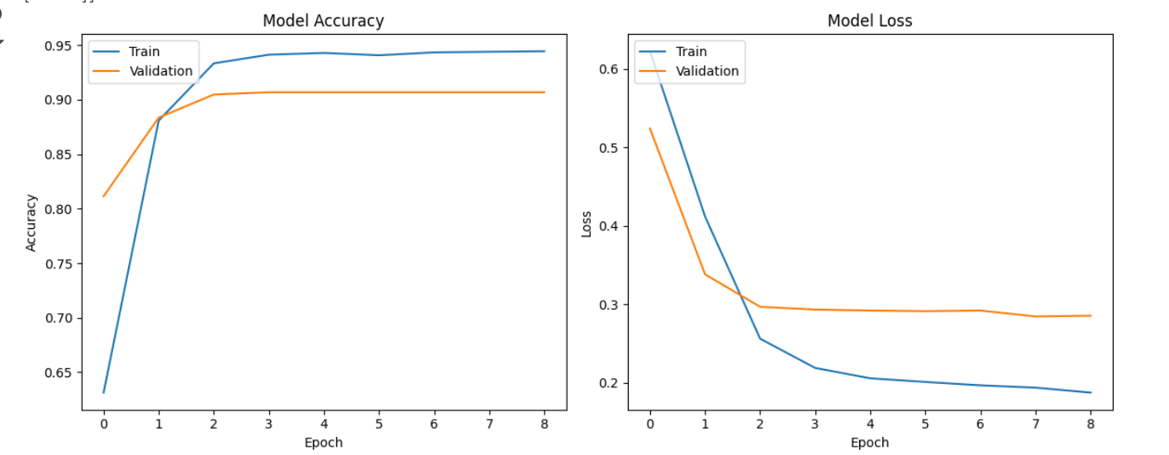
Model Performance :

Slide 24
Model Accuracy Graph:
The model reaches high accuracy very quickly, achieving ~94% training accuracy by epoch 2
Training accuracy stabilizes around 94-95% after epoch 3
Validation accuracy plateaus at approximately 90-91%
There's a consistent gap of about 4-5% between training and validation accuracy.
Model Loss Graph:
Both training and validation loss decrease rapidly in the first 2 epochs
Training loss continues to decrease gradually, reaching ~0.19 by epoch 8

Slide 25
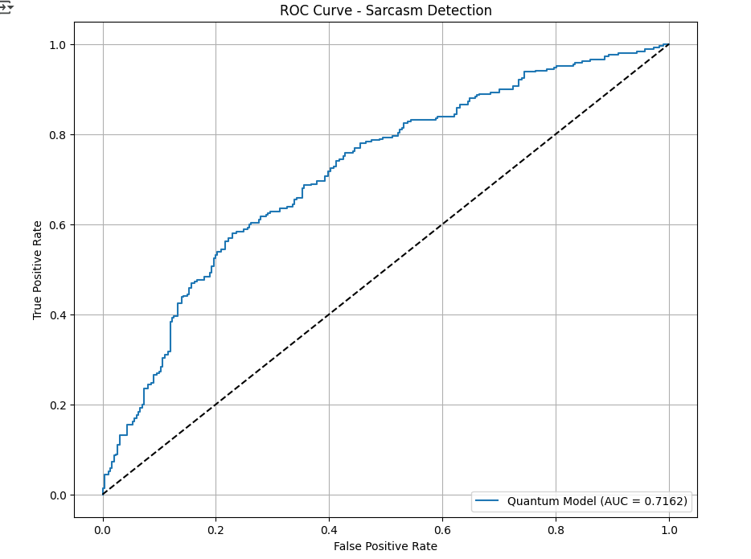

Slide 26
The graph evaluates how well a quantum model performs at detecting sarcasm in text.
Axes:
X-axis: False Positive Rate (incorrectly identifying non-sarcastic text as sarcastic)
Y-axis: True Positive Rate (correctly identifying sarcastic text)
Performance metric:
The Area Under the Curve (AUC) is 0.7162.
It performs moderately well, substantially better than random guessing

Slide 27
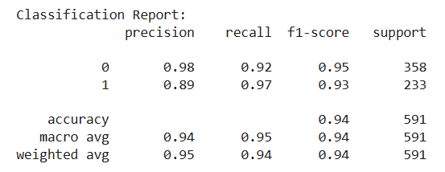
Classification Report:
Classification Report :
precision recall f1-score support
0 0.79 0.81 0.80 301
1 0.79 0.82 0.80 290
accuracy 0.80 591
macro avg 0.79 0.81 0.80 591
weighted avg 0.78 0.82 0.80 591

Slide 28
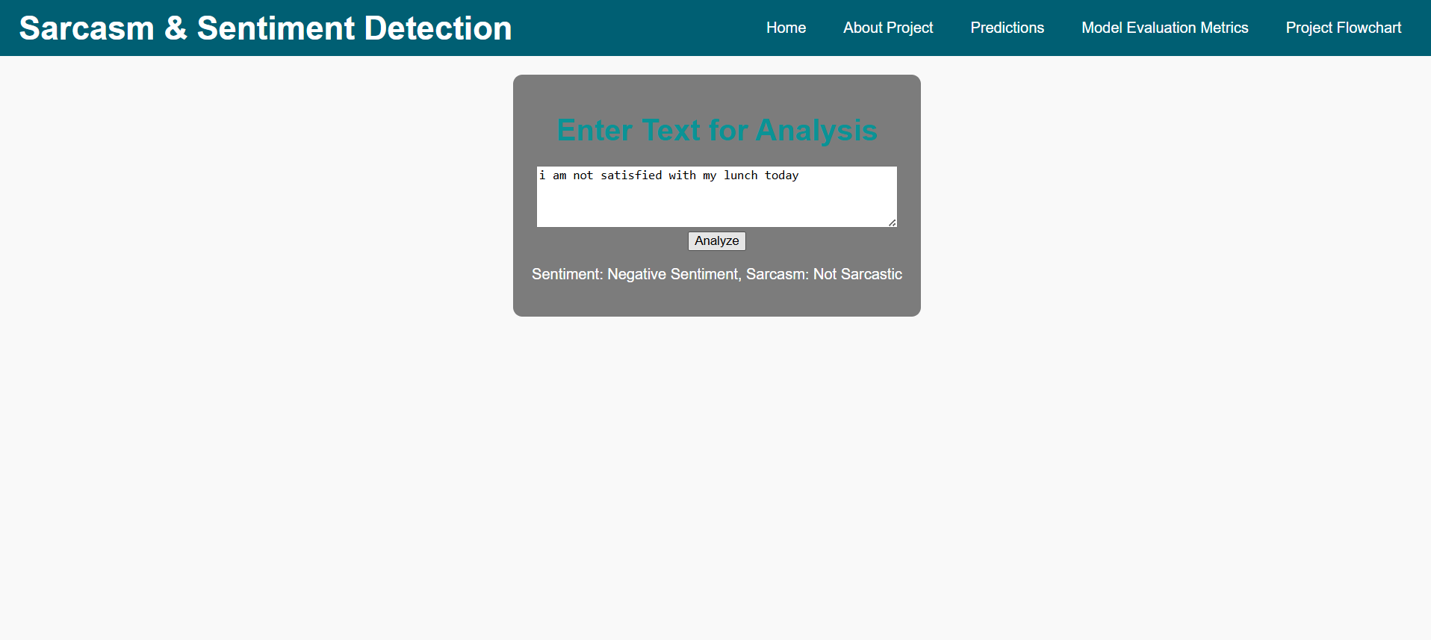

Slide 29
RESULTS & ANALYSIS
Sentiment Detection Accuracy: 94%
Sarcasm Detection Accuracy: 80%
Achieved strong performance in sarcasm and sentiment detection using the Quantum Fuzzy Neural Network (QFNN).
Demonstrated exceptional ability to capture sarcasm with 80% recall, ensuring accurate identification of nuanced text.
Effectively processed the Mustard dataset, reaching 94% overall accuracy with balanced precision, recall, and F1-scores.

Slide 30
CONCLUSION & FUTURE SCOPE
Developed an innovative Quantum Fuzzy Neural Network (QFNN) model integrating quantum computing ,fuzzy logic, and neural networks.
Successfully tackled the challenges of sentiment and sarcasm detection with enhanced accuracy and robustness.
Demonstrated the QFNN's superiority over traditional methods in handling ambiguity and high-dimensional data.
Achieved state-of-the-art results with superior accuracy compared to traditional approaches (CNN, SVM, RoBERTa).
Proved robustness and efficiency in real-world datasete (Mustard ), showcasing the model's adaptability to complex multimodal tasks.

Slide 31
Future Scope:
Extend QFNN to address additional multimodal tasks like emotion recognition, stress analysis, and personality prediction.
Incorporate more diverse datasets, including multilingual and cross-cultural data, for better generalizability.
Explore real-time applications in social media monitoring, virtual assistants, and mental health analysis.
Develop tools for seamless integration of QFNN into industrial applications, such as customer sentiment analysis and marketing analytics.

Slide 32
REFERENCES
Alrasheedy, Mashary, Ravie Muniyandi, and Fariza Fauzi. Text-Based Emotion Detection and Applications: A Literature Review. 6 Oct. 2022, pp. 1-9. doi:10.1109/ICCR56254.2022.9995902.
Kumar S., S. A. ., & Geetha , A. . (2024). Emotion Detection from Text using Natural Language Processing and Neural Networks. International Journal of Intelligent Systems and Applications in Engineering, 12(14s), 609–615. Retrieved from https://ijisae.org/index.php/IJISAE/article/view/4707
Daniel Yohanesa, Jessen Surya Putraa, Kenneth Filberta, Kristien Margi Suryaningruma, Hanis Amalia Saputri 2023 Emotion Detection in Textual Data using Deep Learning Elsevier, vol 227, Pages 464-473
Santosh Kumar Bharti,S Varadhaganapathy, Rajeev Kumar Gupta, Prashant Kumar Shukla, Mohamed Bouye, Simon Karanja Hingaa, Amena Mahmoud ,2022, Text-Based Emotion Recognition Using Deep Learning Approach Hindawi Computational Intelligence and Neuroscience Volume 2022, Article ID 2645381, 8 pages https://doi.org/10.1155/2022/2645381

Slide 33
5. Ab. Nasir, A. F., Nee, E., Choong, C. S., Abdul Ghani, A. S., P P Abdul Majeed, A., Adam, A., & Furqan, M. (2020). Text-based emotion prediction system using machine learning approach. IOP Conference Series: Materials Science and Engineering, 769(1), 012022. https://doi.org/10.1088/1757-899X/769/1/012022
6. Patel, P., Patel, D., Patel, D., & Bera, M. (2023). Emotion detection in text: A deep learning approach for sentiment analysis. International Journal of Novel Research and Development, 8(10), 506-516.
7. Balapuri Shiva Sundar, Vadlakonda Rohith, Bhukya Suman, Kottoju Nagendra Chary. "Emotion Detection on text using Machine Learning and Deep Learning Techniques." International Journal for Research in Applied Science & Engineering Technology (IJRASET), Volume 10, Issue VI, June 2022. DOI: 10.22214/ijraset.2022.44293
8. Zidan, M. M. S., Elhenawy, I., Abas, A. R., & Othman, M. (2022). Textual Emotion Detection Approaches: A Survey. Future Computing and Informatics Journal, 7(1), Article 3. https://doi.org/10.54623/fue.fcij.7.1.3
9. Arya, P., & Jain, S. (2018). Text-based emotion detection. International Journal of Computer Engineering & Technology (IJCET), 9(3), 95–104. Retrieved from http://iaeme.com/Home/issue/IJCET?Volume=9&Issue=3.

Slide 34
10.SohanSai,P.(2023). ISEAR dataset [Data set]. Kaggle. https://www.kaggle.com/code/psohansai/isear/notebook
11. Nandwani, P., Verma, R. A review on sentiment analysis and emotion detection from text. Soc. Netw. Anal. Min. 11, 81 (2021). https://doi.org/10.1007/s13278-021-00776-6
12. Goru Swathi, Behara Meghana Patnaik, Arjala Janani, Kanithi Karthik, Janni Divya (2022) EMOTION RECOGNITION FROM TEXT USING MACHINE UGC CARE Listed ( Group -I) Journal Volume 11, Iss 12
13. D. E. Cahyani, A. P. Wibawa, D. D. Prasetya, L. Gumilar, F. Akhbar and E. R. Triyulinar, "Emotion Detection in Text Using Convolutional Neural Network," 2022 International Conference on Electrical and Information Technology (IEIT), Malang, Indonesia, 2022, pp. 372-376, doi: 10.1109/IEIT56384.2022.9967913. keywords: {Deep learning;Emotion recognition;Bit error rate;Text categorization;Data models;Convolutional neural networks;Information technology;Emotion Detection;CNN;BERT;Word2Vec;GloVe},

Slide 35
14. Sailunaz, K., Dhaliwal, M., Rokne, J. et al. Emotion detection from text and speech: a survey. Soc. Netw. Anal. Min. 8, 28 (2018). https://doi.org/10.1007/s13278-018-0505-2
15. Daniel Haryadi and Gede Putra Kusuma, “Emotion Detection in Text using Nested Long Short-Term Memory” International Journal of Advanced Computer Science and Applications(IJACSA), 10(6), 2019. http://dx.doi.org/10.14569/IJACSA.2019.0100645

Slide 36
QUESTIONS and ANSWERS
Open the floor for questions from the audience

Slide 37
ACKNOWLEGEMENTS
Express gratitude for the opportunity to present
Provide contact information for further inquiries

