Slide 1
Department of Computer Science and Engineering Optimized Deep Learning Framework for Fruit Disease Detection Using Feature Fusion and Neural Network Architectures
PRESENTED BY
Shaik Jaleel
Puli Sai Lokesh Reddy
Tirupathi Eswar Vara Prasad
Vemula Rajesh
(21471A05Q0)
(21471A05O6)
(22475A0512)
(22475A0520)
Under the Guidance of,
Mr.K .V. Narasimha Reddy _{M.Tech},
Asst.Professor,
Department of Computer Science and Engineering,
Narasaraopeta Engineering College (Autonomous),
Narasaraopet- 522 601.
Review No.01
Department of CSE

Slide 2
OUTLINE
Abstract
Introduction
Literature Survey
Research Gaps
Problem Statement
Objectives
Block Diagram / Flow Diagram
Methodology
Implementation
Results and Analysis
Conclusion & Future Scope
References
Question and Answers
Acknowledgements
Review No.01
Department of CSE

Slide 3
ABSTRACT
Our project more advanced framework for fruit disease detection with special emphasis on apple and grape leaves using deep learning models. For this purpose, first, the Inception-ResNet-V2 model, pre-trained in ImageNet, was used because it has the ability to capture multi-scale patterns better, which are ultimately significant for detecting complex disease symptoms. Due to its inception modules’ residual connections, this model will work pretty well in processing complex visual data. What makes this study different is the fact that it used several architectures of neural networks for comparison: Trilayered, Bilayered, wide and medium-sized models. The interesting thing about this is that although the Inception- ResNet-V2 network model 90.1% classification accuracy, a wide neural network surprised this in doing 98.5%. It was seen that the Bilayered model showed the lowest accuracy at 94.8%, but this was a very simple network. A part from model selection, the study underlined dataset preprocessing for quality and diversity improvement. Techniques like contrast enhancement, data augmentation (flipping, rotation, and scaling), and entropy- based feature selection were used.
Review No.01
Department of CSE

Slide 4
INTRODUCTION
Highlights the impact of climate change on agriculture and the need for accessible and advanced technologies in underdeveloped regions.
Focuses on providing a lightweight, on-device deep learning solution for resource-constrained environments.
Our Approach Aims to classify apple and grapes crop diseases accurately using optimized Deep Neural Networks (DNNs), including CNNs and Inception-ResNet-V2.
To enhance model performance, the study incorporates preprocessing techniques such as contrast enhancement, data augmentation, and noise reduction.
Review No.01
Department of CSE

Slide 5
LITERATURE SURVEY
No | Title | Author | Journal Name & Year | Methodology Adapted | Key Findings | Gaps
1 | An Integrated Framework of Two-Stream Deep Learning Models: Optimal Information Fusion for Fruits Disease Recognition. | Areej Alasiry, Mehrez Marzougui, Anum Masood, Unber Zahra, Muhammad Attique Khan. | IEEE,2024 https://ieeexplore.ieee.org/document/10342713 | Used Hybrid contrast enhancement, Inception-ResNet-V2, entropy-based feature selection, intelligent fusion. | High accuracy achieved; effective feature selection and fusion improved disease classification performance.. | Generalization issues, reliance on handcrafted features, limited dataset diversity. .
2 | Constructing and Optimizing RNN Models to Predict Fruit Rot Disease Incidence in Areca Nut Crop Based on Weather Parameters | Rajashree Krishna, K. V. Prema. | IEEE,2023 https://ieeexplore.ieee.org/document/10238702 | Used Data preprocessing, RNN model establishment, optimization algorithms, performance comparison. | Proposed model enhances disease prediction accuracy using weather data. | Limited studies on fruit rot disease prediction using deep learning.
3 | Automatic Detection of Citrus Fruit and Leaves Diseases Using Deep Neural Network Model | Asad Khattak, Muhammad Usama Asghar,Ulfat Batool, Hayat Ullah | IEEE,2021 https://ieeexplore.ieee.org/document/9481921 | Used Proposed CNN model with preprocessing, layers, and classification for detection. | Achieved 94.55% accuracy in detecting citrus diseases using CNN. | Limited datasets and need for improved feature extraction techniques identified.
Review No.01
Department of CSE

Slide 6
LITERATURE SURVEY
No | Title | Author | Journal Name & Year | Methodology Adapted | Key Findings | Gaps
4 | Apple Leaf Disease Recognition and Sub-Class Categorization Based on Improved Multi-Scale Feature Fusion Network | Yuanqiu Luo, Jun Sun, Jifeng Shen, Xiaohong Wu, Long Wang, Weidong Zhu | IEEE,2021 https://ieeexplore.ieee.org/document/9475059 | Improved multi-scale feature fusion network for apple leaf disease classification. . | Optimized model achieved 94.99% accuracy, enhancing disease classification robustness. | Limited real-world application and expert validation of classification models.
5 | FieldPlant: A Dataset of Field Plant Images for Plant Disease Detection and Classification With Deep Learning | Emmanuel Moupojo, Dongmo Wilfried, Appolinaire Tagne, Florent Retraint | IEEE,2023 https://ieeexplore.ieee.org/document/10086516 | Images captured, annotated, classified by disease using deep learning. | High accuracy in plant disease detection using deep learning models. | Insufficient annotated images and complex backgrounds hinder model performance.
Review No.01
Department of CSE

Slide 7
RESEARCH GAPS
Existing models often struggle with generalization due to insufficient diversity in training datasets, leading to overfitting.
Many deep learning models are computationally expensive, making them impractical for use in low-resource environments or on edge devices.
Current approaches may not effectively handle variations in lighting conditions and leaf orientations, impacting classification accuracy.
There is a need for more effective feature selection methods to enhance model performance by reducing redundancy and focusing on relevant disease characteristics.
Review No.01
Department of CSE

Slide 8
PROBLEM STATEMENT
Agricultural Challenges: Climate change and limited access to advanced crop monitoring tools threaten food security, especially in underdeveloped regions.
Lack of Accessibility: Farmers in rural areas often lack affordable and effective solutions for timely disease diagnosis, impacting yields and economic stability.
Inefficiency of Existing Systems: Current cloud-based solutions are resource-intensive, requiring high computational power and reliable internet connectivity, making them unsuitable for remote areas.
Disease Complexity: Accurate detection of complex disease symptoms in fruits, such as apple and grape leaves, remains a challenge due to variability in patterns and lighting conditions.
Need for Real-Time, Scalable Solutions: A lightweight, efficient, and edge-compatible framework is essential for empowering farmers with real-time, on-device fruit disease detection.
Review No.01
Department of CSE

Slide 9
OBJECTIVES
Develop a Scalable Framework: Create an optimized deep learning framework for accurate fruit disease detection, focusing on apple and grape leaves.
Enhance Detection Accuracy: Utilize advanced preprocessing techniques, feature selection, and fusion methods to improve model performance and robustness.
Enable Real-Time Solutions: Design a lightweight, edge-compatible system for disease detection on devices like smartphones and Raspberry Pi, reducing dependency on cloud-based systems.
Support Precision Agriculture: Provide farmers with an accessible tool to enhance crop monitoring, enabling timely and efficient disease management in resource-constrained environments.
Review No.01
Department of CSE

Slide 10
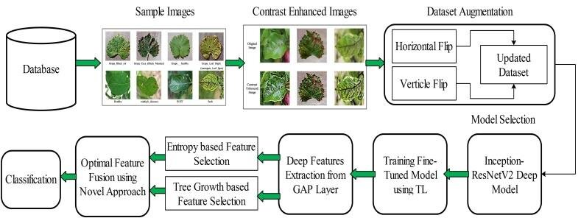
BLOCK DIAGRAM OR FLOW DIAGRAM
Fig. 1. Proposed flow diagram for fruit disease recognition.
Review No.01
Department of CSE

Slide 11
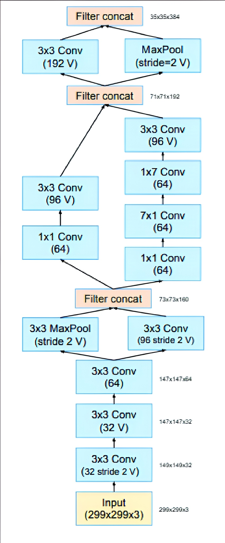
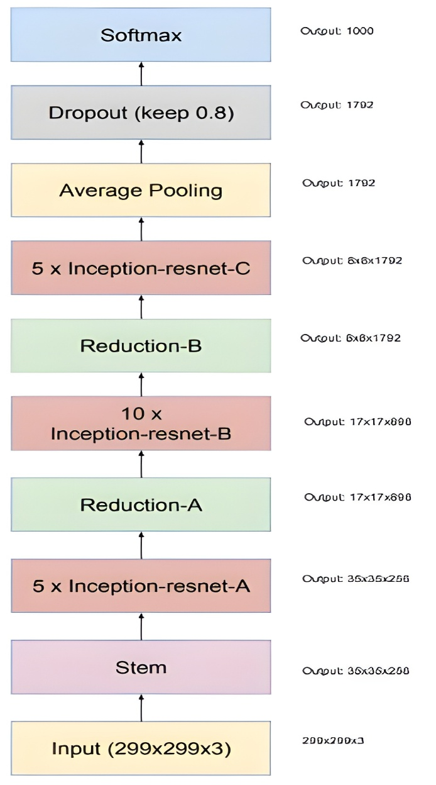
Fig. 2 .Inception-ResNet-v2 model architecture
Review No.01
Department of CSE

Slide 12
METHODOLOGY
Data Collection: The project begins with the collection of images of Apples and Grapes exhibiting healthy and diseased conditions. The dataset is obtained from https://www.kaggle.com/code/abdallahwagih/plant-village-disease-classification-acc-99-6 wedsite
Preprocessing: The collected images dataset undergo preprocessing techniques such as resizing, normalization, and augmentation to prepare them for model training. This step ensures that the dataset is uniform and enhances the model's generalization capabilities.
Model Development: A machine learning or deep learning models, convolutional neural networks (CNNs)and Inception-ResNet-V2, is used to developed and trained the processed dataset. The model is designed to classify the images into different categories (e.g., healthy or specific diseases).
Evaluation and Optimization: The model's performance is evaluated using metrics like accuracy, precision, recall, and F1-score. Hyperparameter tuning and optimization techniques are applied to improve the model's accuracy and robustness.
Review No.01
Department of CSE

Slide 13
METHODOLOGY
1. Data Preprocessing Techniques:
These methods prepare the input data for effective training and classification:
Image Resizing: Standardizes all images to a fixed size (256 × 256 pixels) to maintain consistency across inputs.
Data Augmentation: Introduces diversity in the dataset through flipping, rotation, zooming, and other transformations, helping the model generalize better to unseen data.
Contrast Enhancement: Highlights diseased regions in leaf images, improving the clarity of critical features.
Noise Reduction: Uses Gaussian filtering to smooth images and eliminate random noise, enhancing feature extraction.
Normalization: Scales pixel values to a standard range, improving learning efficiency and stability.

Slide 14
IMPLEMENTATION
Software Specifications:
1. Programming Language: Python
2. Libraries/Frameworks: Scikit-learn, Pandas, NumPy, Matplotlib
3. Operating System: Windows 10 / Linux (Ubuntu)
4. IDE/Editor: Jupyter Notebook / PyCharm / VS Code / Google colab
5. Data Source: Plant village dataset from kaggle
Hardware Specifications
1. Processor: Intel Core i5 12th Gen or equivalent
2. RAM: 8 GB
3. Storage: 512 GB SSD
4.GPU(Optional): NVIDIA GTX 1650 or equivalent (for faster model training)
5. Other: High-speed internet for dataset access and model training
Review No.01
Department of CSE

Slide 15
RESULTS & ANALYSIS
High Accuracy Achieved: The Inception-ResNet-V2 model demonstrated superior performance with a classification accuracy of 99.9%, outperforming simpler neural network architectures.
Effectiveness of Preprocessing: Techniques like data augmentation, contrast enhancement, and feature selection significantly improved the model’s ability to identify complex disease patterns accurately.
Robustness Across Metrics: The framework achieved high precision, recall, and F1-scores, indicating balanced and reliable classification performance, even across visually similar disease categories.
Review No.01
Department of CSE

Slide 16
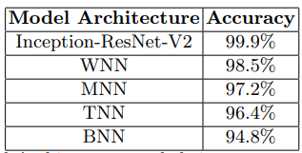
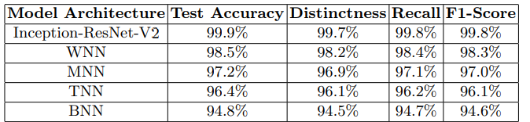
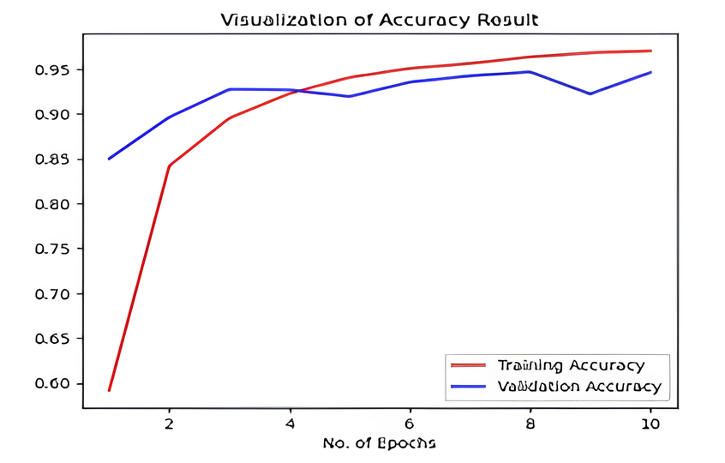
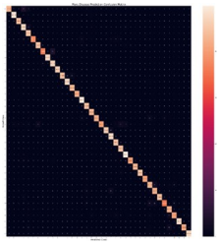
Table 1. Model Architectures and their corresponding Accuracies
Table 2. Performance metrics for different model architectures
Fig. 3. Plant Disease Prediction Confusion matrix.
Fig. 4. Visualization of Accuracy Result.
Review No.01
Department of CSE

Slide 17
CONCLUSION and FUTURE SCOPE
Conclusion:
We observed that our framework achieved an impressive accuracy of 99.9%, demonstrating its capability to detect complex disease patterns in fruit leaves. By employing advanced preprocessing techniques like data augmentation and feature fusion, we significantly enhanced model performance.
Our results demonstrate the importance of advanced deep learning and preprocessing in achieving accurate, real-time fruit disease detection, enhancing agricultural productivity and management.
Future Scope:
To further enhance the fruit disease detection framework, future work will focus on optimizing preprocessing techniques to improve accuracy while reducing computational complexity. We can also use integrate IoT devices for large-scale monitoring.
Future work will explore integrating real-time monitoring capabilities to enable more efficient disease detection and management in dynamic agricultural environments.
Our project have some limitations like potential lack of robustness in real-world scenarios due to dataset diversity and environmental variability
Review No.01
Department of CSE

Slide 18
REFERENCES
Khan, M.A., Akram, T., Sharif, M., Saba, T.: Fruits diseases classification: Exploiting a hierarchical framework for deep features fusion and selection. Multimedia Tools Appl. 79, 25763–25783 (2020).
Mohanty, M., Qureshi, M.A., Mannan, A., Awan, T.: An Improved Detection Method for Crop & Fruit Leaf Disease under Real-Field Conditions. AgriEngineering 6(1), 344–360 (2024).
Ali, M.M., Hashim, N., Zhang, et al.: Development of deep learning based userfriendly interface for fruit quality detection. Journal of Food Engineering 112165, (2020).
Sharif, M., Khan, M.A., Iqbal, Z., Azam, M.F., Lali, M.I.U., Javed, M.Y.: Detection and classification of citrus diseases in agriculture based on optimized weighted segmentation and feature selection. Comput. Electron. Agriculture 150, 220–234 (2018).
Al-bayati, J.S.H., Zhang et al., Üstündag, B.B.: Evolutionary feature optimization for plant leaf disease detection by deep neural networks. Int. J. Comput. Intell. Syst. 13, Article no. 12 (2020).
Review No.01
Department of CSE

Slide 19
Rehman, S., Zhang et al.: Fruit leaf diseases classification: A hierarchical deep learning framework. Comput. Mater. Continua 75, 1179–1194 (2023).
Wang, H., Shang, S., Wang, D., He, X., Feng, K., Zhu, H.: Plant disease detection and classification method based on the optimized lightweight YOLOv5 model. Agriculture 12, Article no. 931 (2022).
Chandrashekar, G., Sahin, F.: A survey on feature selection methods. Computer Electrical Engineering 40, 16–28 (2014).
Rehman, S., et al.: A framework of deep optimal features selection for Apple leaf diseases recognition. Comput. Mater. Continua 75, 697–714 (2023).
Zhu, J., Wu, A., Wang, X., Zhang, H.: Identification of grape diseases using image analysis and BP neural networks. Multimedia Tools Appl. 79, 14539–14551 (2020).
Sladojevic, S., Arsenovic, M., Anderla, A., Culibrk, D., Stefanovic, D.: Deep neural networks based recognition of plant diseases by leaf image classification. Comput. Intell. Neurosci. 2016, Article no. 3289801 (2016).
Review No.01
Department of CSE

Slide 20
Jhuria, M., Zhang et al., Kumar, A., Borse, R.: Image processing for smart farming: Detection of disease and fruit grading. In: Proc. IEEE 2nd Int. Conf. Image Inf. Process., pp. 521–526 (2013).
Annabel, L.S.P., Annapoorani, T., Lakshmi, P.D.: Machine learning for plant leaf disease detection and classification—A review. In: Proc. Int. Conf. Commun. Signal Process., pp. 538–542 (2019).
Cheraghalipour, H., Hajiaghaei-Keshteli, M., Paydar, M.M.: Tree growth algorithm (TGA): A novel approach for solving optimization problems. Eng. Appl. Artif. Intell. 72, 393–414 (2018).
Szegedy, C., Ioffe, S., Vanhoucke, V., Alemi, A.A.: Inception-v4, inception-Resnet and the impact of residual connections on learning. In: Proc. 31st AAAI Conf. Artif. Intell., pp. 4278–4284 (2017)
Review No.01
Department of CSE

Slide 21

Review No.01
Department of CSE

Slide 22

Review No.01
Department of CSE

