Slide 1
Mixing Fortran, C and C++
Qingming He
Xi’an Jiaotong University, NECP Lab.
2019.07.28

Slide 2
Overview
Fortran
Fortran and C can be mixed directly
C and C++ can be mixed diretly
Fortran and C++ should be mixed through C
C
C++

Slide 3
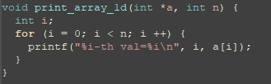
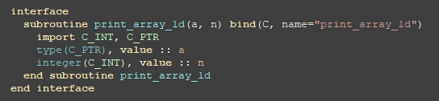

Fortran call C (1)
C function:
Declare Fortran interface:
Fortran call C:

Slide 4
Fortran call C (2)
C variable | Fortran variable
Int *a | Type(C_PTR), value :: a
Int n | Integer(C_INT), value :: n
C_PTR: defined in module iso_c_binding (Fortran 2003), type of C pointer
C_INT: defined in module iso_c_binding, type of C int
value: C passes by value while Fortran passes by address by default. “value” means passing by value.
Bind: Fortran will add “_” to name of subroutine in compiling while C will not. Bind make Fortran subroutine behave as C function
C_loc: get the address, return C pointer
Target: only pointer or target can be called by c_loc

Slide 5
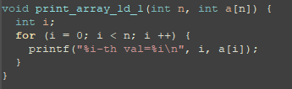
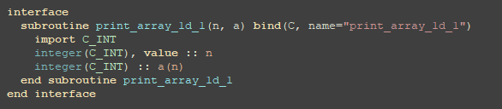

Fortran call C (3)
C function:
Declare Fortran interface:
Why there is no “value”?
Fortran call C:
“target” can be ignored

Slide 6
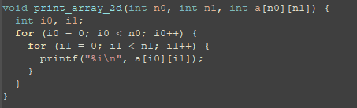
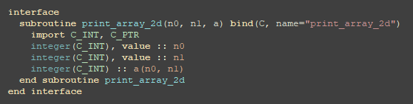

Fortran call C (4)
C function:
Declare Fortran interface:
Fortran call C:

Slide 7
Fortran call C (5)
Fortran
1 | 3 | 5
2 | 4 | 6
C
1 | 2
3 | 4
5 | 6
C variable | Fortran variable
Int a[n0][n1] | Integer(C_INT) :: a(n1, n0)
Int **a | None

Slide 8
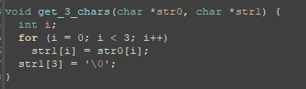
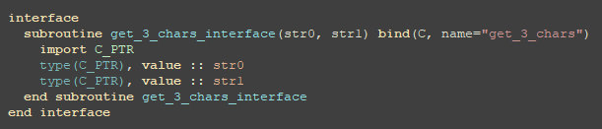
Fortran call C (6)
C function:
Declare Fortran interface 1:

Slide 9
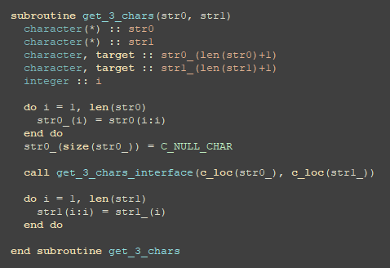

Fortran call C (7)
Define Fortran interface 2:
Fortran string
Corresponding C string
C string ends with ‘\0’
Fortran call C:

Slide 10
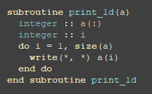

C call Fortran (1)
Fortran function:
Define Fortran interface:

Slide 11

C call Fortran (2)
Declare function in C code:
C call Fortran:

Slide 12
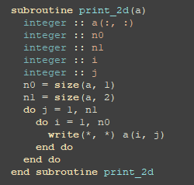
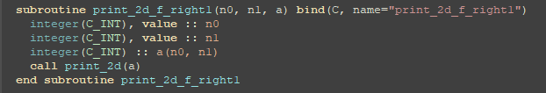
C call Fortran (3)
Fortran function:
Define Fortran interface:

Slide 13

C call Fortran (4)
Declare C interface:
C call Fortran:

Slide 14


Fortran call C++ (1)
C++ function:
Define C interface in C++ code:
Now print_array_1d_c can be recognized as C function

Slide 15
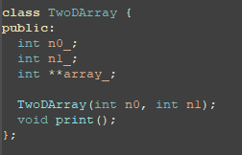
Fortran call C++ (2)
How to access the C++ class in Fortran, see the source code, which is a little bit complex.

Slide 16
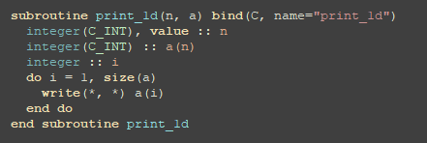

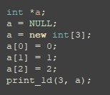
C++ call Fortran (1)
Fortran function (with interface):
Declare function (linked as C function) in C++ :
C++ call Fortran:

Slide 17
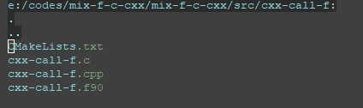
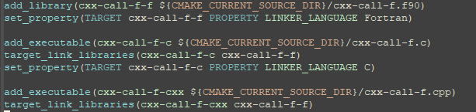
Compiling
Files in the directory:
CMakeLists.txt:

Slide 18
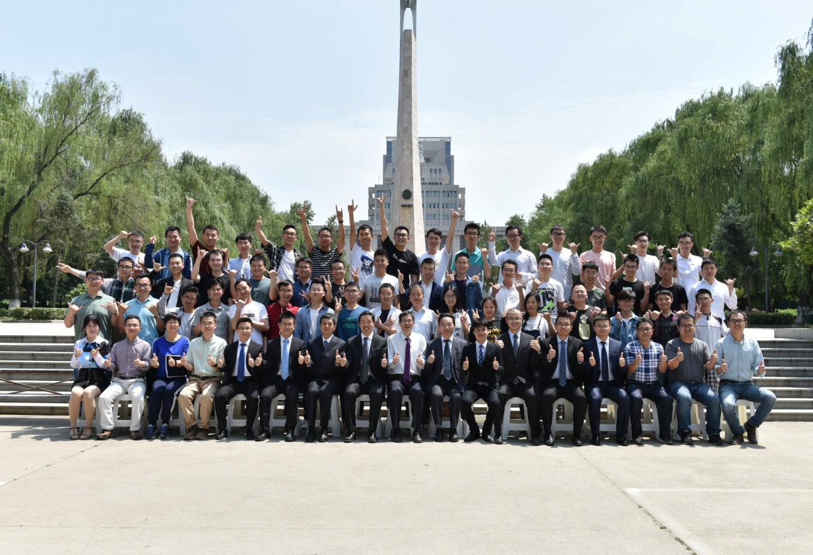
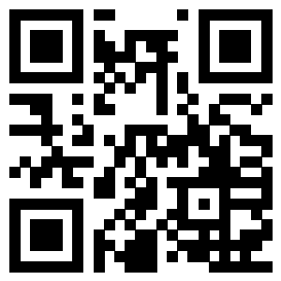
Thank you for your attention.
Visit us:
http://necp.xjtu.edu.cn
Phone:+86-29-8266 8916
Fax: 8266 8916

