Slide 1
NEET INTEL
neetintel.github.io
Research on the High Frequency Global Communications System (HFGCS) and the Emergency Action Messages (EAMs) broadcast on it
An in-depth reference to the site, part by part
G1 · G2 · G3 · G4 · G5 — share of 15,275 airings by group, Jan 2022 – Oct 2026
Notes:
This is a long reference to NEET INTEL at neetintel.github.io. NEET INTEL is a research project on the HFGCS, a US Air Force shortwave network, and on the Emergency Action Messages broadcast over it. The site is where the recordings, the transcripts, the structure analyses and the reference material all ended up. I’m going to start with background, because nearly everything later depends on it: how the network is built, what a broadcast actually contains, how the messages sort into groups by their two-character prefix, how the airborne relay works, and why the characters look the way they do. Then the size of the record itself, and after that the site, one part at a time, with what each view shows and how to read it. The colored bar at the bottom is the whole record split by message group, in the colors the site uses everywhere: green for Group 1, orange for Group 2, yellow for Group 3, pink for Group 4 and purple for Group 5. You’ll see those five colors on nearly every page, and on most of the slides that follow.

Slide 2
Nine parts
CONTENTS
1
Background
6
Structure by length
2
The site
7
Structure by group
3
Recordings
8
Events and outside data
4
The gallery
9
Reference, method and close
5
Timelines
NEET INTEL · neetintel.github.io
BACKGROUND
Notes:
Here’s how the deck is laid out. There are nine parts. Part 1 is background: the network, what a broadcast carries, the message groups, the airborne relay and the size of the record, because everything after it leans on that. Parts 2 through 5 go through the site itself: how it’s laid out, the recordings, the gallery and the timelines. Parts 6 and 7 are the structure work, first by message length and then by message group. Part 8 is events and the outside data, and Part 9 covers the reference pages, the method, and a short close with seven places on the site to start from. Anything that only gets a slide here can get a closer look on the site itself, and every view the deck mentions has an address you can type.

Slide 3
Ground stations
WHAT THE HFGCS IS
13 ground stations and 2 network control stations (FY27 budget document)
ANCS (Andrews?)
GFNCS (Grand Forks?)
ANDREWS
ELMENDORF
HICKAM
OFFUTT
An Air Force squadron’s wall map reads “1 of 14 HF Sites”
SIGONELLA
CROUGHTON
DIEGO GARCIA
ASCENSION
Either control station appears able to run any station remotely
YOKOTA
PUERTO RICO
LAJES
ANDERSEN
Transmitter and receiver sites sit apart: 45 km at Offutt, 97 km in Puerto Rico
WEST COAST
Split from the hfgcs-msl repository, as tabled in the FAQ.
FAQ map: 14 markers, these 13 (ANDERSEN as GUAM) plus SOUTH ATLANTIC.
NEET INTEL · neetintel.github.io
BACKGROUND
Notes:
The HFGCS is a worldwide network of high-power shortwave ground stations. They simulcast EAM broadcasts, run phone patches, and carry a fair amount of other long-range traffic. The best current official description is in the FY27 Air Force procurement budget, program element 0303133F: a network of 13 strategically located ground stations and two network control stations. The FAQ points out that the Air Force doesn’t agree with itself on the count. A 2022 DVIDS release about an antenna at Elmendorf also says 13, but the photo attached to it shows the squadron’s own wall map, labeled 1 of 14 HF Sites, with fourteen sites plotted. For a long time the whole network ran from one control station at Andrews. A post-9/11 review flagged that as a single point of failure. Offutt was meant to become the second, a 2019 flood may have interrupted that, and Grand Forks ended up as the secondary. A public GitHub repository, hfgcs-msl, splits the 13 stations between two control stations labeled ANCS and GFNCS. It’s a reasonable guess that those are Andrews and Grand Forks, which is why the headers carry question marks, and that’s the split on screen. In practice either one seems able to run any station. The two station pages on the site show what a station physically is. Puerto Rico has no base of its own. It’s a transmitter site at Isabela and a receiver and control site at Salinas, 97 km apart on opposite coasts, run around the clock from Andrews and Grand Forks, with contractors on site during the day and on call after hours. At Yokota the transmitters, rated up to 25 kW, are kept away from the receivers so they don’t deafen them. The airborne half, the E-6B, comes a few slides from now.

Slide 4
Parts of a broadcast
WHAT YOU HEAR
Part | What the site says
Frequencies | 4724 · 8992 · 11175 · 15016 kHz (2025) · usually all at once
Callsign | daily, e.g. CHOPHOUSE (221116) · usually new at 00:00 UTC
Addressee | in about half of Group 2: FOR [CALLSIGN], before the message
Message | read character by character, A–Z and 2–7 · first two = prefix
Length | read on air for any message over 30 characters
Source: HFGCS FAQ and the site’s structure pages
BACKGROUND
Notes:
Here’s what a listener actually gets, and what ends up in the log. The primary frequencies, as of 2025, are 4724, 8992, 11175 and 15016 kHz. Ground stations usually simulcast a message on all four, but not always. A broadcast can go out on one or some of them, which is why someone who missed a message on 8992 will insist it never aired there. Individual stations have historically kept per-frequency schedules as well. The station identifies itself with a callsign. Stations used to use their own names, like ANDREWS or OFFUTT. Around 2014 they all moved to MAINSAIL for EAM broadcasts, and around 2015 to a rotating pool of daily callsigns that almost always change at 00:00 UTC. CHOPHOUSE, the callsign on a November 16, 2022 broadcast, is one. The FAQ found that virtually every callsign on the network fits in nine characters, spaces included, with a couple of ambiguous exceptions. MAINSAIL is still around as an open request: someone keying up for MAINSAIL is asking for whichever ground station can hear them. In Group 2, about half the time, the operator names a recipient first: FOR, then a callsign. Then comes the message itself, read out one character at a time from an alphabet of A to Z plus 2 to 7. The first two characters are the prefix, and the prefix decides the group. For anything over 30 characters the operator also reads the length, so the long-message lengths on the site are ground truth. The FAQ says not to lean on two things: SKYKING messages, which are now rare on HF, and the operator’s tone of voice, which the FAQ says you can’t read anything into.

Slide 5
Four message groups
WHAT AN EAM IS
Every EAM opens with a two-character prefix; groups follow prefix behavior
GROUP 1
GROUP 2
GROUP 3
GROUP 4
~66%
~26%
~3%
~3%
30 characters. One prefix at a time, changing every 3–8 weeks.
Mostly 30–163 characters. About 47% name a recipient first.
Clustered lengths. Sporadic prefixes: days on, then weeks or months off.
Mostly 36–292 characters. About 60% hold a run like FFFF or ZZZZ.
Shares from the FAQ · Group 5: 13 airings on four days in Jun 2025 and Jan 2026
NEET INTEL · neetintel.github.io
BACKGROUND
Notes:
Every EAM starts with a two-character prefix, and the four groups come from how those prefixes behave over time. I put the scheme out in a video in November 2023, and it has held up since. On the site, a message goes into a group by looking up its prefix in a table of which group used that prefix from which year. Group 1 is about two-thirds of the traffic. The FAQ’s rule is that every documented Group 1 message is exactly 30 characters, and only one Group 1 prefix is in use across the network at a time, changing every three to eight weeks. These are also the messages the E-6B relays most: 2,834 of the 2,966 E-6B airings in the calendar are Group 1. Group 2 is about a quarter, mostly 30 to 163 characters, and a little under half of it names a recipient, which gets its own slide. Group 3 clusters at a few lengths, with 22, 27 and 25 the most common in the calendar, and often carries runs of three or more repeated characters. Its prefixes are the sporadic ones: QL shows up once in the record in September 2023, then not again until July 11, 2026, and then on 13 days that month. Group 4 is the long messages, mostly 36 to 292 characters. About 60% contain a run of four or more identical characters and about 38% repeat multi-character sequences, and Group 4 has the highest operator-error rate. Group 5 is rare: 13 airings on four days. The percentages on the cards are the FAQ’s. Counted from the calendar as it stands, it’s about 67, 24, 5 and 3.5. The FY27 budget names four message classes, and whether they line up with the four groups can’t be confirmed.

Slide 6
Prefix reigns
GROUP 1
One Group 1 prefix on the air at a time, across the whole network
A replaced prefix never returns; the switch isn’t tied to 00:00 UTC
All 28 days with two Group 1 prefixes are handoff days
52 Group 1 prefixes in the record, Jan 2022 – Oct 2026
DTCP Part 1 · comprehensive monitoring · 230623 – 240201
YL
YT
PJ
CZ
WR
AS
since
230524
35 days
41 days
52 days
58 days
to 240209
THU 230706
15:06 → 15:56
THU 230810
17:33 → 18:42
WED 230920
21:32 → 23:50
SAT 231111
05:17 → 05:57
MON 240108
20:10 (240107) → 00:23
Times UTC: last airing of the old prefix → first airing of the new one.
Data: the published EAM calendar
BACKGROUND
Notes:
This is what one prefix at a time looks like. The bar covers the 224 days from June 23, 2023 to February 1, 2024. That’s the first part of the Daily Timecard Project, which the site describes as continuous and near-comprehensive coverage, so a boundary here marks a real change of prefix. Six Group 1 prefixes cover it end to end. YL was already running when the window opened, and AS was still running when it closed. In between, YT lasted 35 days, PJ 41, CZ 52 and WR 58, which is the three-to-eight-week range in practice. Each handoff is one-way. On July 6, 2023, the last YL message aired at 15:06 UTC and the first YT at 15:56, and YL never came back. The same thing happens at 17:33 to 18:42 on August 10, 21:32 to 23:50 on September 20, and 05:17 to 05:57 on November 11. These changes don’t wait for midnight UTC, even though the daily callsigns do. Across the whole record there are 52 Group 1 prefixes, and only 28 days on which two of them appear, every one of them a handoff day. On three of those days, re-airs of the old prefix’s messages still went out after the new prefix’s first message, but never on a later day. One handoff matters later in this deck: on October 1, 2024, C6 replaced 3E, and the 30-character paper suspects a format change took effect that same day. Outside the comprehensive stretches, coverage gaps can make a reign look shorter or longer than it was, so I’d read reign lengths from windows like this one.

Slide 7
Directed EAMs
GROUP 2
About 47% of Group 2 messages name a recipient before the message
Kind | Day | Time | Prefix | Recipients
Alphabet FORCE | TUE 251028 | 17:03 UTC | 7R | FOR ALPHA FORCE, CHARLIE FORCE
Alphabet REGION | THU 231228 | 01:03 UTC | DC | FOR REGION BRAVO, REGION CHARLIE
Numbered callsign | MON 230626 | 15:38 UTC | T5 | FOR TAMPA52
Word-only callsign | THU 241024 | 12:06 UTC | AR | FOR UPSTAGE, … 10 names
Examples from the gallery data
NEET INTEL · neetintel.github.io
BACKGROUND
Notes:
A little under half of Group 2 does something almost nothing else in the record does: before the message, the operator names who it’s for. I call these Directed EAMs. Other people call them FOR messages or addressee messages, and none of those names are official. Counting every airing in the gallery’s data, that’s 1,771 of 3,745 Group 2 airings, the same 47% the FAQ gives. They come in four kinds. Alphabet FORCE messages go to a FORCE named by a NATO phonetic letter. ALPHA, BRAVO, CHARLIE, FOXTROT, GOLF, KILO, ROMEO, SIERRA, TANGO, UNIFORM and VICTOR are all documented, and they recur across years and across exercises, so they read like standing organizations. REGION messages work the same way, for REGIONs ALPHA, BRAVO and CHARLIE and for ALL REGIONS. Numbered callsigns, a word plus a number like TAMPA52, are strongly tied to E-6B aircraft. You can usually match one to a specific airframe on ADS-B trackers, though that has gotten harder since late 2024. The biggest kind by far is word-only callsigns. Several hundred messages to them have been documented, some in a burst over a few hours and some trickling out over days. Around 8% of directed messages name more than one recipient. They can mix kinds, such as a FORCE with a word-only callsign, but a FORCE has never been seen with a numbered callsign, and a REGION only ever pairs with another REGION. The most recipients on any documented message is ten, on October 24, 2024, the GLOBAL THUNDER 25 SKYMASTER day. The FAQ’s extreme case is the 285-character message of October 28, 2025, addressed FOR EXERCISE GT 26 CPX AC ST, which still carried a Group 2 prefix.

Slide 8
The E-6B relay
THE AIRBORNE HALF
E-6B Mercury: Navy aircraft that receive, verify and retransmit EAMs
Rebroadcasts on HF, and on VLF through a trailing wire for submarines
Slot roughly tracks the water: :00/:30 Gulf · :10/:40 Atlantic · :20/:50 Pacific
SAT 260919 · one Group 1 message · ACZC4D…
first airing · 18:00
E-6B
E-6B
E-6B
E-6B
17:50
18:00
18:10
18:20
18:30
18:40
18:50
19:00
19:10
19:20
19:30
19:40
19:50
:00 / :30 · Gulf of America
:10 / :40 · Atlantic
:20 / :50 · Pacific
Same day: 21:16 first airing → 21:40 E-6B. Times UTC, from the calendar and the rebroadcast timeline.
NEET INTEL · neetintel.github.io
BACKGROUND
Notes:
The airborne half of the system is the Navy’s E-6B Mercury, flown by Strategic Communications Wing 1. In the Navy’s words its main job is to receive, verify and retransmit Emergency Action Messages to US strategic forces. The ground stations broadcast on HF. The E-6B rebroadcasts on HF and also on VLF through a trailing wire antenna, which is how the messages reach submerged ballistic missile submarines that can’t hear HF at all. The VLF side is called VERDIN, with designators that include ATLANTIC, PACIFIC and GULF. The same aircraft carries the Airborne Launch Control System, and the site’s Minuteman page, which calls it the E-6B TACAMO, lists three test launches sent that way. On HF the relay runs on a timetable. In the FAQ’s version, a ground station sends a message for a specific aircraft and follows it with a second, unaddressed one. A while later another transmitter, very probably that aircraft, airs the second message again every half hour. The minute it keys up on roughly tracks the water it’s covering: on the hour and half hour for the Gulf of America, ten past and twenty to for the Atlantic, twenty past and ten to for the Pacific. Here’s September 19, 2026. The AC message first aired at 18:00 UTC, then an E-6B aired it again at 18:10, 18:40, 19:10 and 19:40, the Atlantic slot. On the rebroadcast timeline, 2,571 of 2,807 E-6B-flagged airings land within a minute of a slot. More broadly, about one EAM in three is rebroadcast at all, and most are done within two hours. The E-6B airings are overwhelmingly Group 1.

Slide 9
The one-time-pad claim
WHY THEY LOOK THIS WAY
Base 32: A–Z and 2–7. 0, 1, 8 and 9 never appear in standard EAMs
M and 5 run about a third low
Group 1’s last six characters: all different 97% of the time (chance: 61%)
The same blocks recur in different messages weeks or months apart
2.00%
2.13%
even share 3.1%
absent
absent
0
1
2
3
4
5
6
7
8
9
A
B
C
D
E
F
G
H
I
J
K
L
M
N
O
P
Q
R
S
T
U
V
W
X
Y
Z
Share of each character, 3,584 unique 30-character Group 1 EAMs (FAQ chart)
BACKGROUND
Notes:
The most repeated claim about EAMs is that they’re encrypted with one-time pads. The FAQ’s view is that this is probably wrong, for three kinds of reason. First, logistics. EAMs go to receivers all over the world at once, and the daily volume isn’t fixed in advance. Even decrypted, the content would be codewords and authentication elements. Encryption strong enough to resist real-time cryptanalysis is enough. Second, the characters themselves. The alphabet is base 32: A to Z plus 2 to 7, exactly 32 symbols. The FAQ’s explanation for the missing 0 and 1 is that, handwritten, they’re too easy to confuse with O and I. The chart is the FAQ’s, over 3,584 unique Group 1 messages. Thirty of the thirty-two characters sit close to the even 3.1%, and M and 5 sit around 2%, about a third low. The last six characters of a Group 1 message are all different 97% of the time, where random text would manage about 61%, and the calendar can highlight the days with an exception as tail-repeat days. And identical blocks turn up in different messages that share a prefix, weeks or months apart. A one-time pad can’t produce that for two different messages. Third, the paperwork. The FY27 budget documents name the KG-3XA program, an embeddable module and its host, used in equipment for processing Emergency Action Messages in the nuclear triad and described as a form, fit, function modernization. A pad isn’t a device, so that’s an odd line to write for one, though the FAQ grants it isn’t proof, since pads need key-handling hardware too. The FAQ’s guess is that the idea came from numbers stations, which probably did use pads, and that listeners carried the assumption over. Later on, the 30-character paper goes through this position by position.

Slide 10
The record
WHAT THE SITE IS BUILT ON
15,277
Jan 25, 2022 – Oct 9, 2026
2,966 of them aired by E-6Bs
airings logged on 1,072 days
Rebroadcasts count as airings
G1 10,207 · G2 3,740 · G3 784 · G4 531 · G5 13 · 2 unclassified
Source: the published EAM calendar, generated 261009
BACKGROUND
Notes:
This is the size of what the site is built on, taken from the published calendar’s own data: 15,277 airings on 1,072 days, from January 25, 2022 to October 9, 2026. A rebroadcast counts as another airing here, and 2,966 of the airings came from E-6Bs. Two messages have no group, which is why the group counts add up to 15,275. The calendar is built without partial copies, disregarded reads, or reads with an uncopied character. By year that’s 1,144 in 2022, 3,988 in 2023, 4,401 in 2024, 2,823 in 2025 and 2,921 so far in 2026. The calendar says plainly that the dataset isn’t comprehensive except for select periods, and that caveat applies to every count in this deck. The most complete stretch is the first part of the Daily Timecard Project, June 23, 2023 to February 1, 2024, and the FAQ’s daily figures are for that stretch: 14 to 15 messages a day on average, median 14. Later sampled windows ran 18 or 19 a day. Days with zero to three messages are rare and tend to fall on federal holidays. The rhythm is a working week: daytime and early evening are busiest, the small hours are nearly empty, and Wednesday and Thursday run heaviest. On the news cycle, the FAQ’s position is that no consistent link between EAM traffic and the headlines has ever been established. Where it does see a signature is around specific, pre-scheduled activity: a distinctive prefix bracketing NATO’s STEADFAST NOON exercise in 2023, and Group 4 running at about 3.6 times its baseline in the one to three days before Minuteman III test launches, with 8 of 11 covered launches showing a rise. The site has a page on those launches.

Slide 11
The site
PART 2
How the site is organized and driven, then how its data is made, counted and covered
NEET INTEL · neetintel.github.io
THE SITE
Notes:
This part is about the site itself. First, how it’s organized and how you get around it: the index and its seven tabs, the short addresses and keys, and where the language and theme switches work. Then how the data is made, from recording and review to the log the pages are built from, the two ways the site counts, and what counts as covered.

Slide 12
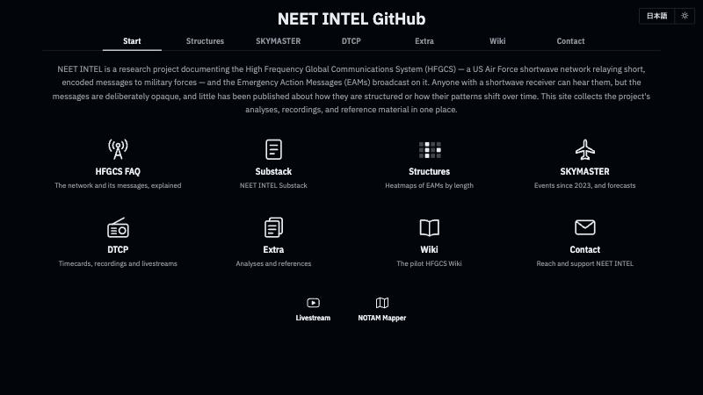
Site map
HOW THE SITE IS ORGANIZED
Start · Structures · SKYMASTER · DTCP · Extra · Wiki · Contact
Start: 8 tiles, plus Livestream and the NOTAM Mapper
Structures: 103 heatmap pages, 17 to 292 characters
SKYMASTER: 33 dated events, 2023–2026 · DTCP: 3 galleries
Extra: 20 analysis links, 4 references · Wiki: 27 archived pages
NEET INTEL · neetintel.github.io
THE SITE
Notes:
Everything starts from one page, the index at neetintel.github.io. It has seven tabs, and Start is the one you land on: a one-paragraph description of the project and a grid of eight tiles. The FAQ and Substack tiles open in a new tab; the other six just switch tabs on the same page. Under the grid are two small links, the YouTube livestream and the NOTAM Mapper. Structures is a list of 103 heatmap pages, one for each of 103 message lengths between 17 and 292 characters. Each has a small heat strip and six dots, one per group plus unclassified, lit for the groups on that length’s page. SKYMASTER lists 33 dated events from 2023 to 2026, 26 listed as SKYMASTERs and 7 as FAKEMASTERs or NOTHINGMASTERs, and 20 of those dates link straight to that day’s timecard in the DTCP gallery. The DTCP tab holds the three recording galleries: the early compilations, the daily timecards and the livestream tapes. Extra is the shelf: 20 analysis links in four topic groups, plus four reference pages, which are the FAQ, the two station pages and the NOTAM Mapper. Wiki links to 27 archive.org snapshots of a pilot HFGCS wiki I started in December 2025, and Contact covers contact and support. The next few slides are about getting around all of this, and then about where the data comes from.

Slide 13
Addresses and keys
GETTING AROUND THE INDEX
ADDRESS
KEYS FROM START
OPENS
(bare URL)
—
Start
?structures
→
Structures, 103 lengths
?skymasters
→ →
SKYMASTER, 2023 list
?compare
→ → ↑
SKYMASTER, Compare view
?dtcp
→ → → ↓ ↓
DTCP tab, timecard gallery in focus
?misc
← ← ←
Extra, Analyses
?references
← ← ← ↓
Extra, References and resources
?wiki · ?contact
← ← · ←
Wiki · Contact
—
→ 1 4 2 Enter
142-character heatmap, in a new tab
NEET INTEL · neetintel.github.io
THE SITE
Notes:
Every tab and subtab on the index has a short address you can type by hand, and a key path from the Start tab. The address is a plain word after a question mark, in upper or lower case. The left and right arrows step through the seven tabs and wrap around, so Contact is one step left of Start and Extra is three. Up and down step through subtabs. SKYMASTER has 2023, 2024, 2025, 2026 and Compare, so one up from 2023 wraps to Compare, and Extra has Analyses and References and resources. On the DTCP tab, down moves a focus box through the three galleries, and Enter opens the one in focus. On Structures you can type a length. Each digit adds to the number, so 1 picks 17, 14 picks 142, and 142 stays on 142, and a pause of a second and a half starts a new number. Enter opens that heatmap in a new tab, and Esc puts the list back in order. Each tab or subtab change also rewrites the address bar to the shortest address that reopens it, so you can copy a tab and send it. A typed length isn’t kept in the address, though. A few aliases work too, like ?heatmap, ?skymaster, ?live and ?support, and keys combine: ?skymaster&2025 opens the 2025 list, and the FAQ links to ?skymasters&compare. ?extra and ?start aren’t keys; they just land on Start, so use ?misc. Several other pages do the same kind of thing. The calendar takes ?2023, the galleries put the whole search in the address, and every FAQ answer has its own # link.

Slide 14
Language and theme
TWO SWITCHES
Pages | Language | Theme | Remembered
Index, FAQ, 2 stations, 16 analyses | 日本語 / EN | light / dark | yes
Calendar | 日本語 / EN | dark | no
3 galleries, 103 heatmaps, IPE Maps I and II | English | dark | —
NOTAM replay, NOTAM Mapper | no switch | dark | —
Keys | J, N or E | A or D | —
On the 20 pages in the first row, the choice is saved in your browser and carried to the next page; until you pick a theme, the page follows your system’s setting.
NEET INTEL · neetintel.github.io
THE SITE
Notes:
Two switches sit at the top right of the index, the FAQ and most analysis pages: 日本語 / EN for the language, and a sun or moon for light and dark. Twenty published pages share them: the index, the FAQ, both station pages, and sixteen analysis and explainer pages, from About These Heatmaps and the structure pages to the format papers, the rebroadcast timeline, the E-6B flight history, the Minuteman case study and the 8888 page. On those pages the choice is saved in your browser and carried to the next page, so if you switch to Japanese on the index, the FAQ opens in Japanese too. Until you pick a theme, the page follows your operating system’s light or dark setting. The keyboard does the same job: J, N or E switches the language, and A or D the theme. On the other nineteen, the left and right arrows switch the language as well, except where a page uses them itself; the index keeps its arrows for the tabs. The switch is built so nothing jumps: the button holds both labels at once, and the page keeps your reading place when the language changes. Outside those twenty pages it’s different. The calendar has its own 日本語 button and the same J, N, E keys, but no theme switch, and it doesn’t remember the choice. The three galleries, the 103 heatmap pages and the two IPE map pages are English and dark only. The NOTAM replay shows a few Japanese labels next to the English, with no switch, and the NOTAM Mapper is English.

Slide 15

Data pipeline
HOW THE DATA IS MADE
RECORDING
REVIEW
LOG · SHORTWAVES
PAGES · AS OF, 2026
Online radios, North America + Europe
Each EAM written down:
UTC time · callsign · text
One row per airing
Calendar
Oct 9
*
partial capture
Long G4 block pages
Oct 13
Livestream: each day in an A and a B half
Reviewed day = DTCP timecard
\
disregarded read
Pairs Across Lengths
Oct 6
809 tape days
230203–260908
641 timecard days
230623–261013
? _ .
uncopied character
About These Heatmaps
Oct 5
Rebroadcast timeline
Sep 24
Earlier: DCRP compilations from 220125
Tape days reviewed:
474 of 809
Lengths over 30 are read on air
30-character paper
Jul 29
Last updated: Minuteman Mar 3 · 8888 Mar 15, 2026
Each page is built from the log on its own day: two pages can be months of data apart
NEET INTEL · neetintel.github.io
THE SITE
Notes:
Here’s how a message gets from the air onto a page. It starts as a recording. Most of the monitoring has gone through online radios in North America and Europe, with limited coverage of the Pacific. The livestream tapes start with a one-off stream in February 2023. From August 31, 2023 the regular streams split each day into an A half and a B half, at midnight and noon US Eastern time until August 2025 and at midnight and noon UTC since. The livestream gallery has 809 days of tape, the last on September 8, 2026. Before the livestreams there are the DCRP compilations, from January 2022. Each EAM is written down with its time, the callsign and the text, and a day that has been gone through completely becomes a DTCP timecard. There are 641 timecard days, and 474 of the 809 tape days have been reviewed. Everything transcribed goes into one log, which the pages call SHORTWAVES, with one row per airing. A row can carry a mark: an asterisk for a partial capture, a backslash for a read the operator disregarded, and a character that couldn’t be copied is written as a question mark, underscore or dot. For any message over 30 characters the operator reads the length aloud, so long-message lengths are known exactly. The pages are built from that log, each on its own day, and most of them say when. The calendar was generated October 9, the long G4 block pages were built October 13, the heatmap guide’s counts are as of October 5, the rebroadcast timeline stops at September 24, and the 30-character paper’s corpus ends July 29. So two pages can be days or even months of data apart, and the date on the page tells you why.

Slide 16
Airings and messages
TWO WAYS TO COUNT
Group 4 · 50 characters · first aired 251027 15:41 UTC · COMPETENT
S
7
S
S
Y
6
6
2
E
K
D
J
Q
F
C
R
O
D
B
4
O
S
A
4
O
C
C
B
4
3
E
E
E
S
S
2
R
U
U
U
I
P
E
U
T
D
Z
V
V
I
1
10
20
30
40
50
● broadcast · ○ E-6B-flagged airing
32 airings · span 8.98 h · 27 E-6B
15:00
17:00
19:00
21:00
23:00
00:00 UTC
date changes
01:00
CALENDAR · AIRINGS
50-CHARACTER HEATMAP · MESSAGES
OCT 27–28, 2025
32
1 row
4 S7 messages
28 on 251027 + 4 on 251028
20251027 15:41 COMPETENT
85 calendar airings · 4 heatmap rows
Data: rebroadcast timeline, EAM calendar, 50-character heatmap
THE SITE
Notes:
The site counts in two ways, and it matters which one a page is using. Here’s one message to show it. On October 27, 2025, at 15:41 UTC, under the callsign COMPETENT, a 50-character Group 4 message starting S7SSY6 went out. It aired five times in the first two hours. From 19:34 UTC the airings are E-6B relays, and they kept going until 00:40 UTC the next day. That’s 32 airings in about nine hours, 27 of them by E-6Bs, and the rebroadcast timeline shows exactly that: 32 airings, a span of 8.98 hours, 27 E-6B. The calendar counts airings, so it shows 28 Group 4 messages on October 27, and the last four land on October 28, because the UTC date changes at midnight. The structure pages count messages: the 50-character heatmap has one row for it, dated to its first airing. The next morning three more S7 messages went out and were aired 17, 19 and 17 times. So across the two days the calendar counts 85 Group 4 airings, and the 50-character heatmap gains four rows. Neither number is wrong. Airings tell you how busy the network was. One row per message is what structure work needs, because a message aired 32 times would otherwise count as 32 votes for the same pattern. And the calendar counts relays as airings too: 2,966 of its 15,277 airings were broadcast by E-6Bs.

Slide 17
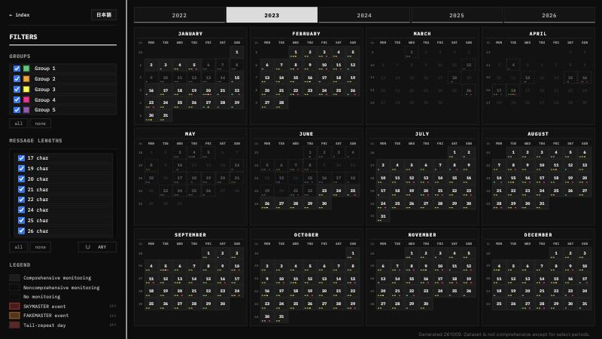
Coverage tiers
WHAT COUNTS AS COVERED
Jan 25, 2022 – Oct 9, 2026: 1,719 days
Solid · comprehensive: 789 days (788 recorded, 1 confirmed zero)
Dashed · noncomprehensive: 305 days with traffic logged
Blank · no monitoring: 625 days
12,641 of the 15,277 airings fall on solid days
Source: the published EAM calendar, generated 261009
THE SITE
Notes:
A quiet day only means something if somebody was listening, so the site marks coverage wherever it can. The calendar has three tiers, and its legend names them. Comprehensive monitoring is drawn solid, and those are the days with a DTCP or DCRP recording; click one and the video opens. Noncomprehensive monitoring is dashed: traffic was logged, but there’s no full recording. Blank means no monitoring. Over the calendar’s span, January 25, 2022 to October 9, 2026, that’s 789 solid days, 305 dashed and 625 blank. One solid day, March 1, 2026, has no recording. It’s one of 14 dates the calendar treats as confirmed zero-traffic days, and its tooltip reads “Total Messages: 0”. The eight recorded days with nothing in the log read “No messages in dataset.” instead. Six of those 14 fall on Thanksgiving or between Christmas Eve and the day after Christmas. On screen is 2023. January and February are mostly solid from the DCRP compilations, March to June is mostly dashed or blank, and from June 23 every day is solid. That’s the start of DTCP Part 1, which runs without a gap to February 1, 2024. Of the full years, 2025 has the most blank days, 171. The livestream gallery uses a similar rule for tape. A reviewed day is drawn flat, so an empty stretch is real silence. An unreviewed day is hatched, because its bars are only a floor, and a gap there may just be a stretch nobody has written down yet. Overall, 12,641 of the calendar’s 15,277 airings fall on solid days.

Slide 18
Recordings
PART 3
The three recording archives: the DCRP compilations,
how to read a DTCP timecard, what the timecards cover, and the livestream tapes
NEET INTEL · neetintel.github.io
RECORDINGS
Notes:
This part is about the recordings the rest of the site is built on. There are three archives, all reached from the DTCP tab on the index: the DCRP compilations, the DTCP daily timecards, and the livestream gallery’s raw tape. I’ll show how to read a timecard, how much of each year the timecards cover, and how the livestream tapes, their A/B cut and their review status tie back to the timecards.

Slide 19
Three recording archives
DTCP TAB
DCRP · 161 cards · 2022–2023, a few later
DTCP · 641 day timecards · 230623–261013
Livestream · 809 days of tape · 230203–260908
A day with a timecard is a reviewed day of tape
2022
2023
2024
2025
2026
Q1
Q2
Q3
Q4
Q1
Q2
Q3
Q4
Q1
Q2
Q3
Q4
Q1
Q2
Q3
Q4
Q1
Q2
Q3
Q4
DCRP
19
2
77
50
2
1
3
1
DTCP
8
92
92
37
57
26
75
19
25
67
13
13
38
66
13
Part 1 · 230623–240201
LIVESTREAM
2
20
79
70
86
63
82
48
59
85
87
31
64
33
Days per quarter. DTCP runs to 261013; the livestream page ends 260908.
NEET INTEL · neetintel.github.io
RECORDINGS
Notes:
Most of the site is built on transcripts of my recordings, and the recordings sit in three archives, all reached from the DTCP tab on the index. The DCRP, the daily compilation recordings, came first: 161 cards, almost all from 2022 and early 2023. The DTCP, the daily timecard project, started on June 23, 2023 and turns each UTC day into one timecard. There are 641 of them, through October 13. The livestream gallery holds the raw tape: 809 days from February 3, 2023 to September 8, 2026, most of them split into an A half and a B half. This grid counts days per quarter in each one, so you can see the hand-off: the compilations thin out in early 2023, the timecards start that summer, and the daily tape starts at the end of August 2023. The three are tied together in one direction. A timecard is what I make after going through a day of recordings, so a day with a timecard is a reviewed day, and the livestream gallery uses that to mark which tapes have been gone through. The messages calendar leans on the two card series the same way: a day with a DTCP or DCRP recording is drawn as comprehensive monitoring, and its current build, which runs to October 8, has 788 of them. The two card series barely overlap, only August 1 to 3, 2025. Of the 641 timecard days, 481 also have a panel in the livestream gallery. Of the other 160, 68 are the opening weeks of Part 1, before the daily tape begins, 35 come after the gallery’s last day, and 57 are days with no stream listed.

Slide 20
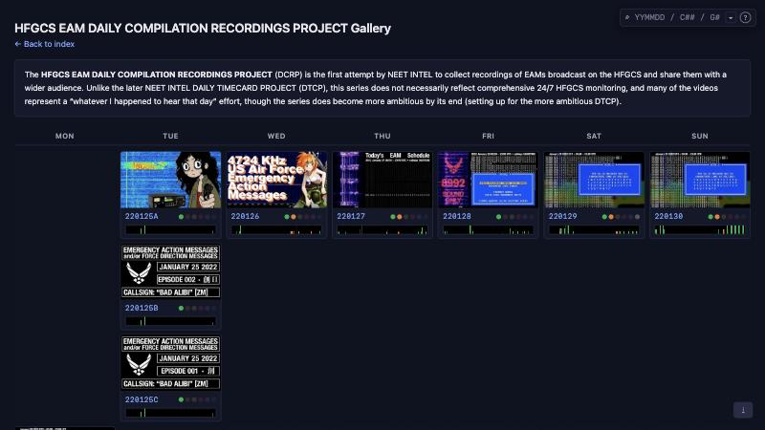
Compilation recordings
DCRP GALLERY
First attempt:
“whatever I happened to hear that day”
161 cards on 155 dates, from 108 videos
2022: 103 · 2023: 51 · 2024–2026: 7
One video can span weeks:
Dec 13, 2022 – Jan 4, 2023 = 23 cards
Letters split a day: 220125A, B, C
NEET INTEL · neetintel.github.io
RECORDINGS
Notes:
The DCRP was my first attempt at collecting these recordings and putting them in front of people. The page is upfront about it: it doesn’t claim round-the-clock monitoring, and many of the videos are, in its words, a “whatever I happened to hear that day” effort, getting more ambitious toward the end and setting up the DTCP. There are 161 cards on 155 dates, made from 108 videos. 103 of the cards are from 2022, 51 from 2023, and only seven come after that. The cards are the videos’ own title images, so they vary a lot. The early ones read like episode cards: “EMERGENCY ACTION MESSAGES and/or FORCE DIRECTION MESSAGES”, the date, an episode number, and the day’s callsign with its Group 1 prefix, here BAD ALIBI with ZM. When one day got more than one video, the date gets a letter, like 220125A, B and C on that first Tuesday, or 230222A, whose card reads “PART I: 28 of 35 MESSAGES”. It goes the other way too: one compilation covers December 13, 2022 through January 4, 2023, and that single video fills 23 cards. December 2022 is the densest month, with 34 cards. The site’s SKYMASTER list starts in 2023, and only one day on it falls in this series: February 1, 2023, callsign MONARCHY. Long empty stretches fold into dashed dividers of 30, 55, 8, 60 and 29 weeks. The gallery has the same search, player and compare view as the DTCP gallery, but no Internet Archive mirror.

Slide 21
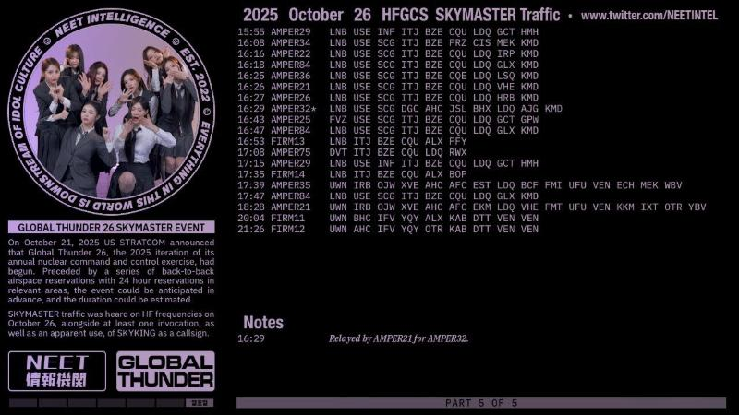
Anatomy of a timecard
DTCP · ONE CARD
Header: the date and what the card covers
Rows: UTC time · callsign · message,
a Notes block below
Left: the music pairing,
then the day’s statement or event
Bottom: a weekday strip,
and PART 5 OF 5 on long days
Source: DTCP timecard 251026, last window
RECORDINGS
Notes:
This is one timecard, the last window of October 26, 2025, and most cards are laid out the same way. Across the top is the date and what the card covers. On a typical day it says “HFGCS EAMs and/or FDMs”; this day says “HFGCS SKYMASTER Traffic”. Under that are the rows: UTC time, callsign, and the message. Most cards space an EAM out one character at a time; the SKYMASTER traffic here is read in three-letter groups, and the callsigns are numbered ones, like AMPER29 and FIRM13. Below the rows is a Notes block for whatever doesn’t fit on a row. Here it’s 16:29 UTC, “Relayed by AMPER21 for AMPER32”, which is what the asterisk after AMPER32 points to. The left side is the music pairing. Each day is paired with J-pop, K-pop and occasionally C-pop, so there’s a photo inside a ring of text, and a logo tile. The gallery’s intro describes it as combining the timecards with the output of the Korean, Japanese and Chinese entertainment industries, to look for trends in military and musical activity. Under the photo, a normal card carries a short statement: the timecards give a “not less than” idea of traffic, they try to cover every message from the ground stations and a representative portion from airborne stations, and some messages can still be missed. On event days that box describes the event instead, here Global Thunder 26. At the bottom left is a strip of seven boxes, and the lit one names the weekday in Korean; this one is Sunday. And when a day doesn’t fit on one screen, the video steps through several windows, so this one reads “PART 5 OF 5”.

Slide 22
Rows, markers and notes
DTCP · 260915
UTC time
daily callsign
first 30 characters
marker
15:23
SIXPENCE
K
7
7
4
X
T
E
B
Z
5
H
5
Q
R
N
R
H
4
E
C
3
A
2
G
E
A
3
U
K
L
+
15:39
SIXPENCE
N
B
6
A
P
3
O
X
A
D
G
6
S
S
4
D
H
N
C
Q
Z
H
N
4
Z
6
R
+
16:30
SIXPENCE
K
7
O
E
E
I
\
16:32
SIXPENCE
K
7
O
E
E
I
Q
C
G
S
6
O
5
O
G
N
C
7
K
L
P
G
7
G
7
7
K
2
E
H
+
Notes
full length
15:23
C
V
F
Z
H
R
H
I
F
C
3
A
2
X
E
A
3
U
K
L
C
V
F
Z
K
[55 CHAR]
15:39
27 character message
16:32
S
L
O
M
7
Q
2
[37 CHAR]
+ not 30 long: Notes give the rest, or the length
\ a disregarded read, struck through
> directed: the note names the addressee
Newer cards tint the prefix: G2 orange, G3 yellow, G1 white
Source: DTCP timecard 260915 and the 55-character heatmap
RECORDINGS
Notes:
Here’s how to read the rows, using four of them from September 15, 2026, a Tuesday. The callsign is SIXPENCE on every row, because the rotating daily callsign almost always changes at 00:00 UTC. Each row holds the first 30 characters of a message, and the last column carries a marker. At 15:23 UTC the marker is a plus sign. A plus means the message isn’t 30 characters long, and the Notes give the rest: the remaining 25 characters, tagged [55 CHAR]. Put back together, that’s the 55-character Group 2 message listed on the 55-character heatmap for 15:23 SIXPENCE. At 15:39 UTC there’s another plus, on a shorter row, and the note just says “27 character message”. At 16:30 UTC the row is struck through and ends in a backslash. That’s a disregarded read: K7OEEI, six characters, and then it was dropped. Two minutes later, at 16:32 UTC, the whole message goes out, 37 characters, the same one first aired at 15:35 UTC, and its note carries the last seven. On this card the two-character prefix is tinted in its group’s color, orange for Group 2 and yellow for Group 3, and a Group 1 prefix stays white; older cards, like October 1, 2024, have no tints. Some letters inside a message are tinted too. In the 55-character message they pick out RH, C3A2 and EA3UKL, which all come back twenty places later. Two more markers don’t appear here. A greater-than sign marks a directed message, and its note names the addressee, like “FOR VOGUE 1” on February 1, 2024. An ampersand marks MORE TO FOLLOW.

Slide 23
Part 1 and after
DTCP GALLERY
Part 1: all 224 days, 230623–240201, in 200 videos
After: 417 more days in 46 separate stretches
Longest later runs: 69, 49 and 42 days
Every card linked to an Internet Archive copy (616 files)
Part 1 · 224 of 224 days · 200 videos
8
31
31
30
31
30
31
31
4
2
20
7
30
1
25
31
30
14
17
2
12
1
12
31
16
20
13
13
8
30
14
22
30
13
J
J
A
S
O
N
D
J
F
M
A
M
J
J
A
S
O
N
D
J
F
M
A
M
J
J
A
S
O
N
D
J
F
M
A
M
J
J
A
S
O
2023
2024
2025
2026
Days with a card, by month; shade = share of the month’s days. Jun 2023 counts from the 23rd, Oct 2026 to the 13th.
69 days · 240924–241201
42 days · 250628–250808
49 days · 260826–261013
NEET INTEL · neetintel.github.io
RECORDINGS
Notes:
Each cell here is a month, and the number is how many of its days have a timecard. Part 1 is the solid run on the left: every one of the 224 days from June 23, 2023 to February 1, 2024 has a card. It went out as 200 videos, because three videos cover several days at once, September 12 to 22 and December 13 to 26, 2023 among them. The last card of Part 1 is labeled bonus timecard number seven, and it says the bonus cards brought the project to 200 videos. That stretch is the baseline for a lot of what I say about volume. The FAQ’s figure of 14 to 15 messages a day on average, median 14, comes from those 224 days. After Part 1 the project kept going, but not every day. As the DTCP tab puts it, the rest is mostly non-consecutive dates with some shorter continuous runs. That’s 417 more days in 46 separate stretches, 18 of them single days. The longest is 69 days, September 24 to December 1, 2024, and it runs straight through October 1, 2024, the date the 30-character paper gives for the Group 1 format change. The latest run, August 26 to the last card on October 13, 2026, is 49 days, and summer 2025 has 42 in a row. The biggest hole is 124 days, from mid-January to mid-May 2026. Thirteen cards are zero days with no messages at all, December 24 to 26, 2023 among them; the gallery’s ZERO search finds them. Every card also points to a copy on the Internet Archive, 616 files in one Archive item, and in the gallery player the a key switches playback between YouTube and the Archive copy.

Slide 24
Livestream A/B tapes
LIVESTREAM GALLERY
One panel per UTC day: A = first half, B = second
809 days on tape: 474 reviewed, 335 to go
Until Aug 2025: cut at US Eastern midnight and noon
Since Sep 2025: cut at 00:00 and 12:00 UTC
Flat = reviewed · hatched = no timecard, bars are a floor
00:00
03:00
06:00
09:00
12:00
15:00
18:00
21:00
24:00
241216 MON · Eastern cut, winter
previous day’s B half
A
B → past 00:00
250808 FRI · Eastern cut, summer
prev. day’s B half
A
B →
250831 SUN · first day cut on UTC
TA
TB
251026 SUN · UTC cut
A
B
Solid = the gallery’s rail: each tape’s go-live time and length, cut at 24:00.
Dashed = the previous day’s B half under the Eastern cut, which the rail does not draw.
NEET INTEL · neetintel.github.io
RECORDINGS
Notes:
Under the timecards is the tape: the livestream gallery has one panel per UTC day, 809 of them from February 3, 2023 to September 8, 2026. A tape whose title names two days, like 230927C + 230928A, sits in both panels: 17 of them, all August to October 2023. A is the first half of the day and B the second, and the cut has moved. Until August 2025 it was midnight and noon US Eastern time, so A usually started at 05:00 UTC in winter and 04:00 UTC in summer, like the first two rows. That puts the first four or five hours of each UTC day in the previous day’s B half, and between November 2023 and August 2025, 407 of the 431 measured B tapes were still running at 00:00 UTC. The rail stops at 24:00, so the dashed piece here comes from that rule. Since September 2025 the cut is at 00:00 and 12:00 UTC: A usually runs 00:00 to 11:55 UTC and B 12:00 to 23:55 UTC, five minutes off tape before each cut. The first day cut on UTC was August 31, 2025, on two tapes labeled TA and TB. The rail under each panel shows what was on tape, from each stream’s own go-live time and length, and 123 windows are faded because they’re inferred from that month’s habit. Clicking a bar opens the tape just before its message. A flat strip means the day has been reviewed, so an empty stretch is real silence. A hatched strip has no timecard, so its bars are a floor. That’s 474 reviewed and 335 to go, 123 of them with nothing logged. Besides A and B there are auxiliary streams: commentary, other frequencies such as 260821T on 13200 kHz, and SKYMASTER specials like 230830X.

Slide 25
The gallery
PART 4
The DTCP gallery as a research tool:
day records, searches, motifs, the player and compare
NEET INTEL · neetintel.github.io
GALLERY
Notes:
This part is about the DTCP gallery as a research tool, not only a video index. Under its 641 cards the page carries a block of day data, 15,358 airings on 1,091 logged days, and every search is a question asked of those records. I’ll go through the search syntax with a few worked searches, the twelve motifs, the player and its chips, and the compare view. All of it was checked on the published page.

Slide 26
One record per airing
DTCP GALLERY
641 cards on top · 15,358 airings in the day data underneath
1,091 logged days · Jan 25, 2022 – Oct 15, 2026
Each airing: minute · group · length · prefix · flags · FOR · blocks · motifs
A search returns card days; compare takes any logged day
250923 TUE
945
2
75
“27”
“”
“”
“5,15”
“m4032”
15:45 UTC
Group 2
75 chars
prefix
flags: none
FOR: none
blocks 5, 15
40+/32 block pair
241020 SUN
908
2
30
“P5”
“d”
“ALPHA FORCE+CHARLIE FORCE”
15:08 UTC
Group 2
30 chars
prefix
d = directed
FOR ALPHA FORCE, CHARLIE FORCE
flags: r re-air · d directed · e E6B · t MORE TO FOLLOW · c carousel · u early campaign · k E6B exclusive
Data: day data embedded in the published DTCP gallery
GALLERY
Notes:
The archive slide showed the cards. This section is about what sits under them, because that’s what makes the gallery a research tool and not only a video index. The page carries a block of day data: 15,358 airings on 1,091 days, from January 25, 2022 through October 15, 2026. That’s 450 more days than there are cards. 195 of them come before the first card, June 23, 2023, 253 are days in between that have no card, and the last two, October 14 and 15, are newer than the newest card. Each airing is one short record, and here are two real ones from the page. The first is from September 23, 2025. Minute 945 is 15:45 UTC; then Group 2, 75 characters, prefix 27, no flags, no addressee, built from 5- and 15-character blocks, and part of a motif called the 40+/32 block pair. The second is from October 20, 2024: 15:08 UTC, Group 2, 30 characters, prefix P5, the flag d for directed, and the addressees ALPHA FORCE and CHARLIE FORCE. The other flag letters mark re-airs, E6B broadcasts, MORE TO FOLLOW sets, carousels, early campaigns and E6B-exclusive messages. Every search in the next few slides is a question asked of these records. A search answers with card days, the 641 days that have a timecard, so a hit always has a video behind it. The compare view is looser and will line up any logged day. On the card face, five colored dots, one per group, are lit for the groups heard that day, and hovering a lit dot shows that group’s prefix, or both on a changeover day, like 7R, DE on October 26, 2025. The strip underneath is 72 bars, one per 20 minutes.

Slide 27
Day tokens
GALLERY SEARCH
Token | Finds | Card days
2501 | a partial date, matched anywhere: January 2025 | 17
23 · 23-- | anywhere vs. anchored (‘-’ = any digit): 2023 | 207 · 192
--06 · ----01 | every June · every 1st of a month | 80 · 23
tue | a weekday (mon … sun) | 93
c32,27 | days with every listed length | 10
g12 | days with both groups · only-those days brightest | 497 (236)
sky · fake · zero | SKYMASTER · FAKEMASTER · no messages | 17 · 6 · 13
Counts re-run on the published page, Oct 15, 2026
GALLERY
Notes:
You don’t need to click into the search box. You type anywhere on the page, and Ctrl or Cmd+F lands in the same box. Case doesn’t matter, a counter says how many card days match, the address bar follows along, and the text turns red when nothing matches. Days that don’t match fade to a tenth. The simplest tokens pick days. A plain number is a substring match, so 2501 gives January 2025, 17 days, but 23 gives 207 days, because it catches any date with 23 anywhere in it. A dash means any digit and anchors to the start: 23-- is all of 2023, 192 days; --06 is every June, 80 days; ----01 is the first of every month, 23 days. Weekdays are written mon to sun, and tue gives 93. C plus a number finds days with a message of that length, and a comma list means all of them: c32,27 gives 10 days. Typing c on its own opens a list of all 90 lengths with day counts, and after c32, it only offers lengths that share a day with 32. G works the same way for groups. g12 gives 497 days with both Group 1 and Group 2; the 236 days that had only those two stay bright, and the rest drop to 40 percent. Then there are three day marks: sky for SKYMASTER, 17 days with a card; fake for FAKEMASTER, 6; and zero for days with no messages at all, 13, including December 24, 25 and 26, 2023.

Slide 28
Message tokens
GALLERY SEARCH
Token | One message that is… | Card days
g2c43 | Group 2, 43 characters | 23
g2c43@0909 | …within ±10 min of 09:09 UTC (@09, ~30, @0900-0930) | 5
g2car · g4car | a carousel: odd length, ~every 30 min, 4+ times | 23 · 17
dir · e6 · e6only | directed · by an E6B · E6B, no ground copy | 355 · 353 · 19
mtf · g1mtf | in a MORE TO FOLLOW set: non-G1 · Group 1 | 28 · 264
g2b15 · g3b14 · g3b23 | built from 15-, 14-, 23-character blocks | 47 · 17 · 7
charlieforce | addressed to a named FORCE, written as said | 12
Counts re-run on the published page, Oct 15, 2026
GALLERY
Notes:
Day tokens ask what a day had. Message tokens ask about one message, and every part of the token has to hold for the same airing. g2c43 is a Group 2 message of 43 characters, on 23 days. Add a time and it narrows. @0909 means within ten minutes of 09:09 UTC; @09 means the whole hour; ~30 after a time widens it to half an hour either side; and @0900-0930 is a range. For this message all four give the same five days: September 16 and 18, 2025, and September 9, 14 and 16, 2026. Flags go into the same token. car is a carousel, which the page defines as one odd-length message rebroadcast every 30 minutes or so, four or more times in a day: g2car finds 23 days and g4car 17. dir is directed traffic, 355 days; e6 is a broadcast by an E6B, 353; e6only is a message from an E6B with no ground broadcast of it within a day, 19. mtf finds MORE TO FOLLOW sets that include a non-G1 message, 28 days; Group 1 sets are routine, so you ask for them by name with g1mtf, 264. dawn is the early campaign, three or more directed EAMs to a non-numbered addressee during early CONUS hours, 14 days. The block tokens come from the G2/G3 structure page: g2b15 is a Group 2 message that reads one 15-character block two to four times, or twice with other characters between, 47 days; g3b14 is 17 and g3b23 is 7. Named addressees are written the way they’re said, charlieforce or regioncharlie, and they go last, so g2charlieforce@14 works and finds one day, October 25, 2025.

Slide 29
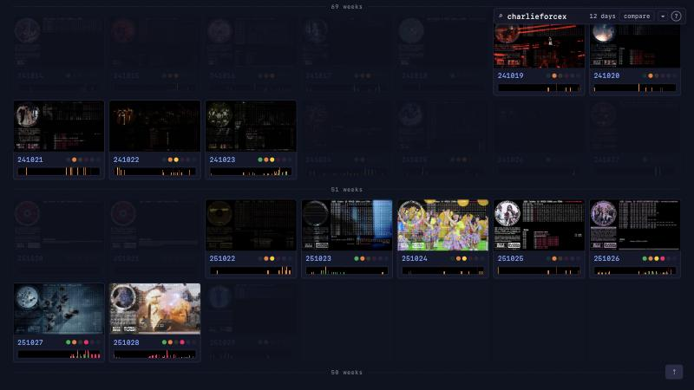
Combining tokens
GALLERY SEARCH
& and · / or · ! not: 2609&!g1 → 1 day (260927)
, any of: m3537,m43 → 10 days
a>b: b within 15 min after a ·
a~b: either order · ~N: the window
g3c22>g3c31 → 260915, 261013 ·
with ~5 → 261013 only
Trailing x folds weeks without a hit:
charlieforcex → 12 days
neetintel.github.io/dtcp_gallery.html?charlieforcex
GALLERY
Notes:
Tokens combine. An ampersand means and, a slash means or, and an exclamation mark means not. 2609&!g1 is September 2026 without Group 1, and it finds a single day, September 27. A comma is a shorter or for weekdays, the day marks, motifs and block lengths: sky,fake and sky/fake both give 23 days, and m3537,m43 gives 10. Then there are sequences between two messages. a>b means b comes within 15 minutes after a; a~b allows either order; and ~N on the end sets the window in minutes. g3c22>g3c31 is a 22-character Group 3 message followed by a 31, and it finds two days, September 15 and October 13, 2026. Tighten it to five minutes and only October 13 is left, where the two are three minutes apart. g2c40~g3c27 finds the same eight days as one of the named motifs, the 27/40 pair, so some motifs are plain searches with a name on them. Last, the x. Put it at the end and every week without a hit folds into a dashed line with a count. This is charlieforcex: 12 days, five in October 2024 and seven in October 2025, with runs of 69, 51 and 50 weeks folded away. The filters panel under the small arrow covers the common tokens with tick boxes, and it writes the query text for you, so a ticked search is still a link; it switches off for searches with a slash or a v. A leading dot, like .2501, only scrolls to a date without filtering.

Slide 30
Two Tuesdays, one week apart
GALLERY SEARCH
g2c75 → 13 days
tue&g2c75 → 4
tue&g2c75@15 → 2
250916 TUE
250923 TUE
09:09 G2-43
14:53 G2-30
14:53 G2-30
15:09 G2-30
g3c25>g2c43~10 → the same two: 250916, 250923
15:50 G2-75
15:45 G2-75
tue&g2c75@15
15:51 G3-32
3 G2 slots line up ·
G2 prefix WM → 27 ·
G3 prefix 7Z both weeks
16:07 G2-30
16:07 G2-30
16:28 G2-30
21:17 G3-25
→
21:24 G2-43
21:38 G3-25
→
21:43 G2-43
g3c25>g2c43~10
?v250916,250923 → 3 linked: 14:53 · 15:50/15:45 · 16:07
23:18 G2-30 (prefix 27)
linked · times UTC · G2 prefix WM, 27 from 23:18 on 250916 ·
G3 prefix 7Z · Group 1 30s and re-airs left out
Data: day data in the published DTCP gallery, Oct 15, 2026
GALLERY
Notes:
Here’s one search followed all the way through, and it happens to be built from the help popover’s own examples. g2c75, a 75-character Group 2 message, shows up on 13 card days. Add tue and it’s four. Add @15, the 15:00 UTC hour, and it’s two: September 16 and September 23, 2025, one week apart. A completely different question lands on the same pair. g3c25>g2c43~10 asks for a 25-character Group 3 message followed within ten minutes by a 43-character Group 2. On the 16th that’s 21:17 then 21:24 UTC; on the 23rd it’s 21:38 then 21:43 UTC. With a five-minute window only the 23rd is left. Put the two days side by side and three afternoon slots line up: a Group 2 30 at 14:53 UTC on both days, the 75 at 15:50 and 15:45 UTC, another 30 at 16:07 UTC on both. The compare view links exactly those three. The rest don’t pair off: the 16th has a 30 at 16:28 UTC and the 23rd one at 15:09 UTC with nothing opposite. The Group 2 prefix is WM for most of the 16th and 27 by 23:18 UTC that night, so the second Tuesday runs on the new prefix with the same clock. The Group 3 prefix is 7Z both weeks. The 23rd also has a 32-character Group 3 at 15:51 UTC, six minutes after the 75, and the page counts that pair as a 40+/32 block pair. The 16th has a morning 43 at 09:09 UTC. The gallery’s own closest-day list for the 16th puts the 23rd first, at 0.28. Shift+Enter on either search opens this comparison with the searched messages lit, and ?v250916,250923 opens it directly.

Slide 31
Twelve motifs
GALLERY MOTIFS
Token | Rule (hover text, shortened) | Days
m43 | A G2-43 at 09:00–09:15 UTC | 5
m09 | 3+ directed EAMs to one addressee, 04:00 US Central hour | 5
mpair | Two G2 or G4 messages of the same length, 20–29 | 6
mopen | A G3-22 or -25, soon followed by a longer G3 | 36
m2740 | A G2-40 and a G3-27 within 15 min, either order | 8
m3227 | A G3-32 followed by a G3-27 | 7
m3537 | A G2-35, then a G2-37 within 30 min | 5
m4032 | A G2 40+ and a G3 32 within 14 min, three 5-char blocks repeat | 8
m55 | Two G2-55s in the same day | 3
m5243 | G2-52, G2-43 within 15 min, then a G3-30 and a G3-34 | 2
mburst | 4+ new G1-30s within 15 min on the day a G1 prefix changes | 6
mburst1 | The same, or the day before or after (draft) | 10
Counts re-run on the published page, Oct 15, 2026
GALLERY
Notes:
The motifs are recurring patterns written down as fixed rules, so the page can find every instance. There are twelve, in five kinds, and hovering a box in the filters panel or a chip in the player shows the rule word for word. Two are morning slots: the morning 43, a Group 2 43 between 09:00 and 09:15 UTC, and the morning direct campaigns, three or more directed EAMs to one addressee in the 04:00 hour US Central time, which is 09:00 UTC in daylight time and 10:00 UTC in standard time. Two are short pairs. The short/long pair is the busiest motif at 36 days: a Group 3 22 or 25, soon followed by a longer Group 3, in nine set pairings, 22/25, 22/31, 22/32, 22/41, 22/45, 25/36, 25/38, 25/48 and 25/63. Five are numbered pairs, one is a four-message sequence, and two are super burst impacts: four or more new Group 1 30s within 15 minutes of each other on the day a Group 1 prefix is retired or introduced, with a draft version that also allows the day before or after. Several of these can be typed out as plain searches and, right now, give the same days. m2740 and g2c40~g3c27 are both 8 days, m3537 and g2c35>g2c37~30 are both 5, m3227 and g3c32>g3c27 are both 7, and m43 matches g2c43@0909. The motif token saves the typing and gives the pattern a name on the chips.

Slide 32
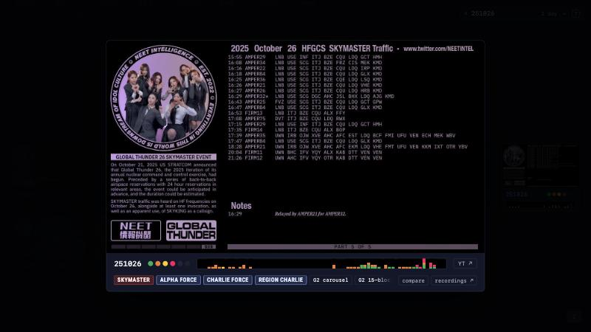
The player and its chips
GALLERY PLAYER
Click a card or press Enter · Space plays the video
← → previous / next card day ·
↑ ↓ same weekday · a = Archive copy
251026: SKYMASTER · ALPHA FORCE ·
CHARLIE FORCE · REGION CHARLIE ·
G2 carousel · G2 15-block · 4 non-G1 MTF
Every chip is a search:
G2 15-block → g2b15x → 47 days
neetintel.github.io/dtcp_gallery.html?251026
GALLERY
Notes:
Clicking a card opens the player, and so does Enter on the first search hit. You see the timecard image first, and Space or a click starts the video. The arrow keys walk the timecards: left and right for the previous and next card day, up and down for the same weekday a week earlier or later. In a collapsed search they skip the folded weeks. The a key switches to the copy on the Internet Archive and back; every card links one, and the browser remembers the choice. Under the video is a row of chips, the day’s marks in a fixed order: SKYMASTER or FAKEMASTER, named FORCE and REGION addressees, ZERO, carousels, early campaigns, motifs, block lengths, and then counts of non-G1 MORE TO FOLLOW and E6B-exclusive messages. October 26, 2025 shows SKYMASTER, ALPHA FORCE, CHARLIE FORCE, REGION CHARLIE, G2 carousel, G2 15-block and 4 non-G1 MTF; the last one is scrolled off to the right, and the row fades on the side that has more. Most days carry no chips at all, 406 of the 641. The most is ten, on September 24, 2026, from FAKEMASTER through 1 E6B exclusive. Each chip is a search. Click G2 15-block and the gallery folds down to the weeks holding the 47 days that have one. Hovering a traffic, motif or block chip shows the rule behind it; the SKYMASTER and addressee chips have no rule to show. The last two buttons are compare, which comes next, and recordings, which searches the YouTube channel for that date.

Slide 33
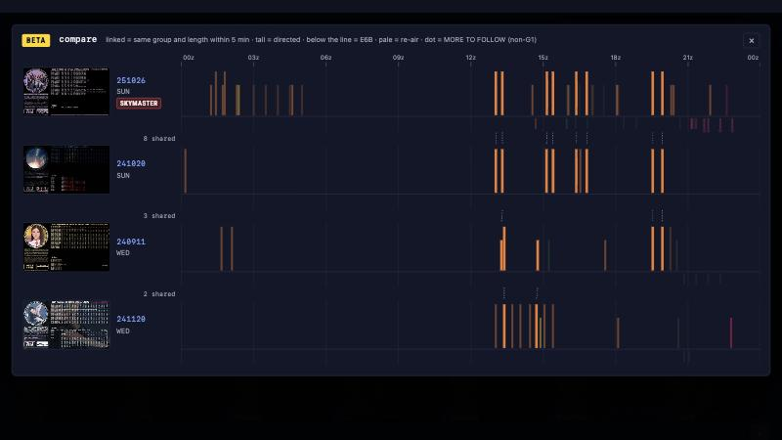
Reading the compare view
COMPARE VIEW
One row per day on a 00:00–24:00 UTC axis · bars in group color
Tall = directed · below the line = E6B ·
pale = re-air · dot = non-G1 MTF
Linked = same group and length within 5 min, next row only
Click a bar → its own search:
g2c30@1302x → 60 days
?v250916,250923 opens a comparison ·
any logged day works
neetintel.github.io/dtcp_gallery.html?v251026,241020,240911,241120
GALLERY
Notes:
Press c in the player, click compare, Shift+Enter on a search, or open a v link, and the days stack on one axis from 00:00 to 24:00 UTC, so a clock time sits in the same place on every row. Each bar is one airing in its group’s color. The legend on the page says the rest in one line: tall means directed, below the line means E6B, pale means a re-air, and a dot means MORE TO FOLLOW outside Group 1. The dashed lines between two rows are links. A link means the same group and the same length within five minutes, and nothing more; the page doesn’t compare the text, so two linked airings needn’t be the same message. The count between rows reads “shared”, but read it as linked slots. Re-airs and the Group 1 30-character background are left out of the links, and each airing links at most once. Links are only drawn between rows that sit next to each other, so changing the row order changes the counts. When the search box names messages, those are at full strength, linked ones at 40 percent and the rest at a tenth. Hover a bar for its time, prefix, length and addressees. Click it and the gallery runs that message’s own search; the 13:02 UTC Group 2 30 gives g2c30@1302x, 60 days. Click a date to open that day in the player on top, and click a thumbnail to play it in place. A v link takes any logged day, card or not, and a row without one says “no timecard”. The view is still labeled beta.

Slide 34
251026 against 241020
COMPARE VIEW
Closest days to 251026: 241020 · 240911 · 241120
241020: 8 linked Group 2 30-character slots,
7 to the minute
All 16 directed FOR ALPHA FORCE,
alone or with CHARLIE FORCE
Different prefixes (7R, P5), same clock times
SKYMASTER
A+C
A+C
A+C
A+C
A+C
A+C
A+C
A+C
251026 SUN · 7R
13:02
13:18
15:09
15:24
16:22
16:48
19:32
19:56
8 linked
241020 SUN · P5
13:02
13:18
15:08
15:24
16:22
16:48
19:32
19:56
A
A
A+C
A+C
A
A+C
A+C
A+C
1 min apart
times UTC · A = ALPHA FORCE · C = CHARLIE FORCE · all directed · closest-day score 0.14
Data: day data in the published DTCP gallery, Oct 15, 2026
GALLERY
Notes:
Here’s what compare does with October 26, 2025, a SKYMASTER Sunday. The gallery keeps up to three closest days for each card day, picked from the other card days: 550 of the 641 cards have at least one, and 527 have all three. The page doesn’t spell out the scoring, but roughly: each airing outside the Group 1 30s counts twice, as its exact group and length and as its group with a 30-or-other length class, with directed traffic kept apart; airings within ten minutes pair off one to one, rarer kinds count for more, and the score runs from 0 to 1. For 251026 the top three are October 20, 2024 at 0.14, September 11, 2024 at 0.10 and November 20, 2024 at 0.09, so these are loose matches. In best-match order, 251026 sits on top of 241020 and the two are joined by eight links. All eight are Group 2 30-character messages, seven at the same minute and one a minute apart, 15:09 UTC against 15:08 UTC. The prefixes differ, 7R and P5, and all sixteen are directed: on 251026 to ALPHA FORCE and CHARLIE FORCE together, on 241020 to ALPHA FORCE alone or to both. Both days are Sundays, and both fall inside the CHARLIE FORCE runs from the search slide. Switch the same four days to date order with c and the links read 3, 4 and 3, because only neighboring rows are compared. What I’m showing is a timing match a year apart; what it means is a separate question.

Slide 35
Timelines
PART 5
How to read the messages calendar, then a zoom from days to minutes on rebroadcasts
NEET INTEL · neetintel.github.io
TIMELINES
Notes:
Part 5 is about the two timeline pages. First the day-level messages calendar in depth: the cells and group bars, the three coverage tiers, the SKYMASTER and FAKEMASTER marks and the tooltip, the group and length filters with ANY and ALL, and the tail-repeat flags. Then we zoom from days to minutes on the rebroadcast timeline, to see what re-airing looks like and where the figure of 94.3% within two hours comes from.

Slide 36
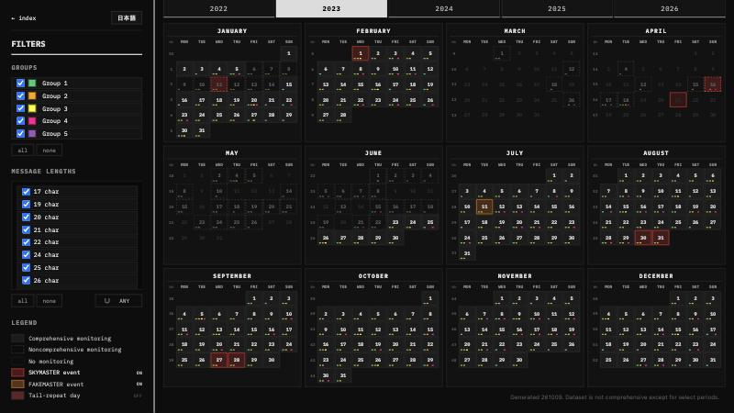
Messages calendar
DAY BY DAY SINCE 2022
One cell per day, one tab per year; data Jan 25, 2022 – Oct 9, 2026
15,277 cleanly copied messages on 1,072 days, rebroadcasts included
Bars show which groups aired that day, in fixed slots, not how many
Click a day that has a recording to open its DTCP or DCRP video
?2023 opens a year · ← → step through the years
NEET INTEL · neetintel.github.io
TIMELINES
Notes:
The calendar is the day-level index of everything in the data set. Each year is a tab with twelve month grids, Monday to Sunday plus a week-number column, and each cell is one day. Start with the bars at the bottom of a cell. There is one slot per group, Group 1 on the left through Group 4, and Group 5 gets a small square at the end because it is so rare. A bar only says that the group aired that day. It doesn’t grow with the count, so a day with 107 Group 1 messages looks the same as a day with one. The counts are in the hover, which I’ll get to. Behind the page are 15,277 cleanly copied messages on 1,072 days, from January 25, 2022 to October 9, 2026. Cleanly copied means partial copies, disregarded broadcasts and anything with an uncertain character are left out. Every airing counts, so a rebroadcast adds to the day’s total. The footer says the data set is not comprehensive except for select periods, and the cell borders show which days were covered. That’s the next slide. The red and orange cells in this shot are the SKYMASTER and FAKEMASTER layer, which is off when the page loads. Clicking a day that has a recording opens it on YouTube, the DTCP timecard if there is one, otherwise the DCRP recording. The year sits in the URL, so ?2023 opens 2023, and the left and right arrow keys step through the years. The calendar draws the group colors in slightly different shades from the rest of the site.

Slide 37
Three coverage tiers
EAM CALENDAR · COVERAGE
CELL
LEGEND
RULE
DAYS
14
solid
Comprehensive monitoring
DTCP/DCRP recording, or logged as zero
789
14
dashed
Noncomprehensive monitoring
no recording, messages logged
305
14
blank
No monitoring
no recording, nothing logged
625
Jan 25, 2022 – Oct 9, 2026: 1,719 days, 46% solid · per year: solid / dashed / blank
2022 · from Jan 25
2023
2024
2025
2026 · to Oct 9
98 / 4 / 239
242 / 51 / 72
198 / 103 / 65
124 / 70 / 171
127 / 77 / 78
Dec 24–26, 2023 (SUN–TUE): three solid days, each “Total Messages: 0”
Source: the published messages calendar, generated 261009
TIMELINES
Notes:
The border of a cell matters most on this page, because it tells you whether anyone was listening. The legend has three entries, and these are its exact words. Comprehensive monitoring is a solid box. That means there’s a DTCP or DCRP recording for the day, or my log marks the day as watched with nothing broadcast. Noncomprehensive monitoring is a dashed outline. There’s no recording, but some messages were logged, so somebody heard something, and the bars on those days are drawn at half strength. No monitoring is blank: no recording and nothing logged. Across the 1,719 days from January 25, 2022 to October 9, 2026, that’s 789 solid, 305 dashed and 625 blank, so a little under half the days are solid. It changes a lot from year to year. 2023 has 242 solid days out of 365. 2025 has 124 solid and 171 blank. 2026 so far has 127 solid, 77 dashed and 78 blank. That’s why an empty day only means something when it’s solid, and a blank day tells you nothing either way. There are 22 solid days with no messages at all. Fourteen are confirmed zero-traffic days, and their tooltip says “Total Messages: 0”. The other eight have a recording but nothing in the data set, and their tooltip says “No messages in dataset.” Christmas 2023 is the clearest zero case: December 24, 25 and 26 are three solid days in a row, each with zero. It works the other way too. A dashed day with a few messages tells you that something aired, but you can’t take it as everything that aired.

Slide 38
SKYMASTER and FAKEMASTER marks
EAM CALENDAR · EVENT MARKS
30
230830
Aug 30, 2023 · WED
SKYMASTER event
event mark (legend toggle)
DTCP
the day’s recording
One legend click turns on both: 31 red days and 7 orange days
HFGCS TIMECARD 230830 ※ SKYMASTER
thumbnail
Red = the index’s 26 dated SKYMASTERs + the next day for 5
Total Messages: 17
clean copies, every airing counted
16 broadcast by E6Bs
flagged as E-6B broadcasts
Orange = 5 FAKEMASTERs + 2 NOTHINGMASTERs (250430, 260421)
■ Group 1: 16 message(s)
LENGTHS 30[×16]
PREFIXES PJ[×16]
per group: lengths longest first, top 5 prefixes
■ Group 2: 1 message(s)
Red days by coverage: 18 solid, 10 dashed, 3 blank
LENGTHS 30[×1]
PREFIXES RM[×1]
Redrawn from the published calendar’s CSS · thumbnail scaled down
TIMELINES
Notes:
SKYMASTER and FAKEMASTER days are a layer you switch on from the legend, and one click turns on both. The FAQ explains the two terms. A SKYMASTER event is, properly, a large STRATCOM-driven exercise, and the SKYMASTER callsign on the radio is one optional sign of it. A FAKEMASTER has every hallmark I’d expect of a SKYMASTER but no documented SKYMASTER call. The red days are the 26 dated SKYMASTERs on the index’s list, plus the following day for five of them, which makes 31. The orange days are the five FAKEMASTERs plus the two days the index calls NOTHINGMASTERs, April 30, 2025 and April 21, 2026, which makes 7. The marks come from that event list, so they sit on top of coverage: 18 red days are solid, 10 are dashed and 3 are blank. The three blank ones still get a red box when the layer is on, so the hover is where you see that nothing is in the data set. Here’s what the hover gives you, using August 30, 2023. First the date and the event label. Then the recording, here the DTCP timecard with SKYMASTER in its title, with its thumbnail under it. Then the total, 17 messages, and how many of them were broadcast by E-6Bs, 16. Then a block per group: Group 1 had 16 messages, all 30 characters, all with the prefix PJ, and Group 2 had one, prefix RM. Lengths are listed longest first, and the prefixes show the top five. The next day, August 31, looks different: 9 messages, 7 of them Group 2 RM, one of those 47 characters long. Its tooltip has no E-6B line at all, because none of its messages is flagged as an E-6B broadcast.

Slide 39
Group and length filters
EAM CALENDAR · FILTERS
A day stays lit if one message matches a checked group AND length
LENGTHS CHECKED
GROUPS CHECKED
MODE
DAYS LIT
17 char
all
ANY
6, all in 2026, all Group 2
all
Group 5
ANY
4: 250610, 250611, 260127, 260129
22 + 41 char
all
ANY
128, 15 of them boxed in cyan
22 + 41 char
all
ALL
15, from 241015 to 260907
22 + 41 char
Group 3 only
ALL
10
Cyan box on the page: a day carrying two or more of the checked lengths, in either mode
Checked on the published messages calendar
TIMELINES
Notes:
The filters sit in the sidebar: five group boxes, 103 length boxes from 17 to 292 characters, and a button that switches between ANY and ALL. The rule underneath is stricter than it looks, because group and length are matched on the same message. If I tick Group 2 and 30 characters, a day lights up only if it had a Group 2 message that was 30 characters long. A Group 2 41 and a Group 1 30 on the same day don’t count. Days that don’t match fade to a faint outline, the bars of unticked groups disappear, and the SKYMASTER and FAKEMASTER washes stay visible when that layer is on. With ANY, a day needs one of the ticked lengths. With ALL, it needs every ticked length within the ticked groups, and if every length is ticked, ALL behaves like ANY. In either mode, a day that carries two or more of the ticked lengths gets a cyan box. Here are some worked examples, all checked on the published page. 17 characters on its own, across all five years, leaves six days, all in 2026 and all Group 2. Group 5 on its own leaves four days: 7 messages on June 10, 2025, 4 on June 11, and one each on January 27 and 29, 2026. Now tick 22 and 41. In ANY, 128 days light up and 15 of them are cyan. Switch to ALL and only those 15 stay, the first on October 15, 2024 and the last on September 7, 2026. Five of the 15 pair a Group 3 22 with a Group 2 41, so if I untick everything but Group 3, ten remain.

Slide 40
Tail-repeat days
EAM CALENDAR · FORMAT DEVIATIONS
Group 1: the last six characters are all different 97.2% of the time
Random base32 would give 60.8% (30-character paper)
Tail-repeat day: a Group 1 30-character message breaks the rule
121 days, 128 messages · its own legend toggle, a red dot per day
1
5
10
15
20
25
30
20:43 — HMJ2JJ
260923 WED · 20:43 UTC · Group 1
H
M
J
2
J
J
A
C
R
J
D
4
L
S
N
G
Z
U
Z
W
S
L
S
7
R
F
E
I
A
W
22:16 — A5NND5
A
5
N
N
D
5
220213 SUN · 22:16 UTC · Group 1
B
4
S
O
X
Z
D
Q
X
Y
B
V
G
Q
N
M
2
L
P
C
L
R
T
D
tail · positions 25–30
Tooltip: ! Format deviation — tail repeat
Messages from the published calendar’s tail-repeat list
TIMELINES
Notes:
This toggle comes straight out of the 30-character paper. In Group 1, the last six characters of a message, positions 25 to 30, almost never repeat a character. The paper puts it two ways. Any two of those positions match about 0.2% of the time, against 3% for random. And all six are different 97.2% of the time, where random base32 would give 60.8%. The paper also says the rule held in every prefix and was untouched by the October 2024 change. So when a Group 1 30-character message does repeat a character in its tail, the calendar flags the day. Turn on “Tail-repeat day” in the legend, which is separate from the event marks, and those days get a small red dot in the top right corner. The hover adds a red line, “Format deviation, tail repeat”, followed by the time and the six-character tail. Here are two real ones. September 23, 2026 at 20:43 UTC, prefix AC, ends HMJ2JJ, with three J’s in the tail. February 13, 2022 at 22:16 UTC, prefix B4, ends A5NND5, with two N’s side by side and two 5’s. Across the whole calendar that’s 121 days and 128 listed messages, between 16 and 34 days a year. The page calls them format deviations and leaves it there. It doesn’t say why they happen, and I won’t either. The mark is for Group 1 only. For contrast, the paper has Group 2’s tail all different 61.3% of the time, which is about the chance rate.

Slide 41
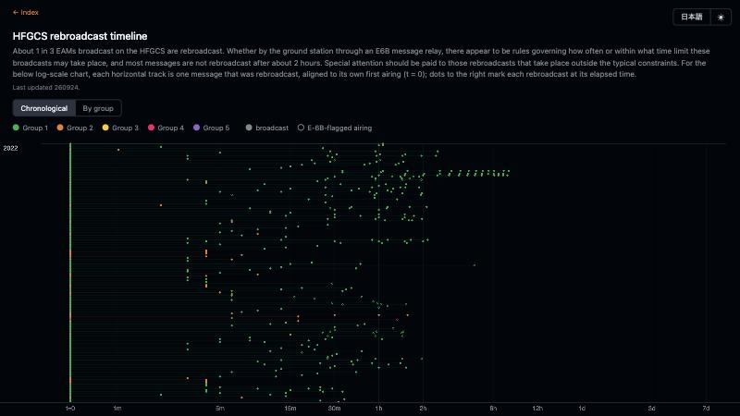
Rebroadcast timeline
REBROADCASTS
One row per message aired at 2 or more distinct minutes: 2,725 rows
Each row starts at its first airing; dots are re-airings, on a log scale
94.3% of rows end within 2 h of the first airing · median span 34 min
Last airing at 115–119 min: 66 rows · at 120–124 min: 15
Example row: B46UDI, 220130 19:00 UTC, 14 airings over 7.48 h
Data: the published rebroadcast timeline, last updated 260924
TIMELINES
Notes:
The calendar works in days. This page zooms in to minutes and asks what happens after a message first airs. Each thin row is one message that was aired at two or more distinct minutes, and every row is lined up on its own first airing, t equals zero, at the left. The dots to the right are the later airings, on a log scale with ticks from one minute to seven days. A hollow ring marks an airing flagged as coming from an E-6B. A row is the same exact string heard again, however far apart, so two airings a week apart still make a row. The page’s own intro says about 1 in 3 EAMs are rebroadcast and that most aren’t rebroadcast after about 2 hours. Here’s what the page’s data gives. There are 2,725 rows, from January 25, 2022 to September 24, 2026, with 9,134 airings, 2,807 of them flagged E-6B. 2,571 rows, 94.3%, have their last airing within 2.00 hours of the first. The median span is 34 minutes, and the first re-airing comes a median 13 minutes after the first airing. The edge at two hours is sharp: 66 rows end between 115 and 119 minutes, and only 15 between 120 and 124. On the chart the dots thin out right at the 2h tick. The rows past it are the ones the intro says deserve attention. One example row, from January 30, 2022, is labeled by its first six characters, B46UDI. It aired 14 times over 7.48 hours, roughly every half hour after the first hour. Hovering a row on the page shows its date, group, label, airings and span. The longest is a Group 2 directed message, aired twice 173.98 hours apart. One caution: a row only holds the airings that were heard and copied.

Slide 42
Structure by length
PART 6
How the site reads messages by length: 103 heatmap pages, format papers and the IPE maps
NEET INTEL · neetintel.github.io
LENGTHS
Notes:
This part is about how the site reads the messages by length. It starts on the Structures tab, which lists 103 heatmap pages, one per message length from 17 to 292 characters, and goes through what the rows and colors mean, the significance bar, a worked example from the 142 page, and Pairs Across Lengths, which stacks the pages on top of each other. Then it goes deep on the 30-character paper — the M and 5 shortage, the last-six rule and the dated October 2024 change — before the four shorter format papers for 34, 40, 42 and 46 characters, and the IPE maps.

Slide 43
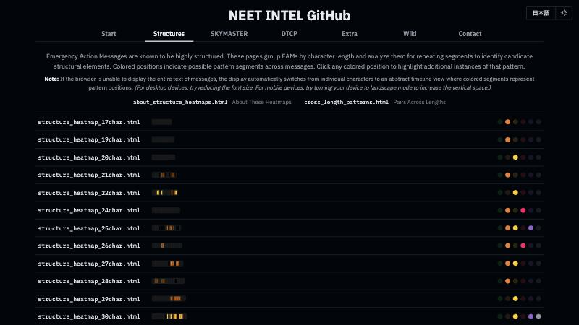
103 heatmap pages
STRUCTURES TAB
One page per message length, 17 to 292 characters
Strip: where that page’s colors fall; width to scale (292 = full)
Dots: Groups 1–5 and Unknown; a lit dot means that group is on the page
Hover a lit dot for its prefixes · type a length, then Enter
Source: neetintel.github.io/?structures
LENGTHS
Notes:
The Structures tab is where the structure work starts. It lists 103 pages, one per message length, from 17 characters up to 292. Each row has a file name, a thin strip and six dots. The strip sums up where that page’s colored characters fall, one cell per position, and the strips are drawn to one length scale, so a 30-character strip is short and the 292-character strip runs the full width. The dots are Groups 1 to 5 plus Unknown. A lit dot means that group is on the page. Hover it and the strip redraws for that group alone, and the tooltip lists that group’s prefixes at that length. On the 142 row only the Group 4 dot is lit, and it lists 18 prefixes, from 3Q to ZX. Across all 103 rows, Group 2 is lit on 59, Group 4 on 50 and Group 3 on 38. Group 1 isn’t lit anywhere. Every documented Group 1 message is 30 characters, and Group 1 is left off the 30 page on purpose; the 30-character paper covers it, and I’ll get to that. Typing a length on the keyboard picks that row, and Enter opens the page. Above the list are the two companion pages: About These Heatmaps, which explains every color, and Pairs Across Lengths, which stacks the pages on top of each other. The tab’s own intro puts the goal plainly: group the messages by length, look for repeating segments, and find candidate structural elements.

Slide 44
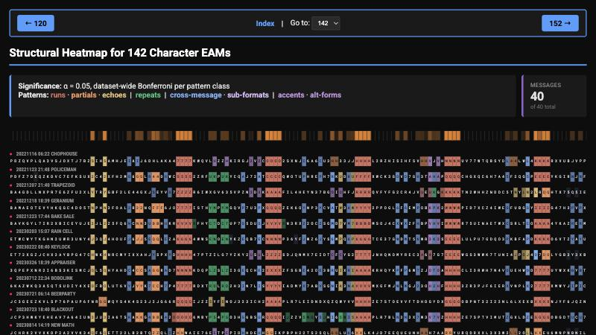
One row per message
HEATMAPS
One row per message text; a rebroadcast appears once
Group set by the prefix; each group tested alone at each length
Left out: partial or disregarded copies, uncopied characters, positions 1–2
Orange bar: average fill per column · 1,838 rows across the 103 pages
NEET INTEL · neetintel.github.io
LENGTHS
Notes:
This is one heatmap page, the one for 142 characters. Every row is one message text. If a message was rebroadcast it still appears once, and the date, time and callsign above it come from its first row in the log. Rows are sorted by group and then oldest first; on pages with more than one group, a Display Mode switch puts every row in time order instead. The group comes from the prefix, the first two characters, looked up in the log’s PR_GROUPS table, where the latest entry at or before the year of the broadcast decides. Every test runs separately inside each group at each length. Groups never share evidence and nothing is borrowed from other lengths, and that’s why a well-known pattern can show up pale on a small page, which I’ll come back to. A few things are left out: partial captures, reads I marked as disregarded, rows with no message, and any message with an uncopied character. Positions 1 and 2 are never part of any pattern, because the prefix is a label that rotates. The About page counts 15,211 log rows passing those filters as of 261005. On the pages themselves a rebroadcast shows once and the 30 page leaves out Groups 1 and 2, so the 103 pages hold 1,838 rows in all. The orange bar across the top has one cell per position, and its shade is the average fill of the colored characters in that column, so the peaks show where the structure sits. The info box names the test: alpha 0.05, with a dataset-wide Bonferroni correction for each kind of pattern. This page has 40 messages, all Group 4. The left and right arrow keys step to the previous or next length.

Slide 45
Colors and their rules
HEATMAPS
Color | Pattern | Rule
Red | Same character 4+ times in a row | Always colored, no test
Coral | Run of 2–3 where the group’s runs line up | Only inside a run zone
Amber | X??X: same character 3 positions apart | Pair test, dataset-wide
Blue | Hot pair across messages, or a mirror block | Pair or mirror-block test
Teal | A message repeating part of itself | Own rule: too long for chance
Violet | Pairs held by only some of the group | Own group’s tests × 74
Pale | Any color: a near miss | Under 2 chance hits on its page
Source: About These Heatmaps (about_structure_heatmaps.html)
LENGTHS
Notes:
The About page has a section for each color, and they aren’t all decided the same way. Red is a run, the same character four or more times in a row, and runs are colored in every message with no test. They’re full brightness inside a run zone, a stretch where the group’s runs line up, and at least 0.75 outside one. Coral is a run of two or three, and it only gets color inside a run zone. Amber and blue come out of the same pair test. For each pair of positions, count the messages where both carry the same character, with at least 3 needed, and compare that with the chance that two characters of that group match, about 3% for Group 4. If the two positions are exactly three apart, the X??X shape, it’s amber; otherwise it’s blue. Blue also marks mirror blocks, a block of 2 to 5 characters that each message repeats at the same two places. Teal is a message repeating part of itself. For exact and gapped repeats the rule is length: the expected number of chance repeats, L squared over 2 times 26 to the k, has to be under 0.05. That works out to 3 characters at length 30, 4 at 142 and 5 at 292. Motifs, 3 or more characters that come back at least 3 times in one message, get their own dataset-wide test. Violet is a sub-format, pairs that hold only in some of the group’s messages. Pale is a near miss. Mauve, rose and periwinkle are just accent shades that separate overlapping pairs. Brightness shows how common a column’s pattern is in the group, so a dim chip still passed. Where patterns overlap, runs win, then short runs, then repeats, then pairs.

Slide 46
The significance bar
HEATMAPS
1 in 11 million
0.05 ÷ 538,498 pair and run tests, counted across every page (261005)
PALE
SOLID
4 of 4 messages
5 of 5
At a 3% match rate: about 1 in 1.2 million
About 1 in 41 million
Older pages: a pair is hot at 30% of messages, with no dataset-wide test
Source: About These Heatmaps (about_structure_heatmaps.html)
LENGTHS
Notes:
With hundreds of thousands of position pairs, some will match often just by luck. So every kind of pattern is corrected for all the tests of its kind across the whole data set, every pair at every length in every group. As of 261005 that’s 538,498 pair and run tests. Divide 0.05 by that and a solid pair or run needs a chance probability under about 1 in 11 million. Mirror blocks have their own count, 1,879,956 tests, about 1 in 38 million. Format changes have 52 tests, one for each group of 8 or more messages at a length. The payoff is that the chance of even one solid pair or run anywhere being luck is at most 5%. The cost is that small groups need near-total agreement. If two positions match by chance 3% of the time, all 4 of 4 messages matching is about 1 in 1.2 million. That’s not enough, so it shows pale. All 5 of 5 is about 1 in 41 million, and that’s solid. Pale is corrected only for the tests on its own page: under 2 chance hits expected there. That 52-test format check is also how some groups get split into two parts: 3A and 3B at 38 characters for Group 3, and 2A and 2B at 39, 43 and 55 for Group 2. Press the up or down arrow on any page and you get the older version: there, a pair counts as hot if it shows up in 30% of the group’s messages, and there’s no dataset-wide test at all. It’s still up.

Slide 47
Columns on the 142 page
HEATMAPS
17
21
24
30
32
42
45
48
221116 06:22 CHOPHOUSE
J
7
B
Z
S
I
H
S
A
M
H
J
E
I
A
I
J
6
D
H
L
A
K
A
4
7
7
7
7
K
W
Q
221123 21:48 POLICEMAN
K
S
U
X
2
C
4
2
X
F
H
2
M
G
6
G
G
L
R
4
4
D
R
W
C
5
5
5
5
2
Z
R
230721 06:14 BEERPARTY
U
P
6
F
N
R
G
G
W
Q
Y
S
4
K
4
S
2
3
J
2
J
G
6
6
R
Q
Q
Q
Q
I
J
Z
240124 13:46 FIRELIGHT
7
5
G
H
S
J
6
Y
4
I
3
I
U
6
2
I
V
7
J
3
J
N
S
K
K
Q
Q
Q
Q
D
E
P
Positions 17–48 of four rows on the 142 page, in its own colors: amber X??X · blue pair across messages · coral double · red run of four
21 = 24 (amber): 34 of 40 messages
5 of the 6 without it double at 23–24 instead (coral)
Runs of four at 42, 64, 86 and 108: 38 or 39 of 40 each
Click the amber S: 34 rows stay bright, 6 fade
Data: the published 142-character heatmap page
LENGTHS
Notes:
Here’s how to read a page down the columns rather than along the rows. These are four real rows from the 142 page, positions 17 to 48, in the page’s own colors. The first row, CHOPHOUSE from 06:22 UTC on November 16, 2022, is also the About page’s worked example. It has S at 21 and S at 24, which is the amber X??X shape, I at 30 and 32 in blue, and 7777 at 42 to 45 in red. POLICEMAN a week later has a 2 at 21 and 24 and 5555 at 42. Across the whole page, 21 equals 24 in 34 of the 40 messages. The About page then asks what the other six do, and 5 of the 6 have a doubled character at 23 and 24 instead, which is BEERPARTY’s GG here. That’s tested as an alternative form and colored coral. FIRELIGHT, from January 24, 2024, is the one message with neither. The runs keep going past this window. Counting the published rows, a run of four sits at 42 to 45 in 38 of the 40 messages, and at 64, 86 and 108 in 39 of 40, so they’re 22 positions apart, the same 22-character spacing the Group 4 structure page is built on. At 130 it drops to 28 of 40. On the page, clicking the amber S in the first row keeps the 34 rows that carry 21 equals 24 bright and fades the other 6, and missing pieces show as dashed outlines.

Slide 48
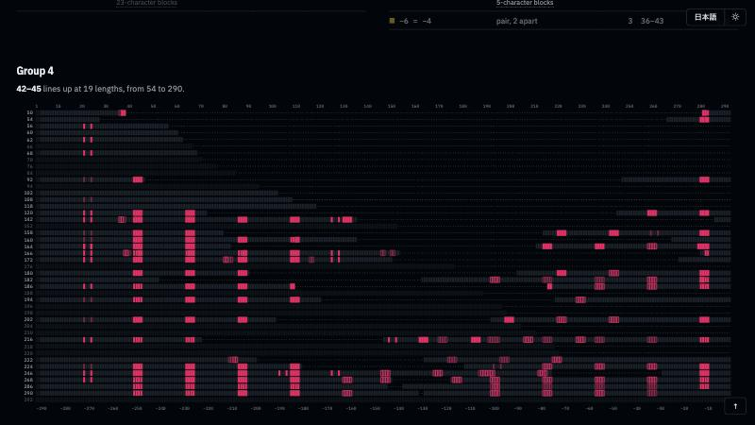
Pairs across lengths
PAIRS ACROSS LENGTHS
Every length’s results stacked: one row per length, per group
Square: passes here and at 2+ other lengths, same place · pale = near miss
Group 4: 21 = 24 at 12 lengths, 56 to 268 · by chance 0.0
Group 2: 16–24 = 21–29 at 16 lengths, 39 to 85 · by chance 0.0
Source: cross_length_patterns.html
LENGTHS
Notes:
Each heatmap page tests one length on its own. Pairs Across Lengths stacks them: one row per length, positions running across, one grid per group. A colored square means its pattern passes at that length and also, in the same place, at two or more other lengths of the same group, so a pattern that holds across lengths stands up as a column. Pale squares are near misses. Lining lengths up means choosing an anchor, so shorter messages open a dashed gap: their start lines up on the left and their end on the right, and the ruler underneath counts from the end, with minus 1 as the last character. To check for luck, each page’s patterns were moved to a random place 500 times. Patterns that line up at only two lengths came up about as often that way, so they’re left out, and the “by chance” column is how many patterns this widespread the random placements average. My example is Group 4’s 21 equals 24. It passes at 12 lengths from 56 to 268, and by chance you’d expect 0.0 like it. The tooltips give the counts: 36 of 39 at 120, 34 of 40 at 142, 14 of 14 at 216, 8 of 8 at 246. It’s a near miss at 7 more lengths, such as 3 of 3 at 158 and 4 of 4 at 224, while 5 of 5 at 186 passes, which is the 4-of-4 against 5-of-5 point from the significance slide. The run zone at 42 to 45 lines up at 19 lengths. The page calls itself a rough tool, and when in doubt the heatmap page itself wins. Clicking a square opens that length’s page.

Slide 49
The M and 5 shortage
30-CHARACTER PAPER
1.9%
5,881 unique: 3,917 Group 1, 1,964 Group 2 · Jan 25, 2022 – Jul 29, 2026
Short in all 18 prefixes with 100+ messages, before and after Oct 2024
M and 5 in Group 1 message bodies; an even share is 3.125% (z −22.8, −22.3)
A matched random control stays within ±2
Source: eam_30char_format_analysis.html
LENGTHS
Notes:
The 30 heatmap leaves out Groups 1 and 2, over 9,000 messages by its own count, and its notice says why: their structure shows up as match shortages and skewed character counts, which the heatmaps don’t highlight. The 30-character paper covers them, from ciphertext only. It takes the first airing of every distinct 30-character string from January 25, 2022 to July 29, 2026: 10,899 observations, 5,881 unique messages. The messages use a 32-symbol alphabet, the letters A to Z and the digits 2 to 7. The starting assumption is what good encryption would give you, every symbol equally likely at every position, 3.125% each. Group 1 breaks that first with M and 5. Across 109,676 Group 1 body characters, M is 1.929% and 5 is 1.952%, about 40% short overall. Those are z-scores around minus 22, and a same-size draw from a cryptographic random generator, pushed through the same steps, stays within plus or minus 2. The shortage is at nearly every body position. It shows up in every one of the 18 Group 1 prefixes with at least 100 messages, from GF in 2022 to 3G in 2026, and it’s about the same before and after October 2024. Positions 3 and 4, right after the prefix, escape it in both formats, and the paper calls them a head slot. The paper calls the shortage a fixed property of whatever produces the messages; it didn’t change with the format. Group 2 has it too, but only weakly.

Slide 50
The last six characters
30-CHARACTER PAPER
Messages whose neighbors match (Table 5); each count sits between its two positions
last six
1
2
3
4
5
6
7
8
9
10
11
12
13
14
15
16
17
18
19
20
21
22
23
24
25
26
27
28
29
30
Group 1 · 3,917 · ~122 expected
146
130
114
141
127
117
136
147
119
130
128
123
110
118
124
125
115
132
48
49
130
123
143
119
8
5
10
10
9
Group 2 · 1,964 · ~61 expected
↑ 19–21: pooled over both formats, next slide
101
58
67
60
57
51
69
51
62
60
71
63
61
69
58
65
54
63
54
70
64
65
65
61
70
56
67
73
70
Group 1: any two of the last six match ~0.2% of the time (random: 3%)
All six different in 97% of Group 1 messages; chance is about 61%
Holds in all 18 large prefixes, before and after Oct 2024
Group 2: 61.3% all different, chance 60.8%, so no rule
Source: eam_30char_format_analysis.html, Table 5
LENGTHS
Notes:
The second Group 1 finding is about the last six characters, positions 25 to 30. This strip is the paper’s Table 5. For every pair of neighboring positions it counts the messages where both carry the same character. With 3,917 Group 1 messages you’d expect about 122 at each pair, and that’s roughly what you see, until the end: 8, 5, 10, 10 and 9. The paper then checks all fifteen pairs inside the last six, not just neighbors, and finds every one suppressed about fifteen-fold. Any two of those six positions match only about 0.2% of the time, against 3% at random. Put another way, six random characters from a 32-symbol alphabet are all different only about 61% of the time; that’s the birthday problem with 32 days. Group 1 sits at 97%. The rule holds in every one of the 18 large prefixes, from 2022 through 2026, and it’s the same before and after the October 2024 change, 0.9722 against 0.9729. The paper calls it the most robust feature of the format. The orange row is Group 2: no dip at the end, 61.3% all different against 60.8% by chance. The dip at 19 to 21 in the green row is real but pooled across two formats, and it’s the subject of the next slide. One more place this shows up: the calendar’s day tooltips flag Group 1 messages whose last six characters include a repeat, as “Format deviation — tail repeat”, 128 flags across the whole calendar.

Slide 51
A dated format change
30-CHARACTER PAPER
Before Oct 1, 2024
1
2
3
4
5
6
7
8
9
10
11
12
13
14
15
16
17
18
19
20
21
22
23
24
25
26
27
28
29
30
prefix
X head slot
T: no M/5 shortage, no repeats
R: all six different, 97%
After
1
2
3
4
5
6
7
8
9
10
11
12
13
14
15
16
17
18
19
20
21
22
23
24
25
26
27
28
29
30
prefix
X
X₂: new slot, no M/5 shortage
T removed
R
Best split: 00:33–00:57 UTC on Oct 2, 2024 (the evening of Oct 1 in the US)
Bracket at 20:1: Sep 25 to Oct 3 · shuffled order: no break (p < 0.0002)
Before: 19–21 skip the M/5 shortage and never repeat (0 and 1 in 2,587)
After: both gone (48 and 48 in 1,330); 16–17 now skip the M/5 shortage
Source: eam_30char_format_analysis.html
LENGTHS
Notes:
Group 1 changed format once, and the paper dates it. Here’s how. Sort the 3,917 Group 1 messages by broadcast time, try every split point, and ask where the pattern of which positions match each other changes most, leaving the prefix out because prefixes rotate with time anyway. One break dominates, with a likelihood ratio of 320, between messages at 00:33 and 00:57 UTC on October 2, 2024. That’s the evening of October 1 in the US, hours after the C6 prefix replaced 3E. The edge is fuzzy, though. The only near-certain sign of the new format in a single message, a repeat inside 19 to 21, turns up in only about one new-format message in ten, so the split can slide 14 messages earlier or 7 later before the odds reach 20 to 1. That brackets it between September 25 and October 3. Shuffle the message order and the break disappears. Before it, positions 19 to 21 escape the M/5 shortage and never repeat each other: 0 and 1 neighbor matches in 2,587 messages. After it, both properties are gone together, 48 and 48 in 1,330, which is the random rate, and a new slot that escapes the shortage shows up at 16 and 17. The paper suspects the change came in at 00:00 UTC on October 1, with that day’s prefix change, and the heatmaps, IPE Maps II and the G2/G3 page all use that moment as the break. The paper doesn’t name a cipher, and it labels each region only by how it behaves. Group 2 shows no change point at all.

Slide 52
Four more format papers
FORMAT PAPERS
Length | Group (unique) | Main finding
34 | G2 (146) | Only a mild M/5 shortage; 0 of 561 position pairs pass
40 | G3 (20) | A 3–7 character chunk from 22 repeats at 31 (17 of 20)
40 | G2 (39) | 16–17 repeats at 21–22 in 22 of 35 messages
42 | G3 (8) | A 3-character chunk 3 to 5 times on a 5-position grid (7 of 8)
42 | G2 (17) | 15 = 23 in 15 of 17; 15→23→27 and 17→25→29, +8 and +12
46 | G2 (7) | 15 = 23 in 7 of 7; 15, 23 and 27 all match in 5 of 7
Source: the 34, 40, 42 and 46-character format papers
LENGTHS
Notes:
Four shorter papers run the same kind of tests on other lengths, including the every-pair probe, inter-position equality, which checks every pair of positions, not just neighbors. The 34-character band is all Group 2, 146 unique messages, and it comes back nearly empty: a mild M and 5 shortage, about one-fifth the strength of Group 1’s by the paper’s own comparison, and none of 561 position pairs passes. At 40 characters, Group 3 copies itself: a chunk of 3 to 7 characters starting at 22 shows up again at 31, nine positions later. In the paper’s own table that’s 17 of the 20 messages at exactly 22 and 31. Group 2 at 40 repeats a two-character bit, 16 and 17 again at 21 and 22, in 22 of 35. At 42, Group 3 repeats a short chunk three to five times; one message has U7N at 17, 22, 27, 32 and 37. Group 2 at 42 has two threads: the character at 15 comes back at 23 in 15 of 17 messages and often again at 27, and the one at 17 comes back at 25 and 29. The 46 paper has only 7 Group 2 messages, but 15 equals 23 in all 7, the same 15, 23, 27 shape as at 42. These are small samples, and three of the papers are dated April 17, 2026, before the current 30 paper; the figures here come from the papers’ tables. None of them claims to know what the repeats mean.

Slide 53
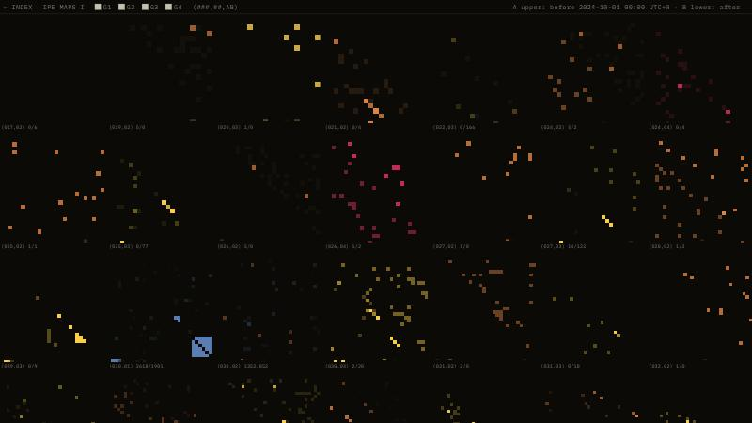
One map per cohort
IPE MAPS
One small map per length and group: 146 on IPE Maps, 147 on IPE Maps II
Pixel (i, j): how often positions i and j match, against 1 in 32
Group color = more matches than chance · blue = fewer
II: upper triangle before Oct 1, 2024, 00:00 UTC; lower after
Source: ipe_maps.html and ipe_maps2.html
LENGTHS
Notes:
The IPE maps take that every-pair probe and draw it for every cohort at once. A cohort is one length in one group, Groups 1 to 4, and each gets a small square map. The pixel at row i, column j is about one question: how often do positions i and j carry the same character, compared with the 1 in 32 you’d expect by chance? More matches shows in the group’s color, fewer in blue, and anything within about two standard deviations stays dark. IPE Maps II is the newer version. It leaves out the prefix, and it splits every map at Oct 1, 2024, 00:00 UTC, with before in the upper triangle and after in the lower one, so a format that survived the break looks symmetric. The Group 1 30-character map, second in the third row, is the paper in one picture: a blue block at 19 to 21 above the diagonal only, and a blue corner at 25 to 30 on both sides. The Group 4 142 map lights 21 and 24 on both sides, 27 messages before and 7 after, which adds up to the 34 from earlier. Group 3’s 22-character map has only a lower triangle, because those messages only exist after the break. Of the 147 maps, 59 have messages on both sides, 40 only before and 48 only after. The left and right arrow keys step through the groups, up and down through the lengths, e cycles the before and after views, and clicking a map opens that length’s older heatmap page with that group picked. The maps count a little differently from the paper, so I keep their numbers apart.

Slide 54
Structure by group
PART 7
How each group’s messages are built:
G4 grammar, G3 frame, G2 copies, G2/G3 pairs
NEET INTEL · neetintel.github.io
GROUPS
Notes:
This part goes inside the messages, one group at a time, using real messages from the published structure pages. It starts with Group 4: the markers that close each field, one length formula, what sits inside a 22-character block, the versions, the trailer, and how later messages copy earlier ones under the same prefix. Then come the three long-G4 block pages on the Extra tab, which use their own set of 242 messages. It ends with Groups 2 and 3: one frame for every structured G3 message, with 5-, 14- and 23-character blocks, then the Group 2 15-character copies and the G2/G3 pairs that keep the same slots.

Slide 55
Fields closed by markers
G4 EAM STRUCTURE
Quad (GGGG) closes row B and the body blocks · 765 of 1,005 slots
MM-164 · 261004 SUN 21:38 UTC
1
MM
2 · prefix
3
V4MNSRJISBSI6L5YPH
J
TA
J
22 · row A · 18 + X??X
Echo X??X (1st = 4th) closes row A at positions 21–24
IGTJILNINDI2X2AAQ
EEEE
25
21 · row B · 17 + quad
46
SNDNSHHSGSXKPGPGNG
UUUU
22 · block 1 · 18 + quad
Double ## closes the short fields of the rarer forms
68
7NILZIIT3ASPORRLRN
LLLL
22 · block 2
90
CPPCSOOKIVACBHHHHH
WWWW
22 · block 3
175 of 257 messages split into rows with nothing left over
112
SG7F2DD3BIOGSJGWHJ
GGGG
22 · block 4
134
X75B7222QWEHSDHSQ2
7777
22 · block 5
156
2SYL5KTFH
9 · trailer
2 + 22 + 21 + 5 × 22 + 9 = 164
NEET INTEL · neetintel.github.io
GROUPS
Notes:
The Group 4 page starts from one idea: a long Group 4 message is a stack of fields, and every field ends in a marker. There are three kinds. A quad is one character four times, like GGGG. It’s the marker for row B and the body blocks, and it fills 765 of the 1,005 marker slots on the standard grid, about 76%. An echo is four characters where the first and the fourth match, written X??X. It closes row A, at positions 21 to 24. A plain double, two of the same character, closes the short fields that show up in the rarer forms. Here’s a real message, the MM-164 that aired on 261004 at 21:38 UTC, cut at its markers. Two characters of prefix. Row A is 18 characters and then the echo J-T-A-J. Row B is 17 and then the quad EEEE. Then five blocks, each 18 characters and a quad, and a 9-character trailer with no marker. Block 3 has five H’s in a row just before its quad; those belong to the values, and the marker is the WWWW at the slot. Read this way, 175 of the 257 distinct messages of 54 or more characters, January 2022 to October 2026, split into marker-closed rows with nothing left over. Fifteen more do the same apart from row A, whose echo went missing for a stretch of 2023 and 2024. Every card on the page is drawn from that rule alone. No marker is placed by hand, and stray X??X windows are left visible so you can see the base rate.

Slide 56
One length formula
G4 EAM STRUCTURE
L = 54 + 22n + 38k
n = blocks of 22 · k = extra heads, A′ 17 + B′ 21 = 38
k | Length (messages built exactly this way)
0 | 54 (3) · 120 (35) · 142 (28) · 164 (23) · 186 (4)
1 | 92 (7) · 158 (3) · 180 (2) · 202 (2) · 224 (4) · 246 (6) · 268 (3) · 290 (1)
2 | 196 (1)
k = 0 and 1 stops not heard yet: 98 · 114 · 136 · 208 · 230 · 252
62 have no quad anywhere · 35 not reached by the rules
NEET INTEL · neetintel.github.io
GROUPS
Notes:
Once the rows are fixed, the lengths follow. Prefix 2, row A 22, row B 21, a trailer of 9, and n blocks of 22 add up to 54 plus 22n. Three, four and five blocks give 120, 142 and 164, the most common long lengths. An extra head is a shorter pair of rows, A-prime of 17 and B-prime of 21, so each one adds 38, and that’s the second series, starting at 92. The counts in the table come from the census at the bottom of the page, which is marked beta: messages built exactly this way at each length. The 142 has 40 messages, for example, and 28 of them are plain; ten more end on an echo-closed block. The page treats the formula as an inventory rather than a template. It counts the parts, and the parts can come in a different order: the 246 is three blocks, an extra head, then four more blocks. On the page you can walk each series with the arrow keys, including lengths the formula reaches that haven’t been heard yet, like 98, 114 and 136. The short forms use the same pieces with a run of short ##-closed fields where the blocks would be. The 56 and the 62 are prefix, row A, a run of 23 or 29, and the trailer. The 108 and the 176 have fixed fields of their own and no blocks at all. Then there’s what’s left over. 62 messages carry no quad anywhere. 27 of those still read. The other 35 are what the rules don’t reach, though 15 of the 19 longest still close row A at position 24.

Slide 57
Frame, version, values
G4 EAM STRUCTURE
Frame: opener 1–5, anchor 11, quad 19–22 · names the field
Version: 1, 5, 12, 13 · two or three variants per field
Values: 6–10, 14–18 · 32 symbols, no checksum, no 5-group repeat in 884
position
1
2
3
4
5
6
7
8
9
10
11
12
13
14
15
16
17
18
19
20
21
22
MM-186 · 260901 TUE · block 2
V
M
V
4
O
D
E
Z
M
7
3
U
X
6
A
O
6
U
Q
Q
Q
Q
MM-224 · 260912 SAT · block 4
V
M
V
4
O
7
Z
Z
H
E
3
U
X
6
6
4
A
W
Q
Q
Q
Q
MM-246 · 261012 MON · block 4
V
M
V
4
O
F
E
M
E
B
3
U
X
U
N
N
6
A
Q
Q
Q
Q
opener
values
version
values
quad
anchor
match %
73
81
87
100
72
19
17
8
17
11
99
66
55
18
21
12
16
11
100
100
99
99
% = agreement with the source over 442 reused blocks (chance 3%)
NEET INTEL · neetintel.github.io
GROUPS
Notes:
Now inside one block. The page lines up three copies of one MM field: block 2 of the MM-186 from 260901, and block 4 of the MM-224 on 260912 and of the MM-246 on 261012. A 22-character block has three kinds of character. The frame is the opener, positions 1 to 5, the anchor at 11, and the quad at 19 to 22. It says which field this is, and the page treats it as fixed for that field under a prefix: here V-M-V-4-O, the 3, and QQQQ in all three. The version is positions 1, 5, 12 and 13. A field comes in two or three versions that differ only there, and these three copies share one. The values are 6 to 10 and 14 to 18, and they mostly differ from copy to copy: D-E-Z-M-7, then 7-Z-Z-H-E, then F-E-M-E-B. The numbers under each column come from all 442 reused blocks on the page: how often that position agrees with the block it was copied from, where chance is about 3%. Position 4 agrees 100% of the time, the anchor 99%, the quad 99 to 100%, and positions 2 and 3 81 and 87%. The version positions run 55 to 73%, and the values 8 to 21%. The page also finds the values behave like 32 symbols at full entropy, with no checksum, and not one repeated five-character group in 884. So each block is a label plus two five-character windows of payload. Notice the field also moved, from block 2 to block 4. A copied block doesn’t have to keep its slot.

Slide 58
Versions in lockstep
G4 EAM STRUCTURE
Three BV fields across five airings, 241031 to 250122
Through 241231: only position 13 moves, one field at a time
250122: positions 5, 12, 13 change in all three fields at once
Pairs sharing 2+ fields: almost always all same or all different
position
?UCV?
?MU6?
?4ZV?
BV-268 · 241031 THU · blocks 6–8
1
2
3
4
5
11
12
13
1
2
3
4
5
11
12
13
1
2
3
4
5
11
12
13
BV-160 · 241117 SUN · blocks 1–3
E
U
C
V
F
L
S
Y
I
M
U
6
G
3
D
H
B
4
Z
V
T
K
U
B
BV-164 · 241214 SAT
E
U
C
V
F
L
S
Y
I
M
U
6
G
3
D
H
B
4
Z
V
T
K
U
X
BV-142 · 241231 TUE
E
U
C
V
F
L
S
Y
I
M
U
6
G
3
D
N
B
4
Z
V
T
K
U
B
BV-166 · 250122 WED
E
U
C
V
F
L
S
Y
I
M
U
6
G
3
D
N
B
4
Z
V
T
K
U
B
E
U
C
V
T
L
7
3
I
M
U
6
S
3
H
B
B
4
Z
V
C
K
X
7
as first seen
changed
values (6–10, 14–18) not shown
NEET INTEL · neetintel.github.io
GROUPS
Notes:
The version characters mostly switch together, message by message. This grid follows three fields of the BV prefix through five airings, from 241031 to 250122. I’ve kept only the opener, the anchor and the version positions; the values mostly change and would just be noise here. The fields go by their middle letters, UCV, MU6 and 4ZV. In the first message, the BV-268, they’re blocks 6 to 8, after an extra head, and in the four later ones they’re blocks 1 to 3. The gray letters don’t change anywhere in this grid. The pink ones are the version, faint when they’re as first seen and solid when they’ve changed. Through 241231 the only movement is position 13, in one field at a time. Then the BV-166 on 250122 changes positions 5, 12 and 13 in all three fields at once, nine characters together, while position 1 holds. Across the whole set, of the message pairs that share two or more fields, almost all use the same version for every shared field or a different version for every one; the single-field changes before 250122 are among the exceptions. The page reads that as the version going with the message. And the switch didn’t stop the copying: the BV-160 and BV-166 pair shows up in the lineage table in a moment, 82 of 160 characters identical at offset 0.

Slide 59
Trailer as pointer
G4 EAM STRUCTURE
Trailer = last 9 characters; its first 2 = head of the next field
62 of 68 messages ending on a quad-closed field (chance 0.1%)
Within a prefix, 515 of 520 two-character heads name one field
The other 7 trailer characters match nothing tested so far
MM fields in order (first five characters)
VMV4O
DSQ4I
ZVZW7
E7YTJ
SNDNS
7NILZ
CPPCS
SG7F2
X75B7
2SNCT
ZVZW7
E
7
C
I
W
O
6
N
3
MM-224 · 260912 SAT 16:51 UTC
E7YTJ
S
N
X
Q
Q
V
T
C
Z
MM-246 · 261012 MON 17:05 UTC
SNDNS
7
N
7
V
I
D
G
B
X
MM-186 · 260901 TUE 21:08 UTC
MM-164 · 261004 SUN 21:38 UTC
X75B7
2
S
Y
L
5
K
T
F
H
Field order: MM-186 260901, MM-164 261004, MM-180 260902 (g4_structure.html)
GROUPS
Notes:
The last nine characters of a long Group 4 message are the trailer, and its first two point ahead. A message carries a run of its prefix’s fields, and the trailer opens with the two-character head of the field that comes next in the prefix’s order. This uses the MM messages from September and October 2026. Reading their rows, one run of MM fields goes VMV4O, DSQ4I, ZVZW7, E7YTJ, SNDNS, 7NILZ, CPPCS, SG7F2, X75B7, 2SNCT. The MM-224 on 260912 stops after ZVZW7, and its trailer opens E7. A month later the MM-246 carries one more field, E7YTJ, in exactly that slot. That’s the example on the block layout page. The MM-246’s own trailer opens SN, the field after that. The MM-186 on 260901 stops after SNDNS, and its trailer opens 7N. The MM-164 on 261004 stops after X75B7, and its trailer opens 2S. Across all prefixes this holds in 62 of the 68 messages that end on a quad-closed field, where chance would give 0.1%. Two characters are enough, because within a prefix 515 of 520 two-character heads name a single field. The other seven trailer characters agree with nothing tested so far. When a message ends on a run of short fields, a stub or an extra head, the rule mostly fails, 2 of 38, so those endings are doing something else. The four-message chain here is my reading of the rows on the page; the page gives the 224-to-246 example and the counts. On the slide, each message’s last field sits under its place in the chain, so the trailer starts right under the field it names.

Slide 60
Copies within a prefix
G4 EAM STRUCTURE
145
Prefix | Earlier | Later | Identical | Offset | z
MM | 224 @ 260912 | 246 @ 261012 | 120 / 224 | +0 | 43
LO | 172 @ 240131 | 194 @ 240210 | 96 / 172 | +22 | 40
BV | 222 @ 241113 | 166 @ 241229 | 90 / 166 | −40 | 38
RO | 216 @ 240825 | 166 @ 240918 | 85 / 166 | −44 | 36
BV | 160 @ 241117 | 166 @ 250122 | 82 / 160 | +0 | 35
copy pairs at z ≥ 15 · all same prefix · 0 across a change
Row A is never copied; the trailer is
Offsets mostly 0, ±22, ±44 (whole blocks) or 40 (an extension)
NEET INTEL · neetintel.github.io
GROUPS
Notes:
Flip through the decks on the page and messages under one prefix look like variants of each other. Many of them are: later long messages are partial copies of earlier ones. The page seeds on shared six-character runs, scores every offset, leaves out same-day re-reads, and counts a pair as a copy when the identical characters at one constant offset reach a z of 15 or more. That gives 145 pairs, and all 145 are under the same prefix. An exhaustive scan of all 36,315 pairs, which also catches copies with no six-character run in common, raises it to 169, still every one same-prefix. None crosses a prefix change. The table is five of the top eight pairs on the page. The strongest is the MM one from the last slide: the 224 on 260912 and the 246 on 261012, 120 of 224 characters identical at offset 0, z 43. The offsets are mostly 0, plus or minus 22 or 44, a block or two, or 40, which is an extension: the same body put in a different frame. Row A is never copied, and the trailer is; the block layout page adds that the end of row A sometimes comes along when row B is copied. The page also asks whether the re-keyed characters look like fresh key material, and finds a reshuffle instead: they carry the corpus’s own letter frequencies and share about 1.7 of 5 characters with what they replaced, against 0.5 to 0.7 for any control. The rule it ends on is practical: check any resemblance between two long messages against this first, and a cross-prefix copy would be the anomaly.

Slide 61
Three block pages
G4 BLOCK LAYOUT AND REUSE
block_structure_explainer.html
block_structure.html
block_vocabulary.html
Long G4 Messages
Long G4 Block Layout
Long G4 Block Reuse
The five parts, one worked message
Echo at 21–24 in 179 of 204 · quad at 42–45 in 162
2nd message reuses 2 of 29 · 8th or later 52 of 75
93 of 211 reuse blocks · 170 matches, all same prefix, no odd offset
Copies come in whole blocks: 95 of 153 take 3 or 4 in a row
0 matches in 27,955 cross-prefix pairs
242 long G4s (60+ characters), 31 prefixes, 221116–261012 · not the 257
NEET INTEL · neetintel.github.io
GROUPS
Notes:
The Extra tab has three more Group 4 pages, under G4 block layout and reuse. They go deeper on reuse, but they use a different message set: 242 long G4s of 60 or more characters, first airing only, under 31 prefixes, from 221116 to 261012. The structure page uses 257 distinct messages of 54 or more, so the counts differ, and I keep them apart. Long G4 Messages is the overview: the five parts, the same MM-164 worked through, and four stat cards. 93 of the 211 messages that had something earlier to copy from did reuse blocks, all 170 matches are within a prefix, and none of the 170 has an odd offset. Long G4 Block Layout is the evidence for the rows. The echo at 21 to 24 holds in 179 of 204 messages of 100 or more characters, where chance is about 3%, and the quad at 42 to 45 in 162. It also tests the idea of a repeating key. Matching characters come in runs of whole blocks, 95 of 153 direct matches taking three or four in a row, and inside a reused block 56% of characters match against 9.9% just outside. Long G4 Block Reuse asks who reuses and from where. Reuse builds up as a prefix goes on, from 2 of 29 second messages to 52 of 75 from the eighth on. The source is usually two to five long G4s back, a median of 20 days earlier. Across prefix changes there are 0 matches in 27,955 pairs, and tests for disguised copies came out at chance.

Slide 62
One frame for G3
G2/G3 EAM STRUCTURE
length = prefix + block 1 + K repeating blocks + tail
32 = 2 + 14 + 3 × 5 + 1
45 = 2 + 14 + 2 × 14 + 1
63 = 2 + 14 + 2 × 23 + 1
Block | Messages | Lengths | Block 1 (most common) | First
5 | 56 | 32 to 82, 10 lengths | 14 ×40 · 17 ×7 · 19 ×6 | 230120
14 | 30 | 45 · 48 · 54 · 59 | 14 ×23 · 17 ×7 | 241003
23 | 18 | 54 · 57 · 59 · 63 · 67 · 68 | 14 ×12 · 19 ×4 · 17 ×1 | 230601
103 distinct G3 messages (one DQ-54 is on two lists) · tail almost always 1
NEET INTEL · neetintel.github.io
GROUPS
Notes:
Groups 2 and 3 have their own page, G2/G3 EAM Structure. It covers January 2022 to October 2026, one copy of each message at its first airing, with partial captures and uncertain characters left out, and its break is 00:00 UTC on Oct 1, 2024. The Group 3 result is that every structured G3 message on the page fits one frame. The three lists hold 56, 30 and 18 messages, 103 different ones, because a DQ-54 from 250109 is read both as a 14 and as a 23. Count from the left: two characters of prefix, then a first block that doesn’t repeat, then K repeating blocks, then a tail, almost always one character. The repeating block is 5, 14 or 23 characters long, and inside it some slots hold the same letter in every block. So a 32 is 2 plus 14 plus three 5s plus 1, a 45 is 2 plus 14 plus two 14s plus 1, and a 63 is 2 plus 14 plus two 23s plus 1. Since the break, block 1 is 14 characters in most messages, so the repeating blocks start at character 17 whatever their length. A few start three later, and before the break they started later still. The three families have different histories. The 5s go back to 230120 and the 23s to 230601, and both run across the break. The 14s only exist after it; the first is 241003, two days in. The page also thanks a fellow researcher; their work on identifying G2 and G3 structure is what got it past my early highlighting.

Slide 63
Five-character blocks
G2/G3 EAM STRUCTURE
VQ
ATN6VAEDYSIAZS
OROLD OROED ORO4D OROTD OROGD OROND OROCD OROJD ORHFD ORE4D OROYD OROMD OROOG
I
VQ-82 · 261006 TUE · 82 = 2 + 14 + 13 × 5 + 1
slot
1
2
3
4
5
%
98
84
66
–
57
1
O
R
O
L
D
Slots 1, 2, 3, 5 mostly hold O, R, O, D; slot 4 changes block to block
2
O
R
O
E
D
3
O
R
O
4
D
Across the 56: slot 1 constant 98% · 2: 84% · 3: 66% · 5: 57%
4
O
R
O
T
D
5
O
R
O
G
D
Slot 4 never constant in the 47 that start at character 17 or 20
6
O
R
O
N
D
7
O
R
O
C
D
same slot
same slot, this block differs
slot changes
8
O
R
O
J
D
Stacked so the slots line up; the page draws the blocks side by side in one row
9
O
R
H
F
D
10
O
R
E
4
D
11
O
R
O
Y
D
12
O
R
O
M
D
13
O
R
O
O
G
NEET INTEL · neetintel.github.io
GROUPS
Notes:
Here’s the 5-character family at full stretch. The page lists 56 Group 3 messages where three or more 5-character blocks follow one another, each sharing three or more letters, in the same slots, with the next. It looks for them from every starting character, and by chance you’d expect about none in the whole corpus. The family’s longest are two VQ-82s. The first is from 261006, a Tuesday: VQ, a 14-character first block, thirteen blocks of five, and a final I. The page draws it as one row; I’ve stacked the blocks so the slots line up. Slots 1, 2, 3 and 5 hold O, R, O and D nearly all the way down. Slot 3 turns to H and then E in blocks 9 and 10, and slot 5 to G in the last one. Slot 4 changes from each block to the next. A week later, on 261013, also a Tuesday, the second VQ-82 is built the same way around L-T-C, a changing slot, and G. Those two are the family’s only 82s. Across all 56, slot 1 is constant in 98% of messages, slot 2 in 84%, slot 3 in 66% and slot 5 in 57%, and in the 47 that start at character 17 or 20 the fourth slot is never constant. The shortest members are the 32s, three blocks, and the 32 is the one that turns up beside Group 2 a few slides on.

Slide 64
Longer G3 blocks
G2/G3 EAM STRUCTURE
14s: 30 messages, all since the break · first 241003
VQ-45 · 260923 WED
VQ
TMAKX46542NQ6U
…
Y
100
100
63
–
97
100
100
63
–
40
97
–
30
–
P
U
U
V
J
T
P
Z
L
5
F
P
A
U
All 20 G3 45s and all 7 48s since the break; 48s = 45s read 3 later
P
U
U
I
J
T
P
Z
Z
T
F
P
H
P
23s: 18 messages from 230601 on, across the break
43-63 · 260422 WED
43
CQHTXWYH3UIZVW
…
A
unit
unit, 9 later
83
78
72
–
100
100
100
–
–
–
100
–
–
39
39
39
–
–
–
39
–
–
–
In a 23, slots 6–11 come back 9 later at slots 15–20
H
2
M
M
X
X
B
T
T
7
A
A
Y
6
X
B
T
T
B
A
E
G
S
H
2
M
V
X
X
B
L
6
J
A
N
7
6
X
B
L
6
J
A
I
J
3
same slot
same letter 9 later
slot changes
numbers: % with the slot constant, over the 30 and the 18
NEET INTEL · neetintel.github.io
GROUPS
Notes:
The same frame takes longer blocks. The 14-character family is 30 messages, all since the break: every G3 45, 48, 54 and 59 whose body repeats 14 characters on, seven or more times. That covers all 20 G3 45s and all seven 48s since the break, and the 48s are 45s read three characters later. The first example is a VQ-45 from 260923, a Wednesday, same prefix as the 82s. Block 1 doesn’t repeat. The two repeating blocks share P-U-U, J-T-P-Z and F-P, and the other five slots change. Across the 30, slots 1, 2, 6 and 7 are constant in every message. The 23-character family is 18 messages from June 2023 on, and it runs across the break. Its body repeats 23 characters on and also 9 on: inside each block, a 6-character unit at slots 6 to 11 comes back nine later at slots 15 to 20, shown in blue. The page sums a block up as unit, unit and 5 more. The example is the 43-63 from 260422, also a Wednesday. In block 2 the unit X-B-T-T-7-A comes back as X-B-T-T-B-A; in block 3, X-B-L-6-J-A comes back exactly. The 43 prefix sent three 63s and a 57 in this family between 260422 and 260507. Some blocks stop after slot 14, before the unit comes back, and the page draws those short, in the same columns.

Slide 65
Fifteen-character copies
G2/G3 EAM STRUCTURE
K7-85 · 260903 THU · 85 = 2 + 22 + 4 × 15 + 1
K7
CKKXRQSMRA3LKODTOMODTW
QLH4M5OTV6CQKAO ZEN425OTV6CQKAO ZENQI5OTV6CQKAO ZCU4L5OTV6CQKAO
2
73 long G2 messages, all since the break · lengths 50 to 89
slot
1
2
3
4
5
6
7
8
9
10
11
12
13
14
15
%
–
60
56
–
–
99
99
95
97
100
100
100
100
100
100
copy 1
Q
L
H
4
M
5
O
T
V
6
C
Q
K
A
O
One 15-character block written 2–4 times, then 1 character
copy 2
Z
E
N
4
2
5
O
T
V
6
C
Q
K
A
O
copy 3
Z
E
N
Q
I
5
O
T
V
6
C
Q
K
A
O
Slots 6–15 hold in 95–100% of messages; slots 1–5 vary
copy 4
Z
C
U
4
L
5
O
T
V
6
C
Q
K
A
O
same in all four
same slot
same slot, this copy differs
slot changes
NEET INTEL · neetintel.github.io
GROUPS
Notes:
Group 2 has its own block. 73 long G2 messages, all since the October 2024 break, end with one 15-character block written out two to four times back to back, then one more character. The head in front stretches with the length, so the copies always sit at the end. By chance you’d expect about none of these in the whole corpus. Lengths run from 50 to 89, and the most common are 55, 60 and 75. The example is the K7-85 from 260903, a Thursday: prefix, a 22-character head, four copies, and a final 2. The last ten slots of every copy are the same, 5-O-T-V-6-C-Q-K-A-O. In the first five, slot 1 is a Z in three copies and slot 4 is a 4 in three, and the rest change. That matches the strip across all 73: slots 6 to 15 hold in 95 to 100% of messages, slots 2 and 3 in 56 to 60%, and slots 1, 4 and 5 less often. The first of these is a P5-55 on 241004, three days after the break. The page calls out one exception: the QH-72 on 261008 is built like the 75s that read the block three times, but with 14 other characters where the middle copy would be, and it’s drawn that way.

Slide 66
Matched G2/G3 pairs
G2/G3 EAM STRUCTURE
Long G2 (40+) and G3 32 within 14 minutes: 9 of 10 keep the same slots
Same day, further apart: 0 of 21 · random pairs: about 2 in 100
G2 characters 16–30 vs G3 characters 17–31, three blocks of 5
9 of the 10 G2 halves also carry the 15-character copies
241114 THU
All 10 pairs since the break · times UTC · gap in minutes
BP-60 · 16:47 UTC
DX-32 · 16:52 UTC
Day
G2
G3
gap
same
characters 16–30
characters 17–31
241022 TUE
AR-75 16:54
FJ-32 17:03
+9
yes
S
Y
4
4
O
U
U
J
4
Z
241025 FRI
AR-50 05:36
FJ-32 05:45
+9
no
241114 THU
BP-60 16:47
DX-32 16:52
+5
yes
S
Y
4
S
O
+5 min
U
U
J
Y
Z
241119 TUE
BP-75 16:43
DX-32 16:50
+7
yes
241121 THU
BP-60 16:47
DX-32 16:42
−5
yes
S
Y
4
P
A
U
U
J
Z
7
250911 THU
WM-75 16:05
77-32 16:12
+7
yes
250923 TUE
27-75 15:45
7Z-32 15:51
+6
yes
same mask in both: XXX.X · XXX.. · XXX..
251022 WED
DE-75 21:05
R6-32 20:54
−11
yes
260924 THU
QH-45 16:25
VQ-32 16:36
+11
yes
260924 THU
QH-75 22:17
VQ-32 22:22
+5
yes
NEET INTEL · neetintel.github.io
GROUPS
Notes:
The last section ties the two groups together. Take a long Group 2 message, 40 or more characters, and a Group 3 32 aired within 14 minutes of it. Split the G2’s characters 16 to 30 and the G3’s 17 to 31 into three 5-character blocks each. The same slots repeat in both, with different letters. Since the break that holds for 9 of 10 pairs. Same-day pairs further apart match 0 of 21 times, and a random G2 40-plus with a G3 32 matches about 2 times in 100. The example is 241114, a Thursday: a BP-60 at 16:47 UTC and a DX-32 five minutes later. The G2 has S-Y-4 in the first three slots of all three blocks and O in slot 5 of two. The G3 has U-U-J three times and Z in two. Same pattern, nothing in common letter for letter. The one miss is 241025, an AR-50 at 05:36 UTC with no repeats of its own. Seven of the ten G2 halves aired between 15:45 and 16:54 UTC. And nine of the ten G2 halves are also on the 15-character list from the last slide. In the eight of those that match, the head is 27 characters, so the triple fills the end of the head and its last character is the first character of the first copy.

Slide 67
Events and outside data
PART 8
SKYMASTERs, CARF NOTAMs, E-6B flights and codes, Minuteman III tests and the 8888 catalog
NEET INTEL · neetintel.github.io
EVENTS
Notes:
This part takes a closer look at exercises and at the outside data the site brings in. It starts with what a SKYMASTER is and when they happen, then the CARF NOTAMs, the April 2026 airspace replay and the NOTAM Mapper. After that come E-6B flights and transponder codes, with a preview of the tracker, then Group 4 traffic before Minuteman III test launches, and last the 8888 catalog.

Slide 68
SKYMASTER and FAKEMASTER
EXERCISES
SKYMASTER event
On the HFGCS
FAKEMASTER
NOTHINGMASTER
Hundreds of messages over many hours
Every hallmark, but no documented SKYMASTER call
A large STRATCOM-driven exercise
Logged twice: 250430 and 260421
Several formats at once · extra HF and UHF frequencies
The SKYMASTER callsign is optional and tends to come near the end
Cleanest case: 240623, an E-6 forward-deployed to Norway
Drawn hollow, in the same class as the FAKEMASTERs
Source: HFGCS FAQ · SKYMASTER tab
EVENTS
Notes:
Some days the network gets very busy, and the word people reach for is SKYMASTER. On the site it means two things that are worth keeping apart. A SKYMASTER event is a large STRATCOM-driven exercise. SKYMASTER is also a radio callsign that sometimes shows up during one, and when it does, it tends to come near the end. So the callsign is one optional symptom of the exercise. It’s a real procedural term, too: “SKYMASTER procedures” is a named training subject in a FOIA-released E-6B aircrew training plan. On the HFGCS, a SKYMASTER-scale exercise looks like hundreds of messages over many hours, several formats running at once (ordinary EAMs, SKYMASTER-prefixed messages, 274 messages, RECOVERY REPORTS) and extra HF and UHF frequencies well beyond the usual four. In that mode each primary frequency starts acting like its own network instead of a mirror of the others. When every hallmark is there but nobody calls SKYMASTER, I log it as a FAKEMASTER: E-6B forward deployment, conspicuous airspace reservations, heavy EAM traffic, unusual callsigns, and no documented call. Either the exercise really is different in some operational way, or the call happened and I missed it. The cleanest case is June 23, 2024: an E-6 forward-deployed to Norway, special airspace reservations, and an unusual EAM read by the numeric callsign LOOKOUT44. The FAQ lays out why I think that day was GLOBAL STORM 24. Two April dates are logged as NOTHINGMASTER, and the site draws them hollow, with the FAKEMASTERs. When one of these broadcasts goes viral, the question that comes up most is how I know it isn’t real. Many of these dates were forecast in public well ahead of time, STRATCOM announces its large exercises, and Offutt posted the April 2026 window six days early.

Slide 69
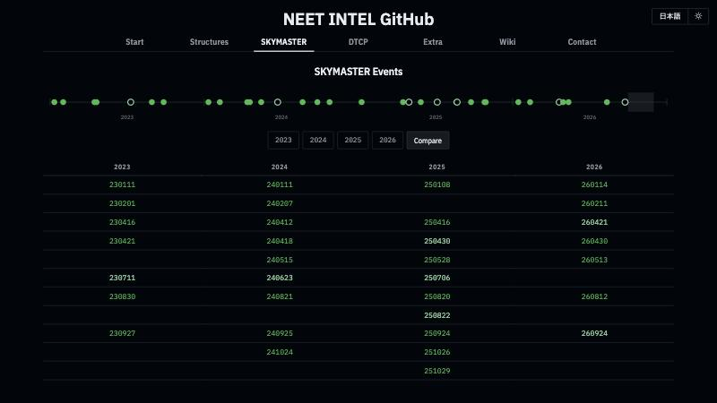
The SKYMASTER list
EXERCISES, 2023–2026
33 dated events: 26 SKYMASTER, 5 FAKEMASTER, 2 NOTHINGMASTER
18 of 26 SKYMASTERs on a Wednesday; 4 of 5 Global Thunder dates are not
January, April and August: a SKYMASTER every year
Compare: four years side by side, lined up by season
20 of 33 dates open that day’s DTCP timecard
NEET INTEL · neetintel.github.io
EVENTS
Notes:
This is the SKYMASTER tab on the index, in its Compare view. The tab lists 33 dated events from 2023 to 2026: 26 SKYMASTERs, five FAKEMASTERs and two NOTHINGMASTERs, or 7, 9, 10 and 7 by year. Each row in the year lists gives the date, the name I logged it under and the ordinal weekday, so 230830 reads “AUGUST SKYMASTER, 5th Wed”. The weekday is the first pattern you notice. 18 of the 26 SKYMASTERs fell on a Wednesday, where a random weekday would give about four. The named Global Thunder dates mostly break that rule: four of the five fell on a Thursday, Friday or Sunday, and only 251029 is a Wednesday. Leave them out and it’s 17 Wednesdays out of 21. The months repeat as well. January, April and August have a SKYMASTER in every year on the list. February, May and September have one in three years out of four, and October in two. On screen, the timeline across the top has filled dots for SKYMASTERs and hollow dots for FAKEMASTERs and NOTHINGMASTERs. Below it, the table puts the four years in columns and lines the dates up by season, 11 rows, so reading across a row you can watch the same window come round each year. The paler dates are the FAKEMASTER and NOTHINGMASTER ones, and hovering any date shows its name. 20 of the 33 dates are links. Click one and that day’s DTCP timecard opens in the gallery, so you can go from the list straight to the day’s transcribed messages and its recording. The other 13 dates have no card in the gallery.

Slide 70
Anatomy of a CARF NOTAM
AIRSPACE
CARF 04/240 · from the April 2026 replay
Colors mark fields, not message groups
!CARF 04/240
ZAK AIRSPACE
DCC KELLY THREE
STNR ALT RESERVATION
ID
facility
name
stationary altitude reservation
WI AN AREA DEFINED AS
80NM RADIUS OF 342500N1293000W
SFC-FL230
2604141400-2604142359
within
circle: 80 NM around 34°25′N 129°30′W
surface to FL230
260414 14:00 → 23:59 UTC
CARF 04/193 · last three fields
SFC-FL210
DLY 1515-1615
2604131515-2604161615
Apr 13
Apr 14
Apr 15
Apr 16
surface to FL210
only 15:15–16:15 UTC each day
260413 15:15 → 260416 16:15 UTC
drawn as four one-hour bars
Shape, altitude band and UTC window: all a map and a time slider need
NOTAM Mapper: paste FAA or ICAO NOTAM text, then + ADD
SHARE copies a link holding the raw text · KML exports the shapes
Source: April 2026 NOTAM replay · NOTAM Mapper
EVENTS
Notes:
Exercises leave traces outside the radio, and airspace is one of the clearest: the FAQ lists conspicuous airspace reservations among the hallmarks. On the site those come as CARF NOTAMs, and each is one line of text that carries everything a map needs. This is CARF 04/240 from the April 2026 set. After the ID comes the facility, ZAK, then the reservation’s name, DCC KELLY THREE, then what it is: a stationary altitude reservation. Then the shape, an 80-nautical-mile circle around 34°25′N 129°30′W, far out in the Pacific west of California. Then the altitude band, surface to FL230. Last is the validity window, written YYMMDDHHMM in UTC: April 14, 14:00 to 23:59 UTC. Some carry a daily window. CARF 04/193 runs from April 13 to April 16 but says DLY 1515-1615, so it’s only active from 15:15 to 16:15 UTC each day, and the site draws it as four one-hour bars. The NOTAM Mapper, a small tile on the Start tab, reads exactly this. You paste FAA or ICAO NOTAM text, press + ADD, and it draws the circles and areas with a time slider. It also takes the radius from an ICAO Q) line, looks up special-use airspace such as W-237J from the FAA’s published boundaries, and expands UK danger-area lists. Colors run from yellow for the shortest to red for the longest in whatever you’ve loaded. SHARE copies a link with the raw NOTAM text packed into it, so the site stores nothing, and KML exports the shapes for Google Earth.

Slide 71
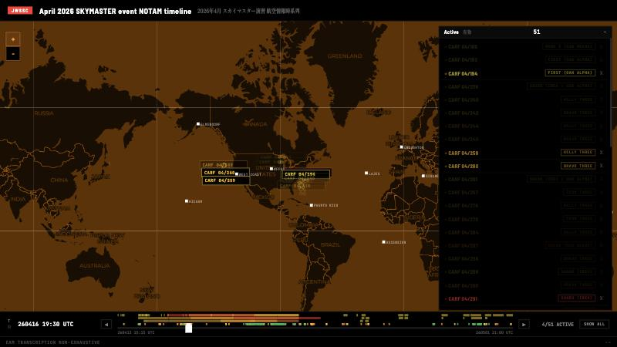
The April 2026 replay
AIRSPACE · APRIL 2026
51 CARF NOTAMs, 260413 15:15 UTC → 260501 21:00 UTC
28 Pacific (ZAK) · 21 New York Oceanic (ZWY) · 2 Upper Midwest (ZMP)
Bars = NOTAMs, yellow (shortest) to red (longest)
Dots under the bars = 415 EAMs, colored by group
Slider shows what was active at that moment: “4/51 ACTIVE”
Source: April 2026 NOTAM replay
EVENTS
Notes:
This page replays the airspace around the April 2026 SKYMASTER. It’s built on the same map and timeline as the Mapper, with 51 CARF NOTAMs built in, plus the EAMs from the same weeks. The window runs from April 13 at 15:15 UTC, when the first reservation opens, to May 1 at 21:00 UTC, when the last one closes. 28 are Pacific reservations filed under ZAK: the KELLY THREE circle, the BRAVO THREE box and the IRON THREE circle, reissued day after day. 21 are New York Oceanic areas with names like SHADO, FIRST, SCORE and PETE, whose text says New York Oceanic will not accept IFR flights inside them. Two sit over the Upper Midwest, one over Lake Superior named, literally, TRAILING WIRE, and RIB MOUNTAIN over Wisconsin, and those two only appear on April 29 and 30. How to read it: the map shows what’s active at the slider’s time and fades the rest, and the list on the right dims the same way. The counter reads like 4/51 ACTIVE. The white squares are HFGCS stations. Along the bottom, the bars are the NOTAMs, packed into three lanes and colored yellow to red by duration, and the dots under them are the EAMs, colored by group. The arrows step to the next start or end. On load the page steps through them once a second until you touch the slider or an arrow, and SHOW ALL lights everything. Click a shape and the popup gives center, radius, altitude, time and the raw text, which copies on click. KELLY THREE was reissued 12 times on one circle, so its popup has arrows of its own. The status bar says the EAM transcription is non-exhaustive.

Slide 72
Airspace and traffic, by day
AIRSPACE · APRIL 2026
Days (UTC) | NOTAMs active | EAMs (replay) | By E-6Bs (calendar) | List entry
Apr 13–18 | 3–8 a day | 56 | 0 | –
Apr 19–21 | 5–8 a day | 225 | 142 | Apr 21: APRIL NOTHINGMASTER
Apr 22–29 | 0–5 a day | 52 | 0 | –
Apr 30 | 5 | 77 | 64 | APRIL SKYMASTER
May 1 | 2 | 5 | 0 | –
NOTAMs active at any point in that UTC day · the calendar marks every day in this window as noncomprehensive monitoring
Data: April 2026 NOTAM replay · EAM calendar
EVENTS
Notes:
Side by side, day by day, the window falls into phases. The NOTAM column counts reservations active at some point each day, the EAM column is the dots on the replay’s timeline, and the E-6B column comes from the calendar, which marks each message broadcast by an E-6B. From April 13 to 18 reservations are active every day and the radio looks ordinary: 56 EAMs in six days, close to the calendar’s 2026 median of 10 a day, none marked as broadcast by an E-6B. Then April 19 to 21, Sunday to Tuesday, traffic jumps to 225 EAMs in three days, mostly Group 1 30-character messages, and the calendar marks 142 of its 223 for those days as broadcast by E-6Bs. April 21 is the day I logged as APRIL NOTHINGMASTER. After that it goes quieter again, 52 EAMs over eight days, while the Pacific blocks come back from April 24 to 27 and the Lake Superior reservation opens at 22:00 UTC on April 29. April 30 is the APRIL SKYMASTER: 77 EAMs, 64 of the calendar’s 76 marked as broadcast by E-6Bs, with RIB MOUNTAIN active from 14:15 to 16:45 UTC. So inside this window, every message the calendar marks as an E-6B broadcast falls on four days: April 19, 20, 21 and 30. Two cautions. The calendar marks these April days as noncomprehensive monitoring, so a quiet day can partly be a gap in listening, and the replay’s status bar says the same. And the totals differ slightly, 415 dots against 408 on the calendar: the replay also plots seven copies with a transcription mark that the calendar doesn’t count. One more link, from the E-6B page: April 13, when the first reservation opened, was one of the nine days with five E-6Bs up at once.

Slide 73
E-6B flights in 2026
E-6B FLIGHT HISTORY
Nine
13 hours in total · six at once only on Feb 12, for 87 minutes
978 sorties · 4,098 flight hours · median sortie 3h38m
days with five or more E-6Bs airborne at once, Jan 2 – Aug 31, 2026
Takeoff and landing for every sortie, from an Aviar Labs SkyGlass export
Each day opens its peak moment on ADS-B Exchange
Data: Aviar Labs SkyGlass export
EVENTS
Notes:
The FAQ calls the E-6B the airborne half of the system, so the site follows the aircraft too. This page answers one question that went around OSINT circles without a firm answer: on how many days in the first eight months of 2026 were five or more E-6Bs airborne at the same time? A live tracker can’t settle that, because it only shows what’s up while you’re looking. Answering it takes a takeoff and landing time for every sortie, and that came from Aviar Labs through their SkyGlass platform. The export cuts a flight at UTC midnight and wherever coverage drops, so its 1,269 rows are stretches of track. Gaps under 15 minutes are rejoined, 270 of them, since no E-6B lands and takes off again that fast, which leaves 978 sorties and 4,098 flight hours. With a start and end for each one, the page can count how many were up at any moment instead of sampling it. The answer is nine days, 13 hours in total. Six at once happened once, on February 12, for 87 minutes, the day after the February SKYMASTER. The page lists all nine with the peak time, how long five or more stayed up and the hex codes, and each date opens ADS-B Exchange at that moment with those aircraft loaded. Under that are the daily peak chart, sorties per day, the busiest days and the longest sorties. The longest, 14 hours 12 minutes, carries a note that it’s likely two aircraft sharing one code. One thing I noticed: if you rank the 237 days by hours flown, three of the five 2026 SKYMASTER days in this window, Feb 11, Apr 30 and Aug 12, land in the top eight. The cut at eight is mine, and I haven’t tested it.

Slide 74
E-6B transponder codes
E-6B FLIGHT HISTORY
Permanent block AE040D–AE041C · 97 sorties
AE
040D
040E
040F
0410
0411
0412
0413
0414
0415
0416
0417
0418
0419
041A
041B
041C
2
2
5
0
0
7
13
9
0
12
0
8
0
14
15
10
285 other codes · 881 sorties
121 start AE, 164 start AF · 66 used once · busiest AF3309, 10 sorties
97
881
978 sorties
16 permanent addresses, AE040D–AE041C: 97 sorties, 5 never used
881 of 978 sorties flew under one of 285 other codes
No code flew two sorties at once · 82 went quiet 60+ days, then returned
Data: Aviar Labs SkyGlass export, Jan 2 – Aug 31, 2026
EVENTS
Notes:
The most useful thing here is about identity. Trackers tell aircraft apart by the address each transponder broadcasts, written as six hex characters. The sixteen E-6Bs have permanent addresses, one block in a row from AE040D to AE041C, shown as the row of cells here. Lit cells flew under their own code, with the sortie count underneath; dark ones never did in this window. Those codes are rarely used. Only 97 of the 978 sorties flew under them, and five of the sixteen never appear at all. The other 881 sorties flew under one of 285 other codes, spread over the AE0000 to B00000 range on the page’s address map, 121 of them starting AE and 164 starting AF. 66 of those codes carried a single sortie, and the busiest, AF3309, carried ten. The FAQ had already noted E-6Bs turning up under false hex codes more often since late 2024; this puts a number on it for 2026. The page checks the pool two ways. No code was ever in the air on two sorties at once, across all 978, and no code turns up with more than one tail number. And 82 codes went unused for 60+ days, then flew again. In the pool that likely means the code was handed back and reissued. In the permanent block it means the aircraft was flying under pool codes in between. The lifelines chart draws it: the sixteen permanent codes pinned on top, five of them empty, and below them a cascade of pool codes in the order they first appeared. For half the pool codes, the first and last sortie in this window are about two weeks apart or less. For anyone watching live, a filter on AE040D to AE041C would have missed nine flights in ten here.

Slide 75
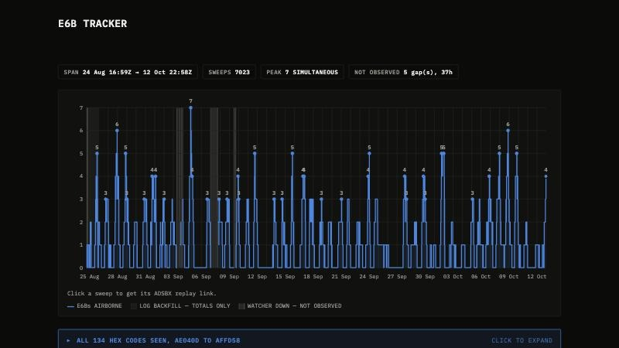
E6B tracker
PREVIEW · NOT YET ON THE SITE
Airborne E-6B count at every watcher sweep, about every 10 minutes
Aug 24 16:59 UTC → Oct 12 22:58 UTC · 7,023 sweeps · peak 7
Confirmed, suspected and out-of-coverage aircraft all count
5 gaps, 37 h not observed: shaded, not drawn as zero
134 hex codes seen · click a sweep for its ADS-B replay
Preview · data through 261012
EVENTS
Notes:
This one is a preview of a page that isn’t on the public site yet; the screenshot shows data through October 12. The flight-history page works from an export after the fact; this one is a live watcher. It polls about every ten minutes and plots how many E-6Bs were airborne at each sweep, from August 24 at 16:59 UTC to October 12 at 22:58 UTC, 7,023 sweeps in all. Two things matter when reading it. First, confirmed, suspected and out-of-coverage aircraft all count as airborne, and each point’s tooltip gives the breakdown. The peak of seven, on September 4 at 20:34 UTC, was two confirmed, four suspected and one out of coverage, so treat it as an upper bound. Second, the shaded bands are times the watcher was down, five gaps adding up to 37 hours. The sky wasn’t observed then, which is different from nothing flying, so the line breaks there instead of dropping to zero, and day totals that span a band are understated. The first day or so, up to August 25, was rebuilt from the running log, so it has totals without identities. The two pages overlap for one week, August 25 to 31, which makes a useful check. Their daily peaks agree on six of the seven days. On August 27 the export says four and the watcher says six, three confirmed and three out of coverage, which is the kind of difference the tooltip is there to show. The code pattern holds as well: 134 codes so far, and only 24 of 198 flights, as the watcher counts them, under an aircraft’s own permanent code. Clicking a sweep gives its ADS-B Exchange replay link.

Slide 76
Minuteman III test launches
ICBM TESTS · CORRELATION ONLY
Group 4 at ~3.6× baseline in D-1 to D-3 · 8 of 11 launches had some
Launch | Date | D-3 | D-2 | D-1 | Note
GT-245 | 230210 | 0 | 1 | 0 | –
GT-246 | 230419 | 2 | 9 | 6 | inside Global Thunder 23 · E-6B launch
GT-247 | 230906 | 0 | 0 | 1 | –
GT-248 | 231101 | 2 | 1 | 0 | anomaly, missile destroyed
GT-249 | 240604 | 0 | 0 | 0 | –
GT-250 | 240606 | 0 | 0 | 0 | –
GT-251 | 241106 | 0 | 1 | 0 | E-6B launch
GT-252 | 250219 | 1 | 0 | 0 | –
GT-253 | 250521 | 0 | 1 | 0 | unverified outside report
GT-254 | 251105 | 0 | 2 | 0 | E-6B launch
GT-255? | 260304 | 0 | 0 | 0 | scheduled when written · none by D-0
Counts: Group 4 long messages per day · Baseline: 807 non-launch days · 0.29 a day · Group 4 on 22% of days
Source: Minuteman III ICBM Test Launches & HFGCS EAM Activity
EVENTS
Notes:
Vandenberg runs unarmed Minuteman III test launches on publicly announced schedules, and this page asks whether the HFGCS does anything different in the days before one. It looks at Group 4, whose messages are almost all long: 99.2% run past the standard 30 characters. Each launch gets a card: a six-day window from D-5 to launch day, a stacked bar per day colored by group, the lengths of the long messages under each day, and a coverage strip showing which monitoring sets and recordings exist for each day. The pink columns are D-3 to D-1. The headline is that Group 4 runs at about 3.6 times its baseline in that window, and 8 of the 11 launches on the page had Group 4 long messages in it. The baseline is the line under the table: over 807 non-launch days, Group 4 appears on 22% of days, at 0.29 long messages a day. Read the table with the page’s own caveats. GT-246 carries most of the weight, 17 of the 27 Group 4 long messages across all eleven windows, and its pre-launch window sat entirely inside Global Thunder 23, so the exercise may be the cause. GT-253’s only datum is an outside report the page marks unverified, and GT-255 was still scheduled when the page was written. Coverage varies a lot from card to card. The page also notes that three of these launches were sent from the Airborne Launch Control System on an E-6B. The page says plainly that this is correlation only, not a confirmed causal relationship. It was written ahead of the March 2026 launch, so that a run of long EAMs that week wouldn’t be read as news-driven. Its last update, March 3, 2026, says no long EAMs had been seen before that launch.

Slide 77
8888 messages
QUAD 8S · OCTOPUS MESSAGES
header
day
time UTC
paired letters
trailer
221122 16:50 · HF
FINNEGAN
8
8
8
8
0
0
2
2
1
6
5
0
A
A
E
E
G
G
K
K
N
N
X
X
Z
Z
8
8
8
8
240517 19:39 · VLF
E-4 ADFEB4
8
8
8
8
0
0
1
7
1
9
3
9
A
A
E
E
G
G
K
K
N
N
X
X
Z
Z
8
8
8
8
251026 09:03 · HF
TEST KIT, disregarded
8
8
8
8
0
0
2
6
0
9
0
1
A
A
E
E
G
G
K
K
N
N
X
X
Z
Z
8
8
8
8
Three catalog rows, character by character · colors mark fields, not message groups
Standard EAMs never use 0, 1, 8 or 9
39 catalog rows, 1999 → 2026: 27 HF, 12 VLF
HF since 2018: 16 of 20 disregarded on air · VLF: none
VLF: broadcast by E-4s ADFEB3/4/6 and E-6s incl. AE0412, AE0414, AE040E
Source: 8888 Messages catalog · HFGCS FAQ
EVENTS
Notes:
Standard EAMs never use the characters 0, 1, 8 or 9. 8888 messages, also called Quad 8s or octopus messages, are the exception, and they’re probably not standard EAMs at all. They open with 888800 and close on 8888. In the complete modern copies, what’s between follows one pattern: a two-digit day that matches the date, a four-digit time at or near the time of transmission, and a block of paired letters, most often AAEEGGKKNNXXZZ. Here are three real ones from the catalog. The top one I recorded myself on November 22, 2022, read by FINNEGAN at 16:50 UTC: day 22, time 1650. The middle one is one of three VLF broadcasts on May 17, 2024 from the E-4 ADFEB4, each stamped with the time it was heard. The bottom one, TEST KIT on October 26, 2025, was disregarded on air, a few hours before the 251026 SKYMASTER. The catalog page has 39 rows, from a 1999 log to March 15, 2026, 27 on HF and 12 on VLF, each with its source, and a timeline above with HF and VLF in separate lanes. In 2023 I could find only 11 documented. On HF, 16 of the 20 since 2018 were followed by a disregard. None of the VLF ones were, and those are tied to specific aircraft: E-4s ADFEB3, ADFEB4 and ADFEB6, and E-6s including AE0412, AE0414 and AE040E, three codes from the permanent block on the earlier slide. The FAQ has two leads: a secondhand report that 8888-format messages once appeared as test traffic on an ICBM satellite test system, and a 2+5 launch-authorization structure from a Titan II museum tour that maps onto the inner fields. None of it confirms they’re ICBM-related. Both point toward test or control traffic somewhere in nuclear command and control.

Slide 78
Reference, method and close
PART 9
The reference shelf, four method checks, the site’s open questions and where to start
NEET INTEL · neetintel.github.io
CLOSE
Notes:
This last part starts with the reference shelf: the FAQ, the two station pages and the wiki archive. Then come four slides on method and limits, each worked through with an example from published data: what counts as a copy, coverage before absence, tests against chance, and correlation only. After that, the open questions the site states itself, and finally seven places on the site to start from, with the links for following the project.

Slide 79
Reference shelf
EXTRA · REFERENCES AND RESOURCES · WIKI
Extra tab: the FAQ, two station pages and the NOTAM Mapper. The Wiki tab comes next.
HFGCS FAQ
YOKOTA
PUERTO RICO
WIKI
36 questions
~14 / ~22 km
JNR
27 pages
72 references · first person · one-time pads: “probably wrong”
Tokorozawa transmits, Owada receives; map distances from the base
ALE callsign: last 3 letters of TJNR, Naval Station Roosevelt Roads
Pages from the December 2025 pilot wiki, as archive.org saved them
Sources: FAQ · Yokota and Puerto Rico station pages · index ?wiki
CLOSE
Notes:
The Extra tab has a second list, References and resources, with four pages: the FAQ, the two station pages and the NOTAM Mapper tool. The Wiki tab sits right after Extra. The FAQ is where the site explains itself in plain language: 36 questions and 72 references, written in my own voice. It covers the basics, like what the HFGCS is and why sources say 13 stations or 14, and then works through claims that get repeated online without much checking. The biggest is the claim that EAMs use one-time pads. The FAQ argues that’s probably wrong, partly on the character statistics I’ll get to in a few minutes. Each answer has its own link, like hfgcs_faq.html#faq-otp, so you can send someone straight to one answer. The two station pages draw on public contract, procurement and property records, plus maps. Yokota, like most stations, transmits and receives from separate sites, so the high-power transmitters don’t desensitize the receivers. Its map puts Tokorozawa, the transmit site, about 14 km from the base, and Owada, the receive site, about 22 km. Puerto Rico has no base of its own. Its ALE callsign, JNR, is the last three letters of TJNR, the ICAO code of Naval Station Roosevelt Roads, which the Navy closed in 2004. The page shows the other stations follow the same rule: RJTY gives JTY at Yokota. Its two sites are 97 km apart on opposite coasts, and the station is run remotely from Andrews and Grand Forks. A full HFGCS wiki is too much for one person, so in December 2025 I started a pilot to show what one could look like. The Wiki tab links 27 of its pages as archive.org saved them: 10 informational pages, 16 day pages and one list page.

Slide 80
One message, five airings
METHOD · WHAT COUNTS
YLRJLP…
Group 1 · 30 characters
5 airings · span 1.97 h · 4 E-6B
WED JUL 5, 2023
THU JUL 6
22:42
23:10
23:40
00:10
00:40
first airing
E-6B
E-6B
E-6B
E-6B
00:00 UTC
Left out of counts: partial captures, disregarded reads, uncopied characters
Calendar counts airings: 3 on Jul 5, 2 on Jul 6
Structure work keeps one copy of each message: here, the 22:42 UTC airing
Data: rebroadcast_timeline.html · messages_calendar_2022_2026.html
CLOSE
Notes:
Everything on the site starts as a transcript. Operators read each message aloud, character by character, and the project wrote them down from its own recordings and from listening on online receivers. A copy only counts if it’s clean. Partial captures, disregarded reads, and any message with a character that couldn’t be copied are all left out of the counts. For anything over 30 characters the length is read on air, which gives a check on the copy. The second rule is about rebroadcasts. The rebroadcast timeline says about one in three EAMs is rebroadcast. Here’s one real example from it: a Group 1 message starting YLRJLP, first aired at 22:42 UTC on Wednesday, July 5, 2023, with no E-6B flag, then four more times on E-6B-flagged airings at 23:10, 23:40, 00:10 and 00:40 UTC. That half-hour spacing fits the E-6B relay schedule in the FAQ, and :10 and :40 are the minutes its table gives to the Atlantic. Which count is right depends on the question. The calendar counts airings, so this one message adds three to July 5 and two to July 6, which is the right number for how busy the air was. The structure pages and papers count each distinct message once, at its first airing, because five copies of one string would make any pattern in it look five times as strong. This one is a 30-character Group 1 message, so it belongs to the 30-character paper, where that rule takes 10,899 airings down to 5,881 unique messages. Across the whole rebroadcast timeline, 2,725 messages were aired more than once, 9,134 airings in all, and 94.3% of those messages are finished within two hours.

Slide 81
Coverage before absence
METHOD · COVERAGE
14
789 comprehensive (solid): a DTCP/DCRP recording or a certified zero
305 noncomprehensive (dashed): traffic logged, no recording
certified zero days out of 1,719,
Jan 25, 2022 – Oct 9, 2026
625 no monitoring (blank): nothing logged, no recording
Receivers: mostly North America and Europe; Pacific coverage is limited
Data: EAM calendar (built 261009) · livestream gallery · Yokota page
CLOSE
Notes:
Start with the calendar. From January 25, 2022, the first day with data, to October 9, 2026, when it was built, it covers 1,719 days, in the three tiers of its legend. 789 days are comprehensive monitoring, drawn solid: there’s a DTCP or DCRP recording for the day, or the day is certified silent. 305 are noncomprehensive, drawn dashed: something was logged but there’s no recording, so treat the count as a floor. 625 are no monitoring, left blank: nothing logged and no recording, so a blank day says nothing about traffic. 14 days are certified zeros, where the tooltip reads Total Messages: 0. They cluster. Seven are Sundays and six fall on Thanksgiving or December 24 to 26, with two days in both, and three in a row at Christmas 2023. That fits the FAQ: very quiet days tend to land on federal holidays. The livestream gallery uses the same rule. A reviewed day has a flat strip and an unreviewed day is hatched, because a gap there is, in the page’s words, an absence of notes rather than of traffic. Of 809 days on tape, 474 are reviewed. Four years of monitoring relied mostly on online radios in North America and Europe, and the Yokota page says Pacific coverage is limited. Stations usually simulcast on all four frequencies but not always, so not hearing a message on 8992 doesn’t mean it wasn’t sent there. The FAQ also says the UTwente receiver many people default to misses a lot of North American traffic, especially E-6B broadcasts. So before I read a quiet stretch as a finding, I check which days and which receivers it rests on. The vintages differ too: the calendar runs to October 9, the timecards to October 13, and the livestream gallery to September 8.

Slide 82
Tests against chance
METHOD · CIPHERTEXT ONLY
Test | Result
Null model | Every base-32 character equally likely: 3.125% each
M in Group 1 | 1.929%, z = −22.8 · same-size random draw: z = −1.15
Last six all different | Chance 61% · Group 1 97%
Pair/run bar | 0.05 ÷ 538,498 tests ≈ 1 in 11 million
Pair, 4 of 4 at 3% | 1 in 1.2 million → pale, a near miss
Pair, 5 of 5 at 3% | 1 in 41 million → colored
Source: eam_30char_format_analysis.html · about_structure_heatmaps.html
CLOSE
Notes:
The structure work uses the ciphertext and nothing else. Nothing gets decrypted and no cipher is named. The method: write down what pure chance would look like, then measure the gap. For 30-character messages, the null model is that every base-32 character is equally likely, 3.125% each, which is what good encryption output would look like. In Group 1 message bodies, M shows up 1.929% of the time, a z-score of about minus 22.8. As a check, the paper pushes a same-size draw from a cryptographic random generator through the same pipeline, and there M sits at minus 1.15. Second, the last six characters. Six random base-32 characters are all different about 61% of the time; that’s the birthday problem. Group 1 is at 97%. These are Group 1 results; Group 2 shows only a weak M and 5 shortage. The heatmaps run so many tests that some pairs will match by luck, so they use a Bonferroni correction. With 538,498 tests of pairs and runs, a pair or run needs a chance probability under 0.05 divided by 538,498, about 1 in 11 million, to be colored solid. That keeps the chance of even one lucky pair or run on any heatmap page at 5% or less. Runs of four or more and repeats inside a message have their own rules. The cost lands on small groups. If two positions match by chance 3% of the time, four matches in four messages is about 1 in 1.2 million, which falls short, so it shows pale as a near miss. Five in five is about 1 in 41 million, and gets colored. Null results get published too. In the 34-character paper the strongest pair reaches z = 3.54 against a threshold of 3.92, and the paper says no pair crosses it.

Slide 83
Correlation only
METHOD · TIMING
Page headline: Group 4 at ~3.6× baseline in D-1 to D-3; seen before 8 of 11 launches
Launch | D-1 to D-3 | What it shows
GT-246 · Apr 19, 2023 | 17 Group 4 long EAMs | Overlaps GLOBAL THUNDER 23; logs only
GT-249 · Jun 4, 2024 | No Group 4 | Comprehensive coverage: the absence counts
GT-253 · May 21, 2025 | Not monitored | One outside report, unverified
GT-255? · Mar 4, 2026 | No long EAMs | Forecast on the page beforehand
“Correlation only—not a confirmed causal relationship.”
Source: minuteman_icbm_x_hfgcs_eams.html (last updated March 3, 2026)
CLOSE
Notes:
Timing is where people most want a story, so here’s the Minuteman III page. Unarmed test launches from Vandenberg are announced ahead of time, which makes them a fair thing to test against. The page’s headline: across 11 launches with monitoring data, Group 4 shows up at about 3.6 times its baseline rate in the one to three days before launch, and 8 of the 11 had Group 4 long messages in that window. The baseline is Group 4 appearing on 22% of 807 ordinary days. Each launch gets its own card with a coverage strip under the chart, and the cards are where the limits show. GT-246, in April 2023, has the strongest signal, 17 Group 4 long messages in three days. But its whole lead-up overlaps GLOBAL THUNDER 23, which ran April 11 to 18, and the page calls that a possible confounding factor. The card also says no recordings are published for that week, only the logs. GT-249, in June 2024, had comprehensive coverage and no Group 4 in the days before launch, so that absence counts. GT-253, in May 2025, fell in a gap: the project wasn’t monitoring, and the only report is from an outside log that still needs checking. For GT-255, scheduled for March 4, 2026, the page wrote a forecast beforehand, expecting Group 4 long EAMs from about March 1. Its card then reports no long EAMs in the days before. The page states the result as correlation only, not a confirmed causal relationship, and adds that the same prefix groups may also carry significant traffic that has nothing to do with test launches. The FAQ draws a related line. Random news events don’t line up with EAM volume, but specific, scheduled military activity sometimes might, at rates you can measure.

Slide 84
Open questions
STATED ON THE SITE
Does Yokota take part in SKYMASTER exercises?
Do the four groups match the four official message classes?
Why do M and 5 run short?
How are the 35 unparsed long Group 4 messages built?
Which stations keep which frequencies, and when?
Sources: hfgcs_station_yokota.html · hfgcs_faq.html · g4_structure.html
CLOSE
Notes:
These are questions the site leaves open in its own words, not ones I’m adding here. The Yokota page notes that SKYMASTER exercises have had European and NATO elements but none confirmed in Japan. It suggests that could be a gap in observation, since the monitoring leaned on North American and European receivers. Japanese online radios exist, so it could be checked. The FAQ points out that the FY27 budget documents name four message classes: EAMs, Force Direction Messages, Force Management Messages and Higher Authority Command Messages. Whether the four groups line up with those four classes can’t be confirmed, but the FAQ calls it a genuine possibility. In Group 1, the M and 5 shortfall shows up in every prefix with 100 or more messages and on both sides of the October 2024 change, and I have no good explanation for it in terms of any standard encryption scheme. The Group 4 page parses 175 of its 257 long messages cleanly and lists 35 that its rules don’t reach. Most of those still open the same way, but within a length there’s too little to go on. And the FAQ says stations have historically kept per-frequency schedules and very likely still do, but I haven’t seen the current schedule documented publicly, and the monitoring hasn’t worked it out. A few more are in the papers. The 30-character paper lists next steps, like a scan across all 150 bits and the same change-point test on other lengths and groups. The 42-character paper asks for a larger sample, ideally 50 or more messages per length. The 46-character paper leaves one pair unresolved until more messages come in. And the FAQ notes that nobody seems to have tried lining traffic up with the ANCS and GFNCS station split.

Slide 85
Where to start
ADDRESSES START AT NEETINTEL.GITHUB.IO
1
The index · tabs, EN / 日本語, light / dark
5
EAM calendar · 2023
/
/messages_calendar_2022_2026.html?2023
2
The 142-character heatmap
6
April 2026 NOTAM replay
/test/structure_heatmap_142char.html
/notams_skymaster_260400.html
3
SKYMASTER · Compare
7
FAQ · the four groups
/?compare
/hfgcs_faq.html#faq-groups
4
DTCP gallery · SKYMASTER days
/dtcp_gallery.html?skyx
More: neetintel.substack.com · youtube.com/@neetintel · the Contact tab
NEET INTEL · neetintel.github.io
CLOSE
Notes:
Seven places on the site to start from, each with an address you can type after neetintel.github.io. The index is the front door: seven tabs, the language switch and the light and dark theme. The 142-character heatmap is the clearest single example of the structure work, 40 Group 4 messages with runs every 22 positions; clicking a colored character keeps the rows that share it and fades the rest. ?compare opens the SKYMASTER timeline and lines the years up by season. In the DTCP gallery, the address ?skyx searches for the SKYMASTER days that have a timecard and collapses the weeks in between; type anywhere on the page to search for anything else, and open a day and press c to compare it with its closest days. The calendar at ?2023 shows a full year with the coverage tiers; the legend toggles mark SKYMASTER and FAKEMASTER days, and the length filters narrow it to any message length. The April 2026 NOTAM replay steps through the airspace reservations around that SKYMASTER, with the EAMs heard in the same window along the bottom. And the FAQ’s answer on the four groups is the plain-language version of most of this deck. For more, the longer write-ups are on the Substack at neetintel.substack.com, and the videos, along with hundreds of hours of recordings, are on YouTube at @neetintel. The Contact tab on the index has the ways to get in touch. The FAQ says the project is effectively shutting down in 2026, but the archives, recordings and write-ups all stay up.

