Slide 1
EventEase: A Containerised CI/CD Pipeline for a Web Booking Application
SWE40006 Software Deployment & Evolution — Project Presentation & Demonstration
Group CL02_Fri12:30_G06 · Tutor: Jan Han · Friday 12:30–2:30
Raza Syed (104041595) · Neeven Emmanuel (105229389) · Thinidu Madurapperuma (104675729)

Slide 3
Overview
The problem — manual, per-environment deployment is slow and error-prone
Our solution — a fully automated “build once, deploy many” CI/CD pipeline
The application — EventEase, a community event booking web app
Design decisions and the trade-offs behind our toolchain
Technical challenges we hit — and how we solved them
Live deployment demonstration: push → staging → production

Slide 4
Project Background and Problem Statement
EventEase lets community groups and student societies post events and let attendees register online.
The real problem is delivery, not the app: moving a code change to a live server by hand is slow, manual and inconsistent.
Rebuilding separately for each environment causes “works on my machine” failures in production.
Goal: take a change from a developer’s laptop to live production automatically, with no manual build.
Strategy — build once, deploy many: one Docker image per commit, tagged by Git SHA, promoted staging → production unchanged.

Slide 5
Project Scope and Objectives
G1 — Provision four reproducible environments: Development, CI/Build, Test/Staging, Production
G2 — Zero-touch CI/CD: fully automated from git push to Production, no manual steps
G3 — Run unit, integration and E2E tests automatically; failures block promotion
G4 — Instrument Production with Prometheus + Grafana monitoring
G5 — Deliver a working EventEase app with a verified production database
Target: the top level — full push-to-deploy automation with monitoring and rollback

Slide 6
Project Outcome/Deliverables
Live EventEase app on AWS EC2 — separate staging and production servers, behind Nginx
Automated GitHub Actions pipeline: test → build & push to GHCR → deploy staging → deploy production
Same SHA-tagged image promoted across environments; a footer version banner proves what is deployed
Automated E2E and smoke tests gate production; failed health check triggers automatic rollback
Production monitoring: Prometheus + Grafana + Node Exporter; Discord deploy notifications

Slide 7
Design Concepts & Trade-offs
Build once, deploy many — one image per commit removes environment drift (the core design choice)
Containerise everything (Docker + Compose) — identical stack locally, in CI, on staging and production
GitHub Actions over Jenkins — no build server to maintain; native integration with GHCR
AWS EC2 over local VMs — public, always-on, a realistic staging/production split
GHCR over Docker Hub — same GitHub account, private, free for the project
pytest + Playwright — fast unit/integration plus real-browser end-to-end tests
Trade-off: free-tier t3.micro limits — we kept each environment lean and single-node

Slide 8
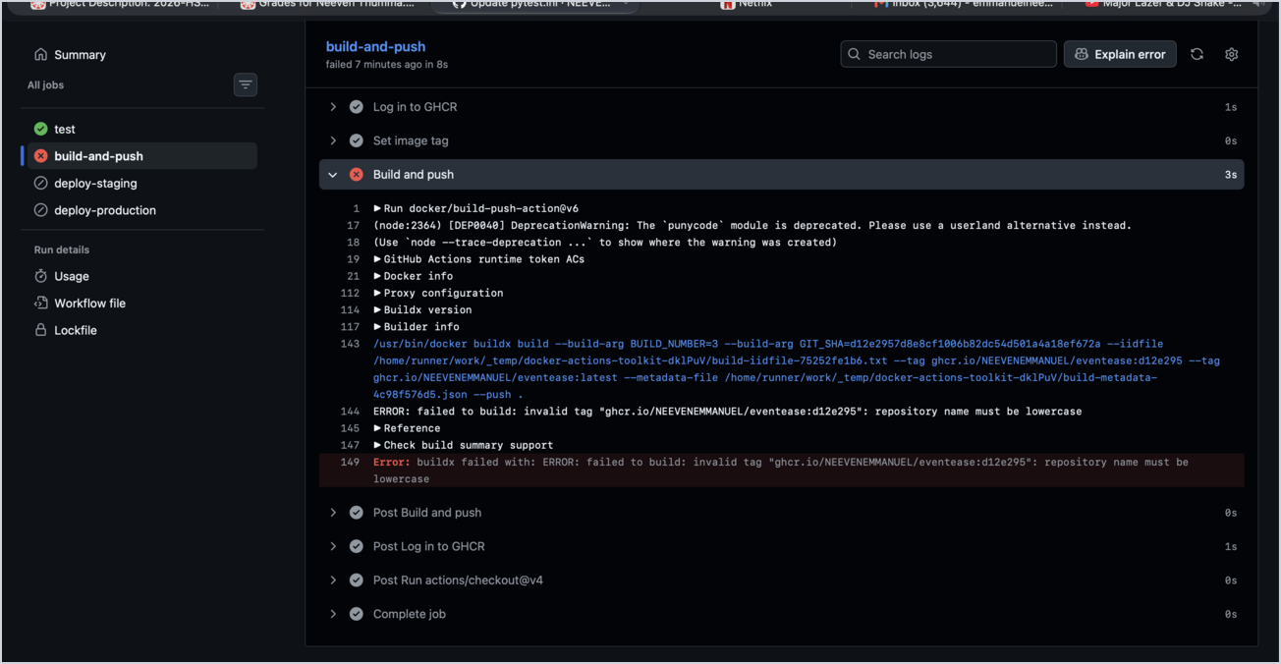
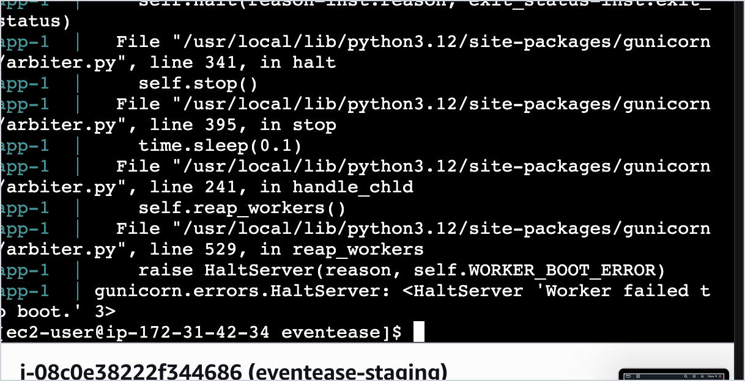
Execution & Technical Challenges
Each stage surfaced a real failure — debugging them was the heart of the project:
CI import failure — tests passed locally but failed in CI (module not found). Fix: set the test pythonpath in pytest config.
GHCR rejected the image — “repository name must be lowercase”. Fix: forced a lowercase image name in the workflow.
Production 502 — three Gunicorn workers raced to create DB tables (duplicate-key crash). Fix: moved table creation to a one-off init step before workers start.
SSH blocked from our shell — used the EC2 Instance Connect browser terminal to set up both servers.
Secrets & tokens — found the GHCR token under account Developer settings and wired six GitHub Secrets.
GHCR rejected the push: “repository name must be lowercase”
Production 502: Gunicorn workers crash on boot (DB table race)

Slide 9
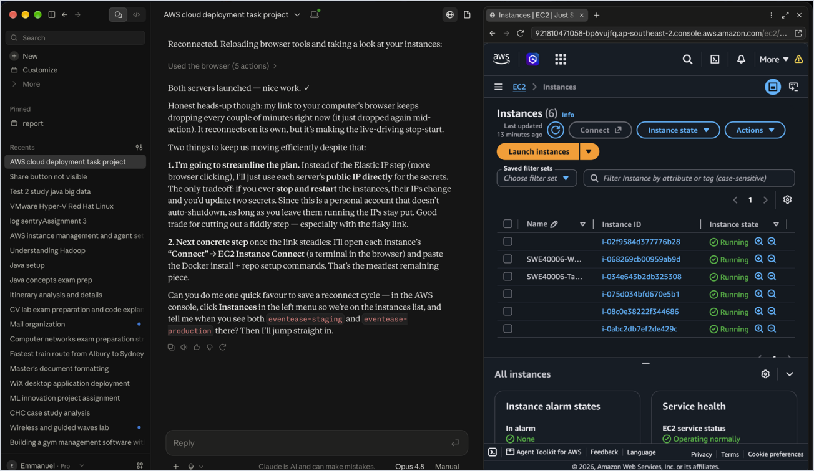
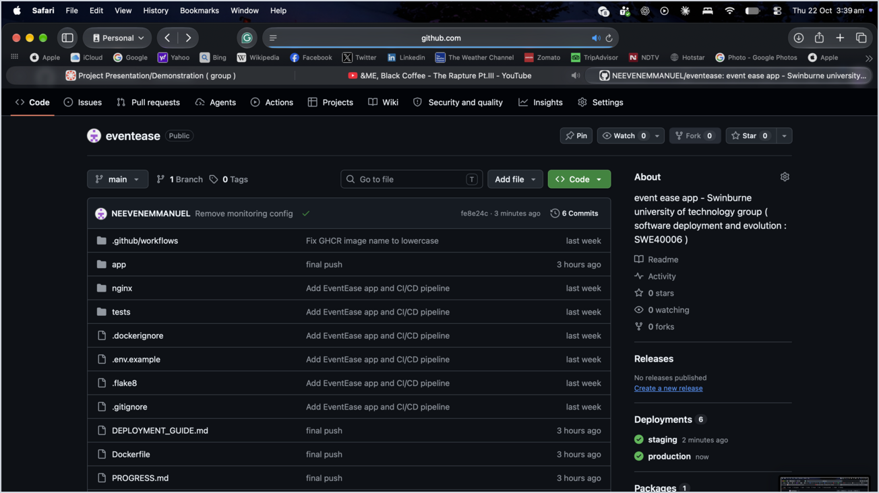
Deployment Demonstration — Infrastructure & Pipeline
Four environments provisioned on AWS; every push to main flows through the pipeline automatically.
AWS EC2 — staging & production instances running (Sydney region)
GitHub Actions — automated staging & production deployments

Slide 10
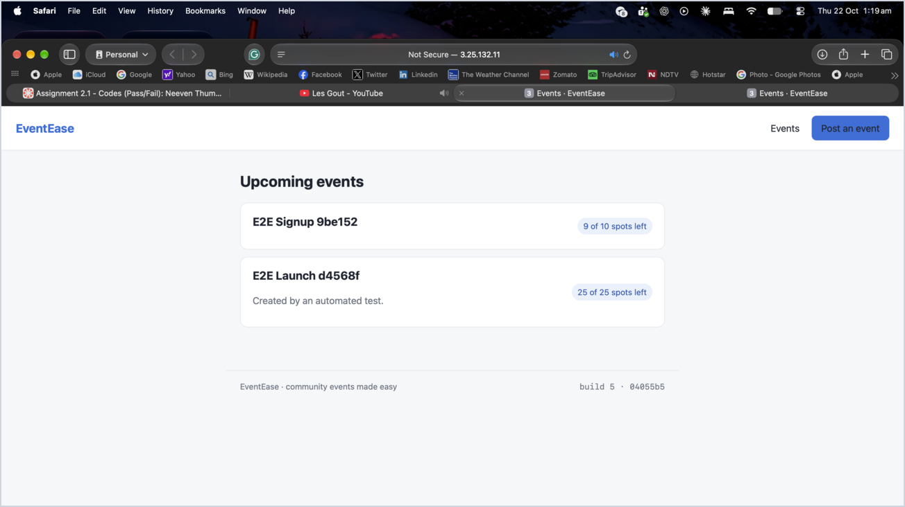
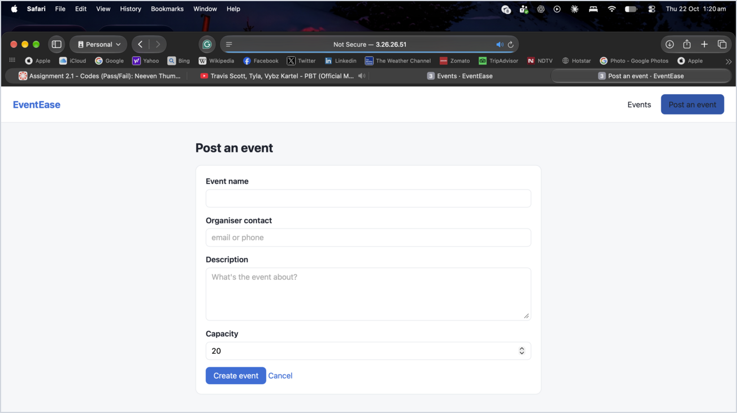
Deployment Demonstration — Live Application
The verified image runs live behind Nginx — confirmed by automated end-to-end tests creating real events.
Live site — upcoming events created automatically by E2E tests
Live site — Create Event form (working production app)

Slide 11
Thank you

