Slide 1
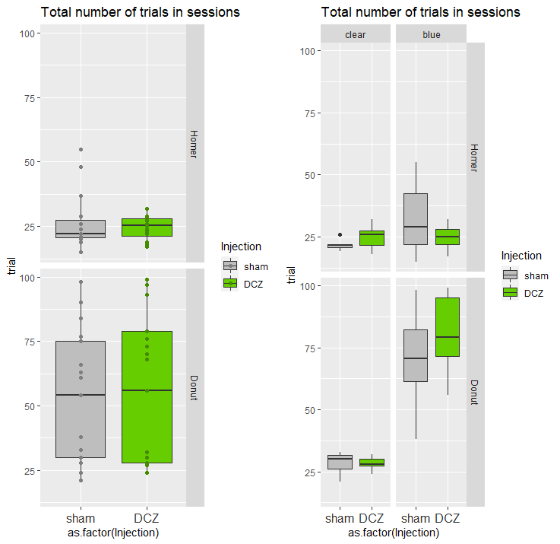
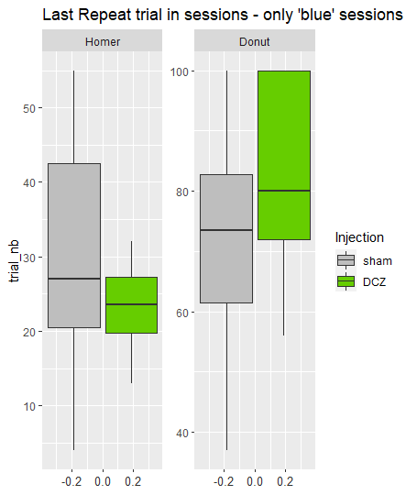

Slide 2
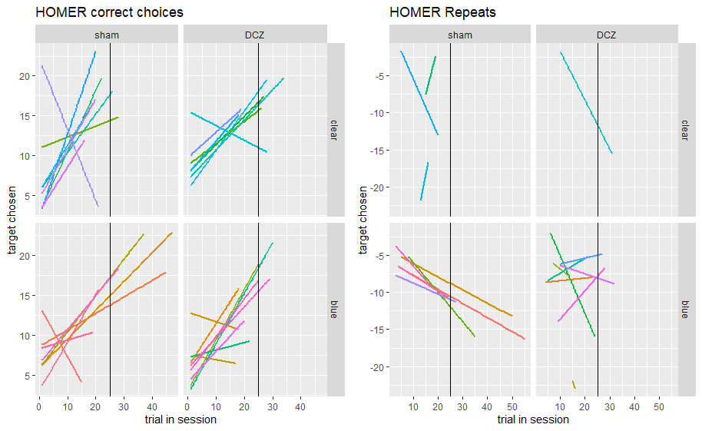

Slide 3
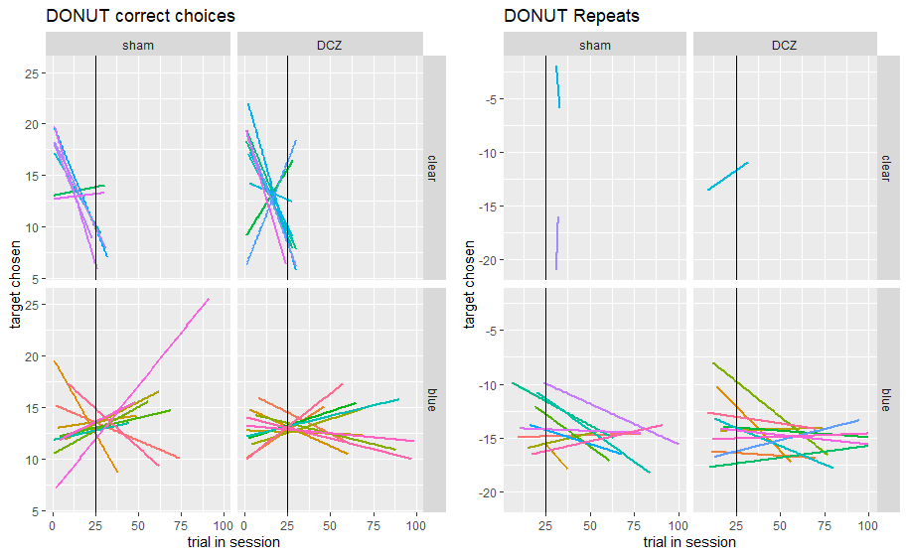

Slide 4
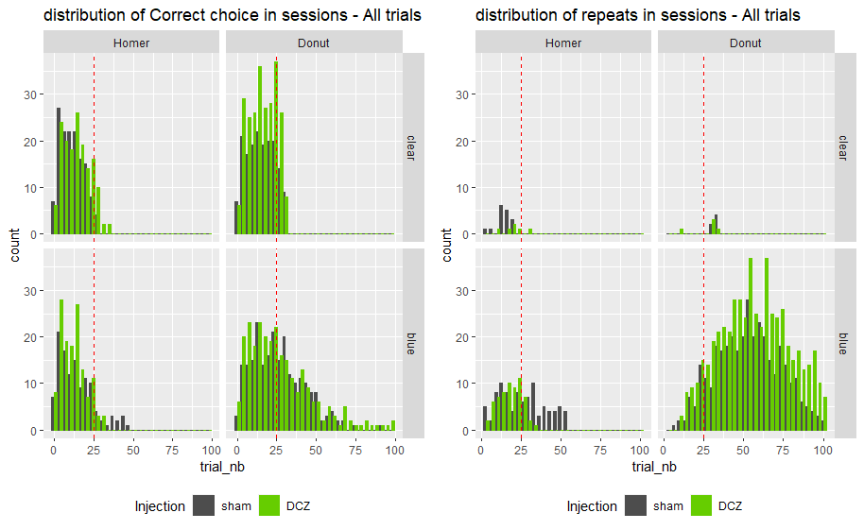

Slide 5
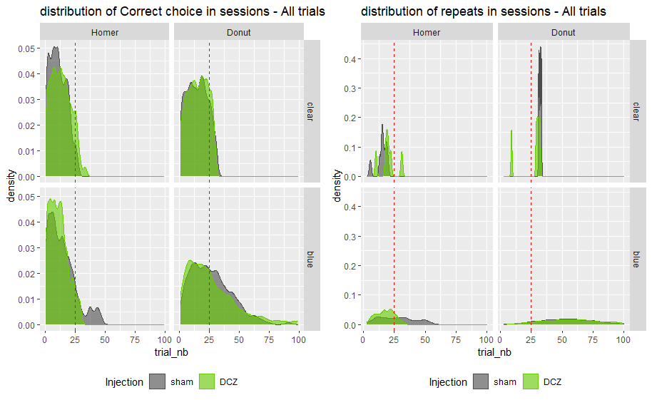

Slide 6
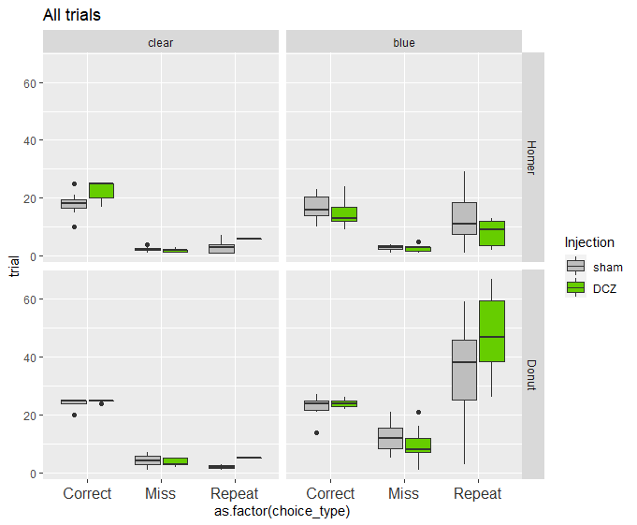
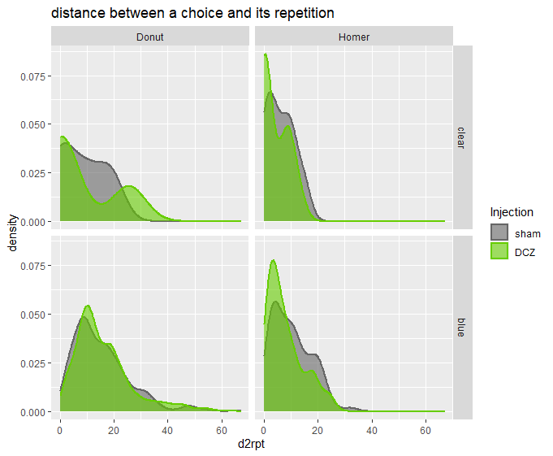
0.9661
0.0597 .
P=0.0755 .
p<0.001
(mult. Compar. Poisson glm)

Slide 7
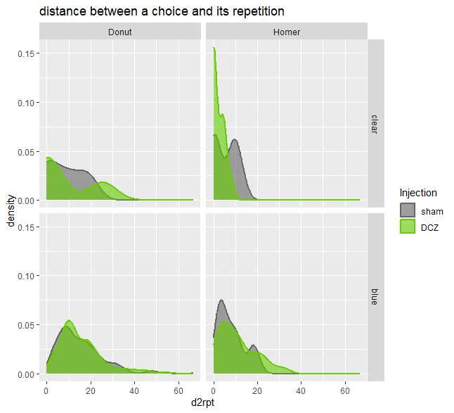
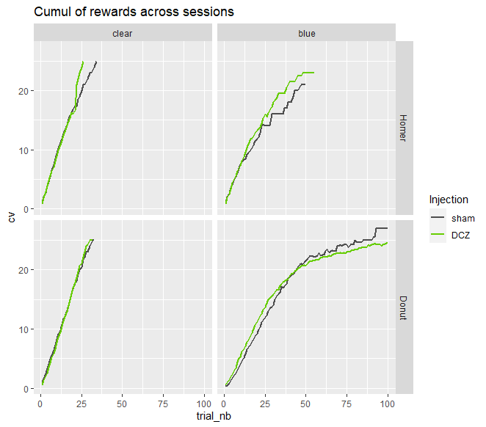
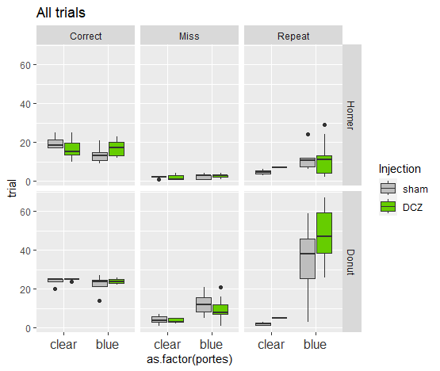
0.9661
0.059 .
HOMER/blue
Exact two-sample Kolmogorov-Smirnov test
D = 0.29128, p-value = 0.01547
alternative hypothesis: two-sided
Donut/blue
Asymptotic two-sample Kolmogorov-Smirnov test
D = 0.21, p-value = 0.02431
alternative hypothesis: two-sided
ns
P=0.015
P=0.075 .
p<0.001
ns
P=0.024
ns
**

Slide 8
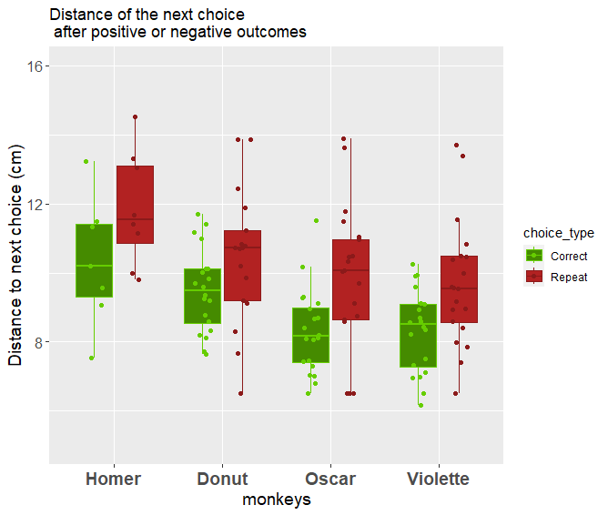
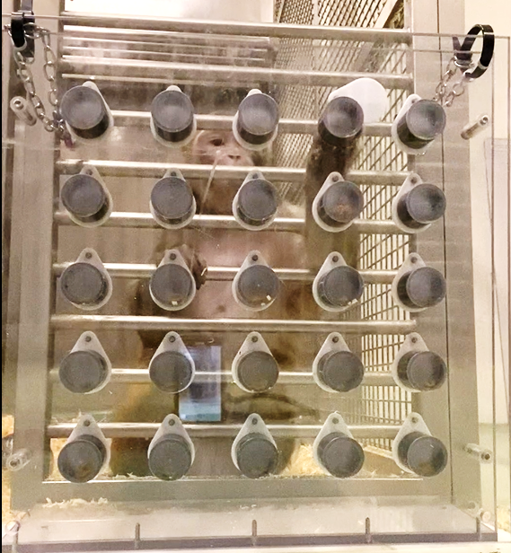
Post-error (negative outcome) adaptation
P=0.17
P=0.011
p=0.013
p=0.008
R
Opaque doors only

Slide 9
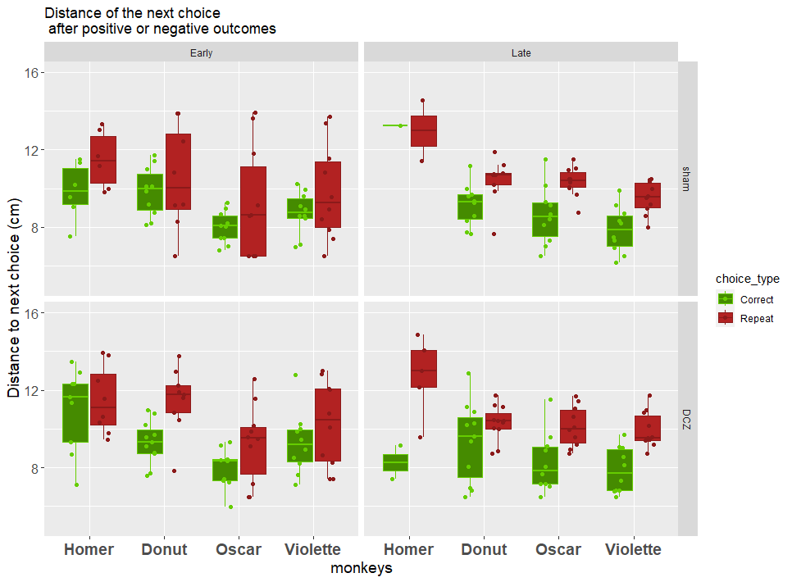

Slide 10
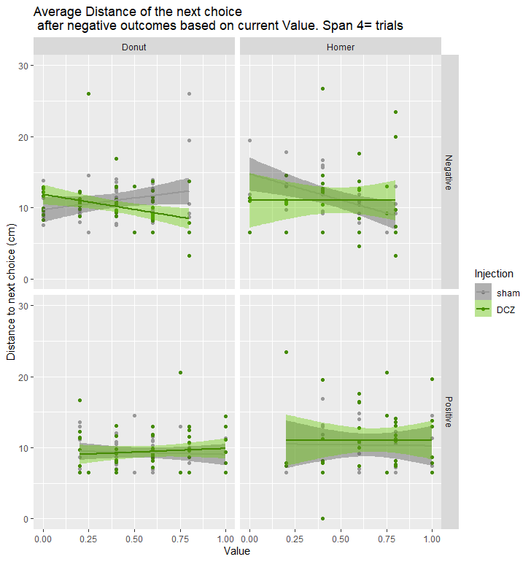
Value:InjectionDCZ -7.5246 2.3665 -3.180 0.00195 **
Value:InjectionDCZ 10.885 5.675 1.918 0.0600 .
Open no take
v
Rwd falls
Looks away
NS
NS
v

