Slide 1
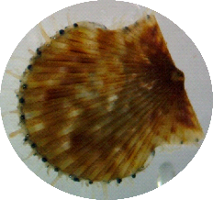
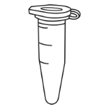

dissectors
bleeders
half of Gill
half of Gill
Adductor
400 ul hemolymph in labeled tube
(replace needle and syring between animals)
90
DONE
90
Empty screw-cap tube
“GILL”
Immediately snap freeze in LN2
90
DONE
Empty screw-cap tube
“ADDUCTOR”
Immediately snap freeze in LN2
Microcentrifuge tube pre-filled with RNA later
“RNA later”
90
DONE
tubes on ice..
200 ul hemolymph
90
100 ul hemolymph
90
100 ul hemolymph
Mito. mem. Potential
JC-10 + CCCP
Mito Superoxides
MitoSOX Green
Cell viability
SYBR + PI
90
100 ul hemol + 100 ul FSW
90
100 ul hemol + 100 ul FSW
Add JC-10 to 15uM
Add JC-10 to 15uM +
CCCP to 10 uM
Cell viability
SYBR + PI
Incubate 37C for 30 minutes
Pipette to FC tube & measure
Pipette to FC tube & measure
Pipette to FC tube & measure
180(90 done)
90
90

Slide 2
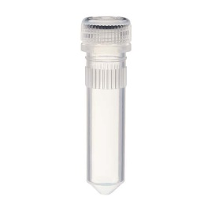
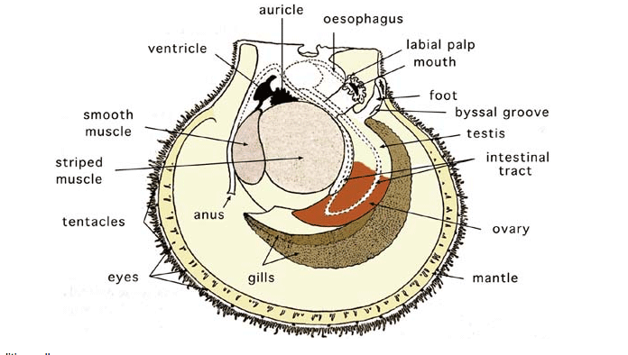
DISSECTION TEAM Overview
Between each individual!
scalpel and forceps
X3 samples per individual
50% bleach
70% ethanol
DI
Gill
ready!
Adductor
half of Gill
half of Gill
open shell slightly to fit the scalpel
(may require rupturing the adductor from the hinge) cut all tissue from one shell
Pre-filled microcentrifuge tube with RNA later
“RNA later”
Empty screw-cap tube
“GILL”
Immediately snap freeze in LN2
Empty screw-cap tube
“ADDUCTOR”
Immediately snap freeze in LN2
open scallop
benchtop is fine
snap freeze in LN2

Slide 3
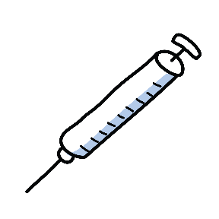
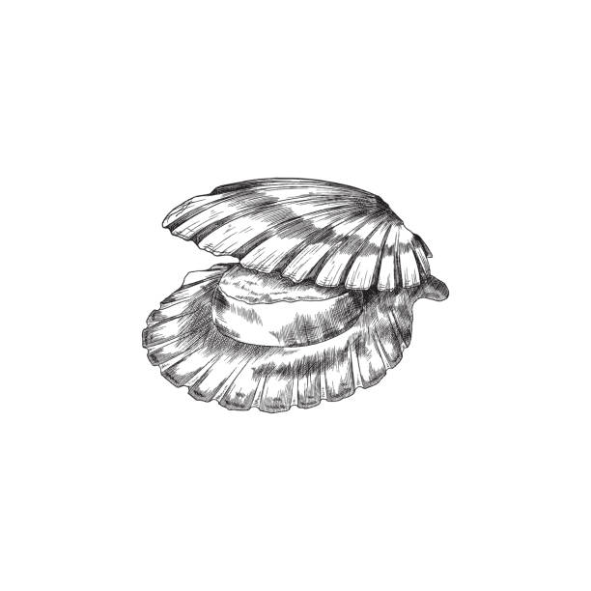

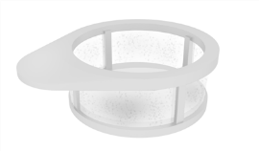
BLEED TEAM Overview
Between each individual!
New 3 mL luer lock pipette & needle
400 ul per individual
ready!
needles disposed in sharps container!
Hold open scallop to see the adductor muscle
(idea: insert disposable 1mL pipette when clapping)
Insert needle into the adductor and take at least 400 ul hemolymph
Hand the scallop to the dissection team!
Remove needle, dispose in sharps
Dispense through strainer into labeled tube
Place tube on ice
Place tube on ice
(cooler at your station)

Slide 4

Flow cytometry: MitoSox Green Overview
Make 3 uM working solution of MitoSox green!
100 ul filtered sea water per individual
Dissolve all stock MSG (9 ug) in 10 uL DMF
(stable for 24 hours, use fume hood!)
+
Add 30 ul of MSG to 10 mL HBSS
(this is our 3 uM working solution)
100 ul hemolymph per individual
Hemolymph on ice
Add 100 ul of 3 uM MSG working solution
(target 1 uM MSG)
NOTE! The volume of hemolymph will dictate how much 3 uM MSG working solution we add.
For example, if we have only 50 ul hemolymph…
add 50 ul FSW and add 33.33 uL 3uM MSG for 1uM!
Incubate for 30 minutes at room temperature
Measure on flow cytometer

Slide 5
Flow cytometry: JC-10 & JC-10 + CCCP Overview
Make 200 uM working solution of JC-10!
NOTE: this targets 15 uM JC-10 in a 200 uL sample
100 ul filtered sea water per individual
JC-10 stock is 3428uM,
To make sufficient 200 uM working solution
for 45 samples.. (actually 90 including the control!)
Add 81.69 ul JC-10 stock with 1,318.3 uL HBSS
+
100 ul hemolymph per individual
NOTE! The volume of hemolymph will dictate how much 200 uM JC-10 working solution we add.
For example, if we have only 50 ul hemolymph…
add 50 ul FSW and add 7.5 uL 200 uM JC-10 for 15 uM
Hemolymph on ice
Add 15 ul of 200 uM JC-10
working solution
(target 15 uM JC-10)
Make 1 mM working solution of CCCP!
NOTE: this targets 10 uM CCCP in a 200 uL sample
Our CCCP is 100 mg of 98% in solid form, molecular weigh is 204.62 g/mole
Incubate for 30 minutes at room temperature
Control!
Add 2 uL of 1 mM CCCP
(target 10 uM
CCCP)
Dissolve all CCCP in 48.8 mL HBSS in a labeled bottle, this is 1 mM CCCP working solution
NOTE! if we have only 50 ul hemolymph…
add 50 ul FSW and add 1 uL 1 mM CCCP for 10 uM
Measure on flow cytometer

Slide 6
Flow cytometry: SYBR Green + Propidium iodide Overview
300 ul filtered sea water per individual
+
100 ul hemolymph per individual
Hemolymph on ice
Add 4 ul of x10000 SYBR Green I
working solution
+
4 ul of 1.5 mM (1 mg/ml) PI
(target 15 uM PI)
Incubate for 30 minutes at room temperature
Measure on flow cytometer

