Slide 1
Geospatial Scallop Area Management System, GeoSAMS Review
Meeting Date: August 21, 2024

Slide 2
GeoSAMS
We begin with the survey data. At present we have both Dredge Survey Data and HabCam Survey Data
Dredge Data provides more accurate scallop size information
HabCam provides more survey points over a larger search area

Slide 3
GeoSAMS
Survey Data Processing

Slide 4
GeoSAMS
PreProcessing: Extract Initial State Information
Two M-file scripts exist to handle either Dredge or HabCam Data
TrawlData5mmbin.m
HabCamData5mmbin.m
Either will extract data into a common data file usable by GeoSAMS

Slide 5
GeoSAMS
PreProcessing: Extract Recruit Information
Three M-file scripts are used sequentially to extract recruit information from both Dredge and HabCam Data
PullOutRecruitData.m
ProcessRecruitData.m
NearestNeighborRecInterp.m
Results in a set of recruit estimates by year

Slide 6
GeoSAMS
Simulation

Slide 7
GeoSAMS
Simulation
GridManager
Reads in initial state data extracted during preprocessing
ScallopRecruit
Reads in recruit data, randomly assigns year data to annual input
ScalloGrowth
Set up growth equations for updating state matrix
Scallop Mortality
Computes fishing mortality and outputs data at time steps

Slide 8
GeoSAMS
Outputs
ABUN: abundance
abundance(loc) = sum(state(loc,:)) * grid_area_sqm
BMMT: biomass
bms(loc) = dot_product(state(loc,:), weight_grams(loc,:) / grams_per_metric_ton)
EBMS: exploitable biomass
ebms_mt(loc) = expl_biomass_gpsqm(loc) * grid_area_sqm / grams_per_metric_ton
FEFF: Fishing Effort
total_catch = sum(landings_wgt_grams)
tmp = sum( expl_biomass_gpsqm(loc)^2 / expl_scallops_psqm(loc))
fishing_effort(loc) = (expl_biomass_gpsqm(loc) * total_catch / expl_scallops_psqm(loc) ) / (tmp * grid_area_sqm)

Slide 9
GeoSAMS
Outputs (continued)
LAND: Landings by number of scallops
landings_by_num(loc) = sum(landings_at_size(:))
LNDW: Landings by weight in grams
landings_wgt_grams(loc) = dot_product(landings_at_size(:), weight_grams(loc,:))
LPUE: Landing Per Unit Effort, (per day)
lpue(loc) = Calc_LPUE(expl_biomass_gpsqm (loc), expl_scallops_psqm (loc))
RECR: Recruitment
Instantiated at startup for each of the years that the simulation will run through

Slide 10
UK Interpolation

Slide 11
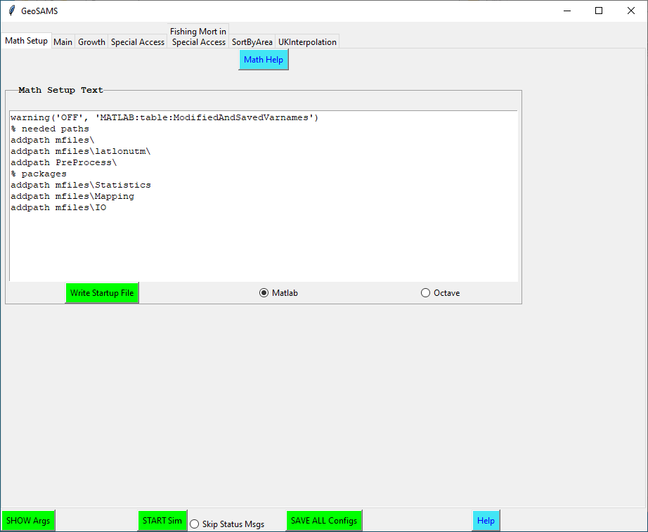
GeoSAMS – GUI: Math Tool Selection

Slide 12
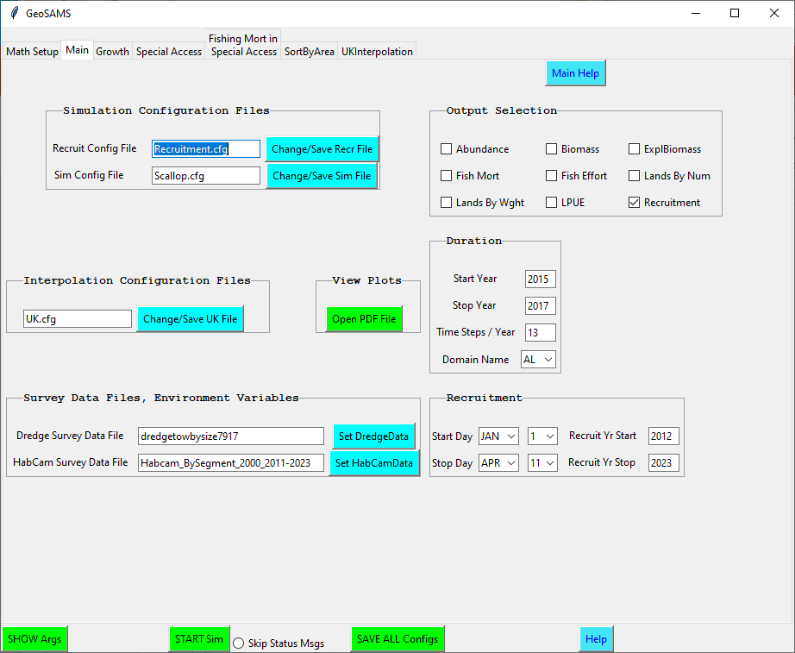
GeoSAMS – GUI: Main Tab

Slide 13
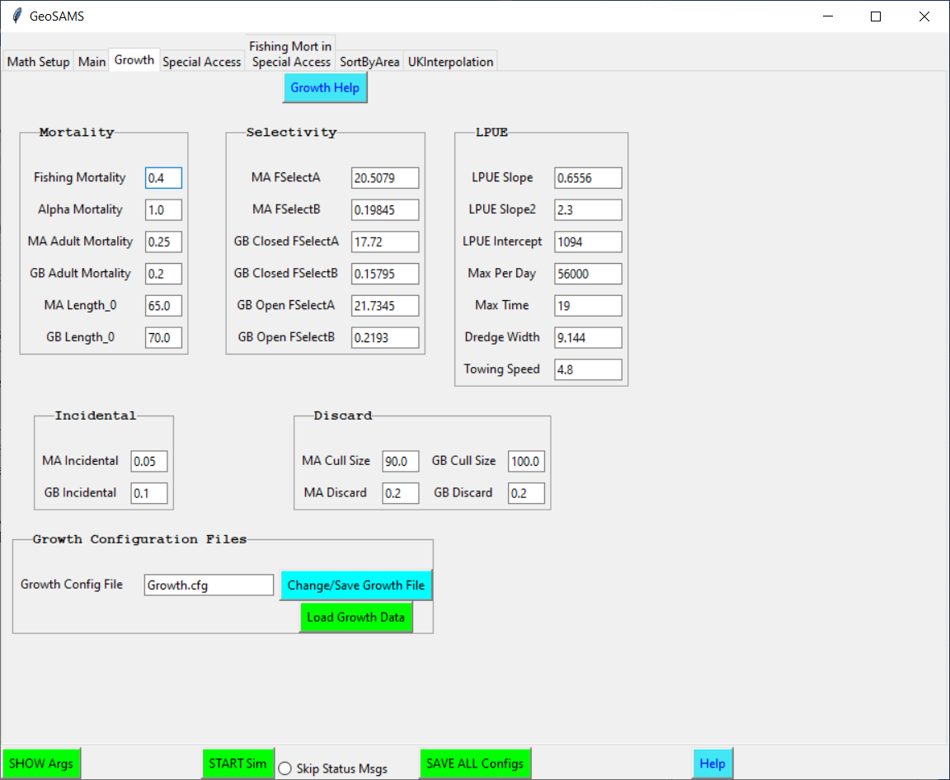
GeoSAMS – GUI: Growth Tab

Slide 14
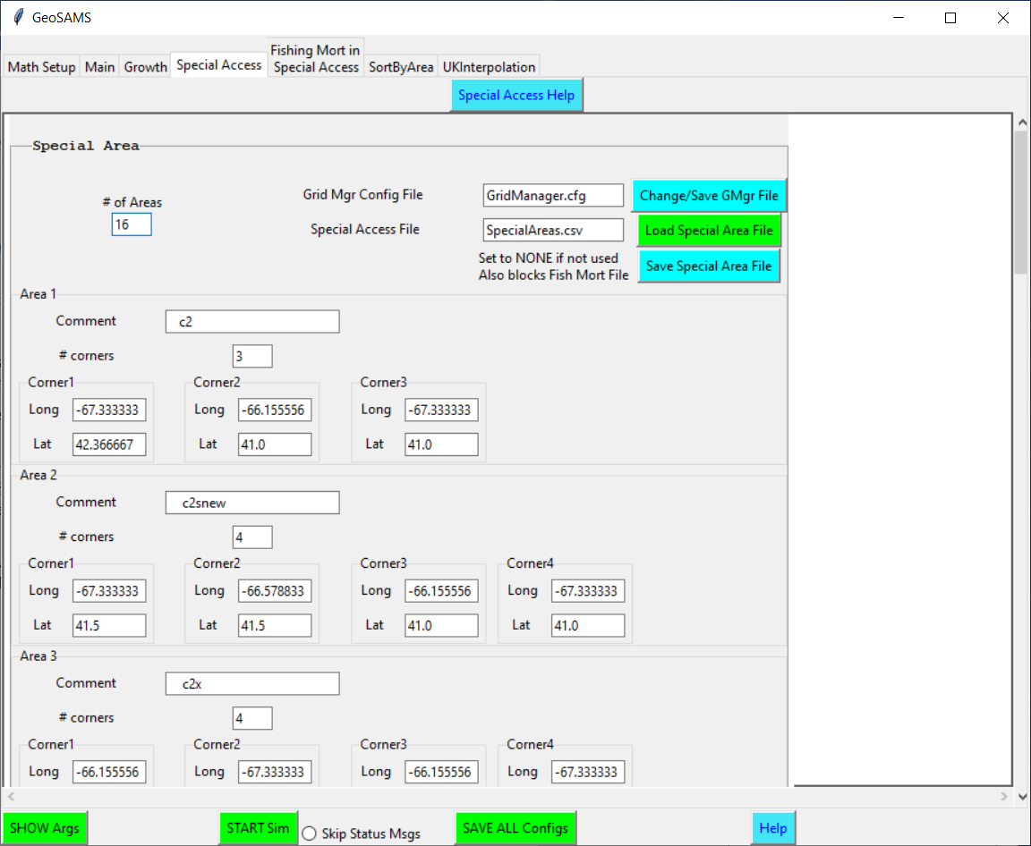
GeoSAMS – GUI: Special Access Tab

Slide 15
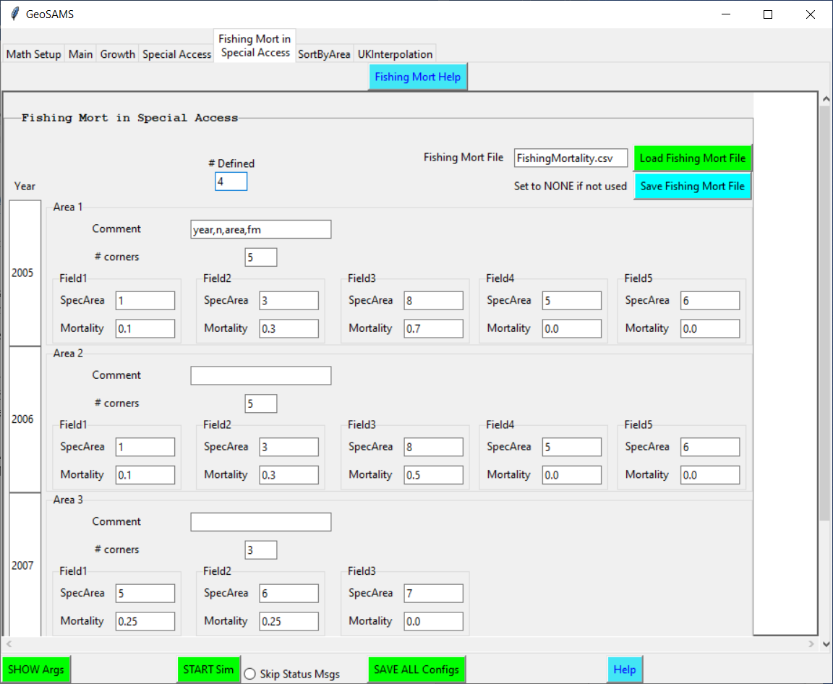
GeoSAMS – GUI: Fishing Mort in Special Access Tab

Slide 16
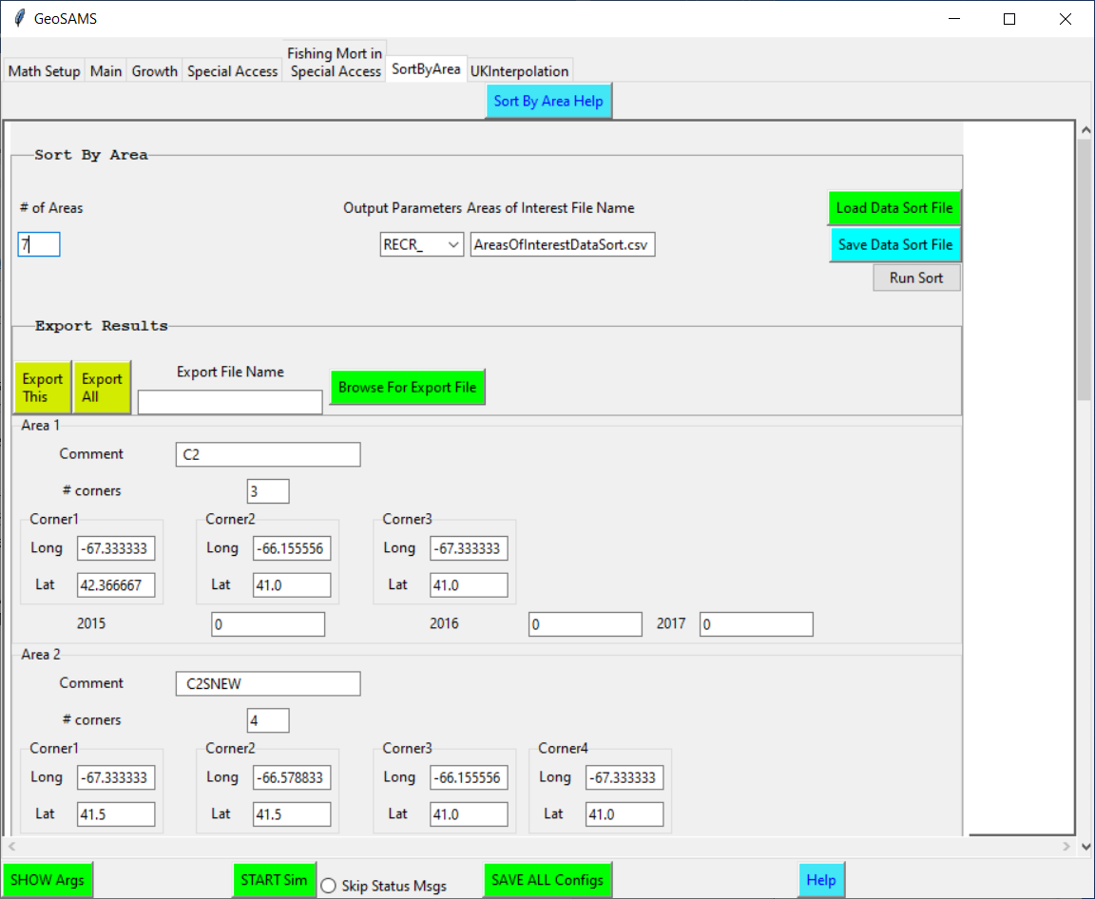
GeoSAMS – GUI: Sort By Area Tab

Slide 17
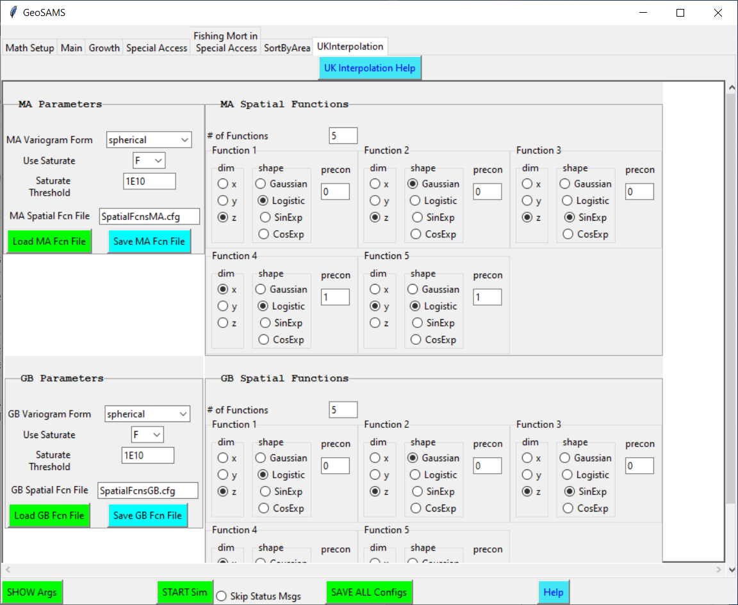
GeoSAMS – GUI: UK Interpolation Tab

Slide 18
GeoSAMS – GUI: Start Sim
Saves all of the configuration files.
Checks to see if the data CSV files have been created. If not it will run the Update.bat/.sh script. This script performs the following:
Unzip Dredge Data
Builds GeoSams and UK executables
Runs the TrawlData5mmbin, HabCamData5mmbin m-file script
Runs the PullOutRecruitData m-file script
Runs the ProcessRecruitData m-file script
Runs the NearestNeighborRecInterp m-file script

Slide 19
GeoSAMS – GUI: Start Sim (continued)
Starts the GeoSAMS growth simulation
Starts the UKInterpolation that takes the GeoSAMS output position on survey locations and interpolates them to regional locations
Plots the results and saves the plots as PDF files in <GeoRoot>\Result

Slide 20
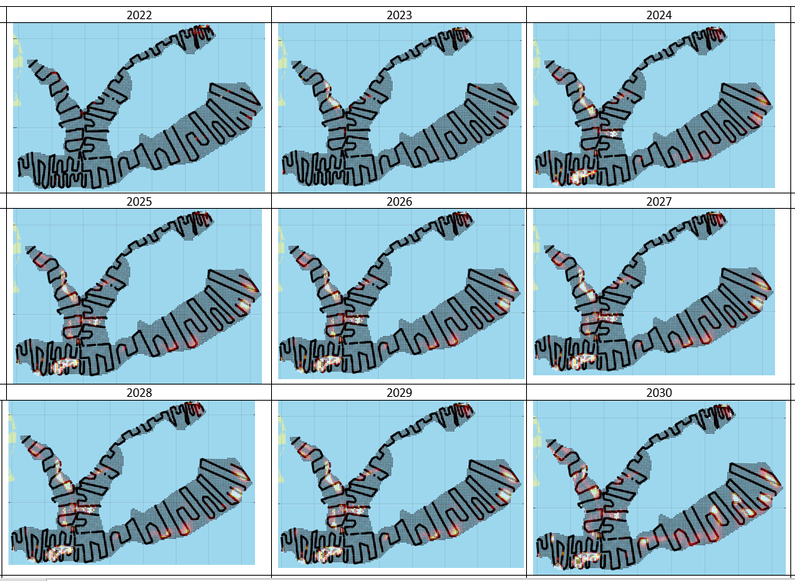
GeoSAMS – Sample Plots: Abundance

Slide 21
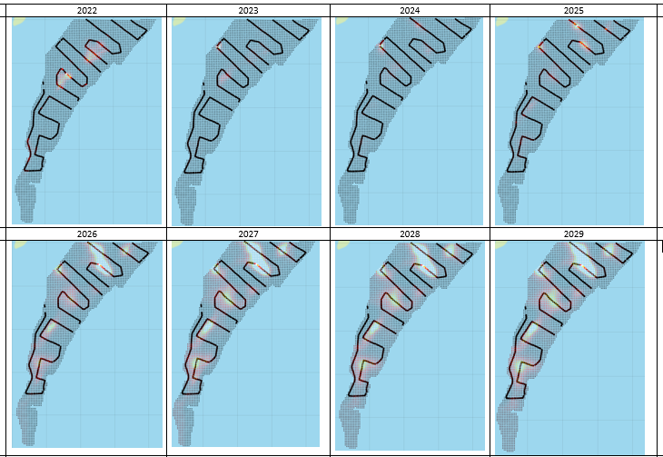
GeoSAMS – Sample Plots: Exploitable Biomass

