Slide 2
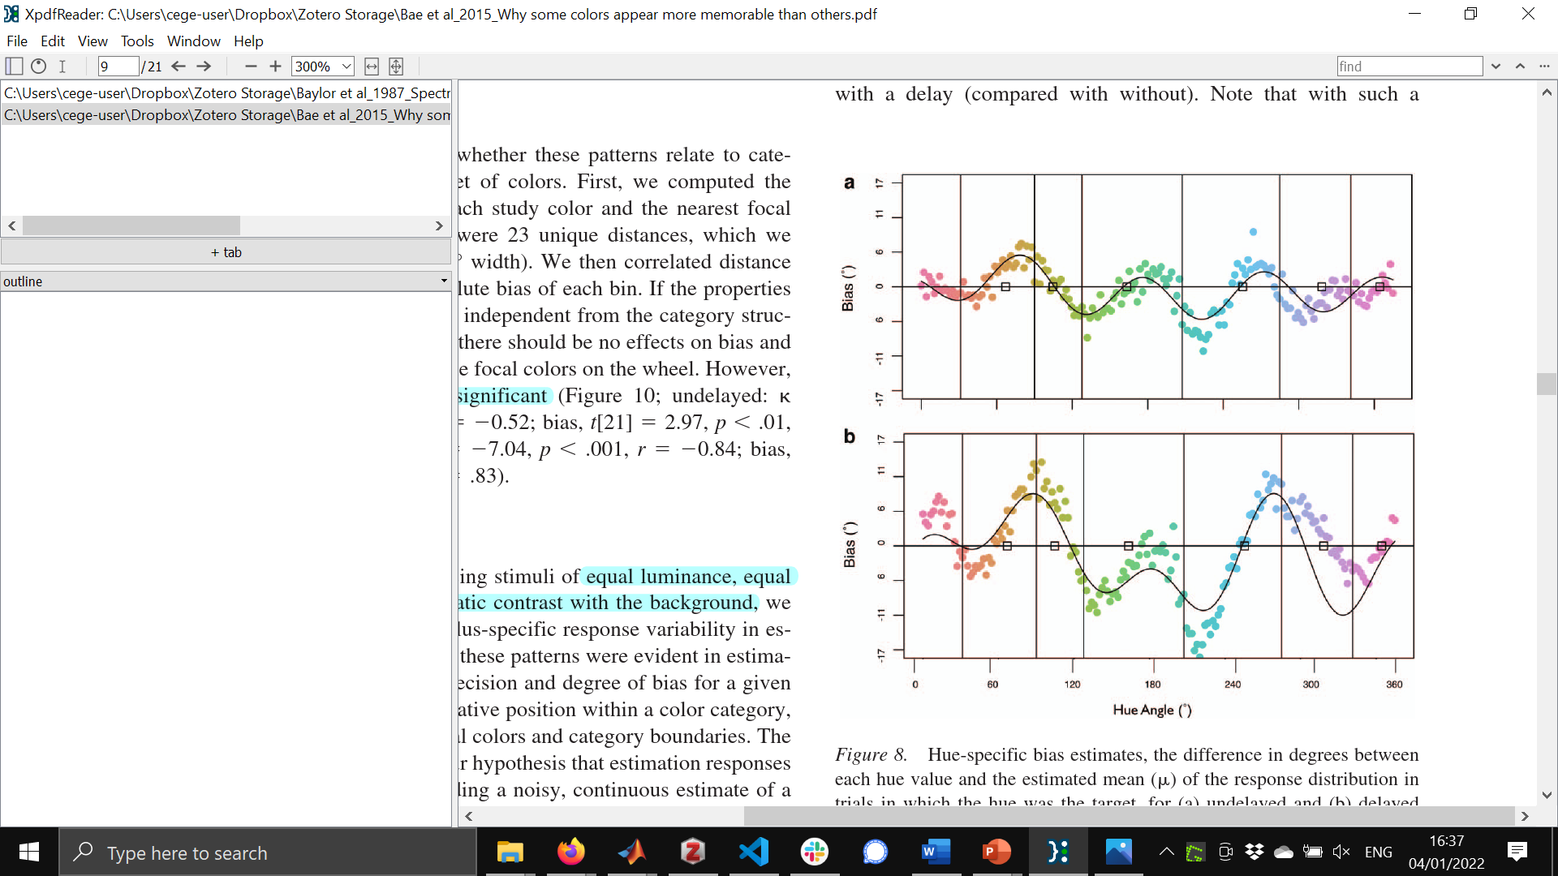
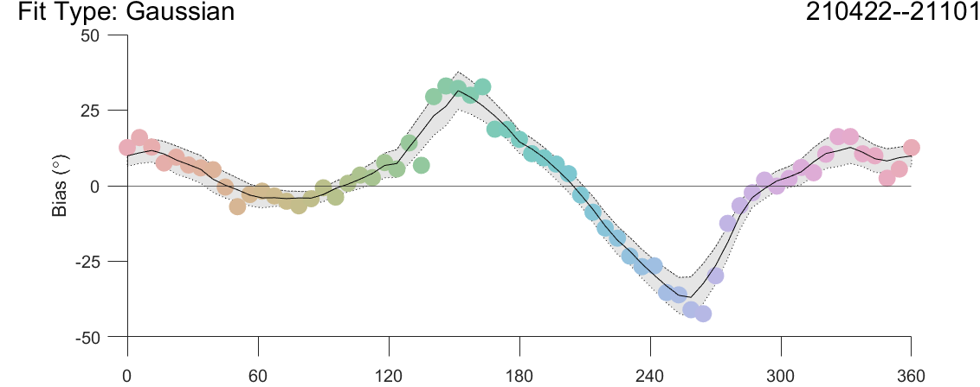
Bae et al. (2015)
M1
Notes:
Bae+ figure is vertically flipped to allow better comparison with our method of plotting (their method of plotting is bad)
Thus, for both graphs, attractor points are zero crossings from positive to negative (and repellor points are zero crossings from negative to positive)
96122 trials
Points are independently fit gaussians
Black line is smoothed
Gray area is smoothed confidence intervals of each point

Slide 3
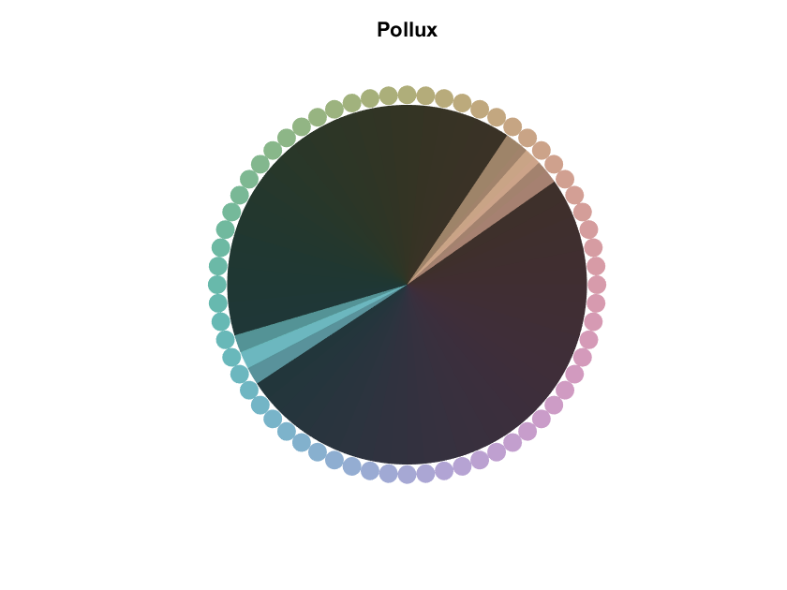
Locations of categories
M1

Slide 4
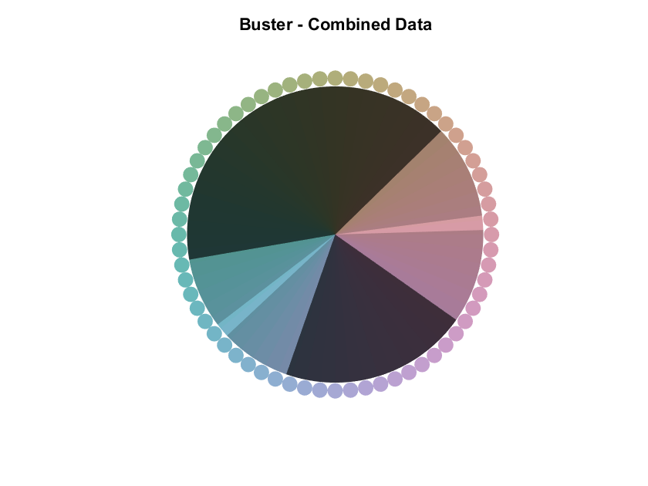
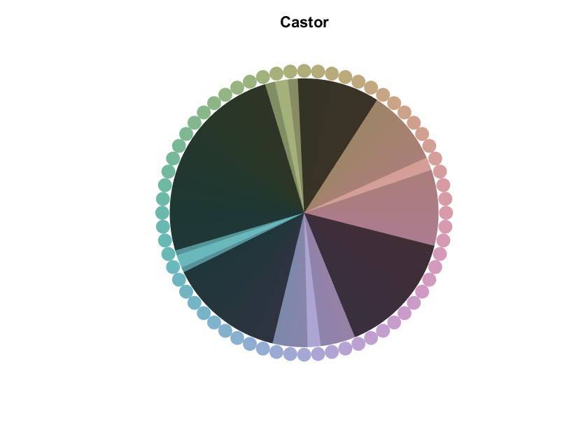
Locations of categories
M1
M2
M3

Slide 5
Locations of categories
Category gradient values: a measure of attractor strength (range: 0 - 90)
M1
M2
M3
65.2
72.3
56.3
78.4
53.7
78.4
67.2
6.9

Slide 6
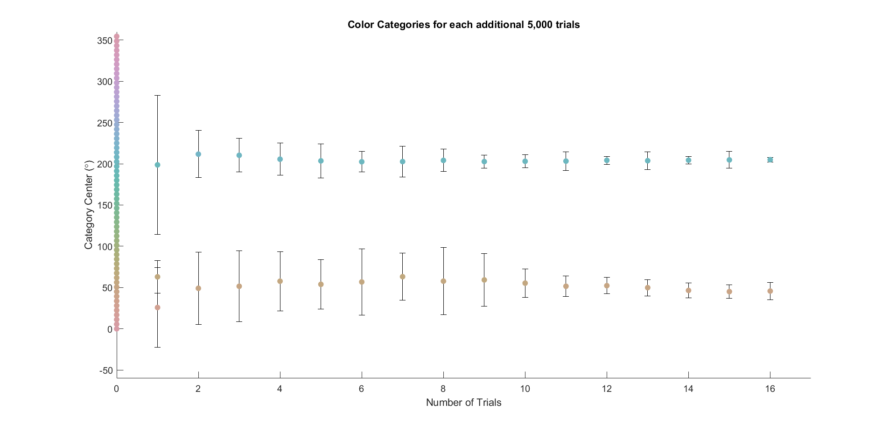
Power analysis
Hue
0 10 20 30 40 50 60 70 80
M1
Number of trials (x1000)

Slide 7
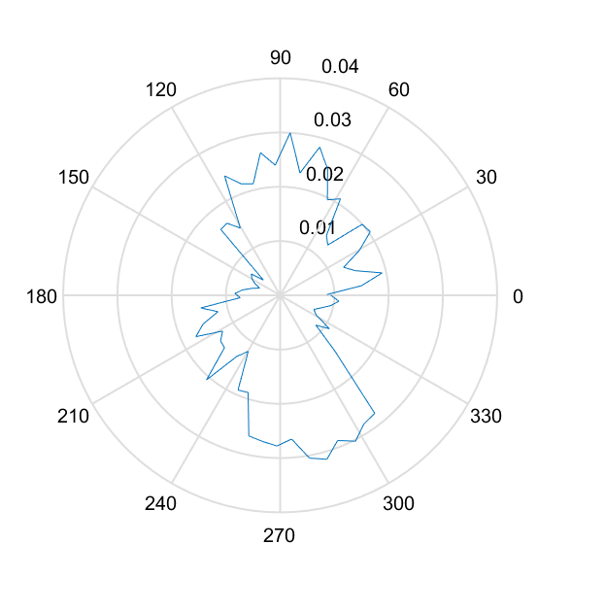
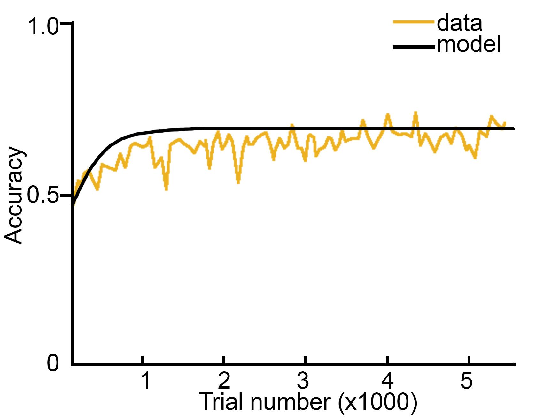
Learning rates
Learning rate
for a single hue
Learning rates
as a function of hue
DKL axis directions

