Slide 1
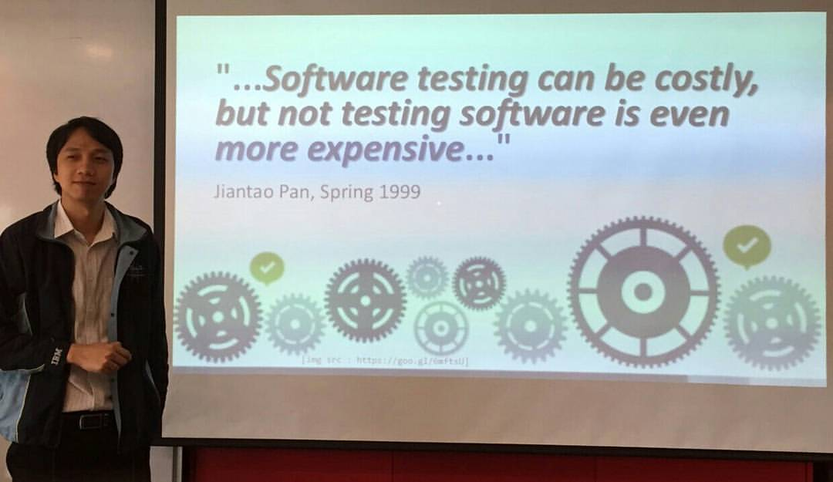

Ref: http://bit.ly/TestingCostly

Slide 2

Test Level
Unit Testing
System A
Systems Integration Testing
Module 1
Module 2
System B
Module 3
Integration Testing
System Testing
[img src : http://goo.gl/AAAAAA]
Does this system work?

