Slide 1
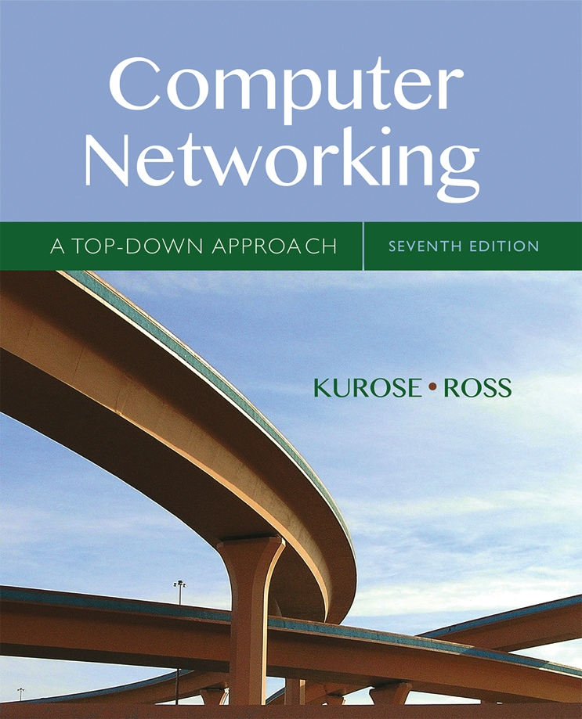
Computer Networking: A Top Down Approach
Seventh Edition
Chapter 5
The Network Layer: Control Plane
Slides in this presentation contain hyperlinks. JAWS users should be able to get a list of links by using INSERT+F7
Copyright © 2017, 2013, 2010 Pearson Education, Inc. All Rights Reserved
Notes:
If this PowerPoint presentation contains mathematical equations, you may need to check that your computer has the following installed:
1) MathType Plugin
2) Math Player (free versions available)
3) NVDA Reader (free versions available)

Slide 2
Chapter 5: Network Layer Control Plane
chapter goals: understand principles behind network control plane
traditional routing algorithms
S D N controlllers
Internet Control Message Protocol
network management
and their instantiation, implementation in the Internet:
O S P F, B G P, OpenFlow, O D L and O N O S controllers, I C M P, S N M P

Slide 3
Learning Objectives (1 of 9)
5.1 introduction
5.2 routing protocols
link state
distance vector
5.3 intra-A S routing in the Internet: O S P F
5.4 routing among the I S Ps: B G P
5.5 The S D N control plane
5.6 I C M P: The Internet Control Message Protocol
5.7 Network management and S N M P

Slide 4
Network-Layer Functions
Recall: two network-layer functions:
forwarding: move packets from router’s input to appropriate router output
data plane
routing: determine route taken by packets from source to destination
control plane
Two approaches to structuring network control plane:
per-router control (traditional)
logically centralized control (software defined networking)

Slide 5
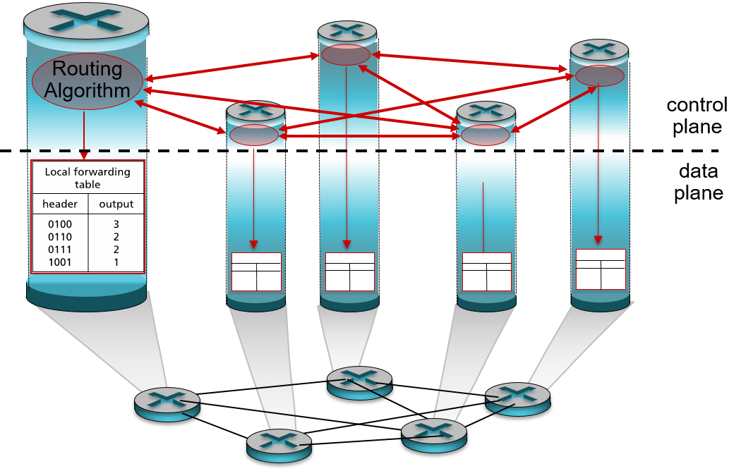
Per-Router Control Plane
Individual routing algorithm components in each and every router interact with each other in control plane to compute forwarding tables

Slide 6
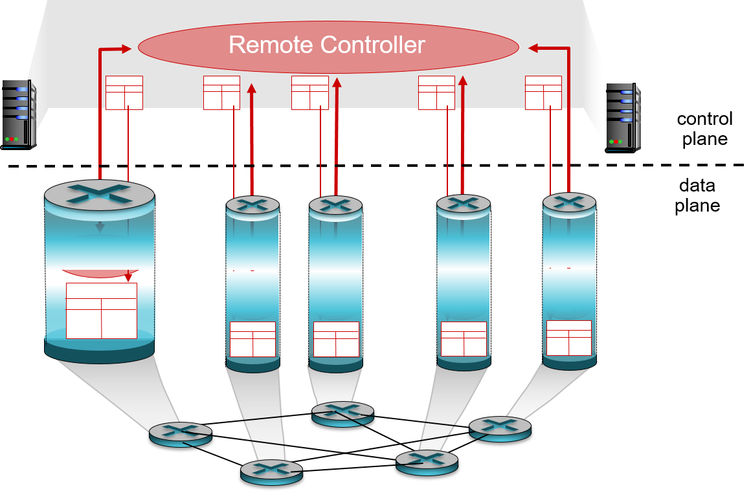
Logically Centralized Control Plane
A distinct (typically remote) controller interacts with local control agents (C As) in routers to compute forwarding tables

Slide 7
Learning Objectives (2 of 9)
5.1 introduction
5.2 routing protocols
link state
distance vector
5.3 intra-A S routing in the Internet: O S P F
5.4 routing among the I S Ps: B G P
5.5 The S D N control plane
5.6 I C M P: The Internet Control Message Protocol
5.7 Network management and S N M P

Slide 8
Routing Protocols
Routing protocol goal: determine “good” paths (equivalently, routes), from sending hosts to receiving host, through network of routers
path: sequence of routers packets will traverse in going from given initial source host to given final destination host
“good”: least “cost”, “fastest”, “least congested”
routing: a “top-10” networking challenge!

Slide 9
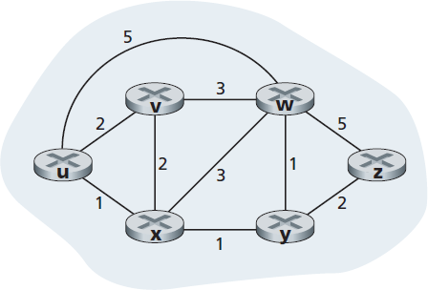
Graph Abstraction of the Network
graph: G = (N, E)
N = set of routers = { u, v, w, x, y, z }
E = set of links ={ (u,v), (u,x), (v,x), (v,w), (x,w), (x,y), (w,y), (w,z), (y,z) }
aside: graph abstraction is useful in other network contexts, e.g., P 2 P, where N is set of peers and E is set of T C P connections

Slide 10
Graph Abstraction: Costs
cost could always be 1, or inversely related to bandwidth, or inversely related to congestion
key question: what is the least-cost path between u and z?
routing algorithm: algorithm that finds that least cost path

Slide 11
Routing Algorithm Classification
Q: global or decentralized information?
global:
all routers have complete topology, link cost info
“link state” algorithms
Q: static or dynamic?
static:
routes change slowly over time
dynamic:
routes change more quickly
  periodic update
  in response to link cost changes
decentralized:
router knows physically-connected neighbors, link costs to neighbors
iterative process of computation, exchange of info with neighbors
“distance vector” algorithms

Slide 12
Learning Objectives (3 of 9)
5.1 introduction
5.2 routing protocols
link state
distance vector
5.3 intra-A S routing in the Internet: O S P F
5.4 routing among the I S Ps: B G P
5.5 The S D N control plane
5.6 I C M P: The Internet Control Message Protocol
5.7 Network management and S N M P

Slide 13

A Link-State Routing Algorithm
Dijkstra’s algorithm
net topology, link costs known to all nodes
  accomplished via “link state broadcast”
  all nodes have same info
computes least cost paths from one node (‘source”) to all other nodes
  gives forwarding table for that node
iterative: after k iterations, know least cost path to k dest.’s
notation:
c(x,y): link cost from node
if not direct neighbors
D(v): current value of cost of path from source to dest. v
p(v): predecessor node along path from source to v
N': set of nodes whose least cost path definitively known

Slide 14
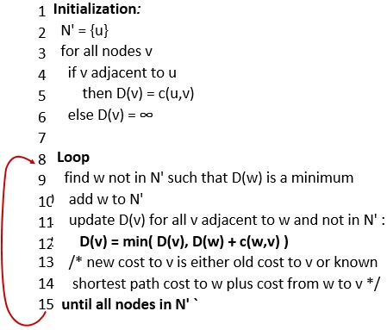
Dijsktra’s Algorithm

Slide 15
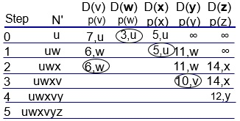
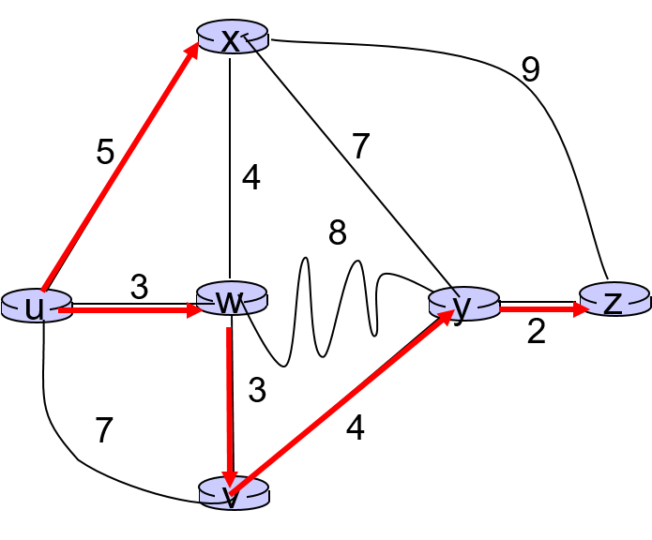
Dijkstra’s Algorithm: Example (1 of 2)
notes:
construct shortest path tree by tracing predecessor nodes
ties can exist (can be broken arbitrarily)

Slide 16
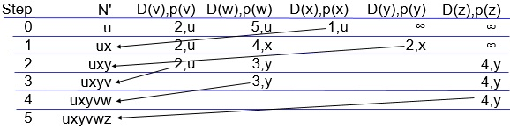
Dijkstra’s Algorithm: Another Example
* Check out the online interactive exercises for more examples: http://gaia.cs.umass.edu/kurose_ross/interactive/

Slide 17
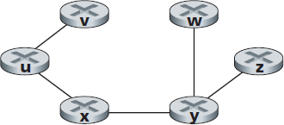
Dijkstra’s Algorithm: Example (2 of 2)
resulting forwarding table in u:
resulting shortest-path tree from u:
destination | Link
V | (u,v)
X | (u,x)
Y | (u,x)
W | (u,x)
Z | (u,x)

Slide 18
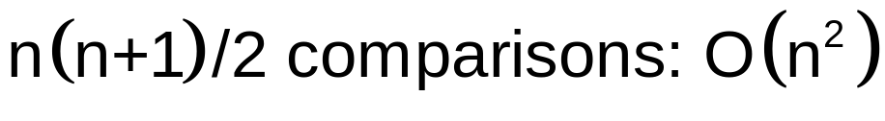
Dijkstra’s Algorithm, Discussion (1 of 2)
algorithm complexity: n nodes
each iteration: need to check all nodes, w, not in N
more efficient implementations possible: O(nlogn)
oscillations possible:
e.g., support link cost equals amount of carried traffic:

Slide 19
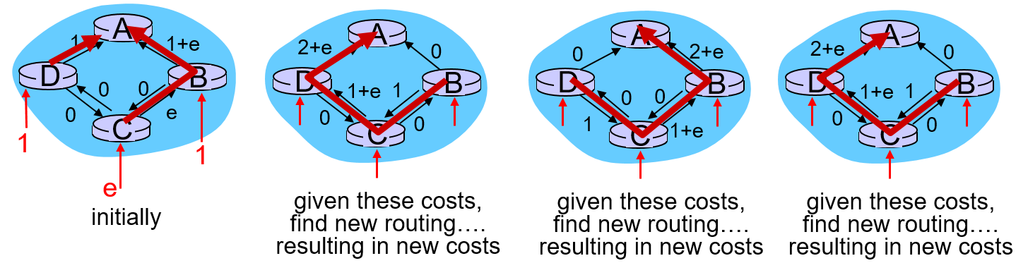
Dijkstra’s Algorithm, Discussion (2 of 2)

Slide 20
Learning Objectives (4 of 9)
5.1 introduction
5.2 routing protocols
link state
distance vector
5.3 intra-A S routing in the Internet: O S P F
5.4 routing among the I S Ps: B G P
5.5 The S D N control plane
5.6 I C M P: The Internet Control Message Protocol
5.7 Network management and S N M P

Slide 21
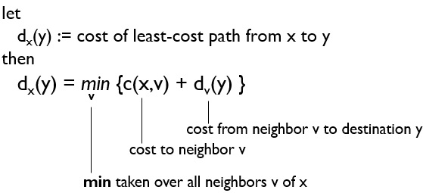
Distance Vector Algorithm (1 of 6)
Bellman-Ford equation (dynamic programming)

Slide 22

Bellman-Ford Example
B - F equation says:
d_{u}(z) = min { c(u,v) + d_{v}(z),
c(u,x) + d_{x}(z),
c(u,w) + d_{w}(z) }
= min {2 + 5,
1 + 3,
5 + 3} = 4
node achieving minimum is next hop in shortest path, used in forwarding table

Slide 23



Distance Vector Algorithm (2 of 6)
estimate of least cost from x to y
  x maintains distance vector
node x:
  knows cost to each neighbor v: c(x,v)
  maintains its neighbors’ distance vectors. For each neighbor v, x maintains

Slide 24



Distance Vector Algorithm (3 of 6)
key idea:
from time-to-time, each node sends its own distance vector estimate to neighbors
when x receives new D V estimate from neighbor, it updates its own D V using B - F equation:
under minor, natural conditions, the estimate
$$\text{converge} \text{to} \text{the} \text{actal} \text{least} \text{cost}$$

Slide 25
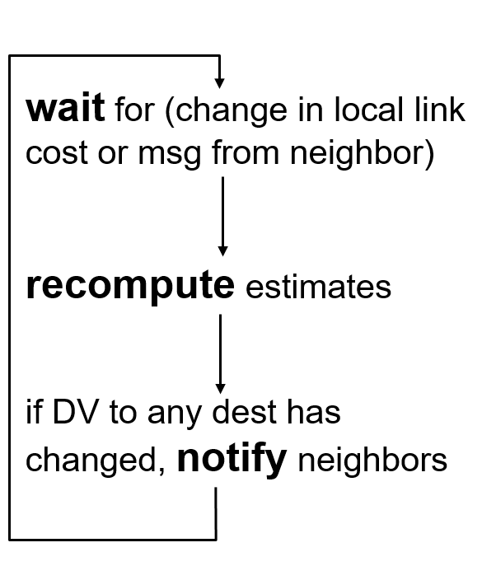
Distance Vector Algorithm (4 of 6)
iterative, asynchronous: each local iteration caused by:
local link cost change
D V update message from neighbor
each node:
distributed:
each node notifies neighbors only when its D V changes
  neighbors then notify their neighbors if necessary

Slide 26
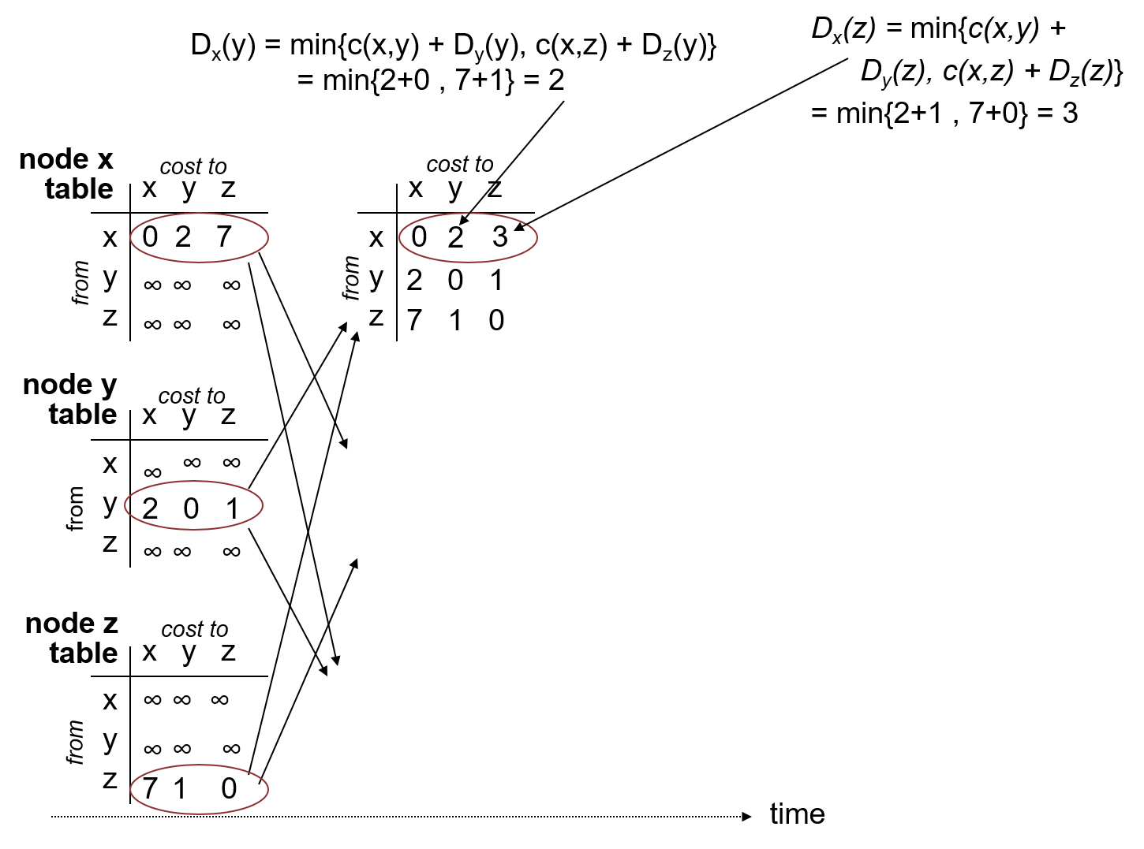
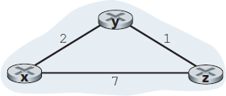
Distance Vector Algorithm (5 of 6)

Slide 27
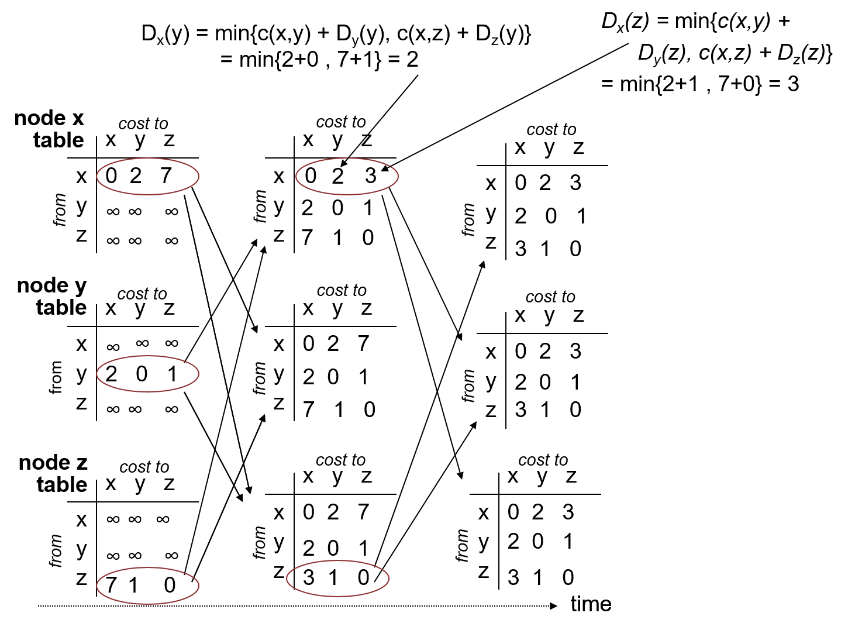
Distance Vector Algorithm (6 of 6)

Slide 28
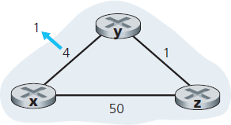
Distance Vector: Link Cost Changes (1 of 2)
link cost changes:
node detects local link cost change
updates routing info, recalculates distance vector
if D V changes, notify neighbors
t₀ : y detects link-cost change, updates its D V, informs its neighbors.
t₁ : z receives update from y, updates its table, computes new least cost to x , sends its neighbors its D V.
t₂ : y receives z’s update, updates its distance table. y's least costs do not change, so y does not send a message to z.
“good news travels fast”
* Check out the online interactive exercises for more examples: http://gaia.cs.umass.edu/kurose_ross/interactive/

Slide 29
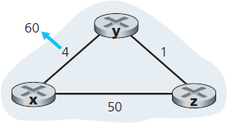
Distance Vector: Link Cost Changes (2 of 2)
link cost changes:
node detects local link cost change
bad news travels slow – “count to infinity” problem!
44 iterations before algorithm stabilizes: see text
poisoned reverse:
If Z routes through Y to get to X:
  Z tells Y its (Z’s) distance to X is infinite (so Y won’t route to X via Z)
will this completely solve count to infinity problem?

Slide 30

Comparison of L S and D V Algorithms
message complexity
LS: with n nodes, E links, O ( n E) msgs sent
DV: exchange between neighbors only
  convergence time varies
speed of convergence
LS:
robustness: what happens if router malfunctions?
L S:
  node can advertise incorrect link cost
  each node computes only its own table
D V:
  D V node can advertise incorrect path cost
  each node’s table used by others
    error propagate thru network
algorithm requires O ( n E) msgs
  may have oscillations
D V: convergence time varies
  may be routing loops
  count-to-infinity problem

Slide 31
Learning Objectives (5 of 9)
5.1 introduction
5.2 routing protocols
link state
distance vector
5.3 intra-A S routing in the Internet: O S P F
5.4 routing among the I S Ps: B G P
5.5 The S D N control plane
5.6 I C M P: The Internet Control Message Protocol
5.7 Network management and S N M P

Slide 32
Making Routing Scalable
our routing study thus far - idealized
all routers identical
network “flat”
… not true in practice
scale: with billions of destinations:
can’t store all destinations in routing tables!
routing table exchange would swamp links!
administrative autonomy
internet = network of networks
each network admin may want to control routing in its own network

Slide 33
Internet Approach to Scalable Routing
aggregate routers into regions known as “autonomous systems” (A S) (a.k.a. “domains”)
intra-A S routing
routing among hosts, routers in same A S (“network”)
all routers in A S must run same intra-domain protocol
routers in different A S can run different intra-domain routing protocol
gateway router: at “edge” of its own A S, has link(s) to router(s) in other A S’es
inter - A S routing
routing among A S ’ e s
gateways perform inter-domain routing (as well as intra-domain routing)

Slide 34
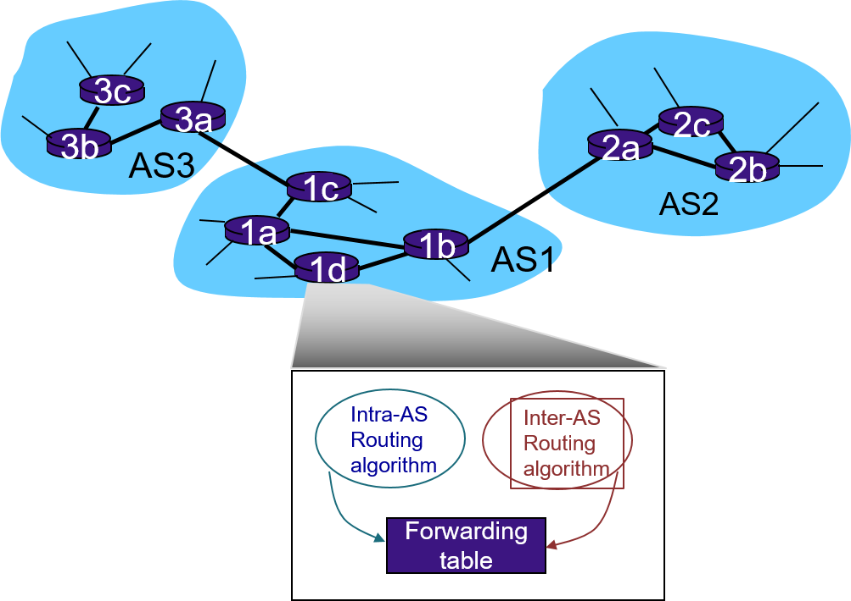
Interconnected ASes
forwarding table configured by both intra- and inter-A S routing algorithm
  intra-A S routing determine entries for destinations within A S
  inter-A S & intra-A S determine entries for external destinations

Slide 35
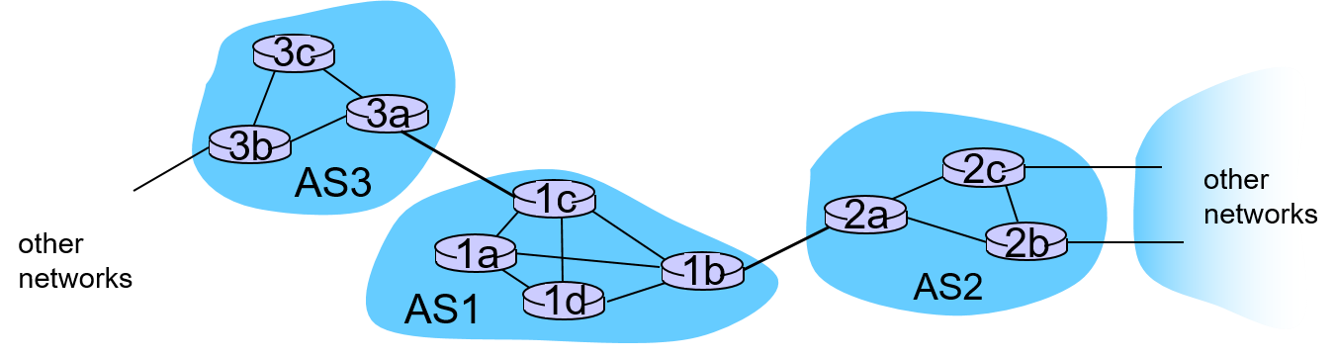
Inter - A S Tasks
suppose router in A S1 receives datagram destined outside of A S1:
  router should forward packet to gateway router, but which one?
A S1 must:
learn which dests are reachable through A S2, which through A S3
propagate this reachability info to all routers in A S1
job of inter-A S routing!

Slide 36
I n t r a - A S Routing
also known as interior gateway protocols (I G P)
most common i n t r a - A S routing protocols:
  R I P: Routing Information Protocol
  O S P F: Open Shortest Path First (I S - I S protocol essentially same as O S P F)
  I G R P: Interior Gateway Routing Protocol (Cisco proprietary for decades, until 2016)

Slide 37
O S P F (Open Shortest Path First)
“open”: publicly available
uses link-state algorithm
  link state packet dissemination
  topology map at each node
  route computation using Dijkstra’s algorithm
router floods O S P F link-state advertisements to all other routers in entire A S
  carried in O S P F messages directly over I P (rather than T C P or U D P
  link state: for each attached link
I S - I S routing protocol: nearly identical to O S P F

Slide 38
O S P F “Advanced” Features
security: all O S P F messages authenticated (to prevent malicious intrusion)
multiple same-cost paths allowed (only one path in R I P)
for each link, multiple cost metrics for different T O S (e.g., satellite link cost set low for best effort ToS; high for real-time ToS)
integrated uni- and multi-cast support:
  Multicast O S P F (M O S P F) uses same topology data base as O S P F
hierarchical O S P F in large domains.

Slide 39
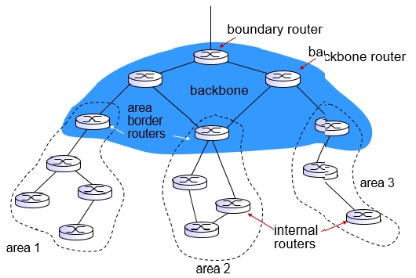
Hierarchical O S P F (1 of 2)

Slide 40
Hierarchical O S P F (2 of 2)
two-level hierarchy: local area, backbone.
  link-state advertisements only in area
  each nodes has detailed area topology; only know direction (shortest path) to nets in other areas.
area border routers: “summarize” distances to nets in own area, advertise to other Area Border routers.
backbone routers: run O S P F routing limited to backbone.
boundary routers: connect to other A S’es.

Slide 41
Learning Objective (6 of 9)
5.1 introduction
5.2 routing protocols
link state
distance vector
5.3 intra-A S routing in the Internet: O S P F
5.4 routing among the I S Ps: B G P
5.5 The S D N control plane
5.6 I C M P: The Internet Control Message Protocol
5.7 Network management and S N M P

Slide 42
Internet i n t e r - A S Routing: B G P
B G P (Border Gateway Protocol): the de facto inter-domain routing protocol
  “glue that holds the Internet together”
B G P provides each A S a means to:
  e B G P: obtain subnet reachability information from neighboring ASes
  i B G P: propagate reachability information to all A S-internal routers.
  determine “good” routes to other networks based on reachability information and policy
allows subnet to advertise its existence to rest of Internet: “I am here”

Slide 43
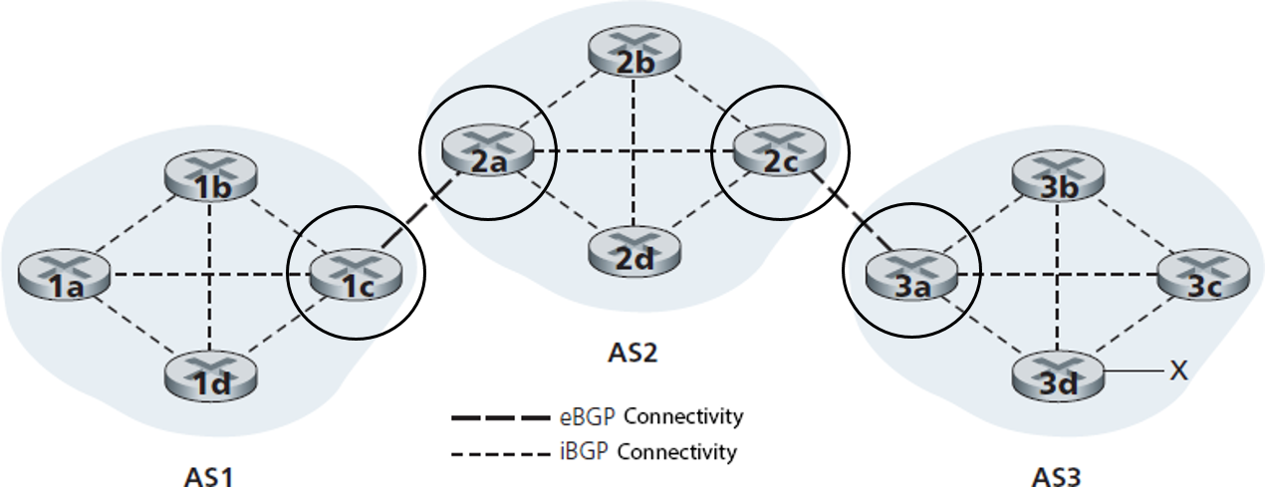

e B G P, i B G P Connections
gateway routers run both e B G P and i B G P protocols

Slide 44
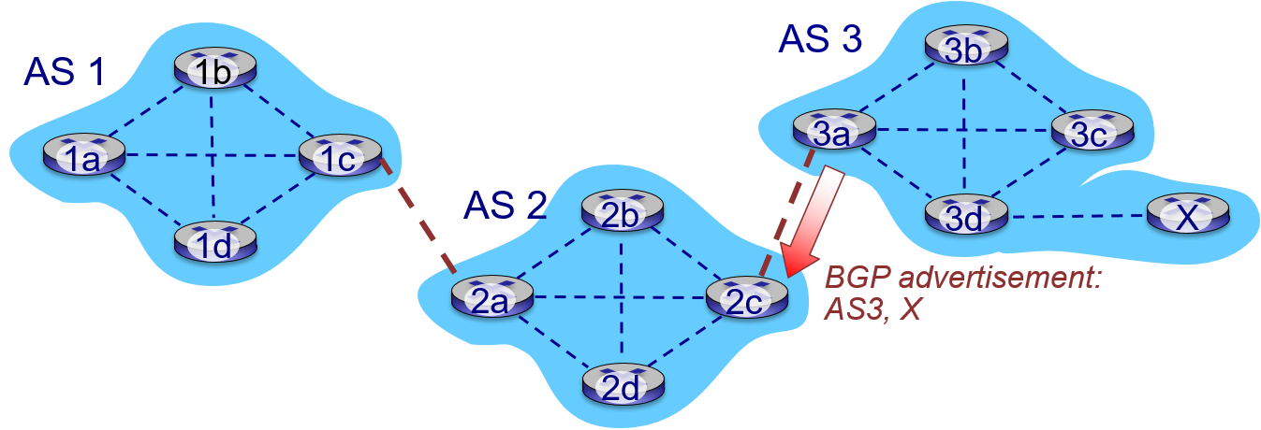
B G P Basics
B G P session: two B G P routers (“peers”) exchange B G P messages over semi-permanent T C P connection:
  advertising paths to different destination network prefixes (B G P is a “path vector” protocol)
when AS3 gateway router 3a advertises path AS3 , X to AS2 gateway router 2c:
  AS3 promises to AS2 it will forward datagrams towards X

Slide 45
Path Attributes and B G P Routes
advertised prefix includes B G P attributes
  prefix + attributes = “route”
two important attributes:
  A S-PATH: list of A Ses through which prefix advertisement has passed
  NEXT-H O P: indicates specific internal-AS router to next-hop AS
Policy-based routing:
  gateway receiving route advertisement uses import policy to accept/decline path (e.g., never route through A S Y).
  A S policy also determines whether to advertise path to other other neighboring ASes

Slide 46
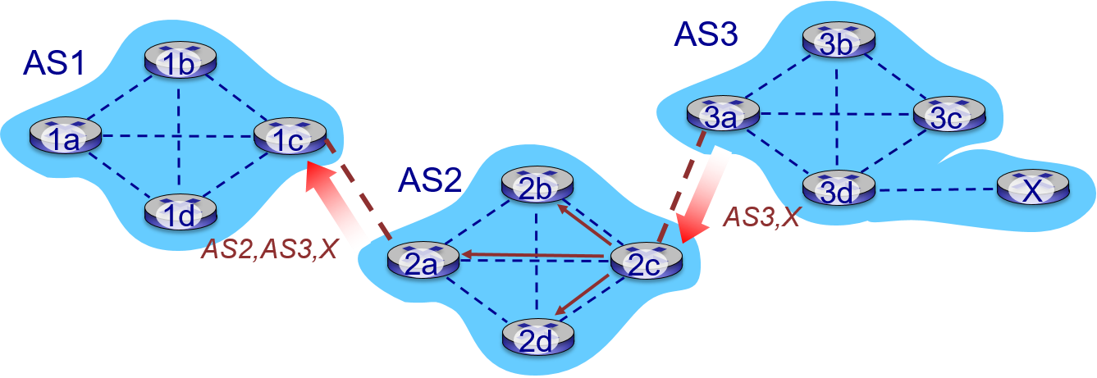
B G P Path Advertisement (1 of 2)
A S 2 router 2 c receives path advertisement A S 3,X (via e B G P) from A S3 router 3a
Based on A S 2 policy, A S 2 router 2 c accepts path A S 3 , X, propagates (via i B G P) to all AS2 routers
Based on A S 2 policy, A S 2 router 2 a advertises (via e B G P) path A S 2, A S 3,X to A S 1 router 1 c

Slide 47
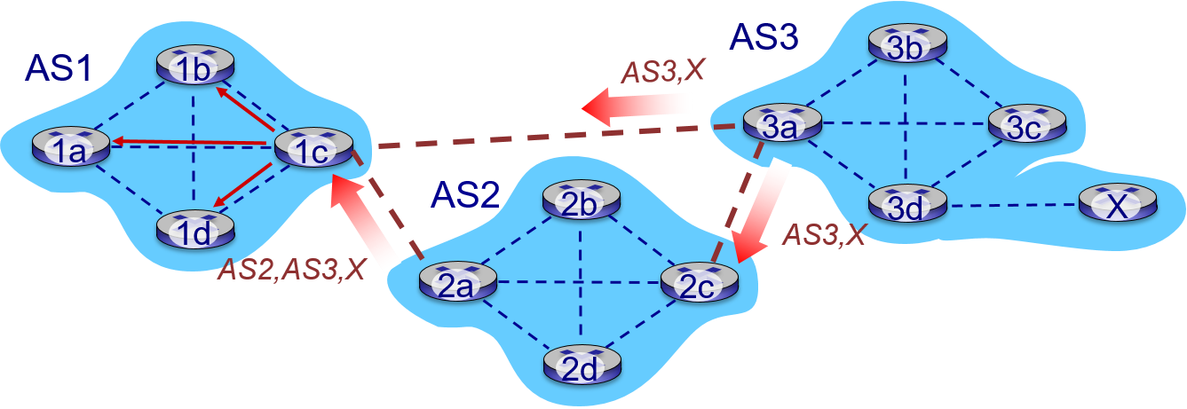
B G P Path Advertisement (2 of 2)
gateway router may learn about multiple paths to destination:
A S 1 gateway router 1 c learns path A S 2,A S 3,X from 2 a
A S 1 gateway router 1 c learns path A S 3,X from 3a
Based on policy, A S 1 gateway router 1 c chooses path A S 3 , X, and advertises path within A S 1 via i B G P

Slide 48
B G P Messages
B G P messages exchanged between peers over T C P connection
B G P messages:
  Open: opens T C P connection to remote B G P peer and authenticates sending B G P peer
  Update: advertises new path (or withdraws old)
  Keepalive: keeps connection alive in absence of Updates; also A C K s Open request
  Notification: reports errors in previous message; also used to close connection

Slide 49
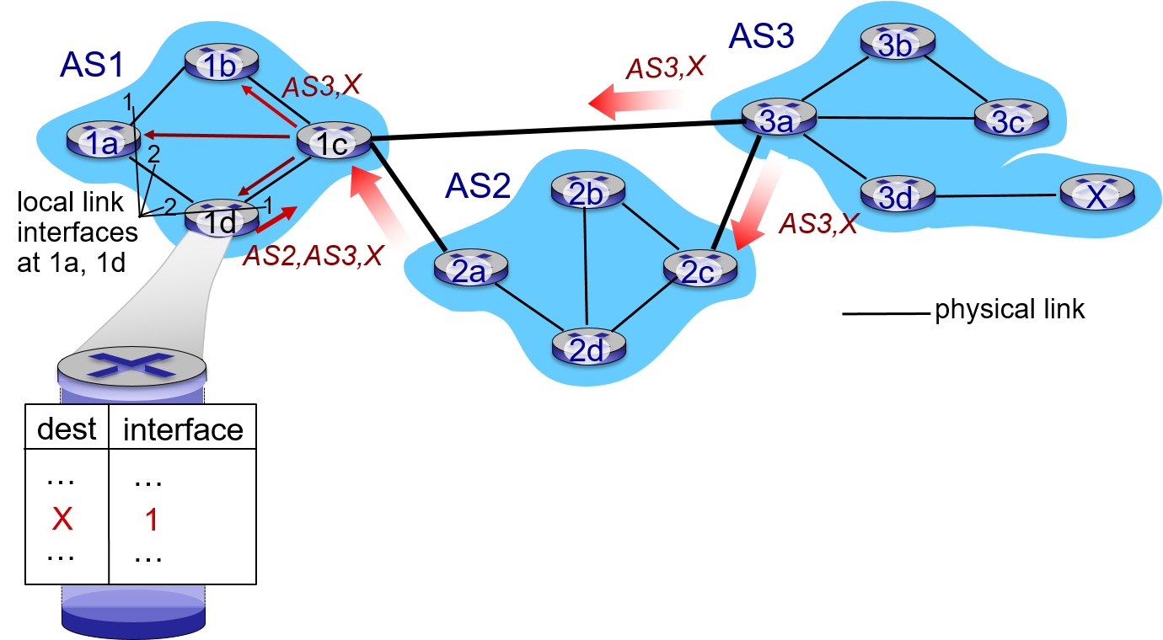
B G P, O S P F, Forwarding Table Entries (1 of 2)
Q: how does router set forwarding table entry to distant prefix?
recall: 1a, 1b, 1c learn about dest X via i B G P from 1c: “path to X goes through 1c”
1d: O S P F intra-domain routing: to get to 1c, forward over outgoing local interface 1

Slide 50
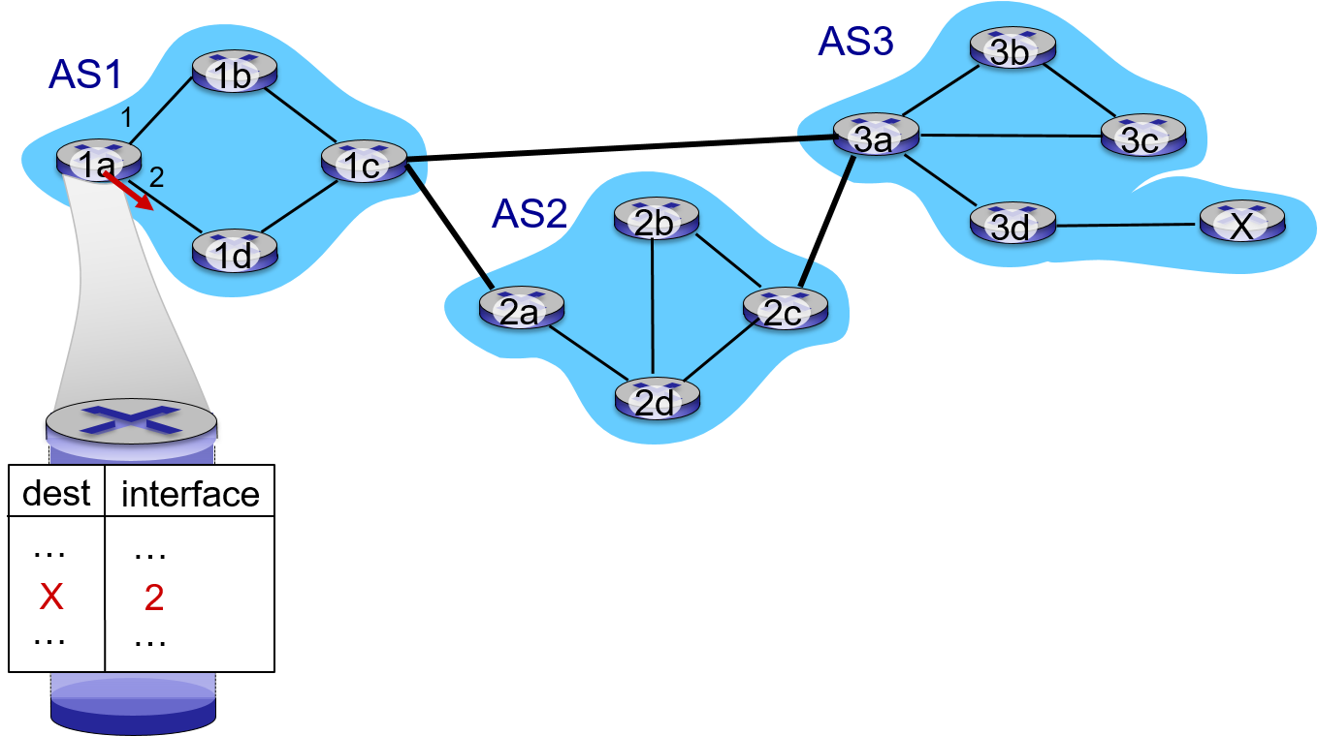
B G P, O S P F, Forwarding Table Entries (2 of 2)
Q: how does router set forwarding table entry to distant prefix
recall: 1a, 1b, 1c learn about dest X via i B G P from 1c: “path to X goes through 1c”
1d: O S P F intra-domain routing: to get to 1c, forward over outgoing local interface 1
1a: O S P F intra-domain routing: to get to 1c, forward over outgoing local interface 2

Slide 51
B G P Route Selection
router may learn about more than one route to destination A S, selects route based on:
  local preference value attribute: policy decision
  shortest A S - PATH
  closest NEXT - H O P router: hot potato routing
  additional criteria

Slide 52
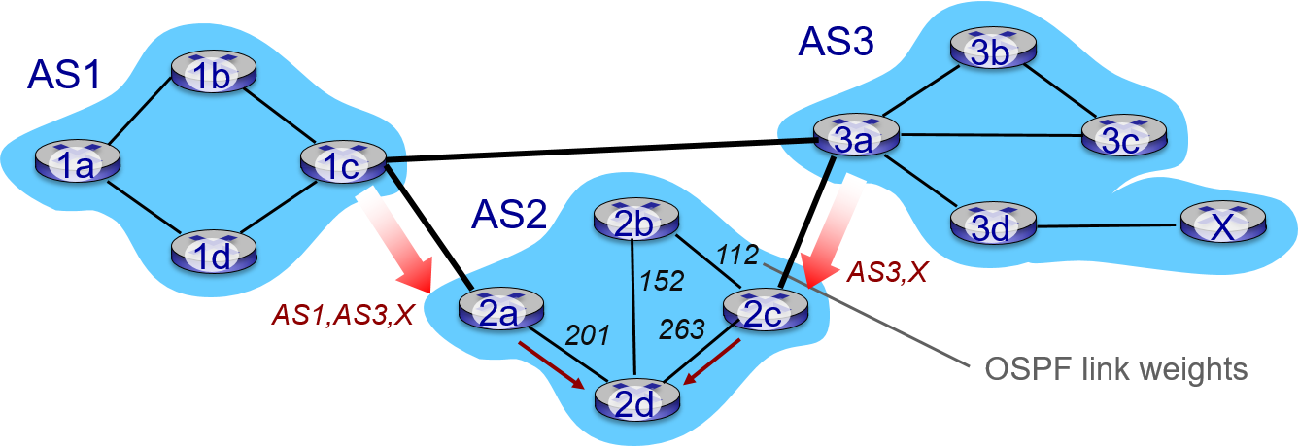
Hot Potato Routing
2d learns (via i B G P) it can route to X via 2a or 2c
hot potato routing: choose local gateway that has least intra-domain cost (e.g., 2d chooses 2a, even though more A S hops to X): don’t worry about inter-domain cost!

Slide 53
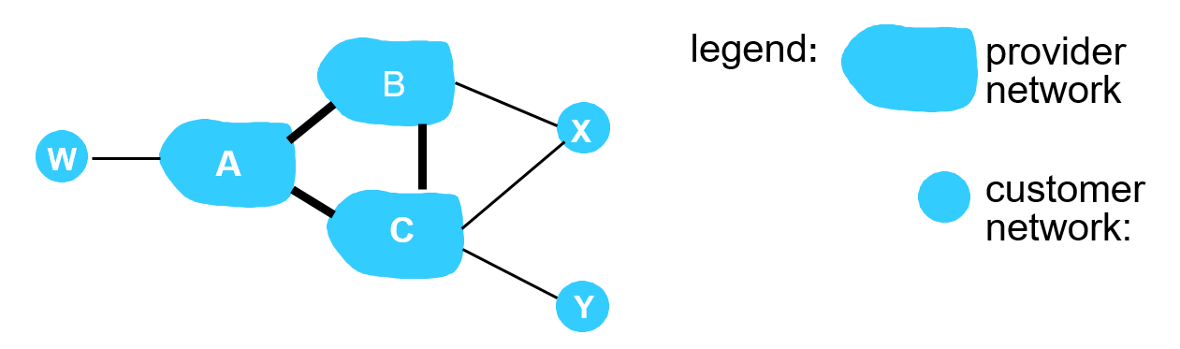
B G P: Achieving Policy Via Advertisements (1 of 2)
Suppose an I S P only wants to route traffic to/from its customer networks (does not want to carry transit traffic between other I S P s)
A advertises path A w to B and to C
B chooses not to advertise B A w to C:
  B gets no “revenue” for routing C B A w, since none of C,A, w are B’s customers
  C does not learn about C B A w path
C will route C A w (not using B) to get to w

Slide 54
B G P: Achieving Policy Via Advertisements (2 of 2)
Suppose an I S P only wants to route traffic to/from its customer networks (does not want to carry transit traffic between other I S Ps)
A ,B ,C are provider networks
X ,W ,Y are customer (of provider networks)
X is dual-homed: attached to two networks
policy to enforce: X does not want to route from B to C via X
  .. so X will not advertise to B a route to C

Slide 55
Why Different Intra-, Inter-As Routing?
policy:
inter - A S: admin wants control over how its traffic routed, who routes through its net.
intra - A S: single admin, so no policy decisions needed
scale:
hierarchical routing saves table size, reduced update traffic
performance:
intra - A S: can focus on performance
inter - A S: policy may dominate over performance

Slide 56
Learning Objectives (7 of 9)
5.1 introduction
5.2 routing protocols
link state
distance vector
5.3 intra-A S routing in the Internet: O S P F
5.4 routing among the I S P s: B G P
5.5 The S D N control plane
5.6 I C M P: The Internet Control Message Protocol
5.7 Network management and S N M P

Slide 57
Software Defined Networking (S D N) (1 of 3)
Internet network layer: historically has been implemented via distributed, per-router approach
  monolithic router contains switching hardware, runs proprietary implementation of Internet standard protocols (IP, RIP, IS-IS, OSPF, B G P) in proprietary router O S (e.g., Cisco I O S)
  different “middleboxes” for different network layer functions: firewalls, load balancers, NAT boxes, ..
~2005: renewed interest in rethinking network control plane

Slide 58
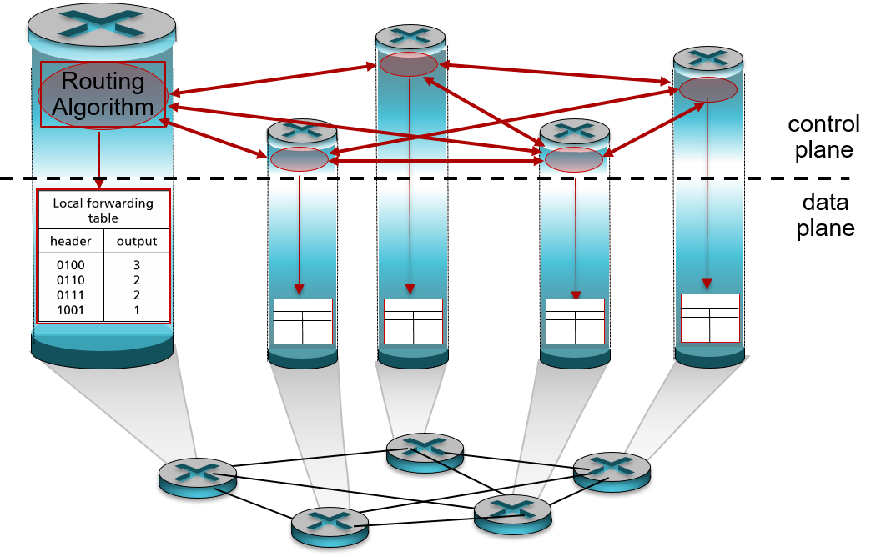
Recall: Per-Router Control Plane
Individual routing algorithm components in each and every router interact with each other in control plane to compute forwarding tables

Slide 59
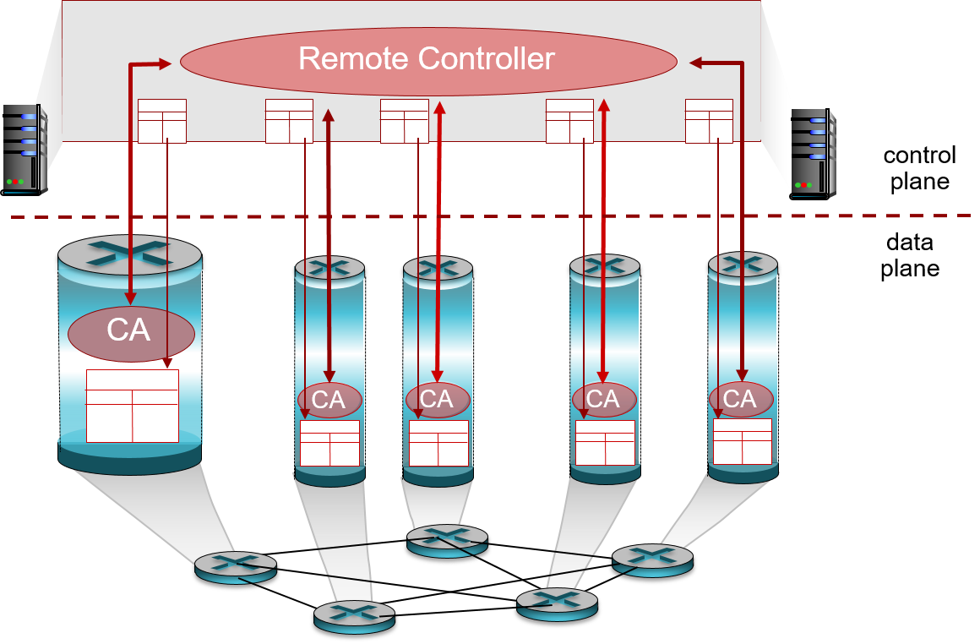
Recall: Logically Centralized Control Plane
A distinct (typically remote) controller interacts with local control agents (C As) in routers to compute forwarding tables

Slide 60
Software Defined Networking (S D N) (2 of 3)
Why a logically centralized control plane?
easier network management: avoid router misconfigurations, greater flexibility of traffic flows
table-based forwarding (recall OpenFlow A P I) allows “programming” routers
  centralized “programming” easier: compute tables centrally and distribute
  distributed “programming: more difficult: compute tables as result of distributed algorithm (protocol) implemented in each and every router
open (non-proprietary) implementation of control plane

Slide 61
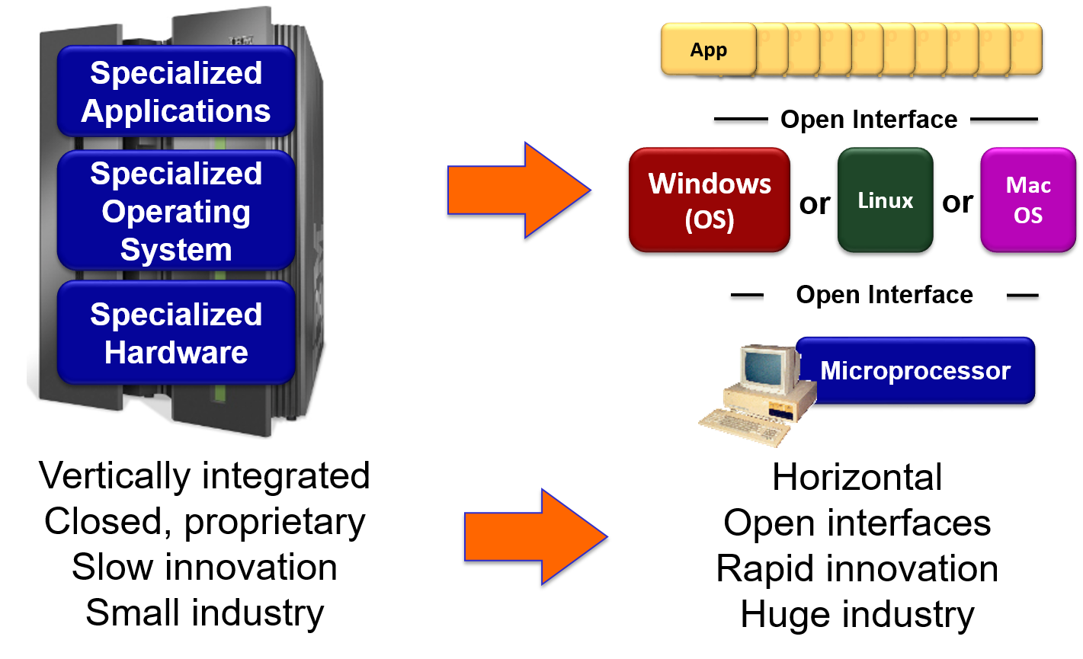
Analogy: Mainframe to P C Evolution*

Slide 62
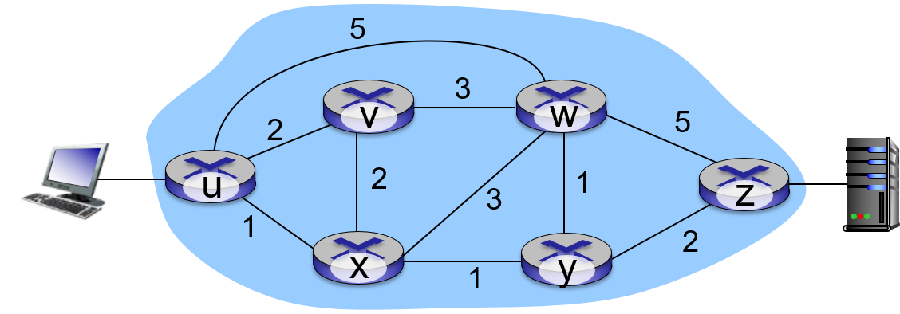
Traffic Engineering: Difficult Traditional Routing
Q: what if network operator wants u-to-z traffic to flow along u v w z, x-to-z traffic to flow x w y z?
A: need to define link weights so traffic routing algorithm computes routes accordingly (or need a new routing algorithm)!
Link weights are only control “knobs”: wrong!
Notes:
Note: implicit assumption here: destination based forwarding

Slide 63
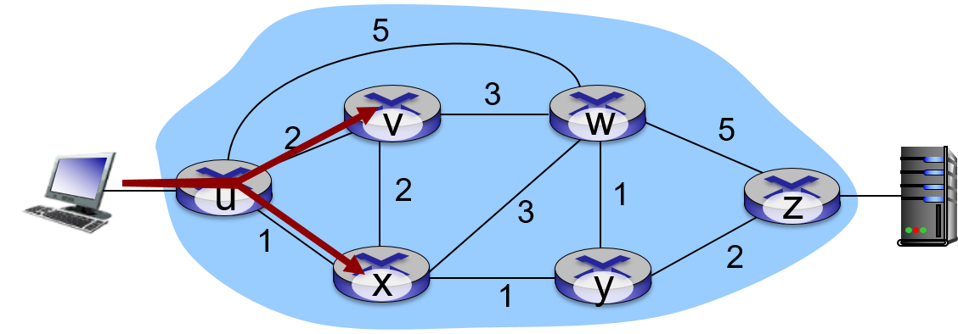
Traffic Engineering: Difficult (1 of 2)
Q: what if network operator wants to split u-to-z traffic along u v w z and u x y z (load balancing)?
A: can’t do it (or need a new routing algorithm)
Notes:
Note: implicit assumption here: destination based forwarding

Slide 64
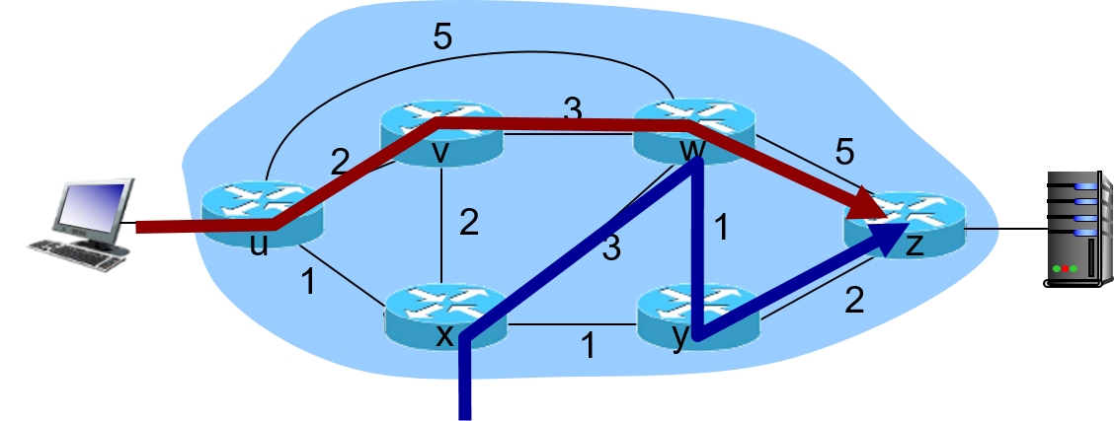
Traffic Engineering: Difficult (2 of 2)
Q: what if w wants to route blue and red traffic differently?
A: can’t do it (with destination based forwarding, and L S, D V routing)
Notes:
Note: implicit assumption here: destination based forwarding

Slide 65
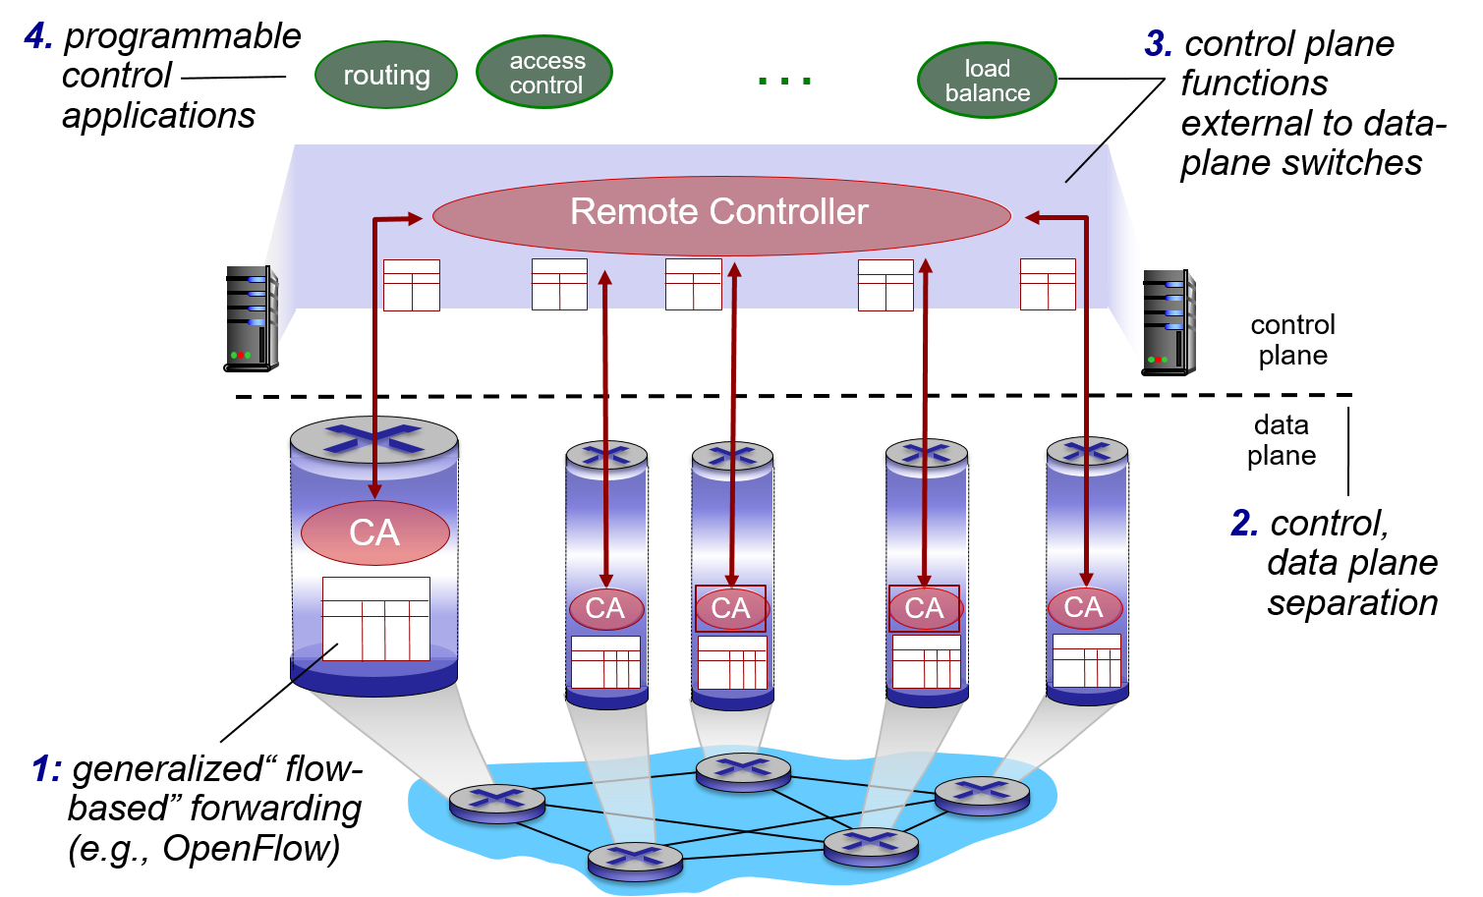
Software Defined Networking (S D N) (3 of 3)

Slide 66
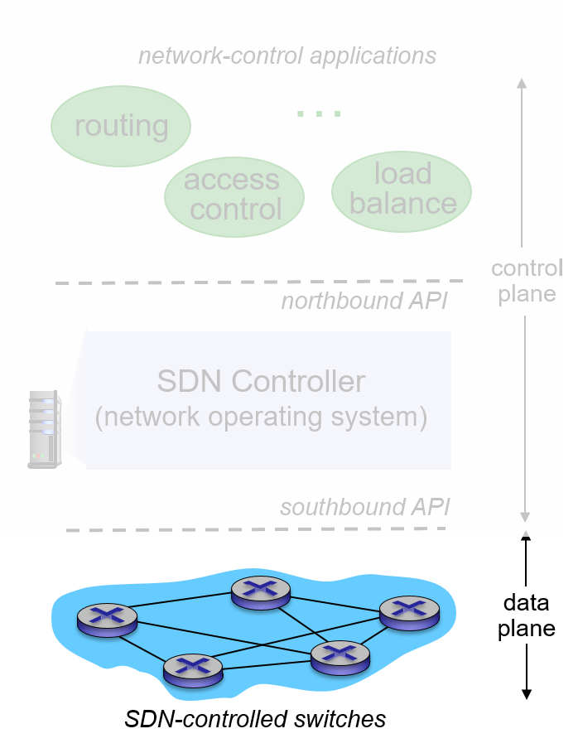
S D N Perspective: Data Plane Switches
Data plane switches
fast, simple, commodity switches implementing generalized data-plane forwarding (Section 4.4) in hardware
switch flow table computed, installed by controller
A P I for table-based switch control (e.g., OpenFlow)
  defines what is controllable and what is not
protocol for communicating with controller (e.g., OpenFlow)

Slide 67
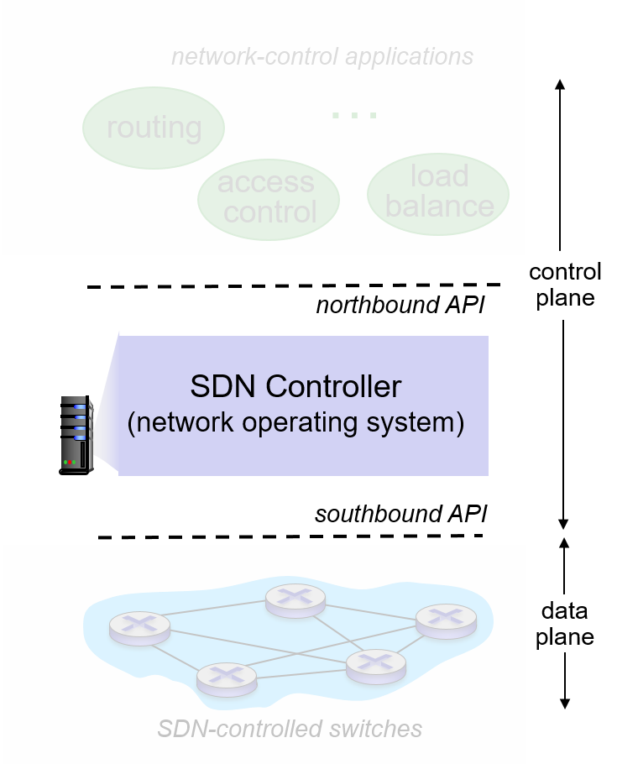
S D N Perspective: S D N Controller
S D N controller (network O S):
maintain network state information
interacts with network control applications “above” via northbound A P I
interacts with network switches “below” via southbound A P I
implemented as distributed system for performance, scalability, fault-tolerance, robustness

Slide 68
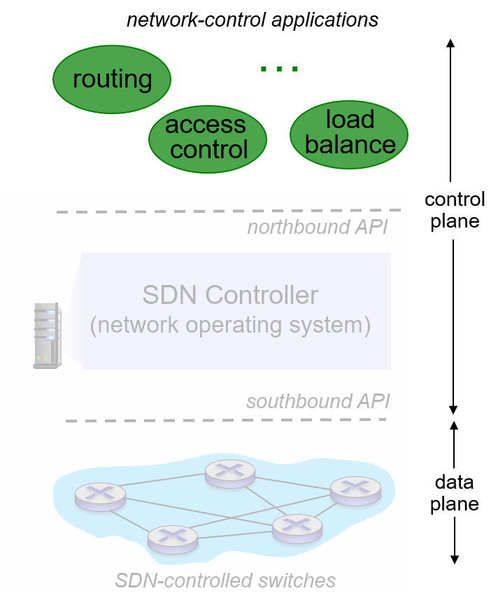
S D N Perspective: Control Applications
network-control apps:
“brains” of control: implement control functions using lower-level services, A P I provided by S N D controller
unbundled: can be provided by 3rd party: distinct from routing vendor, or S D N controller

Slide 69
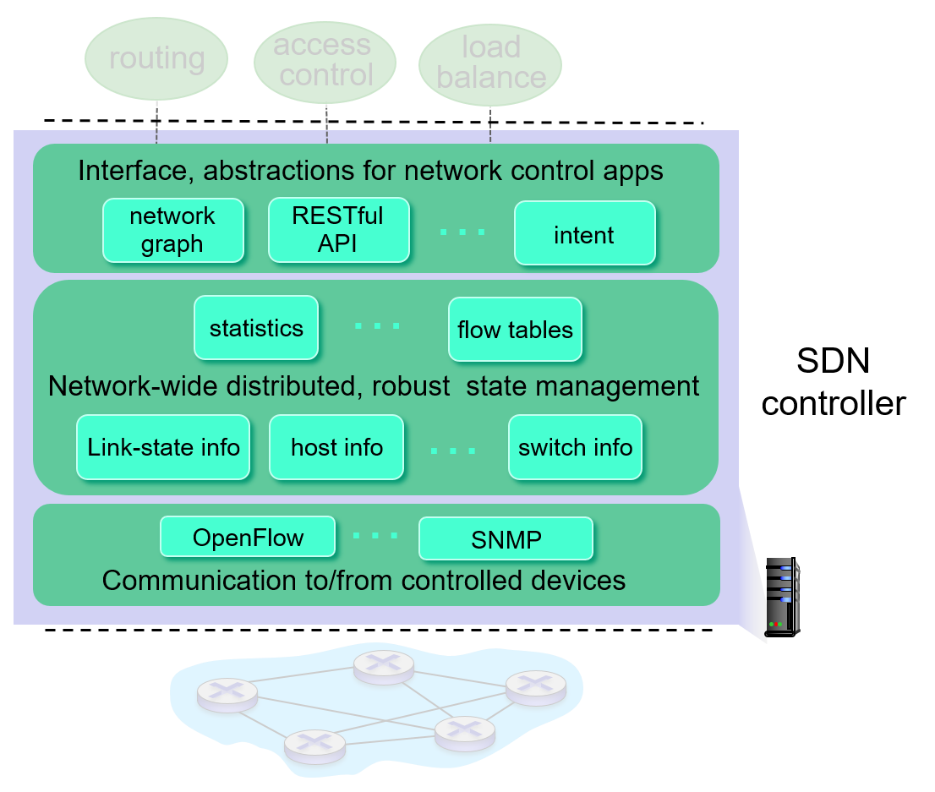
Components of S D N Controller
Interface layer to network control apps: abstractions A P I
Network-wide state management layer: state of networks links, switches, services: a distributed database
communication layer: communicate between S D N controller and controlled switches

Slide 70
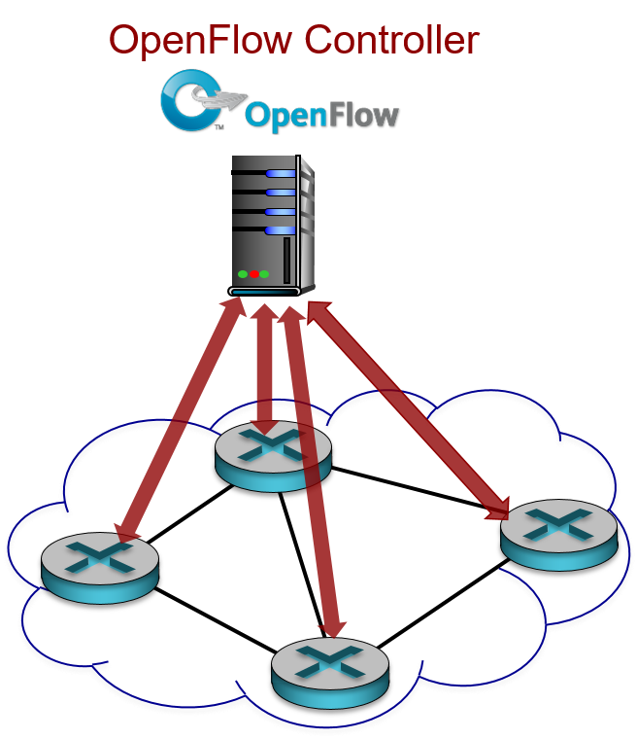
OpenFlow Protocol
operates between controller, switch
T C P used to exchange messages
  optional encryption
three classes of OpenFlow messages:
  controller-to-switch
  asynchronous (switch to controller)
  symmetric (misc)

Slide 71
OpenFlow: Controller-to-Switch Messages
Key controller-to-switch messages
features: controller queries switch features, switch replies
configure: controller queries/sets switch configuration parameters
modify-state: add, delete, modify flow entries in the OpenFlow tables
packet-out: controller can send this packet out of specific switch port

Slide 72
OpenFlow: Switch-to-Controller Messages
Key switch-to-controller messages
packet-in: transfer packet (and its control) to controller. See packet-out message from controller
flow-removed: flow table entry deleted at switch
port status: inform controller of a change on a port.
Fortunately, network operators don’t “program” switches by creating/sending OpenFlow messages directly. Instead use higher-level abstraction at controller

Slide 73
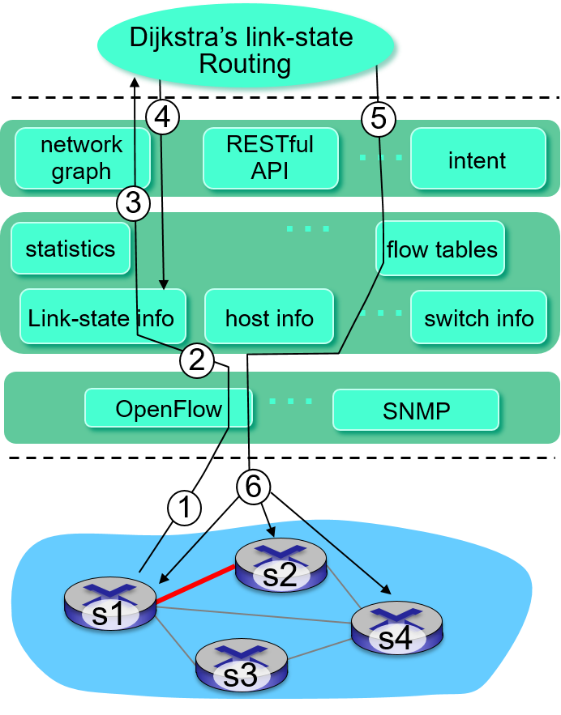
S D N: Control/Data Plane Interaction Example (1 of 2)
S1, experiencing link failure using OpenFlow port status message to notify controller
S D N controller receives OpenFlow message, updates link status info
Dijkstra’s routing algorithm application has previously registered to be called when ever link status changes. It is called.
Dijkstra’s routing algorithm access network graph info, link state info in controller, computes new routes

Slide 74
S D N: Control/Data Plane Interaction Example (2 of 2)
link state routing app interacts with flow-table-computation component in S D N controller, which computes new flow tables needed
Controller uses OpenFlow to install new tables in switches that need updating

Slide 75
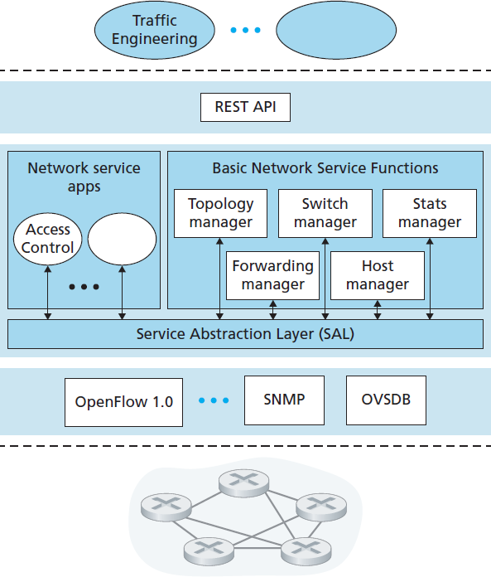
OpenDaylight (O D L) Controller
O D L Lithium controller
network apps may be contained within, or be external to S D N controller
Service Abstraction Layer: interconnects internal, external applications and services

Slide 76
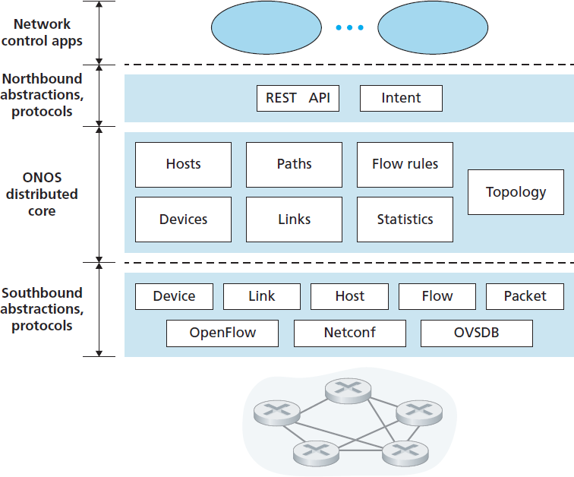
O N O S Controller
control apps separate from controller
intent framework: high-level specification of service: what rather than how
considerable emphasis on distributed core: service reliability, replication performance scaling

Slide 77
S D N: Selected Challenges
hardening the control plane: dependable, reliable, performance-scalable, secure distributed system
  robustness to failures: leverage strong theory of reliable distributed system for control plane
  dependability, security: “baked in” from day one?
networks, protocols meeting mission-specific requirements
  e.g., real-time, ultra-reliable, ultra-secure
Internet-scaling

Slide 78
Learning Objectives (8 of 9)
5.1 introduction
5.2 routing protocols
link state
distance vector
5.3 intra-A S routing in the Internet: O S P F
5.4 routing among the I S P s: B G P
5.5 The S D N control plane
5.6 I C M P: The Internet Control Message Protocol
5.7 Network management and S N M P

Slide 79
I C M P: Internet Control Message Protocol (1 of 2)
used by hosts & routers to communicate network-level information
  error reporting: unreachable host, network, port, protocol
  echo request/reply (used by ping)
network-layer “above” I P:
  I C M P msgs carried in I P datagrams
I C M P message: type, code plus first 8 bytes of I P datagram causing error

Slide 80
I C M P: Internet Control Message Protocol (2 of 2)
I C M P Type | Code | Description
0 | 0 | echo reply (to ping)
3 | 0 | destination network unreachable
3 | 1 | destination host unreachable
3 | 2 | destination protocol unreachable
3 | 3 | destination port unreachable
3 | 6 | destination network unknown
3 | 7 | destination host unknown
4 | 0 | source quench (congestion control)
8 | 0 | echo request
9 | 0 | router advertisement
10 | 0 | router discovery
11 | 0 | T T L expired
12 | 0 | I P header bad

Slide 81
Traceroute and I C M P (1 of 2)
source sends series of U D P segments to destination
  first set has T T L =1
  second set has T T L = 2, etc.
  unlikely port number
when datagram in nth set arrives to nth router:
  router discards datagram and sends source I C M P message (type 11, code 0)
  I C M P message include name of router & I P address
  when I C M P message arrives, source records R T T s

Slide 82
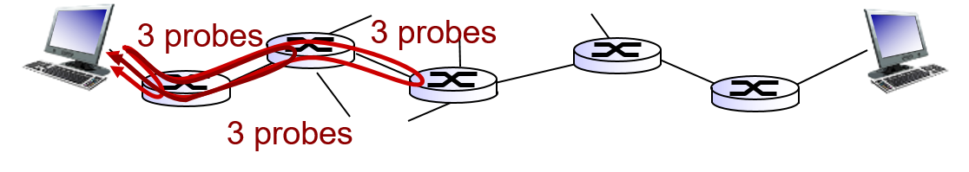
Traceroute and I C M P (2 of 2)
stopping criteria:
U D P segment eventually arrives at destination host
destination returns I C M P “port unreachable” message (type 3, code 3)
source stops

Slide 83
Learning Objectives (9 of 9)
5.1 introduction
5.2 routing protocols
link state
distance vector
5.3 intra-A S routing in the Internet: O S P F
5.4 routing among the ISPs: B G P
5.5 The S D N control plane
5.6 I C M P: The Internet Control Message Protocol
5.7 Network management and S N M P

Slide 84

What is Network Management?
autonomous systems (aka “network”): 1000s of interacting hardware/software components
other complex systems requiring monitoring, control:
  jet airplane
  nuclear power plant
  others?
“Network management includes the deployment, integration and coordination of the hardware, software, and human elements to monitor, test, poll, configure, analyze, evaluate, and control the network and element resources to meet the real-time, operational performance, and Quality of Service requirements at a reasonable cost.”

Slide 85
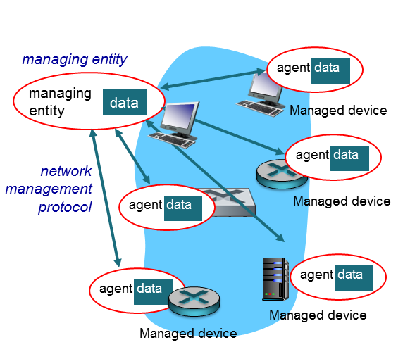
Infrastructure for Network Management
definitions:
managed devices contain managed objects whose data is gathered into a Management Information Base (M I B)

Slide 86
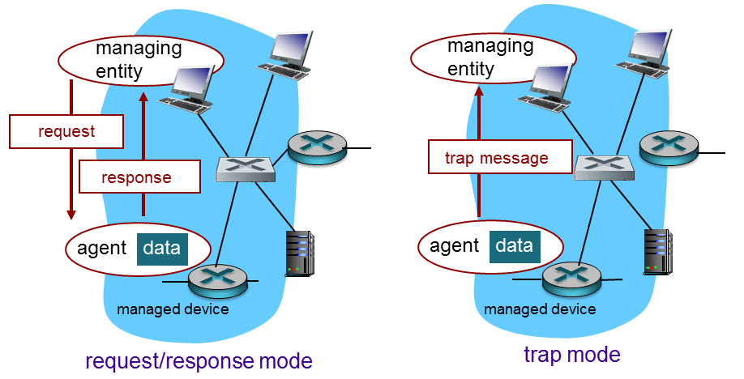
S N M P Protocol
Two ways to convey M I B info, commands:

Slide 87
S N M P Protocol: Message Types
Message type | Function
GetRequest GetNextRequest GetBulkRequest | manager-to-agent: “get me data” (data instance, next data in list, block of data)
InformRequest | manager-to-manager: here’s MIB value
SetRequest | manager-to-agent: set MIB value
Response | Agent-to-manager: value, response to Request
Trap | Agent-to-manager: inform manager of exceptional event

Slide 88
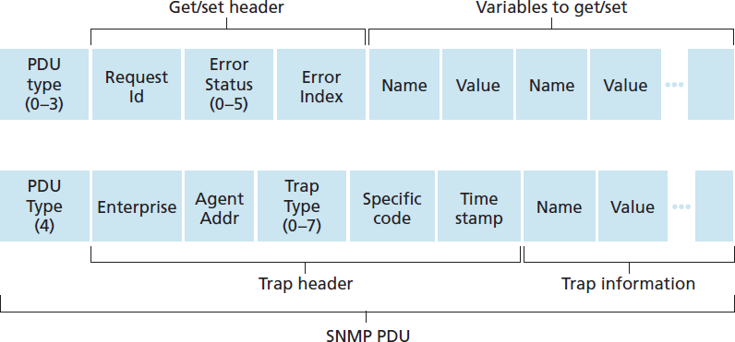
S N M P Protocol: Message Formats

Slide 89
Chapter 5: Summary
we’ve learned a lot!
approaches to network control plane
  per-router control (traditional)
  logically centralized control (software defined networking)
traditional routing algorithms
  implementation in Internet: O S P F, B G P
S D N controllers
  implementation in practice: O D L, O N O S
Internet Control Message Protocol
network management
next stop: link layer!

Slide 90
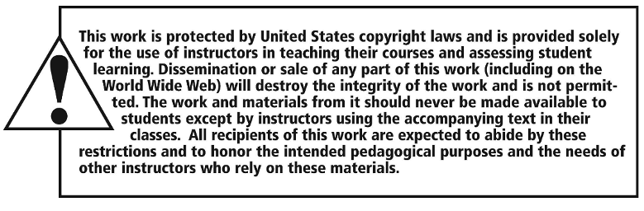
Copyright

