Slide 1

Computer Networking: A Top Down Approach
Seventh Edition
Chapter 3
Transport Layer
Slides in this presentation contain hyperlinks. JAWS users should be able to get a list of links by using INSERT+F7
Copyright © 2017, 2013, 2010 Pearson Education, Inc. All Rights Reserved
Notes:
If this PowerPoint presentation contains mathematical equations, you may need to check that your computer has the following installed:
1) MathType Plugin
2) Math Player (free versions available)
3) NVDA Reader (free versions available)

Slide 2
Transport Layer
our goals:
understand principles behind transport layer services:
  multiplexing, demultiplexing
  reliable data transfer
  flow control
  congestion control
learn about Internet transport layer protocols:
  U D P: connectionless transport
  T C P: connection-oriented reliable transport
  T C P congestion control

Slide 3
Learning Objectives (1 of 10)
3.1 transport-layer services
3.2 multiplexing and demultiplexing
3.3 connectionless transport: U D P
3.4 principles of reliable data transfer
3.5 connection-oriented transport: T C P
  segment structure
  reliable data transfer
  flow control
  connection management
3.6 principles of congestion control
3.7 T C P congestion control

Slide 4
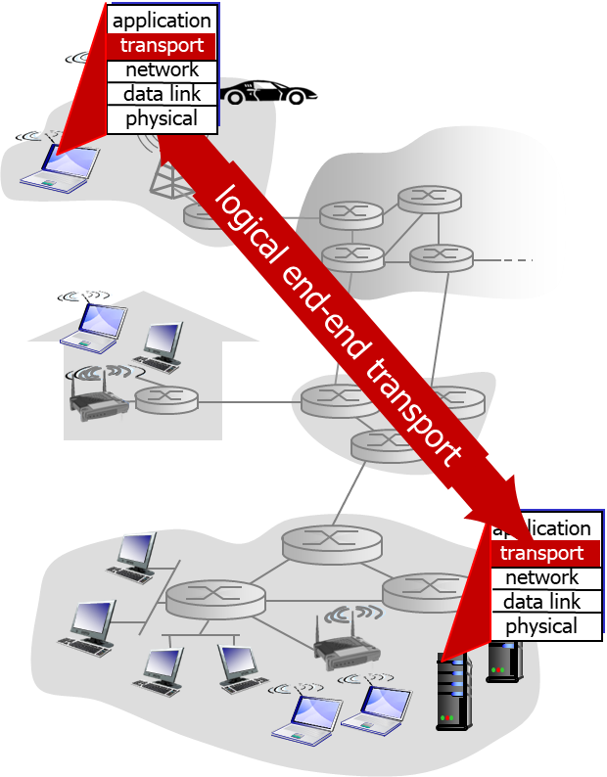
Transport Services and Protocols
provide logical communication between app processes running on different hosts
transport protocols run in end systems
  send side: breaks app messages into segments, passes to network layer
  rcv side: reassembles segments into messages, passes to app layer
more than one transport protocol available to apps
  Internet: T C P and U D P

Slide 5
Transport vs. Network Layer
network layer: logical communication between hosts
transport layer: logical communication between processes
  relies on, enhances, network layer services
household analogy:
12 kids in Ann’s house sending letters to 12 kids in Bill’s house:
hosts = houses
processes = kids
app messages = letters in envelopes
transport protocol = Ann and Bill who demux to in-house siblings
network-layer protocol = postal service

Slide 6
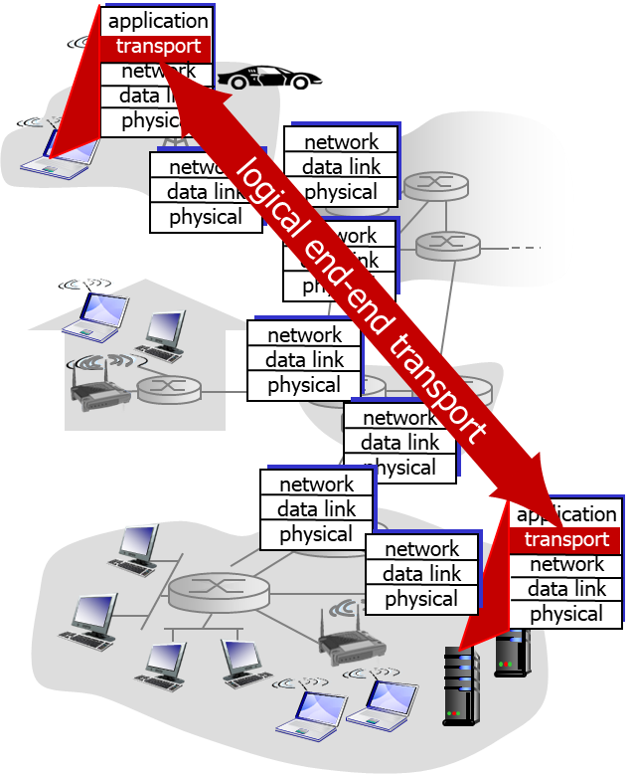
Internet Transport-Layer Protocols
reliable, in-order delivery (T C P)
  congestion control
  flow control
  connection setup
unreliable, unordered delivery: U D P
  no-frills extension of “best-effort” I P
services not available:
  delay guarantees
  bandwidth guarantees

Slide 7
Learning Objectives (2 of 10)
3.1 transport-layer services
3.2 multiplexing and demultiplexing
3.3 connectionless transport: U D P
3.4 principles of reliable data transfer
3.5 connection-oriented transport: T C P
  segment structure
  reliable data transfer
  flow control
  connection management
3.6 principles of congestion control
3.7 T C P congestion control

Slide 8
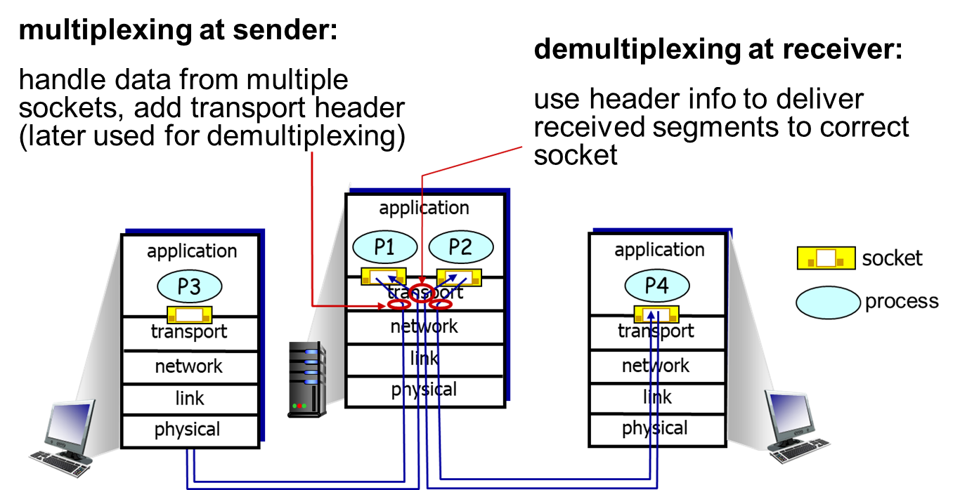
Multiplexing/Demultiplexing

Slide 9
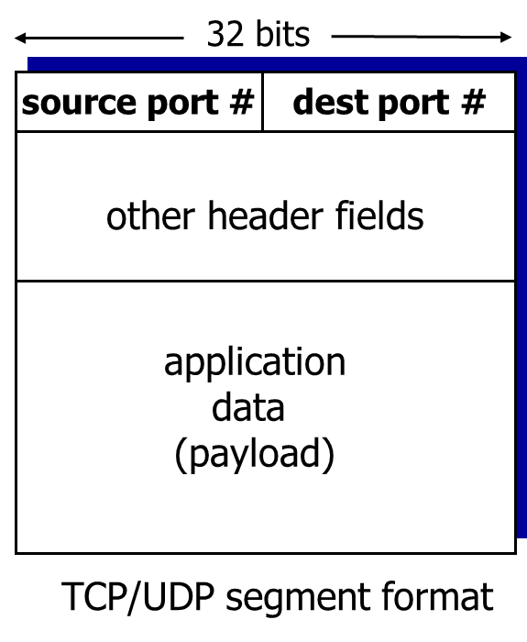
How Demultiplexing Works
host receives I P datagrams
  each datagram has source I P address, destination I P address
  each datagram carries one transport-layer segment
  each segment has source, destination port number
host uses I P addresses & port numbers to direct segment to appropriate socket

Slide 10

Connectionless Demultiplexing
recall: created socket has host-local port #:
recall: when creating datagram to send into U D P socket, must specify
  destination I P address
  destination port #
when host receives U D P segment:
  checks destination port # in segment
  directs U D P segment to socket with that port #
I P datagrams with same dest. port #, but different source I P addresses and/or source port numbers will be directed to same socket at dest

Slide 11
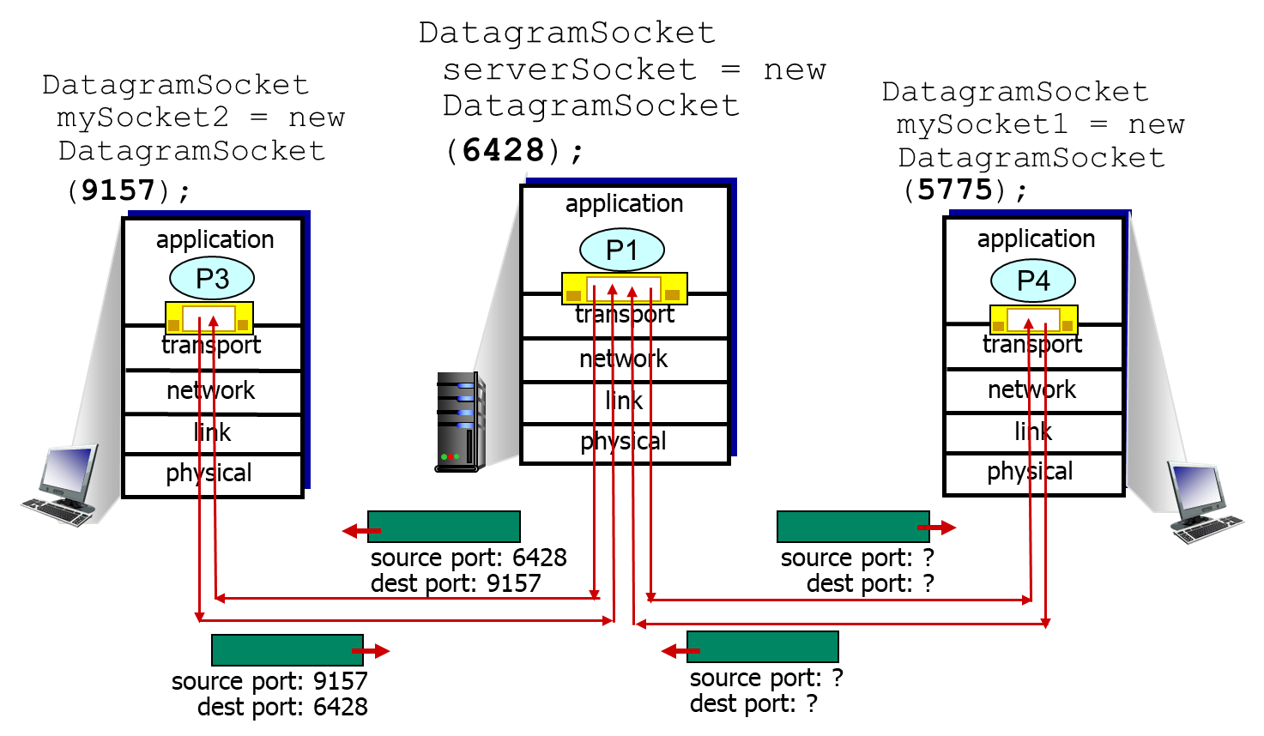
Connectionless Demux: Example

Slide 12
Connection-Oriented Demux
T C P socket identified by 4-tuple:
  source I P address
  source port number
  dest I P address
  dest port number
demux: receiver uses all four values to direct segment to appropriate socket
server host may support many simultaneous T C P sockets:
  each socket identified by its own 4-tuple
web servers have different sockets for each connecting client
  non-persistent H T T P will have different socket for each request

Slide 13
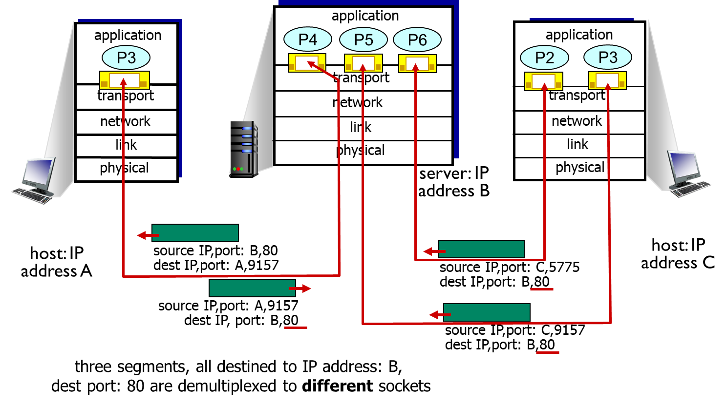
Connection-Oriented Demux: Example (1 of 2)

Slide 14
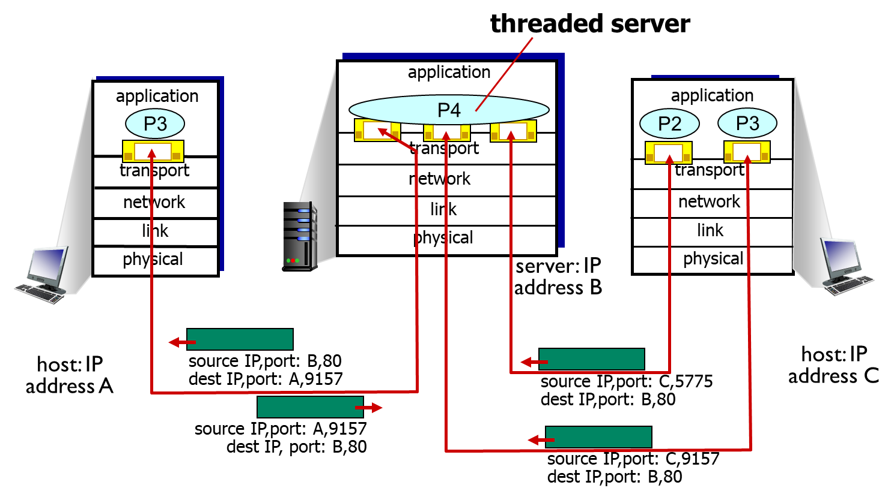
Connection-Oriented Demux: Example (2 of 2)

Slide 15
Learning Objectives (3 of 10)
3.1 transport-layer services
3.2 multiplexing and demultiplexing
3.3 connectionless transport: U D P
3.4 principles of reliable data transfer
3.5 connection-oriented transport: T C P
  segment structure
  reliable data transfer
  flow control
  connection management
3.6 principles of congestion control
3.7 T C P congestion control

Slide 16
U D P: User Datagram Protocol [R F C 768]
“no frills,” “bare bones” Internet transport protocol
“best effort” service, U D P segments may be:
  lost
  delivered out-of-order to app
connectionless:
  no handshaking between U D P sender, receiver
  each U D P segment handled independently of others
U D P use:
  streaming multimedia apps (loss tolerant, rate sensitive)
  D N S
  S N M P
reliable transfer over U D P:
  add reliability at application layer
  application-specific error recovery!

Slide 17
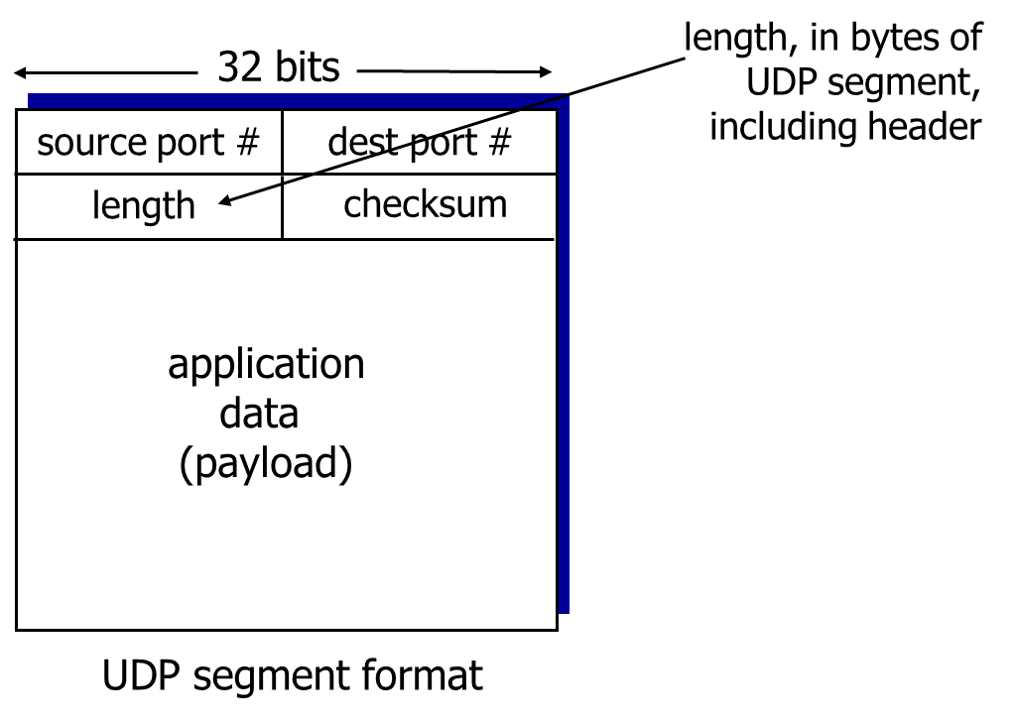
U D P: Segment Header (1 of 2)

Slide 18
U D P: Segment Header (2 of 2)
why is there a U D P?
no connection establishment (which can add delay)
simple: no connection state at sender, receiver
small header size
no congestion control: U D P can blast away as fast as desired

Slide 19
U D P Checksum
Goal: detect “errors” (example, flipped bits) in transmitted segment
sender:
treat segment contents, including header fields, as sequence of 16-bit integers
checksum: addition (one’s complement sum) of segment contents
sender puts checksum value into U D P checksum field
receiver:
compute checksum of received segment
check if computed checksum equals checksum field value:
  NO - error detected
  YES - no error detected. But maybe errors nonetheless? More later ….

Slide 20
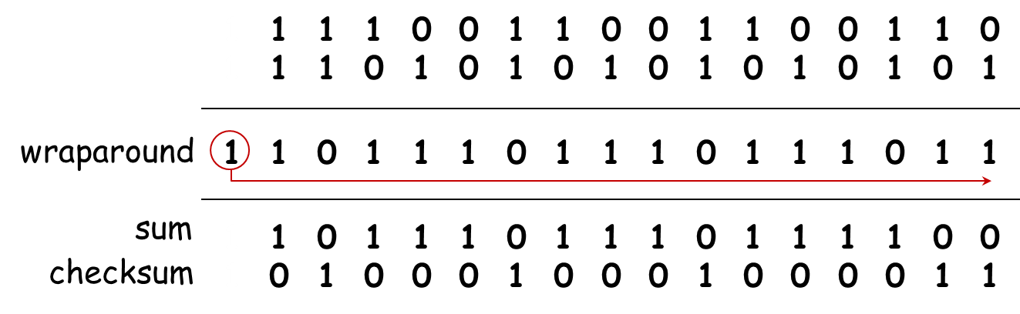
Internet Checksum: Example
example: add two 16-bit integers
+
+
1 1 1 1 1 1 1 1 1 1 1 1 1 1 1 1
Note: when adding numbers, a carryout from the most significant bit needs to be added to the result
Notes:
数据传输可能出错，源于目的间链路不保证都提供差错检测
数据存入内存也可能出错
sum与checksum按位相加，结果各位应全为1.

Slide 21
Learning Objectives (4 of 10)
3.1 transport-layer services
3.2 multiplexing and demultiplexing
3.3 connectionless transport: U D P
3.4 principles of reliable data transfer
3.5 connection-oriented transport: T C P
  segment structure
  reliable data transfer
  flow control
  connection management
3.6 principles of congestion control
3.7 T C P congestion control

Slide 22
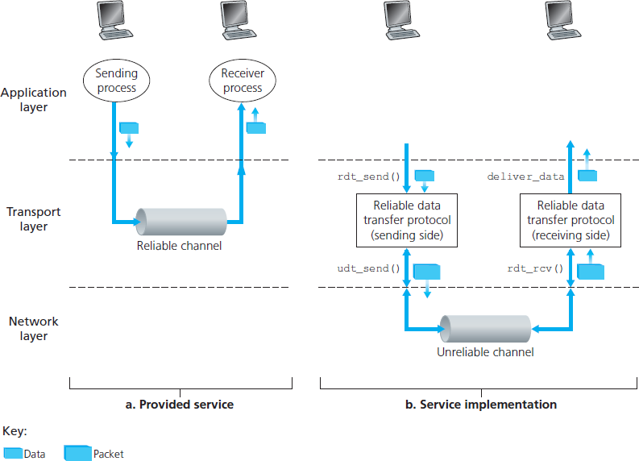
Principles of Reliable Data Transfer
important in application, transport, link layers
  top-10 list of important networking topics!
characteristics of unreliable channel will determine complexity of reliable data transfer protocol (r d t)

Slide 23
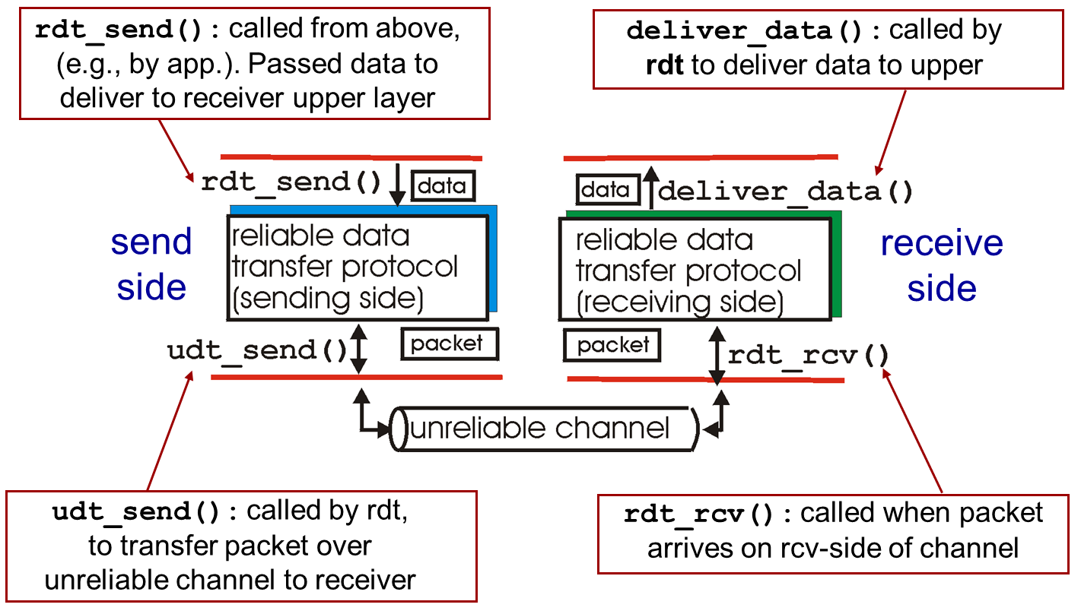
Reliable Data Transfer: Getting Started (1 of 2)

Slide 24
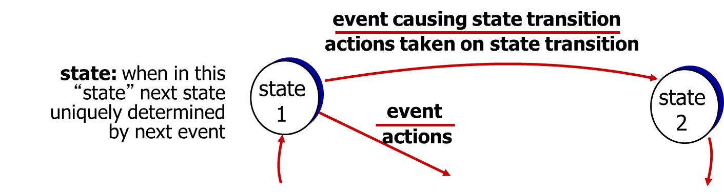
Reliable Data Transfer: Getting Started (2 of 2)
we’ll:
incrementally develop sender, receiver sides of reliable data transfer protocol (r d t)
consider only unidirectional data transfer
  but control info will flow on both directions!
use finite state machines (F S M) to specify sender, receiver

Slide 25
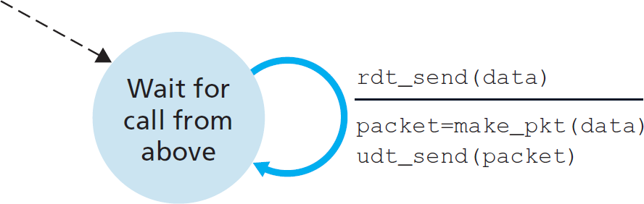
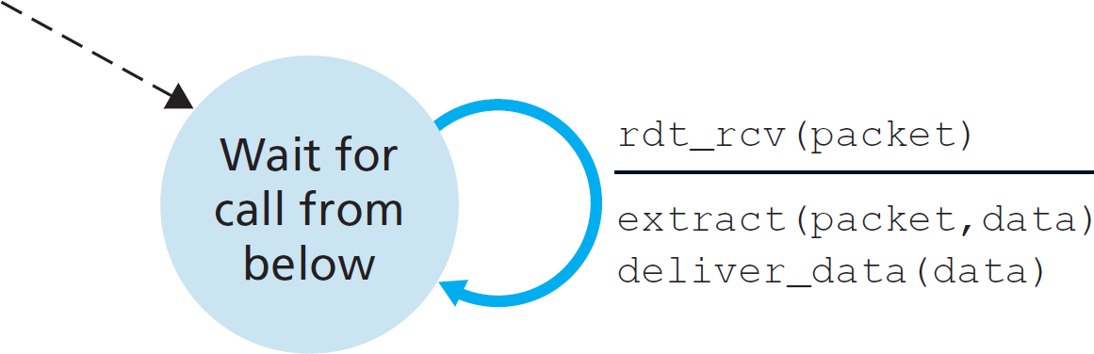
r d t1.0: Reliable Transfer over a Reliable Channel
underlying channel perfectly reliable
  no bit errors
  no loss of packets
separate F S M s for sender, receiver:
  sender sends data into underlying channel
  receiver reads data from underlying channel
sender
receiver
Notes:
底层可靠
双方速度匹配

Slide 26
r d t2.0: Channel with Bit Errors (1 of 2)
underlying channel may flip bits in packet
  checksum to detect bit errors
the question: how to recover from errors:
How do humans recover from “errors” during conversation?

Slide 27
r d t2.0: Channel with Bit Errors (2 of 2)
underlying channel may flip bits in packet
  checksum to detect bit errors
the question: how to recover from errors:
  acknowledgements (A C K s): receiver explicitly tells sender that pkt received O K
  negative acknowledgements (N A K s): receiver explicitly tells sender that pkt had errors
  sender retransmits pkt on receipt of N A K
new mechanisms in r d t2.0 (beyond r d t1.0):
  error detection
  feedback: control msgs (A C K, N A K) from receiver to sender

Slide 28
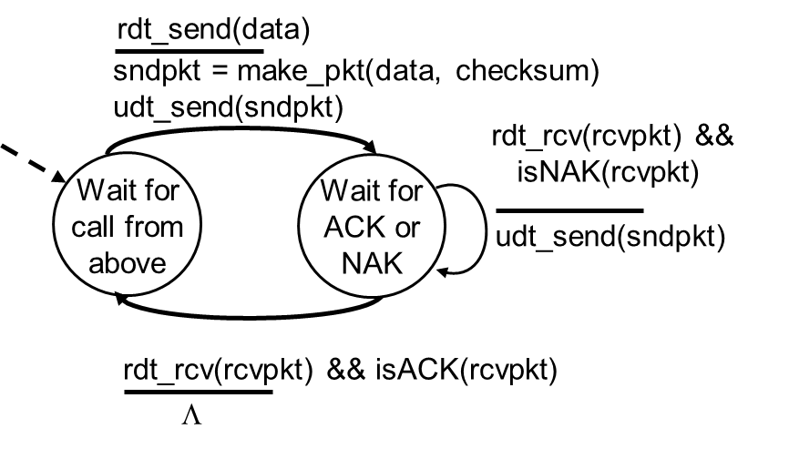
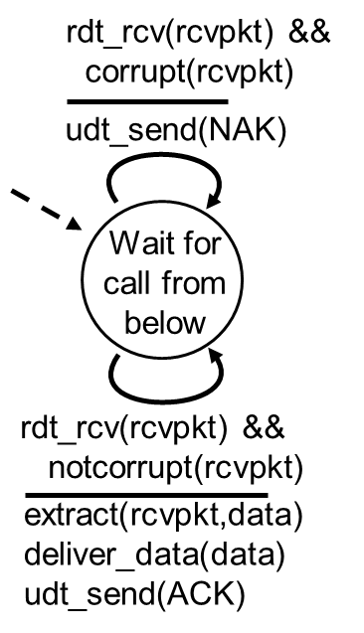
r d t2.0: F S M Specification
sender
receiver
Notes:
校验技术检测错误

Slide 29
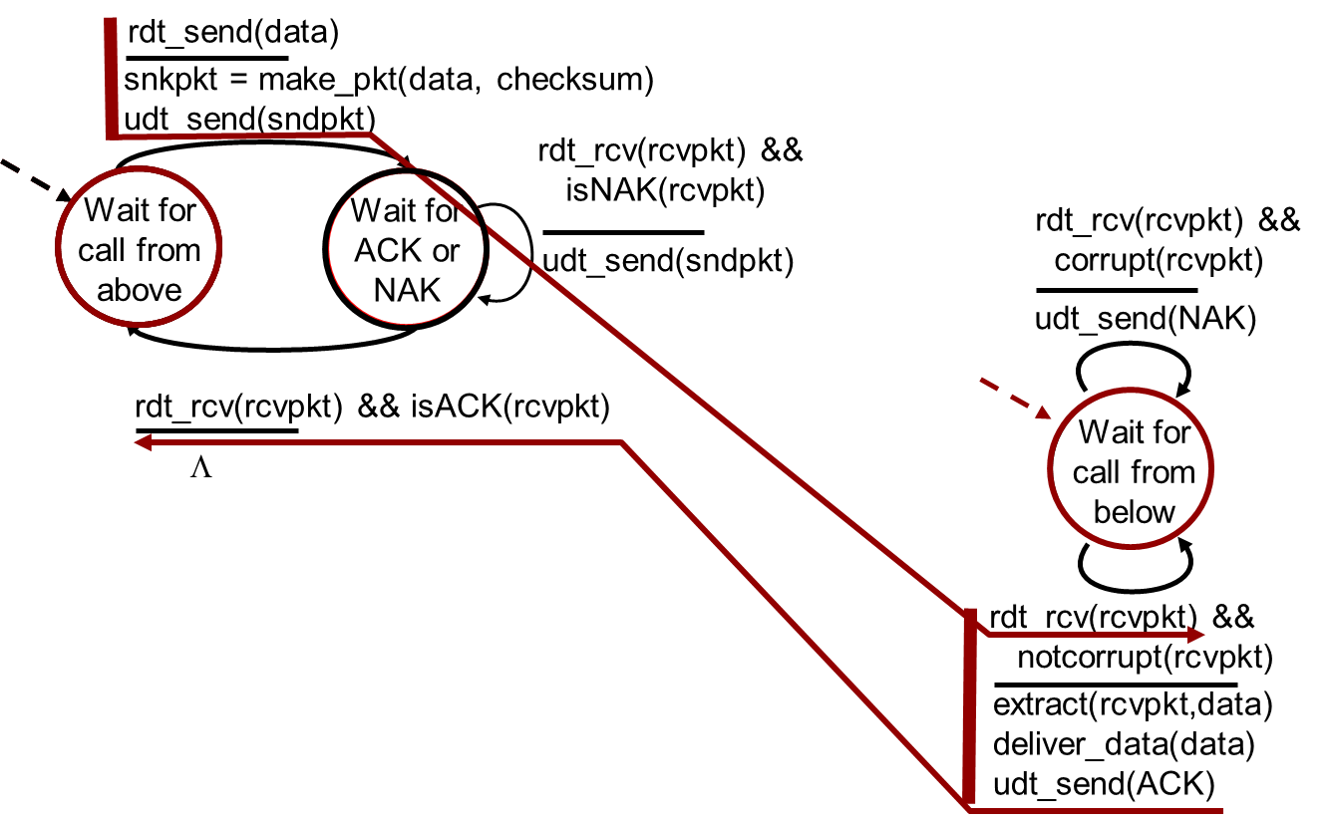
r d t2.0: Operation with No Errors

Slide 30
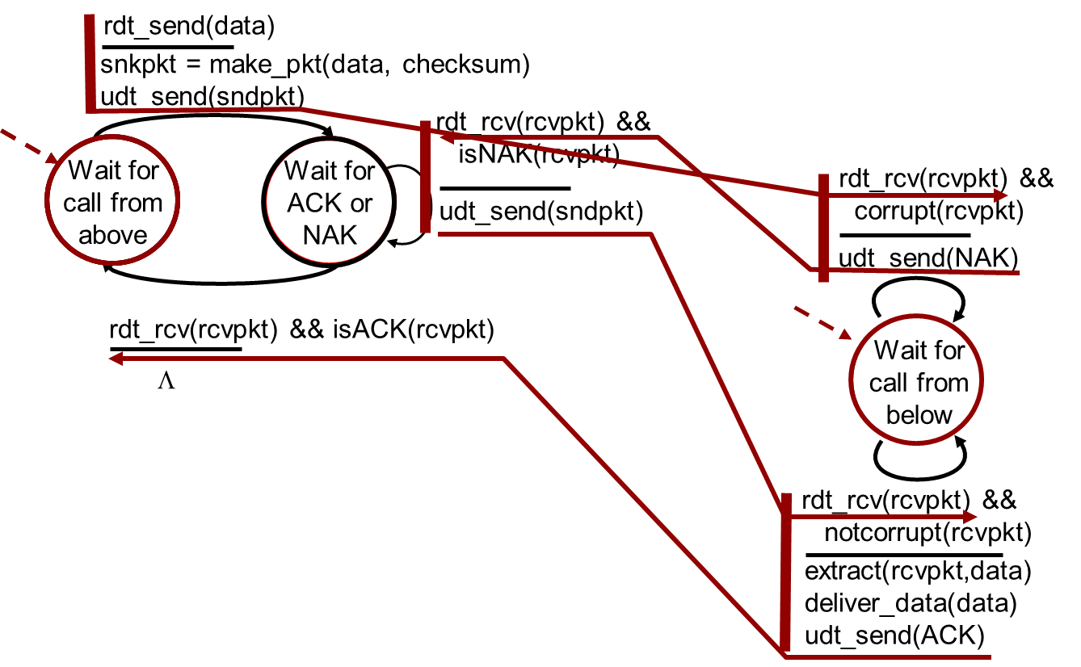
r d t2.0: Error Scenario
Notes:
停等协议

Slide 31
r d t2.0 Has a Fatal Flaw!
what happens if A C K / N A K corrupted?
sender doesn’t know what happened at receiver!
Can’t just retransmit: possible duplicate
handling duplicates:
sender retransmits current pkt if A C K / N A K corrupted
sender adds sequence number to each pkt
receiver discards (doesn’t deliver up) duplicate pkt
stop and wait
sender sends one packet, then waits for receiver response
Notes:
收到损坏的ACK
差错恢复或重发数据包，但接收方要能识别数据包是够重复

Slide 32
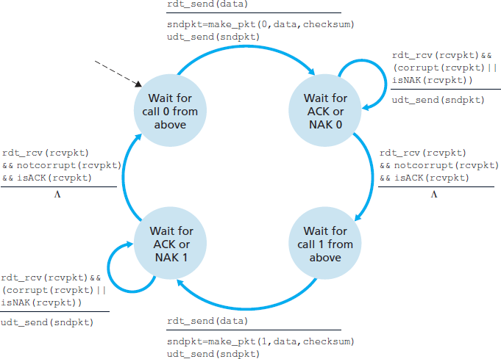
r d t2.1: Sender, Handles Garbled A C K / N A K s

Slide 33
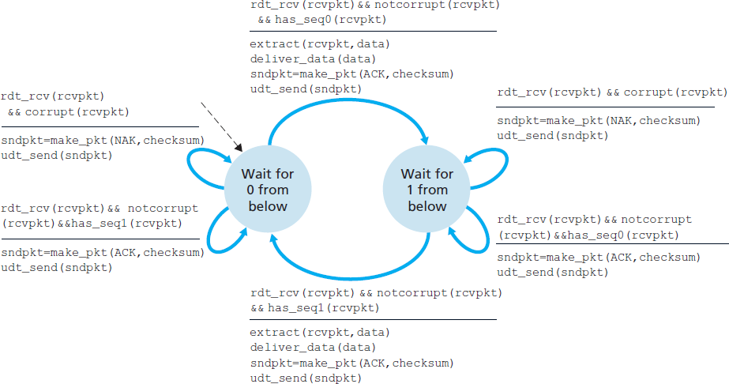
r d t2.1: Receiver, Handles Garbled A C K/N A K s

Slide 34
r d t2.1: Discussion
sender:
seq # added to pkt
two Sequence #’s (0,1) will suffice. Why?
must check if received A C K / N A K corrupted
twice as many states
  state must “remember” whether “expected” pkt should have seq # of 0 or 1
receiver:
must check if received packet is duplicate
  state indicates whether 0 or 1 is expected pkt seq #
note: receiver can not know if its last A C K/N A K received O K at sender
Notes:
假设不丢包
ACK、NAK不带序号
发送方知道收到的ACK是回应最近发的包

Slide 35
r d t2.2: A N A K - f r e e Protocol
same functionality as r d t2.1, using A C Ks only
instead of N A K, receiver sends A C K for last pkt received O K
  receiver must explicitly include seq # of pkt being ACKed
duplicate A C K at sender results in same action as N A K: retransmit current pkt
Notes:
在上一次正确收到数据包的ACK后再发一个ACK，含义和NAK一样

Slide 36
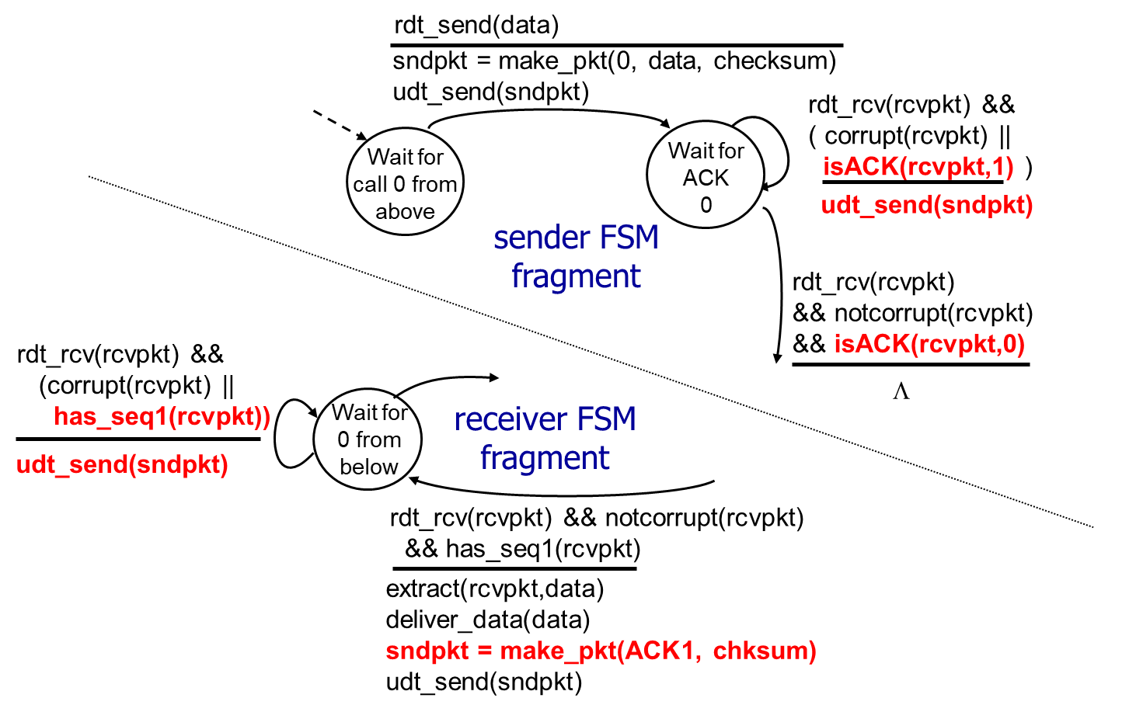
r d t2.2: Sender, Receiver Fragments

Slide 37
r d t3.0: Channels with Errors and Loss
new assumption: underlying channel can also lose packets (data, A C K s)
  checksum, Sequence #, A C K s, retransmissions will be of help … but not enough
approach: sender waits “reasonable” amount of time for A C K
retransmits if no A C K received in this time
if pkt (or A C K) just delayed (not lost):
  retransmission will be duplicate, but Sequence #’s already handles this
  receiver must specify seq # of pkt being ACKed
requires countdown timer

Slide 38
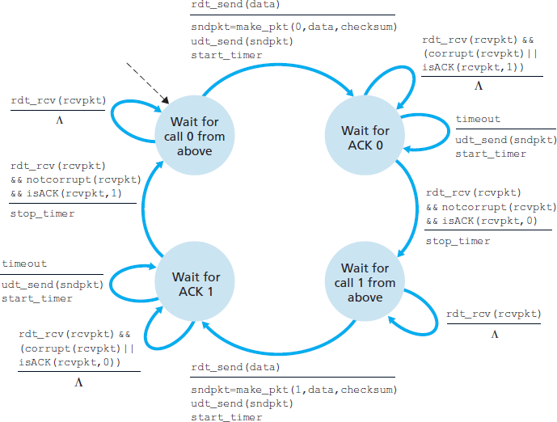
r d t3.0 Sender

Slide 39
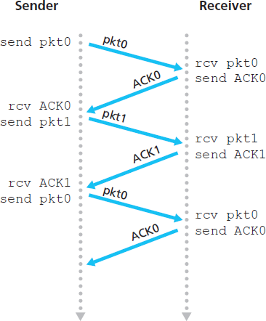
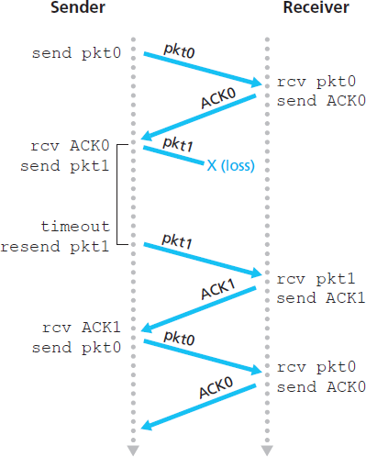
r d t3.0 in Action (1 of 2)
(a) no loss
(b) packet loss

Slide 40
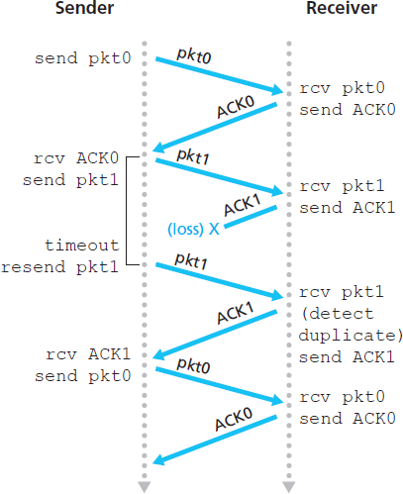
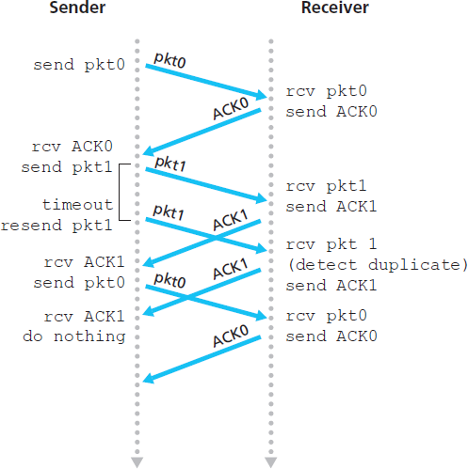
r d t3.0 in Action (2 of 2)
(c) A C K loss
(d) premature timeout/ delayed A C K

Slide 41
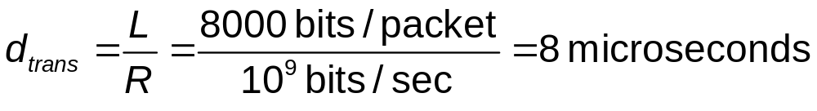
Performance of r d t3.0 (1 of 2)
r d t3.0 is correct, but performance stinks
example: 1 G b p s link, 15 millisecond（ms） prop. delay, 8000 bit packet:
（us）

Slide 42
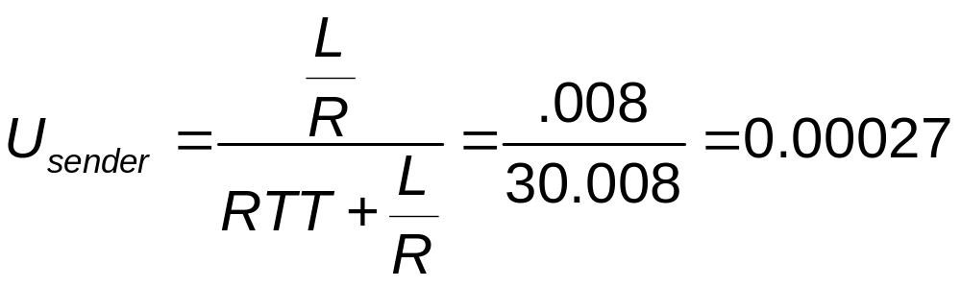
Performance of r d t3.0 (2 of 2)
  U_{sender}: utilization – fraction of time sender busy sending
  if R T T = 30 msec, 1K B pkt every 30 msec: 33k B/sec thruput over 1 G b p s link
network protocol limits use of physical resources!

Slide 43
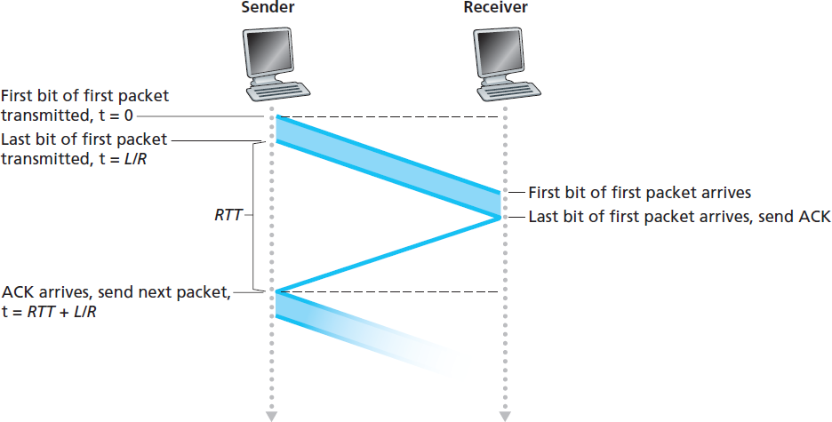

r d t3.0: Stop-and-wait Operation

Slide 44
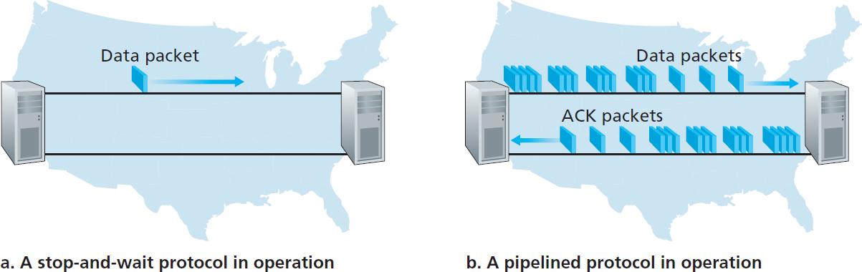
Pipelined Protocols
pipelining: sender allows multiple, “in-flight”, yet-to-be acknowledged pkts
  range of sequence numbers must be increased
  buffering at sender and/or receiver
two generic forms of pipelined protocols: go-Back-N, selective repeat

Slide 45
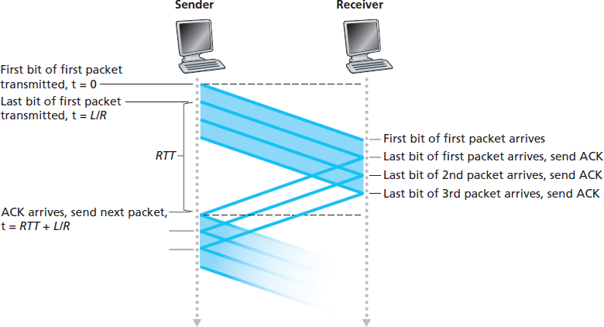
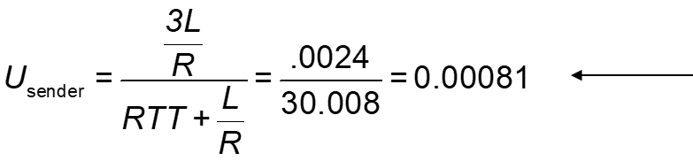
Pipelining: Increased Utilization
3-packet pipelining increases utilization by a factor of 3!

Slide 46
Pipelined Protocols: Overview
Go-back-N:
sender can have up to N unacked packets in pipeline
receiver only sends cumulative a c k
  doesn’t a c k packet if there’s a gap
sender has timer for oldest unacked packet
  when timer expires, retransmit all unacked packets
Selective Repeat:
sender can have up to N unack’ed packets in pipeline
rcvr sends individual a c k for each packet
sender maintains timer for each unacked packet
  when timer expires, retransmit only that unacked packet

Slide 47
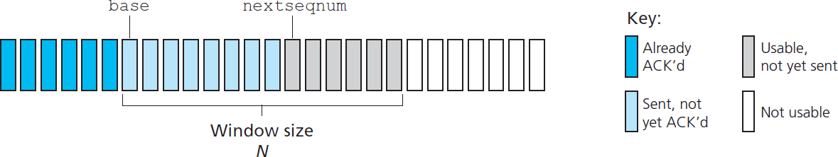
G o - B a c k - N: Sender
k-bit seq # in pkt header
“window” of up to N, consecutive unack’ed pkts allowed
A C K (n): A C K s all pkts up to, including seq # n – “cumulative A C K”
  may receive duplicate A C K s (see receiver)
timer for oldest in-flight pkt
timeout(n): retransmit packet n and all higher seq # pkts in window

Slide 48
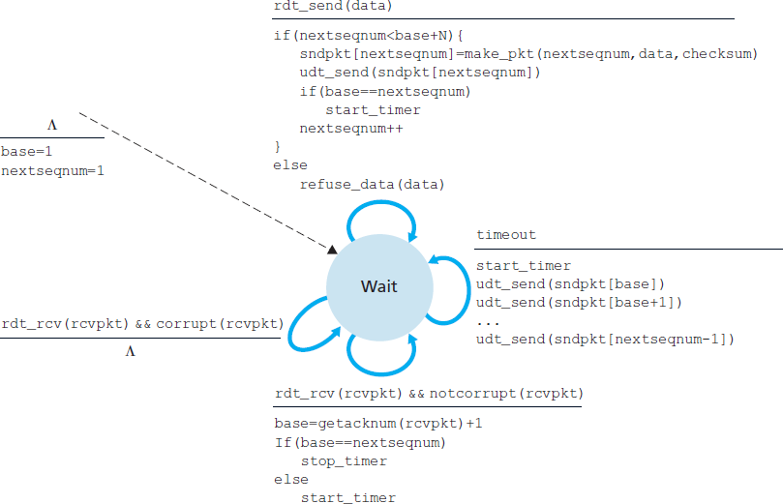
G B N: Sender Extended F S M

Slide 49
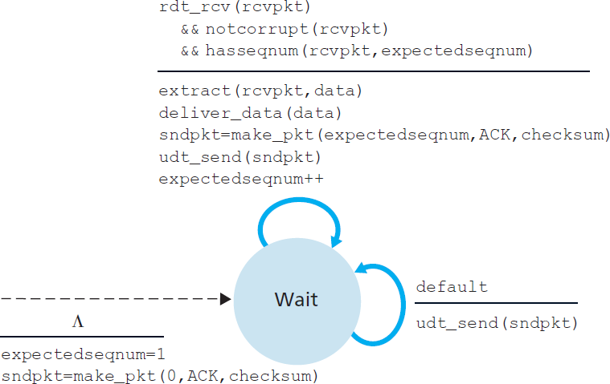
G B N: Receiver Extended F S M (1 of 2)

Slide 50
G B N: Receiver Extended F S M (2 of 2)
A C K-only: always send A C K for correctly-received pkt with highest in-order seq #
  may generate duplicate A C Ks
  need only remember expectedseqnum
out-of-order pkt:
  discard (don’t buffer): no receiver buffering!
  re-A C K pkt with highest in-order seq #

Slide 51
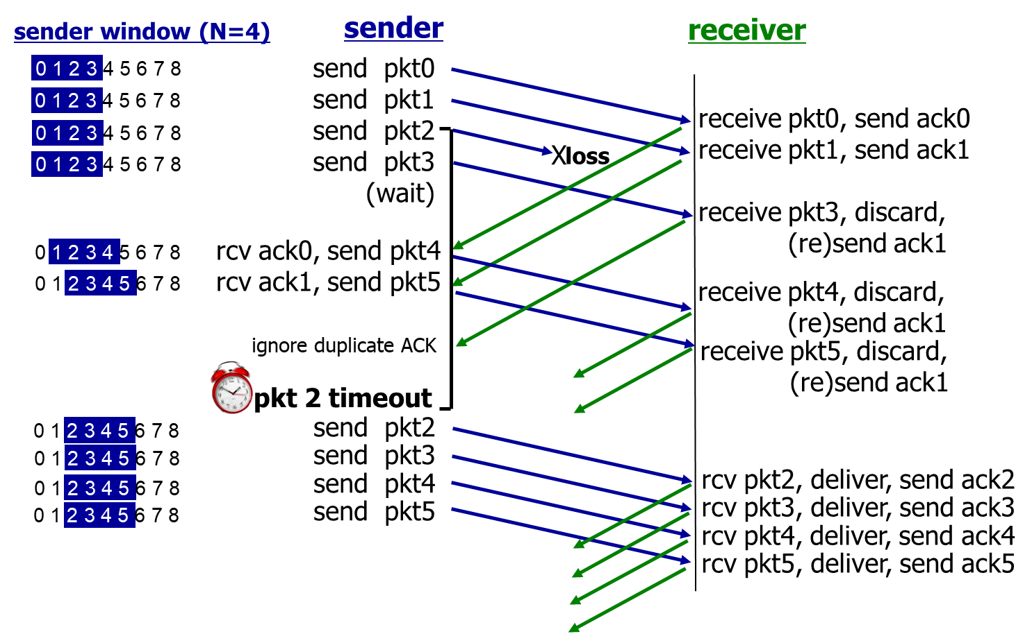
G B N in Action

Slide 52
Selective Repeat (1 of 3)
receiver individually acknowledges all correctly received pkts
  buffers pkts, as needed, for eventual in-order delivery to upper layer
sender only resends pkts for which A C K not received
  sender timer for each un ACKed pkt
sender window
  N consecutive seq #’s
  limits seq #s of sent, un ACKed pkts

Slide 53
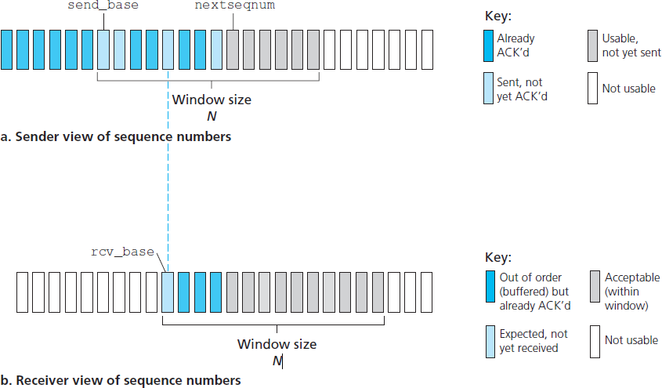
Selective Repeat: Sender, Receiver Windows

Slide 54
Selective Repeat (2 of 3)
sender
data from above:
if next available seq # in window, send pkt
timeout(n):
resend pkt n, restart timer
A C K(n) in [sendbase,sendbase+N]:
mark pkt n as received
if n smallest un ACKed pkt, advance window base to next unA C Ked seq #

Slide 55
Selective Repeat (3 of 3)
receiver
pkt n in [rcvbase, rcvbase+N-1]
send A C K(n)
out-of-order: buffer
in-order: deliver (also deliver buffered, in-order pkts), advance window to next not-yet-received pkt
pkt n in [rcvbase-N,rcvbase-1]
A C K(n)
otherwise:
ignore

Slide 56
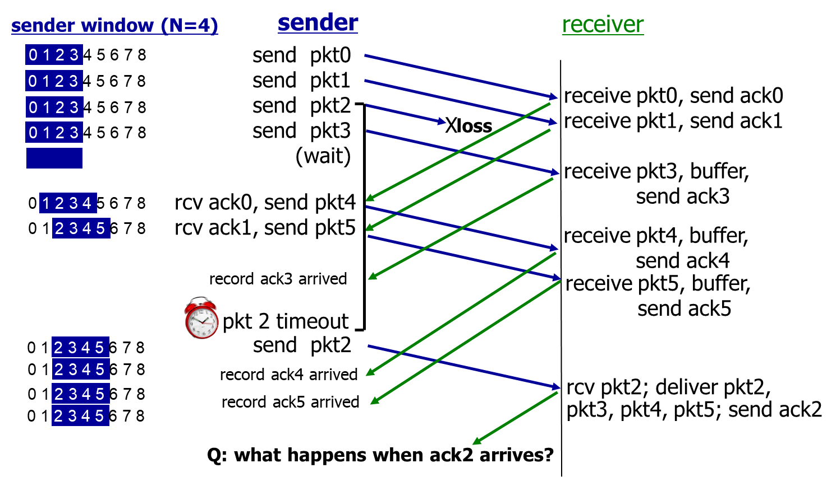
Selective Repeat in Action

Slide 57
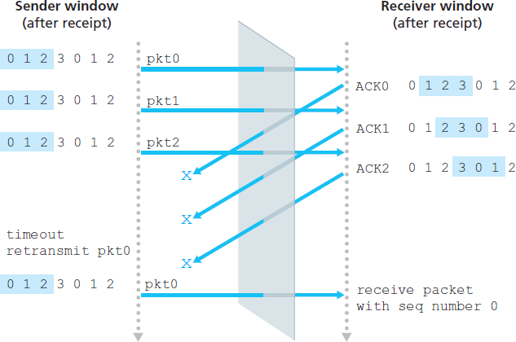
Selective Repeat: Dilemma (1 of 2)
example:
seq #’s: 0, 1, 2, 3
window size=3
receiver sees no difference in two scenarios!
duplicate data accepted as new in (b)
(a) no problem
receiver can’t see sender side. receiver behavior identical in both cases! something’s (very) wrong!

Slide 58
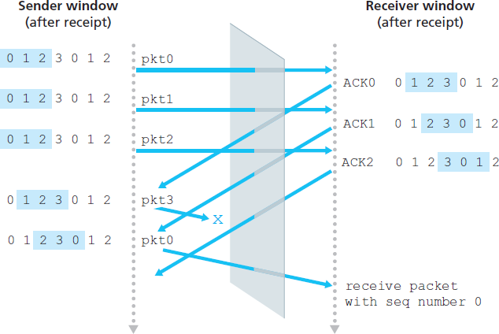
Selective Repeat: Dilemma (2 of 2)
Q: what relationship between seq # size and window size to avoid problem in (b)?
(b) oops!
Notes:
窗口长度必须小于序号空间的一半

Slide 59
Learning Objectives (5 of 10)
3.1 transport-layer services
3.2 multiplexing and demultiplexing
3.3 connectionless transport: U D P
3.4 principles of reliable data transfer
3.5 connection-oriented transport: T C P
  segment structure
  reliable data transfer
  flow control
  connection management
3.6 principles of congestion control
3.7 T C P congestion control

Slide 60
T C P: Overview R F C s: 793, 1122, 1323, 2018, 2581
point-to-point:
  one sender, one receiver
reliable, in-order byte stream:
  no “message boundaries”
pipelined:
  T C P congestion and flow control set window size
full duplex data:
  bi-directional data flow in same connection
  M S S: maximum segment size
connection-oriented:
  handshaking (exchange of control msgs) inits sender, receiver state before data exchange
flow controlled:
  sender will not overwhelm receiver

Slide 61
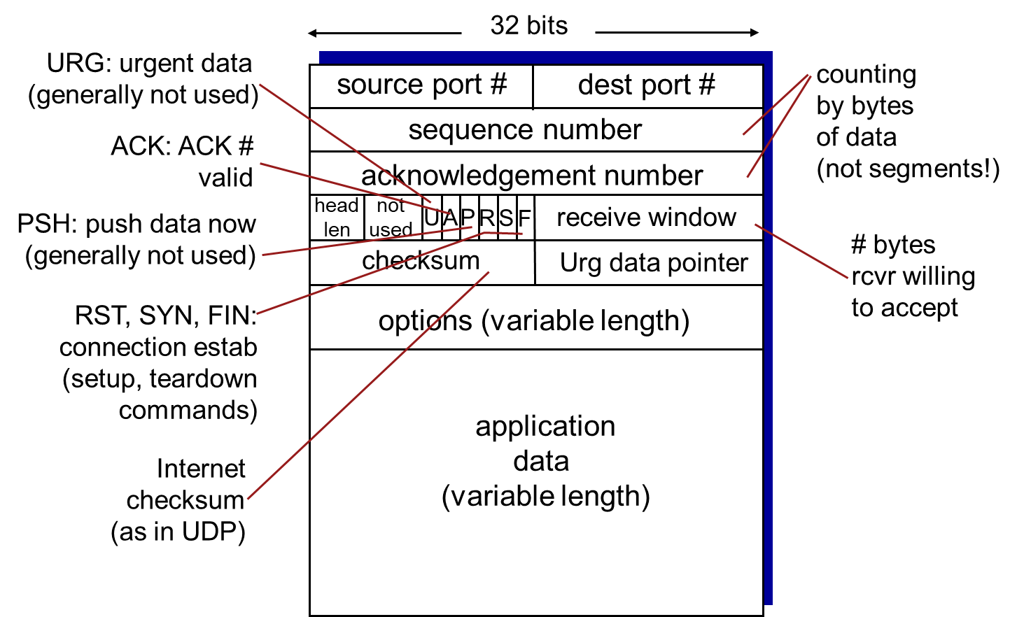
T C P Segment Structure

Slide 62
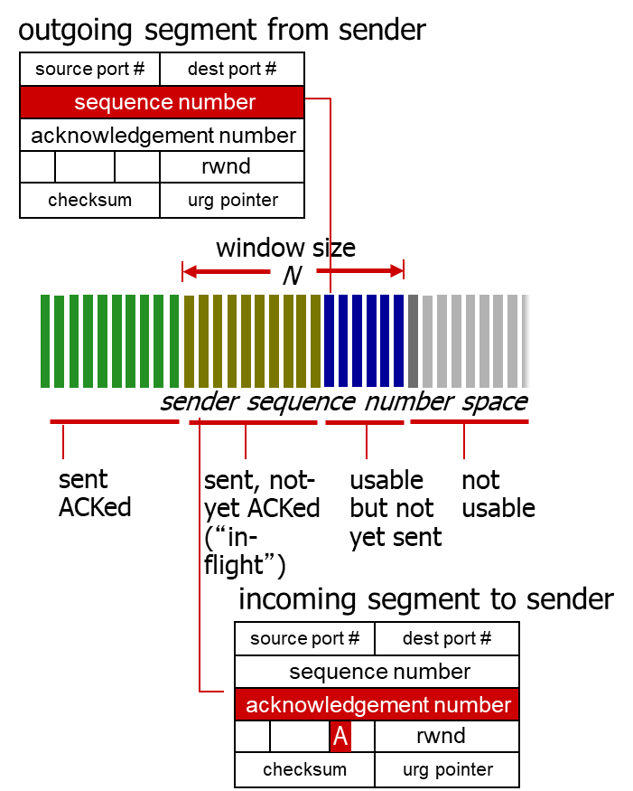
T C P Sequence Numbers, A C K s (1 of 2)
sequence numbers:
  byte stream “number” of first byte in segment’s data
acknowledgements:
  seq # of next byte expected from other side
  cumulative A C K
Q: how receiver handles out-of-order segments
  A: T C P spec doesn’t say, - up to implementor

Slide 63
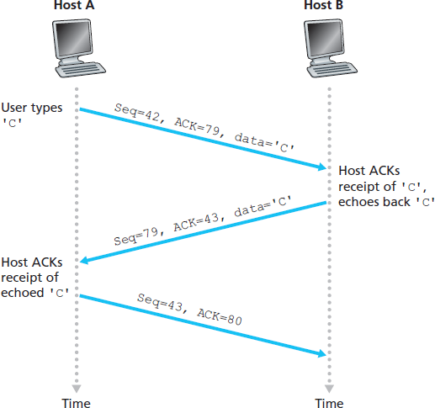
T C P Sequence Numbers, A C K s (2 of 2)

Slide 64
T C P Round Trip Time, Timeout (1 of 3)
Q: how to set T C P timeout value?
longer than R T T
  but R T T varies
too short: premature timeout, unnecessary retransmissions
too long: slow reaction to segment loss
Q: how to estimate R T T?
SampleR T T: measured time from segment transmission until A C K receipt
  ignore retransmissions
SampleR T T will vary, want estimated R T T “smoother”
  average several recent measurements, not just current SampleR T T

Slide 65
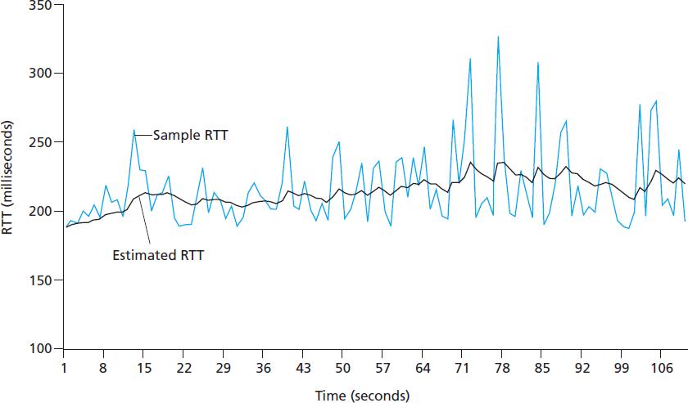
T C P Round Trip Time, Timeout (2 of 3)
exponential weighted moving average
influence of past sample decreases exponentially fast
typical value: α = 0.125

Slide 66
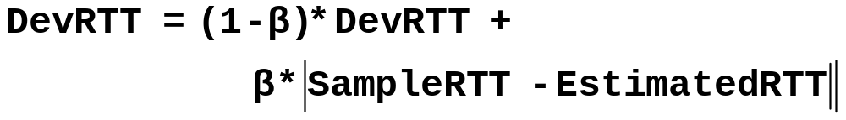


T C P Round Trip Time, Timeout (3 of 3)
timeout interval: Estimated R T T plus “safety margin”
  estimate Sample R T T deviation from EstimatedR T T:

Slide 67
Learning Objectives (6 of 10)
3.1 transport-layer services
3.2 multiplexing and demultiplexing
3.3 connectionless transport: U D P
3.4 principles of reliable data transfer
3.5 connection-oriented transport: T C P
  segment structure
  reliable data transfer
  flow control
  connection management
3.6 principles of congestion control
3.7 T C P congestion control

Slide 68
T C P Reliable Data Transfer
T C P creates r d t service on top of I P’s unreliable service
  pipelined segments
  cumulative acks
  single retransmission timer
retransmissions triggered by:
  timeout events
  duplicate acks
let’s initially consider simplified T C P sender:
  ignore duplicate acks
  ignore flow control, congestion control

Slide 69
T C P Sender Events:
data rcvd from app:
create segment with seq #
seq # is byte-stream number of first data byte in segment
start timer if not already running
  think of timer as for oldest unacked segment
  expiration interval: TimeOutInterval
timeout:
retransmit segment that caused timeout
restart timer
ack rcvd:
if ack acknowledges previously unacked segments
  update what is known to be ACKed
  start timer if there are still unacked segments

Slide 70
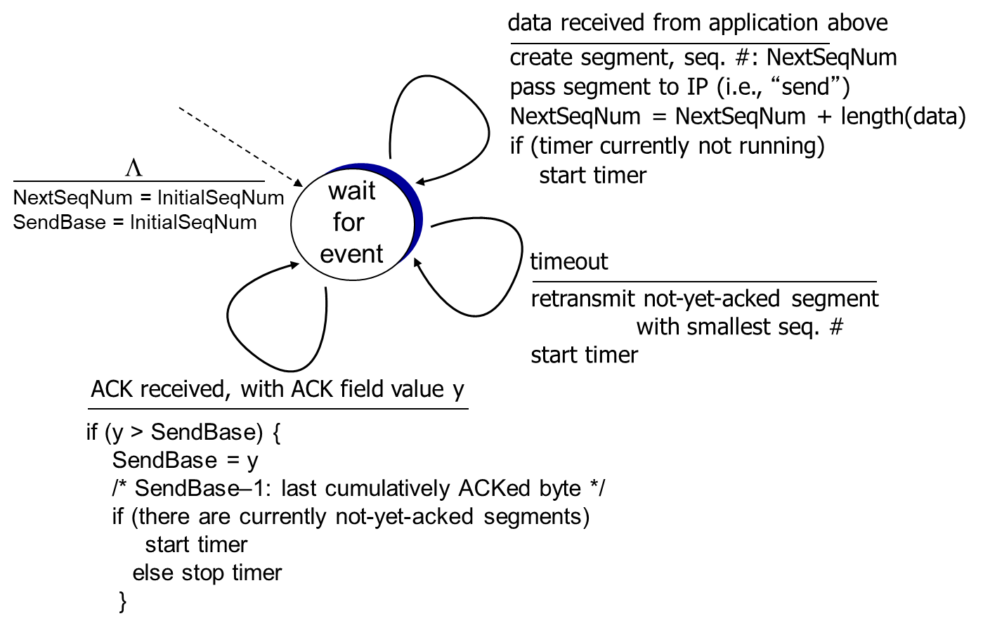
T C P Sender (Simplified)

Slide 71
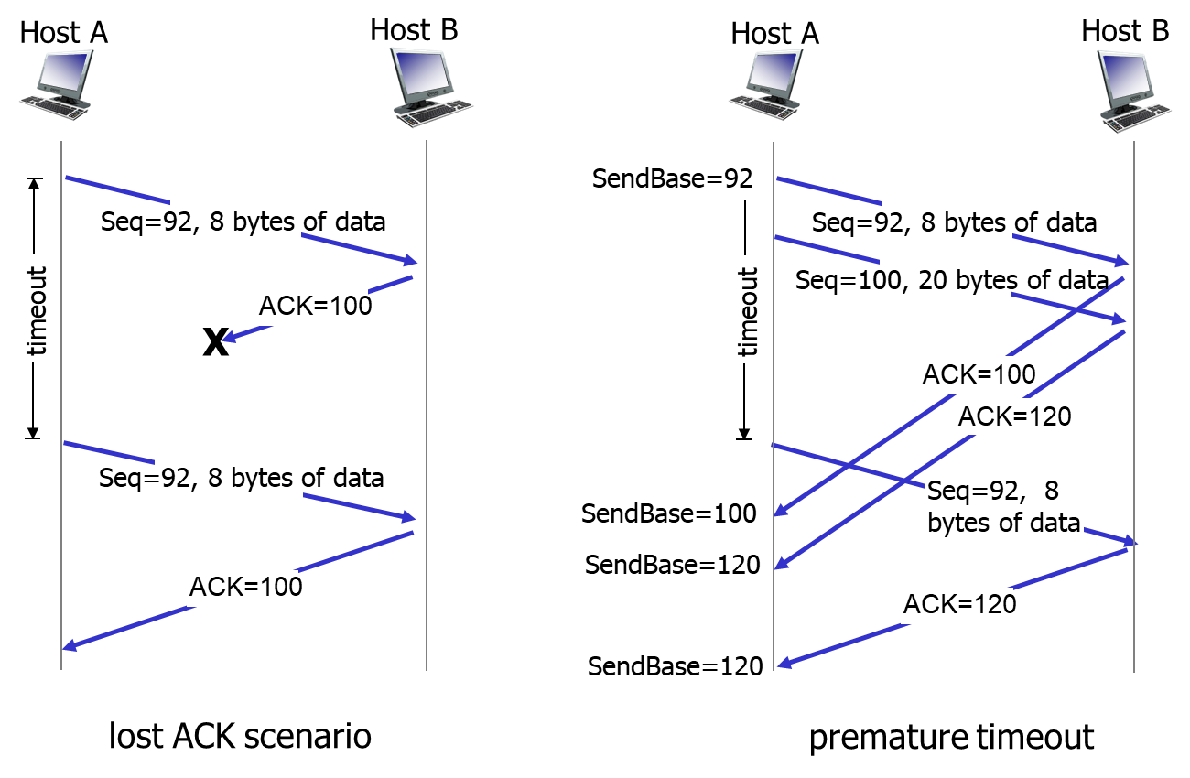
T C P: Retransmission Scenarios (1 of 2)

Slide 72
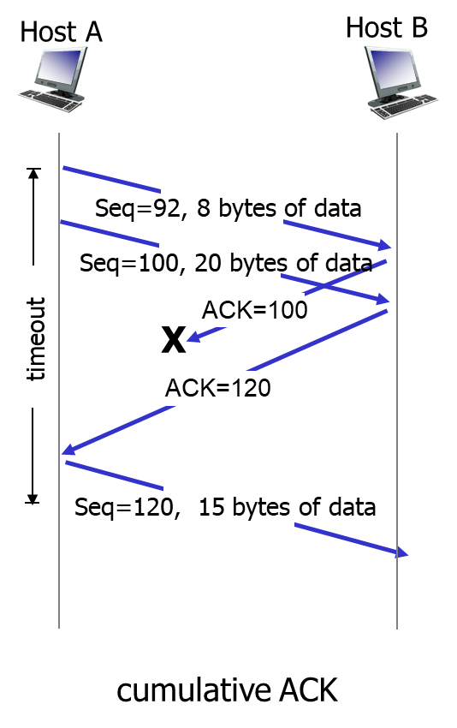
T C P: Retransmission Scenarios (2 of 2)

Slide 73
T C P A C K Generation [R F C 1122, R F C 2581]
event at receiver | T C P receiver action
arrival of in-order segment with expected seq #. All data up to expected seq # already ACKed | delayed ACK. Wait up to 500ms for next segment. If no next segment, send ACK
arrival of in-order segment with expected seq #. One other segment has A C K pending | immediately send single cumulative A C K, A C King both in-order segments
arrival of out-of-order segment higher-than-expect Sequence # . Gap detected | immediately send duplicate ACK, indicating Sequence # of next expected byte
arrival of segment that partially or completely fills gap | immediate send A C K, provided that segment starts at lower end of gap

Slide 74
T C P Fast Retransmit (1 of 2)
time-out period often relatively long:
  long delay before resending lost packet
detect lost segments via duplicate A C K s.
  sender often sends many segments back-to-back
  if segment is lost, there will likely be many duplicate A C K s.
T C P fast retransmit
if sender receives 3 A C K s for same data (“triple duplicate A C K s”), resend unacked segment with smallest seq #
  likely that unacked segment lost, so don’t wait for timeout

Slide 75
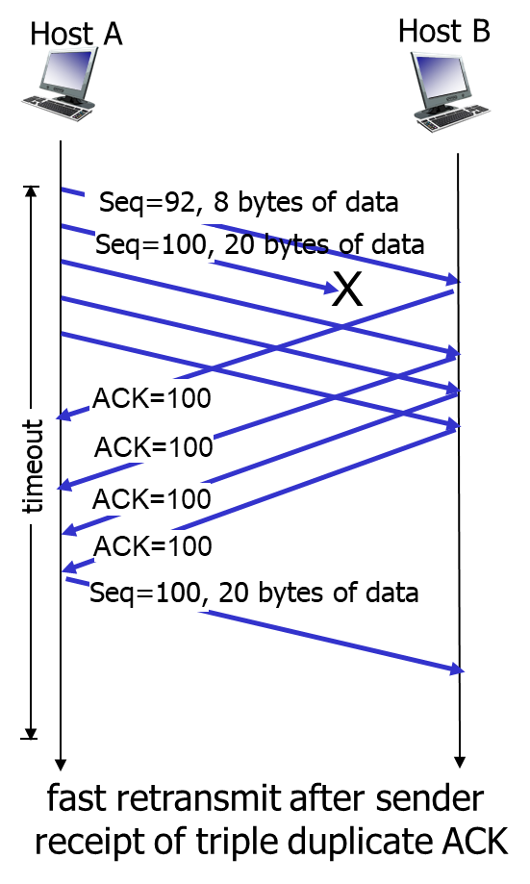
T C P Fast Retransmit (2 of 2)

Slide 76
Learning Objectives (7 of 10)
3.1 transport-layer services
3.2 multiplexing and demultiplexing
3.3 connectionless transport: U D P
3.4 principles of reliable data transfer
3.5 connection-oriented transport: T C P
  segment structure
  reliable data transfer
  flow control
  connection management
3.6 principles of congestion control
3.7 T C P congestion control

Slide 77
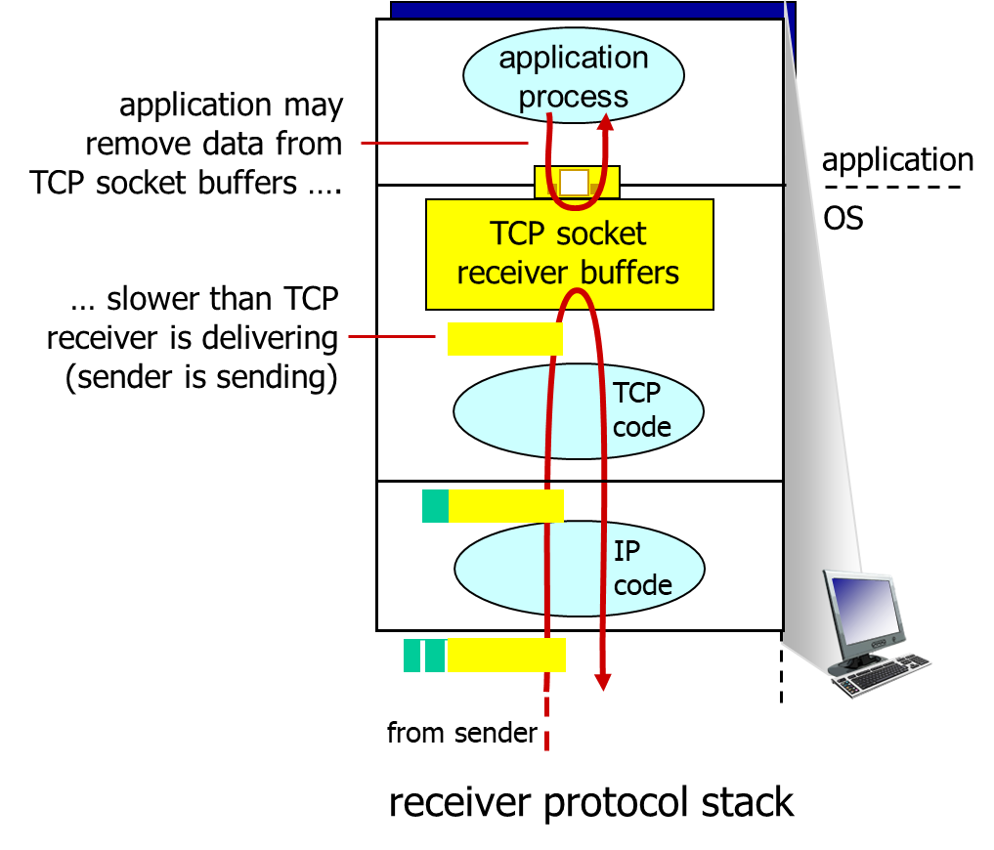
T C P Flow Control (1 of 2)
flow control
receiver controls sender, so sender won’t overflow receiver’s buffer by transmitting too much, too fast

Slide 78

T C P Flow Control (2 of 2)
receiver “advertises” free buffer space by including rwnd value in T C P header of receiver-to-sender segments
  RcvBuffer size set via socket options (typical default is 4096 bytes)
  many operating systems autoadjust RcvBuffer
sender limits amount of unacked (“in-flight”) data to receiver’s rwnd value
guarantees receive buffer will not overflow

Slide 79
Learning Objectives (8 of 10)
3.1 transport-layer services
3.2 multiplexing and demultiplexing
3.3 connectionless transport: U D P
3.4 principles of reliable data transfer
3.5 connection-oriented transport: T C P
  segment structure
  reliable data transfer
  flow control
  connection management
3.6 principles of congestion control
3.7 T C P congestion control

Slide 80

Connection Management
before exchanging data, sender/receiver “handshake”:
agree to establish connection (each knowing the other willing to establish connection)
agree on connection parameters

Slide 81

Agreeing to Establish a Connection (1 of 2)
2-way handshake:
Q: will 2-way handshake always work in network?
variable delays
retransmitted messages (example. req_conn(x)) due to message loss
message reordering
can’t “see” other side

Slide 82

Agreeing to Establish a Connection (2 of 2)
2-way handshake failure scenarios:

Slide 83

T C P 3-Way Handshake

Slide 84

T C P 3-Way Handshake: F S M

Slide 85
T C P: Closing a Connection (1 of 2)
client, server each close their side of connection
  send T C P segment with F I N bit = 1
respond to received F I N with A C K
  on receiving F I N, A C K can be combined with own F I N
simultaneous F I N exchanges can be handled

Slide 86

T C P: Closing a Connection (2 of 2)

Slide 87
Learning Objectives (9 of 10)
3.1 transport-layer services
3.2 multiplexing and demultiplexing
3.3 connectionless transport: U D P
3.4 principles of reliable data transfer
3.5 connection-oriented transport: T C P
  segment structure
  reliable data transfer
  flow control
  connection management
3.6 principles of congestion control
3.7 T C P congestion control

Slide 88
Principles of Congestion Control
congestion:
informally: “too many sources sending too much data too fast for network to handle”
different from flow control!
manifestations:
  lost packets (buffer overflow at routers)
  long delays (queueing in router buffers)
a top-10 problem!

Slide 89

Causes/Costs of Congestion: Scenario 1 (1 of 2)
two senders, two receivers
one router, infinite buffers
output link capacity: R
no retransmission

Slide 90




Causes/Costs of Congestion: Scenario 1 (2 of 2)
maximum per-connection throughput:
large delays as arrival rate,
approaches capacity

Slide 91



Causes/Costs of Congestion: Scenario 2 (1 of 6)
one router, finite buffers
sender retransmission of timed-out packet
  application-layer input = application-layer output:
  transport-layer input includes retransmissions :

Slide 92


Causes/Costs of Congestion: Scenario 2 (2 of 6)
idealization: perfect knowledge
  sender sends only when router buffers available

Slide 93

Causes/Costs of Congestion: Scenario 2 (3 of 6)
Idealization: known loss packets can be lost, dropped at router due to full buffers
sender only resends if packet known to be lost

Slide 94


Causes/Costs of Congestion: Scenario 2 (4 of 6)

Slide 95

Causes/Costs of Congestion: Scenario 2 (5 of 6)
Realistic: duplicates
packets can be lost, dropped at router due to full buffers
sender times out prematurely, sending two copies, both of which are delivered

Slide 96

Causes/Costs of Congestion: Scenario 2 (6 of 6)
“costs” of congestion:
more work (retrans) for given “goodput”
unneeded retransmissions: link carries multiple copies of pkt
  decreasing goodput

Slide 97



Causes/Costs of Congestion: Scenario 3 (1 of 2)
four senders
multihop paths
timeout/retransmit
Q: what happens as
increase ?
A: as red
increases, all arriving blue pkts
at upper queue are dropped, blue throughput → 0

Slide 98


Causes/Costs of Congestion: Scenario 3 (2 of 2)
another “cost” of congestion:
when packet dropped, any “upstream transmission capacity used for that packet was wasted!

Slide 99
Learning Objectives (10 of 10)
3.1 transport-layer services
3.2 multiplexing and demultiplexing
3.3 connectionless transport: U D P
3.4 principles of reliable data transfer
3.5 connection-oriented transport: T C P
  segment structure
  reliable data transfer
  flow control
  connection management
3.6 principles of congestion control
3.7 T C P congestion control

Slide 100

T C P Congestion Control: Additive Increase Multiplicative Decrease
approach: sender increases transmission rate (window size), probing for usable bandwidth, until loss occurs
  additive increase: increase cwnd by 1 M S S every R T T until loss detected
  multiplicative decrease: cut cwnd in half after loss

Slide 101



T C P Congestion Control: Details
cwnd is dynamic, function of perceived network congestion
T C P sending rate:
roughly: send cwnd bytes, wait R T T for A C K S, then send more bytes
sender limits transmission:

Slide 102

T C P Slow Start
when connection begins, increase rate exponentially until first loss event:
  initially cwnd = 1 M S S
  double cwnd every R T T
  done by incrementing cwnd for every A C K received
summary: initial rate is slow but ramps up exponentially fast

Slide 103
T C P: Detecting, Reacting to Loss
loss indicated by timeout:
  cwnd set to 1 M S S;
  window then grows exponentially (as in slow start) to threshold, then grows linearly
loss indicated by 3 duplicate A C K s: T C P R E N O
  dup A C K s indicate network capable of delivering some segments
  cwnd is cut in half window then grows linearly
T C P Tahoe always sets cwnd to 1 (timeout or 3 duplicate acks

Slide 104



T C P: Switching from Slow Start to C A
Q: when should the exponential increase switch to linear?
A: when cwnd gets to
of its value before timeout.
Implementation:
variable ssthresh
on loss event, ssthresh is set to
of cwnd just before loss event
* Check out the online interactive exercises for more examples: http://gaia.cs.umass.edu/kurose_ross/interactive/

Slide 105

Summary: T C P Congestion Control

Slide 106




T C P Throughput
average T C P thruput as function of window size, R T T?
  ignore slow start, assume always data to send
W: window size (measured in bytes) where loss occurs
  average window size (# in-flight bytes) is
average thruput is
per R T T

Slide 107


T C P Futures: T C P over “Long, Fat Pipes”
example: 1500 byte segments, 100ms R T T, want 10 G b p s throughput
requires W = 83,333 in-flight segments
throughput in terms of segment loss probability, L [Mathis 1997]:
→ to achieve 10 G b p s throughput, need a loss rate of
– a very small loss rate!
new versions of T C P for high-speed

Slide 108


T C P Fairness
fairness goal: if K T C P sessions share same bottleneck link of bandwidth R, each should have average rate of

Slide 109

Why is T C P Fair?
two competing sessions:
additive increase gives slope of 1, as throughout increases
multiplicative decrease decreases throughput proportionally

Slide 110


Fairness (More)
Fairness and U D P
multimedia apps often do not use T C P
  do not want rate throttled by congestion control
instead use U D P:
  send audio/video at constant rate, tolerate packet loss
Fairness, parallel T C P connections
application can open multiple parallel connections between two hosts
web browsers do this
example, link of rate R with 9 existing connections:
  new app asks for 1 T C P, gets rate
new app asks for 11 T C P s, gets

Slide 111

Explicit Congestion Notification (E C N)
network-assisted congestion control:
two bits in I P header (ToS field) marked by network router to indicate congestion
congestion indication carried to receiving host
receiver (seeing congestion indication in I P datagram) ) sets E C E bit on receiver-to-sender A C K segment to notify sender of congestion

Slide 112
Chapter Summary
principles behind transport layer services:
  multiplexing, demultiplexing
  reliable data transfer
  flow control
  congestion control
instantiation, implementation in the Internet
  U D P
  T C P
next:
leaving the network “edge” (application, transport layers)
into the network “core”
two network layer chapters:
  data plane
  control plane

Slide 113

Copyright

