Slide 1

APM
Advanced password manager

Slide 2
Introduction
Password security is crucial in todays digital world
Many services require a password authentication of some kind
Keeping track of all of them can prove quite challenging
Especially when they should all be distinct to keep them strong and secure
Personally i have always been quite sceptical about the commercial passwords managers that are being marketed to us.

Slide 3

Features:
Sqlite password storage
Multiple user support
Tkinter user interface
Separated master password via separate symmetrically encrypted cryptographically secure random key
PKDF2 key generation used for symmetric encryption
Strong hashing function with award winning argon2 algorithm
Sql injection prevention
CRUD operations for the services
Work factor increase for brute force attacks(work in process)
Secure password generation (work in progress)

Slide 4
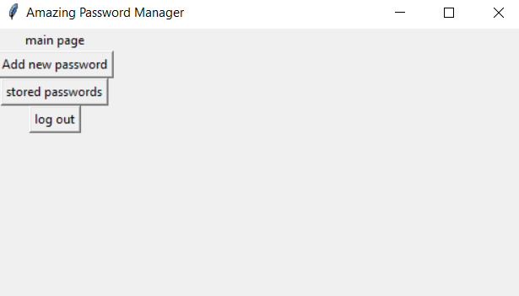
User Interface
User interface built with tkinter
Built in python class
Function over form
Having never built an app with graphical user interface with python, this was a learning opportunity

Slide 5
Security measures
The design aims to follow the OWASP password storage cheat sheet
The users master password, upon registration, is hashed with a cryptographically strong algorith.
A random password is generated for the user to access the password database, which is then symmetrically encrypted with the master password
This password is decrypted on login and is never shown to the user

Slide 6
Used technologies
Argon2
PBKDF2
high level of security against attacks such as brute-force, dictionary, and precomputed table attacks.
Hashing competition winner
uses a memory-hard function that requires a significant amount of memory to compute
popular choice for password hashing
A key derivation function that is commonly used for password hashing and key derivation in a variety of security applications
Computationally expensive
No brute forcing
Flexible, with adjustable parameters and able to produce key of any length
Mainly used for hashing, but can generate keys for Fernet for example

Slide 7

Summary
The APM is a secure tool for managing passwords, built with Python and its tkin library
The master password is hashed using the Argon2 algorithm, providing it strong protection against brute-force attacks.
In addition, symmetric encryption is used with the Fernet library to encrypt and decrypt the stored service data. The encryption key is generated using the PBKDF2 key derivation function
Together this should form a secure environment to store user credentials.

Slide 8

Q&A

