Slide 1
Can We Trust the Confidence?
Per-Class Calibration of Twi and Hausa Hate-Speech Classifiers Under Class Imbalance
TARGET DATASET
AfriHate Benchmark
(Muhammad et al., NAACL 2025)
Twi ('twi') & Hausa ('hau')
MODEL ARCHITECTURE
Word + Char TF-IDF
Balanced Logistic Regression
Deterministic Seed: SEED=42
CORE CONTRIBUTION
Per-Class ECE & Blinding Rates
Temperature Scaling Inversion
Triage Risk-Coverage Frontier
REPOSITORY & CODE
GitHub: NEMESIS-7/CMSMM_finalproject
Primary Notebook: calibration_study.ipynb
Includes Data & Model Cards
Student Submission & Oral Defence | Course: DCIT 316 — Academic Year 2025/2026
Student Name: Elikem Fenuksu | Student ID: 10986542 | GitHub: https://github.com/NEMESIS-7/CMSMM_finalproject
Notes:
Good day, examiners. Today I present my DCIT 316 individual research project: 'Can We Trust the Confidence? Per-Class Calibration of Twi and Hausa Hate-Speech Classifiers Under Class Imbalance'. In content moderation, models don't just output labels—they output confidence scores that drive human review triage. This project investigates whether model confidence can be trusted equally across classes in low-resource African languages, and demonstrates how standard post-hoc calibration methods can silently fail the minority class.

Slide 2
PROBLEM DEFINITION & OPERATIONAL CONTEXT
Why Confidence Calibration Matters in Content Moderation
The Triage Pipeline Promise
• High-Volume Platforms: Human moderators cannot review millions of daily posts. Automated triage divides the workload based on predicted confidence.
• Automated Tier (p >= tau): High-confidence predictions are automatically actioned (removed, flagged, or cleared) without human intervention.
• Human Escalation (p < tau): Low-confidence predictions are routed to human review queues for careful scrutiny.
• The Core Premise: This entire system assumes confidence reflects true correctness probability. If a model claims 90% confidence, it must be right ~90% of the time.
The Failure Mode: 'Moderator Blinding'
• The Danger of Confident Errors: When a model is confidently wrong, it files mistakes under 'Trust Me' and routes them away from human oversight.
• Active Misdirection: The system does not merely fail—it blinds the human reviewer by suppressing the very posts that urgently require correction.
• Directional Harms in African Contexts: Misclassifying Hate as Normal allows harmful abuse to propagate; misclassifying Normal as Hate/Abuse censors innocent Ghanaian/Nigerian speakers.
• The Calibration Blindspot: Standard evaluations report only overall accuracy or aggregate loss, completely hiding class-specific confidence distortions.
CRITICAL DISTINCTION: ACCURACY VS. CALIBRATION
• Accuracy measures overall correctness ('How often is the model right?').
• Calibration measures probability reliability ('When the model claims 80% certainty, is it actually right 80% of the time?').
• A classifier can achieve high accuracy while remaining dangerously overconfident on its critical errors.
Notes:
Why does confidence matter? In real-world content moderation, automated classifiers act as triage filters. Posts predicted with high confidence are actioned automatically, while uncertain cases go to human reviewers. If a model is miscalibrated and produces high-confidence errors, it introduces 'moderator blinding': the tool actively routes errors away from the reviewers who need to catch them. In African languages, this risks either silencing harmless civic discourse or letting hate speech spread undetected.

Slide 3
RESEARCH QUESTIONS & HYPOTHESES
Investigating Per-Class Calibration Under Inverted Skew
RQ1: Trust Across Classes
Is a hate-speech classifier's confidence equally trustworthy across classes, or does calibration degrade substantially on the minority class?
Theoretical Framing:
Hypothesis: Confidence is not uniform; minority classes suffer degraded calibration due to sparse training representations.
RQ2: Mitigation Efficacy
Does standard post-hoc temperature scaling recover calibration uniformly across all classes, or does it fix aggregate loss while leaving specific classes worse off?
Theoretical Framing:
Hypothesis: Scalar temperature scaling optimizes for the majority class, risking per-class calibration inversion on the minority.
RQ3: Cross-Language Inversion
Does the worst-calibrated class follow the rare class when comparing Twi (rare: Normal) against Hausa (rare: Hate)?
Theoretical Framing:
Hypothesis: The miscalibration failure mode flips between languages, tracking whichever class is underrepresented.
A NATURAL EXPERIMENT: INVERTED CLASS PROFILES ACROSS TWO AFRICAN LANGUAGES
• Identical Task & Schema: 3-class classification ('Abuse', 'Hate', 'Normal') using identical preprocessing and features.
• Twi (Ghana): Abuse is dominant (70.5%), while Normal (15.2%) and Hate (14.3%) are rare minority classes.
• Hausa (Nigeria/West Africa): Normal is dominant (56.7%), while Abuse (33.5%) is mid-frequency and Hate (9.8%) is rare.
• Research Value: If miscalibration tracks rarity, the failure mode will cleanly flip between Twi and Hausa.
Notes:
We structure the investigation around three precise research questions. First: Is confidence trustworthy across classes, or does minority status destroy calibration? Second: Does standard temperature scaling fix minority calibration, or only the aggregate? Third: Does the worst-calibrated class follow the rare class when we compare Twi against Hausa? By leveraging the natural experiment where class distributions invert between Twi and Hausa, we isolate the effect of class imbalance on confidence calibration.

Slide 4
THEORETICAL FOUNDATIONS & LITERATURE MATRIX
Synthesizing Calibration Theory and African NLP Benchmarks
Guo et al. (ICML 2017)
On Calibration of Modern Neural Networks
Key Insights:
• Demonstrated modern networks are systematically overconfident.
• Formalized Expected Calibration Error (ECE) and Reliability Diagrams.
• Introduced scalar Temperature Scaling as a simple post-hoc fix.
Relevance: Directly provides our evaluation metrics and mitigation baseline.
Ahuja et al. (EMNLP 2022)
Calibration of Massively Multilingual Models
Key Insights:
• Multilingual calibration degrades on low-resource and typologically distant languages.
• Acceptable accuracy masks severe confidence errors.
• Post-hoc mitigations fail to close the language gap.
Relevance: Motivates evaluating African languages empirically rather than assuming transfer.
Islam et al. (2021)
Calibration for Long-Tailed Recognition
Key Insights:
• Scalar temperature scaling is suboptimal under class imbalance.
• Majority classes dominate validation loss, skewing scalar T.
• Minority classes carry disproportionate calibration error.
Relevance: Provides direct theoretical motivation for per-class ECE measurement.
Muhammad et al. (NAACL 2025)
AfriHate: African Hate Speech Benchmark
Key Insights:
• First extensive hate speech collection across 15 African languages.
• Native-speaker annotations from Ghanaian and Nigerian contexts.
• Documents extreme skew and bidirectional moderation failures.
Relevance: Supplies our benchmark data, ground-truth labels, and baseline framing.
Notes:
Our work sits at the intersection of four foundational literatures. Guo et al. in 2017 established modern calibration measurement, defining ECE and temperature scaling. Ahuja et al. in 2022 showed that multilingual models suffer severe calibration degradation on low-resource languages. Islam et al. in 2021 proved mathematically that single-scalar temperature scaling fails under severe class imbalance. Finally, Muhammad et al. at NAACL 2025 introduced AfriHate, the first native-annotated dataset covering Twi and Hausa.

Slide 5
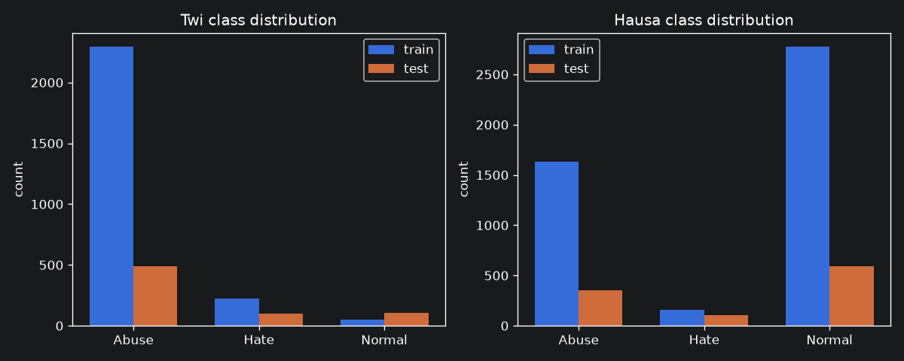
DATA & STEP 0 PRE-VERIFICATION
AfriHate: Verified Class Counts and Natural Experiment Design
Step 0 Pre-Verification Checks (Passed)
• 1. True Label Strings: Verified via df['label'].unique() -> ['Abuse', 'Hate', 'Normal']. Avoided hardcoded prose assumptions.
• 2. Test Cell Viability: Rarest test cell check confirmed N >= 30 (Twi Hate: 100, Normal: 106). Both languages fully viable for statistical evaluation.
• 3. Schema Parity: Twi [id, tweet, label] aligned with Hausa [id, tweet, label, length] by isolating common columns.
Verified Split Distributions:
Subset | Train | Validation | Test | Dominant
Twi | 2,564 | 639 | 698 | Abuse (70.5%)
Hausa | 4,566 | 1,029 | 1,049 | Normal (56.7%)
THE DECEPTIVE ACCURACY TRAP:
On Twi, a dummy classifier predicting 'Abuse' on every post achieves 70.5% accuracy while detecting 0% of Normal or Hate speech. Macro-F1 is the only honest headline metric.
Figure 1: Empirical class distributions across Twi and Hausa splits. Notice the clear inversion: Twi is overwhelmingly dominated by Abuse, whereas Hausa is dominated by Normal speech.
Notes:
Before building models, we ran Step 0 verification checks directly on the data. We confirmed label strings are Abuse, Hate, and Normal, and verified that all test cells exceed the minimum sample threshold of 30. As seen in Figure 1, Twi and Hausa offer an ideal natural experiment: Twi is 70.5% Abuse with rare Normal speech, while Hausa is 56.7% Normal with rare Hate speech. This inverted distribution allows us to test whether calibration tracks the minority class or the majority.

Slide 6
METHODOLOGY & CALIBRATION ARCHITECTURE
Feature Pipeline, Non-Parametric Binning, and Mitigation Setup
1. Feature Engineering & Model
Tailored to African Morphology:
• Word n-grams (1-2): Captures semantic unigrams and phrases with sublinear TF scaling.
• Character n-grams (2-4): Word-boundary char n-grams capture agglutinative affixes and social code-switching.
• Balanced Logistic Regression: Inverse-frequency class weights counteract majority-class gradient drowning.
• Deterministic Execution: Fixed SEED=42 ensures exact scientific reproducibility across all runs.
2. Adaptive ECE with Bootstrap CIs
One-vs-Rest Equal-Mass Binning:
• Equal-Mass (Adaptive) Quantiles: Standard equal-width bins produce empty cells on skewed classes; equal-mass ensures every bin has equal sample mass (M=10 bins).
• Formal Formulation:
ECE_c = SUM (|B_m| / N) * |p_bar_m - y_bar_m|
• 95% Bootstrap CIs: 1,000 resamplings quantify uncertainty arising from small minority cells (N=100-106).
• Reliability Curves: Diagonal tracks perfect calibration; dot sizes encode bin support.
3. Blinding Quantity & Scaling
Operationalizing Triage Risk:
• The Blinding Quantity (tau >= 0.70):
Blinding_c = (Class c Errors with max p >= 0.70) / (Total Class c Errors)
• Operational Consequence: Measures the fraction of errors filed under 'Trust Me' that bypass human review.
• Post-Hoc Temperature Scaling:
p_hat = softmax(z / T)
Scalar T fit on validation NLL via bounded L-BFGS-B (bounds [0.01, 10.0]). Test set strictly held out.
Notes:
Our methodology combines three core technical pillars. First, we use word and character n-gram TF-IDF concatenated with balanced logistic regression. Character n-grams are critical for African languages due to rich morphology and informal code-switching. Second, we measure calibration using equal-mass binning. Standard equal-width bins collapse on imbalanced data; equal-mass binning guarantees each bin contains 10% of the sample, coupled with 1,000 bootstrap iterations for 95% confidence intervals. Third, we define the 'blinding quantity'—the percentage of errors made at high confidence that would bypass triage.

Slide 7
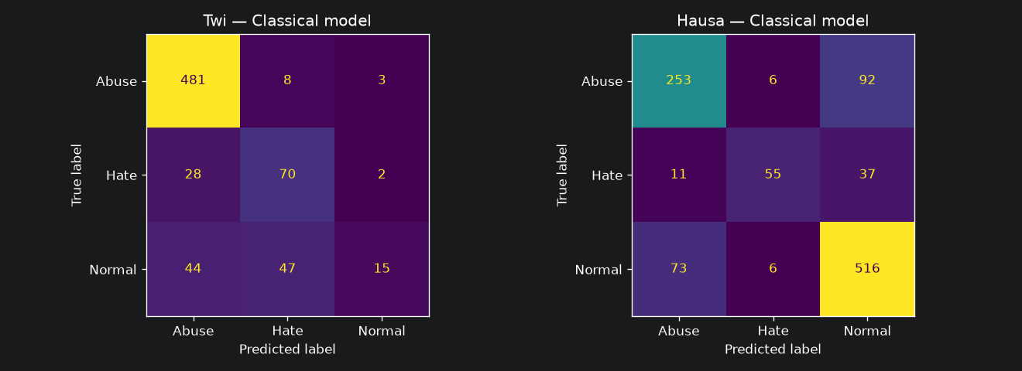
EMPIRICAL FINDINGS: CLASSIFICATION PERFORMANCE
Test Set Evaluation Reveals Severe Minority Class Recall Collapse in Twi
Language | Class | Precision | Recall | F1 | Support
Twi | Abuse | 0.87 | 0.98 | 0.92 | 492
Twi | Hate | 0.56 | 0.70 | 0.62 | 100
Twi | Normal | 0.75 | 0.14 | 0.24 | 106
Twi | Macro Avg | 0.73 | 0.61 | 0.59 | 698
Hausa | Abuse | 0.75 | 0.72 | 0.74 | 351
Hausa | Hate | 0.82 | 0.53 | 0.65 | 103
Hausa | Normal | 0.80 | 0.87 | 0.83 | 595
Hausa | Macro Avg | 0.79 | 0.71 | 0.74 | 1,049
Key Classification Insights:
• Twi Macro-F1 (0.59) vs Hausa (0.74): Hausa model shows significantly stronger and more balanced discrimination across all three categories.
• The Twi Normal Collapse (Recall = 0.14): The Twi model detects only 14% of innocent Normal posts. 86% of innocent speech is misclassified as Abuse or Hate.
• Majority-Class Bias: Twi achieves 98% recall on Abuse by aggressively defaulting to it, creating a severe over-censorship hazard for Ghanaian users.
Figure 2: Normalized confusion matrices. In Twi, Normal posts are heavily misrouted to Abuse (0.42) and Hate (0.43). In Hausa, errors are symmetrically distributed between Abuse and Normal.
Notes:
Looking at classification performance, Hausa achieves a respectable Macro-F1 of 0.74, while Twi languishes at 0.59. The critical vulnerability is Twi's Normal class: recall is just 0.14. As the confusion matrix in Figure 2 demonstrates, 86% of innocent Twi posts are misclassified as either Abuse or Hate. The question is: how confident is the model when it makes these misclassifications?

Slide 8
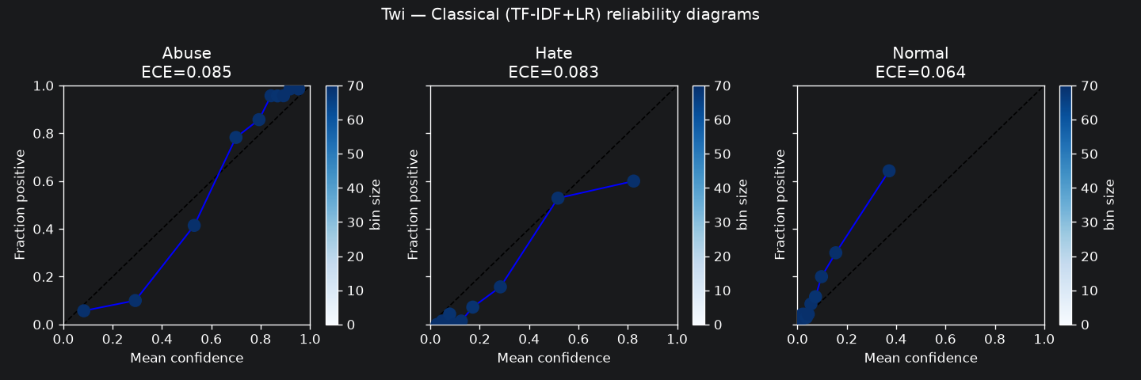
EMPIRICAL FINDINGS: PER-CLASS CALIBRATION (ECE)
Twi Calibration is 2x Worse; Dominant Class Exhibits Highest Calibration Error
Language | Class | ECE (Equal-Mass) | 95% Bootstrap CI
Twi | Abuse (Dominant) | 0.0848 | [0.065, 0.106]
Twi | Hate | 0.0828 | [0.065, 0.103]
Twi | Normal (Rare) | 0.0643 | [0.050, 0.091]
Twi | Macro Average | 0.0773 | —
Hausa | Abuse | 0.0415 | [0.034, 0.066]
Hausa | Hate (Rare) | 0.0243 | [0.018, 0.039]
Hausa | Normal (Dominant) | 0.0468 | [0.040, 0.075]
Hausa | Macro Average | 0.0375 | —
Surprising Theoretical Findings:
• Twi Calibration is 2x Worse: Macro ECE for Twi (0.077) is double that of Hausa (0.038), confirming Ahuja et al.'s finding on low-resource degradation.
• The Dominant Class Paradox: Contrary to our initial hypothesis, the dominant class carries the HIGHEST ECE in both languages (Abuse in Twi: 0.085; Normal in Hausa: 0.047).
• Why Dominant Classes Miscalibrate: Abundant training data causes the model to assign inflated confidence. Rare class predictions, when made, are appropriately hedged.
Figure 3: Twi reliability diagrams before (blue) and after (orange) temperature scaling across Abuse, Hate, and Normal classes. Notice the divergence in the Normal class.
Notes:
Table 2 presents per-class Expected Calibration Error with 95% bootstrap confidence intervals. First, Twi calibration is twice as bad as Hausa (0.077 vs 0.038). Second, we discovered a surprising paradox: in both languages, the dominant class carries the highest calibration error. Because the model sees so many majority examples, it learns to output high confidence scores that outstrip its empirical accuracy. Meanwhile, minority predictions are hedged.

Slide 9
CENTRAL FINDING: THE CALIBRATION TRAP
Temperature Scaling Improves Aggregate ECE but Worsens Twi Normal by +42%
Language | Optimal T | Class | ECE Before | ECE After | Delta / Outcome
Twi | 0.7106 | Abuse | 0.0848 | 0.0426 | -0.042 (Improved)
Twi | 0.7106 | Hate | 0.0828 | 0.0604 | -0.022 (Improved)
Twi | 0.7106 | Normal | 0.0643 | 0.0910 | +0.027 (+42% WORSENED!)
Twi | — | Macro Avg | 0.0773 | 0.0647 | -0.013 (Deceptive Gain)
Hausa | 0.7907 | Abuse | 0.0415 | 0.0361 | -0.005 (Improved)
Hausa | 0.7907 | Hate | 0.0243 | 0.0109 | -0.013 (Improved)
Hausa | 0.7907 | Normal | 0.0468 | 0.0219 | -0.025 (Improved)
Hausa | — | Macro Avg | 0.0375 | 0.0230 | -0.015 (Uniform Benefit)
THE MECHANISM OF THE TRAP
• Why T < 1.0? Optimal temperatures are 0.71 (Twi) and 0.79 (Hausa). T < 1 divides logits by a fraction, sharpening output probabilities toward extremes.
• Validation Loss Domination: In Twi, validation NLL is 70% Abuse instances. The optimizer fits T to satisfy majority Abuse loss.
• The Minority Disaster: Sharpening logits concentrates probability mass on Abuse/Hate. When the model encounters a Normal post, it now misclassifies it with EVEN HIGHER confidence than before!
• The Illusion of Safety: An ML engineer looking only at overall ECE (0.077 -> 0.065) would conclude calibration succeeded. In reality, over-censorship confidence increased by 42%!
Cross-Language Contrast:
• Hausa's balanced distribution allows temperature scaling to work as intended: all classes improve uniformly (Macro ECE drops from 0.038 to 0.023).
• This proves that post-hoc scaling failure is not a flaw of the language, but a direct statistical pathology of severe class imbalance interacting with scalar optimization.
• Core Takeaway: Never deploy post-hoc calibration without auditing per-class ECE.
Notes:
This slide contains the central empirical discovery of our project: 'The Calibration Trap'. When we apply temperature scaling, overall ECE on Twi drops from 0.077 to 0.065. It looks like a win. However, looking at the per-class breakdown reveals a critical failure: Normal class calibration degrades by +42%, with ECE increasing from 0.064 to 0.091! Because validation loss is dominated by majority Abuse instances, the optimizer sharpens logits to please the majority. This makes the model substantially MORE overconfident when it falsely censors innocent Ghanaian speech. An aggregate ECE metric completely hides this regression.

Slide 10
OPERATIONAL RISK & ERROR ANALYSIS
Four in Ten Errors are Confidently Routed Away from Human Scrutiny
Moderator Blinding Rates (tau >= 0.70)
Fraction of class errors made with maximum confidence >= 0.70:
Operational Consequence for Twi Normal:
• Out of 91 total Normal errors, 36 are made at >= 0.70 confidence.
• A triage system set to auto-route confident predictions would silently censor 36 innocent posts without any human review!
Confident Error Patterns (tau >= 0.70)
Twi Confident Errors (51 total / 7.3% of test):
• Normal -> Hate: 18 posts (Over-censorship of harmless speech)
• Normal -> Abuse: 18 posts (Over-censorship of harmless speech)
• Hate -> Abuse: 10 posts (Between-toxic misclassification)
• Abuse -> Hate: 3 posts | Abuse -> Normal: 2 posts
Striking Symmetry in Twi:
Exactly 18 Normal posts are confidently mislabeled as Hate and 18 as Abuse. The model has no stable internal representation of Normal Twi text; it arbitrarily projects innocent posts into toxic feature spaces with high confidence.
Hausa Confident Errors (67 total / 6.4% of test):
• Abuse -> Normal: 25 posts (Under-detection)
• Normal -> Abuse: 25 posts (Over-censorship)
• Hate -> Normal: 11 posts (Critical safety miss)
• Symmetry: 25 posts each way along the Abuse-Normal boundary.
Language | Class | Total Errors | Blinding Rate
Twi | Abuse | 11 | 45.5% (5/11)
Twi | Hate | 30 | 33.3% (10/30)
Twi | Normal | 91 | 39.6% (36/91)
Hausa | Abuse | 98 | 26.5% (26/98)
Hausa | Hate | 48 | 31.2% (15/48)
Hausa | Normal | 79 | 32.9% (26/79)
Notes:
In Slide 10, we connect calibration directly to operational triage risk via the 'blinding rate'. For Twi Normal, 39.6% of errors occur at high confidence (>= 0.70). That means 36 innocent Ghanaian posts would be automatically censored without human scrutiny. Furthermore, our error analysis uncovered a remarkable symmetry: exactly 18 Normal posts were confidently mislabeled as Hate, and 18 as Abuse. The classifier has completely failed to learn a coherent representation of normal Twi speech.

Slide 11
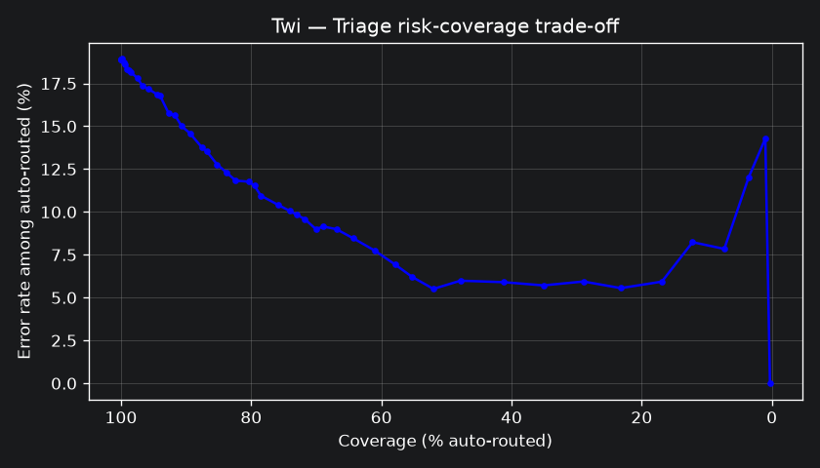
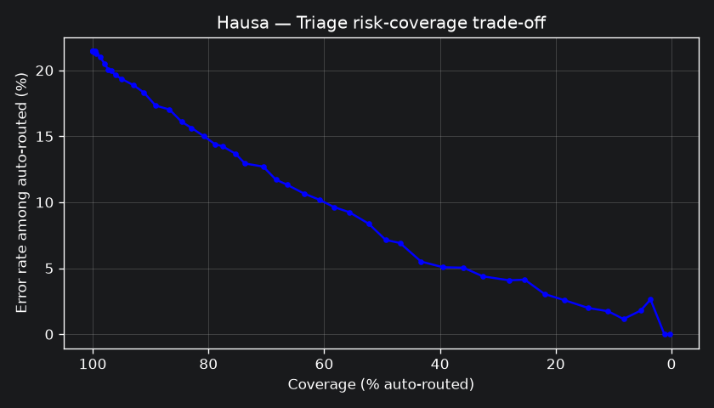
DEPLOYMENT ANALYSIS: RISK-COVERAGE TRADE-OFFS
Workload Reduction vs. Hidden Errors Across Confidence Thresholds
Language | Threshold (tau) | Auto-Routed | Coverage | Precision | Hidden Errors
Twi | 0.50 | 656 / 698 | 94.0% | 83.2% | 110
Twi | 0.70 | 514 / 698 | 73.6% | 90.1% | 51
Twi | 0.90 | 182 / 698 | 26.1% | 94.5% | 10
Hausa | 0.50 | 971 / 1,049 | 92.6% | 81.4% | 181
Hausa | 0.70 | 652 / 1,049 | 62.2% | 89.7% | 67
Hausa | 0.90 | 164 / 1,049 | 15.6% | 98.2% | 3
Operational Trade-off Dilemmas:
• Aggressive Automation (tau = 0.50): Reduces human workload by 93-94%, but permits 110 hidden errors in Twi and 181 in Hausa to slip past review.
• Moderate Tier (tau = 0.70): Auto-routes ~62-74% of posts with ~90% precision. However, 51 Twi errors remain hidden—36 of which are innocent speech.
• Conservative Tier (tau = 0.90): Hausa achieves 98.2% precision with only 3 hidden errors. But Twi still hides 10 errors while routing only 26% of posts automatically.
Figures 4A & 4B: Risk-coverage frontiers for Twi (left) and Hausa (right). Hausa's high-confidence tier is significantly cleaner, while Twi suffers persistent error leakage.
Notes:
In Slide 11, we explore the risk-coverage trade-off for deploying these models in a triage queue. At threshold 0.70, platforms can automate roughly 74% of Twi and 62% of Hausa content. However, that efficiency comes at the cost of hiding 51 Twi errors and 67 Hausa errors. At threshold 0.90, Hausa achieves 98.2% precision with only 3 hidden errors, proving that Hausa's high-confidence tier is far more reliable than Twi's.

Slide 12
ETHICS, DATA GOVERNANCE & RESPONSIBLE AI
Safe Data Handling, Diagnostic Scope, and Transparent AI Disclosures
1. Data Privacy & Zero Redistribution
Conservative Handling Under Apache 2.0:
• Strict Privacy: No raw tweet text is committed to the GitHub repo, printed in notebooks, or stored in artifacts.
• User Anonymity: No user handle tracing, re-identification, or account scraping was performed.
• Derived Outputs Only: Only aggregate confusion matrices, ECE values, and reliability plots are published.
2. Diagnostic Instrument Designation
Strict Operational Boundary:
• Research Tool Only: These models are diagnostic instruments built to study calibration dynamics under skew.
• NOT Deployable: These classifiers must NEVER be deployed in live moderation pipelines.
• Harm Prevention: Live deployment in Ghana would result in severe over-censorship of harmless Twi speech.
3. Sampling & Base Rate Limitations
AfriHate Benchmark Context:
• Keyword & Handle Sampling: The dataset was compiled via targeted queries, not random sampling.
• Not Real-World Base Rates: Class proportions (70% Abuse in Twi) reflect collection filters, not the true prevalence of toxic speech in West Africa.
• Contextual Caveat: Findings evaluate classifier behavior on this distribution, not societal base rates.
4. Transparent AI Disclosure
Methodological Verification:
• Assistance Used: Claude / Gemini used for code scaffolding, plotting utilities, and report drafting.
• Independent Verification: 100% of numerical results, bootstrap CIs, and figures independently verified against deterministic code runs (SEED=42).
• Integrity: No AI was used to fabricate data, citations, or labels.
Notes:
Ethics and responsible AI are core requirements of DCIT 316. First, we strictly adhere to zero raw data redistribution: no tweet text appears anywhere in the repo or presentation. Second, we explicitly designate these models as diagnostic instruments; they must never be deployed in production. Third, we acknowledge that AfriHate's class distribution reflects keyword sampling, not societal prevalence. Finally, all AI assistance in code scaffolding and drafting was independently verified against deterministic code runs.

Slide 13
DISCUSSION & METHODOLOGICAL LIMITATIONS
Critical Analysis of Theoretical Hypotheses and Scope Reductions
1. Single Model Family (Scope Reduction)
Documented Compute Constraint:
• The original proposal envisioned contrasting classical models against a fine-tuned multilingual transformer (AfroXLMR).
• Due to local CPU-only compute constraints and extreme training latency, the transformer was omitted as a documented scope cut.
• Impact: The accuracy-vs-calibration contrast across model families remains an open question for future GPU work.
2. Sampling Uncertainty in Small Cells
Bootstrap Confidence Interval Width:
• With N=100 (Hate) and N=106 (Normal) in Twi test, bootstrap CIs are wide (Normal CI: [0.050, 0.091]).
• Overlapping CIs mean fine-grained rank ordering between Twi Hate and Normal must be interpreted cautiously.
• Larger test splits are necessary to tighten statistical bounds.
3. Uniform vs Class-Conditional Scaling
Single Scalar Limitation:
• We evaluated standard single-scalar temperature scaling (Guo et al., 2017).
• The failure on Twi Normal demonstrates that a single scalar cannot reconcile inverted class gradients.
• Future work should explore class-conditional scaling or Dirichlet calibration (Kull et al., 2019).
4. Reversal of the Rare-Class Hypothesis
Dominant vs Rare Dynamics:
• We hypothesized that miscalibration would track rarity (Twi Normal & Hausa Hate).
• Instead, dominant classes exhibited higher ECE due to inflated confidence from abundant training instances.
• However, rare classes suffer higher operational risk due to high blinding rates (39.6% on Twi Normal).
Notes:
In Slide 13, we candidly address the study's limitations and scientific scope. First, we documented a formal scope reduction: the AfroXLMR transformer was omitted due to local CPU compute constraints, focusing our analysis rigorously on the classical baseline. Second, small test cells in Twi yield wide bootstrap confidence intervals, meaning rank orders should be treated carefully. Third, our findings prove that single-scalar temperature scaling is structurally insufficient for imbalanced data. Finally, while dominant classes carried higher ECE, rare classes carry much higher real-world triage harm.

Slide 14
CONCLUSION & DEFENCE SUMMARY
Key Takeaways and Recommendations for Content Moderation Systems
RULE 1: Never Rely on Aggregate ECE
A single aggregate calibration metric creates a dangerous safety illusion. On Twi, aggregate ECE dropped by -0.013 while minority Normal ECE surged by +42%. Always mandate per-class calibration reporting before deployment.
RULE 2: Audit Post-Hoc Mitigations Per Class
Post-hoc temperature scaling minimizes aggregate NLL, allowing the majority class to hijack the temperature scalar. Recalibration techniques must be validated on every class independently to prevent minority degradation.
RULE 3: Surface Blinding Rates in Triage
System documentation and triage interfaces must visibly report blinding quantities. Human moderation teams must know what fraction of automated decisions conceal confident errors to calibrate review thresholds.
SUMMARY FOR ORAL DEFENCE | READY FOR EXAMINATION QUESTIONS
• Investigating Twi and Hausa under inverted class distributions revealed that calibration does not simply track minority status.
• Majority classes suffer from inflated confidence, and post-hoc temperature scaling can actively worsen minority calibration (+42% on Twi Normal).
• Reproducible Repository: https://github.com/NEMESIS-7/CMSMM_finalproject | Thank you. I welcome your questions.
Notes:
In conclusion, our research offers three clear recommendations for responsible NLP engineering. First: Never rely on aggregate ECE. Second: Always validate post-hoc recalibration per class. Third: Quantify and surface moderator blinding rates so human reviewers know their residual risk. Thank you for your time and attention. I am now ready for the examination questions and oral defence.

