Slide 1
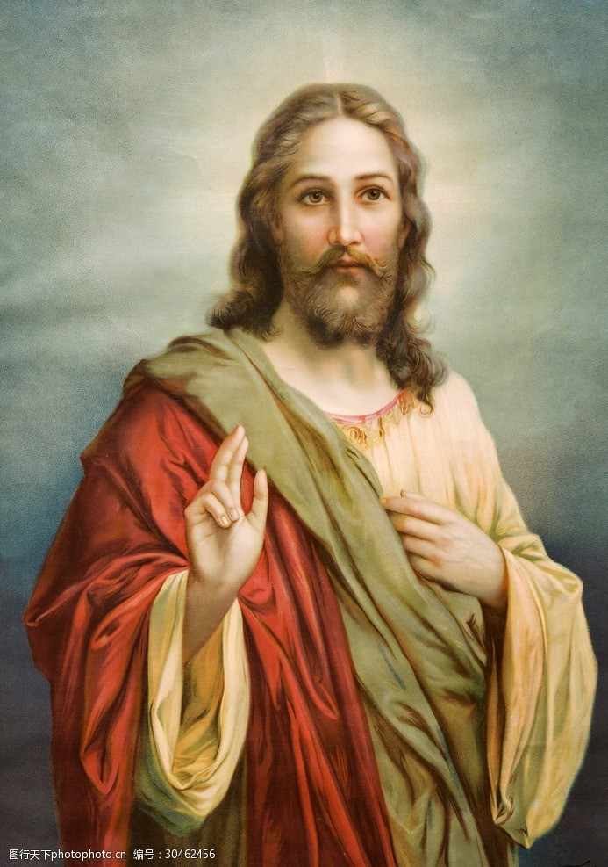
FINAL SPEECH
Jesus is the central figure of Christianity.
A one-minute introduction to who he is, what he taught, and why he still matters.
Short, clear, and easy to present without reading.
Christianity
A short classroom introduction
Jesus in One Minute | Codex
1/4

Slide 2
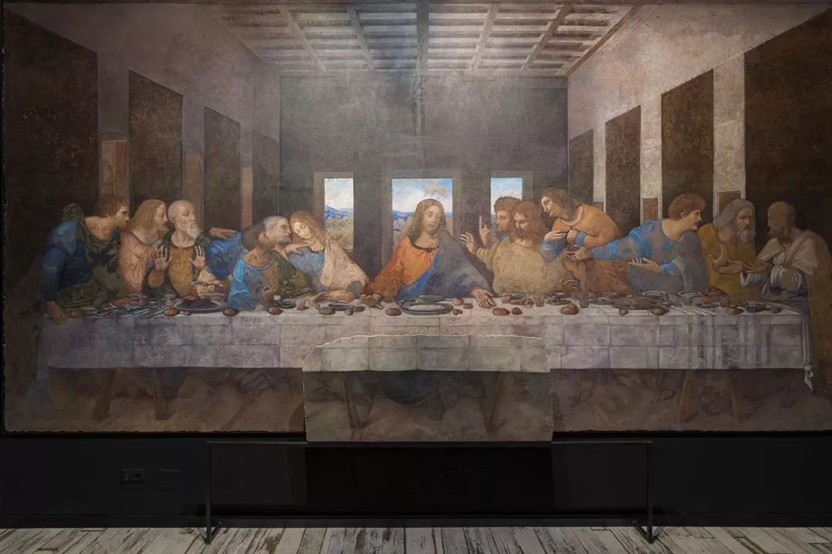
WHO HE IS
Jesus is both a historical person and the heart of Christian faith.
• He lived in the land of Palestine about two thousand years ago.
• Christians believe he is the Son of God and the Savior.
• His life and teachings are recorded in the New Testament.
KEY IDEA
In history he is Jesus of Nazareth; in faith he is Christ, the one sent to save humanity.
Jesus in One Minute | Codex
2/4

Slide 3
WHAT HE TAUGHT
The message of Jesus can be remembered in three simple words.
Love
Forgiveness
Salvation
Core value
How to treat others
Religious meaning
Love God and love other people.
Show mercy instead of hatred.
Christians believe he brings hope and redemption.
His teaching centers on love, forgiveness, and salvation.
Jesus in One Minute | Codex
3/4

Slide 4
WHY HE MATTERS
Jesus shaped not only a religion, but also world history and culture.
Even today, Christianity remains one of the world's most influential religions, and Jesus remains its center.
Thank you.
Jesus in One Minute | Codex
4/4

