Slide 1
Title: Historical Weather Data for Lagos (2010–2024)
Subtitle: Flood Risk Analysis – Key Findings, Challenges & Recommendations
Prepared by: Esther Oziowuh Emmanuel
Date: 5th ,January 2026
Organiztion : Datafied Technologies

Slide 2
Key Findings
Rainfall is the main driver
  Years 2012, 2016, 2020, 2024 show high flood risk with high rainfall.
  Peak rainfall months: May, July, August, December.
Rainy season months are most vulnerable
  Flood risk peaks in July, May, October, August, January, March, December.
Flood risk varies across years
  Peaks in 2010, 2016, 2024, showing variability over time.

Slide 3
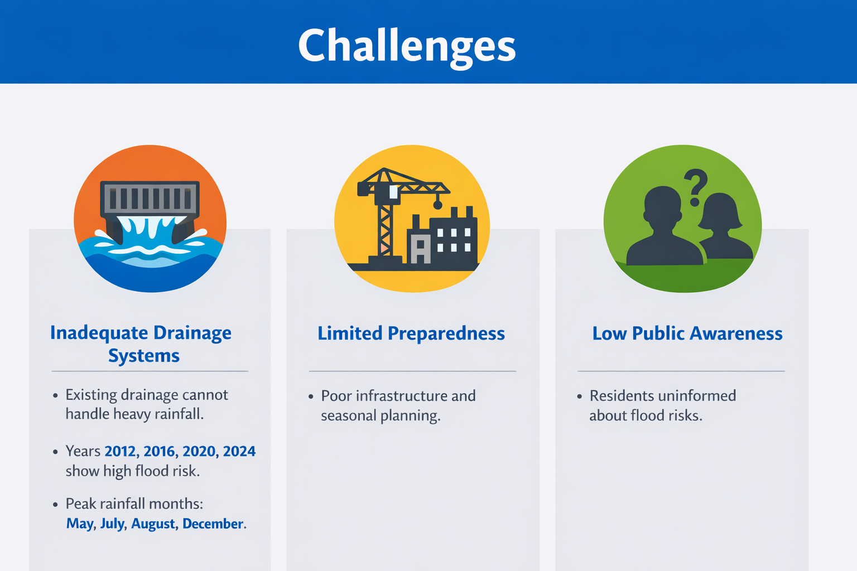
Challenges
Inadequate drainage systems –
unable to manage heavy rainfall.
Limited preparedness for rainy season –
poor infrastructure worsens vulnerability.
Low public awareness –
residents not informed about flood timing or proper drainage.

Slide 4
Recommendation
Upgrade drainage systems –
modernize to reduce waterlogging.
Develop flood-resilient infrastructure –
buildings and roads designed for flooding.
Raise public awareness –
educate residents and builders about proper drainage.

Slide 5
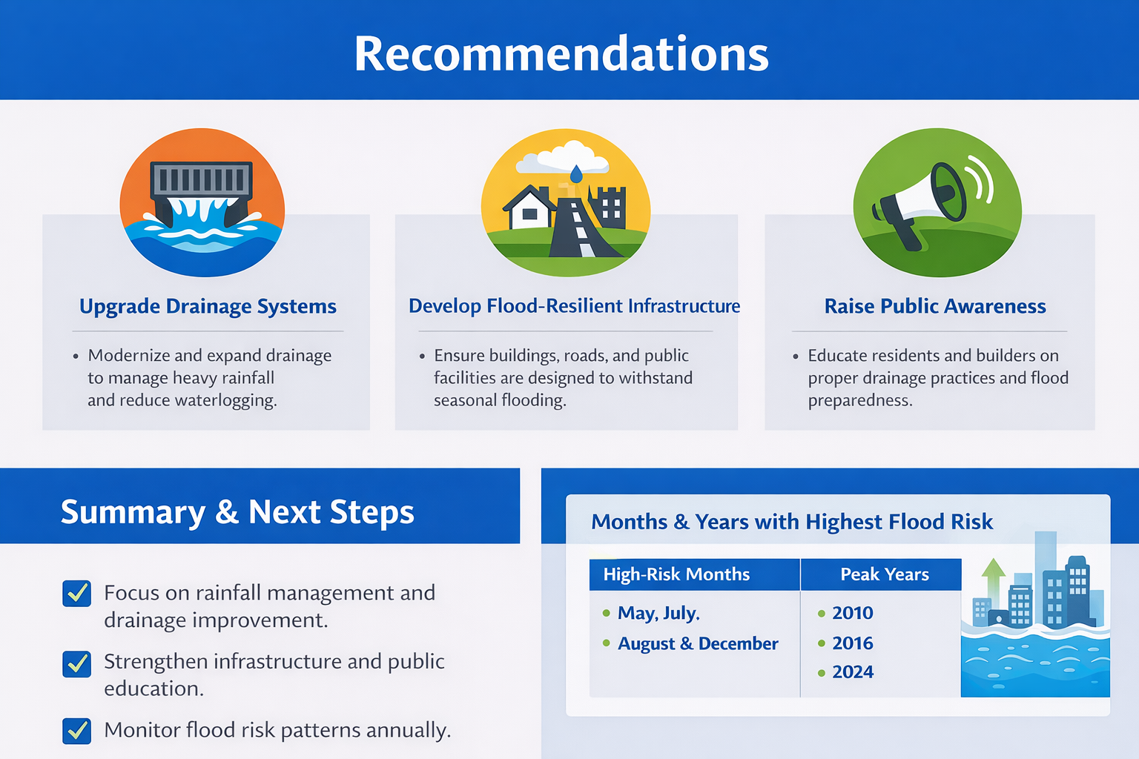
Summary & Next Step
Focus on rainfall management and drainage improvement
Strengthen infrastructure and public education
Monitor flood risk patterns annually

