Slide 1

Smart Contract Programming with Python
NEO DevCon, 2018-01-30

Slide 2
Agenda
💡 What are smart contracts and how do they work, devtools
⭐️ Hands-On 1: Setup neo-python, neo-boa and a private network
💡 Smart contract internals 1: neo-boa, Notify and Log
⭐️ Hands-On 2: Basic smart contract with Log and Notify
💡 Smart contract internals 2: storage and costs
⭐️ Hands-On 3: Domain registration system
💡 Smart contract internals 3: CheckWitness, TriggerType Verification vs Application, timestamps and random numbers
⭐️ Hands-On 4: NEX ICO template (if we have time)

Slide 3
Links, Infos & Resources
https://goo.gl/SRw1nd
^ open it now

Slide 4
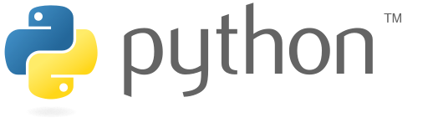
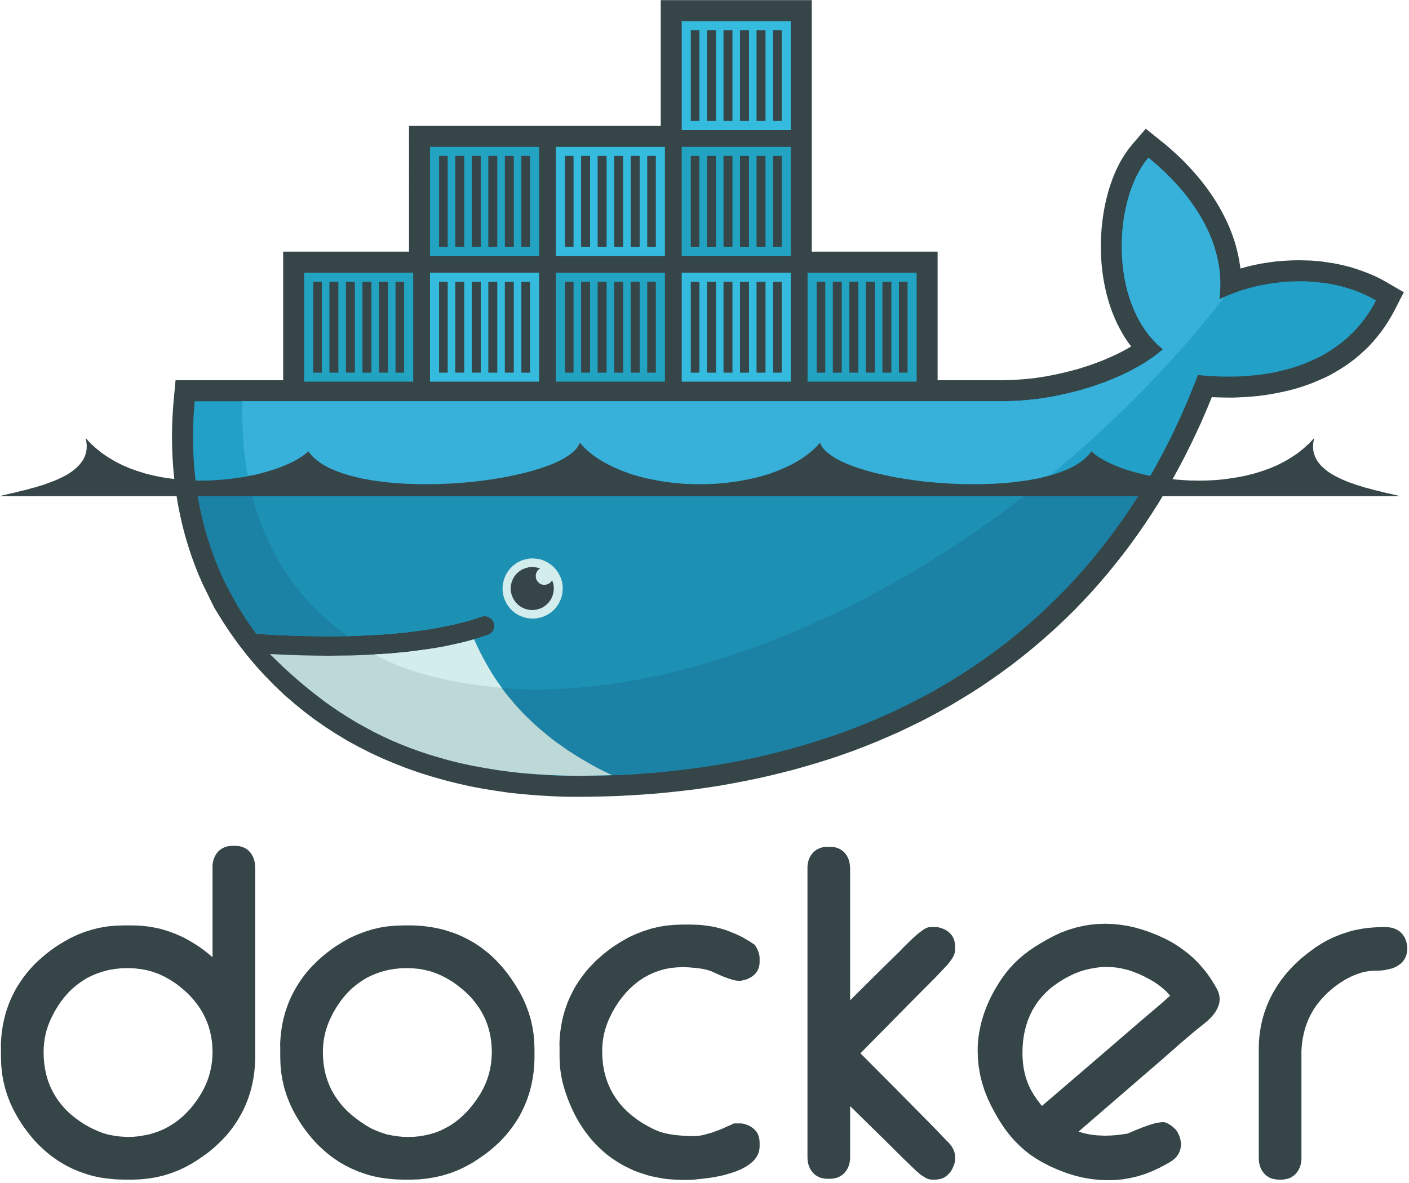
Hands-On 0: System Setup
Python 3.6+
Docker
See links and references document - “System Setup”: https://goo.gl/SRw1nd

Slide 5
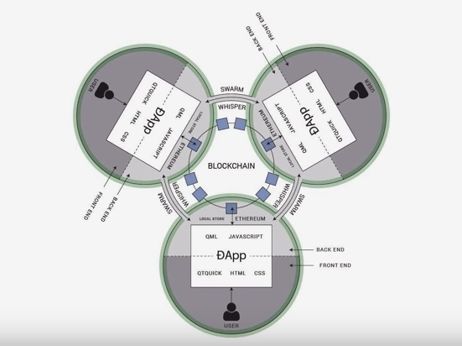
What are Smart Contracts & dApps
General purpose computer programs
Executed by a specific VM on the blockchain nodes
Can use storage and accept cryptocurrency (NEO, GAS)
Methods are invoked by sending specific transactions to the blockchain
Complete history stored on the blockchain
dApps typically also have a frontend
Notes:
Not used for everything, mostly trust-related issues as well as ICOs

Slide 6
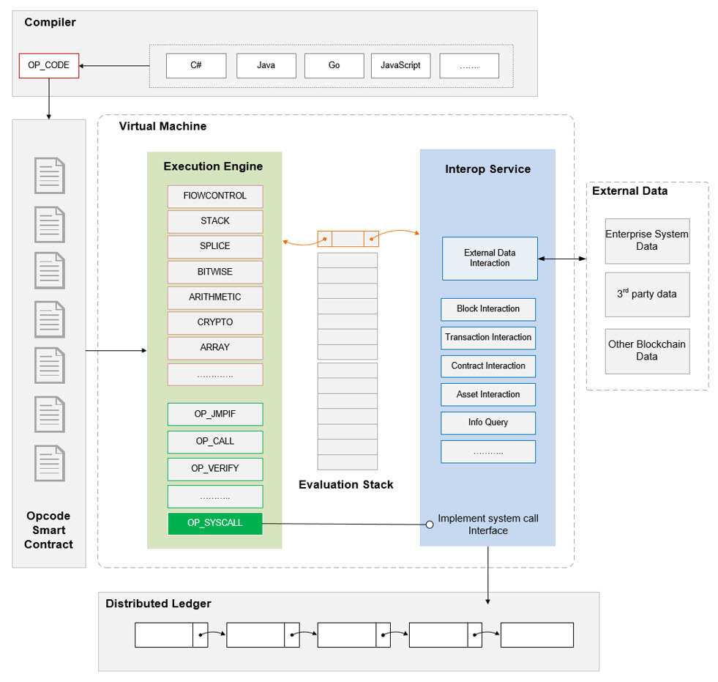
NEO VM
Stack-based virtual machine. Executes the smart contract bytecode.
https://github.com/neo-project/neo-vm
Also implemented in neo-python.

Slide 7
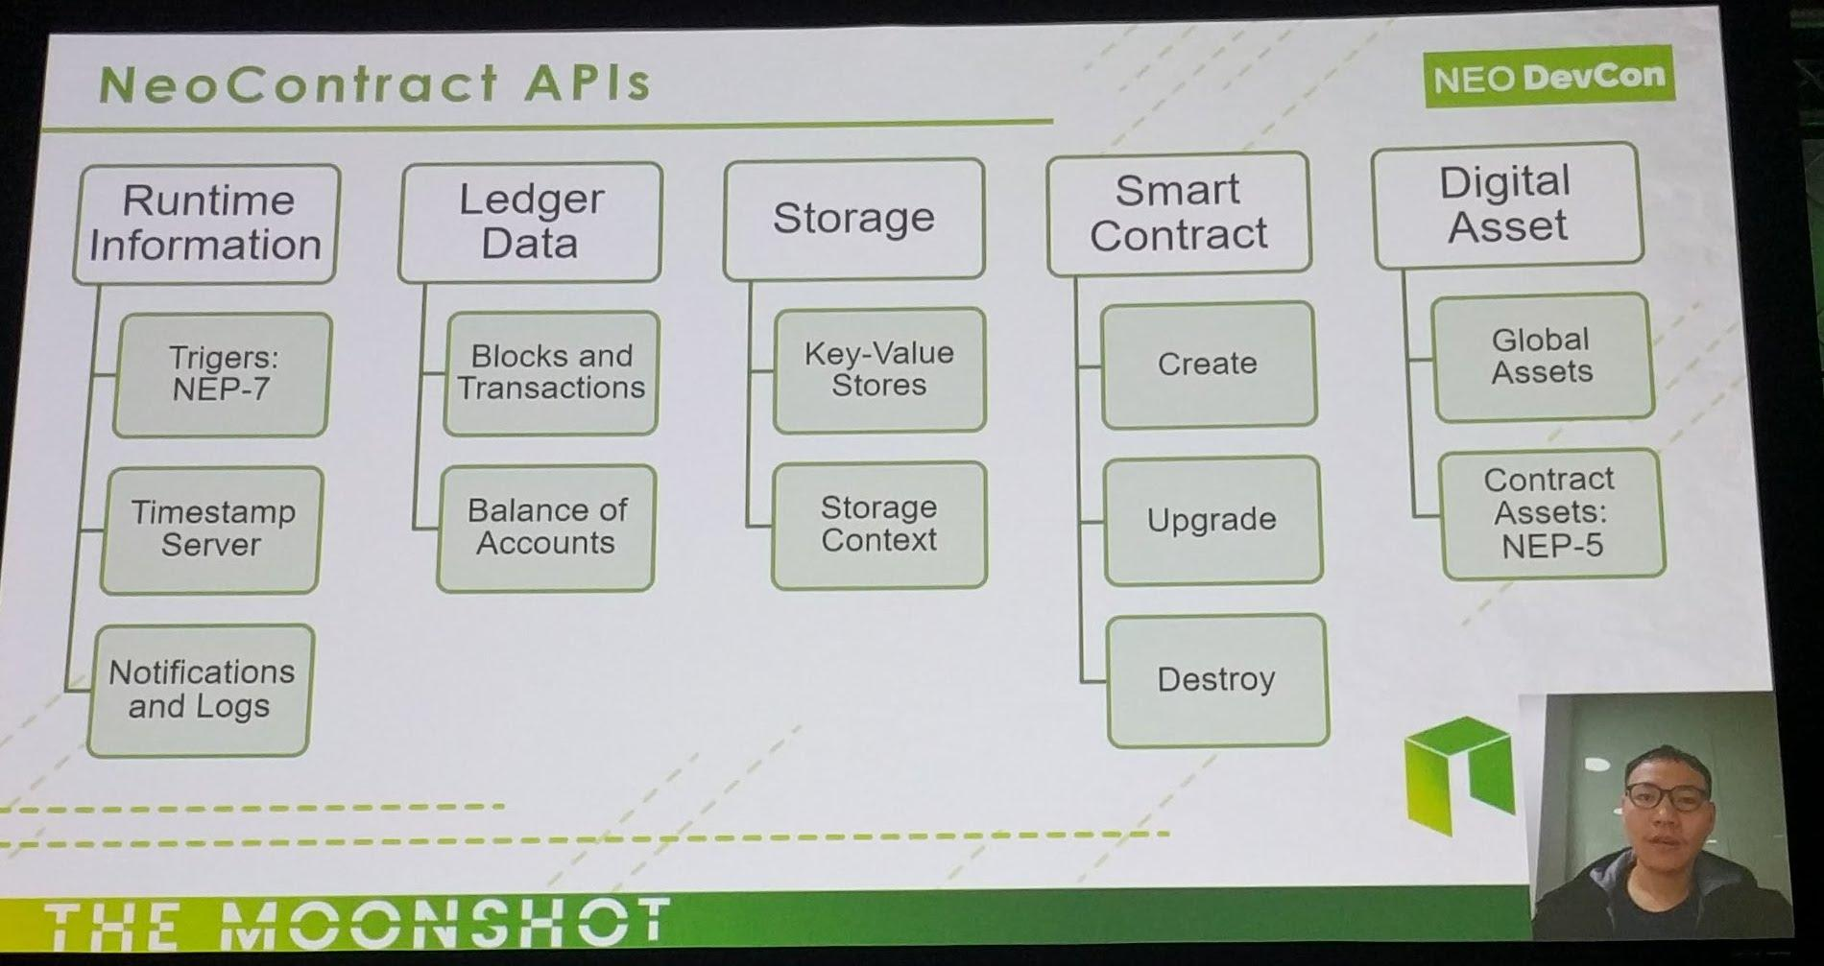

Slide 8
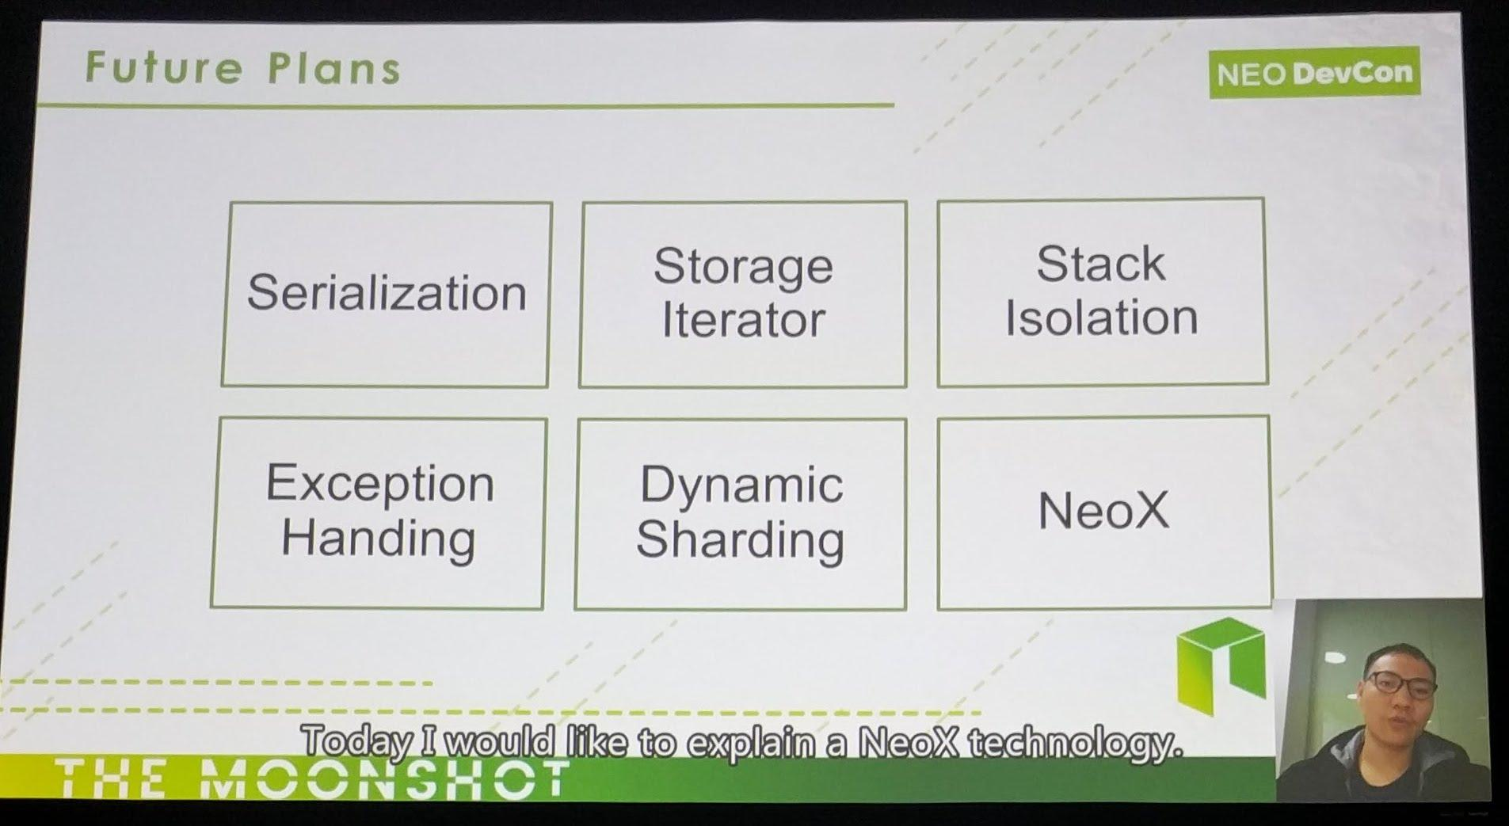

Slide 9
Dev Restrictions
No access to outside data (oracle problem)
Operations and storage cost money (GAS, the first 10 GAS is free) (link)
→ not suitable for general purpose data storage and processing
Deployment costs
Dynamic invocations (are coming)
Not all native programming language built-ins are supported

Slide 10
Dev Tools: privatenet, neo-python & neo-boa
Private network of the NEO blockchain in a Docker container
Neo-python
Port of official C# project
Full node implementation in Python
Cross-platform and very easy to work with
CLI
Python 3.6+, using Twisted for networking
Neo-boa
Compiler for the NEO VM
Only a subset of Python built-ins supported

Slide 11
Hands-On 1: Hooking up neo-python with the privnet
Clone and setup neo-python and neo-boa
Start the private-net Docker container as described in the documentation, and download the wallet file
Start neo-python with the `-p` parameter
Use the neo-python commands `help`, `open wallet neo-privnet.wallet` and `wallet rebuild`
https://goo.gl/SRw1nd

Slide 12
Smart Contract Internals 1
Supported Python methods and built-ins:
neo-boa/blob/master/boa/code/vmtoken.py#L735
boa.code.builtins
Runtime.Log + Notify
Parameter & return value types: https://github.com/neo-project/docs/blob/master/en-us/sc/tutorial/Parameter.md

Slide 13
Smart Contract Internals 1 (b)
neo-python commands
help
build
import contract
contract search
testinvoke

Slide 14
Hands-On 2: Simple “print” Smart Contract
from boa.blockchain.vm.Neo.Runtime import Log, Notify
def Main():
print("log via print 1")
Log("log 2")
Notify("notify2")
…
neo> build sc/1-print.py test 07 05 True False main
Notes:
Explain parameters and return values
https://github.com/neo-project/docs/blob/master/en-us/sc/tutorial/Parameter.md
deploy it to the privnet and invoke it

Slide 15
Smart Contract Internals 2
Costs for deploying and running smart contracts: http://docs.neo.org/en-us/sc/systemfees.html
Storage
you can only store a bytearray, int, and strings in storage
if you want to store more complex objects i'd take a look at the serialization examples ([1], [2])

Slide 16
Hands-On 3: Domain Registration System
Register, transfer, query and delete domains
Uses storage
CheckWitness to verify ownership
4 methods:
query <domain_name>
register <domain_name> <owner>
transfer <domain_name> <new_owner>
delete <domain_name>
Notes:
Step through code, have people replicate it
build & test
deploy to privatenet
invoke all methods

Slide 17
TriggerTypes: Verification vs. Application
Verification
run when funds are send from a contract address
can reject transactions so they are not even recorded on the blockchain
useful for automatic refunds and rejections
only works on deployed contracts
Application
runs whenever a transaction is accepted by the blockchain
can also run locally in test mode
currently with read-only storage
neo> build <filename> test <types> <methodname> <args>

Slide 18
Timestamps and Random Numbers
Smart contract methods have to be deterministic, no matter on what node they are run
Smart contracts can access block metadata
Blocks have a timestamp and random nonce (8 bytes) associated with it
def now():
height = GetHeight()
current_block = GetHeader(height)
return current_block.Timestamp

Slide 19
NEP-5 Token Standard
Token standard (eg. RPX, DBC, ...)
A specific set of methods a smart contract has to implement
Equivalent to Ethereum ERC-20 standard
Tools and exchanges are using these standard methods to interact
Link

Slide 20
Hands-On 4: NEX ICO template
Let’s build some custom NEP-5 tokens!
Start by editing nex/token/mytoken.py

Slide 21
Q & A
Join the NEO/City of Zion community https://discord.gg/R8v48YA

