Slide 1
Objectives
Describe the history and theory of XHTML
Understand the rules for creating valid XHTML documents
Apply a DTD to an XHTML document
Understand how to apply the XHTML namespace
Explore the relationship between HTML5 and XHTML
Test an XHTML document under the transitional DTD
Test an XHTML document under the strict DTD
Explore the use of character and parsed character data

Slide 2
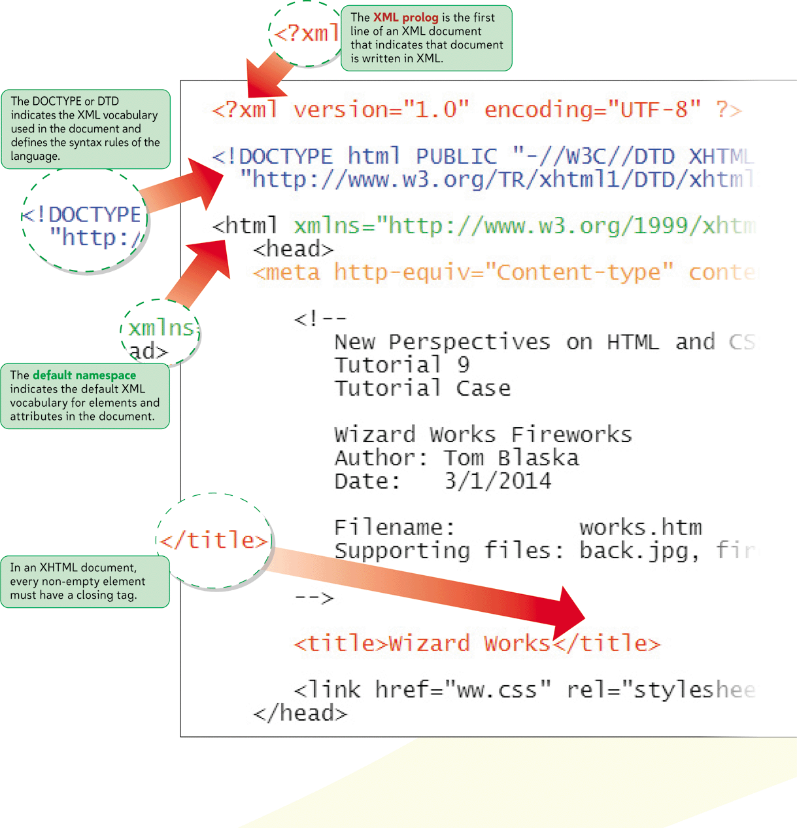
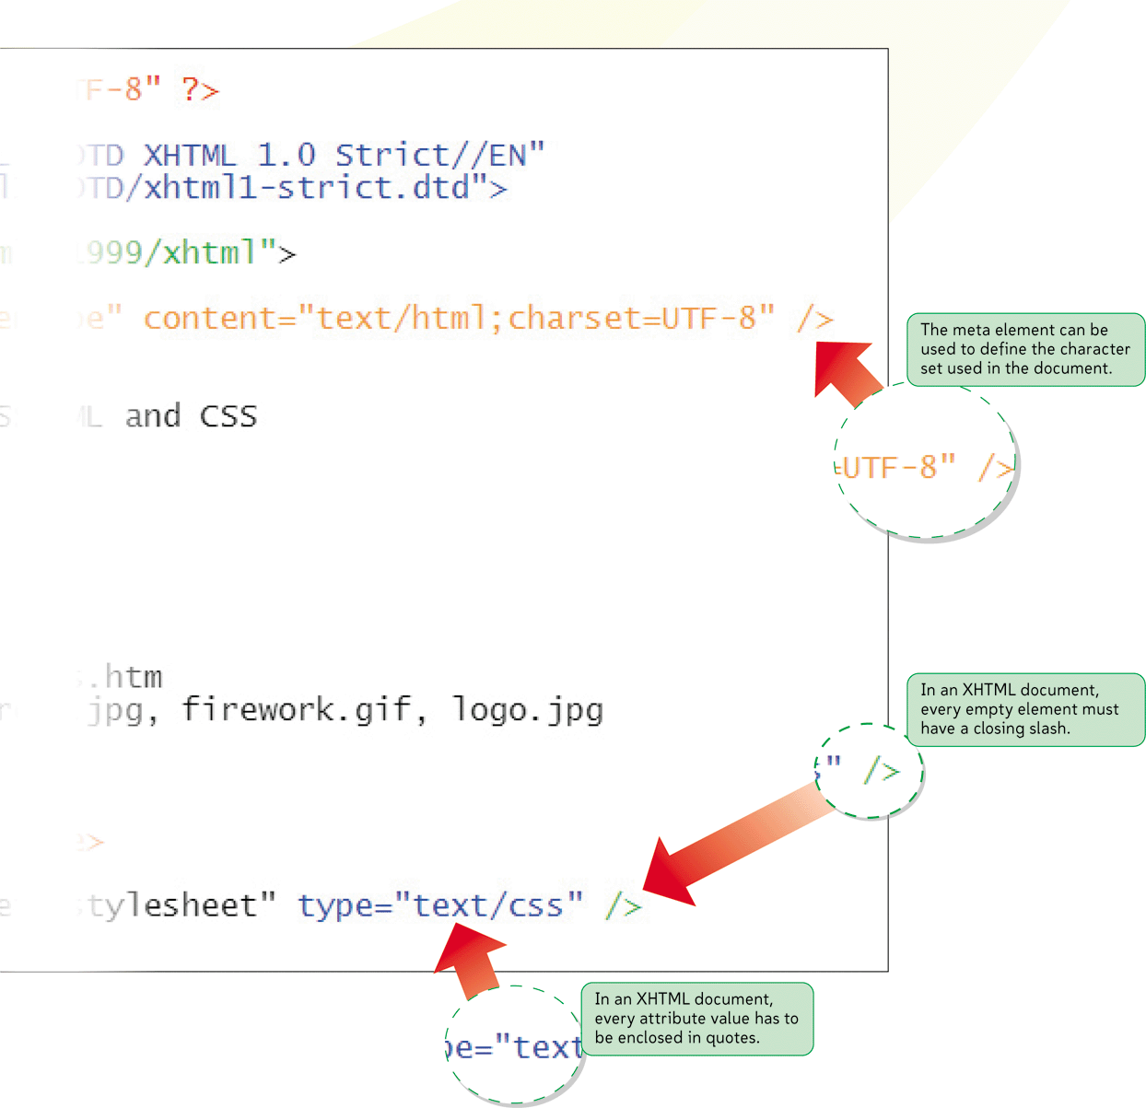
Structure of an XHTML Document

Slide 3
Introducing XHTML
SGML (Standard Generalized Markup Language)
Device-independent and system-independent
Introduced in the 1980s
Not intended for the World Wide Web
HTML
Standards get confusing among browsers
Can be applied inconsistently

Slide 4
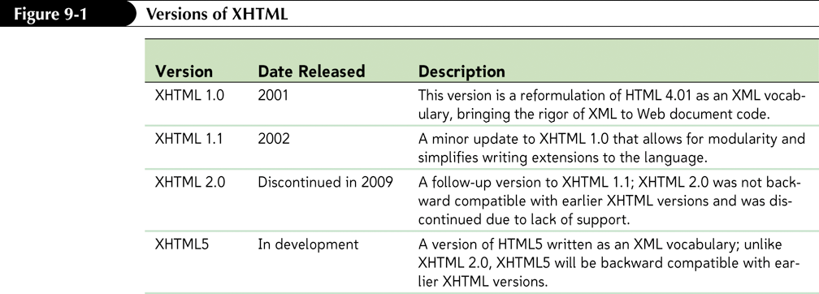
Introducing XHTML

Slide 5
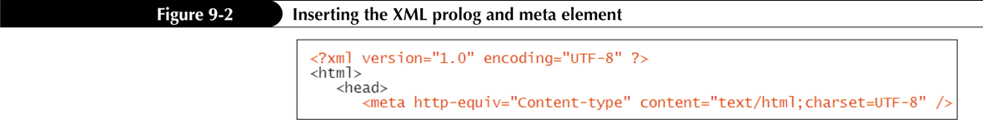
Creating an XHTML Document
The first line of an XHTML file contains a statement called a prolog that indicates the document adheres to the syntax rules of XML. The form of the XML prolog is
<?xml version=”value” encoding=”type” ?>

Slide 6
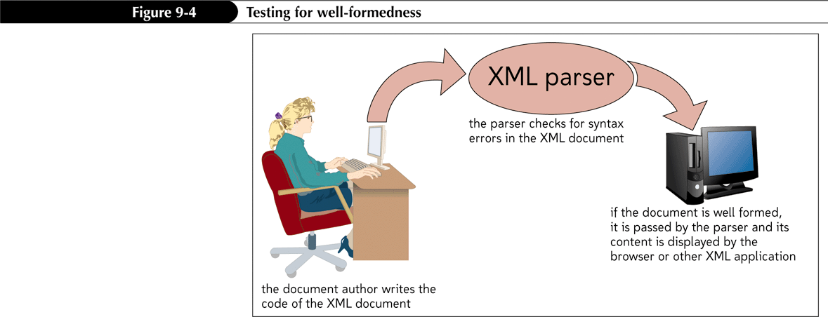
Creating Well-Formed Documents
XML documents must be evaluated with an XML parser
An XML document with correct syntax is a well-formed document

Slide 7
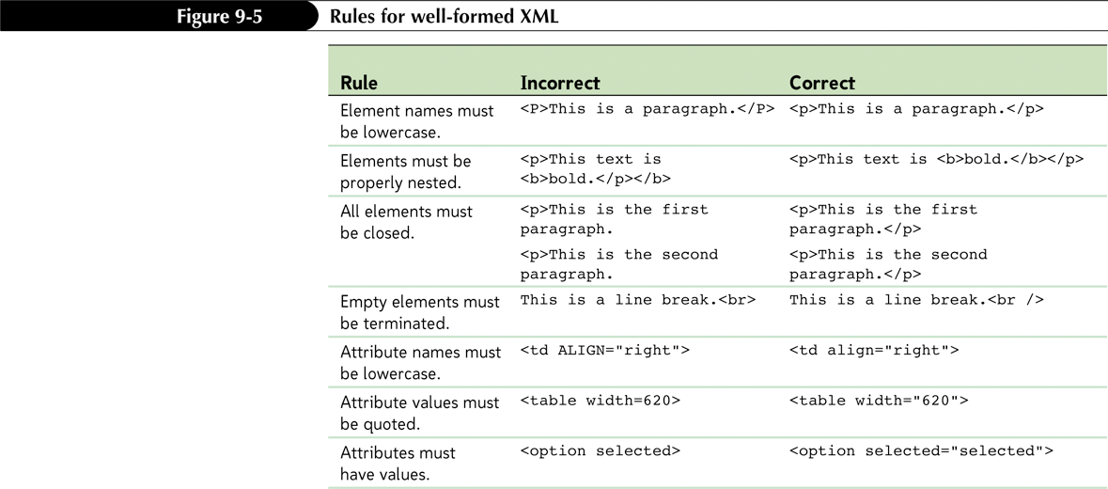
Creating Well-Formed Documents

Slide 8
Creating a Well-Formed Document
XHTML documents must also include a single root element that contains all other elements
For XHTML, that root element is the html element
Attribute minimization is when some attributes lack attribute values
XHTML doesn’t allow attribute minimization

Slide 9
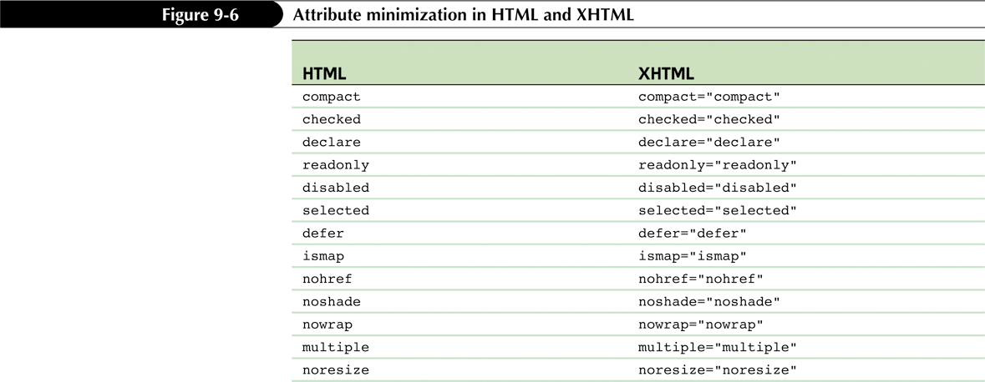
Attribute Minimization in HTML and XHTML

Slide 10
Creating Valid XHTML Documents
A valid document is a well-formed document that also contains only those elements, attributes, and other features that have been defined for the XML vocabulary that it uses
To specify the correct content and structure for a document, the developers of an XML-based language can create a collection of rules called the document type definition or DTD

Slide 11
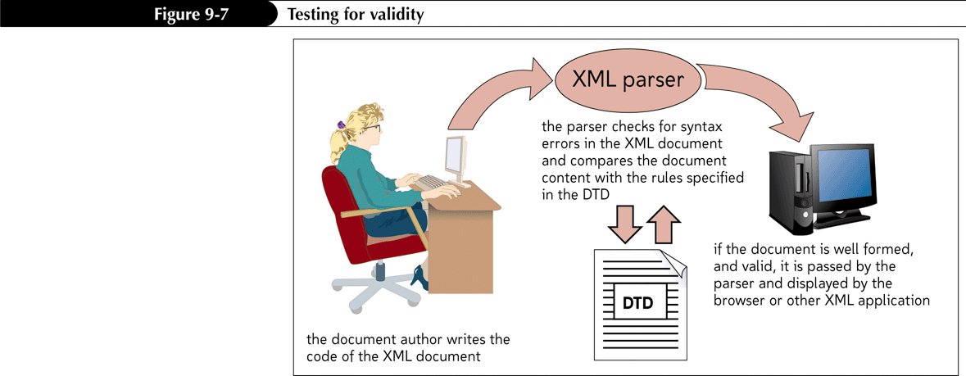
Creating Valid XHTML Documents

Slide 12
DTDs
Transitional: supports many of the presentational features of HTML, including the deprecated elements and attributes. Best used for older documents that contain deprecated features.
Frameset: used for documents containing frames, and also supports deprecated elements and attributes
Strict: does not allow any presentational features or deprecated HTML elements and attributes. Does not support frames or inline frames. It is best used for documents that need to strictly conform to the latest standards

Slide 13
Creating Valid XHTML Documents
The DTD used depends on the content of the document and the needs of your users
To support old browsers, use the transitional DTD
To support old browsers in a framed Web site, use the frameset DTD
To support more current browsers and to weed out any use of deprecated features, use the strict DTD

Slide 14
Creating a Valid Document
Elements not allowed under the strict DTD:
applet
basefont
center
dir
font
isindex
menu
noframes
s
strike
u

Slide 15
Creating a Valid Document
Some attributes are restricted, while others are required in XHTML

Slide 16
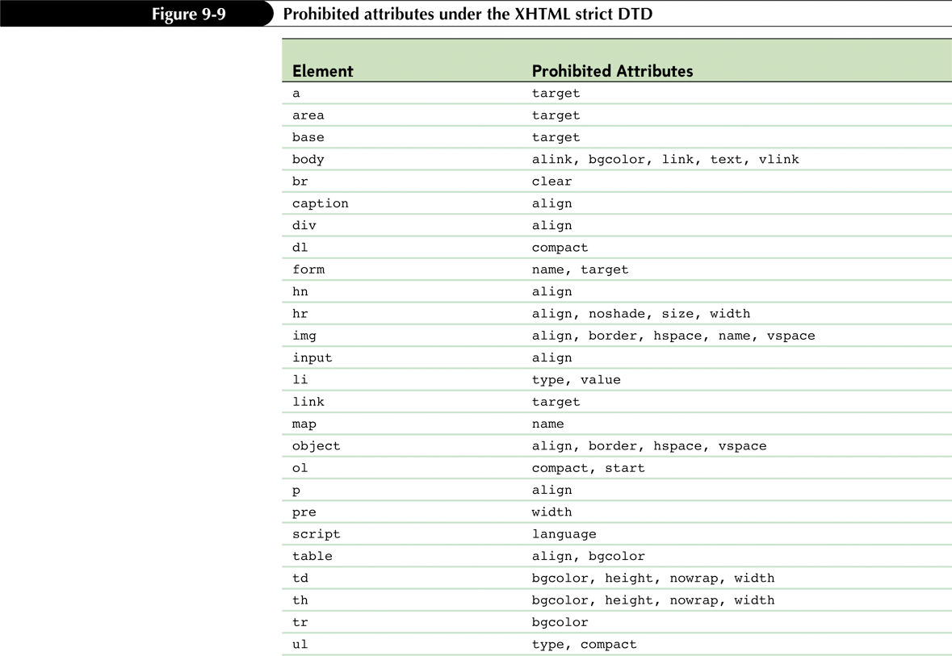
Attributes Prohibited in the Strict DTD

Slide 17
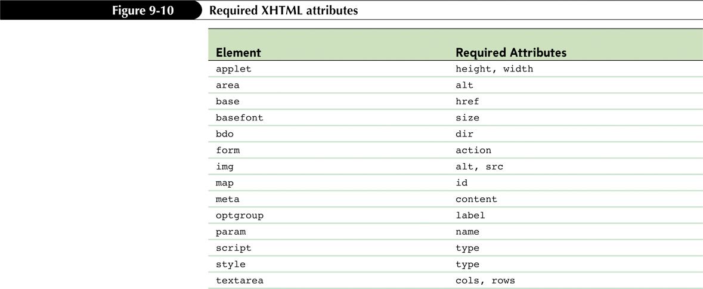
Required XHTML Attributes

Slide 18
Inserting the DOCTYPE Declaration
To specify which DTD is used by an XML document, you add a DOCTYPE declaration directly after the XML prolog
<!DOCTYPE root type “id” “url”>

Slide 19
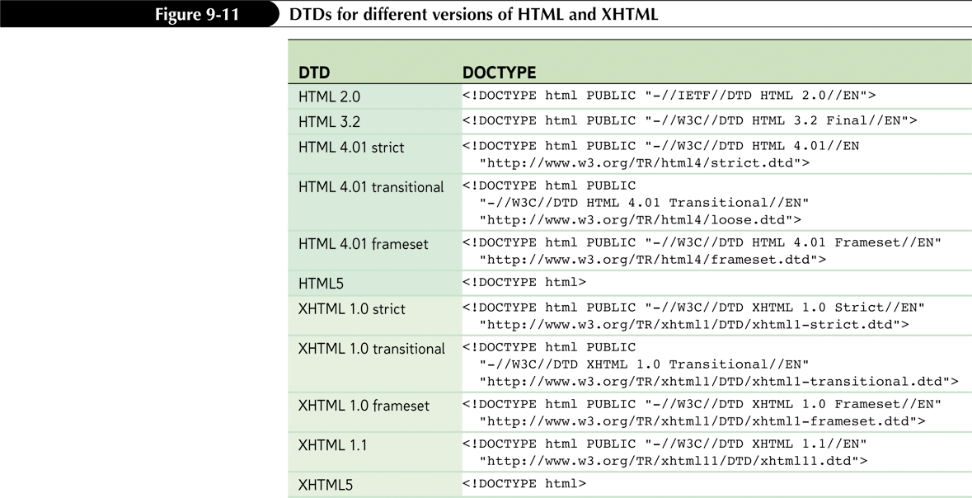
Inserting the DOCTYPE Declaration

Slide 20
The XHTML Namespace
A namespace is a unique identifier for elements and attributes originating from a particular document type (like XHTML or MathML)
Two types of namespaces:
Default: applied to any element or attribute in the document
<root xmlns=“namespace”>

Slide 21
The XHTML Namespace
Local: applies to only select elements
Each element in the local namespace is marked by a prefix attached to the element name
xmlns: prefix=“namespace”
Identify any element belonging to that namespace by modifying the element name in the tag
prefix:element

Slide 22
Setting the XHTML Namespace
To set XHTML as the default namespace for a document, add the xmlns attribute to the html element with the following value:
<html xmlns=http://www.w3.org/1999/xhtml>

Slide 23
HTML5 and XHTML
HTML5 was developed to be backward compatible with earlier versions of HTML, and also to support the common application of HTML syntax
The rules for HTML5 are much more open than for XHTML

Slide 24
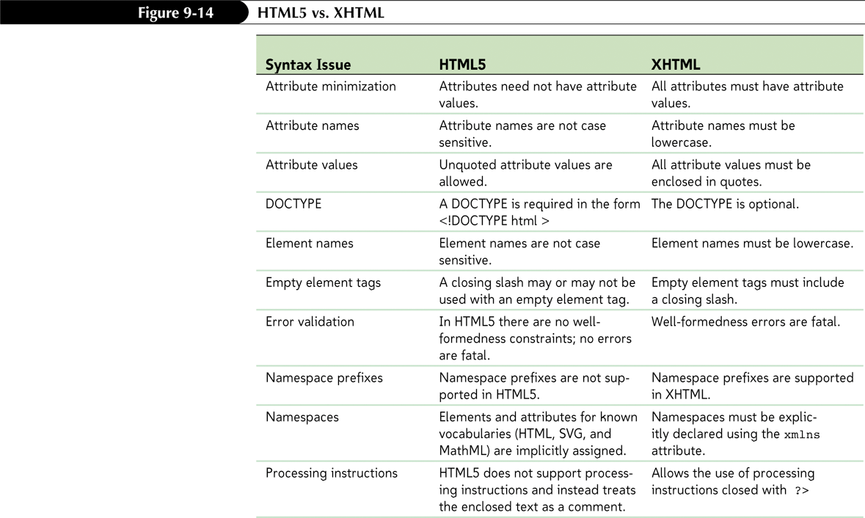
HTML5 and XHTML

Slide 25
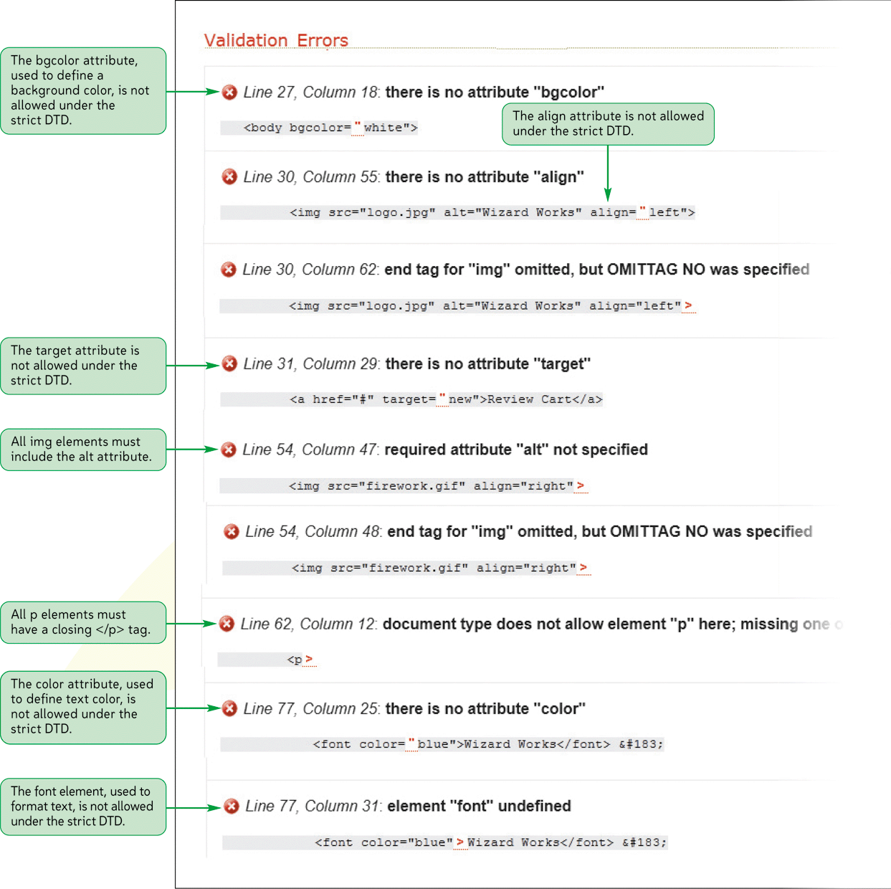
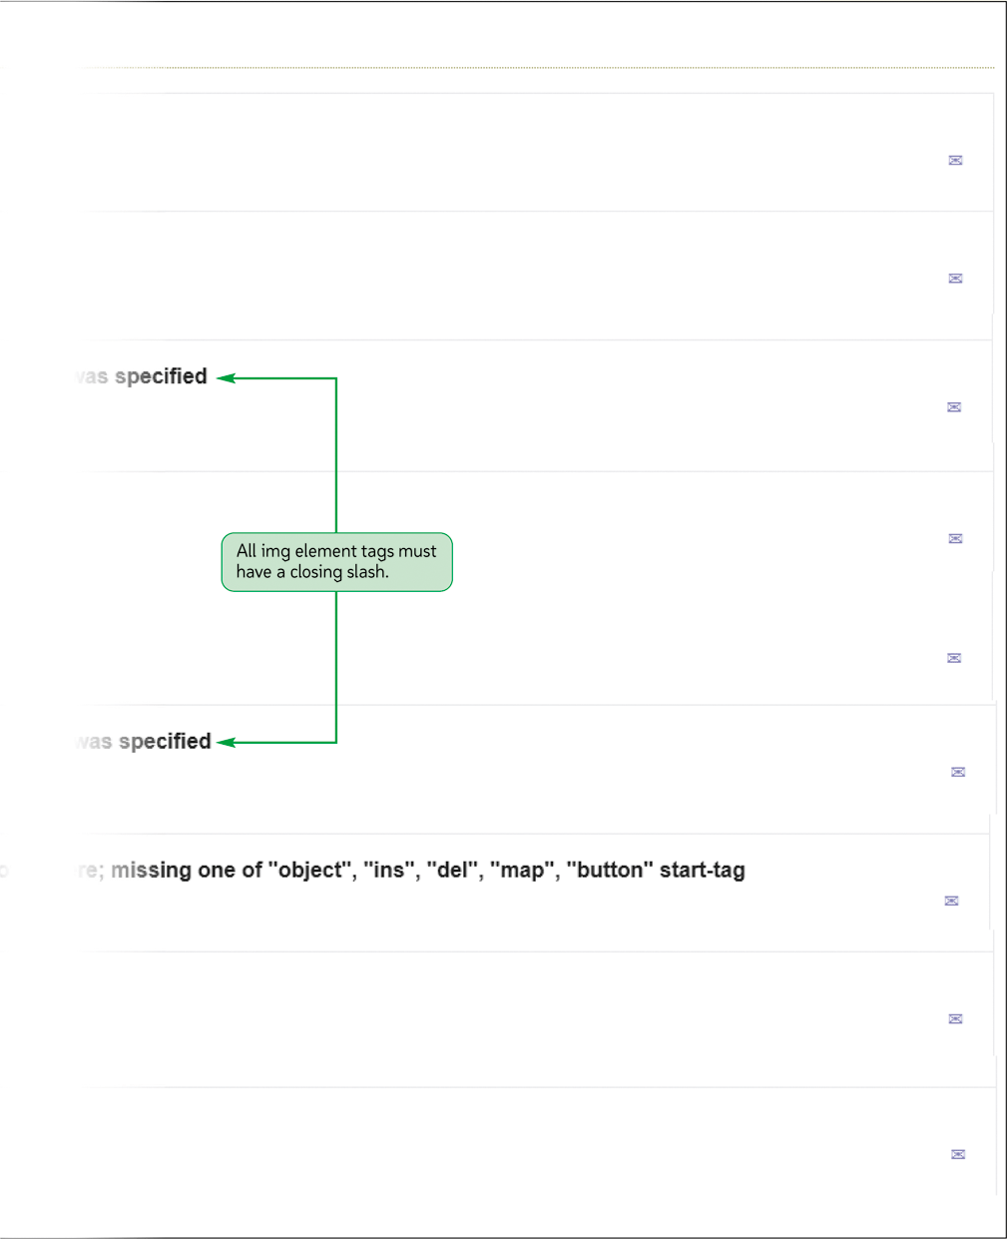
Validating an XHTML Document

Slide 26
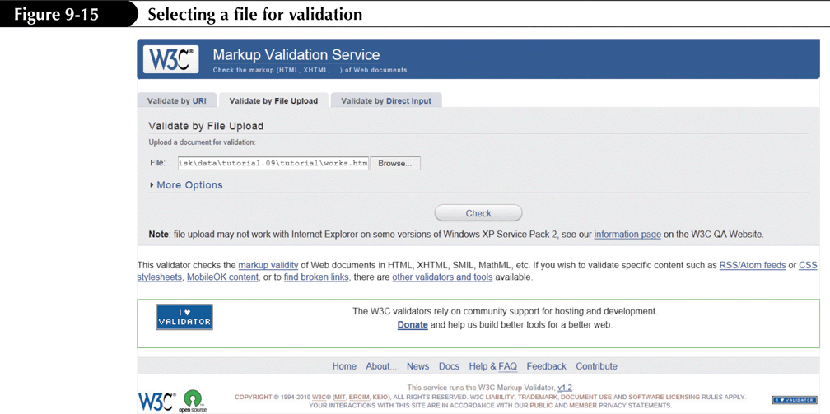
Validating Under XHTML Transitional

Slide 27
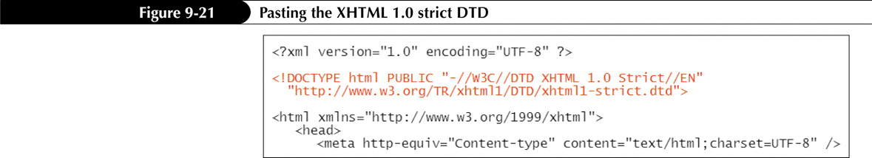
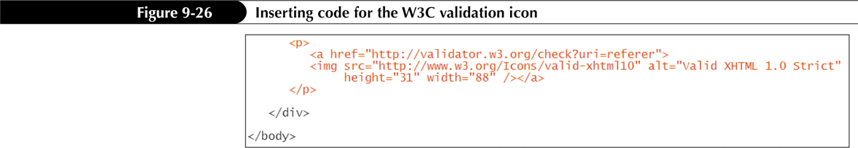
Testing Under XHTML Strict
To test under another DTD, you’ll need to change the DOCTYPE declaration

Slide 28
Using Embedded Style Sheets in XHTML
Parsed character data (PCDATA) is text processed by a browser or parser
Unparsed character data (CDATA) is text not processed by the browser or parser
A CDATA section marks a block of text as CDATA so that parsers ignore any text within it

