Slide 1
Objectives
Explore how Web forms interact with Web servers
Create form elements
Create field sets and legends
Create input boxes and form labels
Create selection lists
Creation option buttons
Create text area boxes
Create check boxes

Slide 2
Objectives
Apply styles to Web forms
Explore HTML5 data types
Create spinners and range sliders
Create form buttons
Validate form data

Slide 3
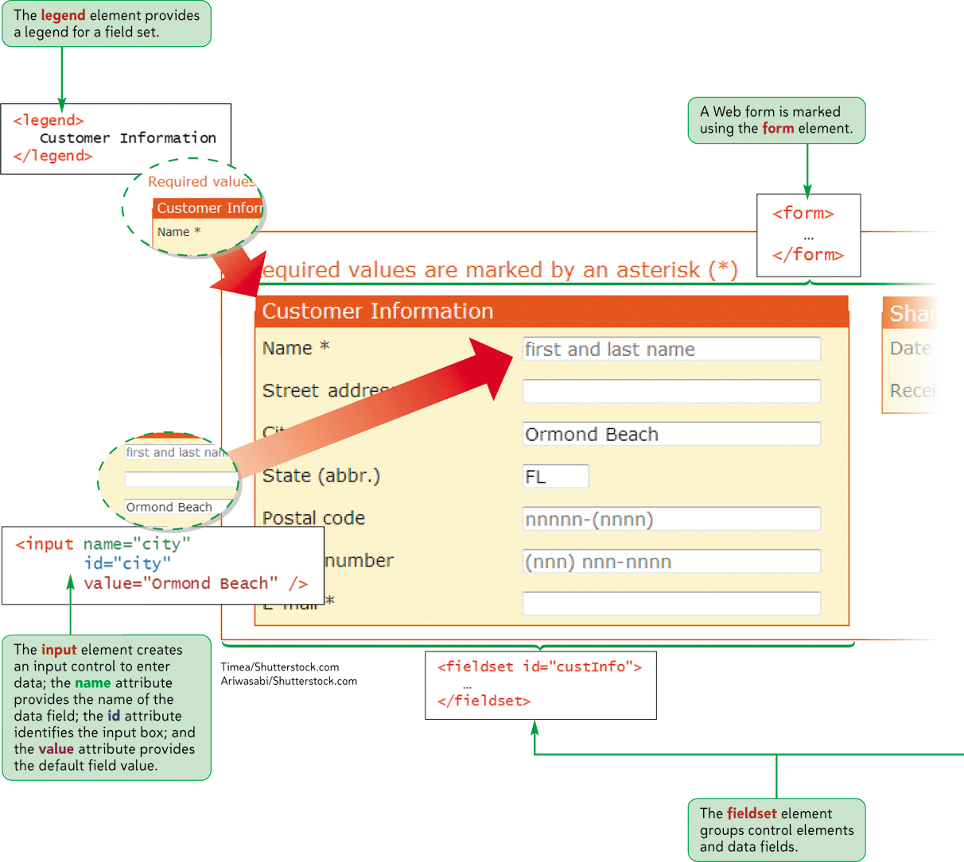
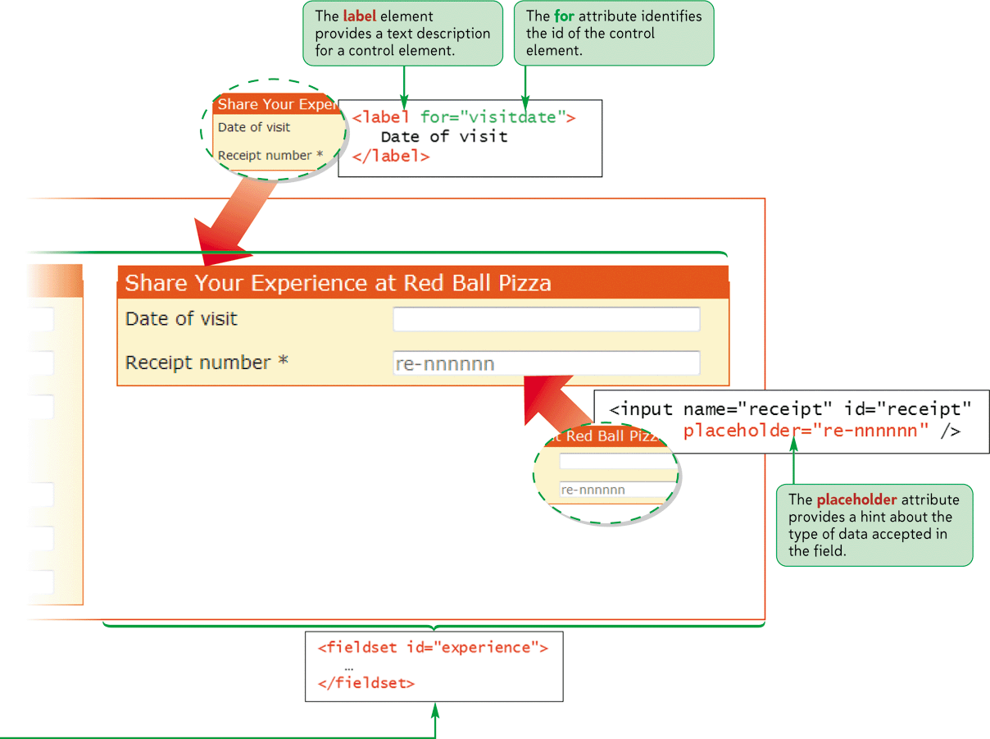
Parts of a Web Form

Slide 4
Introducing Web Forms
Web forms collect information from Web site visitors.
HTML supports the following control elements:
Input boxes
Option buttons
Selection lists
Check boxes
Text areas
Color pickers
Calendar pickers
Spin boxes
Sliders

Slide 5
Creating a Web Form
Forms are created using the form element, structured as follows:
<form attributes>
content
</form>
Where attributes are the attributes that control how the form is processed and content is the content of the form.

Slide 6
Creating a Web Form
Form attributes tell the browser the location of the server-based program to be applied to the form’s data.
Always specify an id or name for the form.
Two attributes are available to identify the form: id and name.

Slide 7
Creating a Web Form
The syntax of the id and name attributes are as follows:
<form id=“id” name=“name”>… </form>
Where id is the id of the form and name is the name of the form.

Slide 8
Creating a Field Set
HTML and XHTML allow you to organize a form into a group of fields called field sets.
<fieldset id=“id”>
controls
</fieldset>
where id identifies the field set and controls are the control elements associated with fields within the field set

Slide 9
Creating a Field Set
To add a legend to a field set, add the following tag after the opening <fieldset> tag:
<legend>text</legend>
Where text is the text of the field set caption.

Slide 10
Creating Input Boxes
The general syntax of input elements is as follows: <input type=“type” name=“name” id=“id” />
Where type specifies the type of input control, and the name and id attributes provide the control’s name and id.

Slide 11
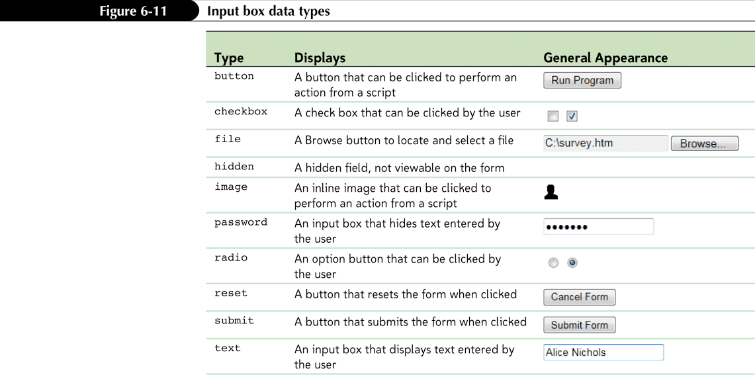
Creating Input Boxes

Slide 12
Adding Field Labels
You can also expressly link text with a control element.
The syntax for creating a form label is as follows:
<label for=“id”>label text</label>
Where id is the value of the id attribute for a field’s control element, and label text is the text of the label.

Slide 13
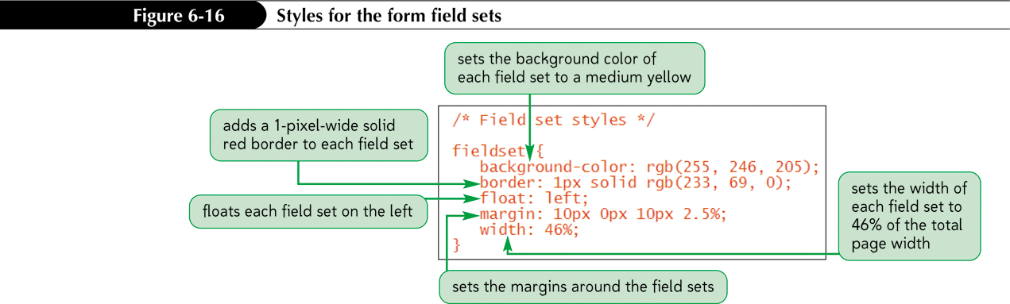
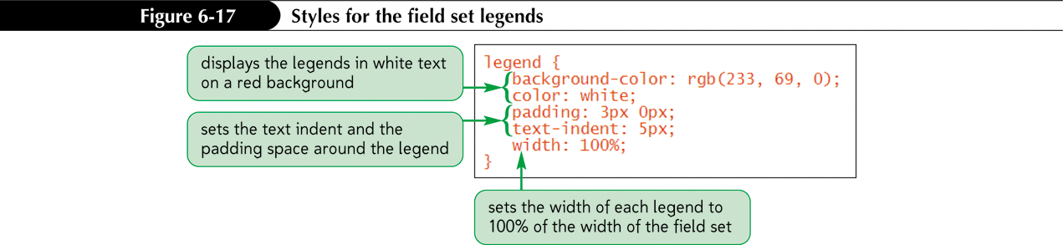
Applying a Style Sheet to a Web Form

Slide 14
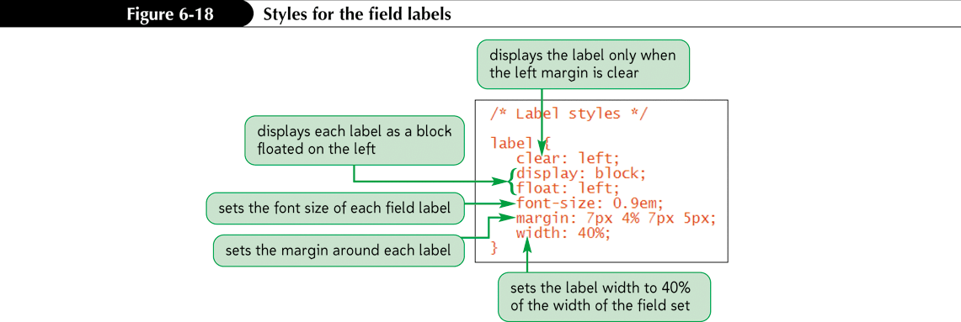
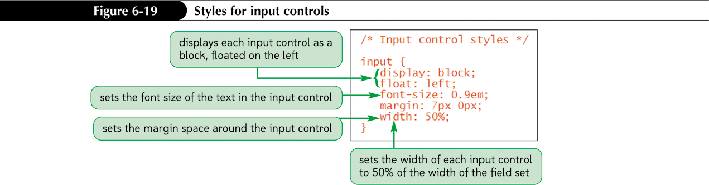
Applying a Style Sheet to a Web Form

Slide 15
Defining Default Values and Placeholders
To define the default value of a field, add the attribute
value=”value”
to the control element, where value is the default value assumed by a browser unless a user enters a different value
Starting with HTML5, you can also populate your input boxes with placeholders. A placeholder is a text string that appears within the control element and provides users with information about the kind of information accepted by the field

Slide 16
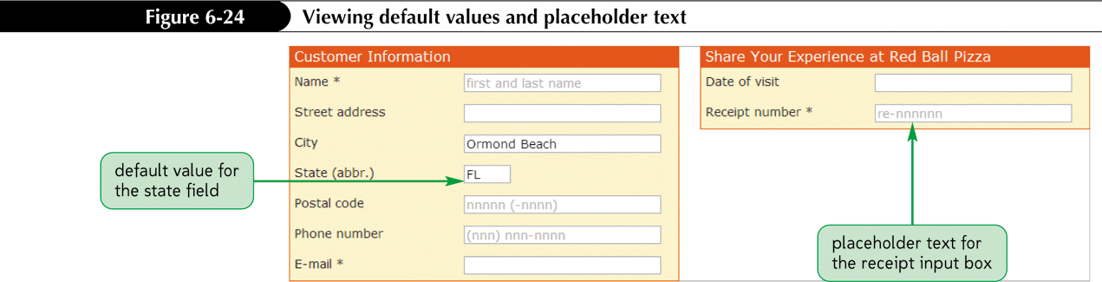
Defining Default Values and Placeholders

Slide 17
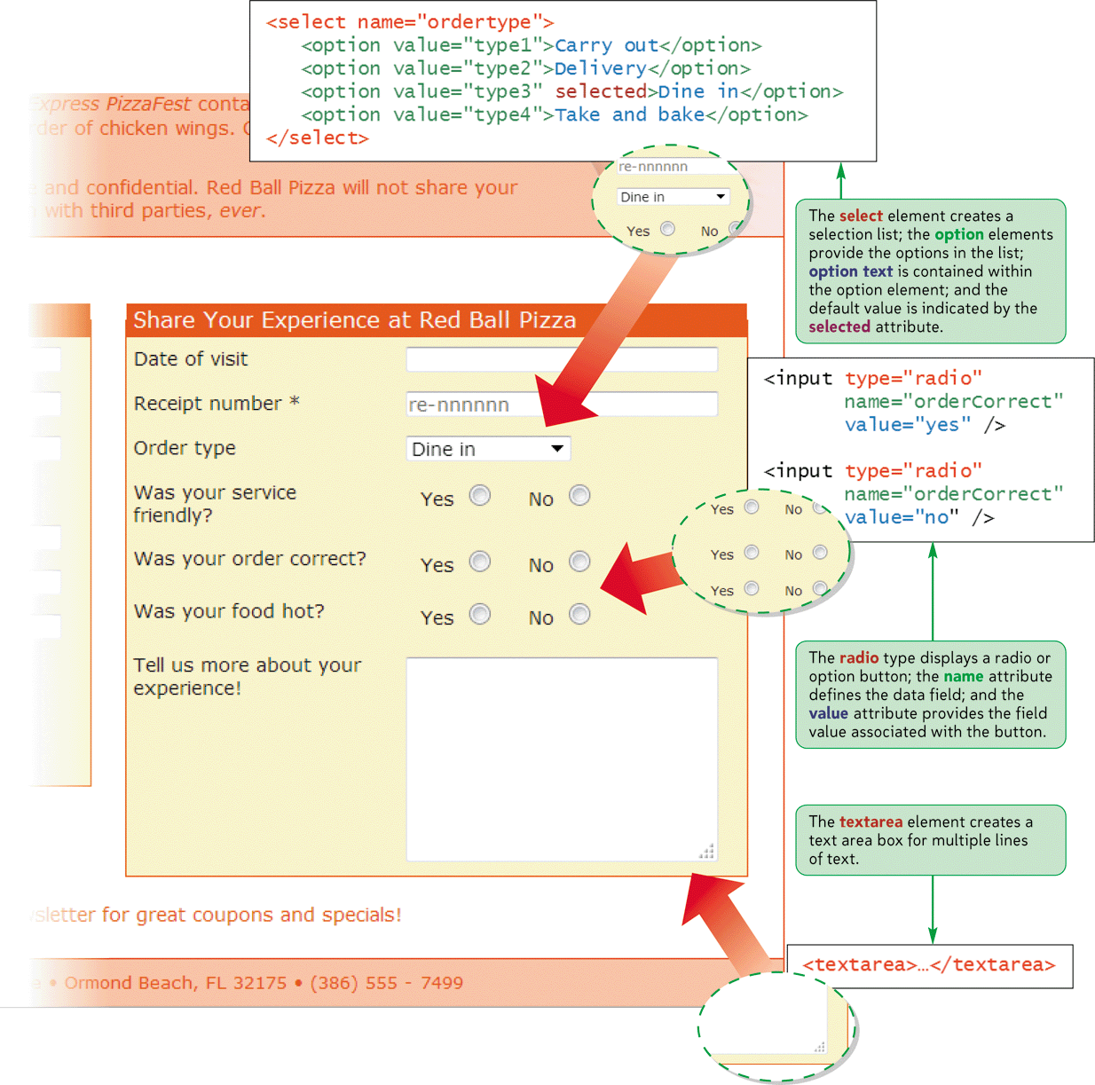
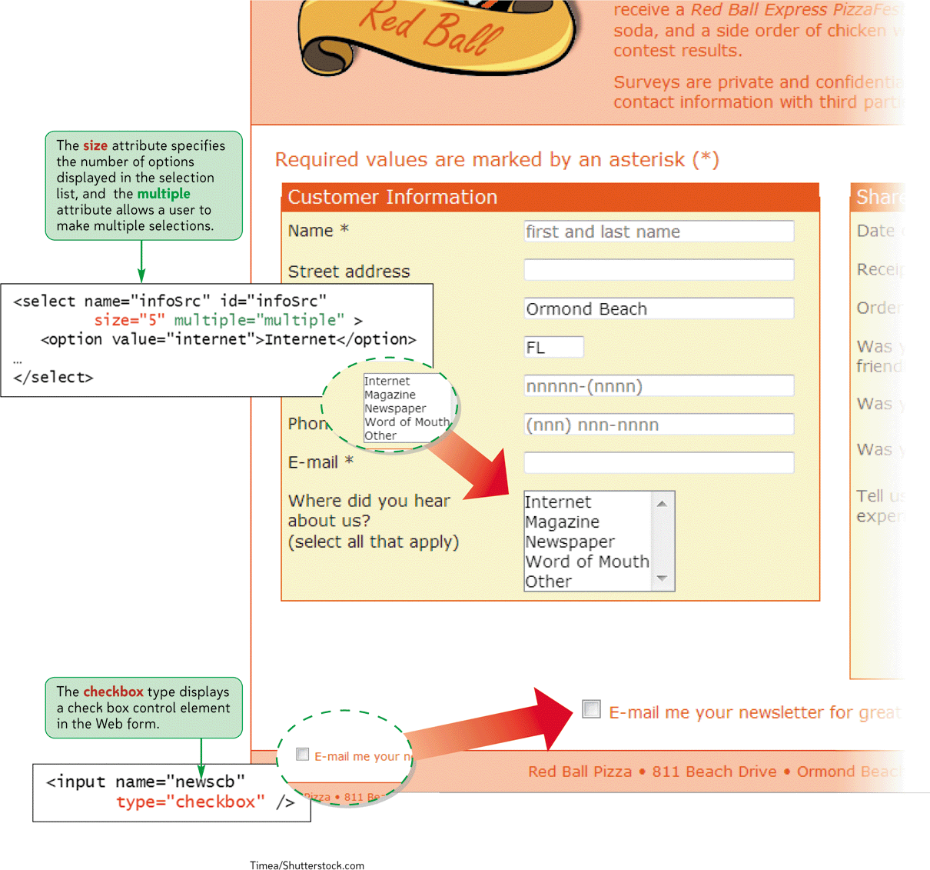
Selection Lists and Option Buttons

Slide 18
Creating a Selection List
A selection list is a list box from which a user selects a particular field value or set of field values.
Selection lists are useful when there are a fixed set of possible responses from the user.
You can create a selection list using the <select> element.
You can specify each individual selection item using the <option> element.

Slide 19
Creating a Selection List
You can change the number of options displayed in the selection list by modifying the size attribute. The syntax is as follows:
<select size= “value”>… </select>
Where value is the number of items that the selection list displays in the form.

Slide 20
Creating a Selection List
Add the multiple attribute to the select element to create multiple selections:
<select multiple=“multiple”>… </select>

Slide 21
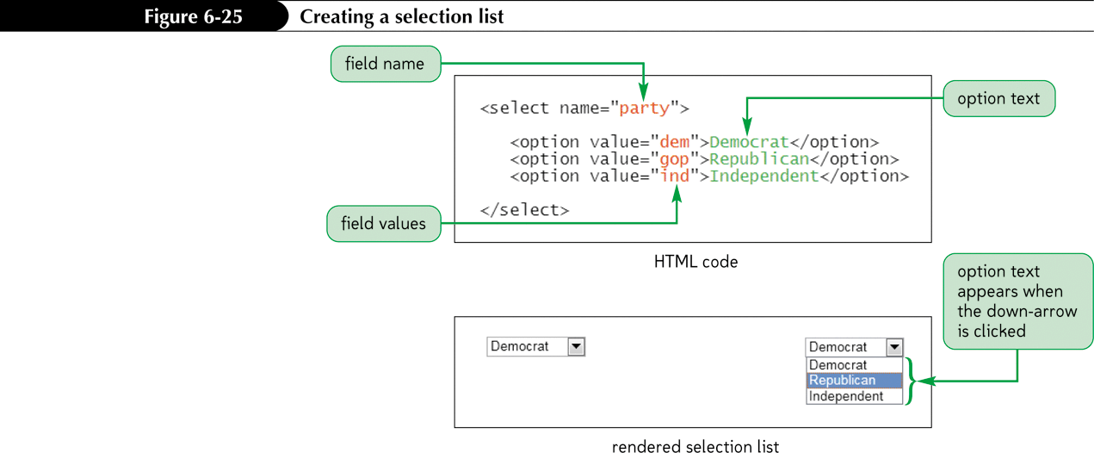
Creating a Selection List

Slide 22
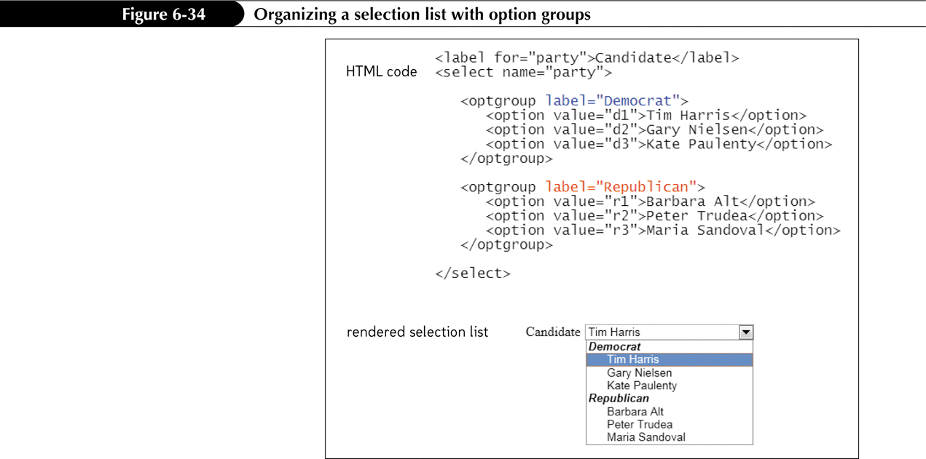
Grouping Selection Options

Slide 23
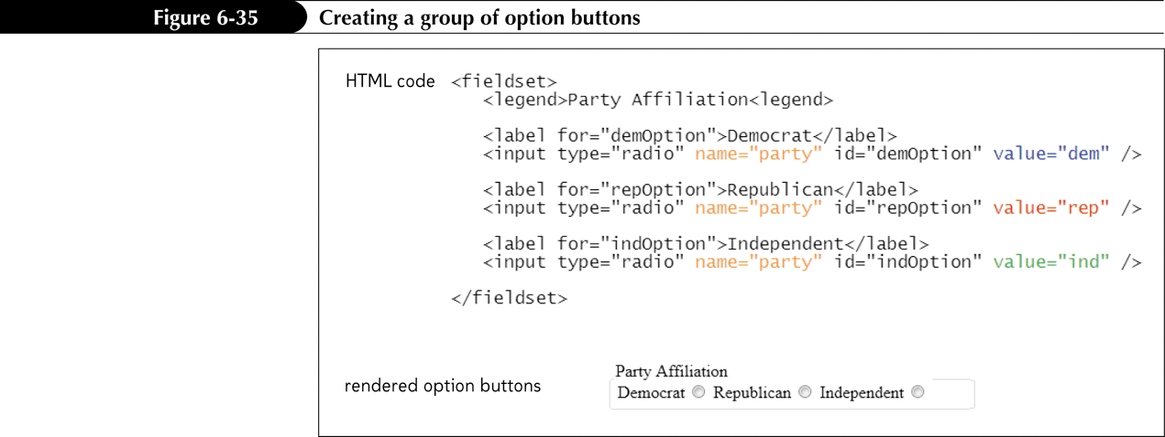
Creating Option Buttons
Option buttons, or radio buttons allow users to make selections.
Unlike selection lists, option buttons only allow the user to select one option at a time.

Slide 24
Creating a Group of Option Buttons
To create a group of option buttons associated with a single field, add the elements:
<input type="radio" name="name" value="value1" />
<input type="radio" name="name" value="value2" />
<input type="radio" name="name" value="value3" />
where name is the name of the data field, and value1, value2, value3, etc. are the field values associated with each option.
To specify the default option, add the checked attribute to the input element as follows:
checked=”checked”

Slide 25
Creating a Text Area Box
Text area boxes allow users to enter comments.
An input box would be too small to accommodate the length of text for this use.

Slide 26
Creating a Text Area Box
To create a text area box, use the textarea element:
<textarea rows="value" cols="value"> ... </textarea>
Where the rows and cols attributes define the dimensions of the input box and the rows attribute indicates the number of lines in the input box.

Slide 27
Creating a Text Area Box
As you type text into a text area box, the text automatically wraps to a new line as it extends beyond the box’s width
You can determine whether the locations of line wrapping are included in the field value by using the wrap attribute
Hard
Soft

Slide 28
Creating Check Boxes
To create a check box, use:
<input type=“checkbox” name=“name” value=“value” />
Where the name attribute identifies the check box controls and the value attribute specifies the value sent to the server if the check box is selected.
To specify that a check box be selected by default, use the checked attribute as follows:
<input type=“checkbox” checked=“checked” />

Slide 29
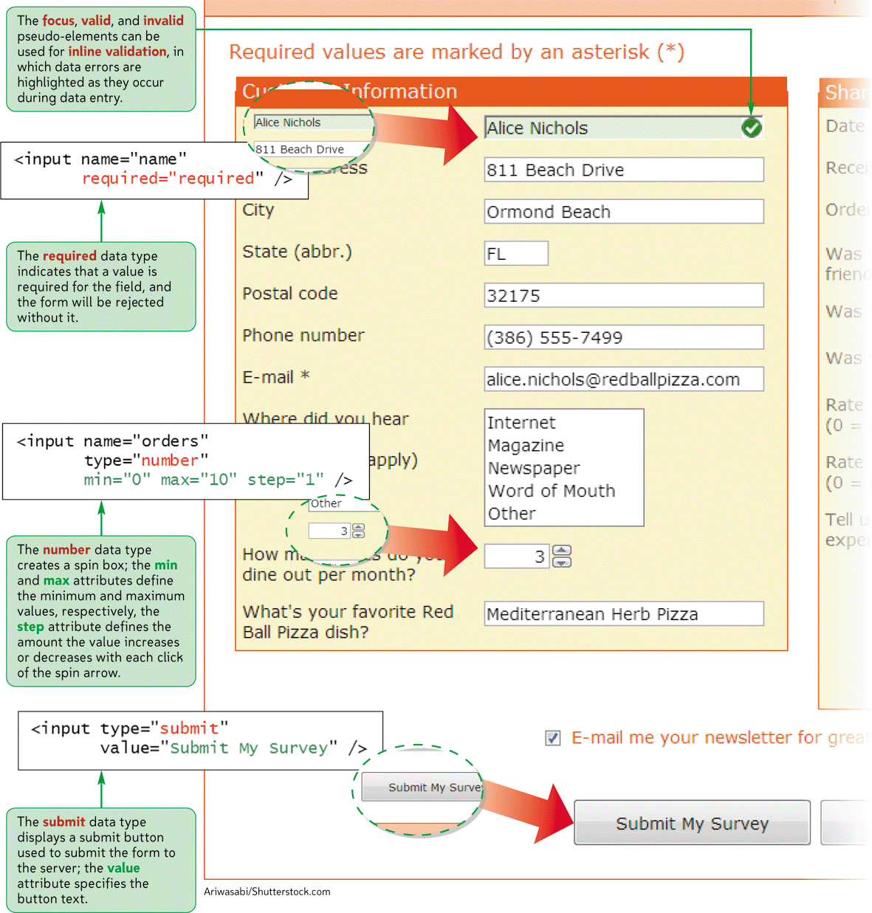
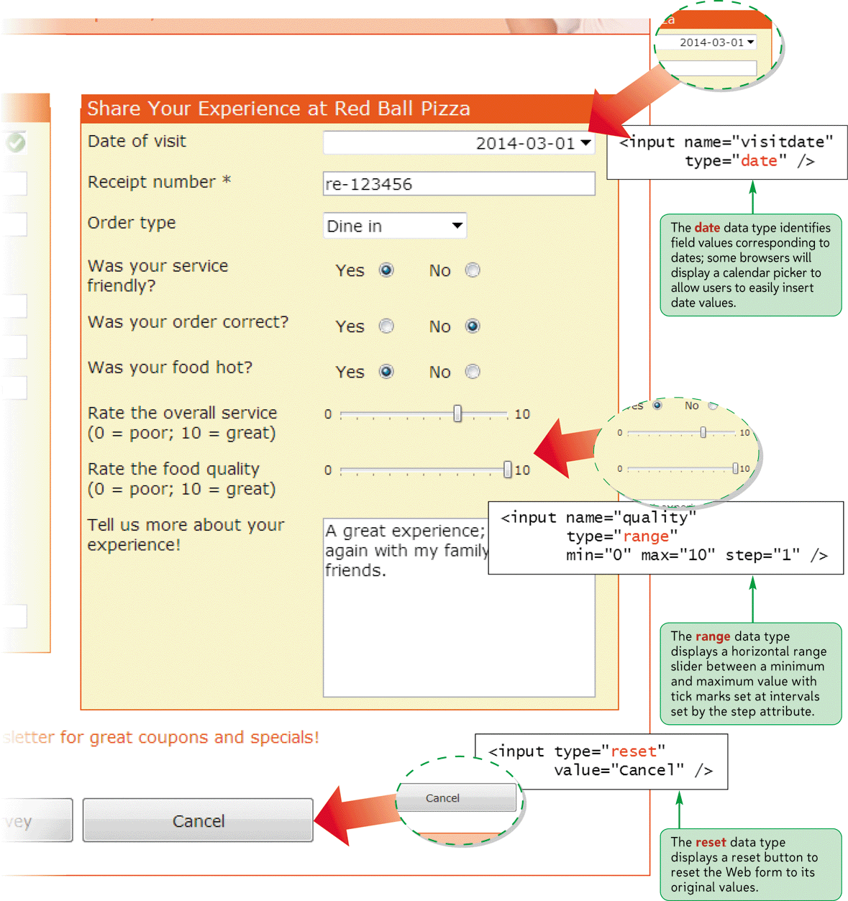
HTML5 Data Types

Slide 30
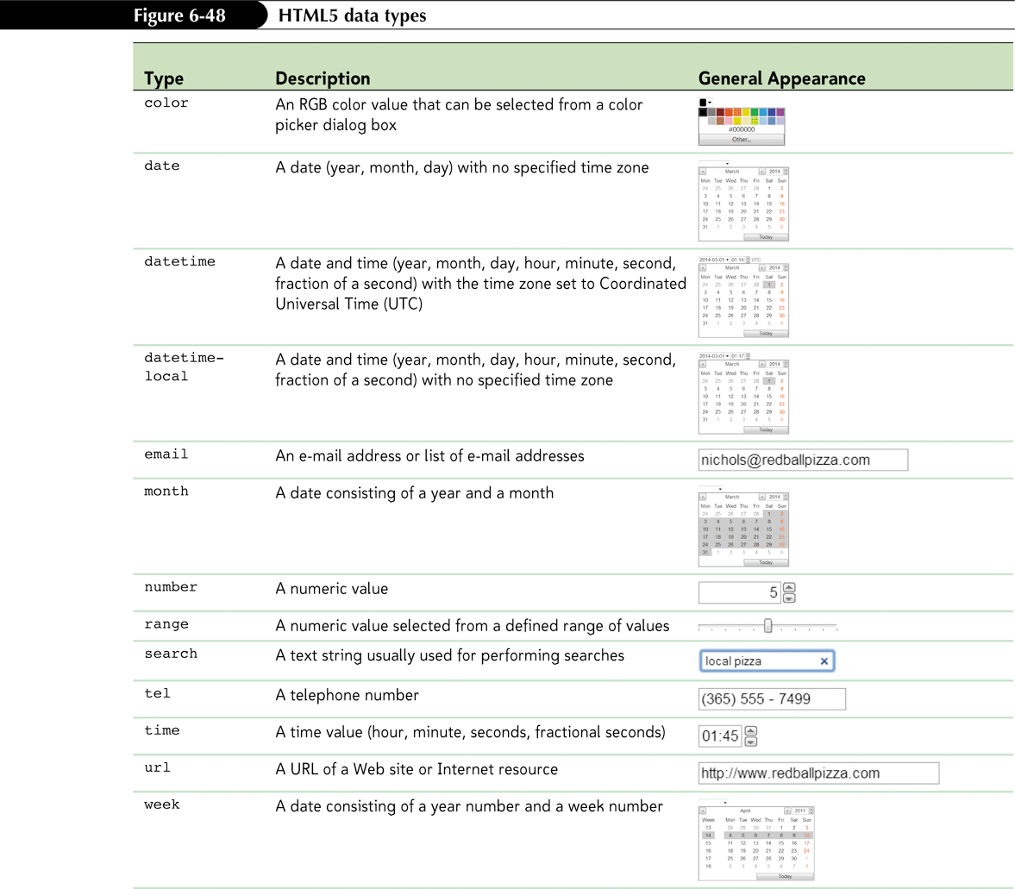
Exploring HTML5 Data Types

Slide 31
Exploring HTML5 Data Types
The email, tel, and url data types are used for storing e-mail addresses, telephone numbers, and Web addresses, respectively
For browsers that support the date type, this will bring up a calendar widget from which users can select a date

Slide 32
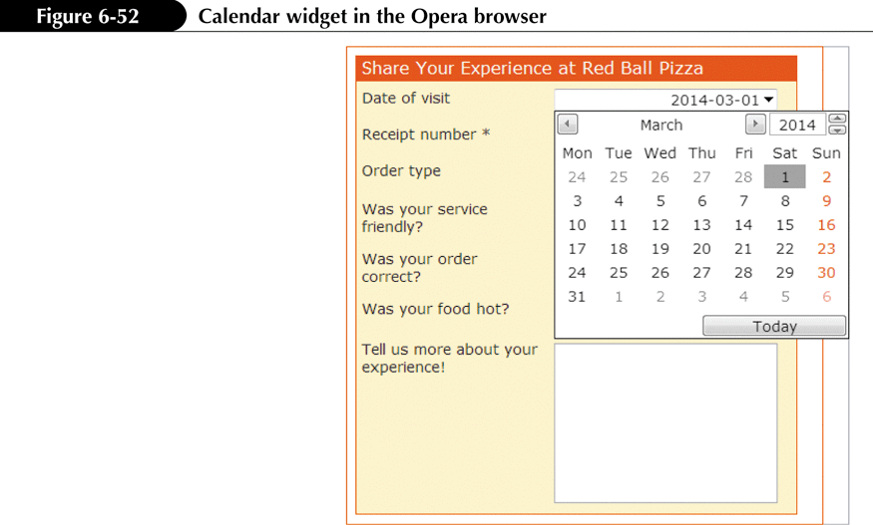
Exploring HTML5 Data Types

Slide 33
Creating Spinner Controls and Range Sliders
To create a spinner control for numeric data, enter the input element
<input name=”name” type=”number” value=”value” step=”value” min=”value” max=”value” />
where the value attribute provides the default field value, the step attribute indicates the amount by which the field value changes when a user clicks the spin arrow, the min attribute defines the minimum possible value, and the max attribute defines the maximum possible value of the field
To create a range slider control for numeric data, use the following input element:
<input name=”name” type=”range” value=”value” step=”value” min=”value” max=”value” />

Slide 34
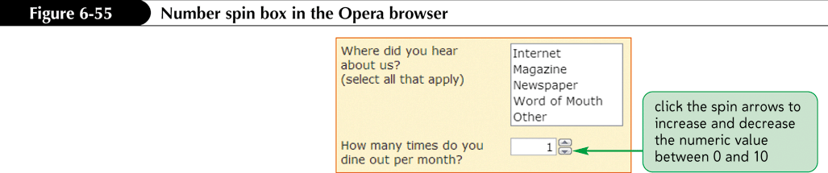
Creating Spinner Controls and Range Sliders

Slide 35
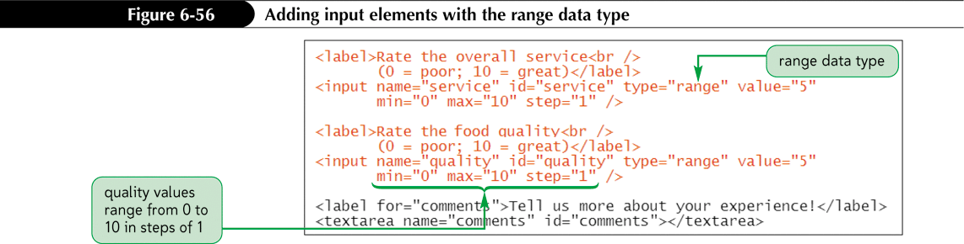
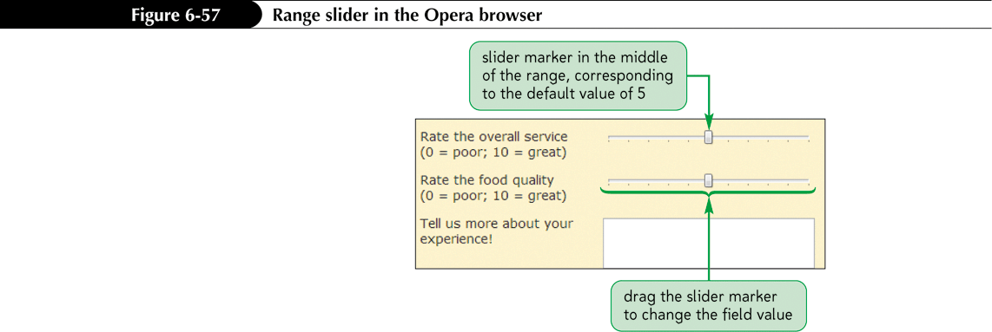
Specifying a Numeric Range with the range Data Type

Slide 36
Creating and Applying a Data List
To create a data list of possible values, enter the HTML code
<datalist id=”id”>
<option value=”value” />
<option value=”value” />
…
</datalist>
where the value attribute provides the text of the possible values in the data list.

Slide 37
Creating and Applying a Data List
To reference the data list from an input control, add the list attribute
<input name=”name” list=”id” />
where id references the id of the data list structure.

Slide 38
Creating Form Buttons
Form buttons are a type of control element that performs an action.
Types of buttons:
Command button
Submit button
Reset button

Slide 39
Creating a Command button
Command buttons are created using the <input> tag:
<input type=“button” value=“text” />
Submit buttons submit forms to the server for processing when clicked. Syntax is as follows:
<input type=“submit” value=“text” />
Reset buttons reset forms to their original (default) values. Syntax is as follows:
<input type=“reset” value=“text” />

Slide 40
Designing a Custom Button
Use the button element for greater artistic control over the appearance of a button.
<button name=“name” type=“text”>
content
</button>
where the type attribute specifies the button type (submit, reset, or button—for creating a command button) and content is page elements displayed within the button

Slide 41
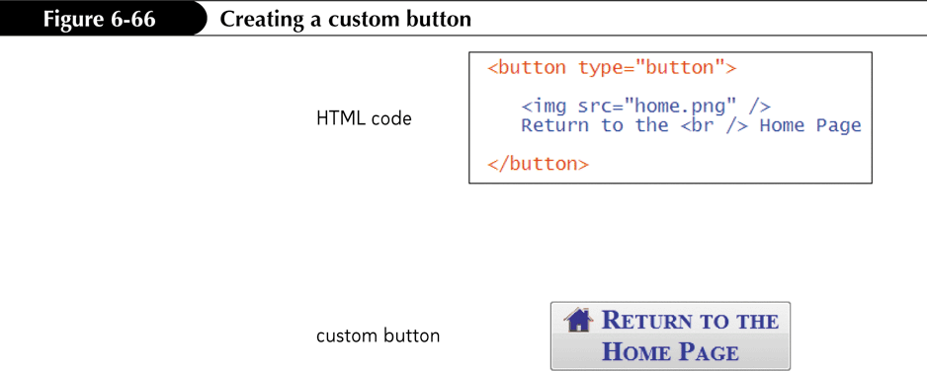
Designing a Custom Button

