Slide 1
Objectives
Explore the history of the Internet, the Web, and HTML
Compare the different versions of HTML
Study the syntax of HTML tags and attributes
Define a Web page head, body, and title
Work with the HTML5 structural elements

Slide 2
Objectives
Mark page headings, paragraphs, block quotes, and addresses
Create unordered and ordered lists
Apply an external style sheet to a Web page
Run a JavaScript program
Mark text-level elements including strong and emphasized text
Insert inline images and line breaks
Insert special characters from extended character sets

Slide 3
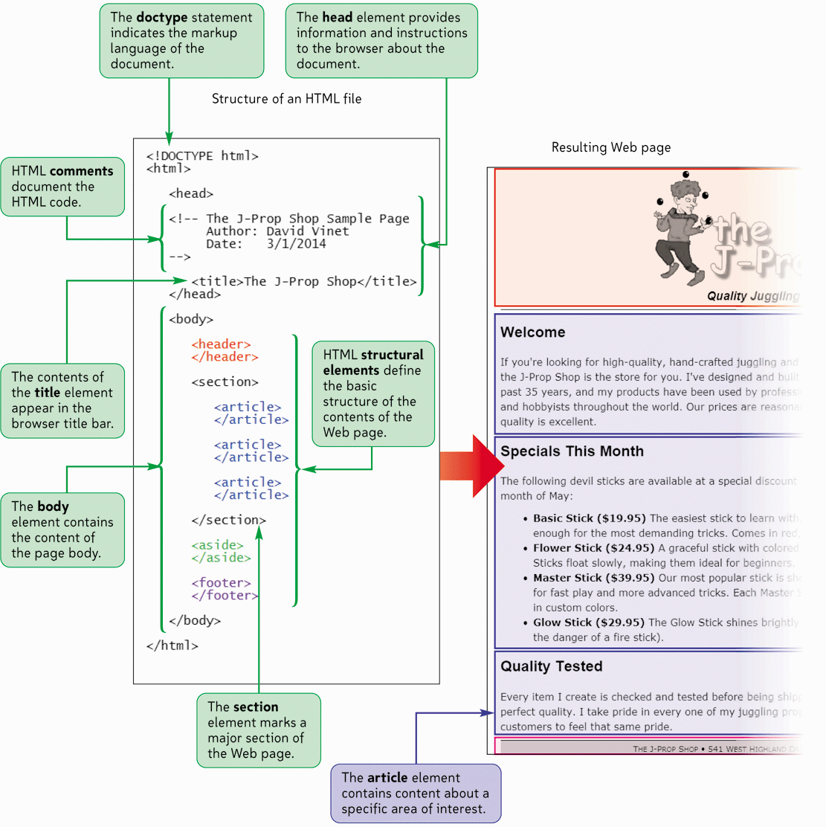
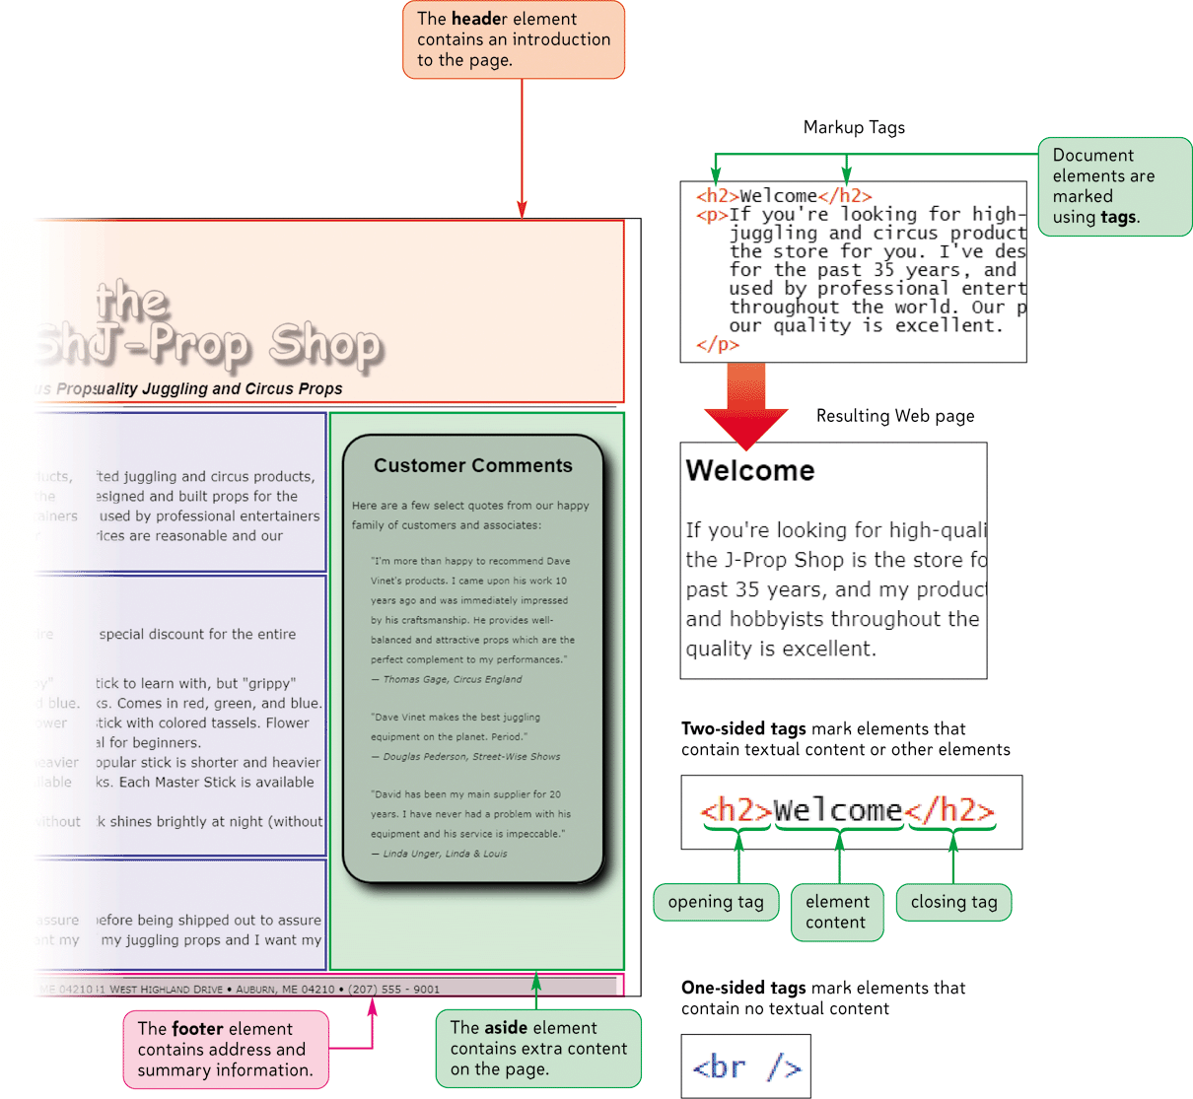
The Structure of an HTML5 Document

Slide 4
Exploring the History of the World Wide Web
A network is a structure linking computers together for the purpose of sharing information and services
Users typically access a network through a computer called a node or host
A host that provides information or a service is called a server

Slide 5
Exploring the History of the World Wide Web
A computer or other device that receives a service is called a client
One of the most commonly used designs is the client-server network
If the computers that make up a network are close together (within a single department or building), then the network is referred to as a local area network (LAN)

Slide 6
Exploring the History of the World Wide Web
A network that covers a wide area, such as several buildings or cities, is called a wide area network (WAN)
The largest WAN in existence is the Internet
Today the Internet has grown to include an uncountable number of networks and hosts involving computers, mobile phones, PDAs, MP3 players, gaming systems, and television stations

Slide 7
Exploring the History of the World Wide Web
Timothy Berners-Lee and other researchers at the CERN nuclear research facility near Geneva, Switzerland laid the foundations for the World Wide Web, or the Web, in 1989
They developed a system of interconnected hypertext documents that allowed their users to easily navigate from one topic to another
Hypertext is a method of organization in which data sources are interconnected through a series of links or hyperlinks that users can activate to jump from one piece of information to another

Slide 8
Web Pages and Web Servers
Each document on the World Wide Web is referred to as a Web page
Web pages are stored on Web servers, which are computers that make Web pages available to any device connected to the Internet
A Web browser retrieves the page from the Web server and renders it on the user’s computer or other device
The earliest browsers, known as text-based browsers, were incapable of displaying images

Slide 9
Introducing HTML
A Web page is a text file written in Hypertext Markup Language
A markup language is a language that describes the content and structure of a document by identifying, or tagging, different elements in the document

Slide 10
The History of HTML
The first popular markup language was Standard Generalized Markup Language (SGML)
In the early years of HTML, Web developers were free to define and modify HTML in whatever ways they thought best

Slide 11
The History of HTML
A group of Web designers and programmers, called the World Wide Web Consortium, or the W3C, created a set of standards or specifications that all browser manufacturers were to follow
The W3C has no enforcement power
The recommendations of the W3C are usually followed since a uniform approach to Web page creation is beneficial to everyone

Slide 12
The History of HTML
Older features of HTML are often deprecated, or phased out, by the W3C That does not mean you can’t continue to use them—you may need to use them if you are supporting older browsers
Current Web developers are increasingly using XML (Extensible Markup Language)
XML is a metalanguage like SGML, but without SGML’s complexity and overhead

Slide 13
The History of HTML
XHTML (Extensible Hypertext Markup Language) is a stricter version of HTML and is designed to confront some of the problems associated with the different and competing versions of HTML
XHTML is also designed to better integrate HTML with other markup languages such as XML

Slide 14
The History of HTML
XHTML 2.0 began development, but work was halted in 2009
HTML5 was developed as the next HTML specification, and the de facto standard for the next generation of HTML

Slide 15
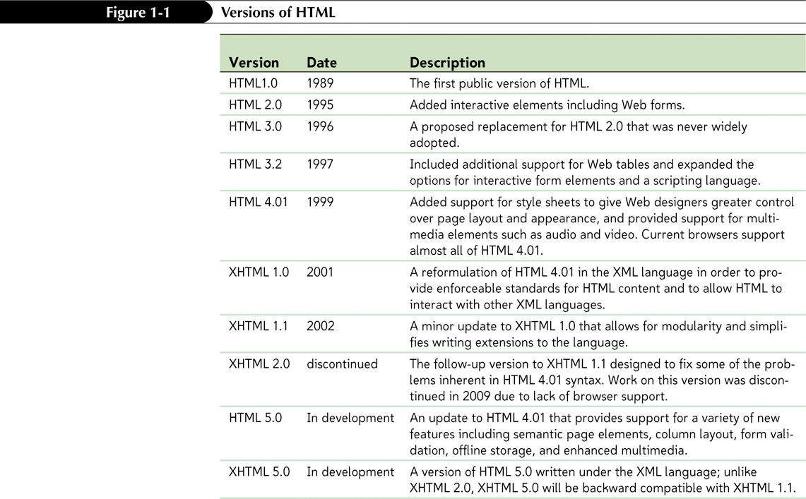
The History of HTML

Slide 16
HTML and Style Sheets
HTML marks the different parts of a document, but it does not indicate how document content should be displayed by browsers
For this reason, the exact appearance of each page element is described in a separate document known as a style sheet
Internal style sheets specify the appearance of different HTML elements

Slide 17
Tools for Creating HTML Documents
Basic text editor such as Windows Notepad
Other software programs that enable you to create documents in different formats, such as Microsoft Word or Adobe Acrobat, include tools to convert their documents into HTML for quick and easy publishing on the Web
Web publishing software manages all of the code and extended features of your site

Slide 18
Entering Elements and Attributes
An HTML document is composed of elements that represent distinct items in the Web page, such as a paragraph, the page heading, or even the entire body of the page itself
Elements are marked by one or more tags
A two-sided tag is a tag that contains some document content. General syntax for a two-sided tag:
<element>content</element>

Slide 19
Marking Elements with Tags
A two-sided tag’s opening tag (<p>) and closing tag (</p>) should completely enclose its content
Elements can contain other elements
Tags cannot overlap
<p>Welcome to the J-Prop Shop</p>

Slide 20
Adding an Attribute to an Element
To add an element attribute, use the format
<element attribute1=”value1” attribute2=”value2” ...>content</element>
where attribute1, attribute2, etc. are the names of attributes associated with the element, and value1, value2, etc. are the values of those attributes

Slide 21
White Space and HTML
HTML file documents are composed of text characters and white space
White space is the blank space, tabs, and line breaks within the file
HTML treats each occurrence of white space as a single blank space
You can use white space to make your document more readable

Slide 22
Exploring the Structure of an HTML File
<html>
<head>
head content
</head>
<body>
body content
</body>
</html>

Slide 23
The Structure of an HTML File
An HTML document is divided into two main sections: the head and the body
The head element contains information about the document, for example the document title or the keywords
The content of the head element is not displayed within the Web page

Slide 24
The Structure of an HTML File
The body element contains all of the content to appear on the Web page
The body element can contain code that tells the browser how to render the content

Slide 25
Converting an HTML Document into XHTML
There is considerable overlap between HTML and XHTML
You can convert an HTML file into an XHTML file by replacing the opening <html> tag with the following three lines of code:
<?xml version="10" encoding="UTF-8" standalone="no" ?>
<!DOCTYPE html PUBLIC "-//W3C//DTD XHTML 10 Strict//EN“ “http://wwww3org/TR/xhtml1/DTD/xhtml1-strictdtd">
<html xmlns=http://wwww3org/1999/xhtml>

Slide 26
The Document Type Declaration
Prior to the opening <html> tag, many HTML files also include a Document Type Declaration, or doctype, to indicate the type of markup language used in the document
<!DOCTYPE html>

Slide 27
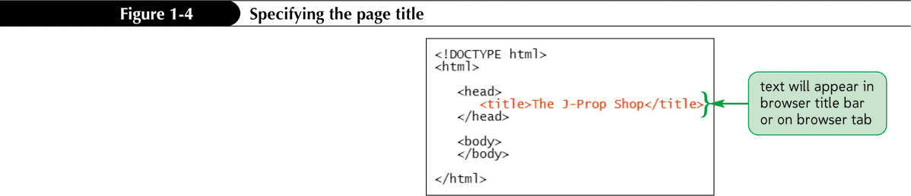
Defining the Page Title

Slide 28
Adding Comments
The comment tag adds notes to your HTML code
<!-- comment -->
Comments can be spread over several lines
Comments are useful in documenting your HTML code for yourself and others

Slide 29
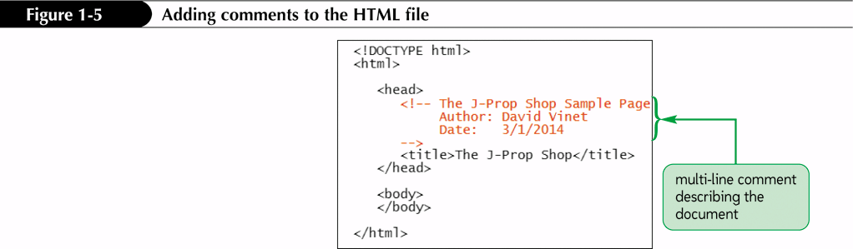
Adding Comments

Slide 30
Displaying an HTML File
As you continue modifying the HTML code, you should occasionally view it with your Web browser to verify that you have not introduced any errors
You may want to view the results using different browsers to check for compatibility

Slide 31
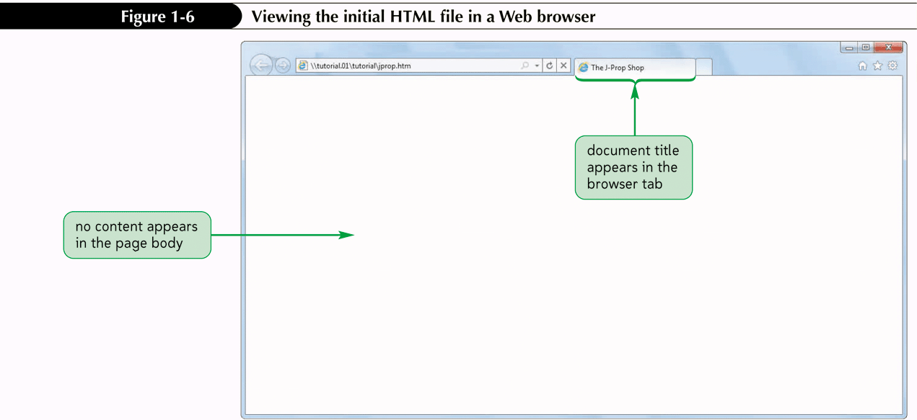
Displaying an HTML File

Slide 32
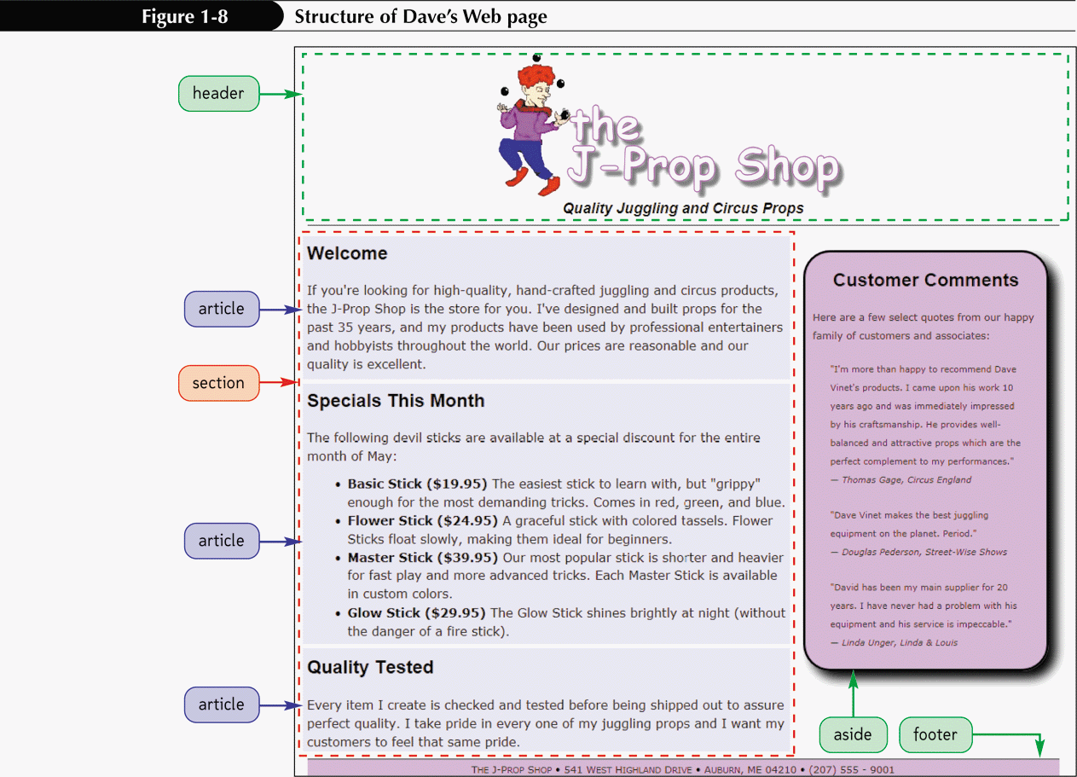
Defining the Structure of the Page Body

Slide 33
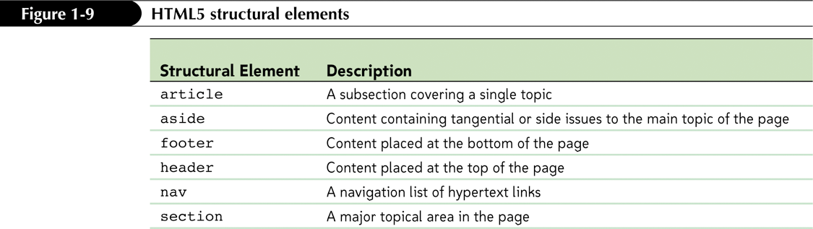
Defining the Structure of the Page Body

Slide 34
Marking Structural Elements in HTML5
To mark the page header, use the header element
To mark the page footer, use the footer element
To mark a main section of page content, use the section element
To mark a sidebar, use the aside element
To mark an article, use the article element

Slide 35
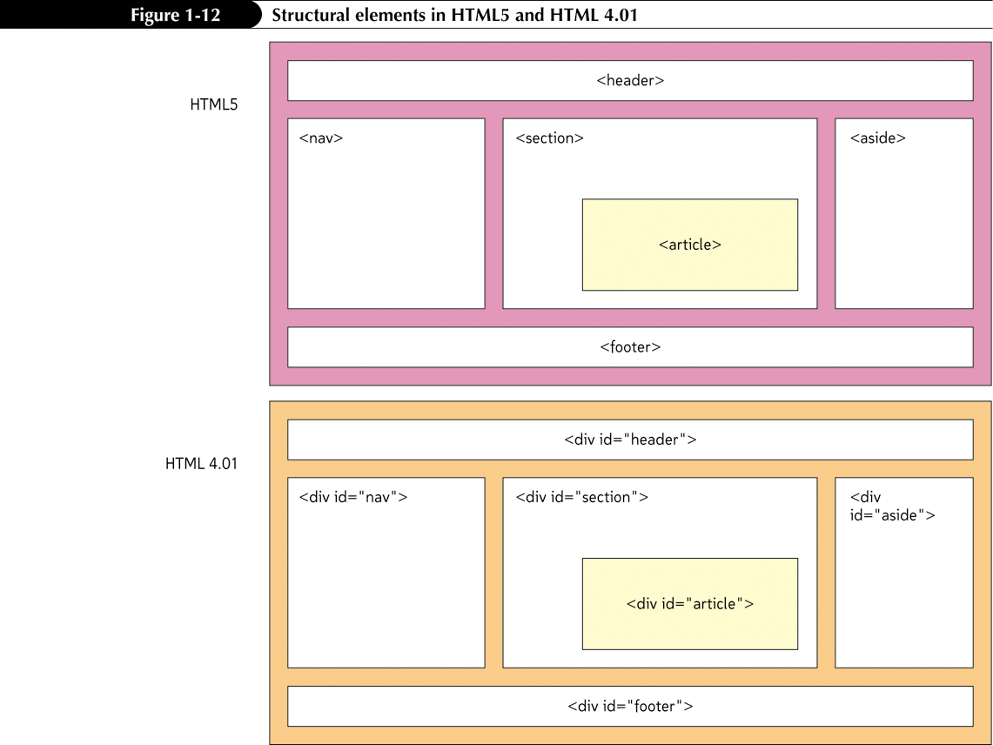
Marking a Section with the div Element

Slide 36
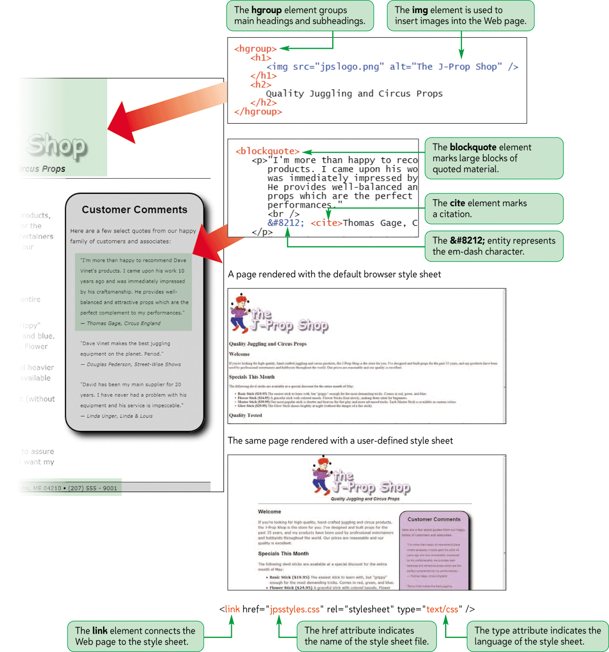
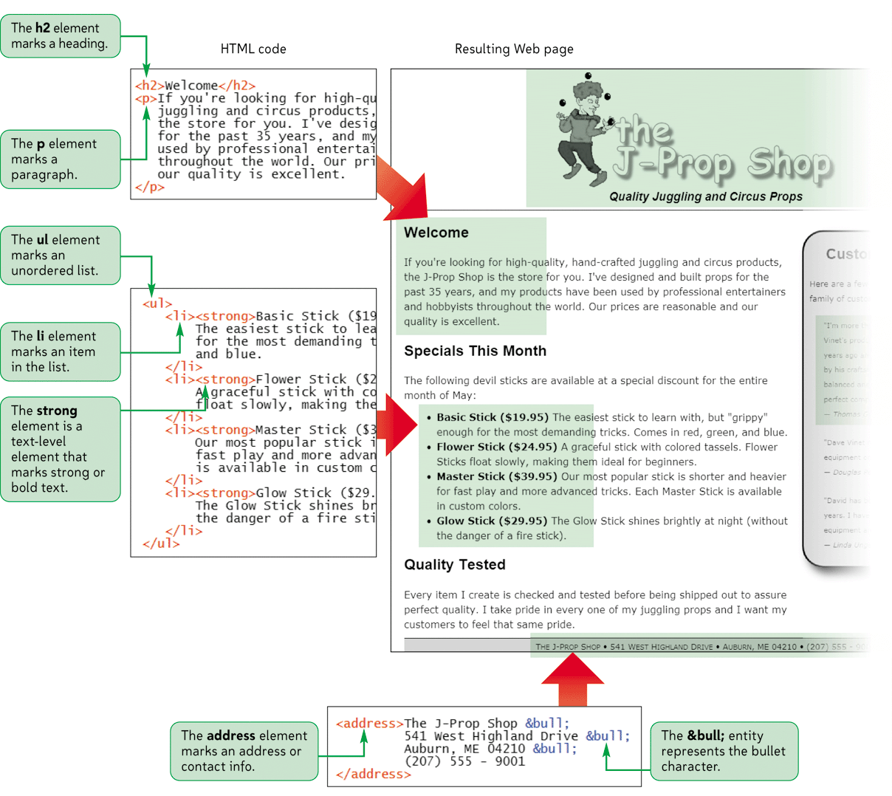
Page Content Elements

Slide 37
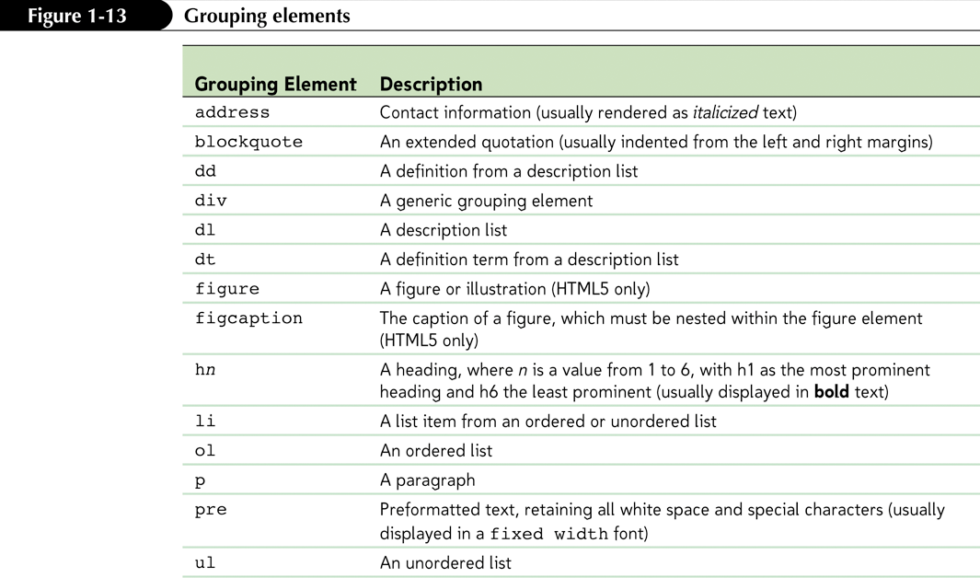
Working with Grouping Elements

Slide 38
Working with Grouping Elements
Grouping elements are elements that contain content that is viewed as a distinct block within the Web page
Heading elements are block-level elements that contain the text of main headings on the Web page
<hn>content<hn>
n is an integer between 1 and 6
<h1> is the largest heading
<h6> is the smallest heading

Slide 39
Marking Grouping Content
To mark a heading, enter
<hn>content</hn>
where n is an integer from 1 to 6 and content is the text of heading
To mark a paragraph, enter
<p>content</p>
To mark a block quote, enter
<blockquote>content</blockquote>

Slide 40
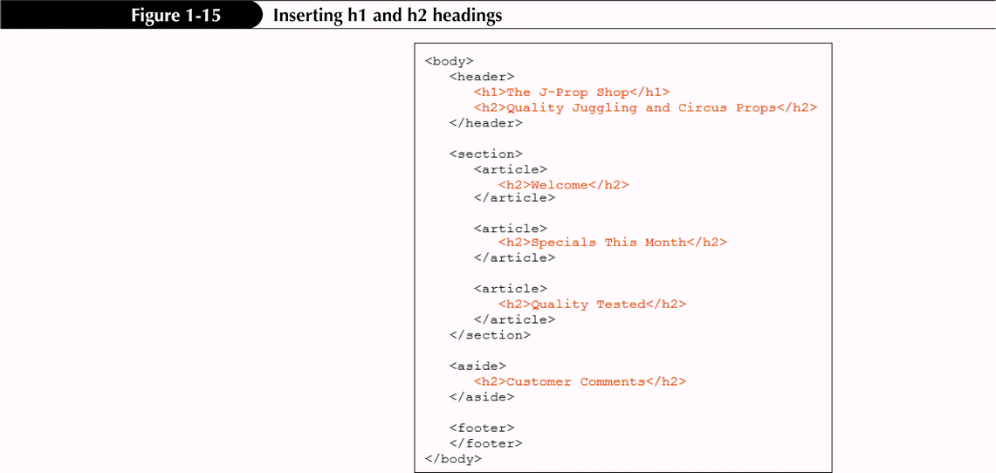
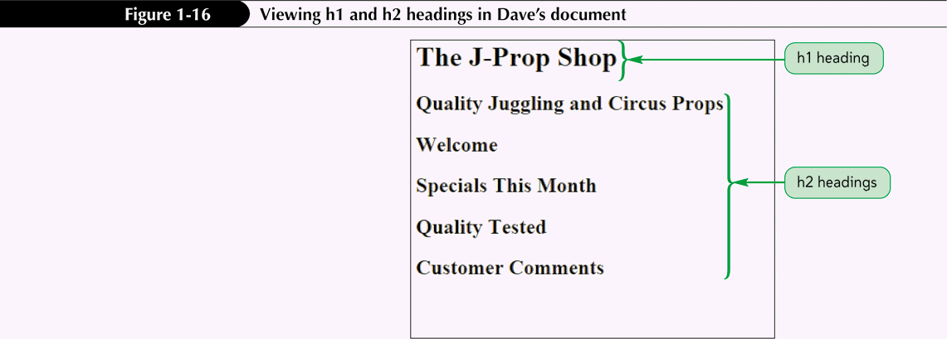
Adding Headings

Slide 41
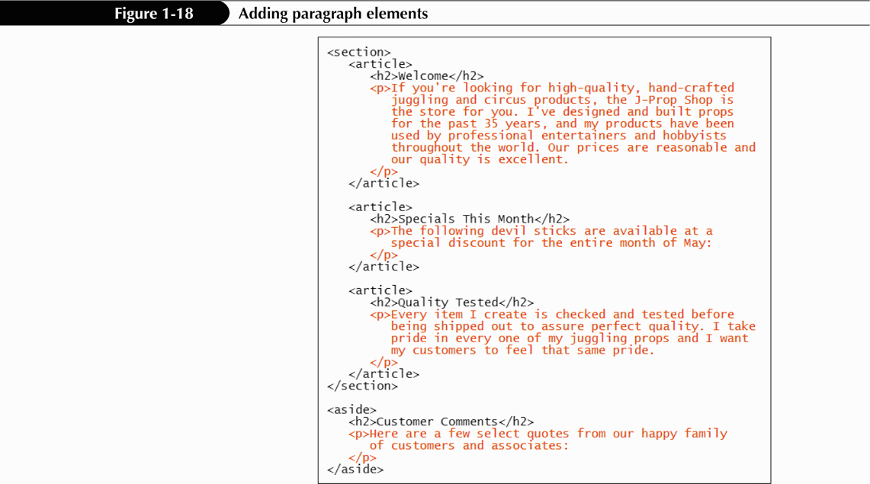
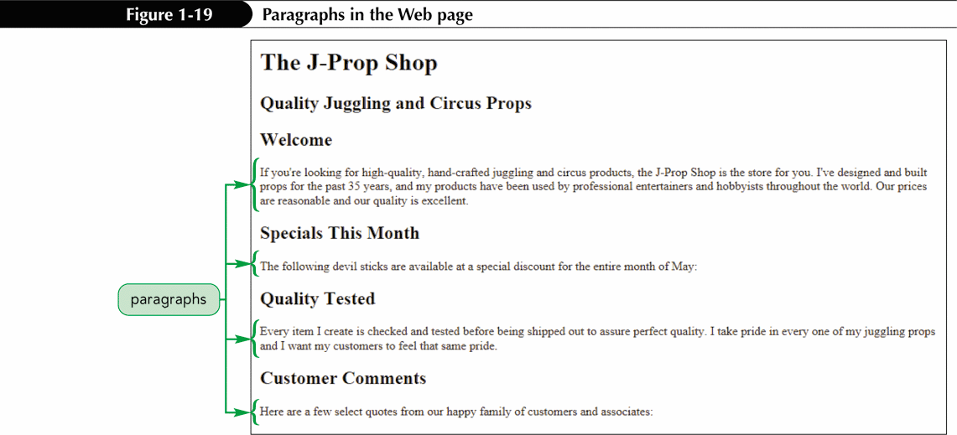
Marking Paragraph Elements

Slide 42
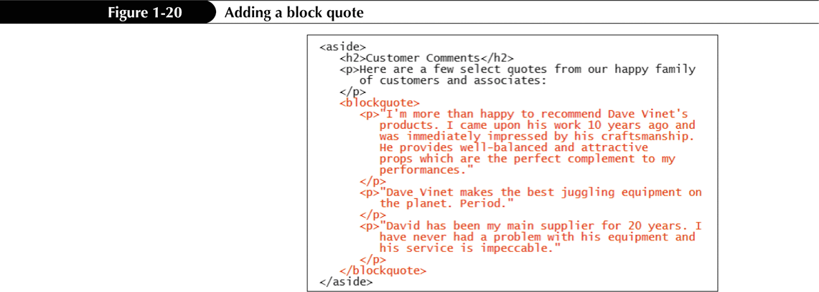
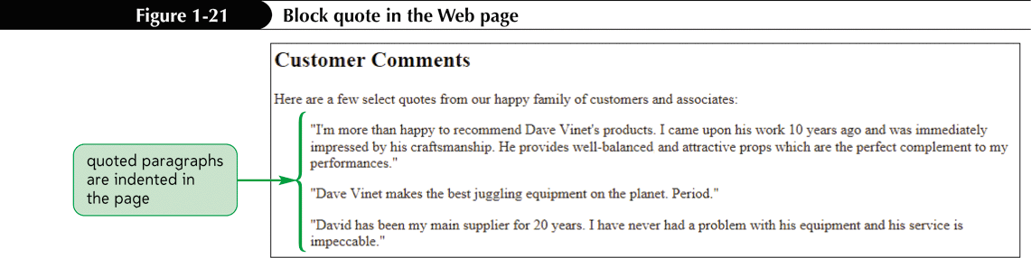
Marking a Block Quote
The syntax for making an extended quote is
<blockquote>content</blockquote>

Slide 43
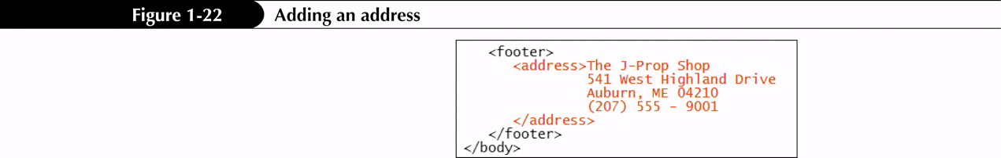
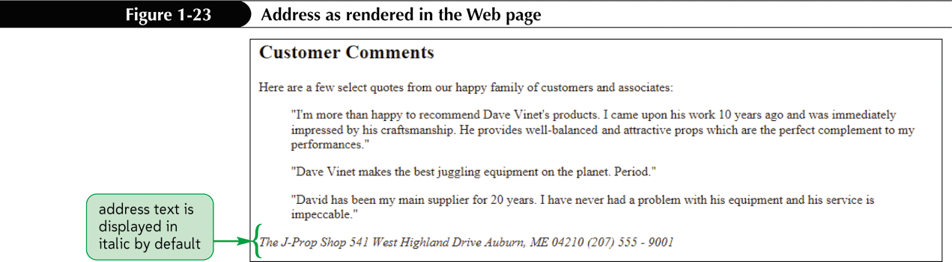
Marking an Address
<address>content</address>

Slide 44
Marking a List
HTML supports three kinds of lists: ordered, unordered, and description
You use an ordered list for items that must appear in a numerical order
You use an unordered list for items that do not need to occur in any special order
One list can contain another list. This is called a nested list

Slide 45
Description Lists
The description list contains a list of terms, each followed by the term’s description
Web browsers typically display the definition description below the definition term and slightly indented:
Basic Stick
Easiest stick to learn

Slide 46
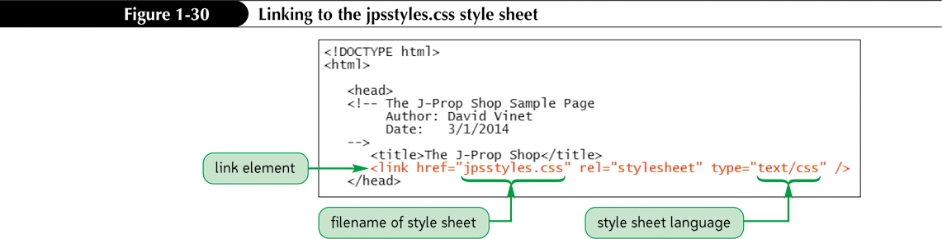
Applying an External Style Sheet
Style sheets are written in the Cascading Style Sheet (CSS) language
To apply an external style sheet to a Web page, you create a link within the document head to the style sheet file using the link element
<link href=”file” rel=”stylesheet” type=”text/css” />

Slide 47
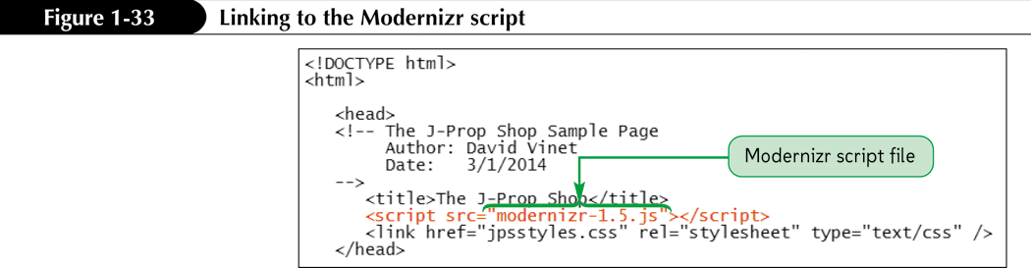
Linking to a JavaScript File

Slide 48
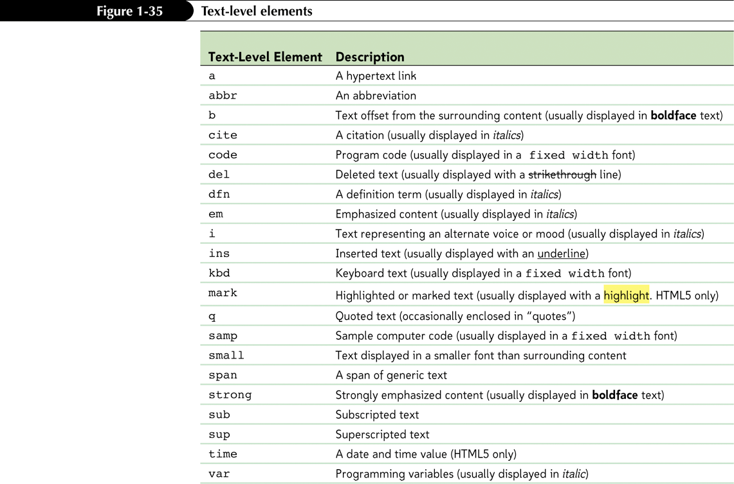
Marking Text-Level Elements

Slide 49
Using the Generic Elements div and span
HTML supports two such generic elements: div and span
The div element is used to mark general grouping content
The span element is used to mark general text-level content

Slide 50
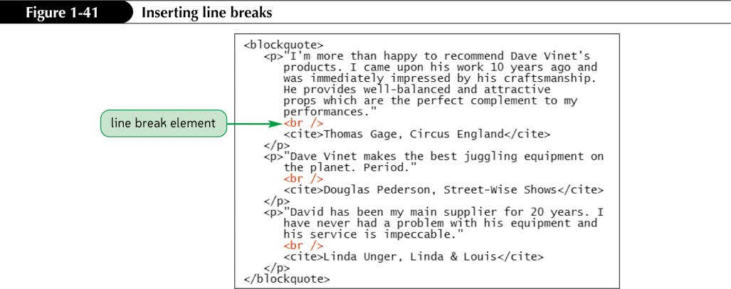
Marking a Line Break

Slide 51
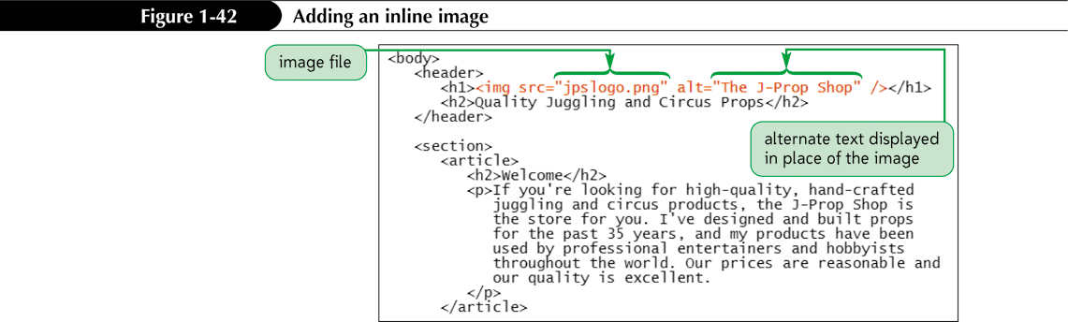
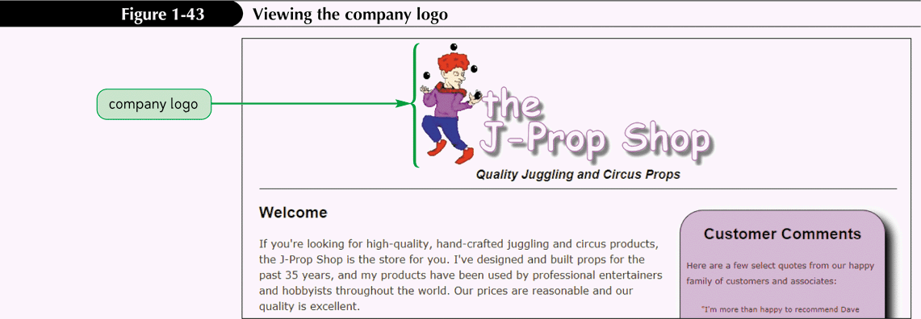
Inserting an Inline Image

Slide 52
Figures and Figure Captions
In books and magazines, figures and figure captions are often placed within boxes that stand aside from the main content of an article
HTML5 introduced this type of object to Web page markup with the figure and figcaption elements
<figure>
content
<figcaption>caption</figcaption>
</figure>

Slide 53
Working with Character Sets and Special Characters
Character sets come in a wide variety of sizes, based on the number of symbols required for communication in the chosen Language
ASCII (American Standard Code for Information Interchange)
Latin-1
ISO 8859-1
Unicode
UTF-8

Slide 54
Working with Character Sets and Special Characters
Character encoding associates each symbol from a character set with a numeric value called the numeric character reference
Another way to insert a special symbol is to use a character entity reference, in which a short memorable name is used in place of the numeric character reference

Slide 55
Working with Character Sets and Special Characters
To insert a symbol based on the encoding number, use the entity
&#code;
where code is the encoding number.
To insert a symbol based on a character entity reference, use the entity
char;
where char is the name assigned to the character.
To insert a nonbreaking space, use the following entity:
&nbsp;
To insert the < symbol, use the following entity:
&lt;
To insert the > symbol, use the following entity:
&gt;

Slide 56
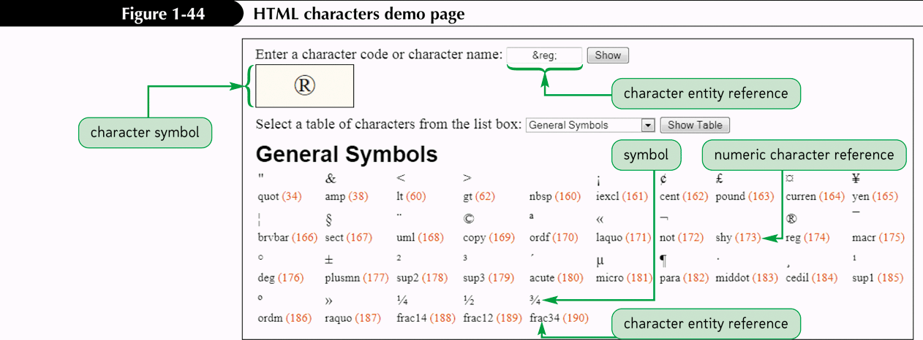
Working with Character Sets and Special Characters

Slide 57
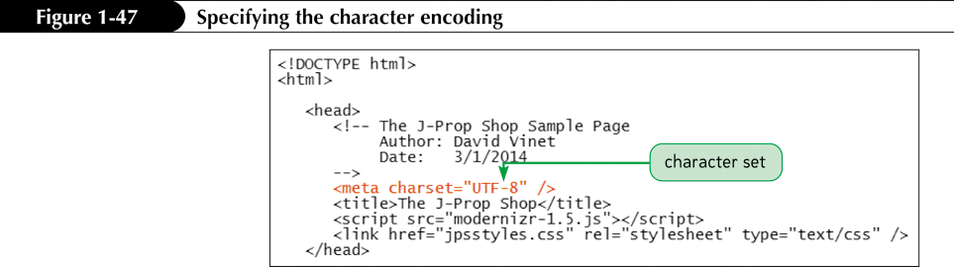
Specifying a Character Set

